Slide 1
How to Measure Robustness
A formal approach
Changjian (CJ) Zhang
Eunsuk Kang
David Garlan
Carnegie Mellon University

Slide 2
Agenda
Robustness Definition

Slide 3
What is Robustness?
IEEE definition:
The degree to which a system or component can function correctly in the presence of invalid inputs or stressful environmental conditions.
Robust control:
In control theory, robust control is an approach to controller design that explicitly deals with uncertainty.

Slide 4
The Source and Goal
A robust system should function correctly with erroneous input or environment.
A robust ML algorithm should have similar performance on datasets other than the training set (i.e., not prone to overfitting).
A robust scheduling algorithm should generate suboptimal scheme which is not sensitive to stochastic disturbances.
…
Notes:
The source and goal concepts are similar to the six dimensions of quality attributes proposed by SEI. Here, we simplify it and only focus on the stimulus (source) and the expected reaction of the system.

Slide 5
We try to measure:
The system capability to deal with uncertainty in environment to ensure correct function.
The source: uncertainty in environment
What’s the representation of uncertainty in the environment?
The goal: to ensure correct function
What’s the formal definition of “correct” function?
To measure: the system capability
How to measure capability? How to define such a metric?

Slide 6
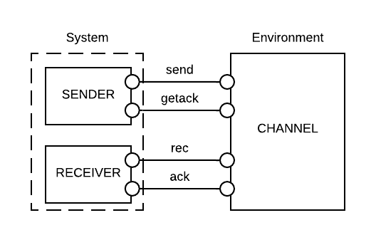
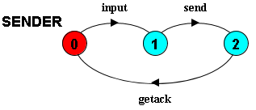
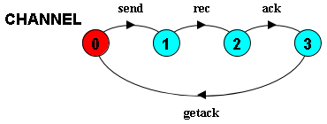
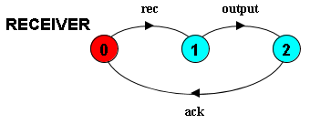
Motivation Example

Slide 7
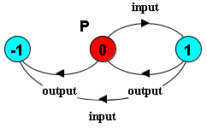
The “correct” function
Informally, (1) bad things should not happen, and (2) good things should happen.
Formally, the correct function is a combination of safety and liveness properties.
In the example, we consider:
Safety Property P: input and output should alternate, i.e.,
Liveness Property: the system should be deadlock-free.
Notes:
Limitations:
A safety property is restricted to the form of LTSA property.
We consider deadlock-free to be the weakest form of liveness, i.e., the system should not be stuck at some step.
I will use “correct” in this presentation for simplicity, but it means the system should satisfy the given safety properties and be deadlock-free.

Slide 8
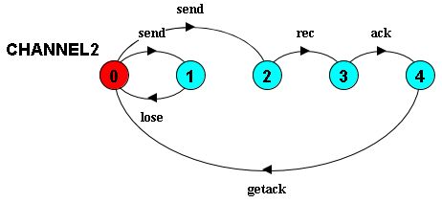
Representation of uncertainty
Combining the system and environment, a trace to deadlock:
<input, send, lose, send>
Notes:
The last send will cause deadlock, i.e., the system is waiting for a rec event, but the environment is waiting for a send event.

Slide 9
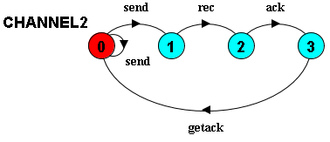
Representation of uncertainty
Uncertainty can be represented as traces of environment which lead to property violation (i.e., an error state or deadlock).
E.g., a trace in environment: <send, lose, send>
Problem: the alphabet of internal events is often unknown.
Solution: project the environment to the known interfaces.
Hide internals
’
The projected trace: <send, send>
Notes:
Interpretation of the projected state machine: we do not know what exactly will happen after a send event (e.g., a lose event or anything else), but we do know that we may need multiple send events to reach a rec event (i.e., the message is successfully received by the receiver).

Slide 10
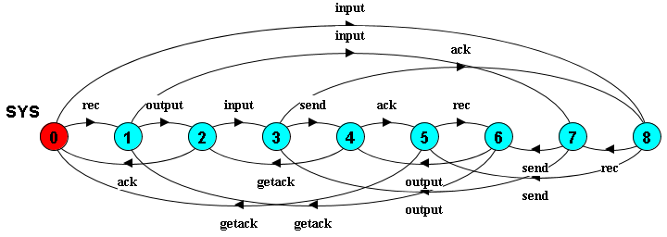
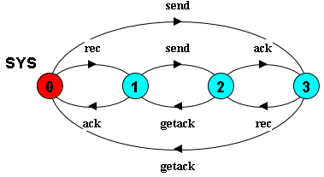
Representation of system capability
The capability of a system can be represented as all the traces of its corresponding state machine.
Problem: the “internal” events are less important when analyzing its capability to work against a given environment.
Solution: project the system to the interfaces of the environment.
Hide internals
Notes:
The definition of internal gives us the flexibility that: we could analyze the system capability against a given component in the environment, and the internal events under a given component could be the interfaces under another environment.
(I didn’t investigate this, but could be a future research direction)

Slide 11
Representation of system assumption
The projected capability describes all the possible traces of the environment that the system can work with.
However, it may include traces that would lead to property violation.
E.g., system allows trace <send, getack, send, getack, …>, which violates property that input and output should alternate.

Slide 12
Representation of system assumption
Most often, a system cannot work under any environment.
Developers make implicit assumptions of the environment to ensure “correct” function.
E.g., system allows trace <send, getack, send, getack, …>, which violates property that input and output should alternate.
To ensure the property, it assumes the environment to be:
Notes:
<send, getack, send, getack, …> means that the environment (channel) only accepts inputs without any output, which violates the property that input and output should alternate.

Slide 13
Strong and Weak assumption
Stronger assumption => less allowed behavior of the environment;
Weaker assumption => more allowed behavior of the environment.

Slide 14
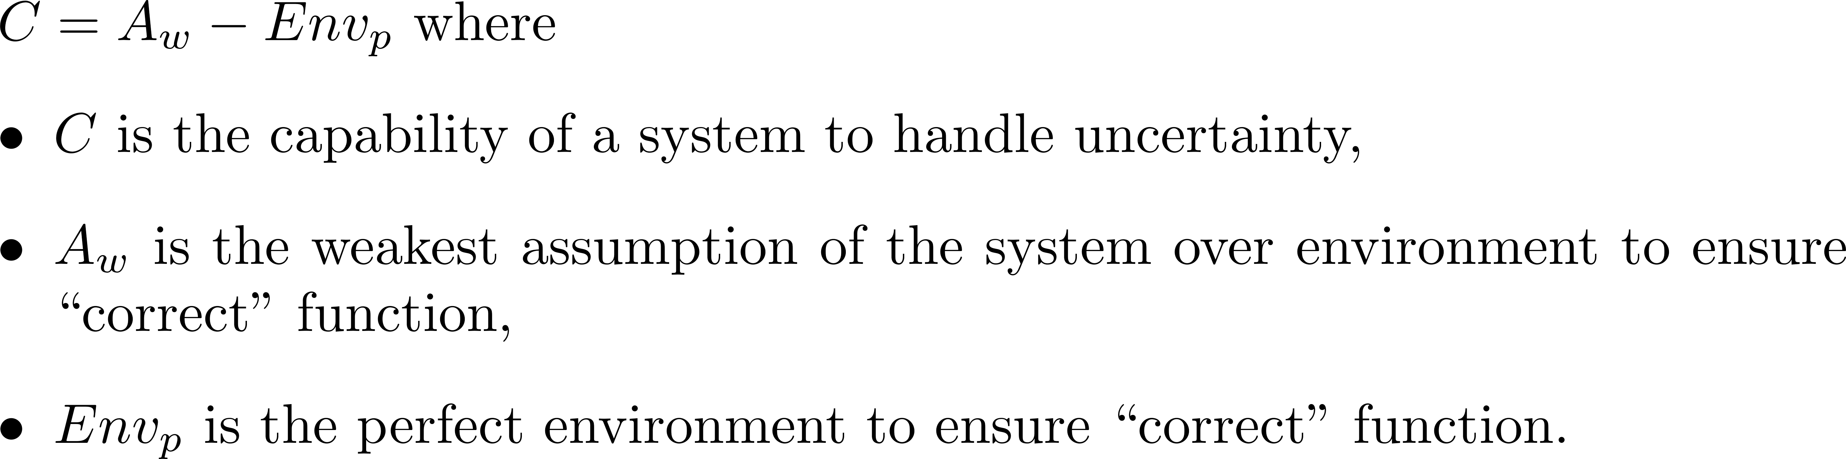
Capability to handle uncertainty
Stronger assumption => Less allowed behavior of the environment;
Weaker assumption => More allowed behavior of the environment
Notes:
The intuition is that:
A system is often designed to work under some environments, e.g., we assume that the environment should work exactly in the sequence of <send, rec, ack, getack>, otherwise, the system would deadlock or violate the safety property.

