Slide 1
How to characterize Software Robustness
A formal approach
Changjian (CJ) Zhang
Eunsuk Kang
David Garlan
Carnegie Mellon University

Slide 2
Agenda
What is Robustness?
Motivation Example
Generating Weakest Assumption
Representation of Robustness
Discussion

Slide 3
What is Robustness?
In general, robustness is the capability of a system to deal with uncertainty.
Uncertainty refers to the differences or errors between models and reality, and whatever mechanism is used to express these errors will be called a representation of uncertainty. [Essential of Robust Control]
Notes:
This definition is not limited to control theory.
Can be applied to many domains, the key is how to define the models and differences

Slide 4
Expected vs Reality
Domain | Expected | Diffs in Reality
Statistics/Machine Learning | Data samples should be in certain distributions | Outliers/Noise in data samples
Distributed Systems | Network is perfect and servers won’t crash | Message lost, duplication; Server crash
Software Security | Attackers only have certain capability (tactics) | Unknown tactics; How they exploit
Human-Computer Interaction | Human operators will follow instructions | Human mistakes
… | … | …
Notes:
Uncertainty comes from the differences between expected versus reality
Might be unknown events, or known events coming in unknown order, and so on
I can do this all day!

Slide 5
What is Robustness in Software?
IEEE definition:
The degree to which a system or component can function correctly in the presence of invalid inputs or stressful environmental conditions.
Existing Work:
Fuzz Testing – uses massive amounts of random input data to fail a system.
Chaos Engineering – puts a system in an extremely chaos environment to fail the system.
… (Mostly focus on verification)
Notes:
IEEE definition OK, but what is correct function, invalid inputs, and stressful env. Need more context
Also, for correct function, what about graceful degradation, is it considered as correct function?
Fuzz testing focuses more on the erroneous input data, and chaos engineering focuses more on the stressful environment
They are great methods, but the problem for testing is that you cannot tell what a system can do and what a system cannot do exhaustively.
For the latter one, that what a system cannot do, it’s often impossible to enumerate all the errors.
But for the first one, we may be able to answer what a system can do, that’s our focus.

Slide 6
What is Robustness in Software?
IEEE definition:
The degree to which a system or component can function correctly in the presence of invalid inputs or stressful environmental conditions.
Existing Work:
Fuzz Testing – uses massive amounts of random input data to fail a system.
Chaos Engineering – puts a system in an extremely chaos environment to fail the system.
… (Mostly focus on verification)
Trial-and-Error
Error Rate as an approximation of robustness.
No direct measurements

Slide 7
Motivation
Instead of trial-and-error, can we directly analyze what a system can/cannot do?
Can we determine the robustness of a system in design phase rather than in testing phase, just like other quality attributes? (Correct-by-design)
Does a design address the concerns with respect to robustness?
Notes:
Of course, ultimately, we want a system to work under any environment.
But that is often impossible. Thus, we often focus on certain error types, and want the system to be robust against them.

Slide 8
Correct-by-design
For a distributed protocol, what are the fault models it can handle?
For a security protocol, what are all the possible exploits it can protect from?
For a human-computer interface, what are all the human errors it can deal with?
Notes:
The cost is too high when we find design defects in testing phase
Also, for a system like a medical device, a defect may cause sever consequences.
We can analyze many quality attributes of a system design, like performance, availability.
We also like to do it for robustness!

Slide 9
Research Focus
How to characterize the ability of a system to ensure correct function against erroneous behaviors in the environment?
What’s the definition of correct system function?
How to represent system/environment behaviors?
What’s the representation of system ability to handle erroneous behaviors (i.e., the representation of robustness)?

Slide 10
Motivation Example

Slide 11
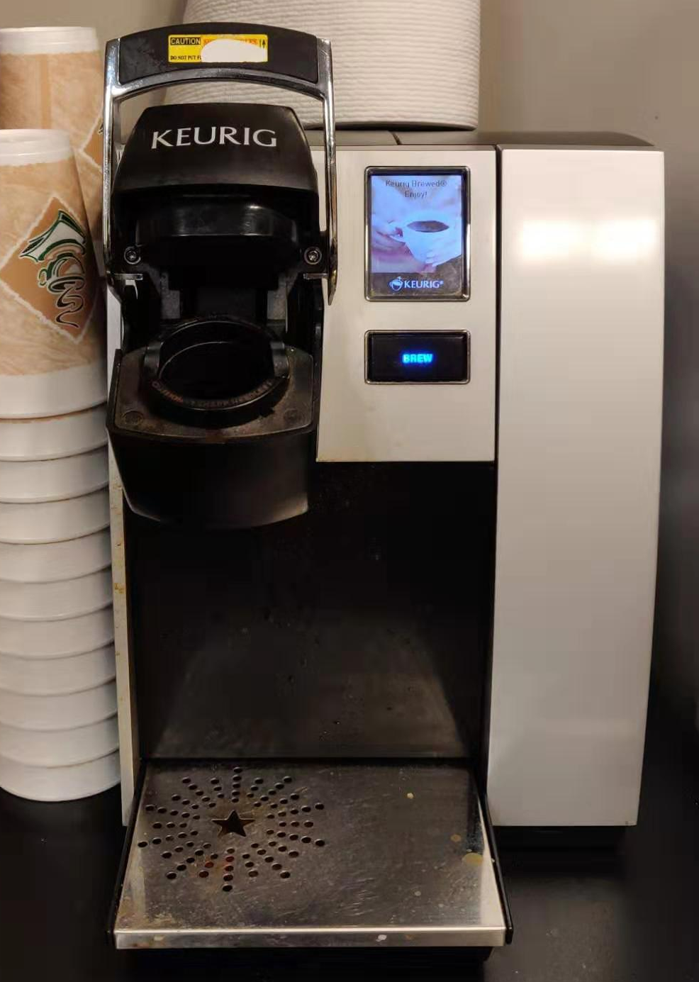
Motivation Example
System: The coffee machine.
Environment: Human operator.
A system is correct if it satisfies certain properties.
Safety Property: the system should not do something.
Liveness Property: the system should do something.

Slide 12
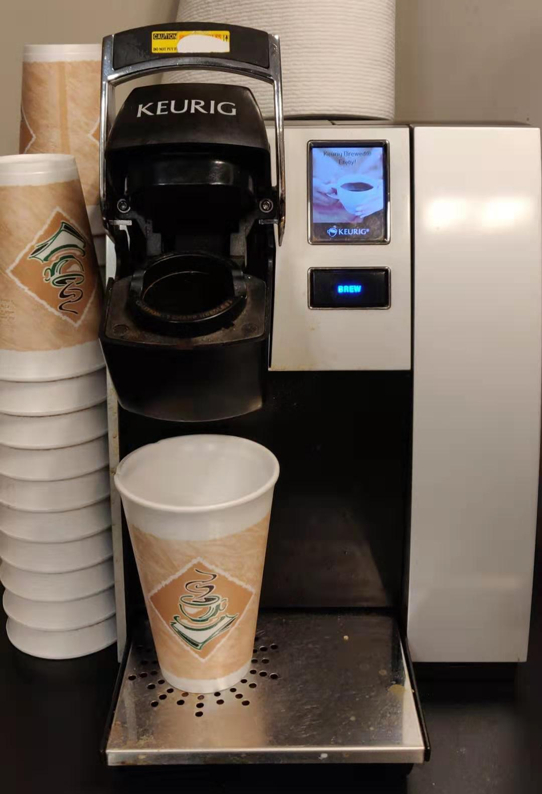
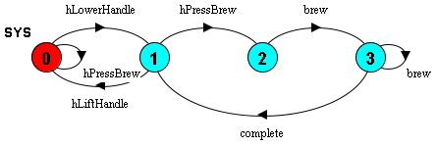
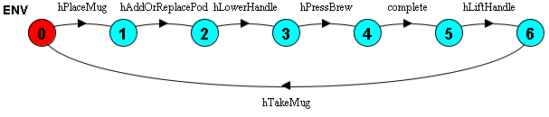
Behavior Model
Use Labelled transition system (LTS)
Notes:
Basically, an LTS describes a state machine

Slide 13
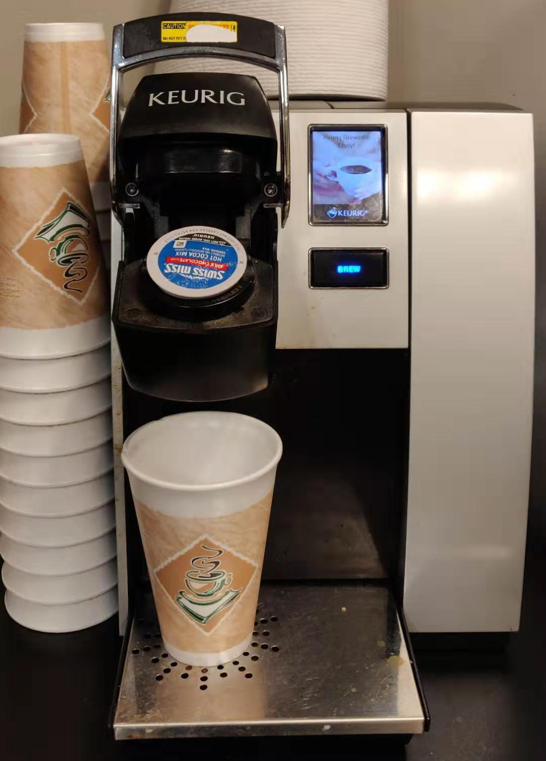
Behavior Model
Use Labelled transition system (LTS)
0 indicates the initial state.
State in red indicates the current state.

Slide 14
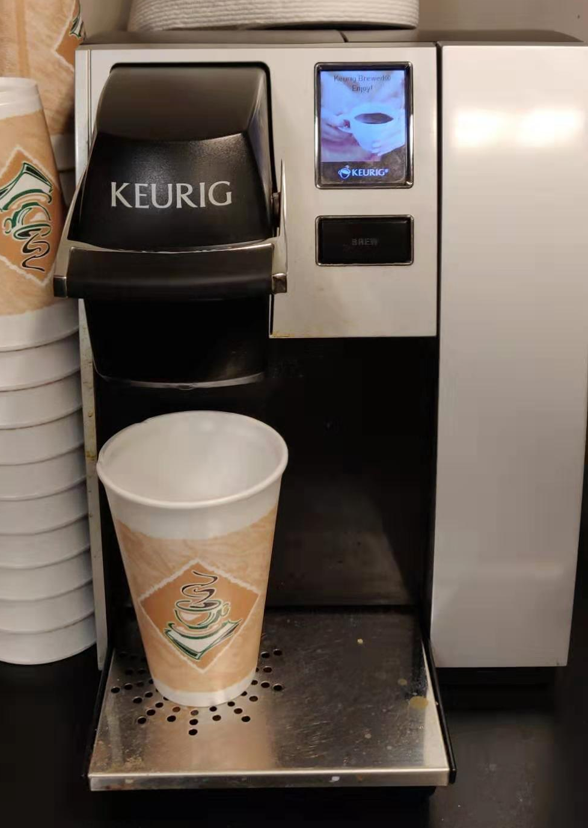
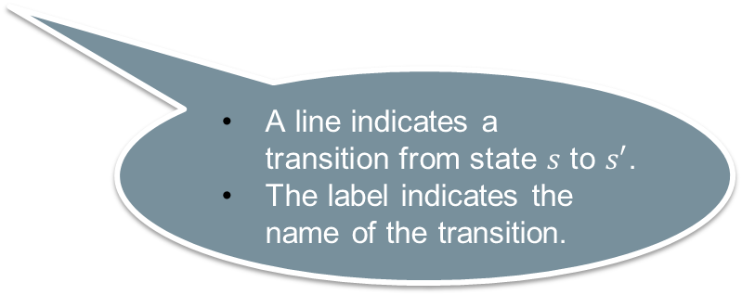
Behavior Model
Use Labelled transition system (LTS)
A line indicates a transition from state $s$ to $s′$.
The label indicates the name of the transition.

Slide 15
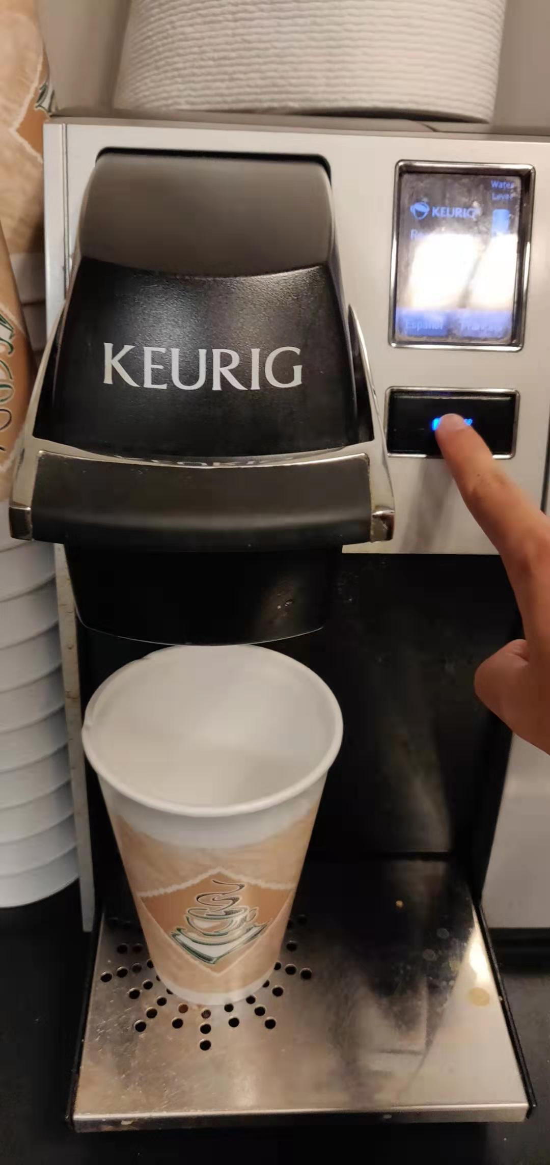
Behavior Model
Use Labelled transition system (LTS)

Slide 16
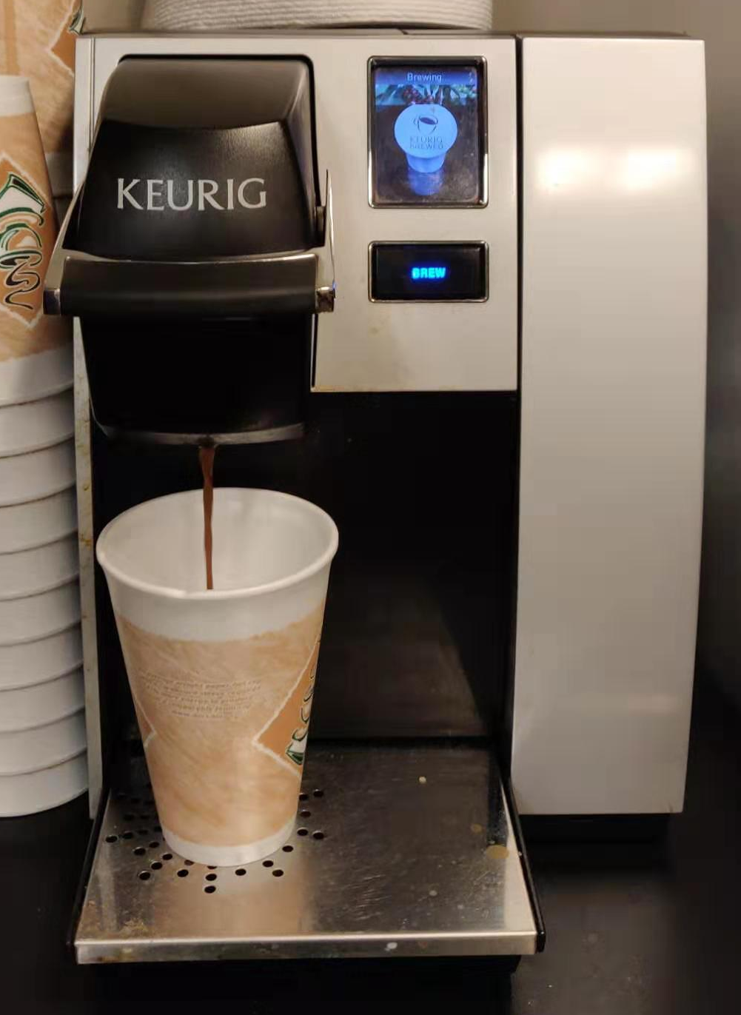
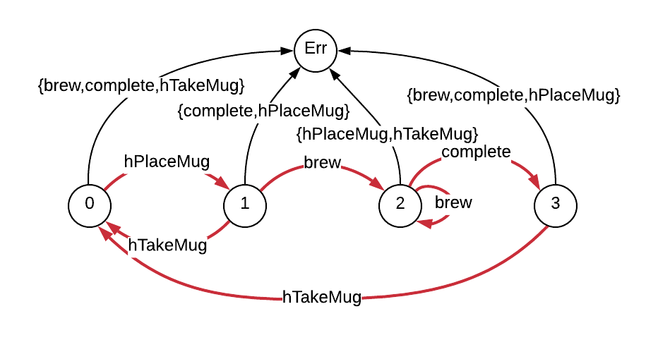
Safety Property
A safety property in LTS describes the acceptable behavior of the system.
E.g., brewing only when the mug is placed.

Slide 17
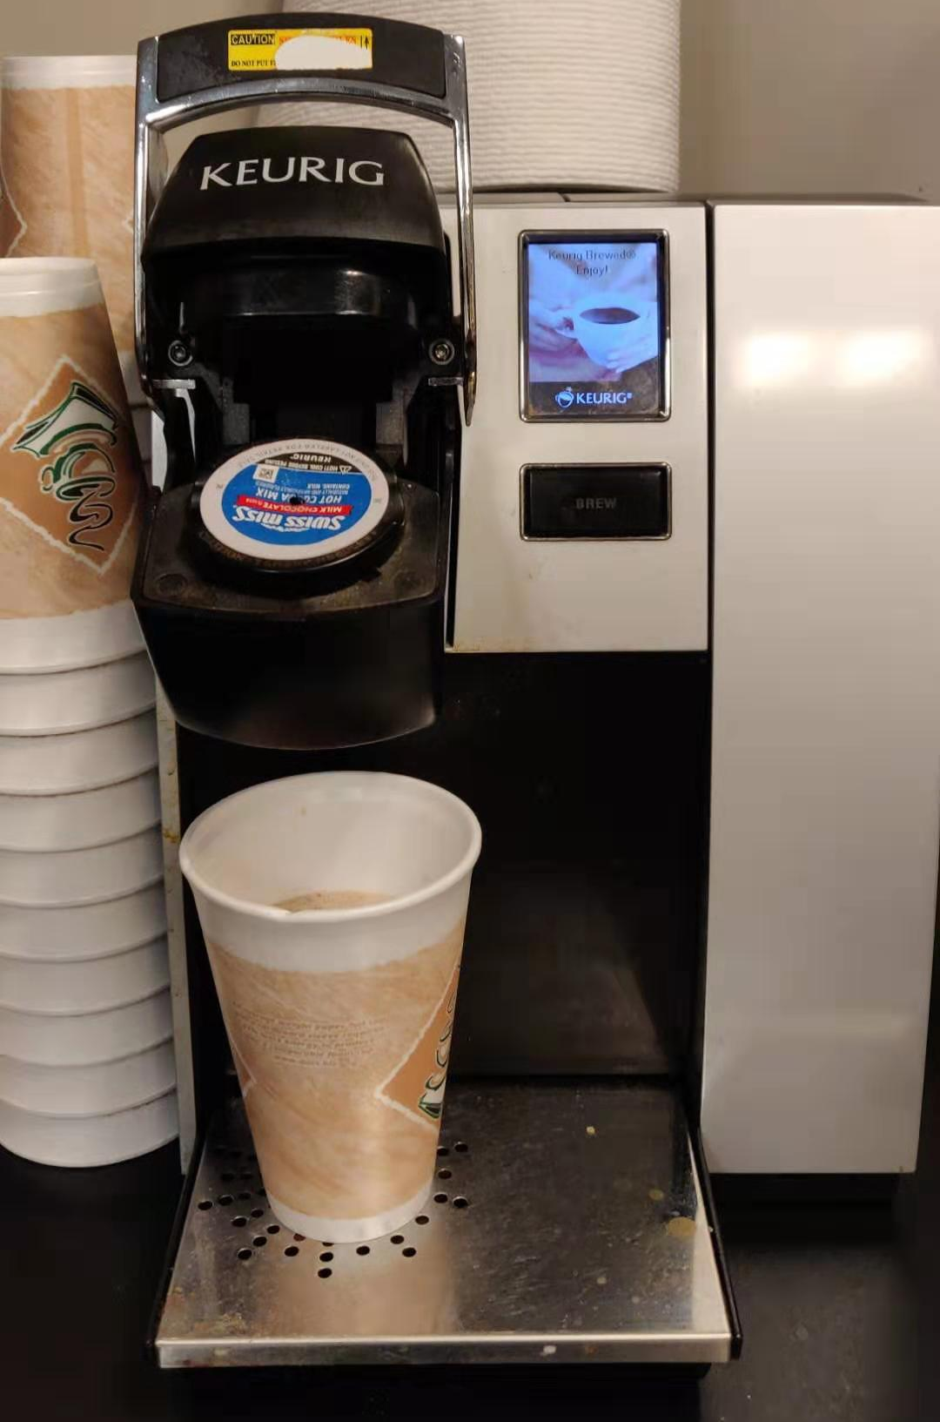
Safety Property
A safety property in LTS describes the acceptable behavior of the system.
E.g., brewing only when the mug is placed.
Safety property is violated when there’s a trace leading the system to the error state.
Notes:
Later, I’ll use an example to show how this can happen

Slide 18
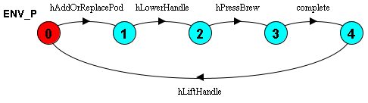
Example of Human Error
Forgot to place the mug!!!

Slide 19
Example of Human Error

Slide 20
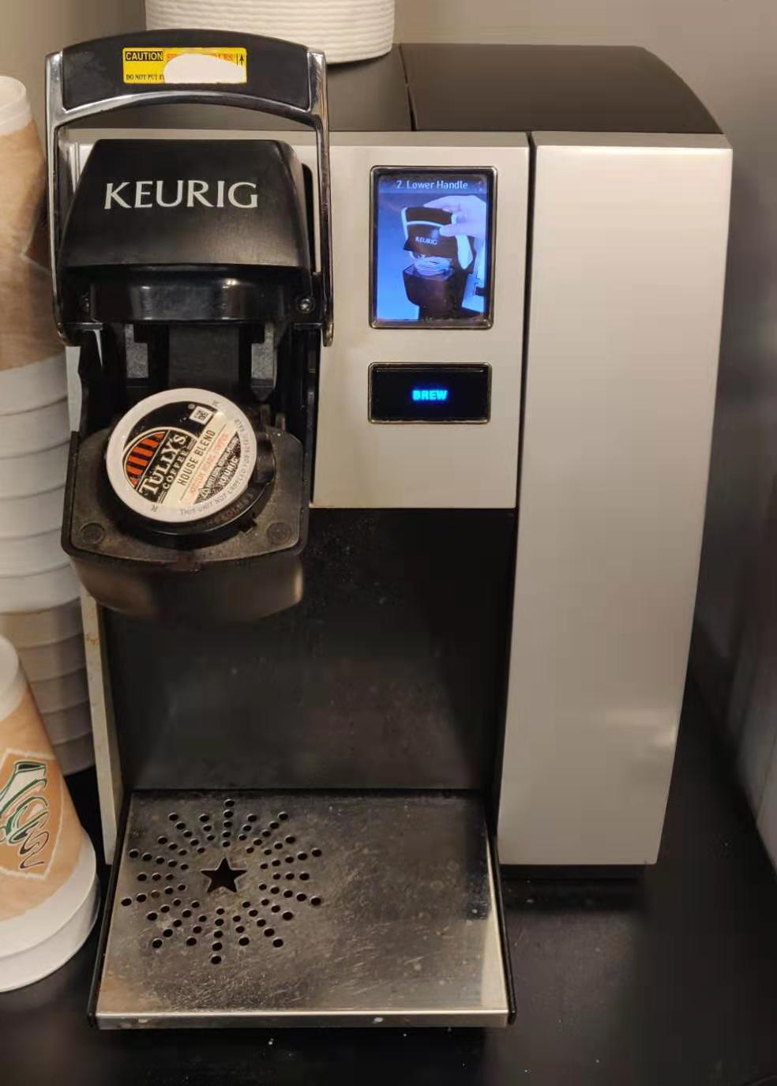
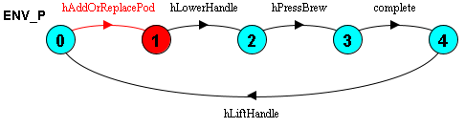
Example of Human Error

Slide 21
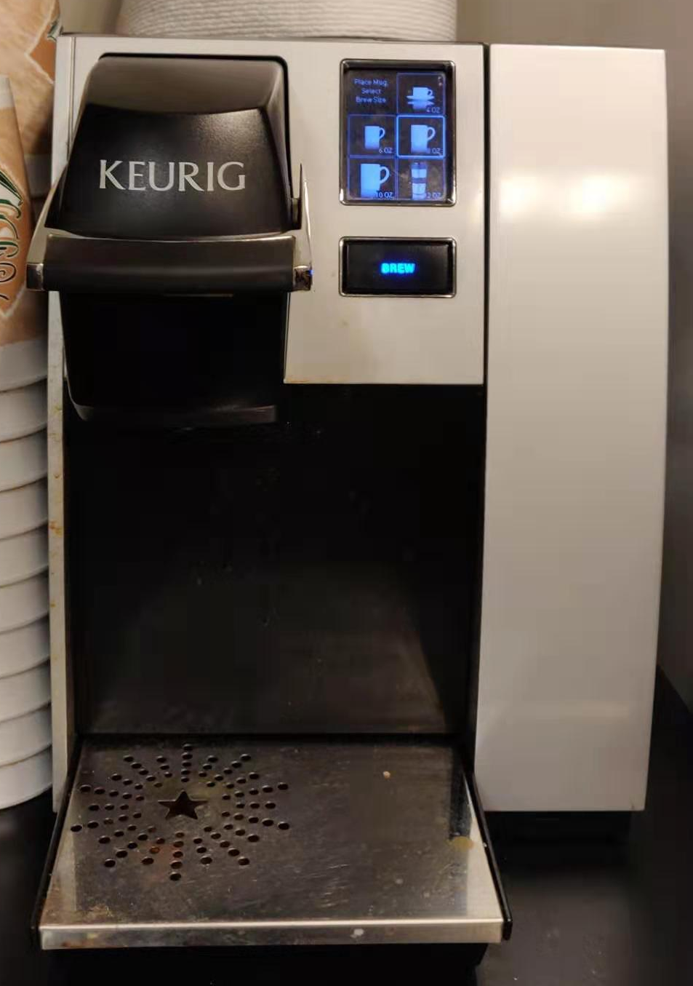
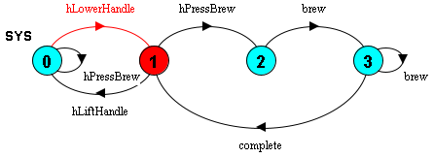
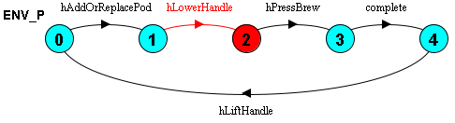
Example of Human Error

Slide 22
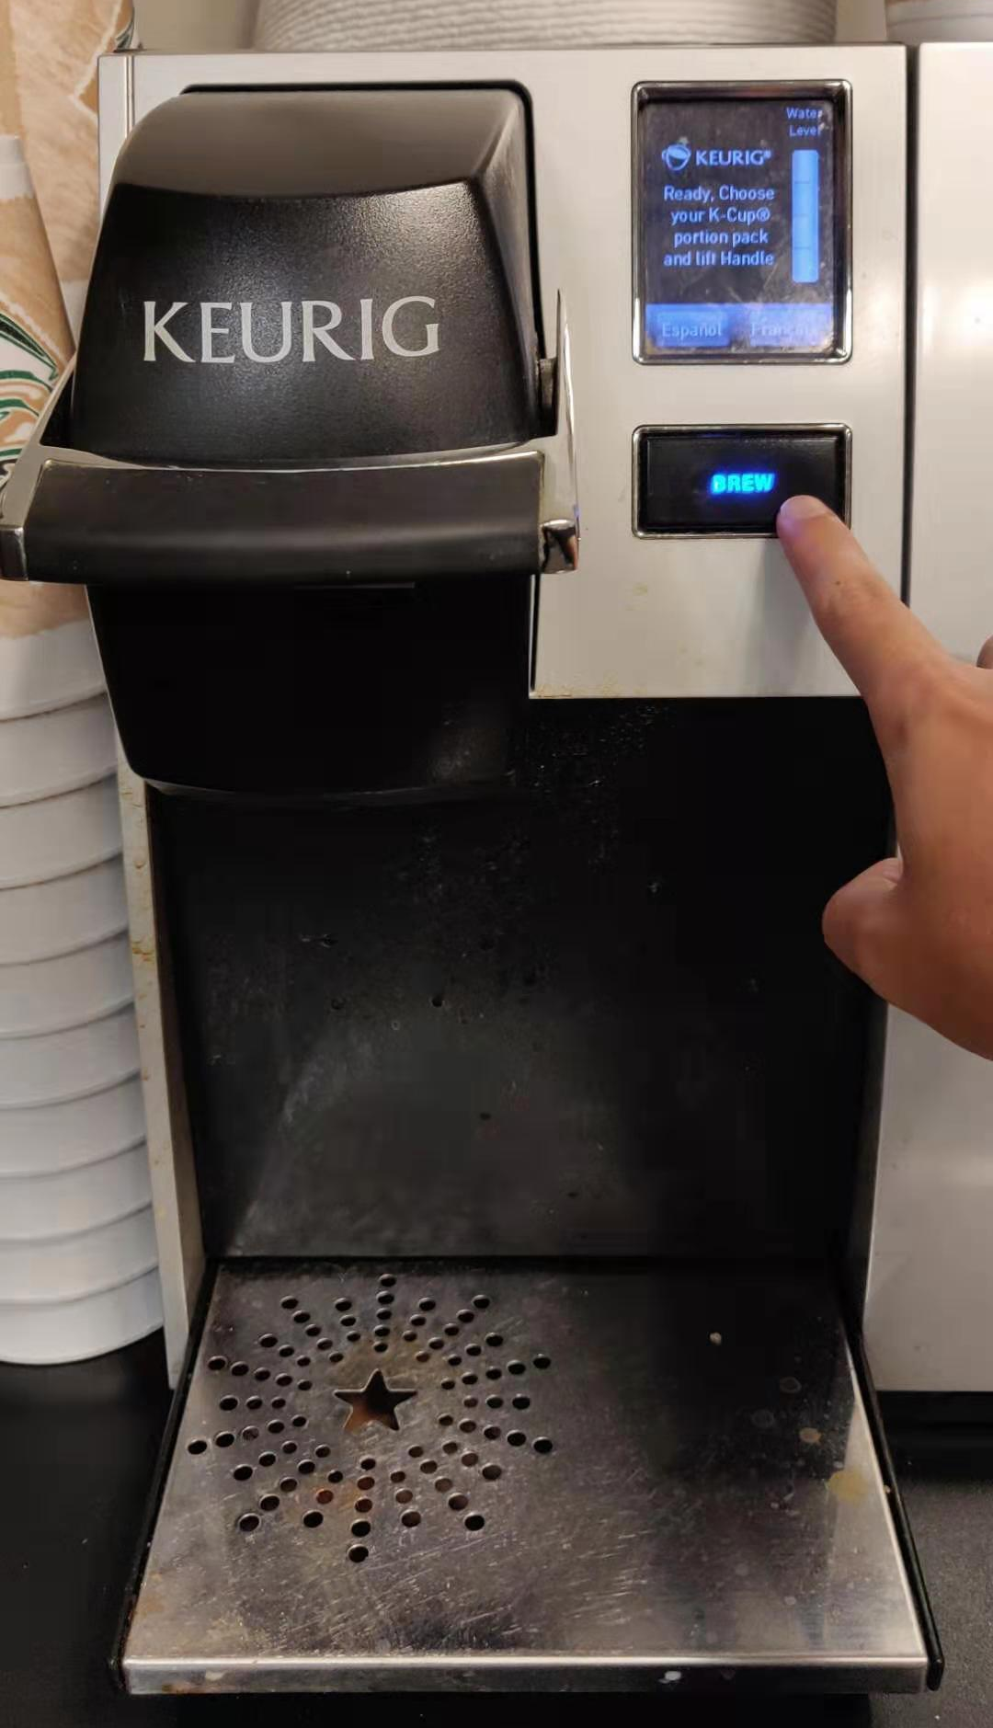
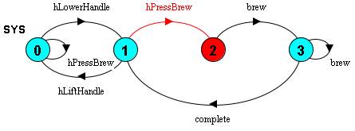
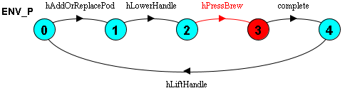
Example of Human Error

Slide 23
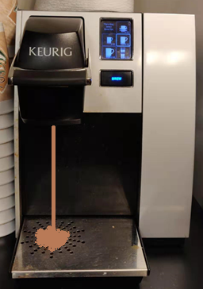
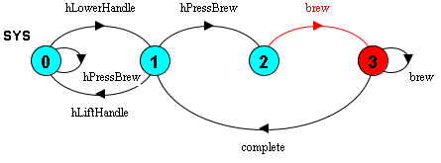
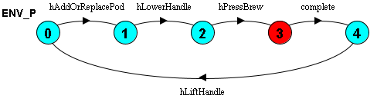
Example of Human Error

Slide 24
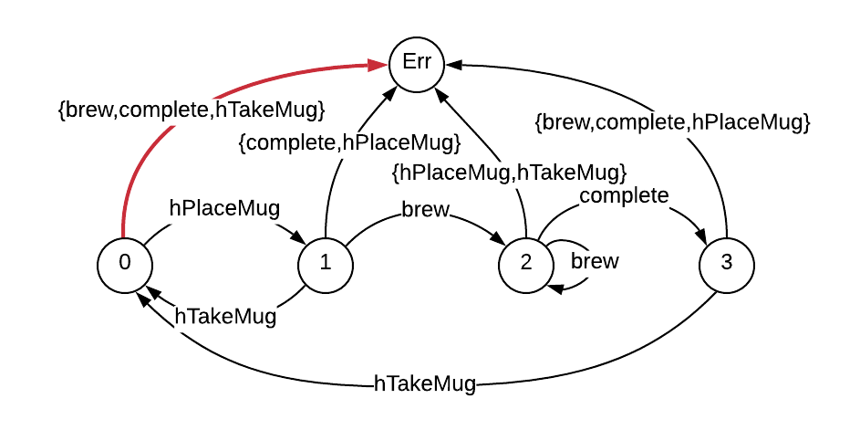

Error Trace
Trace: $<hAddOrReplacePod, hLowerHandle, hPressBrew, brew>$
Notes:
The first three events are not aware of the property, thus it keeps in its initial state.
Then, it synchronize on the brew event, which leads to error

Slide 25
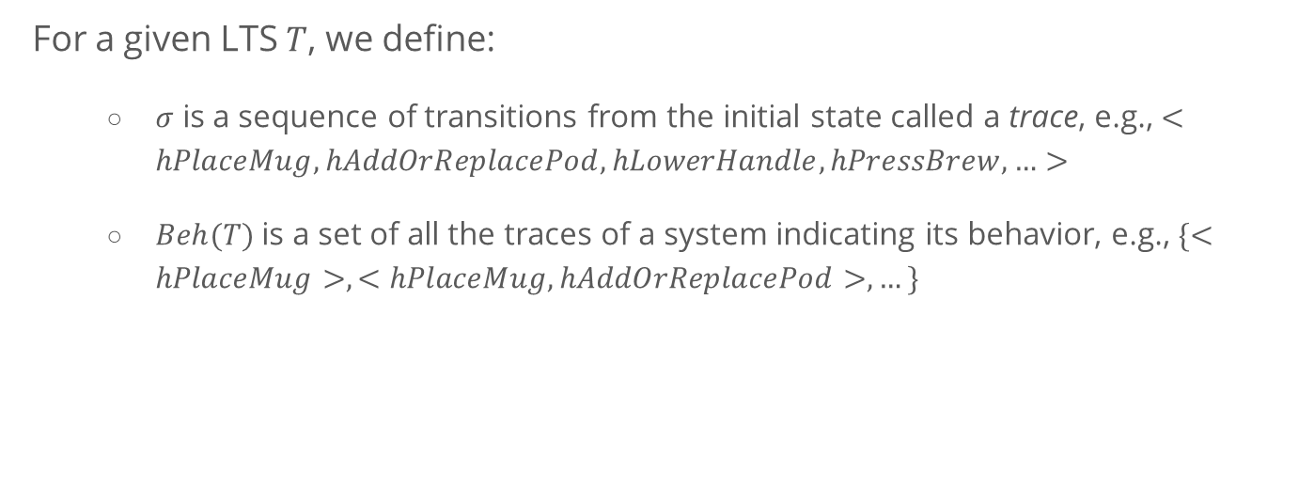
A Formal View of Testing Robustness
For a given LTS $T$, we define:
$σ$ is a sequence of transitions from the initial state called a trace, e.g., $<hPlaceMug, hAddOrReplacePod, hLowerHandle, hPressBrew,…>$
$Beh(T)$is a set of all the traces of a system indicating its behavior, e.g., $\{<hPlaceMug>, <hPlaceMug, hAddOrReplacePod>, …\}$

Slide 26
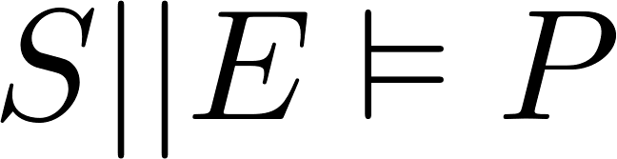
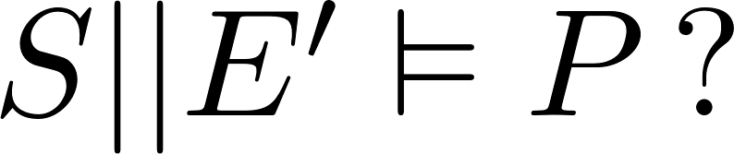
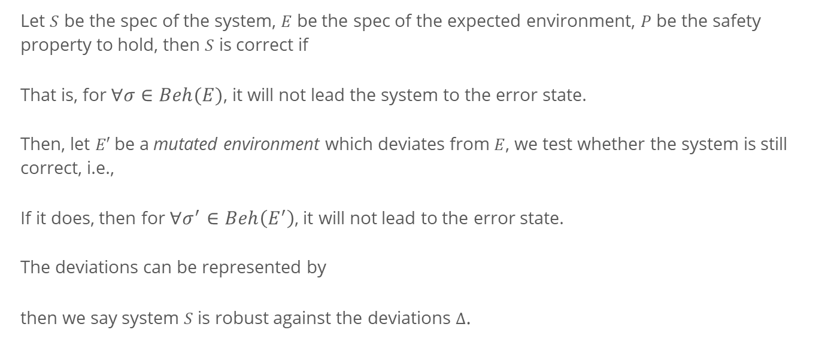
A Formal View of Testing Robustness
Let $S$ be the spec of the system, $E$ be the spec of the expected environment, $P$ be the safety property to hold, then $S$ is correct if
That is, for $∀σ∈Beh(E)$, it will not lead the system to the error state.
Then, let $E′$be a mutated environment which deviates from $E$, we test whether the system is still correct, i.e.,
If it does, then for $∀σ^{′}∈Beh\left(E^{′}\right)$, it will not lead to the error state.
The deviations can be represented by
then we say system $S$ is robust against the deviations $Δ$.

Slide 27
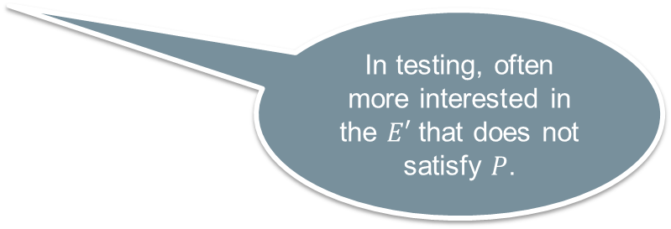
A Formal View of Testing Robustness
Hard to explore all the possible deviations!
Let $S$ be the spec of the system, $E$ be the spec of the expected environment, $P$ be the safety property to hold, then $S$ is correct if
That is, for $∀σ∈Beh(E)$, it will not lead the system to the error state.
Then, let $E′$be a mutated environment which deviates from $E$, we test whether the system is still correct, i.e.,
If it does, then for $∀σ^{′}∈Beh\left(E^{′}\right)$, it will not lead to the error state.
The deviations can be represented by
then we say system $S$ is robust against the deviations $Δ$.
In testing, often more interested in the $E′$ that does not satisfy $P$.
Notes:
In the coffee machine example, we developed an erroneous environment model and verified that it does not satisfy the property.
However, this is just one case, it is often impossible to enumerate all the human behaviors.
Thus, we cannot tell what kind of errors the system can handle and what it cannot.

Slide 28
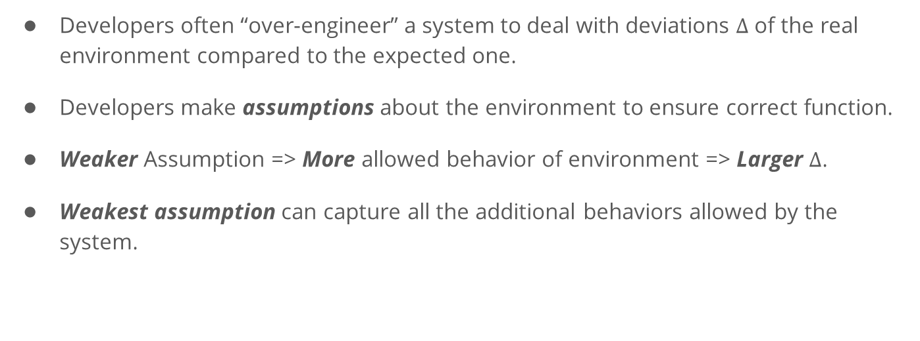
Another Way Around
Developers often “over-engineer” a system to deal with deviations $Δ$ of the real environment compared to the expected one.
Developers make assumptions about the environment to ensure correct function.
Weaker Assumption => More allowed behavior of environment => Larger $Δ$.
Weakest assumption can capture all the additional behaviors allowed by the system.

Slide 29
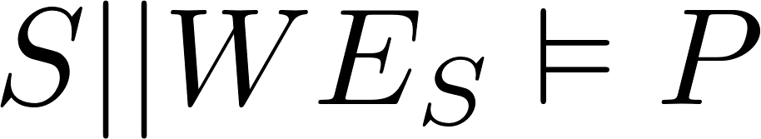
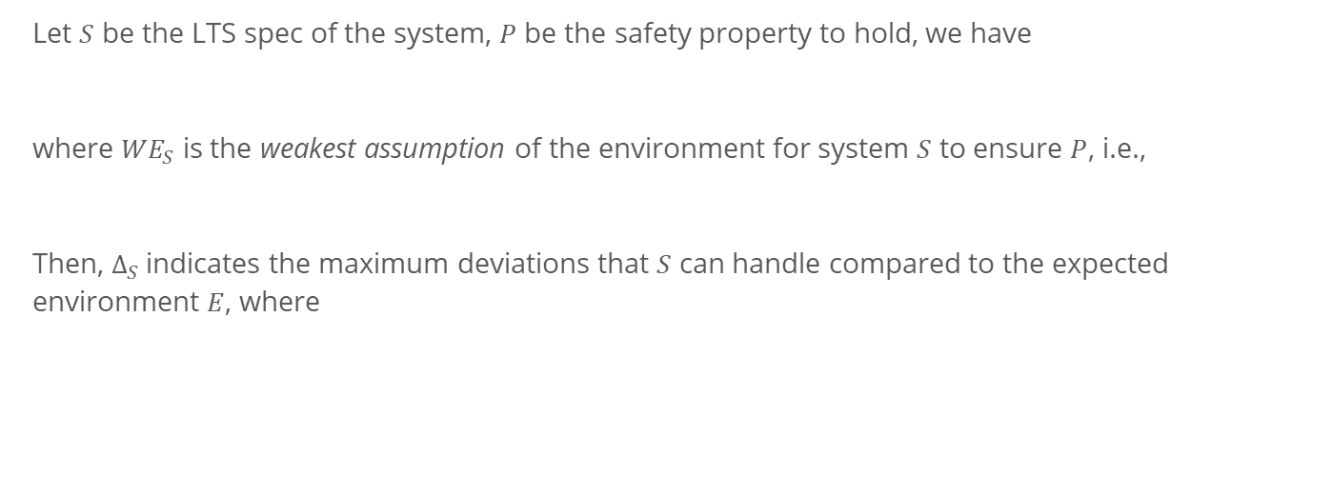
Another way around
Let $S$ be the LTS spec of the system, $P$ be the safety property to hold, we have
where ${WE}_{S}$ is the weakest assumption of the environment for system $S$ to ensure $P$, i.e.,
Then, $Δ_{S}$indicates the maximum deviations that $S$ can handle compared to the expected environment $E$, where

Slide 30
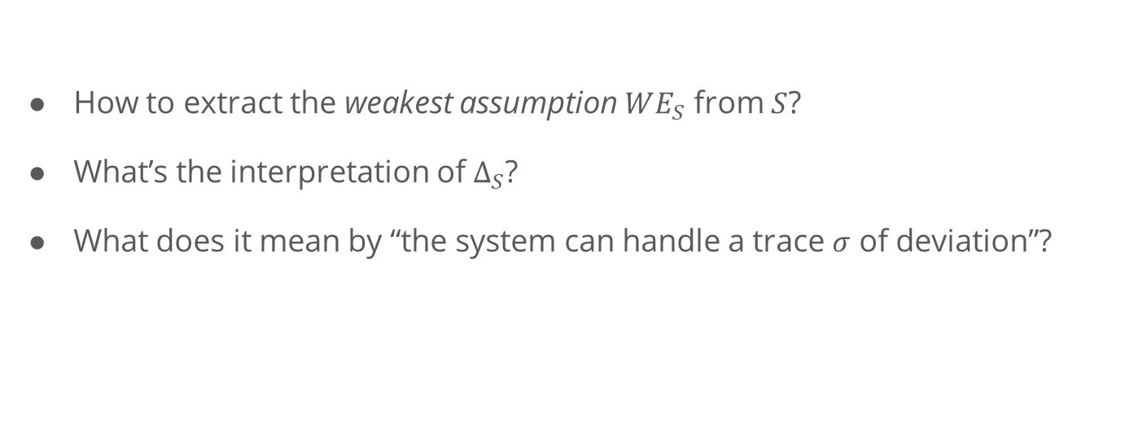
Questions to solve
How to extract the weakest assumption $WE_{S}$ from $S$?
What’s the interpretation of $∆_{S}$?
What does it mean by “the system can handle a trace $σ$ of deviation”?

Slide 31
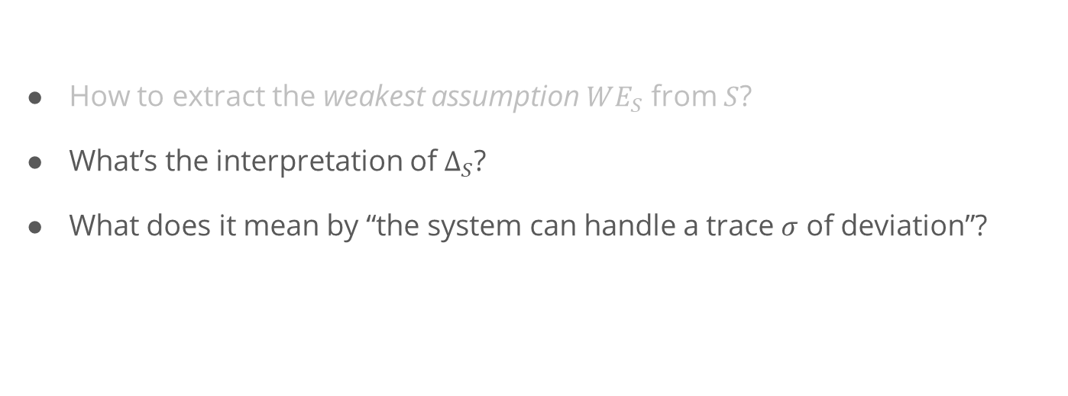
Questions to solve
Starting Point: Existing work present solutions to these problems based on automata theory.
How to extract the weakest assumption $WE_{S}$ from $S$?
What’s the interpretation of $∆_{S}$?
What does it mean by “the system can handle a trace $σ$ of deviation”?
Our Focus

Slide 32
Generating Weakest Assumption

Slide 33
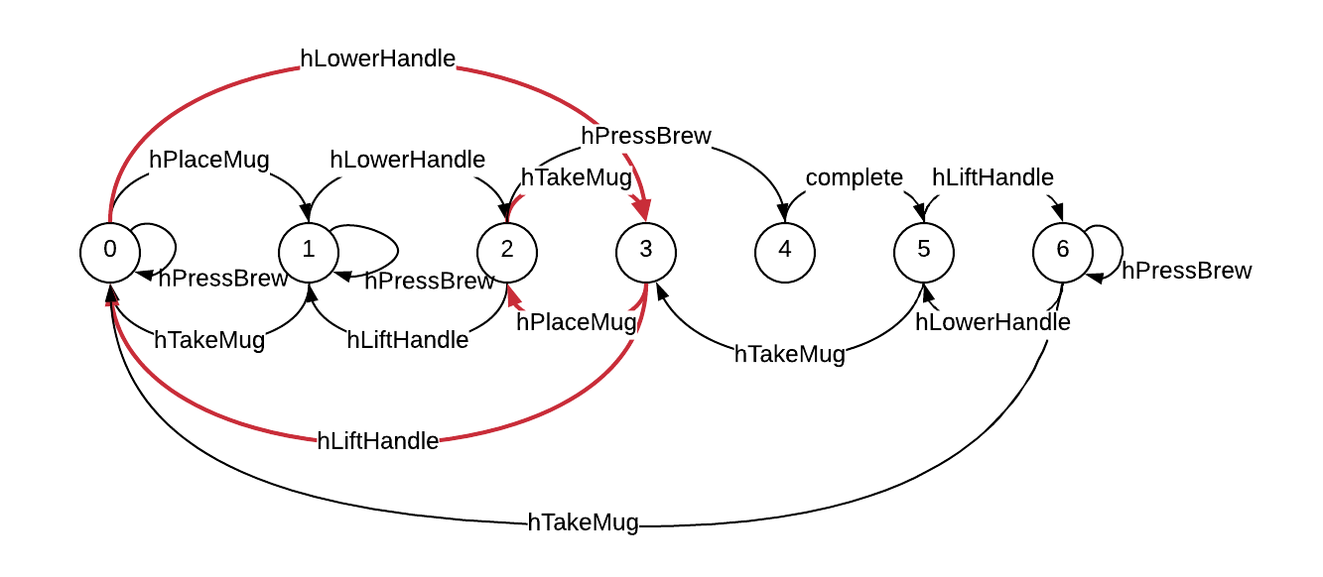
Generating Weakest Assumption
[Dimitra02] presents an approach to generate the weakest assumption.
System Spec
Env Spec
Safety Property
Weakest Assumption
Does not allow hPressBrew!
[Dimitra02] D. Giannakopoulou, C. S. Pǎsǎreanu, and H. Barringer, “Assumption generation for software component verification,” in Proceedings - ASE 2002: 17th IEEE International Conference on Automated Software Engineering, 2002, pp. 3–12.

Slide 34
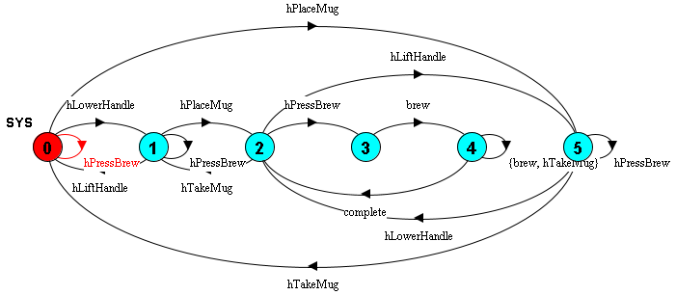
A Robust Version
Add additional sensor to detect the mug.
Key Diff: the system is aware of placing/taking the mug.
Notes:
The problem for the original version is that it is not aware of whether the mug is placed.

Slide 35
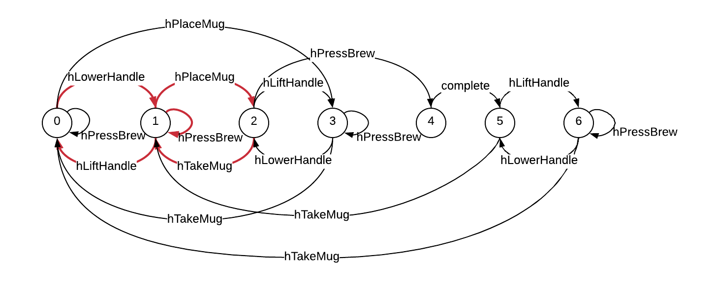
A Robust Version
What is allowed!
Allow hPressBrew when no mug is placed!

Slide 36
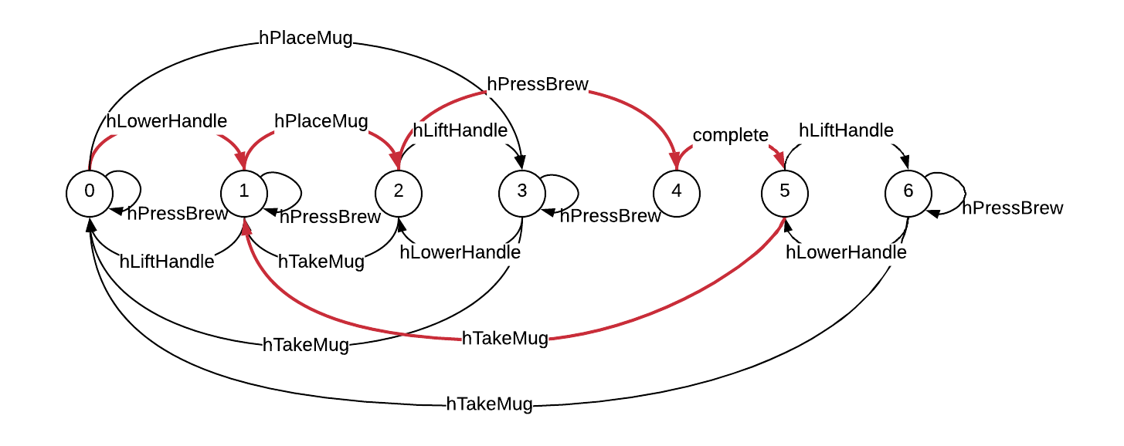
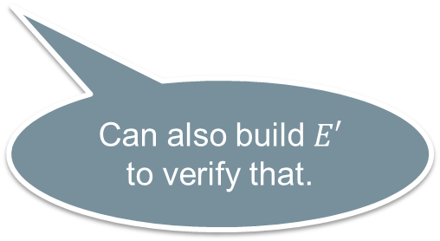
A Robust Version
Cannot handle the error that the mug is removed during brewing.
What is NOT allowed!
Can also build $E′$ to verify that.

Slide 37

Interpretation of $Δ$
$Δ_{S}$ is a set of traces which can represent the deviations.
However, a trace could be infinite, and $Δ_{S}$ could include infinite traces.
IMPORTANT: $Δ_{S}$ is NOT self-explainable!

Slide 38
Representation of Robustness

Slide 39
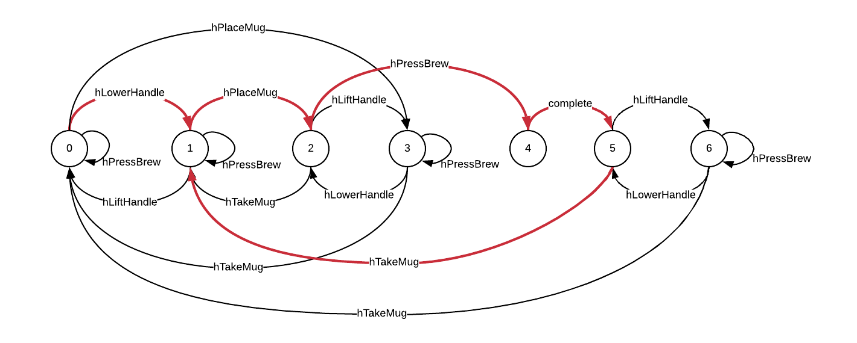
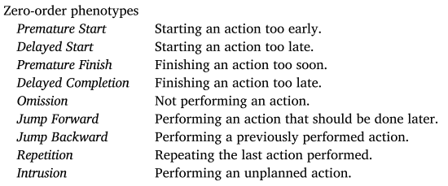
Representation of Robustness
Existing Work:
In distributed systems, different fault models capture varies of failure types (e.g., fail-stop, fail-silent, or fail-arbitrary).
In human behavior study, models are developed to classify erroneous human behaviors (e.g., omissions, repetitions, and commissions).
Notes:
Why this is useful?
One use case: there’s always a cost to make a system more robust!
In the coffee machine example,
what kind of human error we’d like to prevent? Forgetting to place the mug seems not a valuable error to invest on.
Is the design consistent with our intention? Do we address all the errors we’d like to deal with?

Slide 40
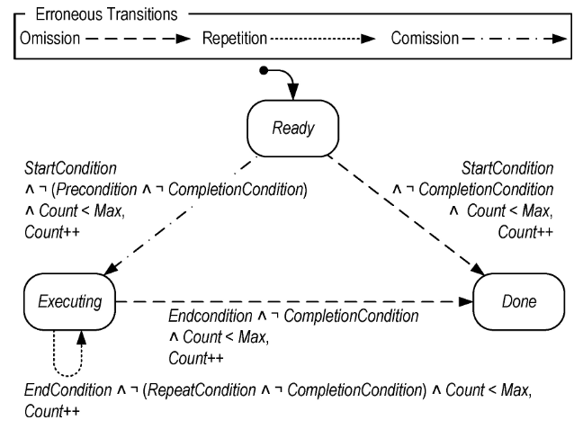
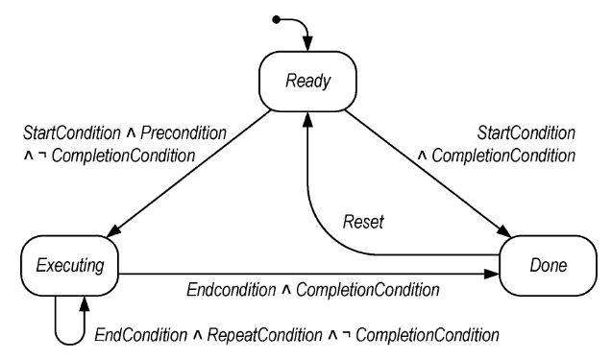
Human Behavior Model: EOFM
[Bolton13] Bolton, M. L., & Bass, E. J. (2013). Generating erroneous human behavior from strategic knowledge in task models and evaluating its impact on system safety with model checking. IEEE Transactions on Systems, Man, and Cybernetics: Systems, 43(6), 1314–1327. https://doi.org/10.1109/TSMC.2013.2256129
Notes:
EOFM is a human task model, it describes that to complete a task, what a human operator should do, when they should perform an action, and when the action is done.
A human activity or action is modeled as a state machine. 3 states: ready refers to the activity is waiting to execute, executing refers to the activity is executing, done refers to the activity is done.
Lines refer to the transitions and labels on the lines refer to the condition to execute a transition.

Slide 41
Human Behavior Model: EOFM
Intuitively, a user should perform an action if the precondition is satisfied and it is not completed.
[Bolton13] Bolton, M. L., & Bass, E. J. (2013). Generating erroneous human behavior from strategic knowledge in task models and evaluating its impact on system safety with model checking. IEEE Transactions on Systems, Man, and Cybernetics: Systems, 43(6), 1314–1327. https://doi.org/10.1109/TSMC.2013.2256129

Slide 42
Human Behavior Model: EOFM
Intuitively, a user should continue performing an action until its completion condition is reached.
[Bolton13] Bolton, M. L., & Bass, E. J. (2013). Generating erroneous human behavior from strategic knowledge in task models and evaluating its impact on system safety with model checking. IEEE Transactions on Systems, Man, and Cybernetics: Systems, 43(6), 1314–1327. https://doi.org/10.1109/TSMC.2013.2256129

Slide 43
Erroneous Human Behaviors
Omission Error-1: A user should perform an action but not!
[Bolton13] Bolton, M. L., & Bass, E. J. (2013). Generating erroneous human behavior from strategic knowledge in task models and evaluating its impact on system safety with model checking. IEEE Transactions on Systems, Man, and Cybernetics: Systems, 43(6), 1314–1327. https://doi.org/10.1109/TSMC.2013.2256129

Slide 44
Erroneous Human Behaviors
Omission Error-2: A user should continue performing an action but stop executing it prematurely!
[Bolton13] Bolton, M. L., & Bass, E. J. (2013). Generating erroneous human behavior from strategic knowledge in task models and evaluating its impact on system safety with model checking. IEEE Transactions on Systems, Man, and Cybernetics: Systems, 43(6), 1314–1327. https://doi.org/10.1109/TSMC.2013.2256129

Slide 45
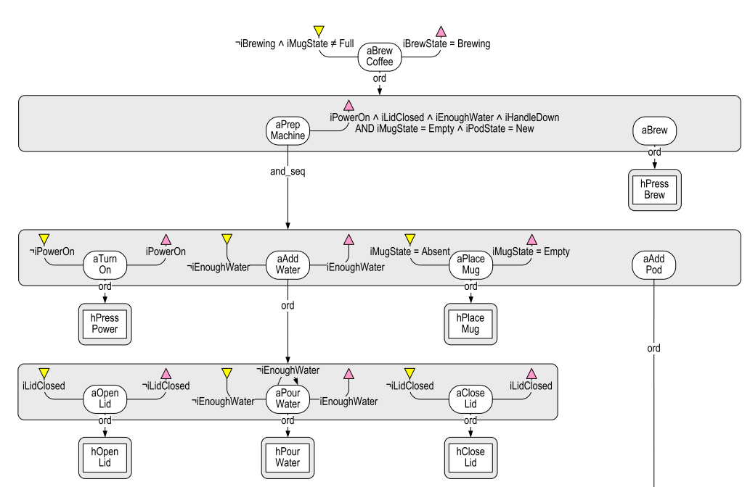
Instantiate the motivation example

Slide 46
Discussion

Slide 47
Limitations and Challenges
Generated weakest assumption can capture the maximum allowed behavior.
However, the alphabet is limited to the defined interface between the system and environment.
CANNOT handle:
Coffee machine example: plug out the machine during brewing.
Security: attackers find a new side-channel or a new 0-day exploit.

Slide 48
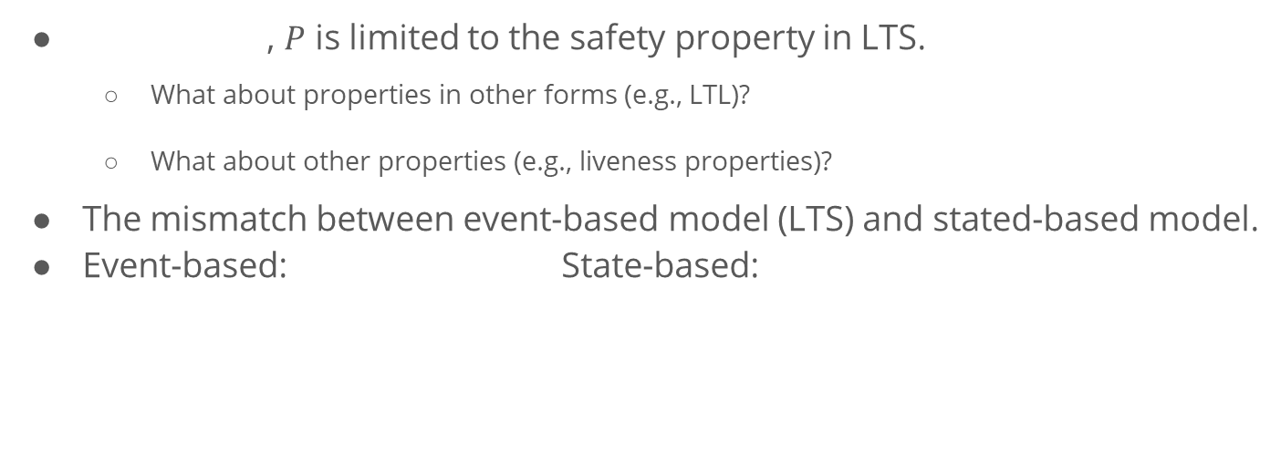
Limitations and Challenges
, $P$ is limited to the safety property in LTS.
What about properties in other forms (e.g., LTL)?
What about other properties (e.g., liveness properties)?
The mismatch between event-based model (LTS) and stated-based model.
Event-based: State-based:
Notes:
In event-based model, we are talking about after doing a, we should do b.
But in state-based model, we are talking about under what conditions we can do a or b.
They can be used to model the same system, but with different focus. Often, state-based model is more expressive, but we are constrained by the previous work on generating weakest assumption.

Slide 49
Thank You!
What is Robustness?
Motivation Example
Generating Weakest Assumption
Representation of Robustness
Discussion

