Slide 1
How to Measure Robustness
A formal approach
Changjian (CJ) Zhang
Eunsuk Kang
David Garlan
Carnegie Mellon University

Slide 2
Agenda
Robustness Definition
Research Problem and Goal

Slide 3
What is Robustness?
IEEE definition:
The degree to which a system or component can function correctly in the presence of invalid inputs or stressful environmental conditions.
Robust control:
In control theory, robust control is an approach to controller design that explicitly deals with uncertainty.
Other fields…

Slide 4
How to measure Robustness?
In other disciplines, there are widely accepted robustness measures and on-going research on it.
Robust control in control theory
Robust statistics in statistics
Robustness measures in computer networks
Robustness metrics in mechanical design
… (by simply Google it)
What about software?
Unlike other quality attributes (e.g., performance, availability), no widely used measures.
The context matters!

Slide 5
The Source and Goal
A robust system should function correctly with erroneous input or environment.
A robust ML algorithm should have similar performance on datasets other than the training set (i.e., not prone to overfitting).
A robust scheduling algorithm should generate suboptimal scheme which is not sensitive to stochastic disturbances.
…
Important to set up the CONTEXT!
Notes:
The source and goal concepts are similar to the six dimensions of quality attributes proposed by SEI. Here, we simplify it and only focus on the stimulus (source) and the expected reaction of the system.

Slide 6
Research Questions
How to measure the system capability to deal with uncertainty in environment to ensure correct function?
What’s the formal definition of “correct” function?
What’s the representation of uncertainty in the environment?
How to measure capability?
How to define such a measure?
How to compare the capability of two systems?
Notes:
In other domain, there are formal definitions of robustness

Slide 7
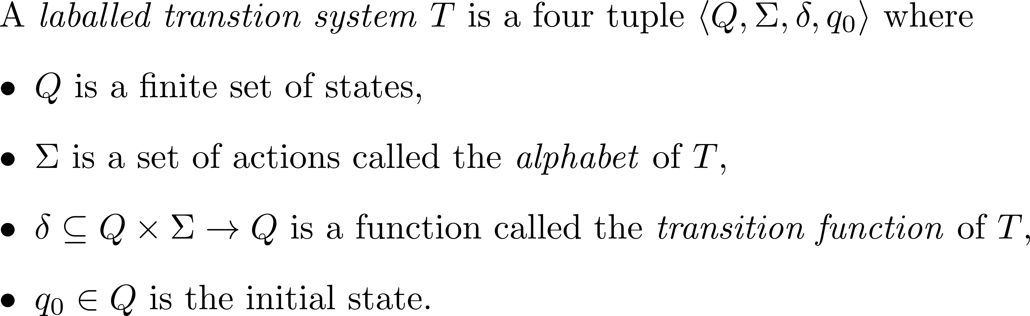
Background
We use labelled transition systems to model the behavior of systems and environments.

Slide 8
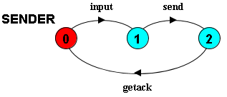
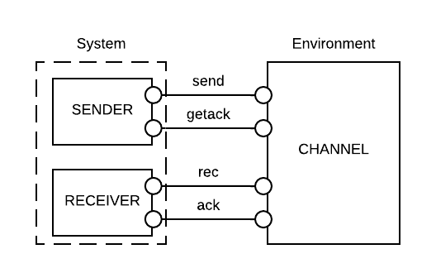
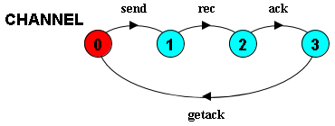
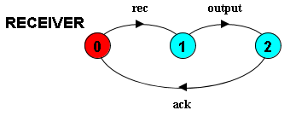
Motivation Example
Notes:
In the diagrams above, state 0 is always the initial state

Slide 9
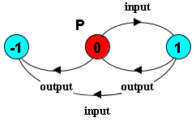
The “correct” function
Informally, (1) bad things should not happen, and (2) good things should happen.
Formally, the correct function is a combination of safety and liveness properties.
In the example, we consider:
Safety Property P: input and output should alternate, i.e.,
Liveness Property: the system should be deadlock-free.
Notes:
State -1 refers to the error state. A trace to the error state means the safety property P is violated.
Limitations:
A safety property is restricted to the form of LTSA property.
We consider deadlock-free to be the weakest form of liveness, i.e., the system should not be stuck at some step.
I will use “correct” in this presentation for simplicity, but it means the system should satisfy the given safety properties and be deadlock-free.

Slide 10
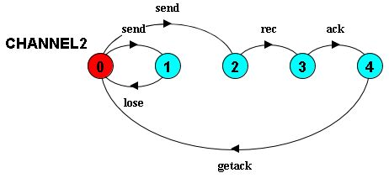
Uncertainty in environment
Is the system capable to deal with such uncertainty?
By model checking, a trace to deadlock: <input, send, lose, send>.
Notes:
The last send will cause deadlock, i.e., the system is waiting for a rec event, but the environment is waiting for a send event.

Slide 11
Representation of Uncertainty
The baseline environment is a pre-defined environment in which the system can ensure “correct” function.
Then, uncertainty is the additional behavior that is not in the baseline environment which may cause property violations.
Intuitively, Uncertainty(Env) = Beh(Env) – Beh(Env_{base}).

Slide 12
Capability to deal with uncertainty
If the additional behavior of the environment would not cause property violation, we say the system can deal with the uncertainty.
Capability of a system to deal with uncertainty is the additional behavior allowed by the system, that is not in the base environment.
Intuitively, Capability(S) = AllowedEnv(S) – Beh(Env_{base}).
How to generate the allowed behavior of the environment?
How to define the LTS minus operator?

Slide 13
Generating weakest assumption
The assumption of a system is

Slide 14
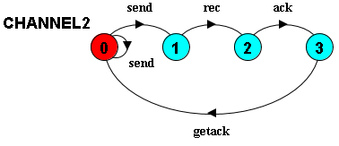
Representation of uncertainty
Uncertainty is the additional behavior that is not in the baseline environment which may cause property violations.
E.g., a trace in environment: <send, lose, send>
Problem: the alphabet of internal events is often unknown.
Solution: project the environment to the known interfaces.
The projected trace: <send, send>

Slide 15
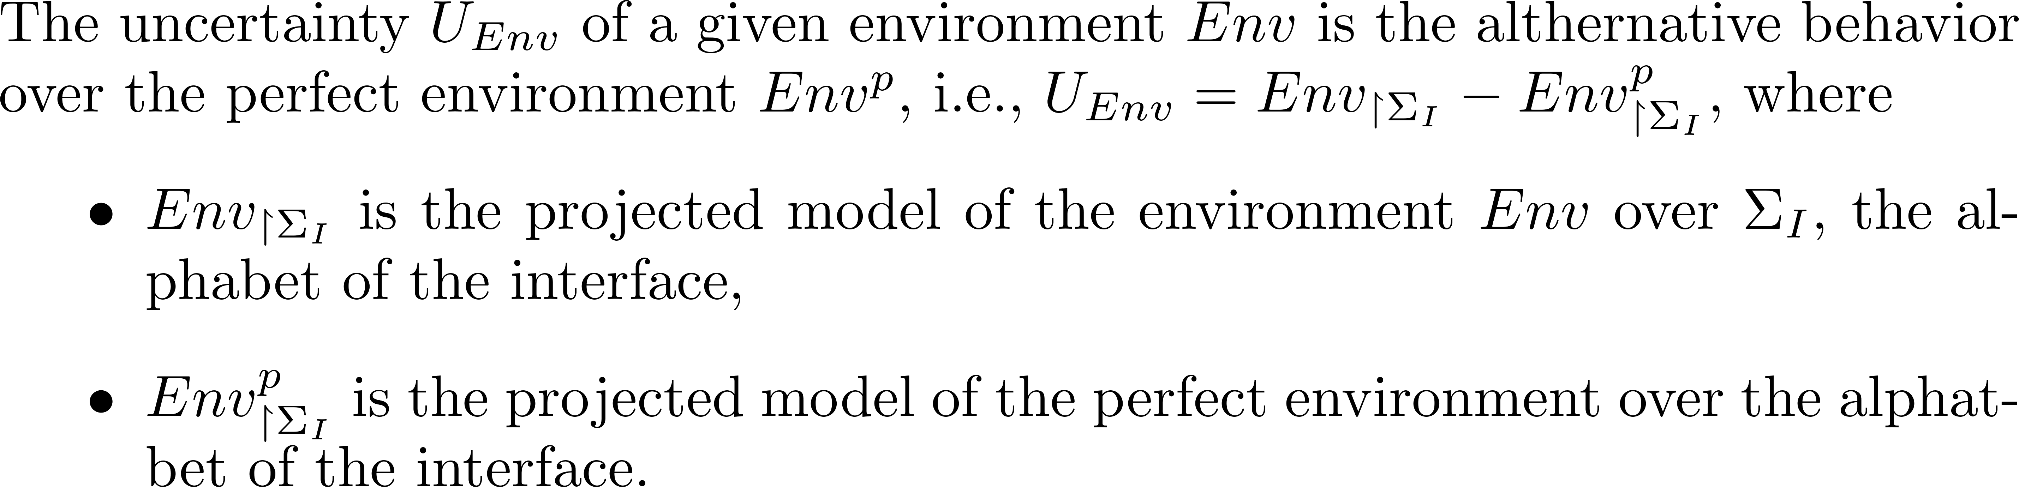
Representation of uncertainty
Notes:
For now, let’s ignore the concrete definition of the ‘-’ operator over state machines.

Slide 16
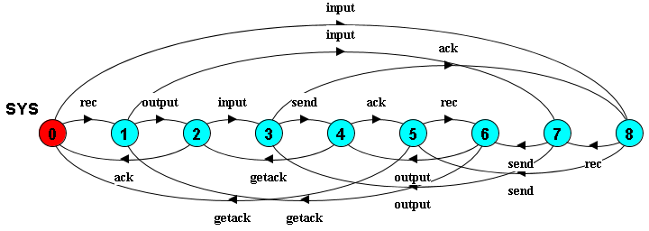
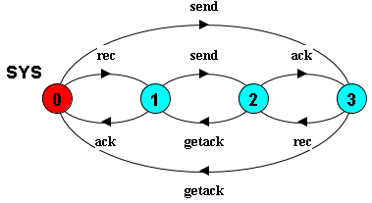
Representation of system capability
The capability of a system can be represented as all the traces of the LTS.
Problem: the “internal” events are less important when analyzing its capability to work against a given environment.
Solution: project the system to the interfaces of the environment.
Notes:
The definition of internal gives us the flexibility that: we could analyze the system capability against a given component in the environment, and the internal events under a given component could be the interfaces under another environment.
(I didn’t investigate this, but could be a future research direction)

Slide 17
Representation of system assumption
The projected model describes all the possible traces of the environment that the system can work with (i.e., deadlock-free).
However, it may include traces that would lead to property violation.
E.g., system allows trace <send, getack, send, getack, …>, which violates property that input and output should alternate.
Notes:
<send, getack, send, getack, …> means that the environment (channel) only accepts inputs without any output, which violates the property that input and output should alternate.

Slide 18
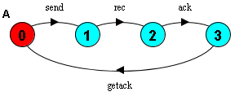
Representation of system assumption
Developers make implicit assumptions of the environment to ensure “correct” function.
The assumption includes a subset of behavior of the system capability.
E.g., to ensure the property, it assumes the environment to be:

Slide 19
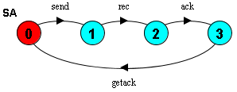
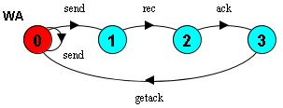
Stronger and Weaker assumption
Stronger assumption => less allowed behavior of the environment;
Weaker assumption => more allowed behavior of the environment.

Slide 20
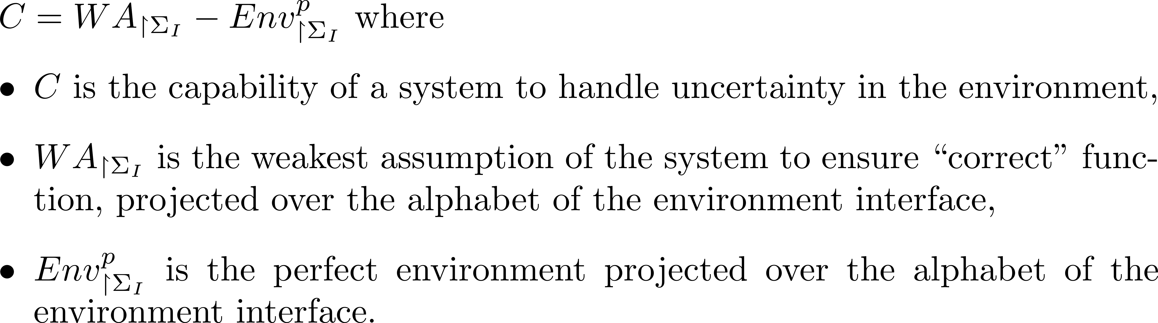
Capability to handle uncertainty
Notes:
The intuition is that:
A system is often designed to work under some environments, e.g., we assume that the environment should work exactly in the sequence of <send, rec, ack, getack>, otherwise, the system would deadlock or violate the safety property.

Slide 21
Application
Security protocol and attacker model
Human machine interface model and human behavior model
Distributed protocol and fault model

