Slide 1
How to “Measure” Software Robustness
A formal approach
Changjian (CJ) Zhang
Eunsuk Kang
David Garlan
Carnegie Mellon University

Slide 2
Agenda
Research Problem
Motivation Example & Overview
Approach In Details
Discussion

Slide 3
Research Problem

Slide 4
What is Robustness?
In general, robustness is the capability of a system to deal with uncertainty.
Uncertainty refers to the differences or errors between models and reality, and
Whatever mechanism is used to express these errors will be called a representation of uncertainty. [Essential of Robust Control]

Slide 5
What is Robustness?
The term is used in many domains:
Robust statistics seek methods to deal with outliers in data samples (e.g., the distribution of data does not perfectly match to normal distribution).
Machine Learning seeks methods to guarantee the performance of a model (e.g., a classifier) against noise in data samples.
A distributed system should be robust to deal with failures of servers. Also mitigation strategies often designed to address certain types of failures (e.g., fail-stop, fail-silent, or fail-arbitrary).
…

Slide 6
What is Robustness in Software?
IEEE definition:
The degree to which a system or component can function correctly in the presence of invalid inputs or stressful environmental conditions.
Existing Work:
Fuzz Testing – uses massive amounts of random data to fail a system.
Chaos Engineering – puts a system in an extremely chaos environment to fail the system.
Fault Injection – injects faults in hardware or software and exams the system behavior.
… (Mostly focus on verification)
Notes:
In different domains, the definition of robustness is different and thus the measure is different

Slide 7
Motivation Example & Overview

Slide 8
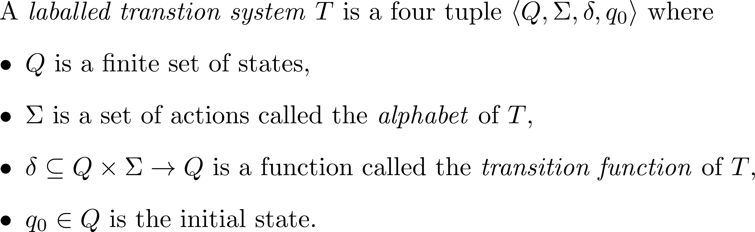
Background

Slide 9
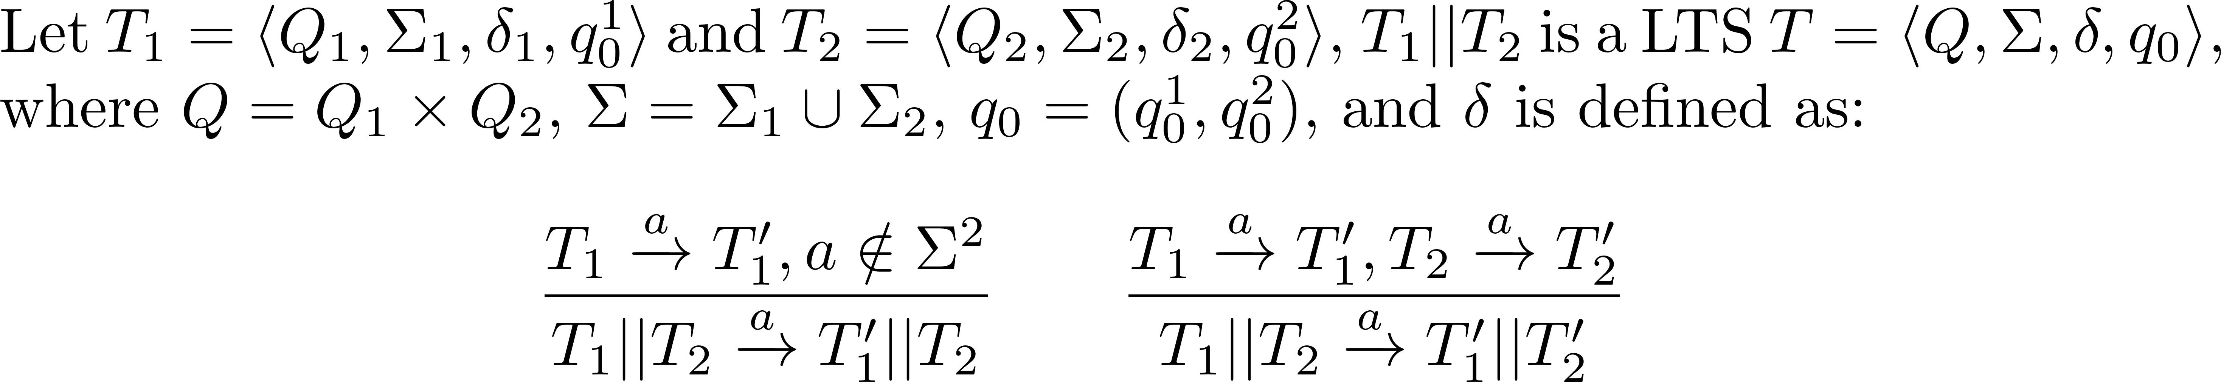
Background
Parallel composition “||” composes two concurrent LTSs as one system.
It combines behavior of two LTSs by synchronizing common actions and interleaving the remaining actions.

Slide 10
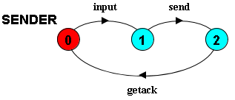
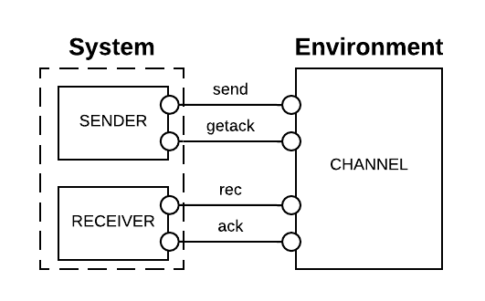
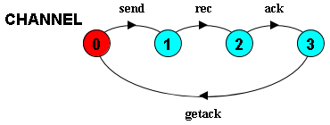
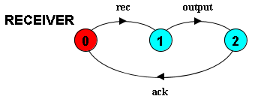
Example
Notes:
In the diagrams above, state 0 is always the initial state

Slide 11
The “correct” function
Informally, in a system
bad things should not happen, and
good things should eventually happen.
Formally, the correct function is a combination of safety and liveness properties.
Notes:
Limitations:
A safety property is restricted to the form of LTSA property.
We consider deadlock-free to be the weakest form of liveness, i.e., the system should not be stuck at some step.
I will use “correct” in this presentation for simplicity, but it means the system should satisfy the given safety properties and be deadlock-free.

Slide 12
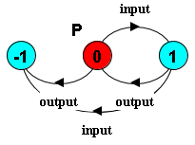


Safety Property
A safety property $P$ is a deterministic LTS which defines the acceptable behavior over the alphabet of $P$.
E.g., assert that the input and output events should alternate, we have:
-1 is the error state. When the system reaches this state, the safety property is violated
Notes:
To check safety property, there should not have a trace that will lead the system enters the error state.

Slide 13


Liveness Property - Deadlock
In LTS, a system is deadlock when it reaches a state where no outgoing transitions can occur.
A wait-for cycle exists. Because A is waiting to do a; but to do a, B has to do b first.

Slide 14
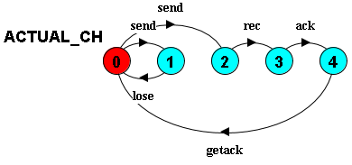
Uncertainty in environment - 1
Messages may be lost in the actual channel.

Slide 15
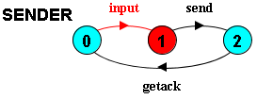
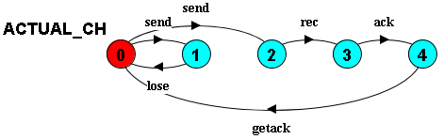
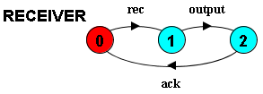

Trace to deadlock
$<input>$

Slide 16
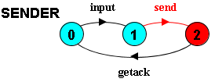
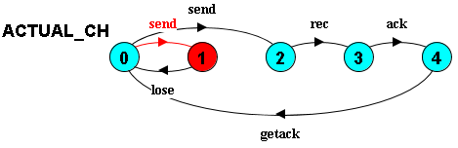

Trace to deadlock
$<input, send>$

Slide 17

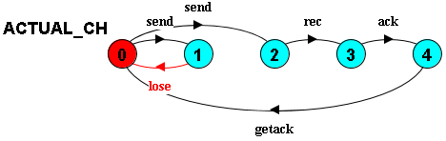

Trace to deadlock
$<input, send, lose>$ DEADLOCK!
SENDER is waiting for getack; RECEIVER is waiting for rec; ACTUAL_CH is waiting for send!

Slide 18
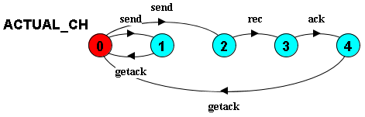
Uncertainty in environment - 2
Instead of lose, the channel acknowledges to the sender immediately after the send.

Slide 19
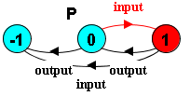
Trace to error state
$<input>$

Slide 20
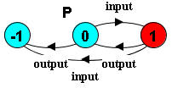
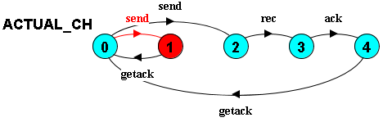
Trace to error state
$<input, send>$

Slide 21
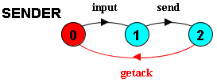


Trace to error state
$<input, send, getack>$

Slide 22
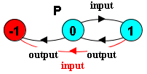

Trace to error state
$<input, send, getack, input>$ ERROR STATE!
<input, input> in P results in entering the error state!

Slide 23
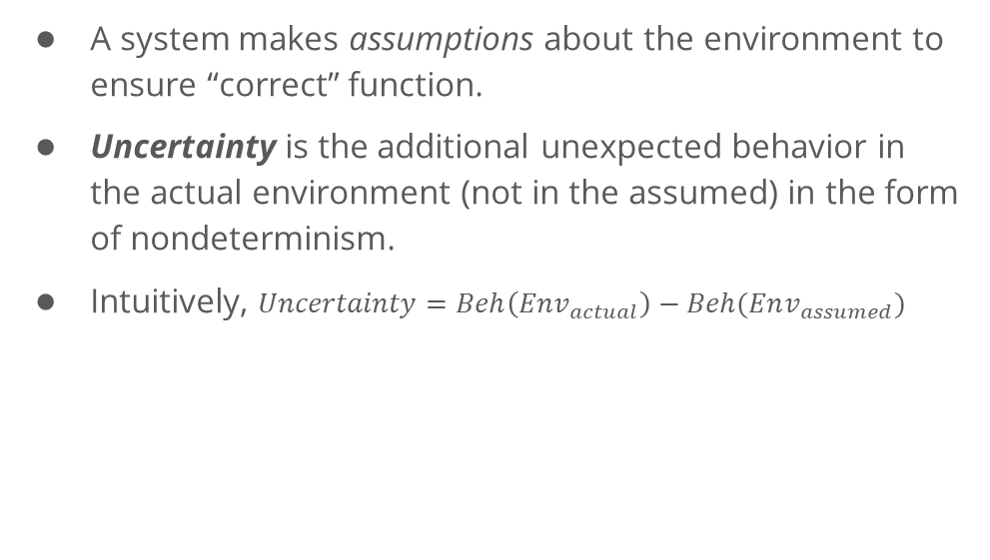
Representation of Uncertainty
A system makes assumptions about the environment to ensure “correct” function.
Uncertainty is the additional unexpected behavior in the actual environment (not in the assumed) in the form of nondeterminism.
Intuitively, $Uncertainty=Beh\left(Env_{actual}\right)−Beh(Env_{assumed})$
CANNOT directly measure uncertainty, because the actual env is often UNKNOWN!

Slide 24
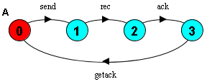
System Assumption
The assumption is the expected behavior of the environment, made by a system, in which the system can ensure the “correct” function.
E.g., to ensure the property, the example system assumes the environment to be:

Slide 25
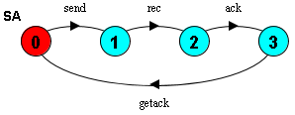
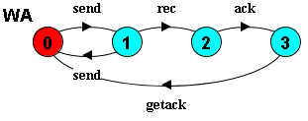
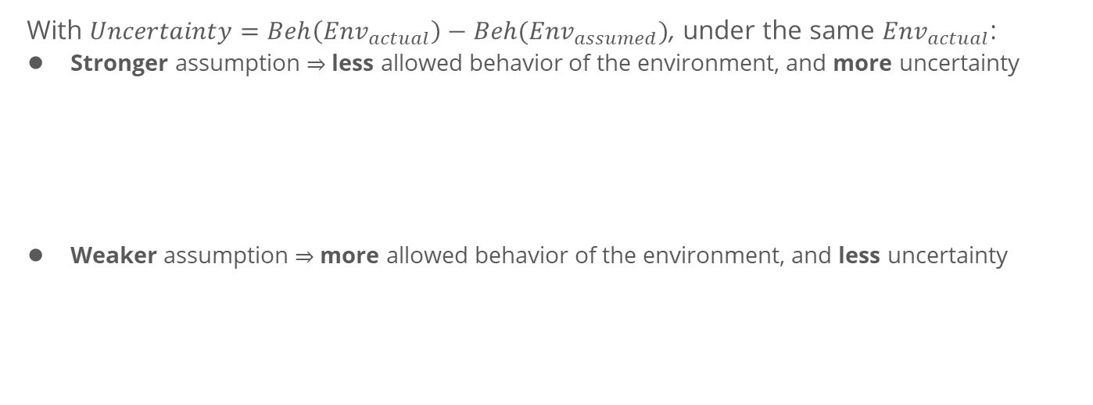
Stronger and Weaker Assumption
With $Uncertainty=Beh\left(Env_{actual}\right)−Beh(Env_{assumed})$, under the same $Env_{actual}$:
Stronger assumption $⇒$ less allowed behavior of the environment, and more uncertainty
Weaker assumption $⇒$ more allowed behavior of the environment, and less uncertainty

Slide 26
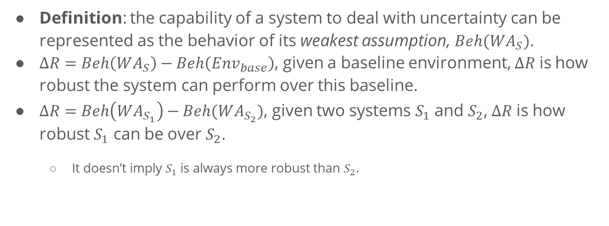
Representation of Capability
Definition: the capability of a system to deal with uncertainty can be represented as the behavior of its weakest assumption, $Beh(WA_{S})$.
$∆R=Beh\left(WA_{S}\right)−Beh\left(Env_{base}\right)$, given a baseline environment, $∆R$ is how robust the system can perform over this baseline.
$∆R=Beh\left(WA_{S_{1}}\right)−Beh(WA_{S_{2}})$, given two systems $S_{1}$ and $S_{2}$, $∆R$ is how robust $S_{1}$ can be over $S_{2}$.
It doesn’t imply $S_{1}$ is always more robust than $S_{2}$.
S₁
S₂
base
Notes:
Although the behavior of the actual environment is often unknown, we can generate the weakest assumption of a system.

Slide 27

Representation of Capability
$$∆R=Beh\left(WA_{S_{1}}\right)−Beh(WA_{S_{2}})$$
How to generate the weakest assumption of a system?
How to define the minus operator over LTSs?

Slide 28
Approach In Details

Slide 29
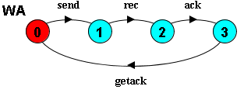
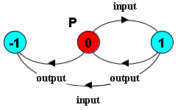
Generating the Weakest Assumption
[Dimitra02] already presents an approach to generate the weakest assumption (a minor modification required).
[Dimitra02] D. Giannakopoulou, C. S. Pǎsǎreanu, and H. Barringer, “Assumption generation for software component verification,” in Proceedings - ASE 2002: 17th IEEE International Conference on Automated Software Engineering, 2002, pp. 3–12.

Slide 30
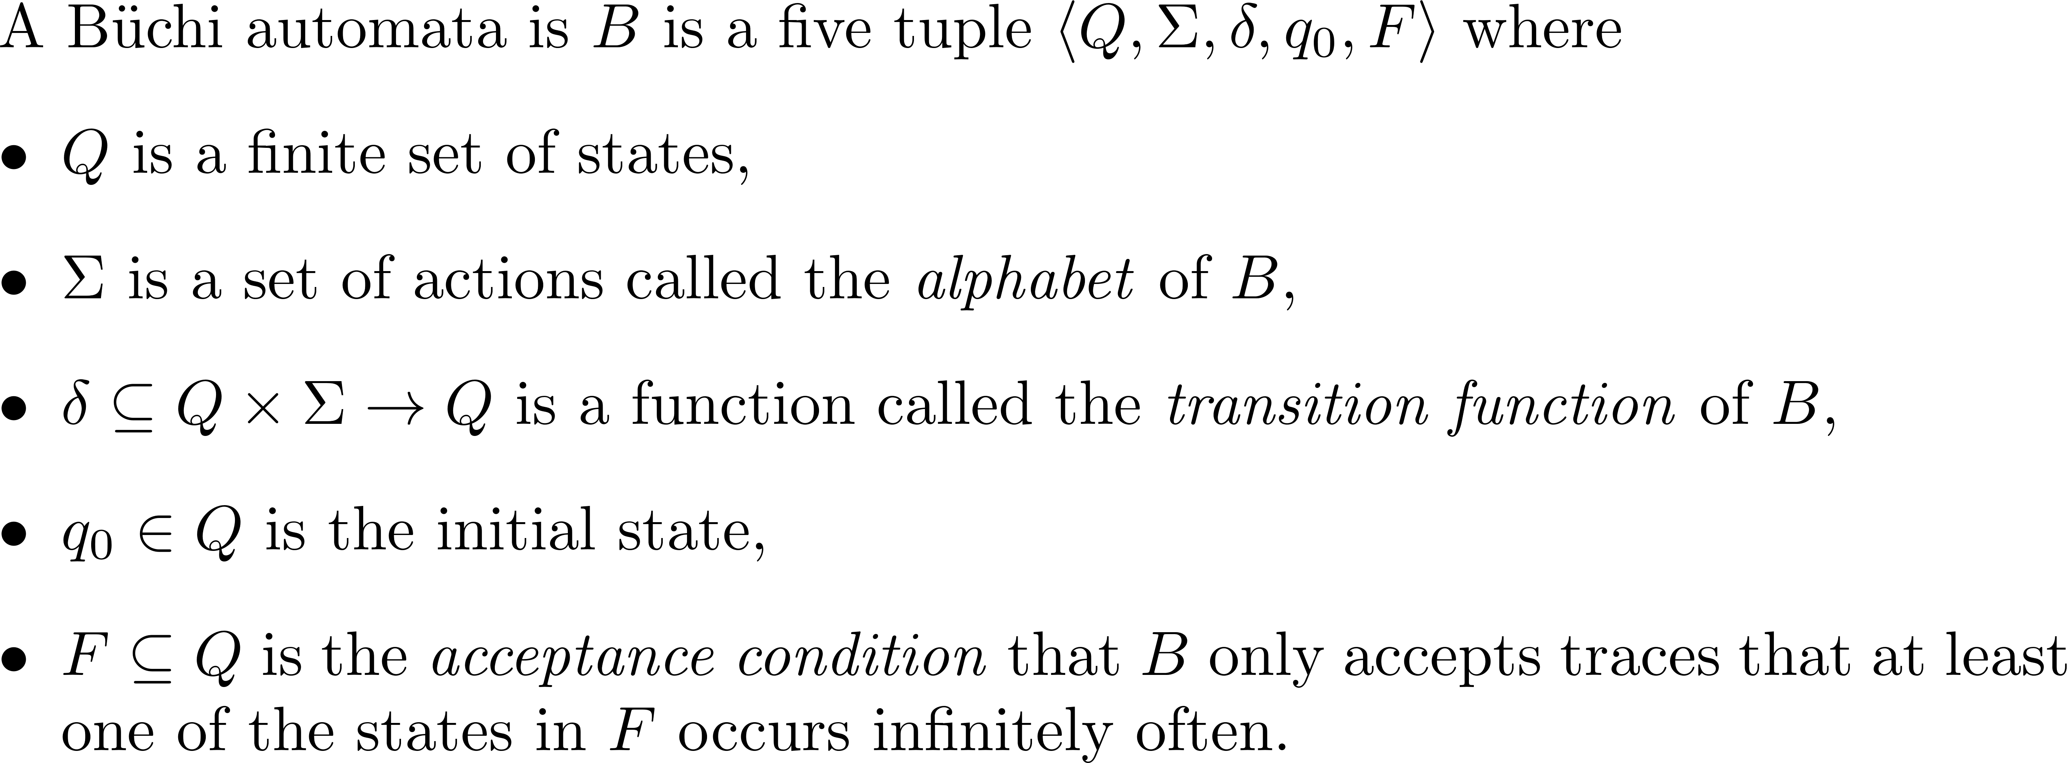
Büchi automata
To define the minus operator, the LTS formalism is not enough, we introduce Büchi automata.

Slide 31
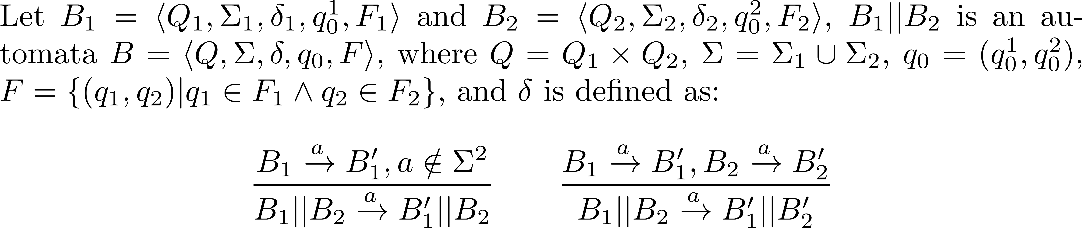
Parallel Composition on Büchi automata

Slide 32
Negation
Negation is an operator that reverts the acceptance condition of a Büchi automata.

Slide 33
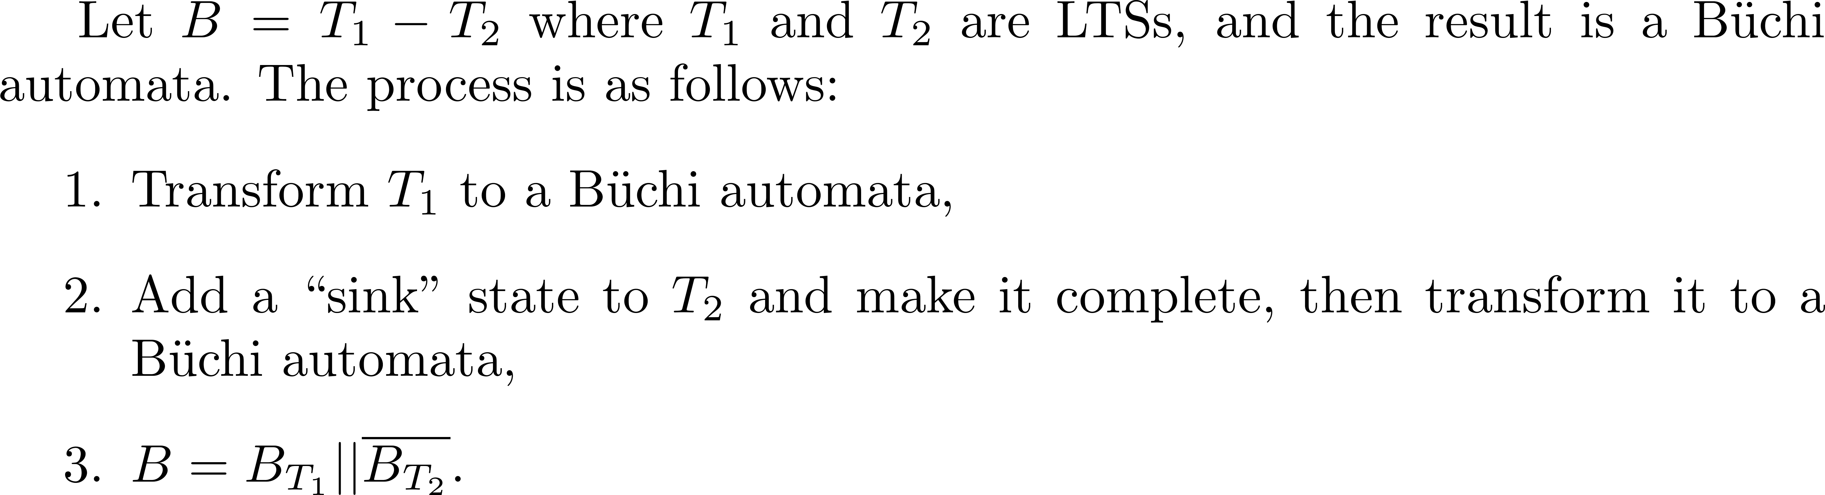
The Minus Operator

Slide 34
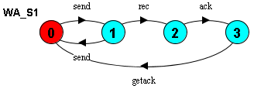
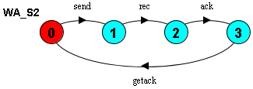


Example
The weakest assumption of $S_{1}$
The weakest assumption of $S_{2}$
?

Slide 35
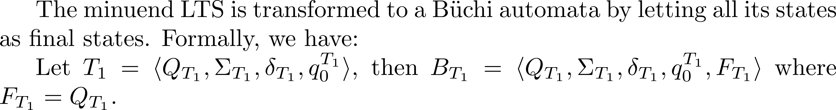
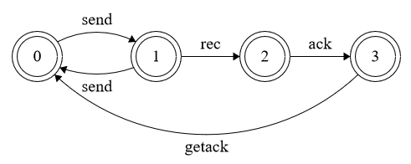
Step 1

Slide 36
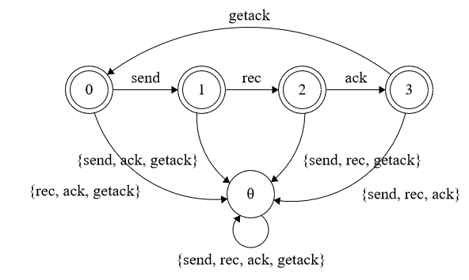
Step 2

Slide 37
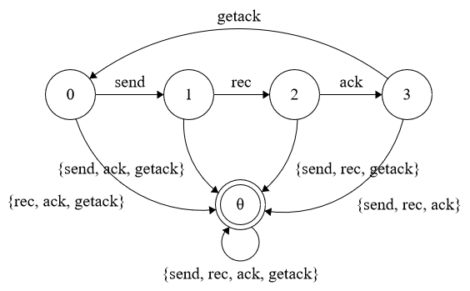
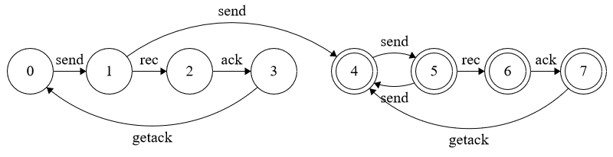
Step 3

Slide 38
Discussion

Slide 39
Potential Applications
Robustness of a Security Protocol against Attacker Models
Robustness of a Human Computer Interface Model against Human Behavior Models
Robustness of a Distributed Protocol against Fault Models
…
Key Insights: How robust is a system when we only have limited information about the environment?

Slide 40
Limitations
Our approach is based on LTSA, thus the form of safety property is limited to it.
We only consider deadlock-free as the only liveness property.
The Büchi automata is not a good representation as a metric.

