Slide 1
How to characterize Software Robustness
A formal approach
Changjian (CJ) Zhang
Eunsuk Kang
David Garlan
Carnegie Mellon University

Slide 2
Agenda
What is Robustness?
Approach Overview
Generating Weakest Assumption
Representation of Robustness
Discussion

Slide 3
What is Robustness?
In general, robustness is the capability of a system to deal with uncertainty.
Uncertainty refers to the differences or errors between models and reality, and whatever mechanism is used to express these errors will be called a representation of uncertainty. [Essential of Robust Control]
Notes:
This definition is not limited to control theory. The model could be mathematic model, a physics model, or our software is also a model of the real world. Then, there are always differences between models and reality.

Slide 4
What is Robustness in other domains?
The term, Robustness, is used in many domains:
Robust statistics seek methods to deal with outliers in data samples (e.g., the distribution of data does not perfectly match to normal distribution).
Machine Learning seeks methods to guarantee the performance of a model (e.g., a classifier) against noise in data samples.
A distributed system should be robust to deal with failures of servers. Mitigation strategies often designed to address certain types of failures (e.g., fail-stop, fail-silent, or fail-arbitrary).
…

Slide 5
What is Robustness in Software?
IEEE definition:
The degree to which a system or component can function correctly in the presence of invalid inputs or stressful environmental conditions.
Existing Work:
Fuzz Testing – uses massive amounts of random input data to fail a system.
Chaos Engineering – puts a system in an extremely chaos environment to fail the system.
… (Mostly focus on verification)
Notes:
Fuzz testing focuses more on the erroneous input data, and chaos engineering focuses more on the stressful environment
They are great methods, but the problem for testing is that you cannot tell what a system can do and what a system cannot do exhaustively.
For the latter one, that what a system cannot do, it’s often impossible to enumerate all the errors.
But for the first one, we may be able to answer what a system can do, that’s our focus.

Slide 6
Research Focus
How to characterize the ability of a system to ensure correct function against erroneous behaviors in the environment?
What’s the definition of correct system function?
What’s the representation of erroneous behaviors in the environment?
What’s the representation of system ability to handle such erroneous behaviors (i.e., the representation of robustness)?

Slide 7
Approach Overview

Slide 8
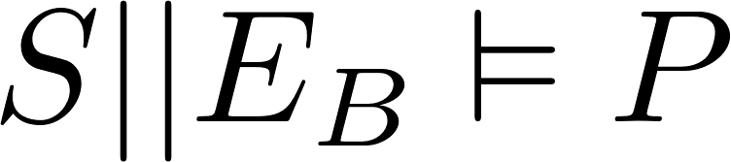
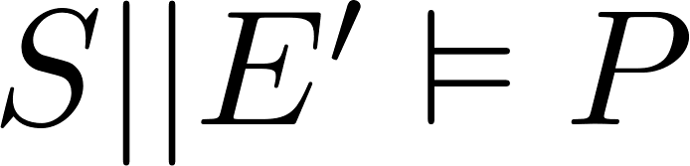
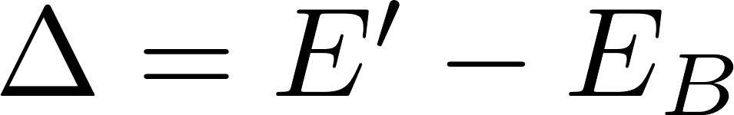
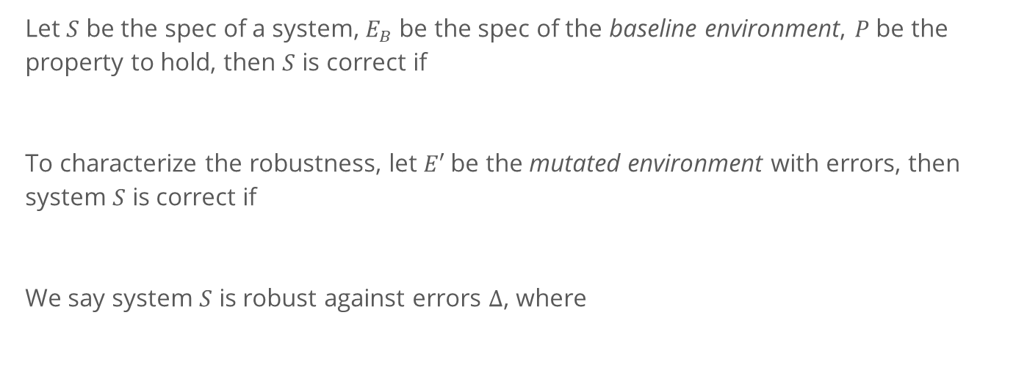
A Formal View of Testing Robustness
Let $S$ be the spec of a system, $E_{B}$ be the spec of the baseline environment, $P$ be the property to hold, then $S$ is correct if
To characterize the robustness, let $E′$be the mutated environment with errors, then system $S$ is correct if
We say system $S$ is robust against errors $∆$, where
Notes:
For baseline environment, it could be any environment that we take as reference when designing a system (ground truth). E.g., a perfect channel without message lost.
For now, let’s ignore the formalism we used to model the behavior and property.
Of course, in testing and verification, we are more interested in the deltas which do not satisfy P.
Also, let’s ignore what does – mean here. I’ll explain it later.

Slide 9
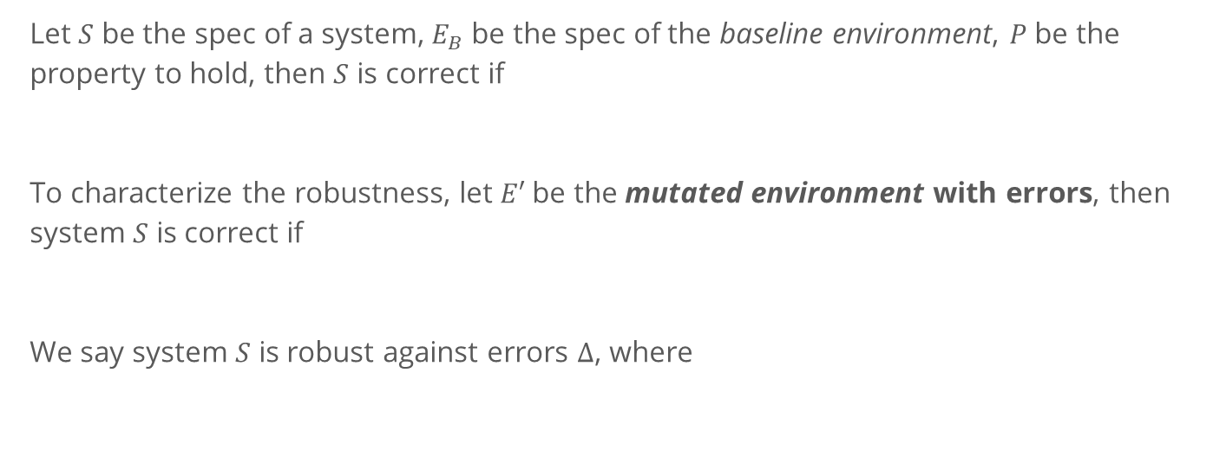
A Formal View of Testing Robustness
Let $S$ be the spec of a system, $E_{B}$ be the spec of the baseline environment, $P$ be the property to hold, then $S$ is correct if
To characterize the robustness, let $E′$be the mutated environment with errors, then system $S$ is correct if
We say system $S$ is robust against errors $∆$, where
Not possible to enumerate all the possible errors!

Slide 10
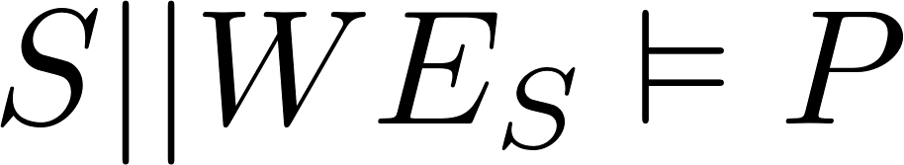
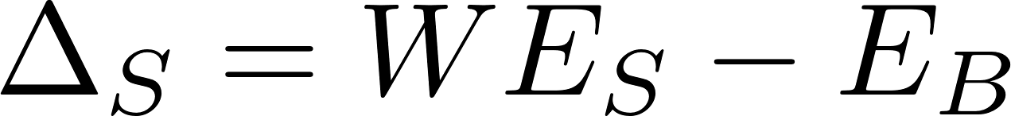
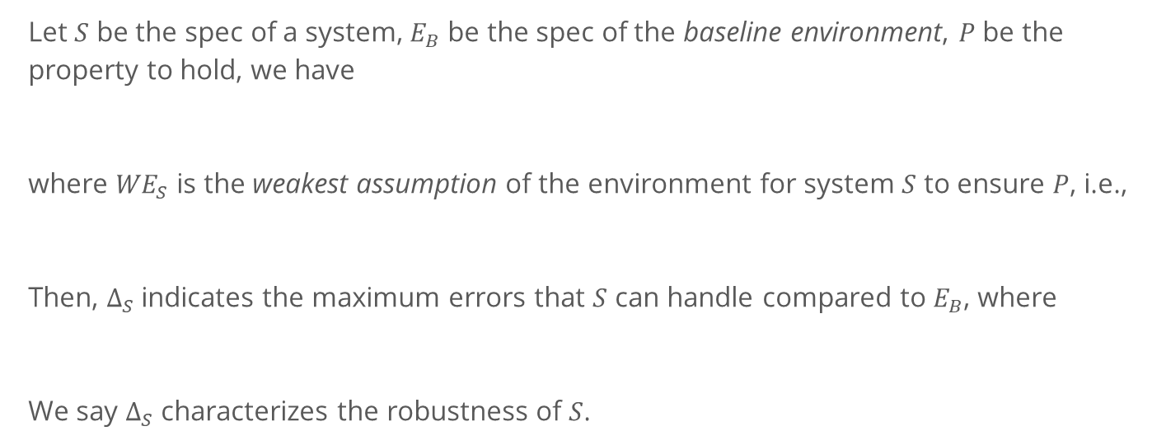
Another way around
Let $S$ be the spec of a system, $E_{B}$ be the spec of the baseline environment, $P$ be the property to hold, we have
where ${WE}_{S}$ is the weakest assumption of the environment for system $S$ to ensure $P$, i.e.,
Then, $∆_{S}$indicates the maximum errors that $S$ can handle compared to $E_{B}$, where
We say $∆_{S}$ characterizes the robustness of $S$.
Notes:
In other words, the weakest assumption defines the maximum behavior of the environment the system expects in order to satisfy P.

Slide 11
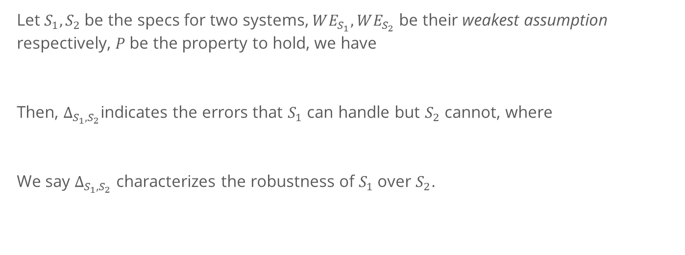
Another way around
Let $S_{1}, S_{2}$be the specs for two systems, $WE_{S_{1}}, WE_{S_{2}}$ be their weakest assumption respectively, $P$ be the property to hold, we have
Then, $∆_{S_{1},S_{2}}$indicates the errors that $S_{1}$ can handle but $S_{2}$ cannot, where
We say $∆_{S_{1},S_{2}}$ characterizes the robustness of $S_{1}$over $S_{2}$.

Slide 12
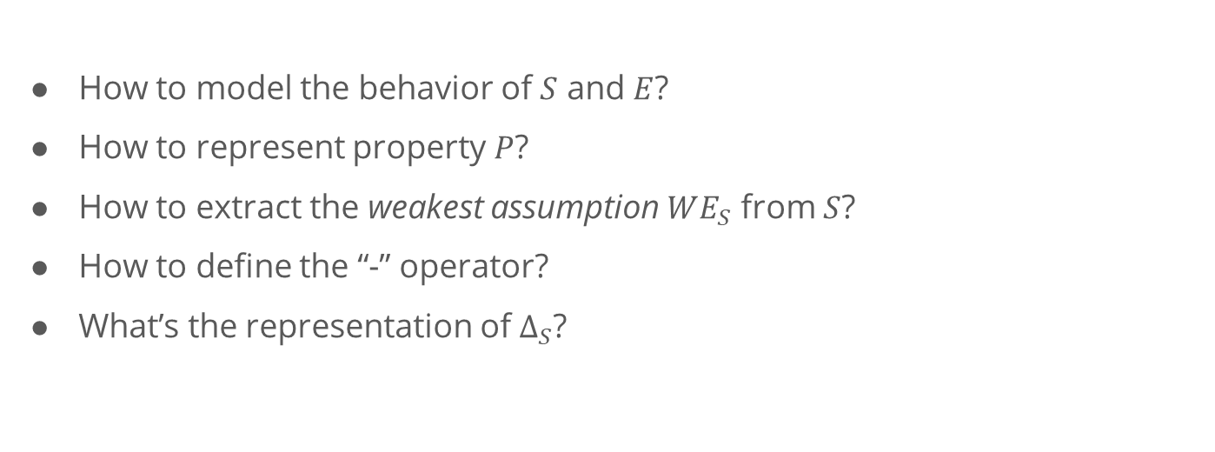
Questions to solve
How to model the behavior of $S$ and $E$?
How to represent property $P$?
How to extract the weakest assumption $WE_{S}$ from $S$?
How to define the “-” operator?
What’s the representation of $∆_{S}$?

Slide 13
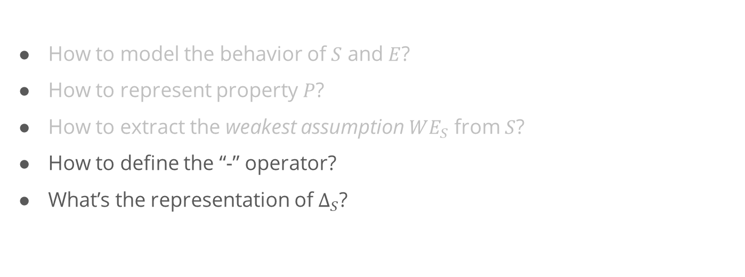
Questions to solve
Starting Point: Existing work present solutions to these problems based on automata theory.
How to model the behavior of $S$ and $E$?
How to represent property $P$?
How to extract the weakest assumption $WE_{S}$ from $S$?
How to define the “-” operator?
What’s the representation of $∆_{S}$?
Our Focus

Slide 14
Generating Weakest Assumption

Slide 15
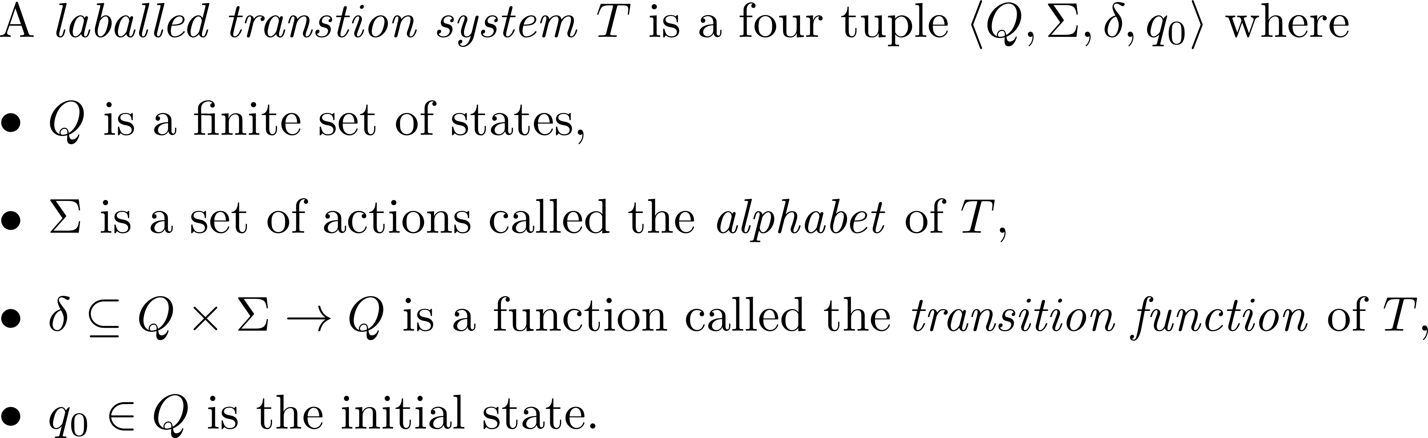
Background

Slide 16
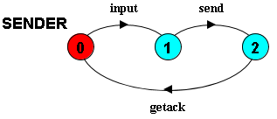
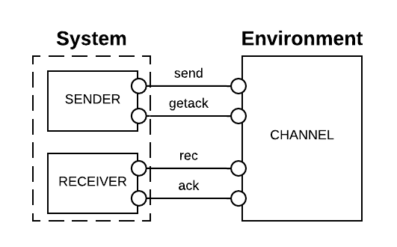
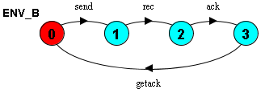
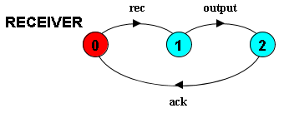
Example
Notes:
By model checking, we know that this system composing with the baseline environment satisfies the property P.

Slide 17
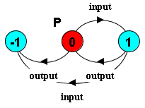


Safety Property
A safety property $P$ is a deterministic LTS which defines the acceptable behavior over the alphabet of $P$.
E.g., assert that the input and output events should alternate, we have:
-1 is the error state. When the system reaches this state, the safety property is violated
Notes:
To check safety property, there should not have a trace that will lead the system enters the error state.
By model checking, we know that this system composing with the baseline environment satisfies the property P.

Slide 18
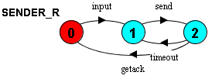
A Robust Version
Introducing timeout and retry to make it more robust
Notes:
Clearly, this system seems to be more robust compared to the original version

Slide 19
A Robust Version
What does it really mean for becoming more robust?
What assumptions does this design decision have made?
Are they consistent with the design intentions?
Introducing timeout and retry to make it more robust
Notes:
Clearly, this system seems to be more robust compared to the original version

Slide 20
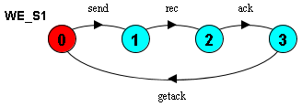
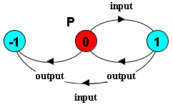
Generating Weakest Assumption
[Dimitra02] presents an approach to generate the weakest assumption.
[Dimitra02] D. Giannakopoulou, C. S. Pǎsǎreanu, and H. Barringer, “Assumption generation for software component verification,” in Proceedings - ASE 2002: 17th IEEE International Conference on Automated Software Engineering, 2002, pp. 3–12.

Slide 21
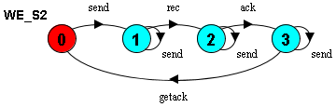
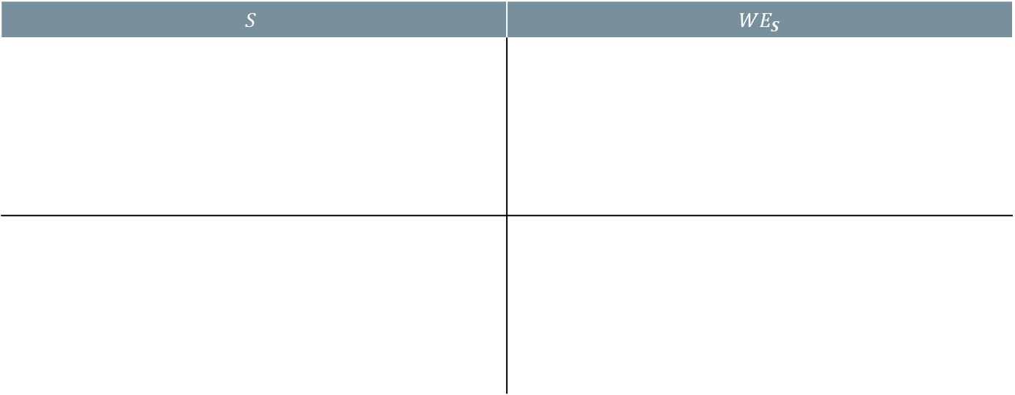
Generating Weakest Assumption
$$S$$ | $$WE_{S}$$

Slide 22
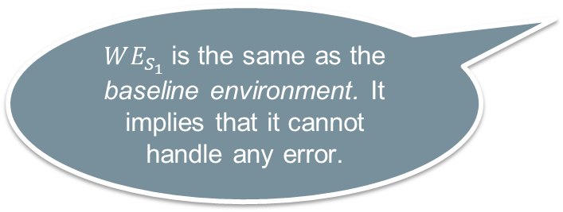
Generating Weakest Assumption
$$S$$ | $$WE_{S}$$
$WE_{S_{1}}$is the same as the baseline environment. It implies that it cannot handle any error.

Slide 23

Generating Weakest Assumption
$$S$$ | $$WE_{S}$$
This is the $∆$! But, are we done? What does it really mean?

Slide 24
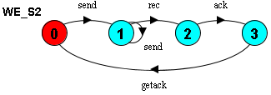
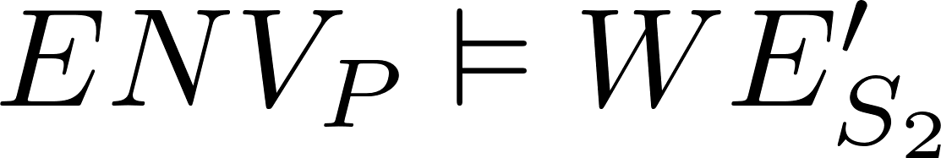
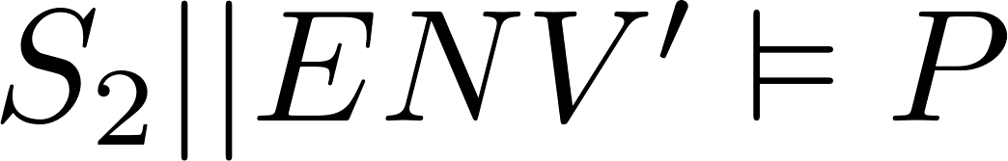
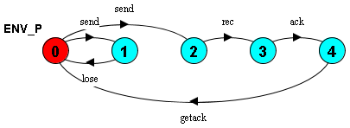
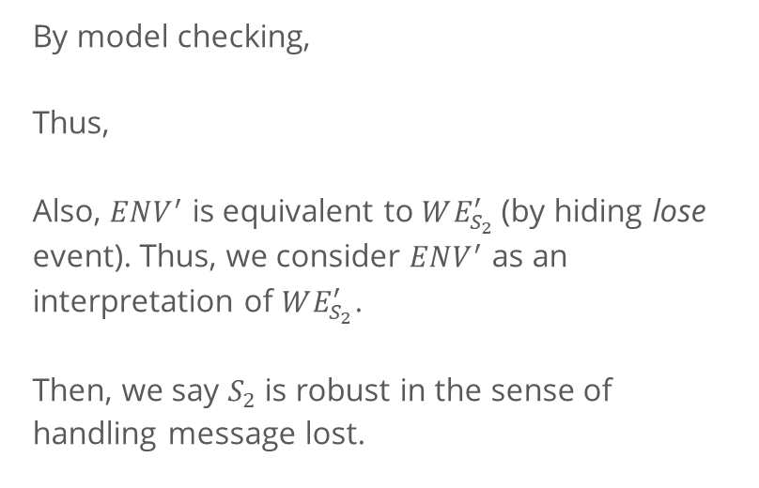
Interpretation of the $∆$
’
By model checking,
Thus,
Also, $ENV^{′}$ is equivalent to $WE_{S_{2}}^{′}$(by hiding lose event). Thus, we consider $ENV^{′}$ as an interpretation of $WE_{S_{2}}^{′}$.
Then, we say $S_{2}$is robust in the sense of handling message lost.
Notes:
For equivalent, it means that any trace in ENV_P is also a trace in WE_S2

Slide 25
Interpretation of the $∆$
But what about these traces?
Do we have other interpretations?

Slide 26
Representation of Robustness

Slide 27
Representation of Errors/Robustness
Based on LTS, errors can be represented by a set of traces, but they are not self-explainable.
Existing Work:
In distributed systems, different fault models capture varies of failure types (e.g., fail-stop, fail-silent, or fail-arbitrary).
In human behavior study, models are developed to classify erroneous human behaviors (e.g., omissions, repetitions, and commissions).
Notes:
In our context, the representation of errors and the representation of robustness refer to the same thing.

Slide 28
Representation of Errors/Robustness
Based on LTS, errors can be represented by a set of traces, but they are not self-explainable.
Existing Work:
In distributed systems, different fault models capture varies of failure types (e.g., fail-stop, fail-silent, or fail-arbitrary).
In human behavior study, models are developed to classify erroneous human behaviors (e.g., omissions, repetitions, and commissions).
Can we map the traces to these models?
Notes:
In our context, the representation of errors and the representation of robustness refer to the same thing.

Slide 29
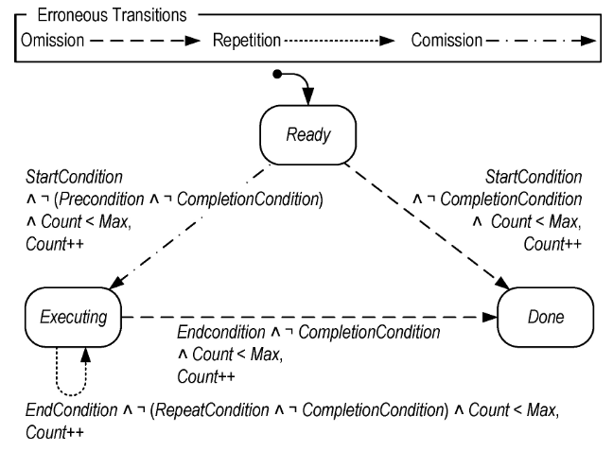
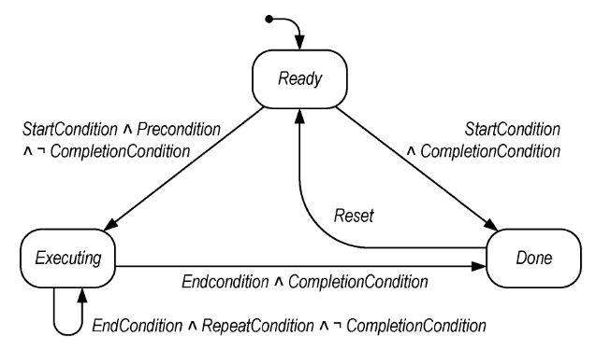
Human Behavior Model: EOFM
[Bolton13] Bolton, M. L., & Bass, E. J. (2013). Generating erroneous human behavior from strategic knowledge in task models and evaluating its impact on system safety with model checking. IEEE Transactions on Systems, Man, and Cybernetics: Systems, 43(6), 1314–1327. https://doi.org/10.1109/TSMC.2013.2256129
Notes:
EOFM is a human task model, it describes that to complete a task, what a human operator should do, when they should perform an action, and when the action is done.
A human activity or action is modeled as a state machine. 3 states: ready refers to the activity is waiting to execute, executing refers to the activity is executing, done refers to the activity is done.
Lines refer to the transitions and labels on the lines refer to the condition to execute a transition.

Slide 30
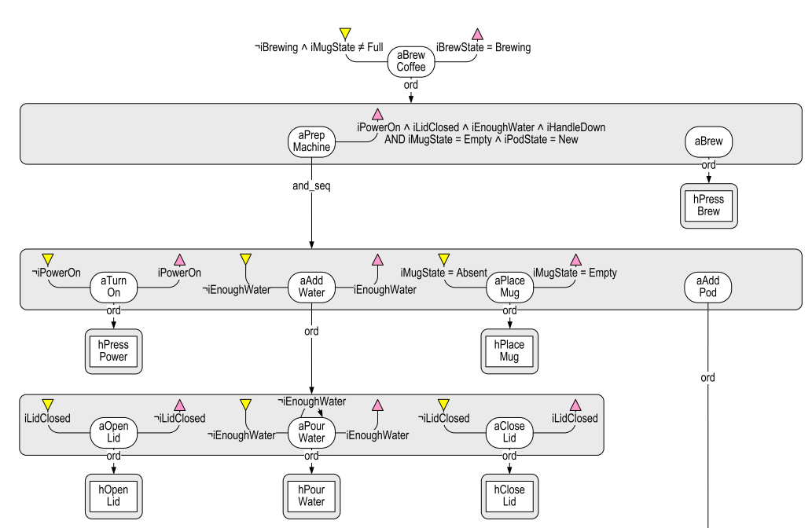
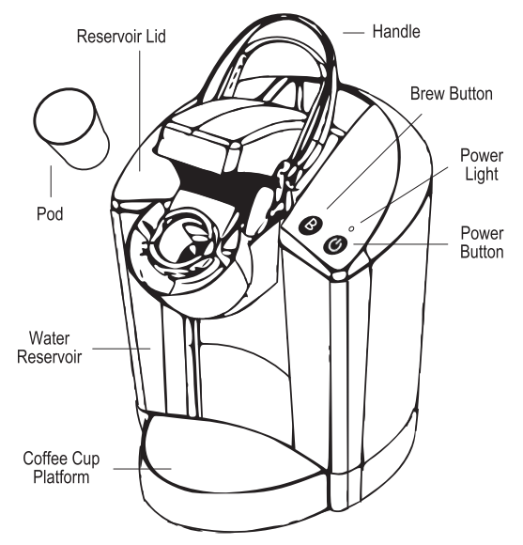
Human Behavior Model: EOFM

Slide 31
Human Behavior Model: EOFM
Intuitively, a user should perform an action if the precondition is satisfied and it is not completed.
[Bolton13] Bolton, M. L., & Bass, E. J. (2013). Generating erroneous human behavior from strategic knowledge in task models and evaluating its impact on system safety with model checking. IEEE Transactions on Systems, Man, and Cybernetics: Systems, 43(6), 1314–1327. https://doi.org/10.1109/TSMC.2013.2256129

Slide 32
Human Behavior Model: EOFM
Intuitively, a user should continue performing an action until its completion condition is reached.
[Bolton13] Bolton, M. L., & Bass, E. J. (2013). Generating erroneous human behavior from strategic knowledge in task models and evaluating its impact on system safety with model checking. IEEE Transactions on Systems, Man, and Cybernetics: Systems, 43(6), 1314–1327. https://doi.org/10.1109/TSMC.2013.2256129

Slide 33
Erroneous Human Behaviors
Omission Error-1: A user should perform an action but not!
[Bolton13] Bolton, M. L., & Bass, E. J. (2013). Generating erroneous human behavior from strategic knowledge in task models and evaluating its impact on system safety with model checking. IEEE Transactions on Systems, Man, and Cybernetics: Systems, 43(6), 1314–1327. https://doi.org/10.1109/TSMC.2013.2256129

Slide 34
Erroneous Human Behaviors
Omission Error-2: A user should continue performing an action but stop executing it prematurely!
[Bolton13] Bolton, M. L., & Bass, E. J. (2013). Generating erroneous human behavior from strategic knowledge in task models and evaluating its impact on system safety with model checking. IEEE Transactions on Systems, Man, and Cybernetics: Systems, 43(6), 1314–1327. https://doi.org/10.1109/TSMC.2013.2256129

Slide 35
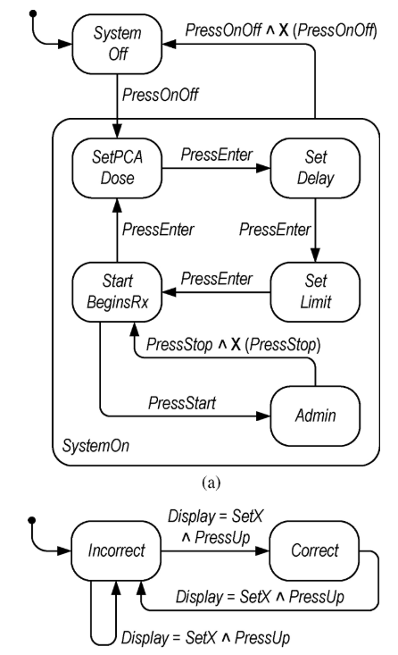
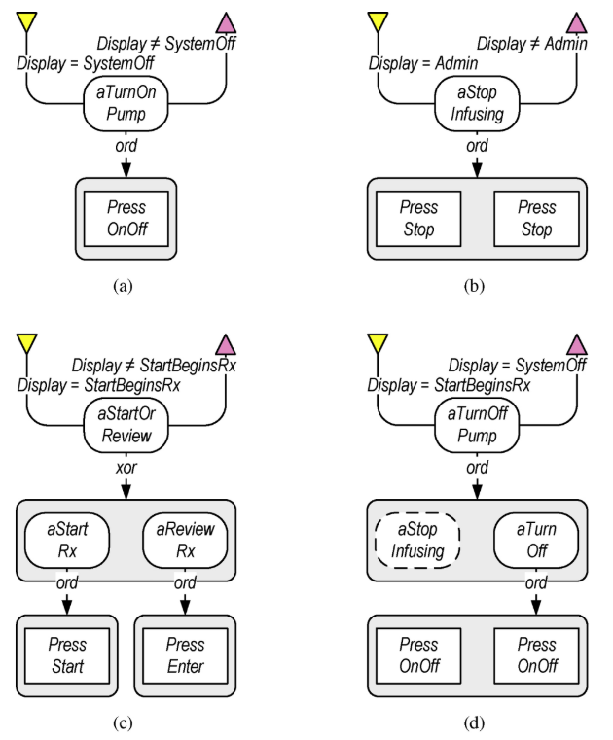
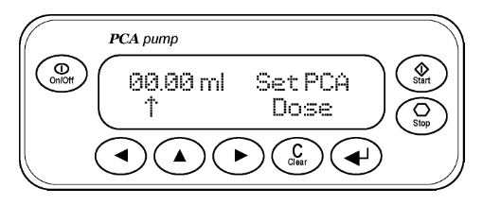
Current Progress
Notes:
Can we extract the design decisions with respect to the robustness of an infusion pump.
Can we map the delta traces we found in the weakest assumption back to the human behavior model.

Slide 36
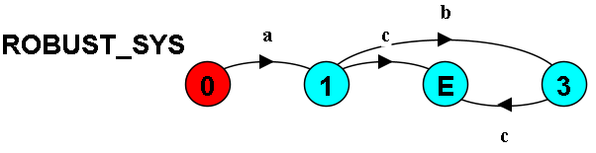
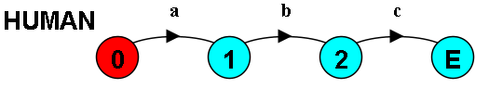
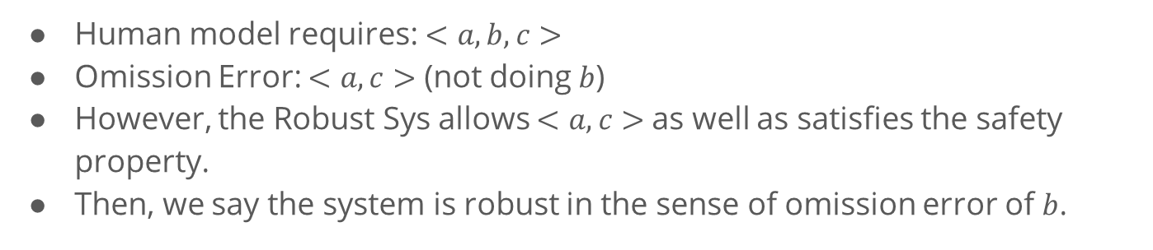
Current Progress
Human model requires: $<a, b, c>$
Omission Error: $<a, c>$ (not doing $b$)
However, the Robust Sys allows $<a, c>$as well as satisfies the safety property.
Then, we say the system is robust in the sense of omission error of $b$.

Slide 37
Discussion

Slide 38
Discussion
Compared to robustness testing, we are interested in finding:
What a system can do,
Instead of what a system cannot do by trial-and-error.
Potential Applications:
Robustness of a Human Computer Interface against Human Errors
Robustness of a Security Protocol against Attackers
Robustness of a Distributed Protocol against Fault Models
…
Notes:
Also, on the other hand, if we are confident about what a system can do, we can infer the errors that the system cannot handle.

Slide 39
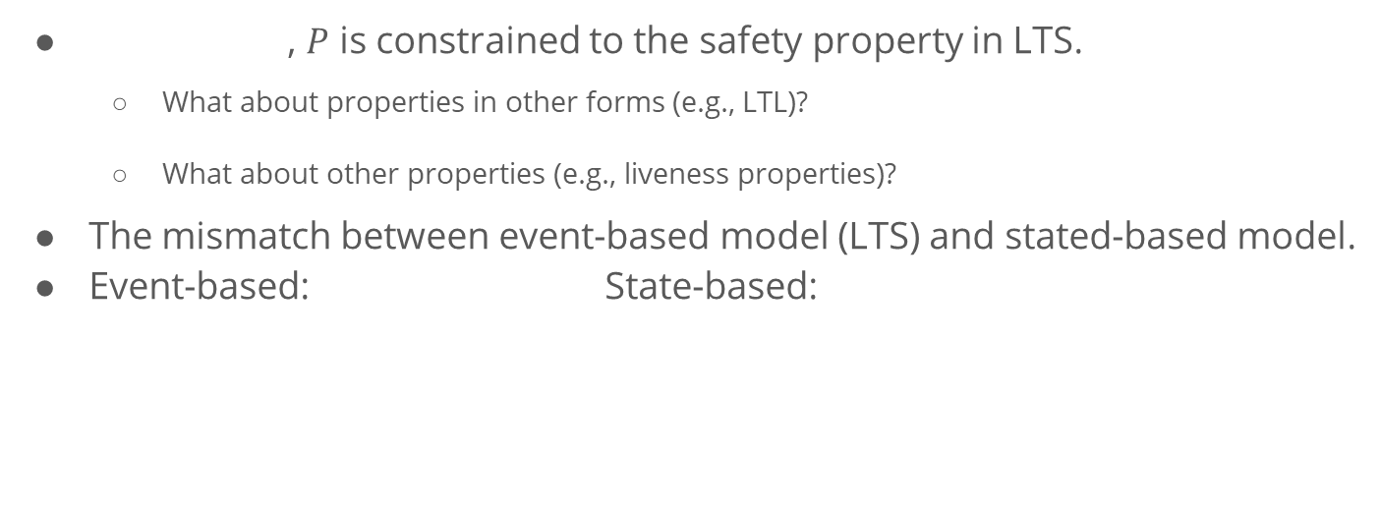
Current Limitations and Challenges
, $P$ is constrained to the safety property in LTS.
What about properties in other forms (e.g., LTL)?
What about other properties (e.g., liveness properties)?
The mismatch between event-based model (LTS) and stated-based model.
Event-based: State-based:
Notes:
In event-based model, we are talking about after doing a, we should do b.
But in state-based model, we are talking about under what conditions we can do a or b.
They can be used to model the same system, but with different focus. Often, state-based model is more expressive, but we are constrained by the previous work on generating weakest assumption.

Slide 40
Thank You!
What is Robustness?
Approach Overview
Generating Weakest Assumption
Representation of Robustness
Discussion

Slide 41
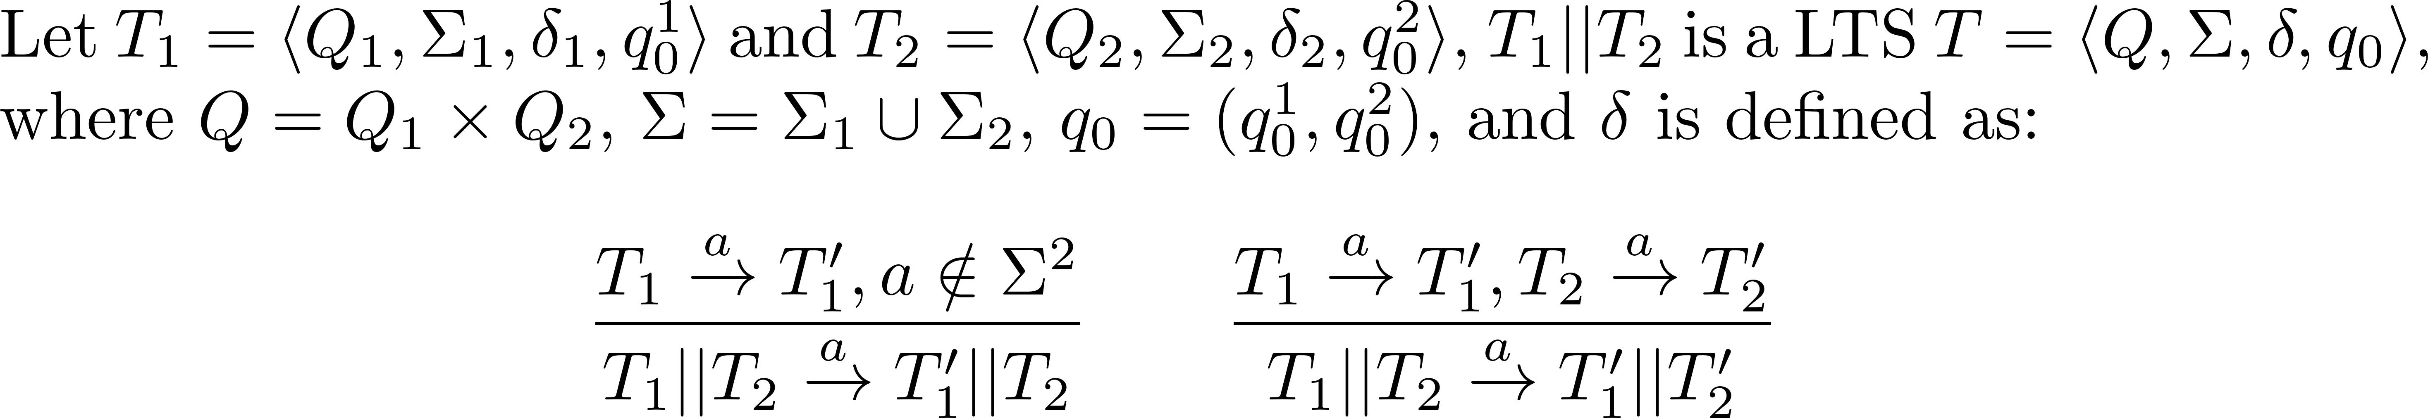
Background
Parallel composition “||” composes two concurrent LTSs as one system.
It combines behavior of two LTSs by synchronizing common actions and interleaving the remaining actions.

Slide 42
The “correct” function
Informally, in a system
bad things should not happen, and
good things should eventually happen.
Formally, the correct function is a combination of safety and liveness properties.
Notes:
Limitations:
A safety property is restricted to the form of LTSA property.
We consider deadlock-free to be the weakest form of liveness, i.e., the system should not be stuck at some step.
I will use “correct” in this presentation for simplicity, but it means the system should satisfy the given safety properties and be deadlock-free.

Slide 43


Liveness Property - Deadlock
In LTS, a system is deadlock when it reaches a state where no outgoing transitions can occur.
A wait-for cycle exists. Because A is waiting to do a; but to do a, B has to do b first.

Slide 44
Errors in the real environment
ERROR: may drop messages.
Notes:
In the diagrams above, state 0 is always the initial state

Slide 45
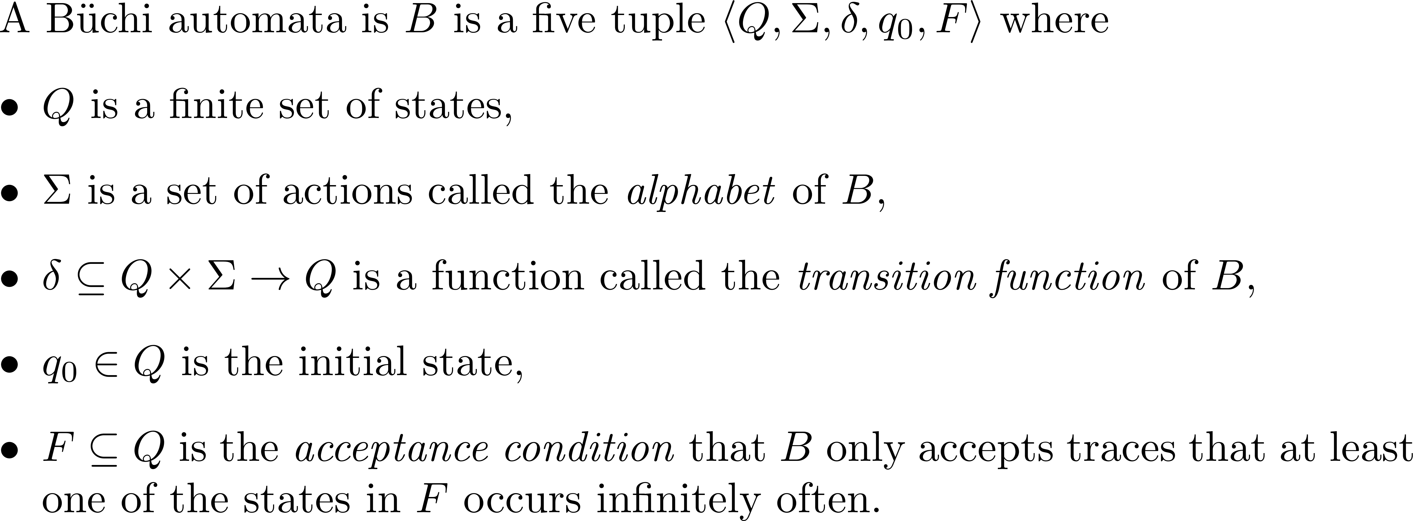
Büchi automata
To define the minus operator, the LTS formalism is not enough, we introduce Büchi automata.

Slide 46
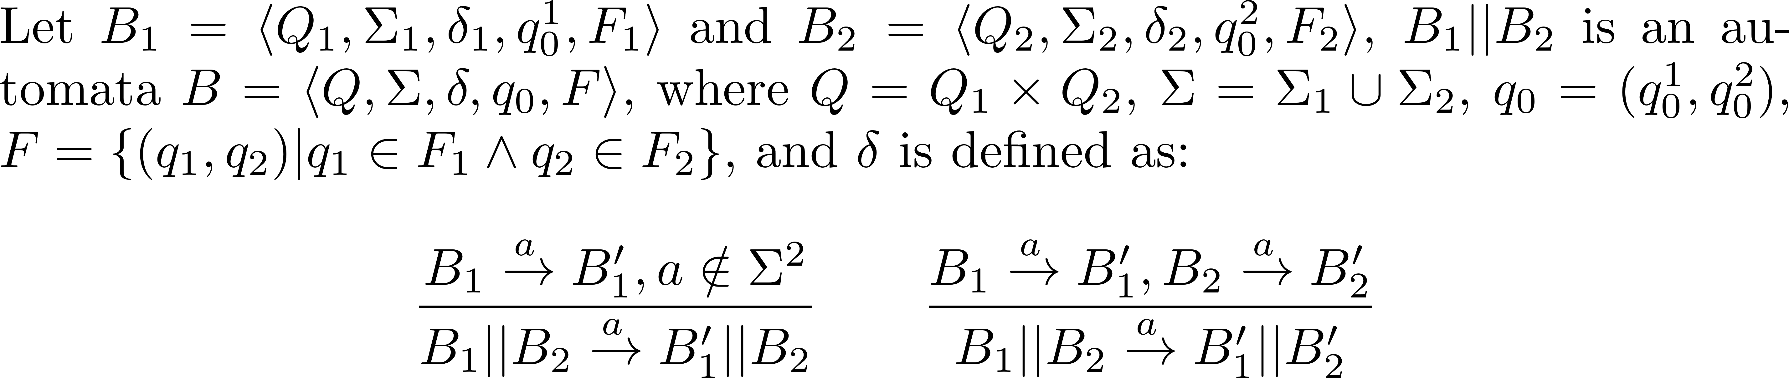
Parallel Composition on Büchi automata

Slide 47
Negation
Negation is an operator that reverts the acceptance condition of a Büchi automata.

Slide 48
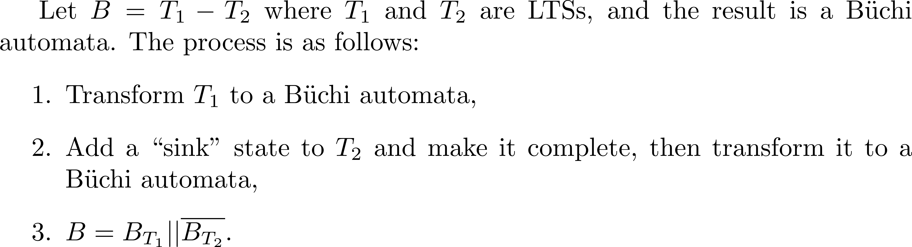
The Minus Operator

Slide 49
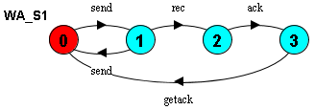
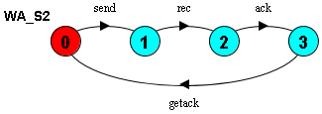


Example
The weakest assumption of $S_{1}$
The weakest assumption of $S_{2}$
?

Slide 50
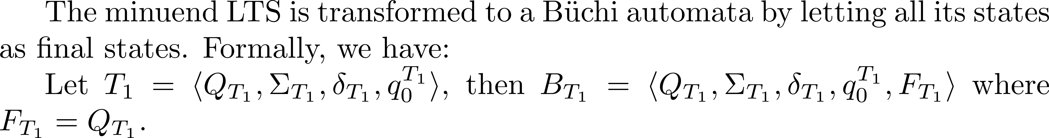
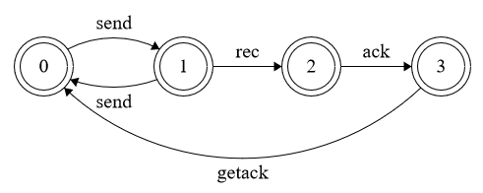
Step 1

Slide 51

Step 2

Slide 52


Step 3

