Slide 1
How to characterize Software Robustness
A formal approach
Changjian (CJ) Zhang
Eunsuk Kang
David Garlan
Carnegie Mellon University

Slide 2
What is Robustness?
In general, robustness is the capability of a system to deal with uncertainty.
Uncertainty refers to the differences or errors between models and reality, and whatever mechanism is used to express these errors will be called a representation of uncertainty. [Essential of Robust Control]

Slide 3
What is Robustness?
The term, Robustness, is used in many domains:
Robust statistics seek methods to deal with outliers in data samples (e.g., the distribution of data does not perfectly match to normal distribution).
Machine Learning seeks methods to guarantee the performance of a model (e.g., a classifier) against noise in data samples.
A distributed system should be robust to deal with failures of servers. Mitigation strategies often designed to address certain types of failures (e.g., fail-stop, fail-silent, or fail-arbitrary).
…

Slide 4
What is Robustness for Software?
IEEE definition:
The degree to which a system or component can function correctly in the presence of invalid inputs or stressful environmental conditions.
Existing Work:
Fuzz Testing – uses massive amounts of random input data to fail a system.
Chaos Engineering – puts a system in an extremely chaos environment to fail the system.
… (Mostly focus on verification)
Notes:
In different domains, the definition of robustness is different and thus the measure is different

Slide 5
Research Focus
How to characterize the ability of a system to ensure correct function against erroneous behaviors in the environment?
What’s the definition of correct system function?
What’s the representation of erroneous behaviors in the environment?
What’s the representation of system ability to handle such erroneous behaviors (i.e., the representation of robustness)?

Slide 6
Overview

Slide 7
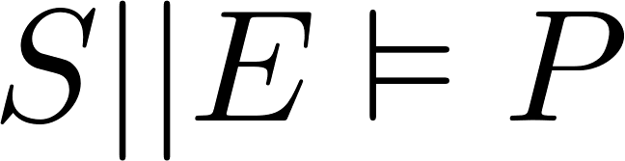
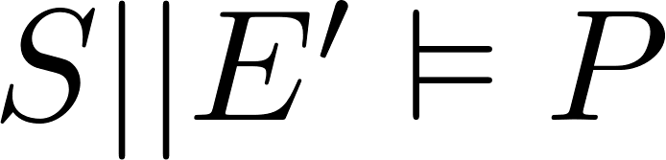

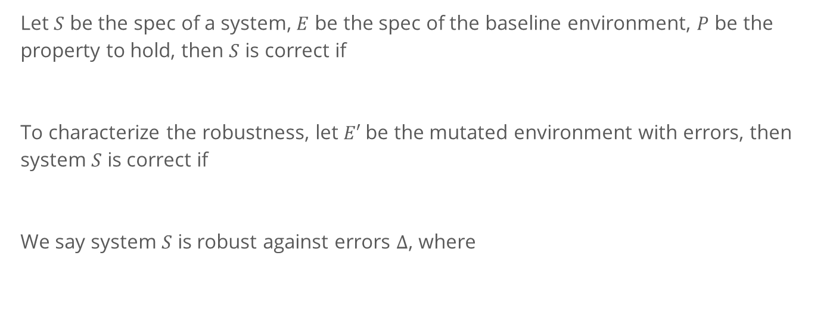
A Formal View of Testing Robustness
Let $S$ be the spec of a system, $E$ be the spec of the baseline environment, $P$ be the property to hold, then $S$ is correct if
To characterize the robustness, let $E′$be the mutated environment with errors, then system $S$ is correct if
We say system $S$ is robust against errors $∆$, where
Notes:
Of course, we are often more interested in the delta which does not satisfy P.

Slide 8
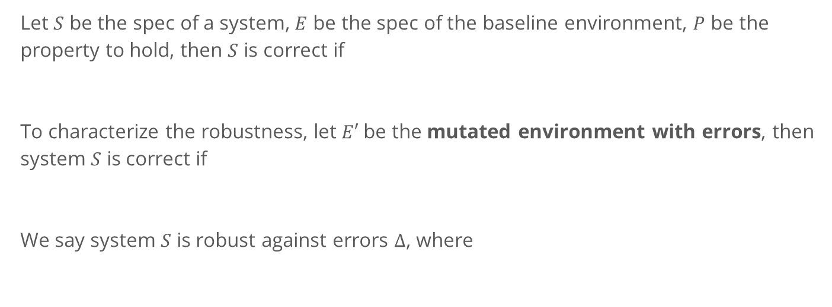
A Formal View of Testing Robustness
Let $S$ be the spec of a system, $E$ be the spec of the baseline environment, $P$ be the property to hold, then $S$ is correct if
To characterize the robustness, let $E′$be the mutated environment with errors, then system $S$ is correct if
We say system $S$ is robust against errors $∆$, where
Not possible to enumerate all the possible errors!

Slide 9
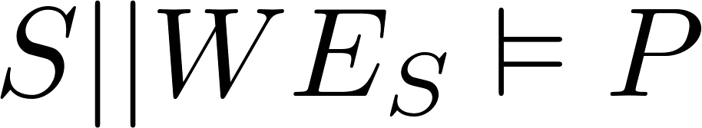
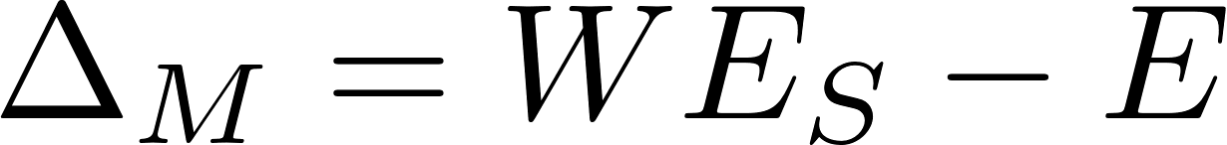
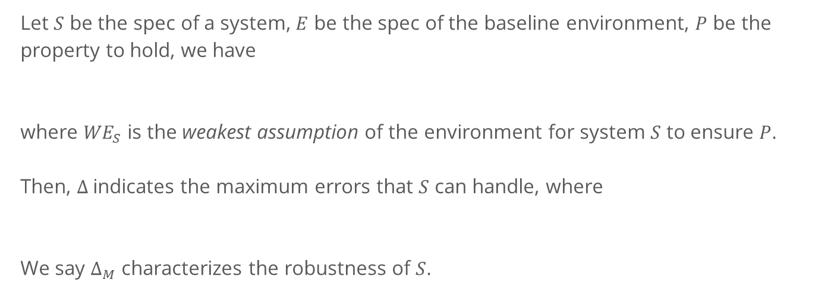
Another way around
Let $S$ be the spec of a system, $E$ be the spec of the baseline environment, $P$ be the property to hold, we have
where ${WE}_{S}$ is the weakest assumption of the environment for system $S$ to ensure $P$.
Then, $∆$indicates the maximum errors that $S$ can handle, where
We say $∆_{M}$ characterizes the robustness of $S$.

Slide 10
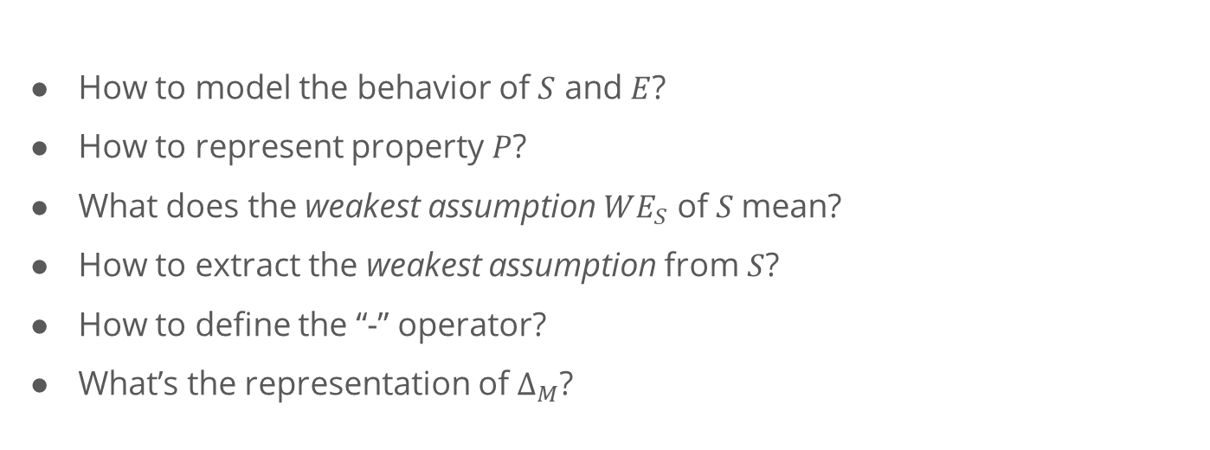
Another way around
How to model the behavior of $S$ and $E$?
How to represent property $P$?
What does the weakest assumption $WE_{S}$ of $S$mean?
How to extract the weakest assumption from $S$?
How to define the “-” operator?
What’s the representation of $∆_{M}$?

Slide 11
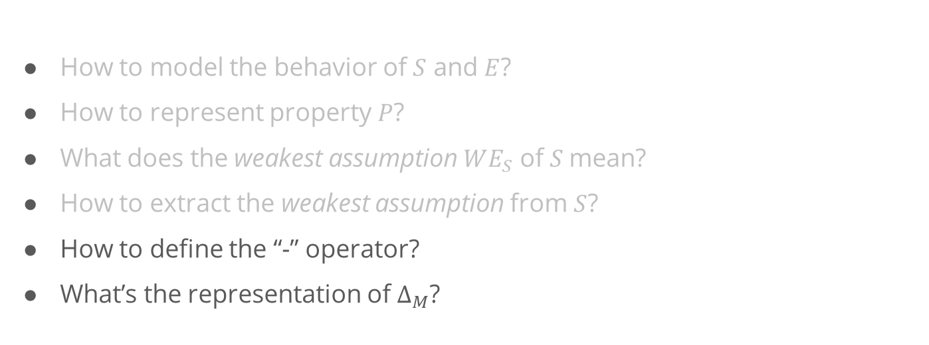
Another way around
Starting Point: Existing work present approaches to these problems based on LTS.
How to model the behavior of $S$ and $E$?
How to represent property $P$?
What does the weakest assumption $WE_{S}$ of $S$mean?
How to extract the weakest assumption from $S$?
How to define the “-” operator?
What’s the representation of $∆_{M}$?
Our Focus

Slide 12
Generating Weakest Assumption

Slide 13
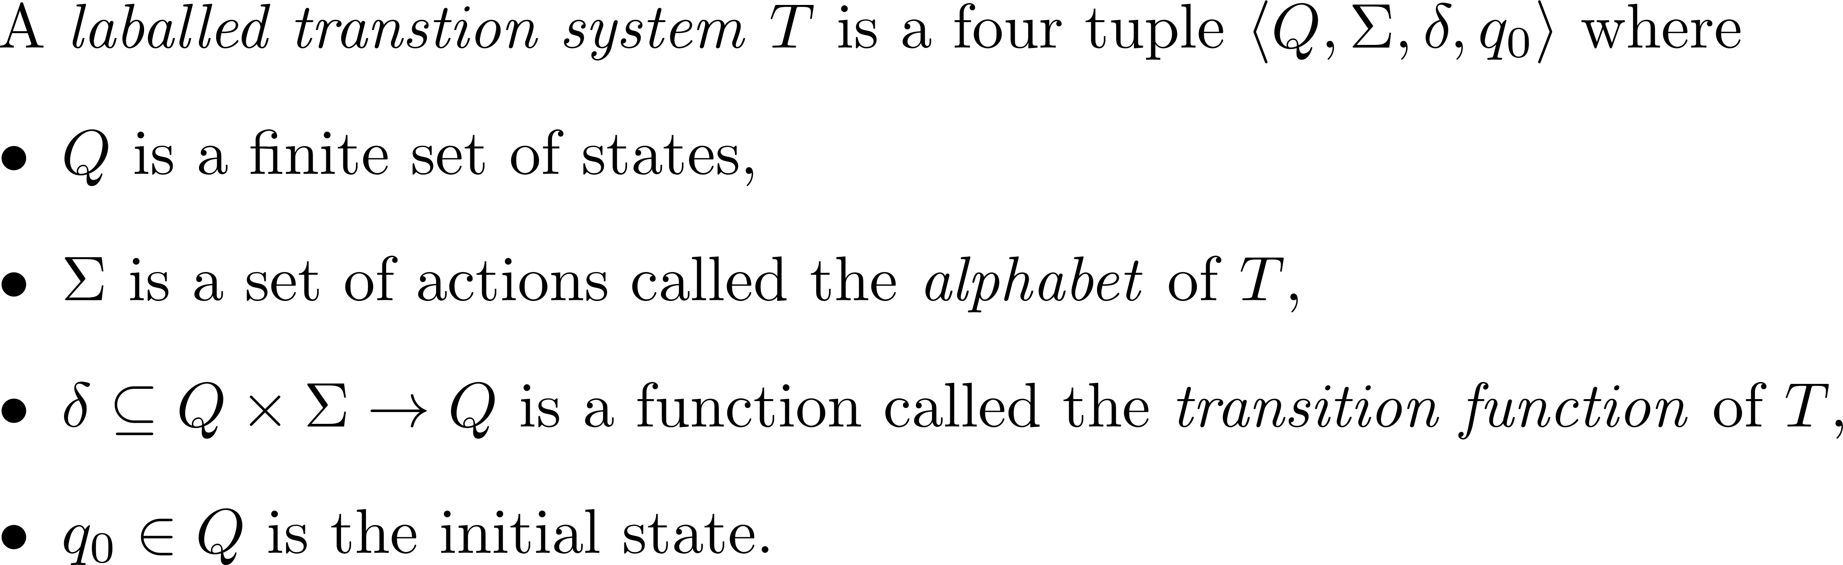
Background

Slide 14
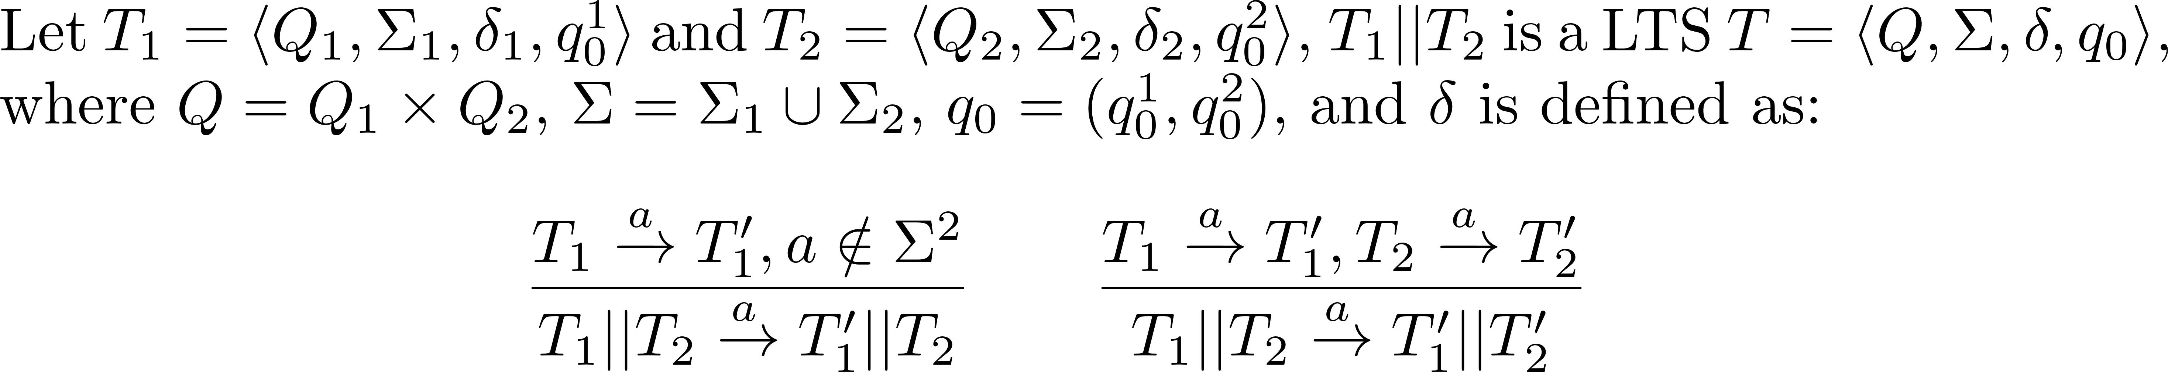
Background
Parallel composition “||” composes two concurrent LTSs as one system.
It combines behavior of two LTSs by synchronizing common actions and interleaving the remaining actions.

Slide 15
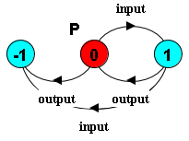


Safety Property
A safety property $P$ is a deterministic LTS which defines the acceptable behavior over the alphabet of $P$.
E.g., assert that the input and output events should alternate, we have:
-1 is the error state. When the system reaches this state, the safety property is violated
Notes:
To check safety property, there should not have a trace that will lead the system enters the error state.

Slide 16
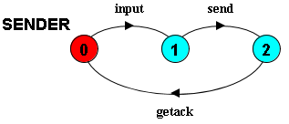
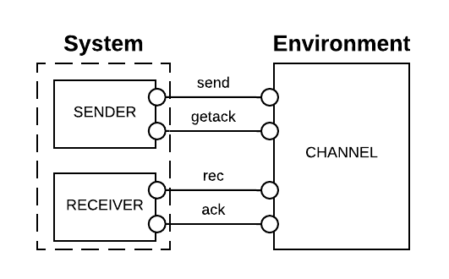
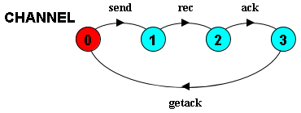
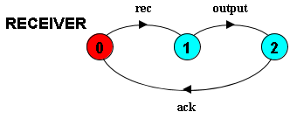
Example
Notes:
In the diagrams above, state 0 is always the initial state

Slide 17
The “correct” function
Informally, in a system
bad things should not happen, and
good things should eventually happen.
Formally, the correct function is a combination of safety and liveness properties.
Notes:
Limitations:
A safety property is restricted to the form of LTSA property.
We consider deadlock-free to be the weakest form of liveness, i.e., the system should not be stuck at some step.
I will use “correct” in this presentation for simplicity, but it means the system should satisfy the given safety properties and be deadlock-free.

Slide 18


Liveness Property - Deadlock
In LTS, a system is deadlock when it reaches a state where no outgoing transitions can occur.
A wait-for cycle exists. Because A is waiting to do a; but to do a, B has to do b first.

Slide 19
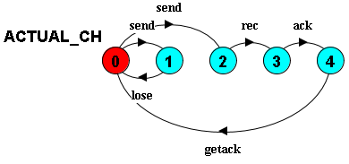
Uncertainty in environment - 1
Messages may be lost in the actual channel.

Slide 20
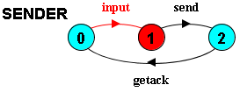
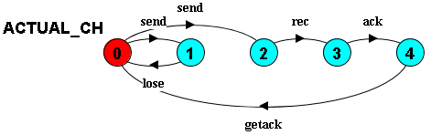
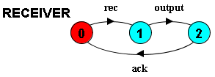

Trace to deadlock
$<input>$

Slide 21
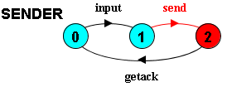
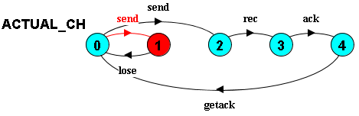

Trace to deadlock
$<input, send>$

Slide 22

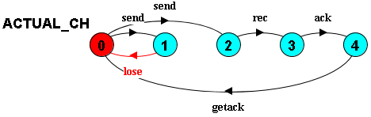
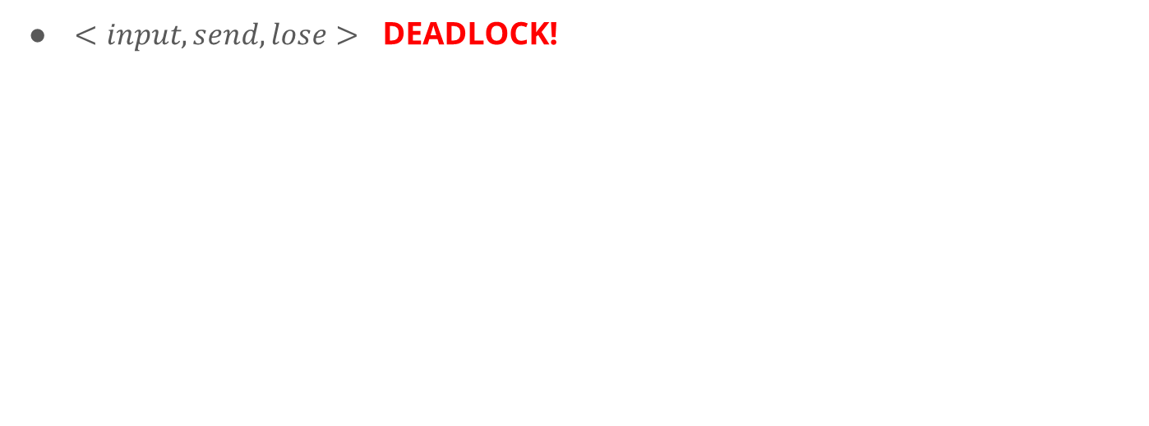
Trace to deadlock
$<input, send, lose>$ DEADLOCK!
SENDER is waiting for getack; RECEIVER is waiting for rec; ACTUAL_CH is waiting for send!

Slide 23
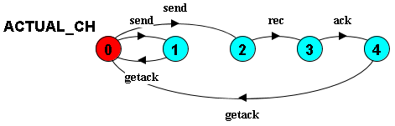
Uncertainty in environment - 2
Instead of lose, the channel acknowledges to the sender immediately after the send.

Slide 24
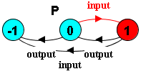
Trace to error state
$<input>$

Slide 25
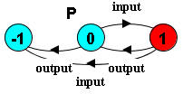
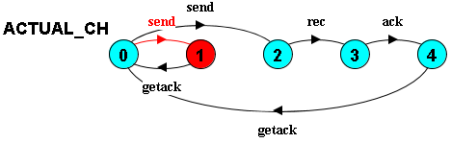
Trace to error state
$<input, send>$

Slide 26
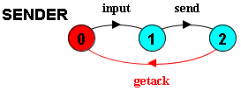


Trace to error state
$<input, send, getack>$

Slide 27
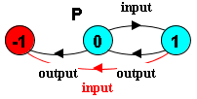

Trace to error state
$<input, send, getack, input>$ ERROR STATE!
<input, input> in P results in entering the error state!

Slide 28
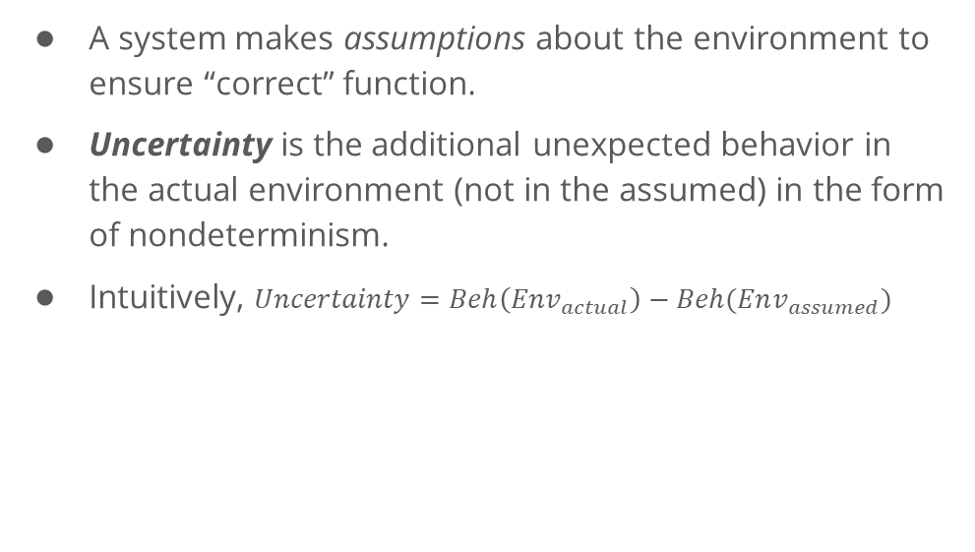
Representation of Uncertainty
A system makes assumptions about the environment to ensure “correct” function.
Uncertainty is the additional unexpected behavior in the actual environment (not in the assumed) in the form of nondeterminism.
Intuitively, $Uncertainty=Beh\left(Env_{actual}\right)−Beh(Env_{assumed})$
CANNOT directly measure uncertainty, because the actual env is often UNKNOWN!

Slide 29
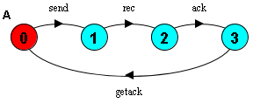
System Assumption
The assumption is the expected behavior of the environment, made by a system, in which the system can ensure the “correct” function.
E.g., to ensure the property, the example system assumes the environment to be:

Slide 30
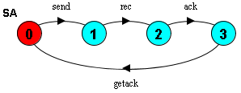
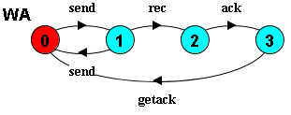
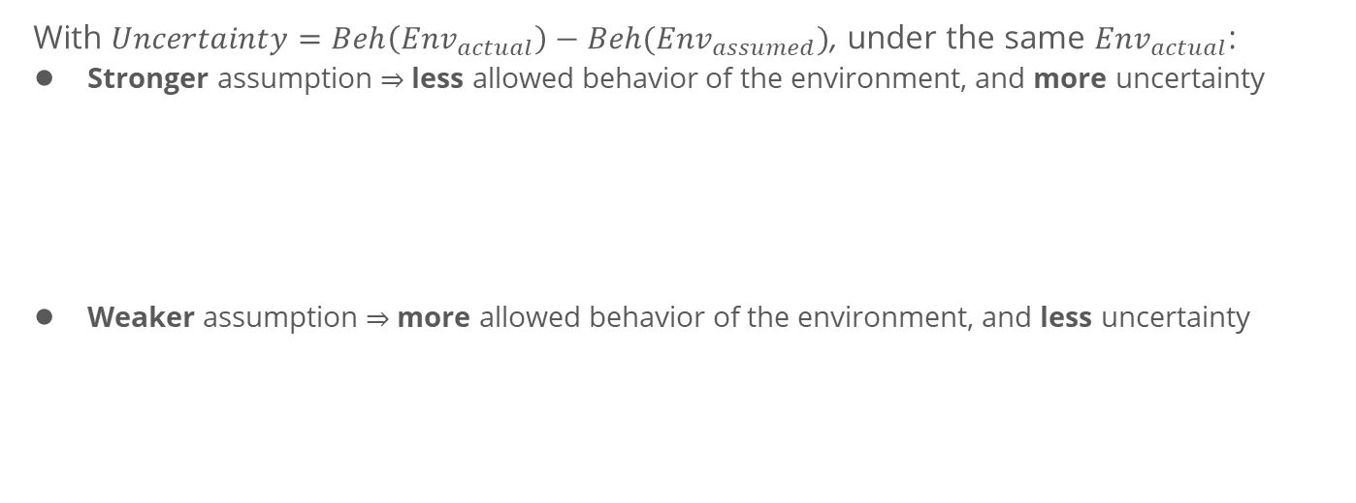
Stronger and Weaker Assumption
With $Uncertainty=Beh\left(Env_{actual}\right)−Beh(Env_{assumed})$, under the same $Env_{actual}$:
Stronger assumption $⇒$ less allowed behavior of the environment, and more uncertainty
Weaker assumption $⇒$ more allowed behavior of the environment, and less uncertainty

Slide 31
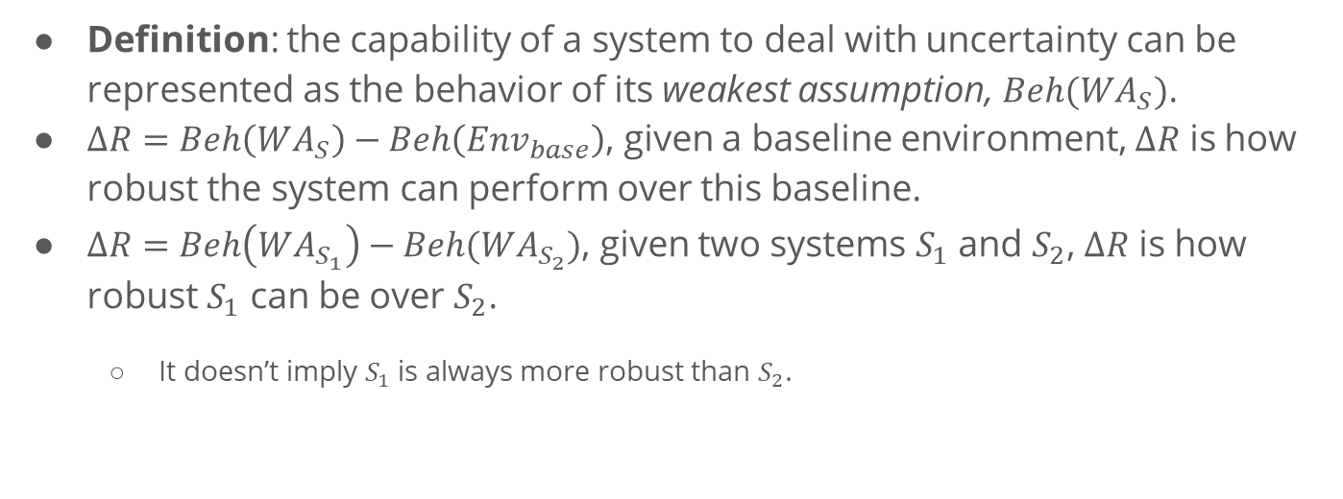
Representation of Capability
Definition: the capability of a system to deal with uncertainty can be represented as the behavior of its weakest assumption, $Beh(WA_{S})$.
$∆R=Beh\left(WA_{S}\right)−Beh\left(Env_{base}\right)$, given a baseline environment, $∆R$ is how robust the system can perform over this baseline.
$∆R=Beh\left(WA_{S_{1}}\right)−Beh(WA_{S_{2}})$, given two systems $S_{1}$ and $S_{2}$, $∆R$ is how robust $S_{1}$ can be over $S_{2}$.
It doesn’t imply $S_{1}$ is always more robust than $S_{2}$.
S₁
S₂
base
Notes:
Although the behavior of the actual environment is often unknown, we can generate the weakest assumption of a system.

Slide 32

Representation of Capability
$$∆R=Beh\left(WA_{S_{1}}\right)−Beh(WA_{S_{2}})$$
How to generate the weakest assumption of a system?
How to define the minus operator over LTSs?

Slide 33
Approach In Details

Slide 34
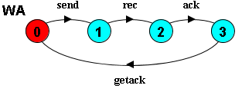
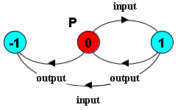
Generating the Weakest Assumption
[Dimitra02] already presents an approach to generate the weakest assumption (a minor modification required).
[Dimitra02] D. Giannakopoulou, C. S. Pǎsǎreanu, and H. Barringer, “Assumption generation for software component verification,” in Proceedings - ASE 2002: 17th IEEE International Conference on Automated Software Engineering, 2002, pp. 3–12.

Slide 35
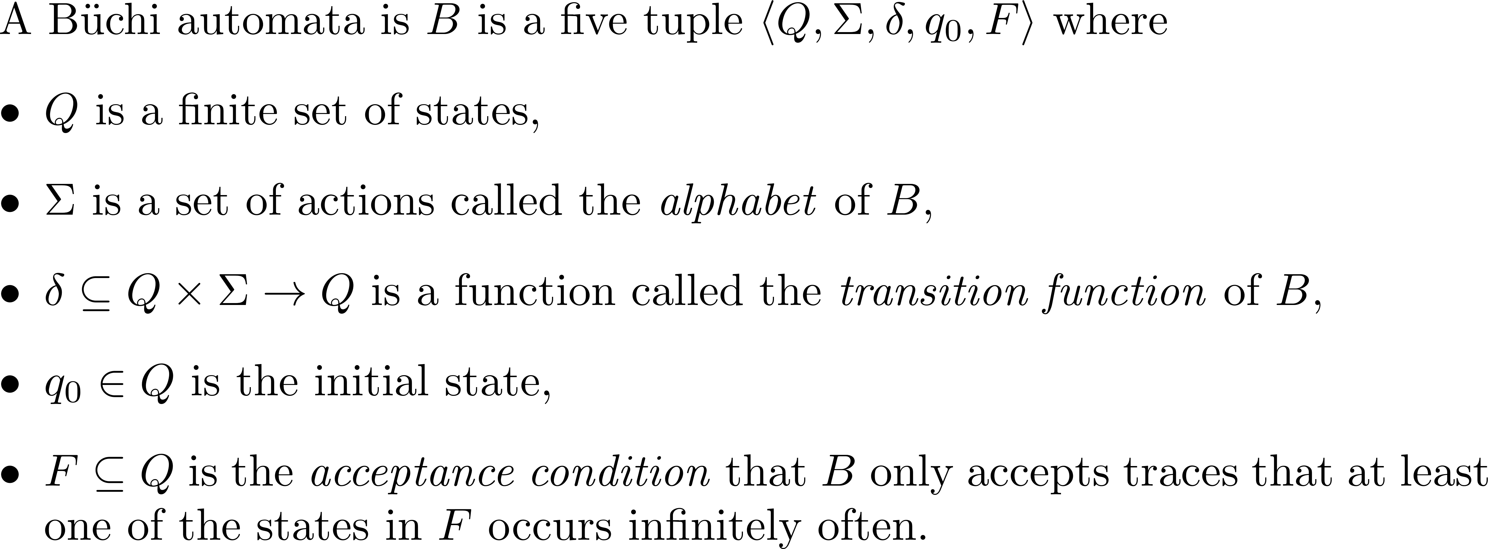
Büchi automata
To define the minus operator, the LTS formalism is not enough, we introduce Büchi automata.

Slide 36
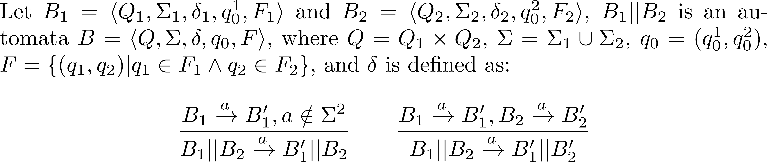
Parallel Composition on Büchi automata

Slide 37
Negation
Negation is an operator that reverts the acceptance condition of a Büchi automata.

Slide 38
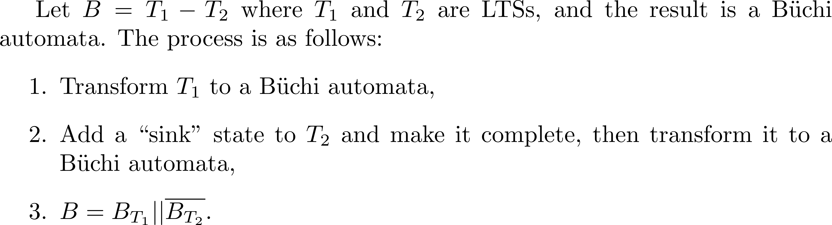
The Minus Operator

Slide 39
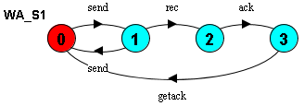
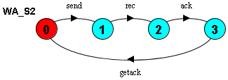


Example
The weakest assumption of $S_{1}$
The weakest assumption of $S_{2}$
?

Slide 40


Step 1

Slide 41

Step 2

Slide 42


Step 3

Slide 43
Discussion

Slide 44
Potential Applications
Robustness of a Security Protocol against Attacker Models
Robustness of a Human Computer Interface Model against Human Behavior Models
Robustness of a Distributed Protocol against Fault Models
…
Key Insights: How robust is a system when we only have limited information about the environment?

Slide 45
Limitations
Our approach is based on LTSA, thus the form of safety property is limited to it.
We only consider deadlock-free as the only liveness property.
The Büchi automata is not a good representation as a metric.

