Slide 1
How to Measure Robustness
A formal approach
Changjian (CJ) Zhang
Eunsuk Kang
David Garlan
Carnegie Mellon University

Slide 2
Agenda
Robustness Definition

Slide 3
What is Robustness?
IEEE definition:
The degree to which a system or component can function correctly in the presence of invalid inputs or stressful environmental conditions.
Robust control:
In control theory, robust control is an approach to controller design that explicitly deals with uncertainty.

Slide 4
The Source and Goal
A robust system should function correctly with erroneous input or environment.
A robust ML algorithm should have similar performance on datasets other than the training set (i.e., not prone to overfitting).
A robust scheduling algorithm should generate suboptimal scheme which is not sensitive to stochastic disturbances.
…
Notes:
The source and goal concepts are similar to the six dimensions of quality attributes proposed by SEI. Here, we simplify it and only focus on the stimulus (source) and the reaction of the system.

Slide 5
We try to measure:
The system capability to deal with uncertainty in environment to ensure correct function.
The source: uncertainty in environment
What’s the representation of uncertainty in the environment?
The goal: to ensure correct function
What’s the formal definition of “correct” function?
To measure: the system capability
How to measure capability? How to define such a metric?

Slide 6
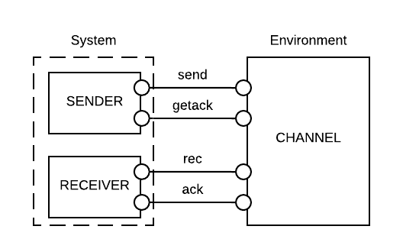
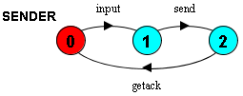
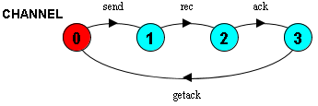
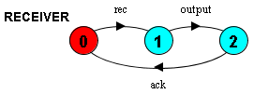
Motivation Example

Slide 7
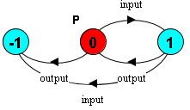
The “correct” function
Informally, (1) bad things should not happen, and (2) good things should happen.
Formally, the correct function is a combination of safety and liveness properties.
In the example, we consider:
Safety Property P: input and output should alternate, i.e.,
Liveness Property: the system should be deadlock-free.
Notes:
Limitations:
A safety property is restricted to the form of LTSA property.
We consider deadlock-free to be the weakest form of liveness, i.e., the system should not be stuck at some step.

Slide 8
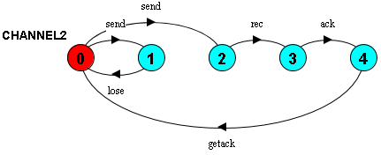
Representation of uncertainty
A trace to deadlock: <input, send, lose>

Slide 9
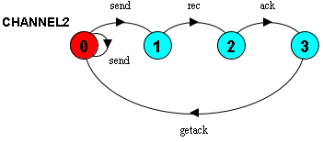
Representation of uncertainty
Uncertainty can be represented as traces of environment which lead to property violation (i.e., an error state or deadlock).
E.g., <send, lose, …>
Problem: the alphabet of internal events is often unknown.
Solution: project the environment to the known interfaces.
Hide internal
’
Notes:
Interpretation of the projected state machine: we do not know what exactly will happen after a send event (e.g., a lose event or anything else), but we do know that we may need multiple send events to reach a rec event (i.e., the message is successfully received by the receiver).

Slide 10
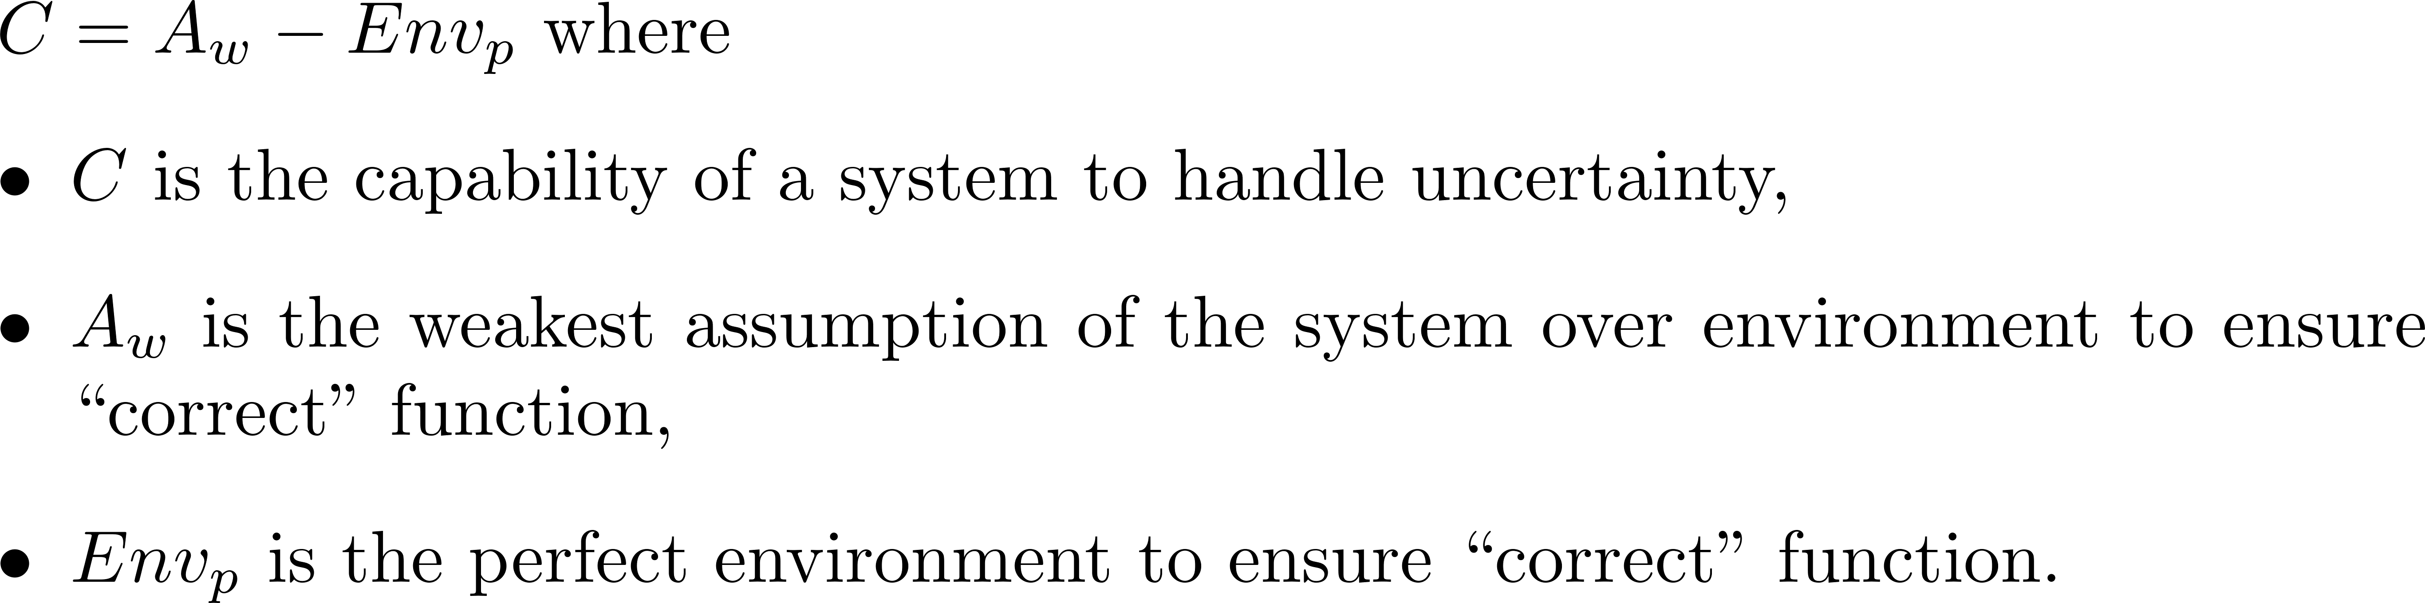
Capability to handle uncertainty
Stronger assumption => Less allowed behavior of the environment;
Weaker assumption => More allowed behavior of the environment
Notes:
The intuition is that:
A system is often designed to work under some environments, e.g., we assume that the environment should work exactly in the sequence of <send, rec, ack, getack>, otherwise, the system would deadlock or violate the safety property.

