Slide 1
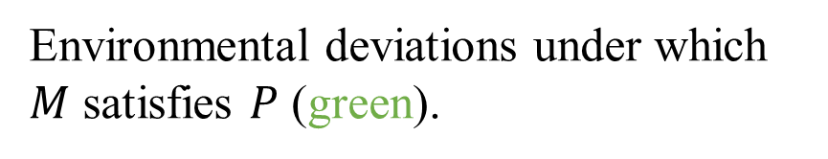

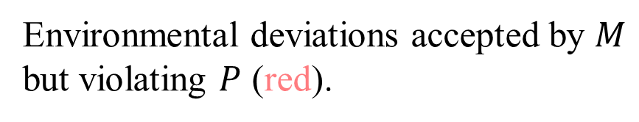

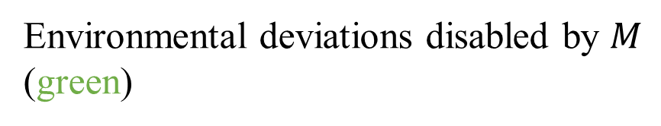


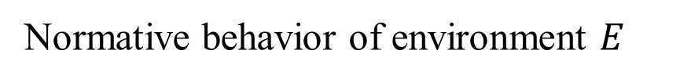
Environmental deviations disabled by $M$ (green)
$$αA^{∗}$$
$$beh\left(M\right)$$
Environmental deviations accepted by $M$ but violating $P$ (red).
$$beh(M_{safe})$$
$$beh(E)$$
Environmental deviations under which $M$ satisfies $P$ (green).
Normative behavior of environment $E$

Slide 2



Design
Robustness
Analysis
Developer, Designer,
Architect
Robustify
Design

Slide 3



Initial
Requirements
Yes
Robust
Enough?
Robustness
Analysis
(In)Tolerable
Deviations
Final
Design
Design
Specification
No
Requirements
Conflicts?
No
Design
Repair
Yes
Specification
Weakening
Resolved
Requirements

Slide 4
Chapter 2
Initial
Requirements
Robust
Enough?
Yes
Robustness
Analysis
(In)Tolerable
Deviations
Final
Design
No
Design
Specification
Chapter 3
No
Requirements
Conflicts?
Robustification
by Control
Yes
Chapter 4
Specification
Weakening
Resolved
Requirements

Slide 5
Contrib. 1
Initial
Requirements
Robust
Enough?
Yes
Robustness
Analysis
(In)Tolerable
Deviations
Final
Design
No
Design
Specification
Contrib. 2
No
Requirements
Conflicts?
Robustification
by Control
Yes
Contrib. 3
Specification
Weakening
Resolved
Requirements

Slide 6
Contrib. 1
Initial
Requirements
Robust
Enough?
Yes
Robustness
Analysis
(In)Tolerable
Deviations
Final
Design
Design
Specification
No
Contrib. 2
No
Requirements
Conflicts?
Robustification
by Control
Yes
Contrib. 3
Specification
Weakening
Resolved
Requirements

Slide 7
Robust
enough?
Yes
Software
Design
Robustness
Analysis
(In)Tolerable
Deviations
Final
Design
No
Design
Conflicts?
No
Design
Repair
Yes
Contributions of
this work
Specification
Weakening

Slide 8

Stakeholders A
Safety
requirements
Conflicts
Stakeholders A&B
Design
Impacted
Scenarios
Resolved
requirements
Functional
requirements
Stakeholders B

Slide 9

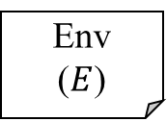

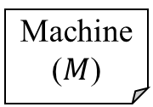
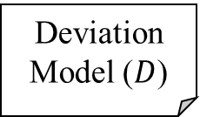

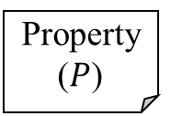
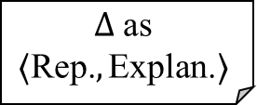
Deviation Model ($D$)
Machine ($M$)
Weakest Assumption Generation
Robustness $Δ$ Computation
Representation Traces and Explanations
Env
($E$)
$$Δ \text{as}$$
$$⟨\text{Rep}\text{.}, \text{Explan}\text{.}⟩$$
$$W(M,E,P)$$
$$Δ$$
Property ($P$)

Slide 10
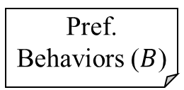



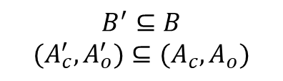


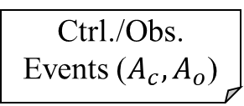
Machine ($M$)
Env
($E$)
Property ($P$)
$$B^{′}⊆B$$
$${(A}_{c}^{′},A_{o}^{′})⊆(A_{c},A_{o})$$
Design Optimizer
Supervisory Control Synthesis
Candidate Solution $M′$
Intolerable Dev. ($\overline{δ}$)
Pref. Behaviors ($B$)
Ctrl./Obs. Events ($A_{c},A_{o}$)
Optimal new designs $M′$

Slide 11
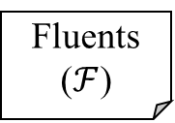




Machine ($M$)
Env
($E$)
Property ($P$)
Examples Generation
Positives & Negatives Identification
LTL Learning from Examples
Weakened Property
Examples $ℰ$
Samples $𝒮=\left(𝒫,𝒩\right)$
Intolerable Dev. ($\overline{δ}$)
Unsat. Pref. Behavior ($\overline{b}$)
Fluents ($ℱ$)

Slide 12




Editing
NotSet
Select Mode
X
E
X
E
X
E
Up
Up
Xray Mode
Ebeam Mode
Confirm Xray
Confirm Ebeam
X
E
Confirm Mode
E
Set
Set
X
Enter
Enter
Up
Up
Enter
SwitchToEbeam
SwitchToXray
Fire Beam
FireXray
Fire Ebeam
(b) Beam Setter ($M_{B}$)
B
B
B
E
Beam Delivered
InPlace
OutOf Place
Task Complete
Enter
X
X
E
(a) Treatment Interface ($M_{I}$)
(c) Spreader ($M_{S}$)
(d) Operator Task ($E$)

Slide 13

NotSet
Editing
X
E
B
B
X
Xray Mode
Ebeam Mode
E
X
E
Up
Up
Confirm Xray
Confirm Ebeam
E
SetEBeam
SetXray
X
B
B
SwitchToEbeam
SwitchToXray
Enter
Up
Up
Enter
FireXray
Fire Ebeam
(b) Beam Setter ($M_{B}$)
B
B
E
Beam Delivered
InPlace
OutOf Place
Enter
X
X
E
(a) Treatment Interface ($M_{I}$)
(c) Spreader ($M_{S}$)

Slide 14
NotSet
Editing
Select Mode
X
E
X
E
B
B
X
E
Xray Mode
Ebeam Mode
Up
Up
X
E
Confirm Xray
Confirm Ebeam
Confirm Mode
E
SetEBeam
SetXray
X
Enter
Up
Up
Enter
B
B
Enter
SwitchToEbeam
SwitchToXray
FireXray
Fire Ebeam
Fire Beam
(b) Beam Setter ($M_{B}$)
B
B
B
E
Beam Delivered
InPlace
OutOf Place
Task Complete
Enter
X
X
E
(a) Treatment Interface ($M_{I}$)
(c) Spreader ($M_{S}$)
(d) Operator Task ($E$)

Slide 15

Select Mode
NotSet
Up
Editing
X
E
GoBack
X/E
B
B
Xray Mode
Ebeam Mode
X
E
X
E
Commission
Up
Up
Confirm Xray
Confirm Ebeam
Confirm Mode
E
SetEBeam
SetXray
X
B
B
SwitchToEbeam
SwitchToXray
Enter
Up
Up
Enter
Enter
FireXray
Fire Ebeam
Fire Beam
(b) Beam Setter ($M_{B}$)
B
B
B
E
Beam Delivered
InPlace
OutOf Place
Task Complete
Enter
X
X
E
(a) Treatment Interface ($M_{I}$)
(c) Spreader ($M_{S}$)
(d) Operator Task ($E$ and $E′$)

Slide 16
NotSet
X
E
E
SwitchToXray
SwitchTo
EBeam
X
X
E
SetXray
SetEBeam
B
B
Xray
Mode
EBeam
Mode
E
X
(b) Beam Setter ($M_{B}$)

Slide 17
Enter
X
Select Mode
Confirm Mode
Enter
Fire Beam
B
Task Complete
E

Slide 18
Enter
X
Select Mode
Confirm Mode
Enter
Fire Beam
B
Task Complete
E
Enter
X
Select Mode
Confirm Mode
Enter
Fire Beam
B
Task Complete
E
Up
Commission
GoBack

Slide 19

Editing
X
E
Up
Up
Confirm Xray
Confirm Ebeam
Enter
Up
Up
Enter
FireXray
Fire Ebeam
B
Beam Ready
B
SetXray
SetEBeam
B
Beam Delivered
Enter
Redesigned Interface ($M_{I}′$)

Slide 20
Editing
X
E
Up
Up
Confirm Xray
Confirm Ebeam
Enter
Up
Up
Enter
FireXray
Fire Ebeam
Beam Ready
SetXray
SetEBeam
B
Beam Delivered
Enter
Redesigned Interface ($M_{I}′$)

Slide 21

Editing
Editing
X
E
Up
Up
X
E
Confirm Xray
Confirm Ebeam
Confirm Xray
Confirm Ebeam
Enter
Up
Up
Enter
Enter
Enter
FireXray
Fire Ebeam
FireXray
Fire Ebeam
SetXray
Beam Ready
SetEBeam
B
B
Beam Delivered
B
Enter
Beam Delivered
Enter
(a) Redesign by disabling $Up$.
(b) Redesign by synchronizing on $SetXray$ and $SetEBeam$.

Slide 22
Enter
X
Select Mode
Confirm Mode
Enter
Fire Beam
B
Task Complete
Omission
E

Slide 23
Enter
X
Select Mode
Confirm Mode
Enter
Fire Beam
B
Task Complete
E
Up
Commission
GoBack

Slide 24
Enter
X
Select Mode
Confirm Mode
Enter
Fire Beam
B
Task Complete
E
Up
Commission
GoBack

Slide 25
Electron Beam
X-ray Beam
X-ray Overdose

Slide 26




$$Xray∧¬InPlace$$
$$true∖\{Xray∧¬InPlace\}$$
$$true$$
$$¬Xray∨InPlace$$

Slide 27
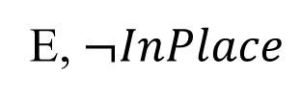
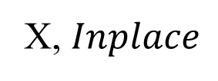
E
X
X, $Inplace$
E, $¬InPlace$

Slide 28
X, E, SetXray, SetEBeam, B
true

Slide 29
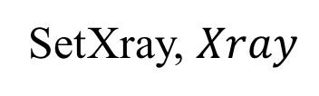
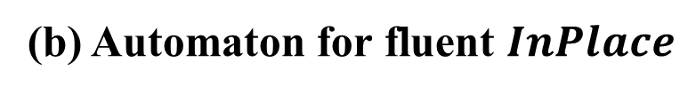
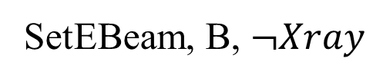
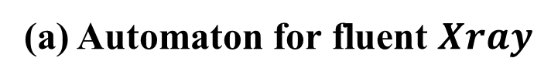
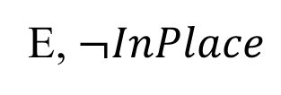
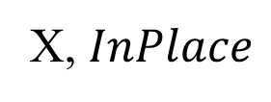
SetXray
E
SetEBeam, B
X
SetEBeam, B, $¬Xray$
SetXray, $Xray$
X, $InPlace$
E, $¬InPlace$
(a) Automaton for fluent $Xray$
(b) Automaton for fluent $InPlace$

Slide 30
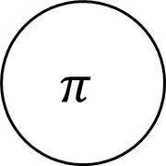
E
SetXray
SetXray, X
E, SetEBeam, B
SetEBeam, B
X, SetEBeam, B
X
E
SetXray
$$π$$

Slide 31
Safety
Functionality
Observability
Controllability
Cost

Slide 32
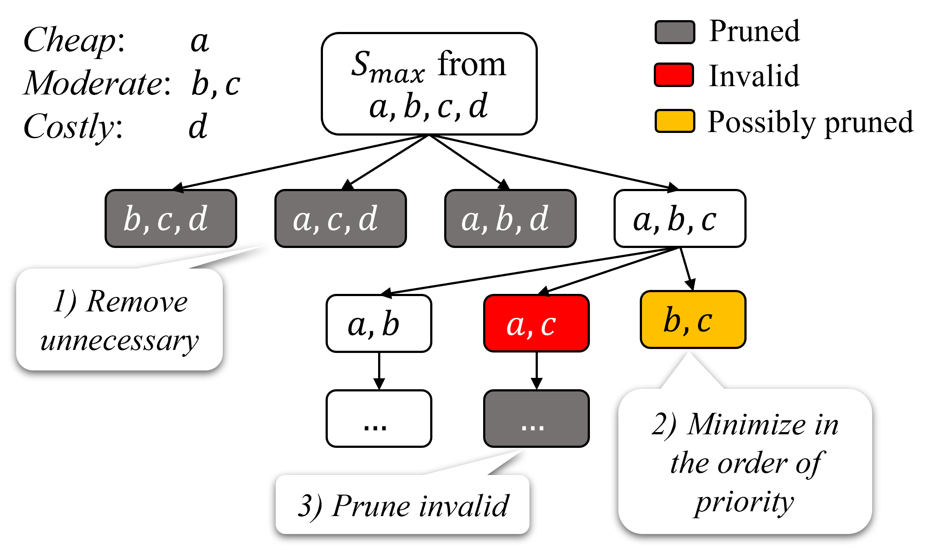

$$C_{max}$$

Slide 33



Preferred Behavior:
$$⟨\text{X}\text{, }\text{Up}\text{, }\text{E}\text{, }\text{Enter}\text{, }\text{B}⟩$$
Machine Executions:
$$⟨\text{X}\text{, }\text{Up}\text{, }\text{E}\text{, }\text{SetEBeam}\text{, }\text{Enter}\text{, }\text{B}⟩$$
$$⟨\text{X}\text{, }\text{Up}\text{, }\text{E}\text{, }\text{Enter}\text{, }\text{B}⟩$$

Slide 34
snd.oyster
snd.card
snd.oyster
rcv.oyster.gin
0
1
2
3
snd.oyster
snd.card
snd.{card, oyster}
rcv.card.gin
rcv.card.gin
snd.card
rcv.oyster.gin

Slide 35
snd.oyster.gin
snd.card.gin
snd.oyster.gin
rcv.oyster.fin
0
1
2
3
snd.oyster.gin
snd.card.gin
snd.{card, oyster}.gin
rcv.card.fin
rcv.card.fin
snd.card.gin
rcv.oyster.fin

Slide 36
rcv.card.fin
rcv.oyster.fin
snd.oyster.gin
0
1
0
1
2
snd.oyster.gin
rld.card
rld.oyster
no_oyster_bal

Slide 37
snd.oyster
snd.card
rcv.card.gin
rcv.oyster.gin
0
1
2
3
4
snd.card.gin
snd.oyster.gin
rcv.card.fin
rcv.oyster.gin

Slide 38



$$a$$
$$∗∖\{a\}$$
$$∗$$

Slide 39
Fortis-Core
Fortis-UI
API
Fortis-Server
API
LTSA
Supremica
log data
log data
AlloyMax
Process
HTTP
Socket
Dependent Package
Java RMI
WebSocket

Slide 40
reset
reset
reset
back
back
0
1
2
3
password
select
vote
confirm

Slide 41
eo.enter
select, vote, confirm, back, reset
v.enter
password
select
vote
6
0
1
2
3
4
eo.exit
v.exit
5
confirm

