Slide 1

ROS Reconfiguration Framework
Changjian Zhang

Slide 2
Problem Context
Problem: How can we safely reconfigure (change the component-topology) a ROS-based robot system in run-time.
Key Issues:
Should safely change the configuration in run-time.
Should minimize the disruption to the system.
Notes:
For the first issue: sine the system is still active, we should ensure the correctness of the reset of a system when modifying some components.
For the second issue: the advantage of run-time reconfiguration is that some services are still available during the reconfiguration instead of shutting down the entire system to apply the configuration change. Thus, we want to minimize the disruption that is maximize the available functions of the system.

Slide 3
Problem Context
What is the property we concern?
When is it safe to execute a reconfiguration?
Which components would be affected?
How should we deal with these affected components?
Ensure Safety
Minimize Disruption
Notes:
We need a more concrete definition of what does “safe reconfiguration” mean. Most often, it is defined by some safety or liveness properties.
We should define that under what conditions we can execute a reconfiguration without violating the above safety or liveness properties.
To minimize the disruption to the system, we should first know that which components are affected by a reconfiguration.
Then, for these components, should we ignore them or put them in some special states to ensure the above system properties.

Slide 4
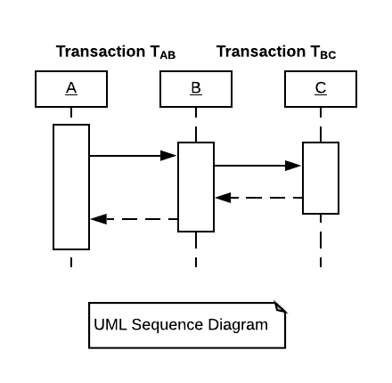
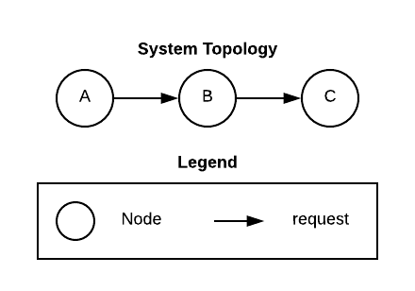
Related Work: Quiescence
Kramer and Magee¹ used a transaction-based model.
A transaction is a sequence of message exchanges between two connected nodes.
A transaction should complete in bounded time.
In the general case, a transaction may depend on some consequent transactions.
T_{AB} depends on T_{BC}.
T_{BC} is the consequent transaction of T_{AB}.
Notes:
[1] J. Kramer and J. Magee, “The Evolving Philosophers Problem: Dynamic Change Management,” IEEE Trans. Softw. Eng., vol. 16, no. 11, pp. 1293–1306, 1990.

Slide 5
Related Work: Quiescence
The Most Concern: All the initiated transactions should complete!
If not, the nodes may be stuck in some intermediate states which violate the system’s global invariants¹.
If C is removed, T_{AB} and T_{BC} cannot complete.
Notes:
The definition is similar to the AC of the ACID properties of transactions in databases that a transaction should be atomic and consistent.
[1] T. Haerder and A. Reuter, “Principles of transaction-oriented database recovery,” ACM Comput. Surv., vol. 15, no. 4, pp. 287–317, 1983.

Slide 6
Related Work: Quiescence
Quiescence ensures that, to change node C:
Transactions which involve C should complete, and
No new transactions which involve C should be initiated during the reconfiguration.
System should first wait T_{AB} and T_{BC} to complete
B should not initiate T_{BC}. Thus, A should not initiate T_{AB}.

Slide 7
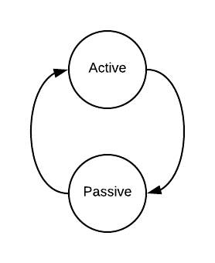
Related Work: Quiescence
Two operation modes:
In active mode, a node can initiate, accept, and service transactions.
In general passive mode, a node can accept and service transactions and initiate consequent transactions, but:
It is not in a (nonconsequent) transaction it initiated, and
It will not initiate new (nonconsequent) transactions
Notes:
Passive mode requires a component reaching a consistent state and a component should not actively changing its states.
However, it is not enough to keep the component in a consistent state, since it can still service transactions from other components.

Slide 8
Related Work: Quiescence
A node N is in Quiescence if:
it is not currently engaged in a transaction that it initiated,
it will not initiate new transactions,
it is not currently engaged in servicing a transaction, and
no transactions have been or will be initiated by other nodes which require service from this node.
N should be in passive mode
Nodes which can initiate transactions involving N should also be in passive mode.

Slide 9
Related Work: Quiescence
To change node C,
C should be in passive state.
B should be in passive because T_{BC}.
A should be in passive state because T_{BC} is the consequent transaction of T_{AB}.
Then, C is in quiescent state.

Slide 10
Related Work: Quiescence
What property should the system satisfy?
All the initiated transactions can eventually complete.
When is it safe to execute a reconfiguration?
When the node to change is in quiescence state.
Which components would be affected?
Nodes that can initiate transactions which involve the node to change.
How should we deal with these affected components?
These nodes should be in passive state.

Slide 11
Can we apply Quiescence to ROS?
ROS¹ provides two communication methods:
topics (Pub/Sub) and services.
We can build various computation models:
Event-driven system based on topics,
Transaction-based system based on services,
Transaction-based system based on topics and services (Actions),
We MAY apply Quiescence to ROS, but
Event-driven system on Pub/Sub is a more common style in ROS.
Notes:
[1] "Documentation - ROS Wiki", wiki.ros.org, 2019. [Online]. Available: http://wiki.ros.org/. [Accessed: 19- Mar- 2019].

Slide 12
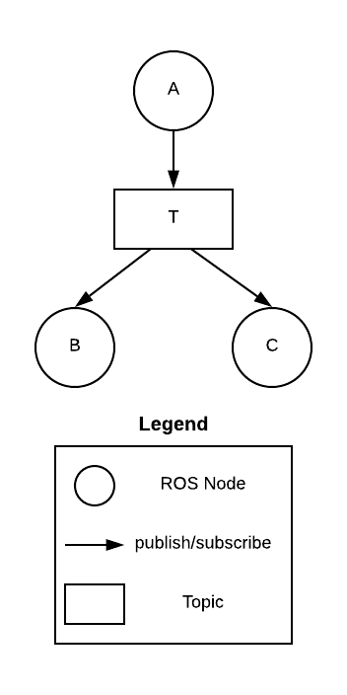
Event-driven system on Pub/Sub
Pub/Sub is well adapted to scalable and loosely coupled systems¹ , especially for event-driven².
Adding/Removing a publisher/subscriber won’t “affect” other nodes.
But from semantics, the correctness of subscribers may rely on the publishers.
E.g., A is an obstacle detector, B is a motor controller.
Notes:
[1] P. T. Eugster, P. A. Felber, R. Guerraoui, and A.-M. Kermarrec, “The many faces of publish/subscribe,” ACM Comput. Surv., vol. 35, no. 2, pp. 114–131, 2003.
[2] P. Clements et al., Documenting software architectures: views and beyond. Pearson Education, 2002.

Slide 13
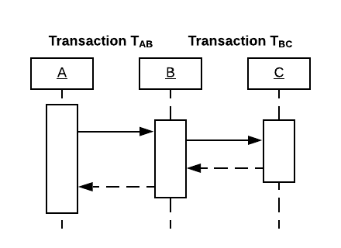
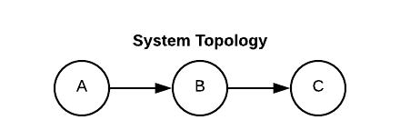
Inspiration from Quiescence
C&C view¹ describes the syntactic model.
It is not enough to show the semantic relationships of components.
Safety of a reconfiguration depends on the semantic model.
Transaction model shows the semantic relationships.
Correctness of A relies on B, but may or may not rely on C
A relies on B and C because of T_{AB} and T_{BC}
Notes:
The C&C view describes the syntactic model of a system in run-time. The syntactic model defines the types of the components and connectors and also defines the component instances and how they are connected by the connector instances. Then, researches classify a model with constraints and particular types of components and connectors as an architecture style, like Pub/Sub and SOA. Transactions define the semantic model of a system. It describes the functional relationships of components. Although a semantic model may not be necessarily associated with a particular type of syntactic model, developers often follow some conventions such as building transaction-based systems with SOA and event-driven systems with Pub/Sub. However, it is possible to apply a transaction model on Pub/Sub too [2, 3, 4].
[1] P. Clements et al., Documenting software architectures: views and beyond. Pearson Education, 2002.
[2] L. Vargas, L. I. W. Pesonen, E. Gudes, and J. Bacon, “Transactions in content-based publish/subscribe middleware,” in 27th International Conference on Distributed Computing Systems Workshops (ICDCSW’07), 2007, p. 68.
[3] A. Michlmayr and P. Fenkam, “Integrating distributed object transactions with wide-area content-based publish/subscribe systems,” in 25th IEEE International Conference on Distributed Computing Systems Workshops, 2005, pp. 398–403.
[4] M. Jergler, K. Zhang, and H. A. Jacobsen, “Multi-client transactions in distributed publish/subscribe systems,” Proc. - Int. Conf. Distrib. Comput. Syst., vol. 2018–July, pp. 120–131, 2018.

Slide 14
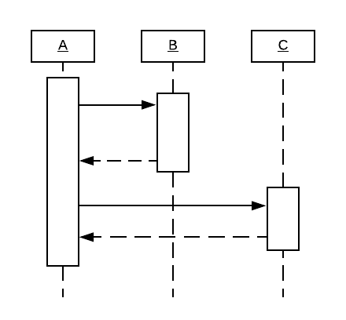
Inspiration from Quiescence
Related work^{1, 2} of Quiescence draw different conclusions from the same sematic model.
Quiescence claims A would be affected because B is involved in the transaction
Tranquility claims A would not be affected because the participation of B in this transaction has completed.
Notes:
[1] Y. Vandewoude, P. Ebraert, Y. Berbers, and T. D’Hondt, “Tranquility: A low disruptive alternative to quiescence for ensuring safe dynamic updates,” IEEE Trans. Softw. Eng., vol. 33, no. 12, pp. 856–868, 2007.
[2] X. Ma, L. Baresi, C. Ghezzi, V. Panzica La Manna, and J. Lu, “Version-consistent dynamic reconfiguration of component-based distributed systems,” in Proceedings of the 19th ACM SIGSOFT symposium and the 13th European conference on Foundations of software engineering, 2011, pp. 245–255.

Slide 15
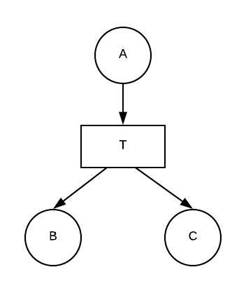
Event-driven on Pub/Sub
In ROS, Pub/Sub is the syntactic model.
Need a semantic model for event-driven systems.
The model must answer:
What is the property we concern?
When is it safe to execute a reconfiguration?
Which components would be affected?
How should we deal with these affected components?

Slide 16
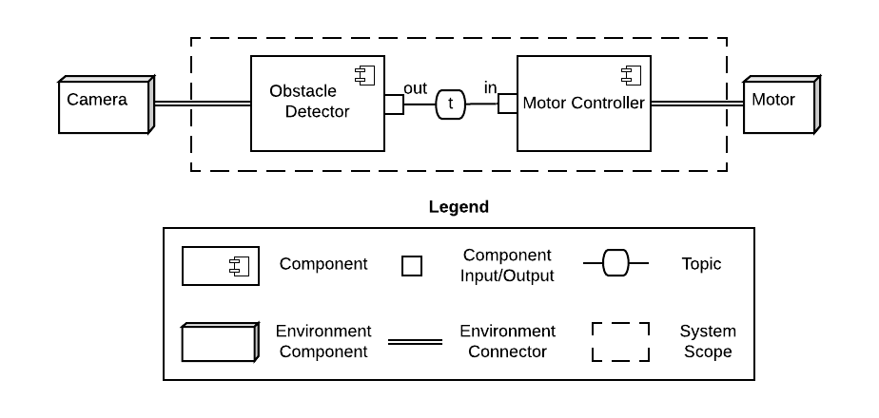
Problem Setting
An obstacle Detector reads data from a camera and publishes obstacle information every second.
A motor controller subscribes the topic and sets the motor to the proper speed.
Notes:
To better explain our semantic model for event-driven systems, we set up an simple event-driven robot system.

Slide 17
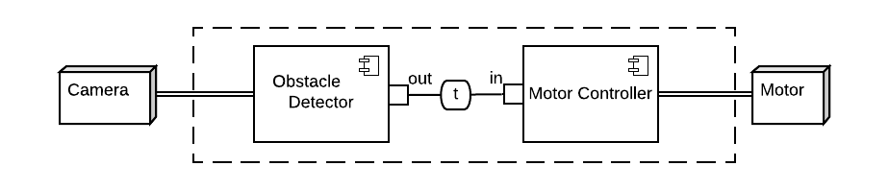
Component provides Functionalities
A component provides a set of functionalities.
A functionality defines a computation process that takes some input data and produces some output.
Function: The detector takes the camera data and produces the obstacle info per second.
Function: The controller takes the obstacle info and produces the proper motor speed.

Slide 18
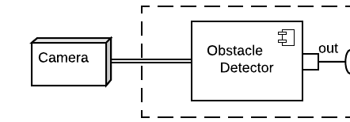
Guarantees and Assumptions
To make a functionality work:
It should have the correct implementation.
It should have the input data and the data should satisfy some assumptions.
When a functionality works:
It should produce new data or change the environment and the data should satisfy some guarantees.
Assumption: Should receive camera data in X resolution
Guarantee: Should produce the obstacle info per second.
Notes:
[1] May reference Tobi’s work of how we define assumptions and guarantees and how we can argue their properties.

Slide 19
Assumptions are satisfied by environment
Assumption: Should receive camera data in X resolution
An environment component can be a hardware device or another system module.
They should provide some guarantees.
We assume these guarantees won’t change in this model.
satisfies
Guarantee: Should produce camera data in X resolution.

Slide 20
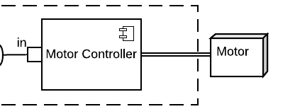
Assumptions are satisfied by input ports
Assumption: Should receive obstacle info at least every second.
Developers make assumptions on the input ports.
The assumption of an input port can satisfy the assumption made by a functionality.
satisfies
Assumption: Should receive obstacle info from the topic per second.
Notes:
The reason to have assumptions over the functionalities and input ports is that an assumption of a functionality can be satisfied by multiple input ports, that is we can say a functionality relies on an input port OR another. This is useful suppose we have a logging component. What deserves our attention is if there are no components providing logging messages.

Slide 21
A Chain of Assumptions and Guarantees
G: Should produce camera data in X resolution.
A: Should receive camera data in X resolution.
A: Should receive obstacle info at least every second.
G: Should produce the obstacle info per second.
A: Should receive obstacle info from the topic per second.
G: Should set the motor to the proper speed.

Slide 22
Summary of the Model
It describes:
The indirect relationship between the inputs and outputs of a component.
The indirect relationship between a component and another.
A component do not need to have visibility to other nodes.
A component do not need to know whom it communicates with.
Notes:
Whether the correctness of an input affects the correctness of an output port.
Whether the correctness of a component affects the correctness of another.
It doesn’t define that the correctness of a component should directly rely on another component, instead it focuses on the assumptions and guarantees of each component.
A component does not need to who provides the guarantees, instead

Slide 23
What is the property we concern?
Assume: when the functionalities of all the components work normally, the system should satisfy its global invariants.
Safety property: The assumptions of all the functionalities should be satisfied.
Thus, a change to the system may cause violation against the property.
Notes:
It may cause problems when a functionality does not receive its required input data.

Slide 24
Which components would be affected?
If a component is removed:
Its output guarantees are removed.
The connected input ports may not be satisfied.
Functionalities relied on these inputs may not be satisfied.
Output guarantees of these functionalities are removed.

Slide 25
How to deal with?
Strategy:
Some functionalities become unsatisfied due to the change.
We can degrade these functionalities, and the degraded functionalities are satisfiable in the changed configuration.
Minimize Disruption: only the unsatisfied functionalities should be degraded.
i.e., maximize the satisfied normal functionalities.

Slide 26
How to deal with?
Extend the model:
Each functionality should have a normal mode and a degraded mode.
The degraded mode should not rely on any assumption.
If the guarantee in degraded mode satisfy an assumption a, then the guarantee in normal mode should also satisfy a.
A naïve solution, which can be improved to further minimize the disruption.

Slide 27
When is it safe to reconfig?
Before executing a reconfig action, the affected functionalities should be degraded.
Before degrading these functionalities, functionalities affected by this degrade action should be degraded.
Until no functionalities would become unsatisfied.
To remove the detector
The assumption of this input port is not satisfied.
The assumption of the motor control function is not satisfied. Should degrade the function.
The guarantee of this output will be removed

Slide 28
Model Summary
What property should the system satisfy?
The assumptions of all the functionalities should be satisfied.
When is it safe to execute a reconfiguration?
All the affected functionalities are properly degraded.
Which components would be affected?
Starting from the node to change, find the affected components recursively.
How should we deal with these affected components?
The affected functionalities of these components should be degraded.

Slide 29
Reconfigure Actions^{1,2}
Detach: detach a port from the role of a connector.
Attach: attach a port to the role of a connector.
Remove: remove a component from the system configuration.
Create: add a component to the system configuration (all its functionalities should be degraded).
Degrade: let a functionality enter its degraded mode.
Upgrade: let a functionality enter its normal mode.
Notes:
[1] J. Magee, J. Kramer, and M. Sloman, “Constructing distributed systems in Conic,” IEEE Trans. Softw. Eng., vol. 15, no. 6, pp. 663–675, 1989.
[2] J. Kramer and J. Magee, “Dynamic configuration for distributed systems,” IEEE Trans. Softw. Eng., no. 4, pp. 424–436, 1985.

Slide 30
Reconfigure Actions
Each action must ensure that the system moves from one valid state to another.
Any reconfiguration process can be compiled into a sequence of these actions.
There may have multiple sequences to change from one configuration to another.

Slide 31
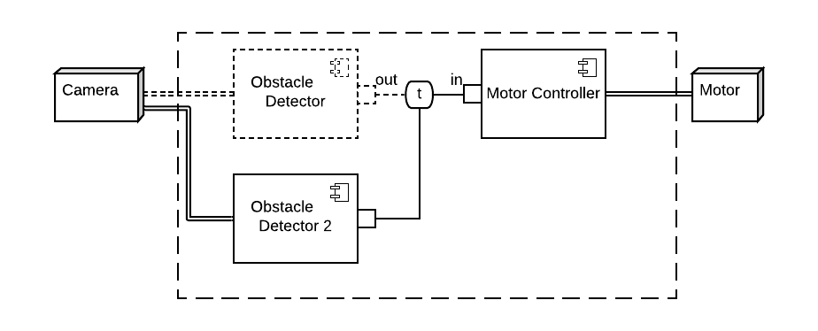
An example trace: Replace
3: Remove
2: Detach the output
1: Degrade the motor control functionality
7: Upgrade the motor control functionality
5: Attach the output
4: Create
6: Upgrade the obstacle detection functionality

Slide 32
A formal model in Alloy¹
Used Alloy to model the semantic model and the reconfig actions.
Checked that every action won’t violate the safety property (no counterexample) in a bounded model.
Checked that every action is consistent (has an instance) in a bounded model.
Notes:
[1] D. Jackson, Software Abstractions: logic, language, and analysis. MIT press, 2012.
Found a design issue: $∀o:Output,a:A∙Satisfy\left(o.degradedG,a\right)⇒Satisfy(o.normG, a)$

Slide 33
A formal model in TLA+
Modeled the Replace algorithm with TLA+/PlusCal.
Verified the algorithm with some given system configurations.
A design issue:
The algorithm cannot handle circular dependencies in the system.

Slide 34
Apply the Model to ROS
How to express assumptions and guarantees?
Assumptions and Guarantees are in fact predicates over the data.
Two Common Patterns in ROS: Message Types and Message Rate.
Message Type: ROS requires developers to define the type of messages for publishers and subscribers.
Message Type: Producing messages periodically is a common practice in ROS.
Notes:
In an event-driven system, the event rate and the message type are often two important factors. This is also true in ROS.

Slide 35
Type + Rate
Use Type + Rate to define the predicates in ROS.
Example:
An output port produces nothing.
An output port produces messages with type T.
An output port produces messages with type T at x Hz.
A functionality requires messages with type T at y Hz.
An input port receives messages with type T.
…

Slide 36
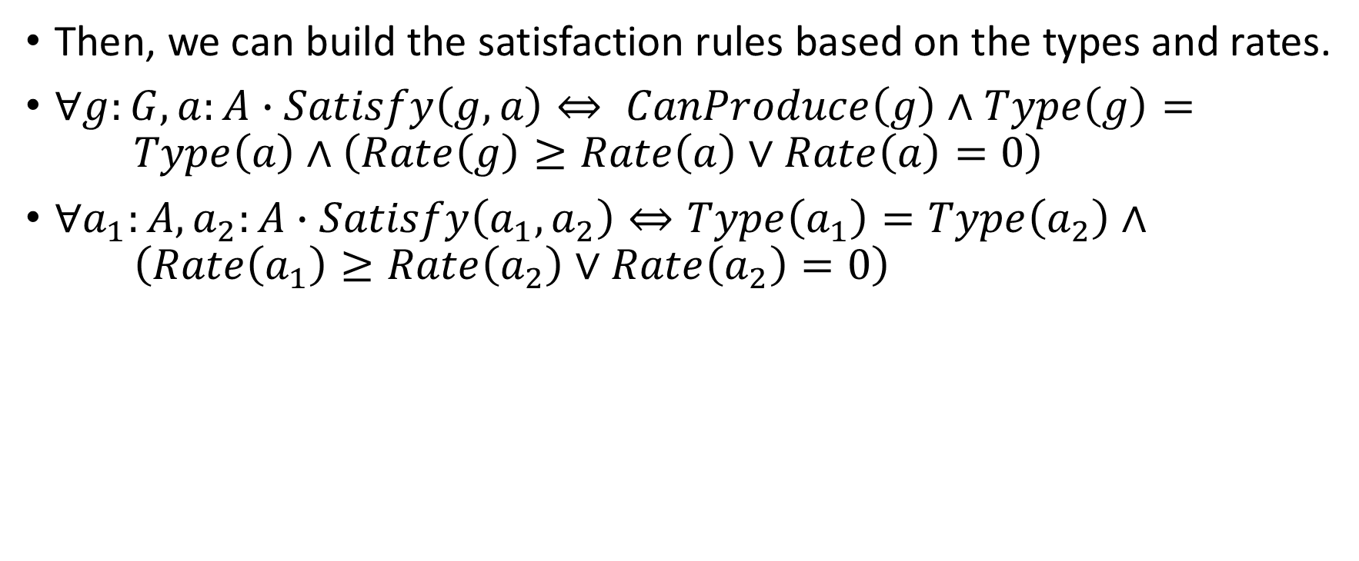
Satisfaction Rules
Then, we can build the satisfaction rules based on the types and rates.
$∀g:G,a:A∙Satisfy\left(g,a\right)⇔ CanProduce\left(g\right)∧Type\left(g\right)= Type\left(a\right)∧\left(Rate\left(g\right)≥Rate\left(a\right)∨Rate\left(a\right)=0\right)$
$∀a_{1}:A,a_{2}:A∙Satisfy\left(a_{1},a_{2}\right)⇔Type\left(a_{1}\right)=Type\left(a_{2}\right)∧ \left(Rate\left(a_{1}\right)≥Rate\left(a_{2}\right)∨Rate\left(a_{2}\right)=0\right)$

Slide 37
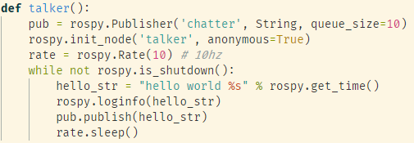
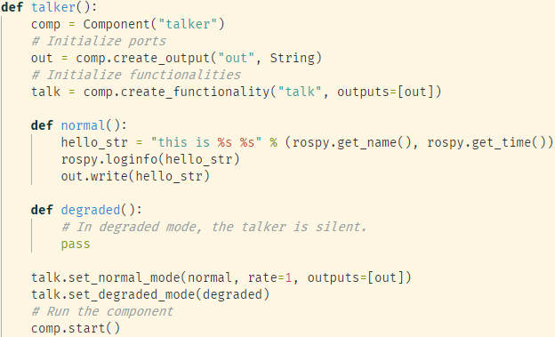
Build the Model in initialization
ROS tutorial example
Refactored ROS tutorial example
Notes:
The framework design follows the design principles from the MSE-ESE student team in 2017. A configuration manager node and wrapped APIs for application developers.

Slide 38
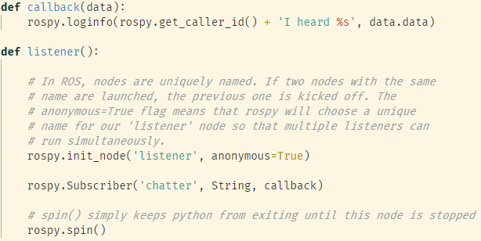
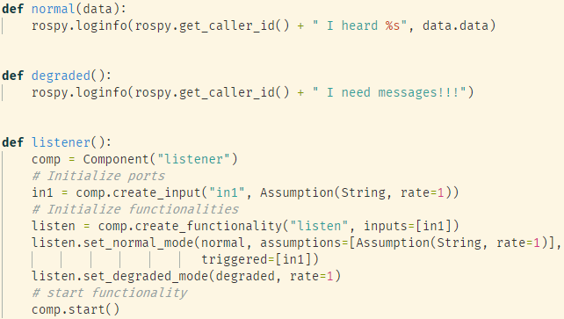
Build the Model in initialization
ROS tutorial example
Refactored ROS tutorial example

Slide 39
Run-time verification of reconfig plans
Check whether a given sequence is valid or not.
Current design:
Given a sequence of reconfig actions.
After each step, dump the changed configuration into an Alloy model.
Use Alloy to verify the model.
Current issue:
Performance!
The way Alloy check integers.

Slide 40
Future Work
Fine-grained degraded modes which provide smaller disruption.
Extend the work to other models in ROS (e.g., services or actions).
Generate a reconfig plan from one configuration to another.
A more comprehensive way of defining assumptions and guarantees.
E.g., assertions over the message fields:
msg T { int a, int b }
rate = 1 Hz
a > 0 and b < 0
A configuration specification language.
Consider the quality impact of the system (Tobi’s work).
What if the assumptions are satisfied at different levels?
Notes:
Highlight why we use formal models.

Slide 41
Thank you!

