Slide 1
A Behavioral Notion of Robustness for Software Systems
Changjian (CJ) Zhang, David Garlan, Eunsuk Kang
Notes:
Hello everyone, my name is CJ from Carnegie Mellon University. This presentation is about our work, A Behavioral Notion of Robustness for Software Systems. Other authors are David Garlan and Eunsuk Kang from Carnegie Mellon.

Slide 2
Robustness for Software Systems
IEEE definition:
The degree to which a system or component can function correctly in the presence of invalid inputs or stressful environmental conditions.
Notes:
According to IEEE, robustness is The degree to which a system or component can function correctly in the presence of invalid inputs or stressful environmental conditions. Just like other quality attributes, we are interested in how to measure robustness and how we can improve the robustness of a system.

Slide 3
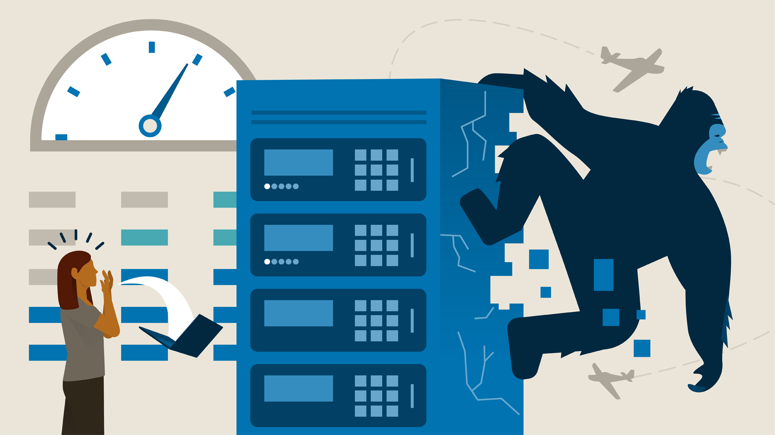
Existing Techniques
Testing: Fuzzing, Chaos Eng.
No crash
Randomized input/Fault injection
Error rate
Approximation of robustness
Notes:
Existing techniques regarding robustness focus on more on testing. For example, fuzzing testing and chaos engineering can be used to approximate the robustness of a system. Often, they use the system not crashing as the standard of correctness. Then, they use randomized inputs or fault injection to try to make a system crash. Finally, they use error rate to measure the robustness. However, error rate is not a direct metric to robustness. And more importantly, it is not applicable to design phase! However, for safety-critical or mission-critical systems, it is important to ensure that the design can guarantee some-level of robustness.

Slide 4
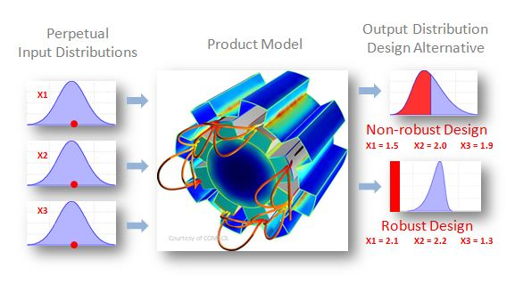
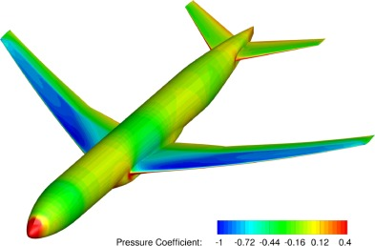
Robustness in Other Disciplines
Notes:
If we look into other disciplines, they do have methods which focus on ensuring the system robustness at design phase. For example, in aircraft engineering, or civil engineering. We cannot afford we build a bridge first and then test whether it is robust or not. However, in software engineering, such methods seem to be missing. We also need a way that can achieve robust by design, especially for those safety-critical or mission-critical systems.

Slide 5





Robust-by-design Development
Robustness Analyzer
Analysis Report
Design
Desired-level of Robustness?
Implement!
Notes:
For robust-by-design, we are proposing a development process where: developers first come up with an initial design. Then, they use a tool to analyze the robustness of that design. Then, with an analysis report, developers can decide whether the design meets the desired-level of robustness. If not, they can do another iteration to improve the design; or if it does, they can go to the implementation phase.

Slide 6
Contributions
A formal definition of software robustness.
A technique for computing and representing robustness.
Support a “robust-by-design” development process.
Notes:
Therefore, the main contributions of this work are: we first provide a formal definition of software robustness. Then, we present a technique for computing and representing robustness according to our definition. Then, we demonstrate that our tool supports the proposed robust-by-design development process.

Slide 7
A Behavioral Notion of Robustness
Use a labelled transition system (LTS) to model behavior.
Goal: Ensure a safety property (i.e., no bad behaviors).
Intuition on robustness:
A system is robust if it is capable of ensuring a safety property under environmental behaviors that deviate from the norm.
Notes:
In this work, we use labelled transition systems to model the behaviors of a system and its environment. LTS is a simple notion to model behaviors as sequences of actions. In our context, a system should ensure a safety property, i.e., intuitively, the system should not have bad behaviors. Then, in general, a system is robust if it is capable of ensuring a safety property under environmental behaviors that deviate from the norm.

Slide 8
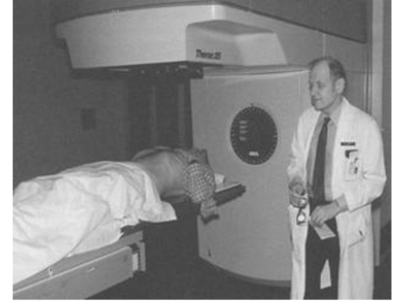
Example: Therac-25 System
Notes:
To better illustrate this idea, we use the infamous Therac-25 system as a running example. Therac-25 is a radiation therapy system which caused a few deaths. A comprehensive defects analysis has been done and it is quite complex, thus, in this talk, we will use a simplified version, and focus only on a race condition error.

Slide 9



Therac-25 System
Editing
Xray
Ebeam
NotSet
up
up
Xray
Ebeam
Confirm Xray
Confirm Ebeam
In place
Xray Mode
Ebeam Mode
confirm
up
up
confirm
Ebeam
Xray
Ebeam
set
set
Xray
Xray Ready
Ebeam Ready
out of place
To Ebeam
To Xray
fire
fire
Spreader $M_{S}$
Beam Fired
Mode Setter $M_{B}$
Interface $M_{I}$
Notes:
For labelled transition systems, basically, we model systems or environments as state machines. For therac-25, it has three components. A model defines its user interface. A model defines the switching of radiation modes. Therac-25 has an Xray mode and an electron-beam mode. And a model defines the switching of a spreader, which is used in Xray mode to reduce the power level to avoid over-dose.

Slide 10
Therac-25 System
Editing
Typical/normal use case:
Select Xray/Electron-beam mode
Confirm
Fire the beam
Xray
Ebeam
up
up
Confirm Xray
Confirm Ebeam
confirm
up
up
confirm
Xray Ready
Ebeam Ready
fire
fire
Beam Fired
Interface $M_{I}$
Notes:
For the interface model, it defines how a user can interact with the system. A typical use case is: the user select either Xray or electron-beam mode; then, confirm the mode; finally, fire the beam. Also, the user can use “up” to back to the previous step.

Slide 11

Therac-25 System
There exists a non-neglectable delay when switching modes.
NotSet
Xray
Ebeam
Xray Mode
Ebeam Mode
Ebeam
set
set
Xray
To Ebeam
To Xray
Mode Setter $M_{B}$
Notes:
For the mode switcher, there is a non-neglectable delay when the user switching from one mode to the other, e.g., if the system is in xray mode, if the user switches to the Ebeam mode, the system will still be in the xray mode until the set action has happened. And we will see that, this delay may cause overdose or underdose problems.

Slide 12

Therac-25 System
In place
 | In-place | Out-of-place
Xray | SAFE | Overdose
Electron-beam | Underdose | SAFE
Ebeam
Xray
out of place
Spreader $M_{S}$
Notes:
A spreader is used in Xray mode to avoid overdose. The table shows the possible combinations of the states of the spreader and the radiation modes. In particular, Xray combined with spreader out-of-place will cause overdose; and ebeam mode combined with spreader in-place will cause underdose.

Slide 13

Therac-25 User Manual
No overdose or underdose under typical use cases.
Can verify: System satisfies this property under this (expected) operator model.
Select Mode
Xray
Ebeam
Confirm Mode
confirm
Fire Beam
What if the operator makes a mistake?
fire
Task Done
Operator Task $E$
Notes:
In this example, the environment is the behavior model of a user. Here, we assume the very basic use cases of the system, i.e., the user chooses either xray or ebeam mode, and then confirm and fire. Under this operation model, we can use existing techniques such as model checking to verify that no overdose nor underdose will happen. However, a system is safe under the typical use cases does not mean it is robust. What if the operator makes a mistake?

Slide 14
A Known Overdose Case
Select Xray mode
Up to change mode
Select Ebeam mode
Spreader goes out of place
But still in Xray mode
Confirm
Fire causing overdose
Editing
Xray
Ebeam
up
up
Confirm Xray
Confirm Ebeam
confirm
up
up
confirm
Xray Ready
Ebeam Ready
fire
fire
Beam Fired
Interface $M_{I}$
Notes:
In fact, the system is not robust. A know overdose case is: the user selects xray mode, but then changes to ebeam mode. At this time, the spreader goes out of place, but the system is still in xray mode. Then, before the mode switching is complete, the user confirms and fires, which causes overdose. Thus, we say the system is not robust against this deviation. On the other hand, it implies that, a more robust system should be able to handle more deviations compared to the initially expected environment. Based on this intuition, we provide a more formal definition of robustness.

Slide 15

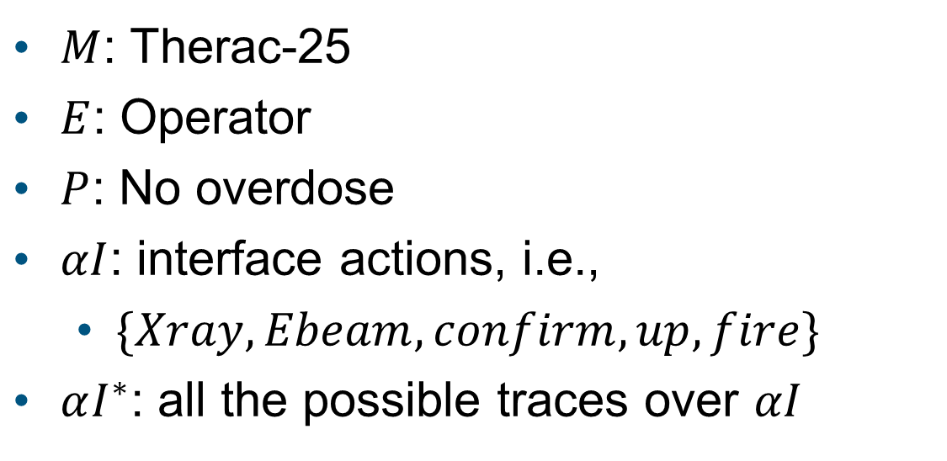
Definition of Robustness
$M$: Therac-25
$E$: Operator
$P$: No overdose
$αI$: interface actions, i.e.,
$\{Xray, Ebeam, confirm, up, fire\}$
$αI^{∗}$: all the possible traces over $αI$
$$αI^{∗}$$
Notes:
To understand our definition, let’s say we have a system model M, which is Therac-25, an environment model E, which is the operator, and a safety property, which is no overdose. Then, alpha I is the set of interface actions, they are Xray, Ebeam, confirm, up, and fire. Alpha I star represents all the possible traces over alpha I.

Slide 16

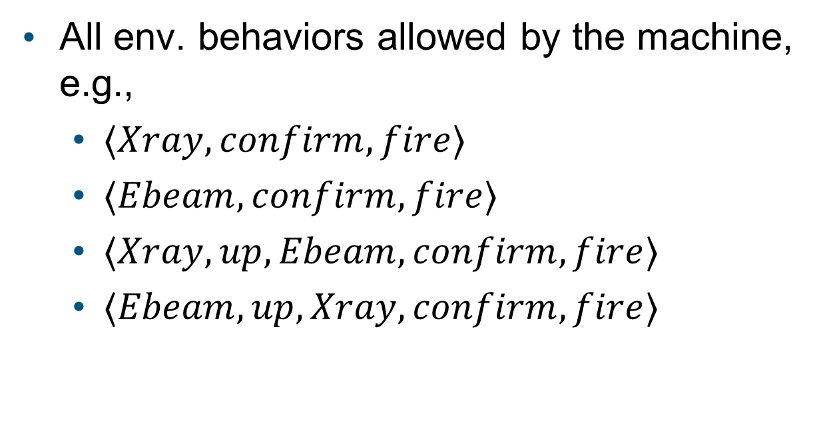
Definition of Robustness
All env. behaviors allowed by the machine, e.g.,
$⟨Xray,confirm,fire⟩$
$⟨Ebeam,confirm,fire⟩$
$⟨Xray,up,Ebeam,confirm,fire⟩$
$⟨Ebeam,up,Xray,confirm,fire⟩$
$$αI^{∗}$$
$$beh\left(M\right)$$
Notes:
The first circle describes all the environmental behaviors allowed by the machine. The traces could be infinite, here we pick the most critical ones, they are: the user choose xray or ebeam mode, and then confirm and fire. Or the user chooses xray mode or ebeam mode, but then changes to the other mode.

Slide 17

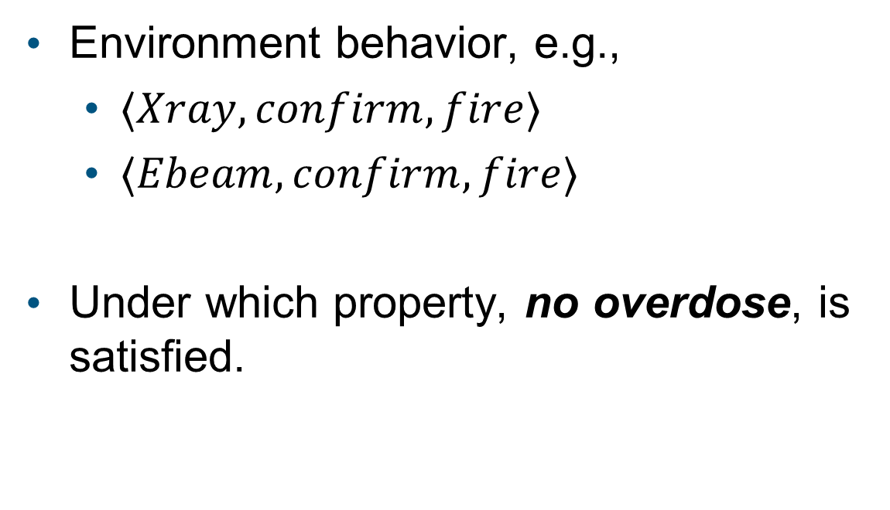
Definition of Robustness
Environment behavior, e.g.,
$⟨Xray,confirm,fire⟩$
$⟨Ebeam,confirm,fire⟩$
Under which property, no overdose, is satisfied.
$$αI^{∗}$$
$$beh\left(M\right)$$
$$beh(E)$$
Notes:
The inner small circle describes the behaviors defined by the environment model, which captures the expected behaviors of the environment, here we have: the user chooses xray or ebeam mode, and then confirm and fire. As we know, under this environment, the property, that no overdose, is satisfied.

Slide 18


Definition of Robustness
Behaviors may or may not satisfy the property, e.g.,
$⟨Xray,up,Ebeam,confirm,fire⟩$
$⟨Ebeam,up,Xray,confirm,fire⟩$
$$αI^{∗}$$
$$beh\left(M\right)$$
$$beh(E)$$
Notes:
Then, the gray area is the subset of behaviors that may or may not satisfy the property. Here, we have the user chooses xray or ebeam mode, but then changes to the other mode and then confirm and fire.

Slide 19


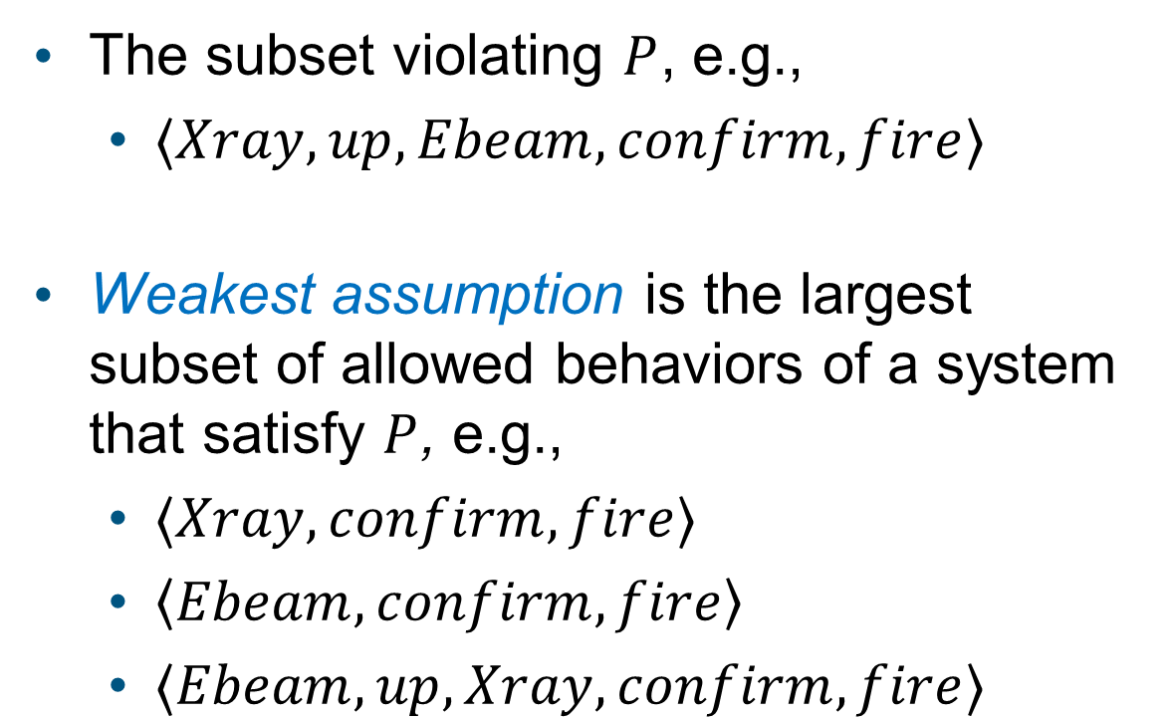
Definition of Robustness
The subset violating $P$, e.g.,
$⟨Xray,up,Ebeam,confirm,fire⟩$
Weakest assumption is the largest subset of allowed behaviors of a system that satisfy $P$, e.g.,
$⟨Xray,confirm,fire⟩$
$\left\langle Ebeam,confirm,fire\right\rangle$
$⟨Ebeam,up,Xray,confirm,fire⟩$
$$αI^{∗}$$
$$beh\left(M\right)$$
$$WA(M,E,P)$$
$$beh(E)$$
Notes:
We can further break it into two parts. The red area describes the subset that violates the property. As we’ve already discussed, switching from xray mode to ebeam mode may cause overdose.
The circle in the middle is the largest subset of the system behaviors that still satisfy the property, which we call the weakest assumption of the system. When we design a system, it is often hard and almost impossible to make it work under any environment. Thus, we make assumptions about the environment and try to make sure that the system should work under these assumptions. Thus, an assumption is weaker means the system is making fewer assumptions about the environment, that is the system should have more behaviors satisfying the property. Thus, the weakest assumption is the largest subset of environmental behaviors under which the system still satisfies the property.

Slide 20

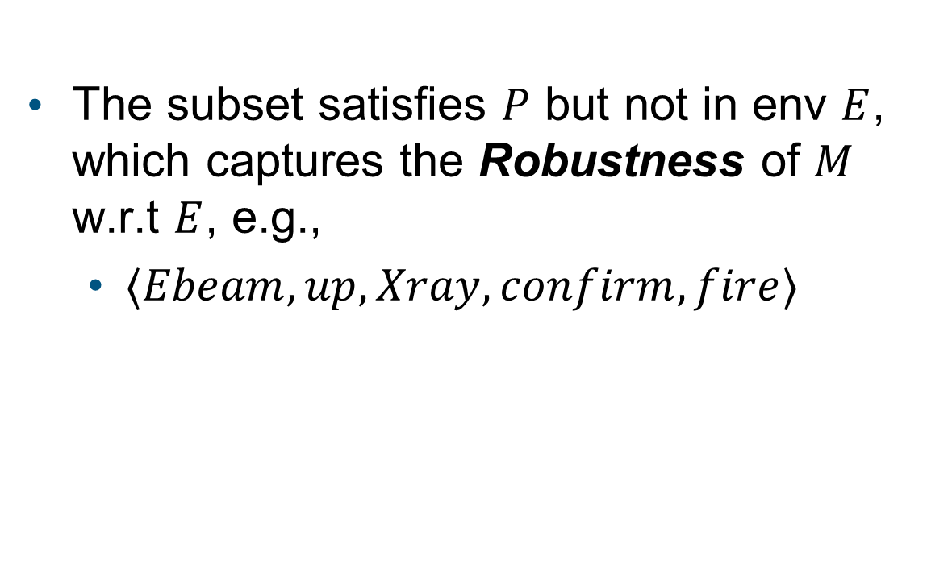
Definition of Robustness
The subset satisfies $P$ but not in env $E$, which captures the Robustness of $M$ w.r.t $E$, e.g.,
$⟨Ebeam,up,Xray,confirm,fire⟩$
$$αI^{∗}$$
$$beh\left(M\right)$$
$$WA(M,E,P)$$
$$beh(E)$$
Notes:
Then, if we compute the difference between the weakest assumption and the given environment, we can get a set of deviations under which the system satisfies the property but is not defined in the given environment. For example, in this case, we have the user chooses ebeam mode first and then switches to xray mode. We know that, this is not defined in the original operation model, but will not cause overdose, even though it may cause underdose.

Slide 21
Definition of Robustness
$$αI^{∗}$$
Robustness is the largest set of deviations of the environment under which the system can still satisfy the safety property.
$$beh\left(M\right)$$
$$WA(M,E,P)$$
$$beh(E)$$
Notes:
In sum, more formally speaking: we measure robustness as the largest set of deviations of the environment under which the system can still satisfy the safety property, which is represented as the blue area in the diagram.

Slide 22
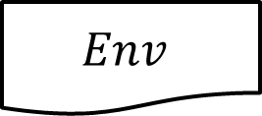
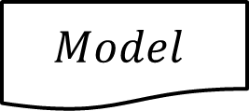
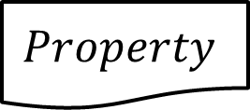
Traditional Verification Tools
$$Model$$
Model Checker
$$Env$$
True/False or a counterexample
$$Property$$
Notes:
With this definition, we can formally compute robustness. Traditionally, by given a system model, an environment model, and a safety property, a verification tool like a model checker can only tell the property is satisfied or violated by a counterexample.

Slide 23
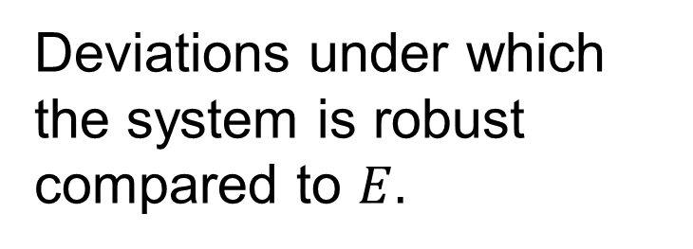
Computing System Robustness
$$Model$$
Robustness Analyzer
Deviations under which the system is robust compared to $E.$
$$Env$$
$$Property$$
Notes:
But now, our tool can compute the deviations under which the system is robust compared to the given environment with respect to the property.

Slide 24
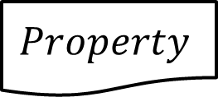

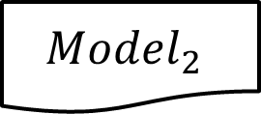
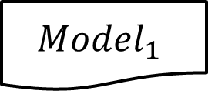
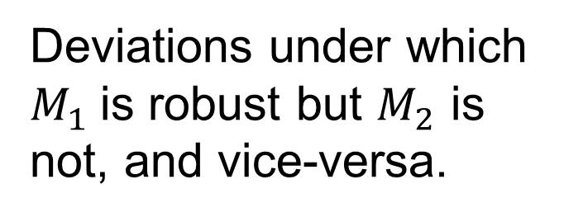
Comparing Two System Designs
$$Model_{1}$$
Robustness Analyzer
$$Model_{2}$$
Deviations under which $M_{1}$is robust but $M_{2}$ is not, and vice-versa.
$$Env$$
$$Property$$
Notes:
We can also compare the robustness of two designs by given two system models M1 and M2. We can compute the deviations under which M1 is robust but M2 is not and vice-versa.

Slide 25
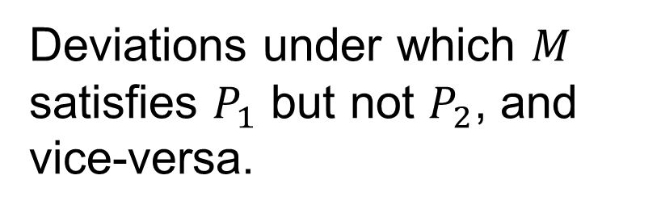
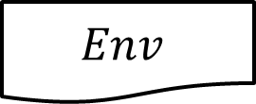

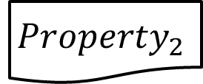

Comparing Under Two Properties
$$Model$$
Robustness Analyzer
$$Env$$
Deviations under which $M$ satisfies $P_{1}$ but not $P_{2}$, and vice-versa.
$$Property_{1}$$
$$Property_{2}$$
Notes:
Also, We can compare the robustness of one design under two properties, for instance, one is stronger, and one is weaker. We can compute the deviations under which M satisfies property 1 but not property 2 and vice-versa.

Slide 26
Computation of Robustness
An existing weakest assumption generation technique for safety properties
Compute the difference
$$αI^{∗}$$
$$beh\left(M\right)$$
$$WA(M,E,P)$$
$$beh(E)$$
Notes:
To compute robustness, we first use an existing approach to compute the weakest assumption of a system with respect to a safety property. Then, we compute the difference between the weakest assumption and the given environment.

Slide 27
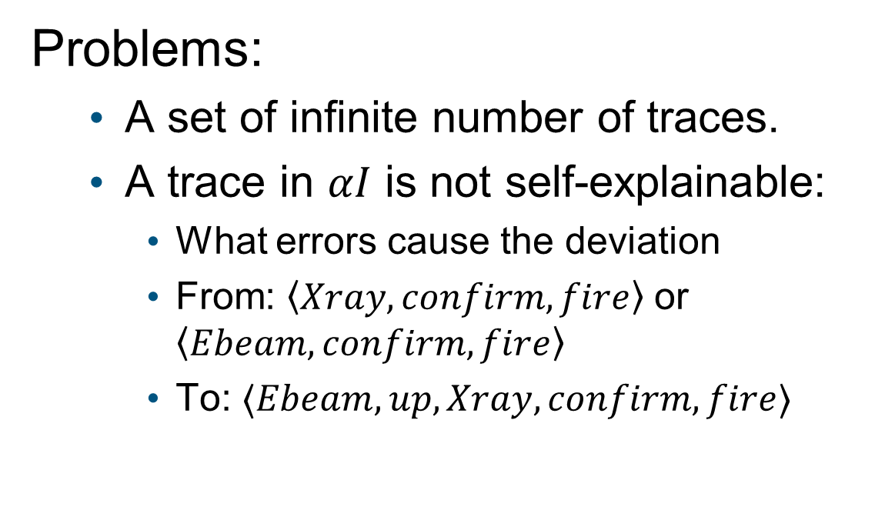
Representation and Explanation
Problems:
A set of infinite number of traces.
A trace in $αI$ is not self-explainable:
What errors cause the deviation
From: $\left\langle Xray,confirm,fire\right\rangle$ or $\left\langle Ebeam,confirm,fire\right\rangle$
To: $⟨Ebeam,up,Xray,confirm,fire⟩$
$$αI^{∗}$$
$$beh\left(M\right)$$
$$WA(M,E,P)$$
$$beh(E)$$
Notes:
However, there are two problems: first, the difference is a set of infinite number of traces. It is not possible for developers to go through these traces to tell how robust their system is. We need a way to extract valuable information from this infinite set of traces. Second, the trace is under the alphabet of the interface, developers cannot tell what are the errors which cause the deviations. For example, what mistakes of the operator can result in a trace like $<Ebeam,up,Xray,confirm,fire$>. We believe that knowing such a trace over the alphabet of the interface is not enough, developers are more interested in what are the errors the system is robust against.

Slide 28
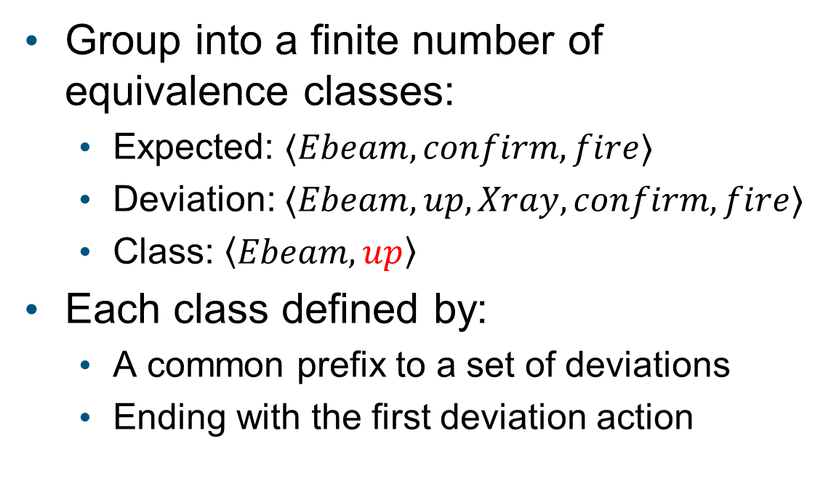
Representative Traces
Group into a finite number of equivalence classes:
Expected: $⟨Ebeam,confirm,fire⟩$
Deviation: $⟨Ebeam,up,Xray,confirm,fire⟩$
Class: $\left\langle Ebeam,up\right\rangle$
Each class defined by:
A common prefix to a set of deviations
Ending with the first deviation action
$$αI^{∗}$$
$$beh\left(M\right)$$
$$WA(M,E,P)$$
$$beh(E)$$
Notes:
For the first problem, we group the traces into a finite number of equivalence classes. For example, take <Ebeam, confirm, fire> as a reference trace, we can create a class of deviations <Ebeam, up> which represents all the deviation traces that start with <Ebeam, up>. So each class is a common prefix to a set of deviations, and that prefix ends with the first deviation action. There are different ways to group the deviation traces, here, we choose to focus only on the first deviation action, for example, ‘up’ is the first deviation action compared to the reference trace. Our rationale is that even if we have a trace with multiple errors, since the behavior already deviates from the expected one, so it may not be important to focus on the reset errors, which might be infinite.

Slide 29


Explanation
up
Deviation model: an env model with error actions
Representative trace: $\left\langle Ebeam,up\right\rangle$
Explanation: $\left\langle Ebeam,commission,up\right\rangle$
Select Mode
Back
Xray
Ebeam
Confirm Mode
commission
confirm
Fire Beam
fire
Task Done
Deviation model $D$
Notes:
For the second problem, we introduce a deviation model to generate explanations for the representative traces. We think such explanations can help developers understand what errors the system is robust against. In short, a deviation model is an environment model with error transitions. For example, in the deviation model for therac-25, we add a commission transition from confirm mode state to select mode state. A commission error means the user does something that should not be done. That is instead of doing confirm, the user does up action. Thus, we can generate an explanation for the representative trace, that is the user chooses ebeam mode and performs up because of a commission error. And we can conclude that the system is robust against this scenario.

Slide 30
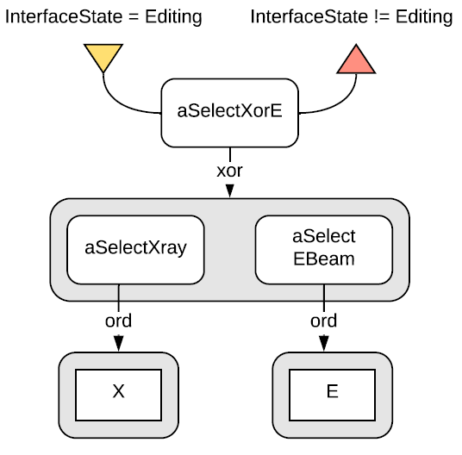
Deviation Model
Human Behavior Model (EOFM)
Deviation Model
up
Select Mode
automatic translation
Back
Xray
Ebeam
Confirm Mode
commission
confirm
Fire Beam
fire
Task Done
Notes:
A deviation model can be manually created by a developer or can be automatically generated from an existing model from another domain. For example, in our case study of therac-25, the environment is the behavior of the operator. In HCI study, they have this tool called enhanced operator function model (EOFM) to model a task for an operator. We won’t go into details about it. But Researchers have developed a technique to generate human mistakes with this task model. Thus, we automatically generate our deviation model from this existing technique. The advantage of doing this is that, developers are not always the experts in the corresponding domain. They could rely on inputs from other domain experts. And developers together with the domain experts can tell what environmental errors the system is robust against.

Slide 31
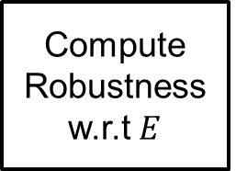
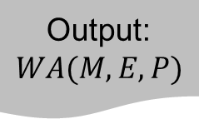
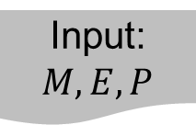
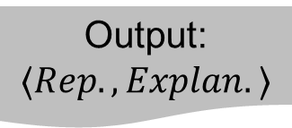
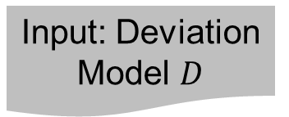
Computation of Robustness
Input: $M,E,P$
Input: Deviation Model $D$
Compute Weakest Assumption
Output: Model of robustness
Generate Equiv. Classes and Rep. Traces
Output: Rep. Traces
Build Explanations
Output:
$$WA(M,E,P)$$
Compute Robustness w.r.t $E$
Output: $⟨Rep.,Explan.⟩$
Notes:
To summarize the computation process, first, by given the model of the machine, the environment, and a safety property, we use an existing technique to compute the weakest assumption of the system. Then, we compute the difference between the weakest assumption and the given environment to get a model of robustness. With this model, we generate equivalence classes and representative traces for representing the robustness. Finally, we introduce a deviation model which is an environmental model with error actions to provide explanations for the representative traces.

Slide 32
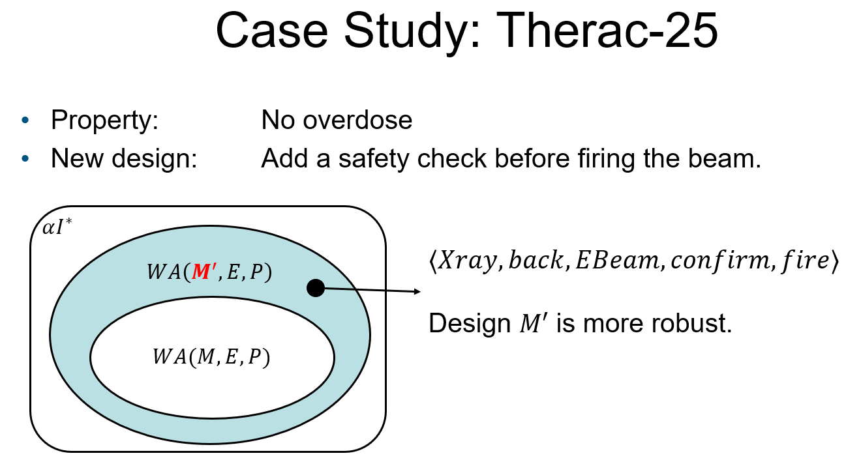
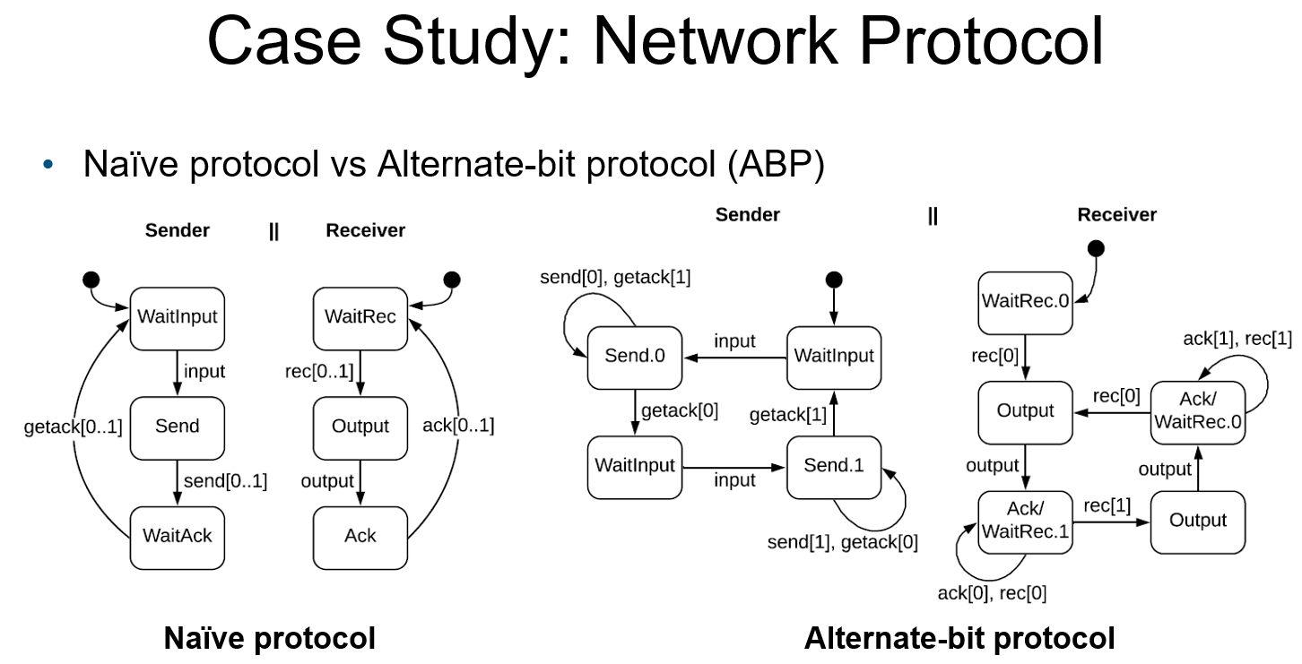
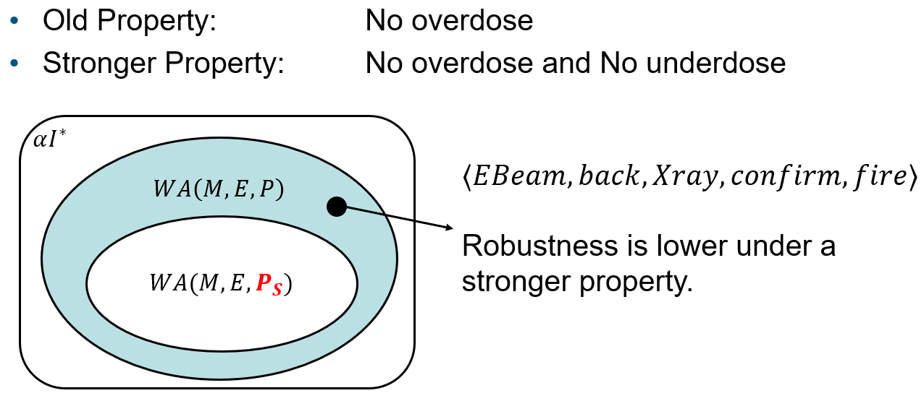
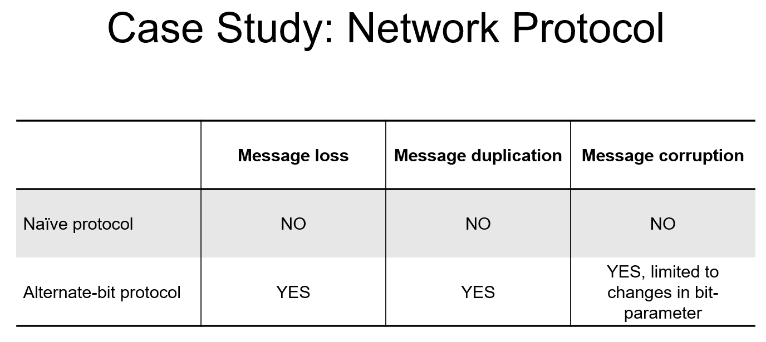
Evaluation
Details in the paper!
Notes:
We conduct two case studies to evaluate our approach. In particular, we’d like to demonstrate that our tool for computing robustness is useful and it can be applied to different domains. In the first case study, we compare the robustness of a new design of therac-25 to the original design. Our tool shows that the overdose scenario is now addressed by the new design where we add a safety check before firing. Then, we compare the robustness of the old design under two properties, one is that there should be no overdose; another is that there should be no overdose and no underdose, which is a stronger property. Our tool shows that robustness is lower under the stronger property.
In the second case study, we analyze the robustness of two network protocols: one is a protocol assuming a perfect channel; another is the alternate-bit protocol, which is a simple protocol designed for unstable channels. Our tool shows that the alternate-bit protocol is more robust in the sense that it can handle message loss, message duplication, and a limited support of message corruption. More than that, we find 8 scenarios where our deviation model cannot find explanations, which means that the protocol is even more robust than we previously believe.
More details can be found in the paper.

Slide 33


Robust-by-design Review
A functional system?
The system is robust against:
<send, msg lost, send>
<send, recv, ack, msg lost>
…
Developers
Design
Possible deviations?
Robustness analyzer
Deviations & Explanations
Domain experts
Deviation model
Notes:
To review the robust-by-design process we are proposing, developers may often start with a design which satisfies the functional requirements under the typical environment. At the same time, a group of domain experts may analyze the potential faults in the environment and create a deviation model. Then, they can use our robustness analyzer to compute the deviations and their explanations that the system is robust against.

Slide 34
Robust-by-design Review
Let’s improve it!
The system is robust against:
<send, msg lost, send>
<send, recv, ack, msg lost>
…
Developers
Design
What about duplication error?
Robustness analyzer
Deviations & Explanations
Comments:
Missing <send, recv, duplicate, recv>
Domain experts
Deviation model
Notes:
In one case, the domain experts may find that some critical scenarios are missing. And the developers can work on fixing that which improve the robustness of the system.

Slide 35

Robust-by-design Review
Over-engineering?!
The system is robust against:
<send, msg lost, send>
<send, recv, ack, msg lost>
…
Developers
Design
This case is unlikely to happen, no need to cover it.
Robustness analyzer
Deviations & Explanations
Comments:
This is unlikely to happen, <send, recv, ack, msg lost>
We must meet the schedule and budget!
Domain experts
Deviation model
Project manager
Notes:
In another case, the domain experts may find that some unlikely scenarios are covered by the system but, on the other hand, may introduce overhead. This often happens in the case that developers are over engineering the system. Then, the project manager may jump in and emphasize that we could simplify the system to remove some checks to meet the schedule and budget.

Slide 36
Robust-by-design Review
Impossible to fix them all within schedule and budget!
The system is robust against:
<send, msg lost, send>
<send, recv, ack, msg lost>
…
Developers
Design
We are missing some cases, but the risk is low.
Robustness analyzer
Deviations & Explanations
Comments:
This is missing but okay, <send, recv, duplicate, recv>
Critical errors are covered! Let’s go and implement!
Domain experts
Deviation model
Project manager
Notes:
Finally, they may find some scenarios are not covered but with low risk. Fixing all these defects may introduce overhead or cause the project to delay or run out of budget. Then, the team may decide to leave them as technical debts and continue to implementation phase. In sum, there are many more use scenarios. compared to traditional model checking tools, our tool provides a systematic view of system robustness at design time, that is what erroneous scenarios are covered and what are not. With this information, developing teams can make more reasonable decisions regarding the robustness or overall quality of the final product.

Slide 37
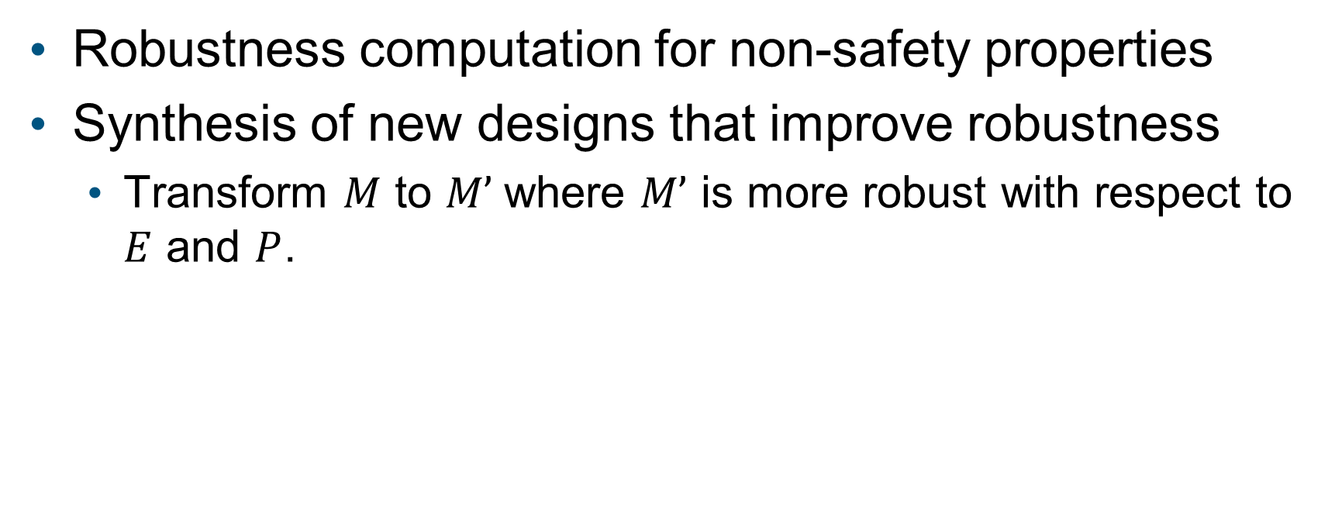
Future Work
Robustness computation for non-safety properties
Synthesis of new designs that improve robustness
Transform $M$ to $M’$where $M’$ is more robust with respect to $E$ and $P$.
Notes:
In the future, we’d like to work on robustness computation for non-safety properties, e.g., liveness properties. Also, we are interested in how to synthesize a new design of a system which improves its robustness. For example, by using some model repair or model transformation techniques, we can get a new design M’ such that M’ is more robust with respect to the environment E and property P.

Slide 38
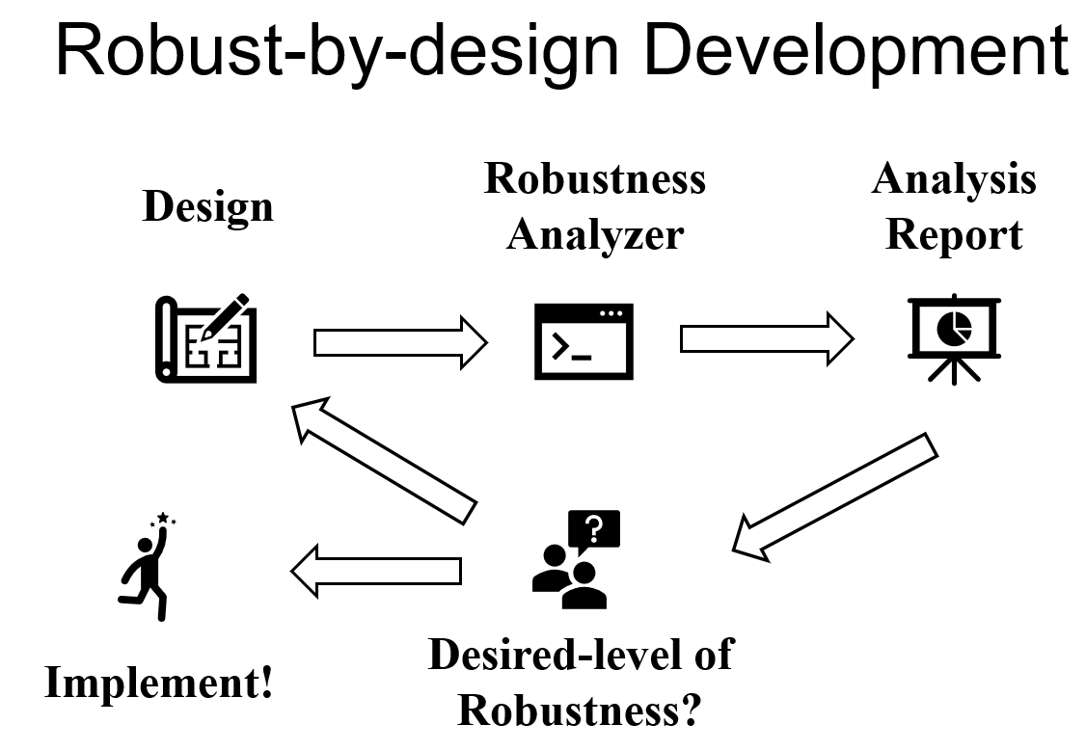
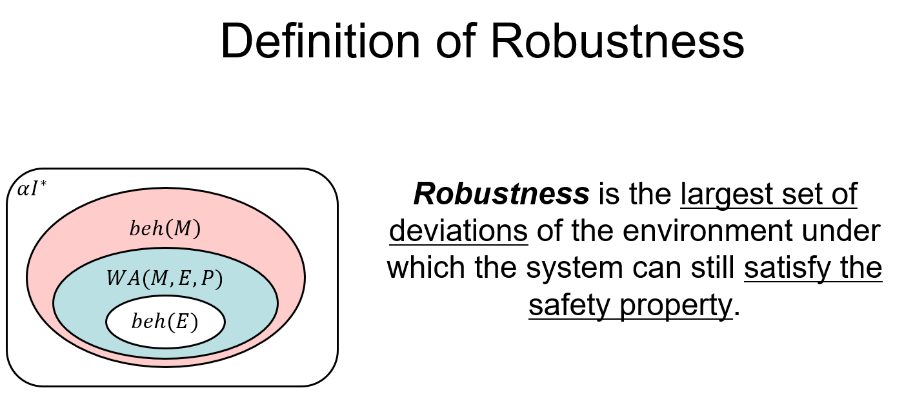
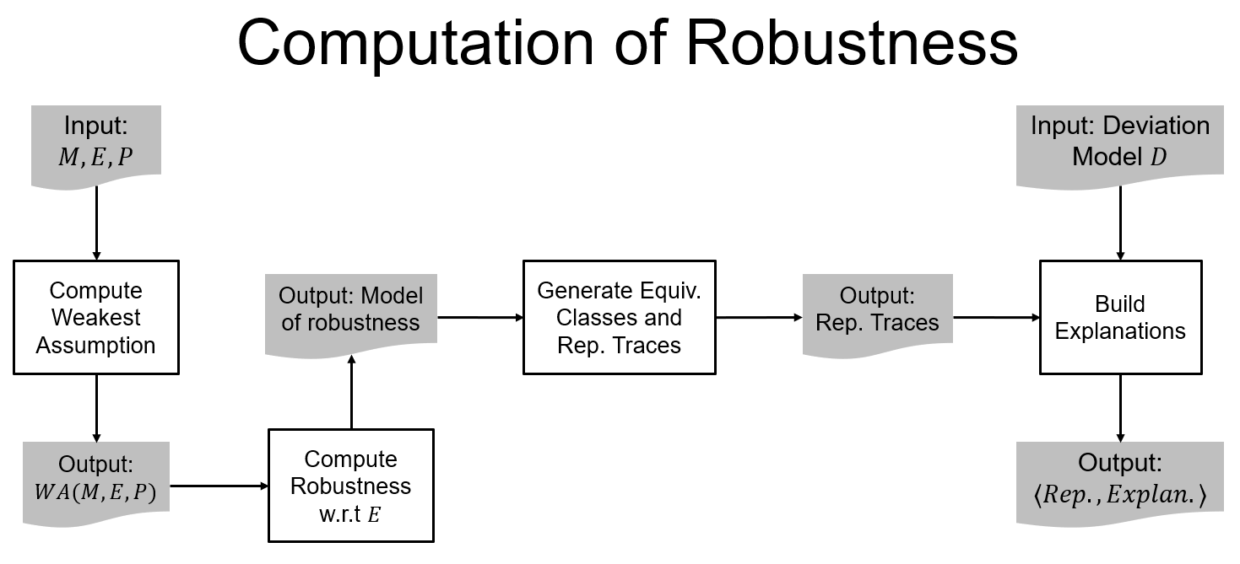
Notes:
To conclude, in this work, we are promoting a robust-by-design process for software development. We propose a formal definition of robustness and present a technique for computing it. And we demonstrate that this tool enables the robust-by-design process. This is the end of the talk, thank you for listening!

Slide 39
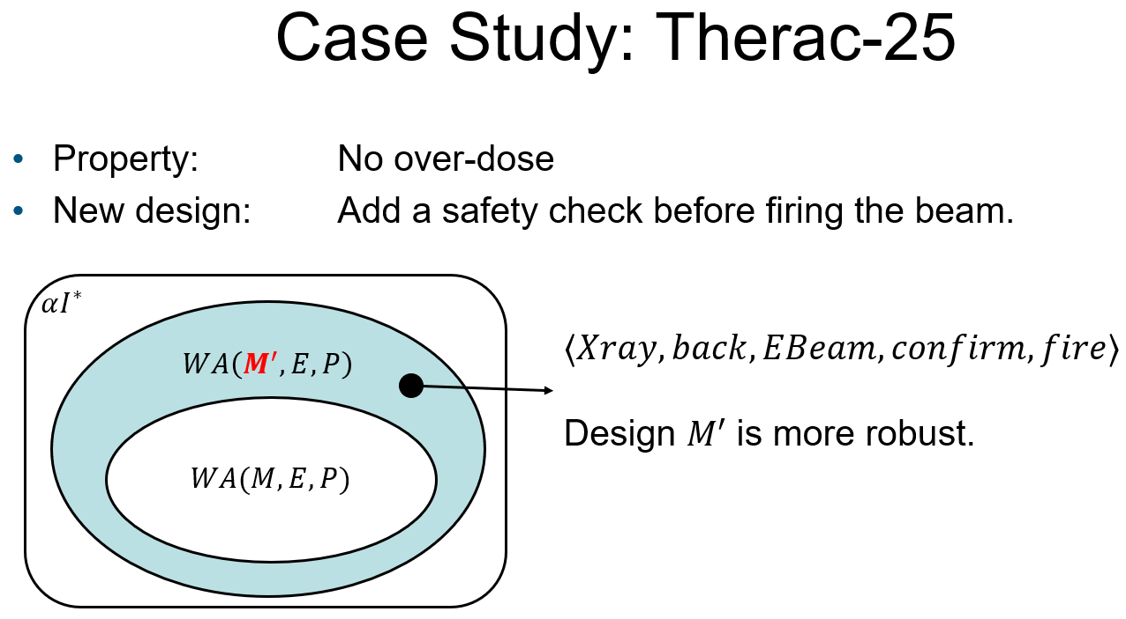
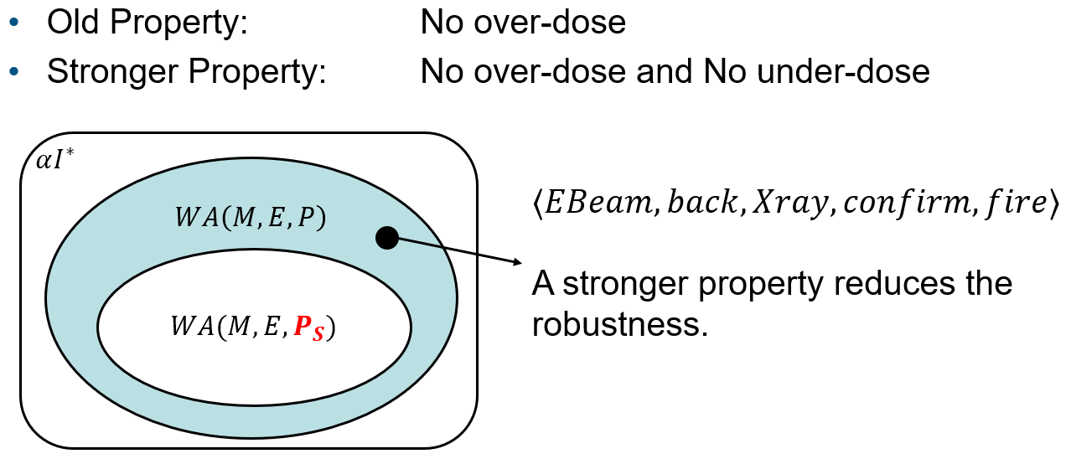
Evaluation
Usefulness
Applicable across domains

Slide 40
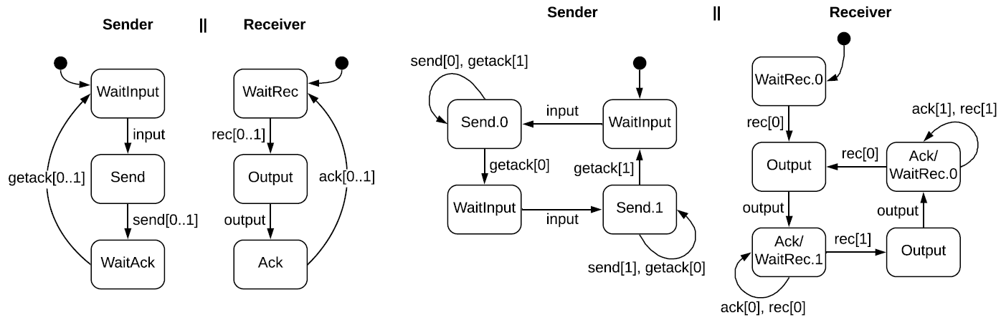
Case Study: Network Protocol
Naïve protocol vs Alternate-bit protocol (ABP)
Naïve protocol
Alternate-bit protocol
Notes:
TODO: introduce ABP - ABP is a well-known simple protocol designed for message loss or duplication.
TODO: emphasize the novelty of our approach - People have done verification of ABP protocol before, But no one has systematically generate all the deviations that ABP can handle.

Slide 41
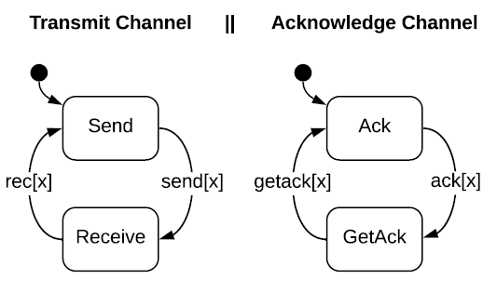
Case Study: ABP Protocol
System: ABP Protocol vs Naïve protocol
Environment: Communication Channel
Channel

Slide 42
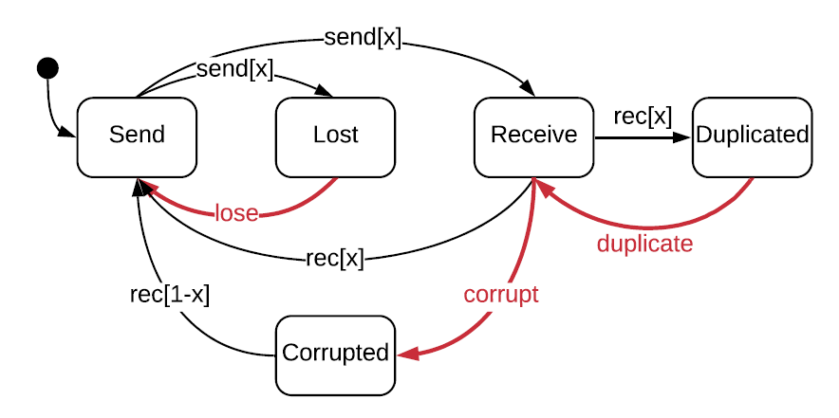
Case Study: ABP Protocol
System: ABP Protocol vs Naïve protocol
Environment: Communication Channel
Deviation model: Channel with message loss, duplication, and corruption

Slide 43
Case Study: Network Protocol
 | Message loss | Message duplication | Message corruption
Naïve protocol | NO | NO | NO
Alternate-bit protocol | YES | YES | YES, limited to changes in bit-parameter
Notes:
TODO: Especially, we find deviations that our deviation model cannot find explanations, which means the protocol is even more robust than what we initially believe.

Slide 44
Case Study: Therac-25
System: Therac-25
Environment: Human Operator
Deviation model: Operator with mistakes, derived from EOFM
Comparing robustness of a new design
Comparing robustness under two properties
Notes:
TODO: combine with the running example.
TODO: maybe worth to introduce EOFM, this cross-discipline work in welcome!

Slide 45




Case Study: Therac-25
Property: No overdose
New design: Add a safety check before firing the beam.
$$αI^{∗}$$
$$WA\left(M^{′},E,P\right)$$
$$⟨Xray,back,EBeam,confirm,fire⟩$$
Design $M′$ is more robust.
$$WA(M,E,P)$$

Slide 46



Case Study: Therac-25
Old Property: No overdose
Stronger Property: No overdose and No underdose
$$αI^{∗}$$
$$WA\left(M,E,P\right)$$
$$⟨EBeam,back,Xray,confirm,fire⟩$$
Robustness is lower under a stronger property.
$$WA(M,E,P_{S})$$

