Slide 1
A Behavioral Notion of Robustness for Software Systems
Changjian (CJ) Zhang, David Garlan, Eunsuk Kang

Slide 2
Robustness for Software Systems
IEEE definition:
The degree to which a system or component can function correctly in the presence of invalid inputs or stressful environmental conditions.
Notes:
Like other QA, how to make a system robust which requires us to have a way to measure it.

Slide 3
How to measure it?
Testing-based Measurements (Fuzzing, Chaos Eng.)
Correct: Not Crash
Invalid inputs/Stressful env.: randomized inputs or fault injection
Metric: Error Rate
Notes:
However, error rate is not a direct measurement to robustness, and it is not applicable to design phase!

Slide 4
Robustness in other disciplines
Robust design methods for materials design
Robust control in control theory
Robust design optimization methods for aircrafts
Software engineering?
Notes:
We seem to missing such a method in SE.

Slide 5





Robust-by-design
Robustness Analyzer
Analysis Report
Design
Desired-level of Robustness?
GO!

Slide 6
Contributions
A formal definition of robustness
A technique for computing and representing system robustness
Enables robust-by-design development process

Slide 7
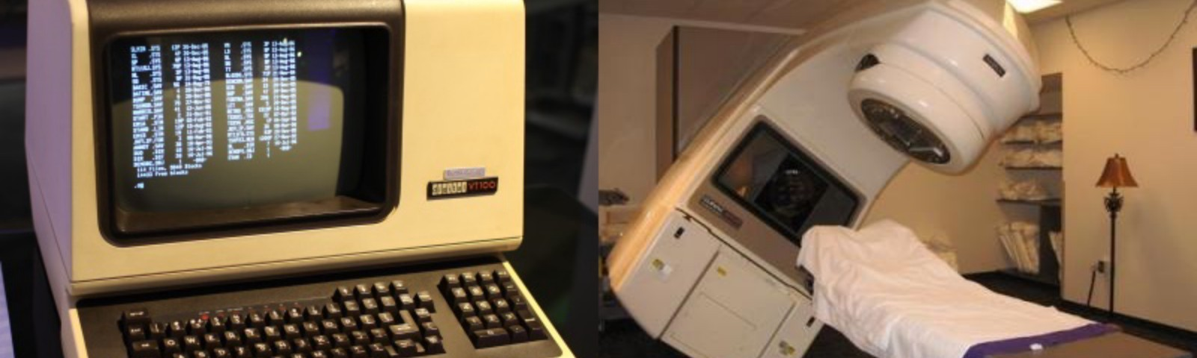
Therac-25
Notes:
Infamous therac25 software crisis, how can we ensure the design is correct?

Slide 8
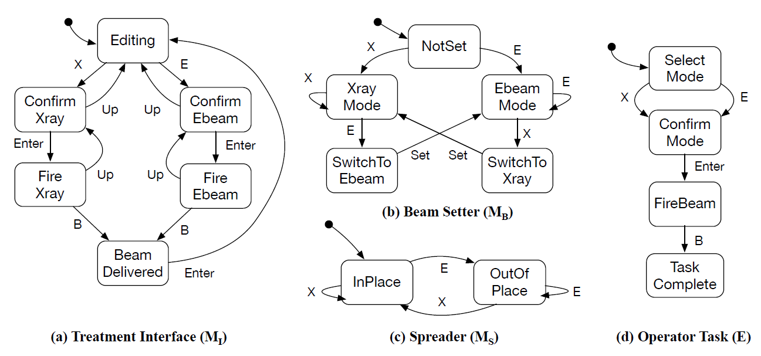
Therac-25
System
Env
Property: not over-dose
Notes:
In formal methods community, traditionally, we model the behaviors of the system and env, and check the property is satisfied.
We are interested in under the deviations of the environment, will the property still be satisfied.
In other words, is the system still robust under the deviations.
That is, we believe the set of deviations under which the system satisfies the property captures the robustness of a system.

Slide 9
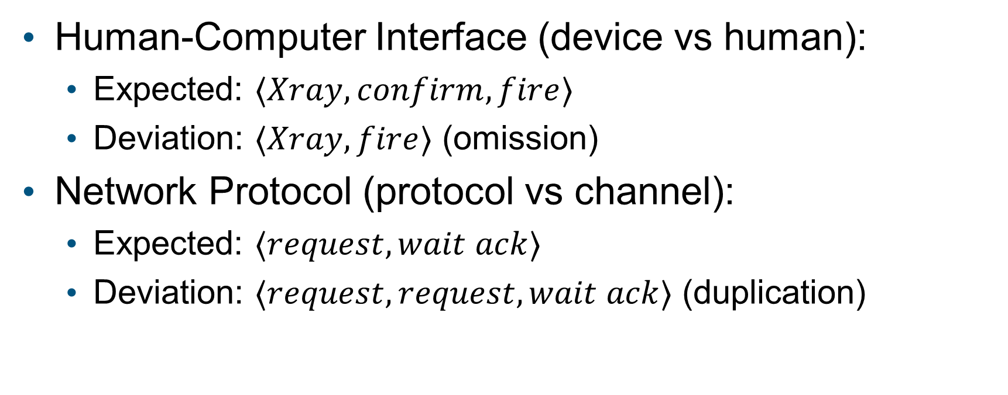
Examples of Deviations
Human-Computer Interface (device vs human):
Expected: $⟨Xray,confirm,fire⟩$
Deviation: $⟨Xray,fire⟩$ (omission)
Network Protocol (protocol vs channel):
Expected: $⟨request,wait ack⟩$
Deviation: $⟨request,request,wait ack⟩$ (duplication)

Slide 10
A Behavioral Notion of Robustness
Use labelled transition system (LTS) to model system and environment behavior.
“Function correctly” means satisfying a safety property.
Intuition on robustness:
A system is robust means it still satisfies the safety property under environmental behaviors that are not defined in expected environment (deviations).
Notes:
Let’s dig into this definition

Slide 11

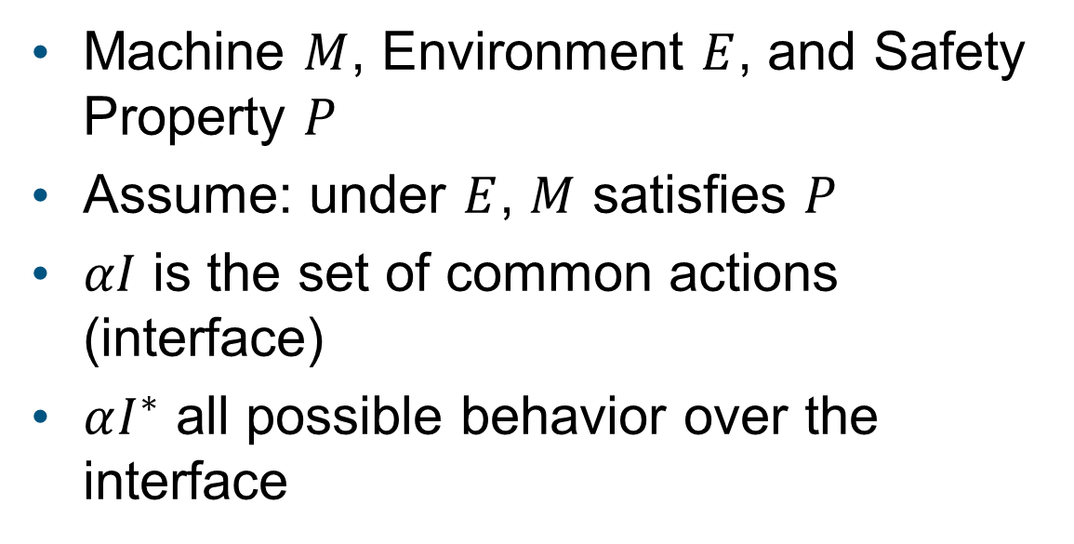
Definition of Robustness
Machine $M$, Environment $E$, and Safety Property $P$
Assume: under $E$, $M$ satisfies $P$
$αI$ is the set of common actions (interface)
$αI^{∗}$ all possible behavior over the interface
$$αI^{∗}$$

Slide 12

Definition of Robustness
All allowed behaviors of the machine.
$$αI^{∗}$$
$$beh\left(M\right)$$

Slide 13

Definition of Robustness
All allowed behaviors of the machine.
Under the normative environment, the machine satisfies the property.
$$αI^{∗}$$
$$beh\left(M\right)$$
$$beh(E)$$

Slide 14

Definition of Robustness
All allowed behaviors of the machine.
May or may not satisfy the property.
Under the normative environment, the machine satisfies the property.
$$αI^{∗}$$
$$beh\left(M\right)$$
$$beh(E)$$

Slide 15
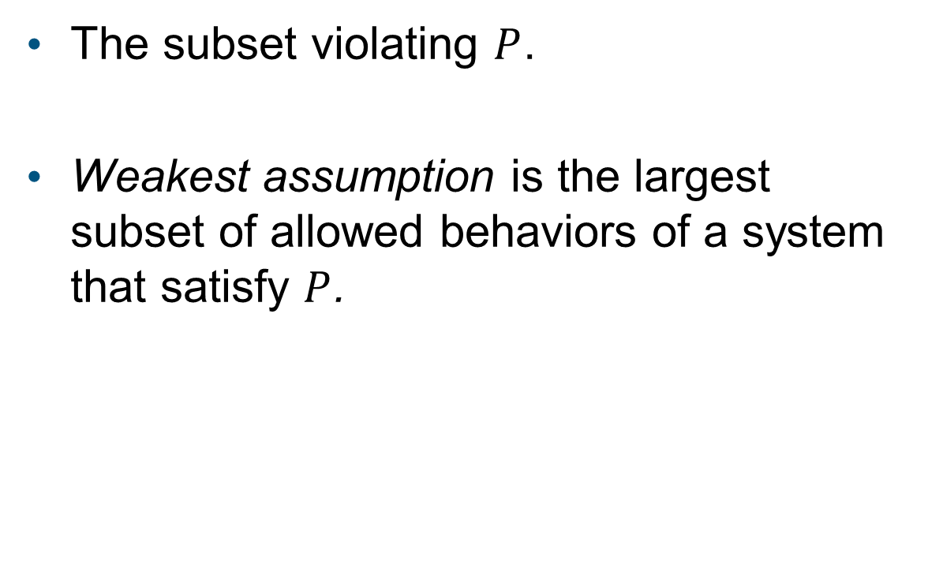


Definition of Robustness
The subset violating $P$.
Weakest assumption is the largest subset of allowed behaviors of a system that satisfy $P$.
$$αI^{∗}$$
$$beh\left(M\right)$$
$$WA(M,E,P)$$
$$beh(E)$$

Slide 16


Definition of Robustness
The subset satisfies $P$ but not in env $E$, which captures the Robustness of $M$ w.r.t $E$.
$$αI^{∗}$$
$$beh\left(M\right)$$
$$WA(M,E,P)$$
$$beh(E)$$

Slide 17
Definition of Robustness
$$αI^{∗}$$
Robustness is the largest set of deviations of the environment under which the system can still satisfy the safety property.
$$beh\left(M\right)$$
$$WA(M,E,P)$$
$$beh(E)$$
Notes:
Robustness w.r.t an env E and property P

Slide 18
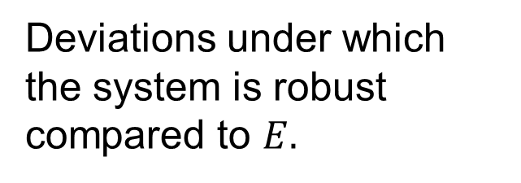



Computing System Robustness
$$M$$
Robustness Analyzer
Deviations under which the system is robust compared to $E.$
$$E$$
$$P$$

Slide 19
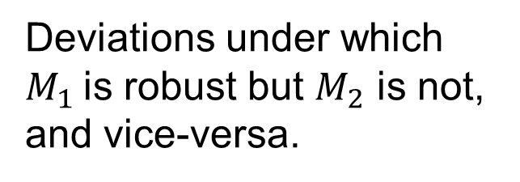




Comparing two system designs
$$M_{1}$$
Robustness Analyzer
$$M_{2}$$
Deviations under which $M_{1}$is robust but $M_{2}$ is not, and vice-versa.
$$E$$
$$P$$
Notes:
Compare the robustness of two system designs

Slide 20
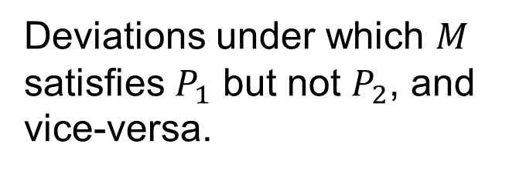




Comparing under two properties
$$M$$
Robustness Analyzer
$$E$$
Deviations under which $M$ satisfies $P_{1}$ but not $P_{2}$, and vice-versa.
$$P_{1}$$
$$P_{2}$$
Notes:
Compare the robustness of one system under two properties, one stronger and one weaker

Slide 21
Computation of Robustness
Existing weakest assumption generation techniques for safety properties
Compute the difference
$$αI^{∗}$$
$$beh\left(M\right)$$
$$WA(M,E,P)$$
$$beh(E)$$

Slide 22
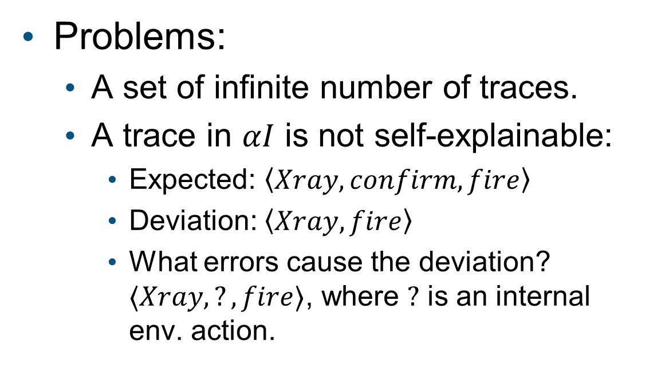
Representation and Explanation
Problems:
A set of infinite number of traces.
A trace in $αI$ is not self-explainable:
Expected: $\left\langle Xray,confirm,fire\right\rangle$
Deviation: $\left\langle Xray,fire\right\rangle$
What errors cause the deviation? $⟨Xray,?,fire⟩$, where $?$ is an internal env. action.
$$αI^{∗}$$
$$beh\left(M\right)$$
$$WA(M,E,P)$$
$$beh(E)$$

Slide 23
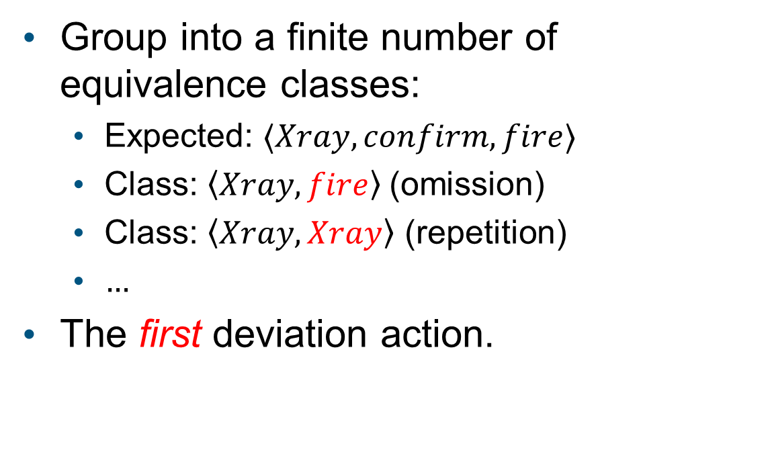
Representative Traces
Group into a finite number of equivalence classes:
Expected: $⟨Xray,confirm,fire⟩$
Class: $\left\langle Xray,fire\right\rangle$ (omission)
Class: $\left\langle Xray,Xray\right\rangle$ (repetition)
$…$
The first deviation action.
$$αI^{∗}$$
$$beh\left(M\right)$$
$$WA(M,E,P)$$
$$beh(E)$$
Notes:
All the traces starting with <Xray, fire> which indicates an omission error.
In particular, we only focus on the first!

Slide 24

Explanation
Deviation model: an env model with error actions
Representative trace: $\left\langle Xray,fire\right\rangle$
Explanation: $\left\langle Xray,omission,fire\right\rangle$
Xray
EBeam
omission
confirm
fire
Deviation model
Notes:
Developers can manually build such a model, or derive it from some fault model of the domain.

Slide 25
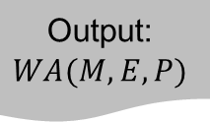
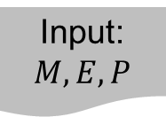
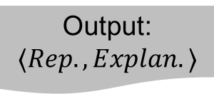
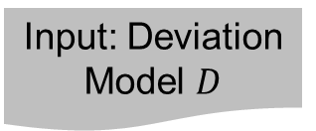
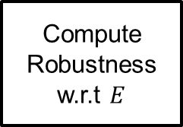
Computation Summary
Input: $M,E,P$
Input: Deviation Model $D$
Compute Weakest Assumption
Output: Model of robustness
Generate Equiv. Classes and Rep. Traces
Output: Rep. Traces
Build Explanations
Output:
$$WA(M,E,P)$$
Compute Robustness w.r.t $E$
Output: $⟨Rep.,Explan.⟩$

Slide 26
Case studies
Usefulness
Applicable across domains

Slide 27
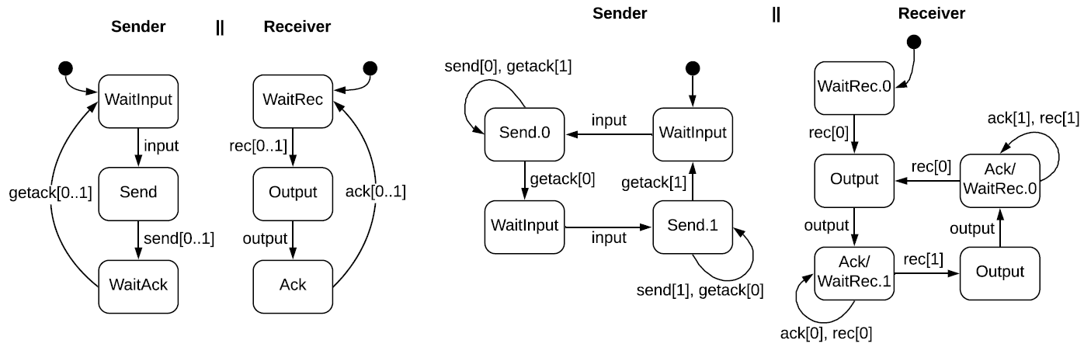
Case Study: ABP Protocol
System: Naïve protocol vs ABP Protocol
Naïve protocol
ABP protocol

Slide 28
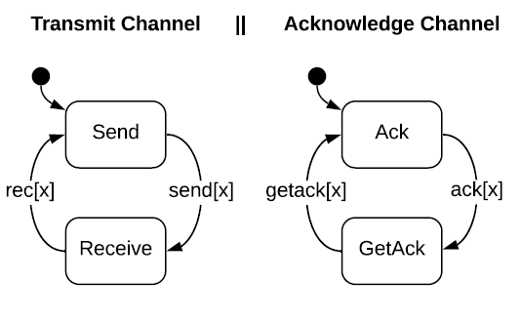
Case Study: ABP Protocol
System: ABP Protocol vs Naïve protocol
Environment: Communication Channel
Channel

Slide 29
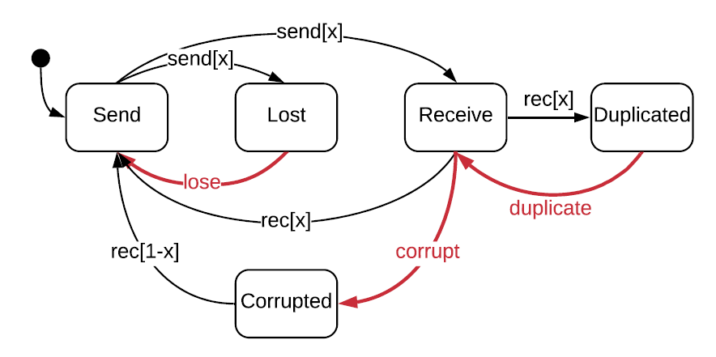
Case Study: ABP Protocol
System: ABP Protocol vs Naïve protocol
Environment: Communication Channel
Deviation model: Channel with message loss, duplication, and corruption

Slide 30
Case Study: ABP Protocol
 | Message loss | Message duplication | Message corruption
Naïve protocol | NO | NO | NO
ABP protocol | YES | YES | YES, limited to changes in bit-parameter

Slide 31
Case Study: Therac-25
System: Therac-25
Environment: Human Operator
Deviation model: Operator with mistakes, derived from EOFM
Comparing robustness of a new design
Comparing robustness under two properties

Slide 32


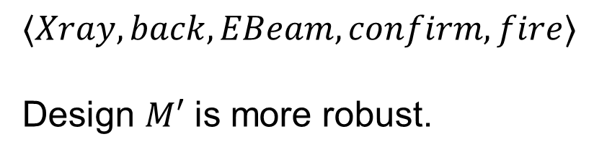

Case Study: Therac-25
Property: No over-dose
New design should be robust against a trace causing overdose
$$αI^{∗}$$
$$WA\left(M^{′},E,P\right)$$
$$⟨Xray,back,EBeam,confirm,fire⟩$$
Design $M′$ is more robust.
$$WA(M,E,P)$$

Slide 33

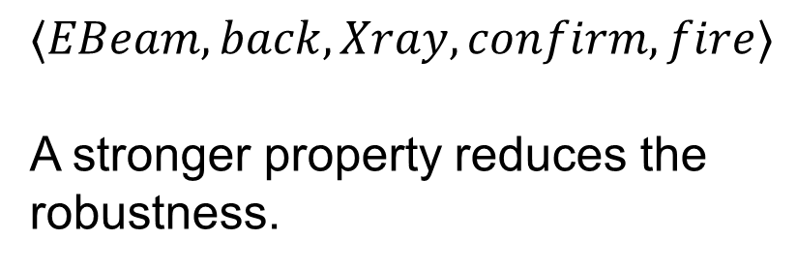

Case Study: Therac-25
Old Property: No over-dose
Stronger Property: No over-dose and No under-dose
$$αI^{∗}$$
$$WA\left(M,E,P\right)$$
$$⟨EBeam,back,Xray,confirm,fire⟩$$
A stronger property reduces the robustness.
$$WA(M,E,P_{S})$$

Slide 34
Future Work
Robustness computation for liveness property
Synthesis of new design which improves robustness

Slide 35
Thank you!
Input: $M,E,P$
Input: Deviation Model $D$
Compute Weakest Assumption
Output: Model of robustness
Generate Equiv. Classes and Rep. Traces
Output: Rep. Traces
Build Explanations
Output:
$$WA(M,E,P)$$
Compute Robustness w.r.t $E$
Output: $⟨Rep.,Explan.⟩$

Slide 36





Analysis of Robustness
Compare two designs
Compare one design under two properties
$$αI^{∗}$$
$$αI^{∗}$$
$$WA\left(M^{′},E,P\right)$$
$$WA\left(M,E,P′\right)$$
$$WA(M,E,P)$$
$$WA(M,E,P)$$

Slide 37

LTS 101
An LTS $T=⟨S, αT,R,s_{0}⟩$ where
Xray
EBeam
confirm
fire
Operator of Therac-25
Notes:
infamous

Slide 38

LTS 101
An LTS $T=⟨S, αT,R,s_{0}⟩$ where
$S$ is a set of states,
Xray
EBeam
confirm
fire
Operator of Therac-25

Slide 39

LTS 101
An LTS $T=⟨S, αT,R,s_{0}⟩$ where
$S$ is a set of states,
$αT$ is a set of actions,
Xray
EBeam
confirm
fire
Operator of Therac-25

Slide 40
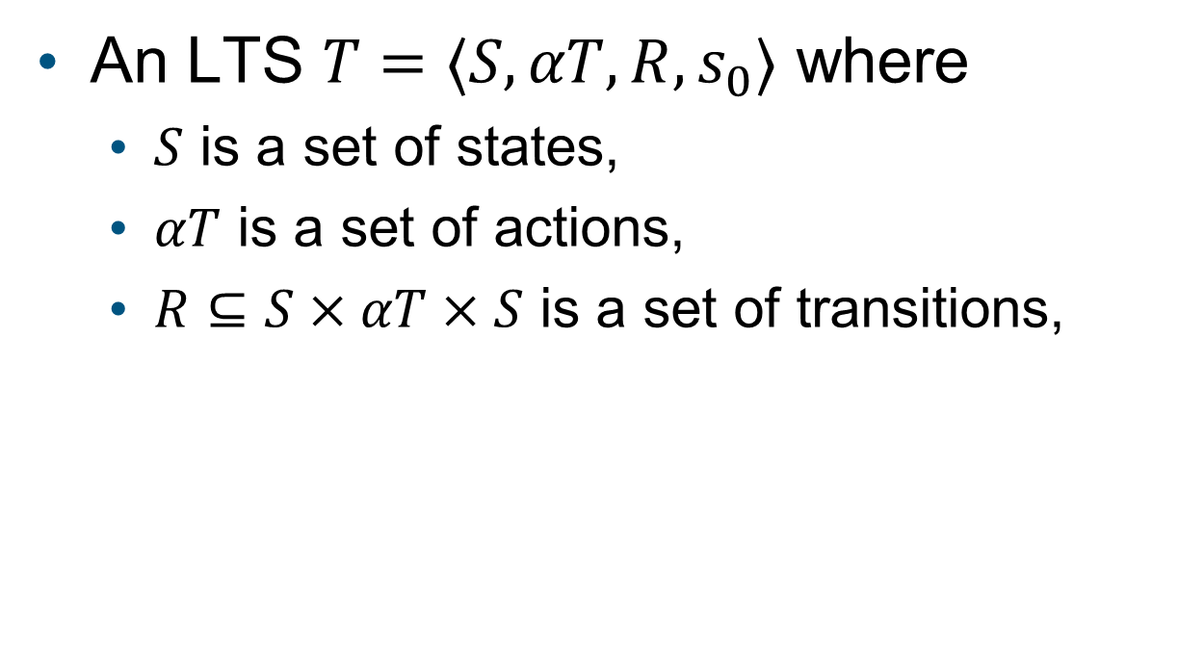
LTS 101
An LTS $T=⟨S, αT,R,s_{0}⟩$ where
$S$ is a set of states,
$αT$ is a set of actions,
$R⊆S×αT×S$ is a set of transitions,
Xray
EBeam
confirm
fire
Operator of Therac-25

Slide 41
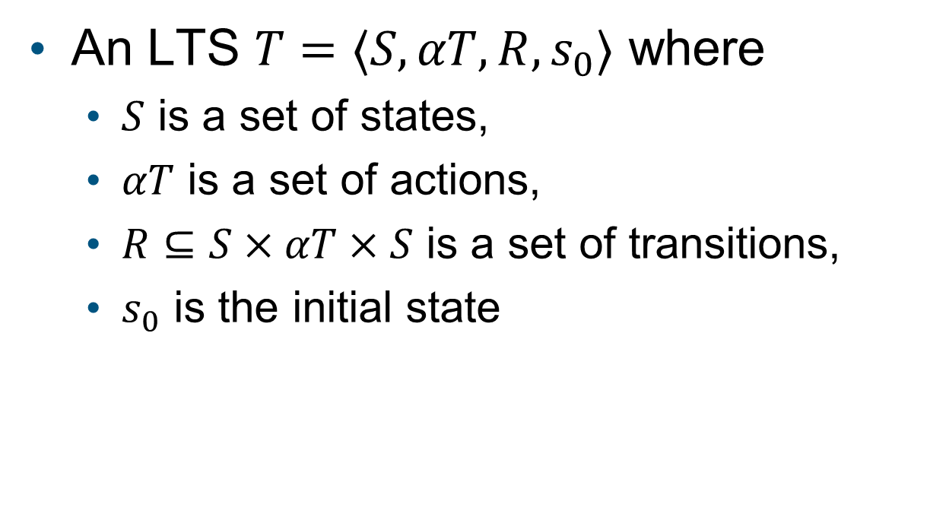
LTS 101
An LTS $T=⟨S, αT,R,s_{0}⟩$ where
$S$ is a set of states,
$αT$ is a set of actions,
$R⊆S×αT×S$ is a set of transitions,
$s_{0}$ is the initial state
Xray
EBeam
confirm
fire
Operator of Therac-25

Slide 42
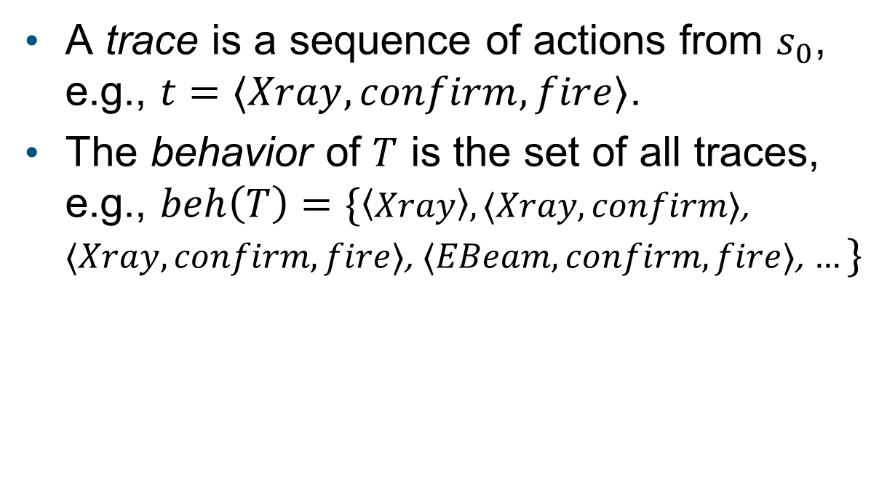
LTS 101
A trace is a sequence of actions from $s_{0}$, e.g., $t=⟨Xray,confirm,fire⟩$.
The behavior of $T$ is the set of all traces, e.g., $beh\left(T\right)=\{\left\langle Xray\right\rangle ,⟨Xray,confirm⟩$, $⟨Xray,confirm,fire⟩$, $⟨EBeam,confirm,fire⟩$, $…\}$
Xray
EBeam
confirm
fire
Operator of Therac-25

Slide 43
LTS 101
A safety property is an LTS which defines the expected behavior of a model.
Xray
EBeam
confirm
confirm
fire
fire
Operator of Therac-25
Property

Slide 44
Limitations of existing approaches
An approximation, not a direct measurement
Not exhaustive in nature (randomness)
Not applicable to design phase:
Robust-by-design?
Notes:
Error rate can only tell a system is likely to crash or not, little info about what cause the crash and how to fix it
To test a system, we have to wait until the implementation is done

