Slide 1
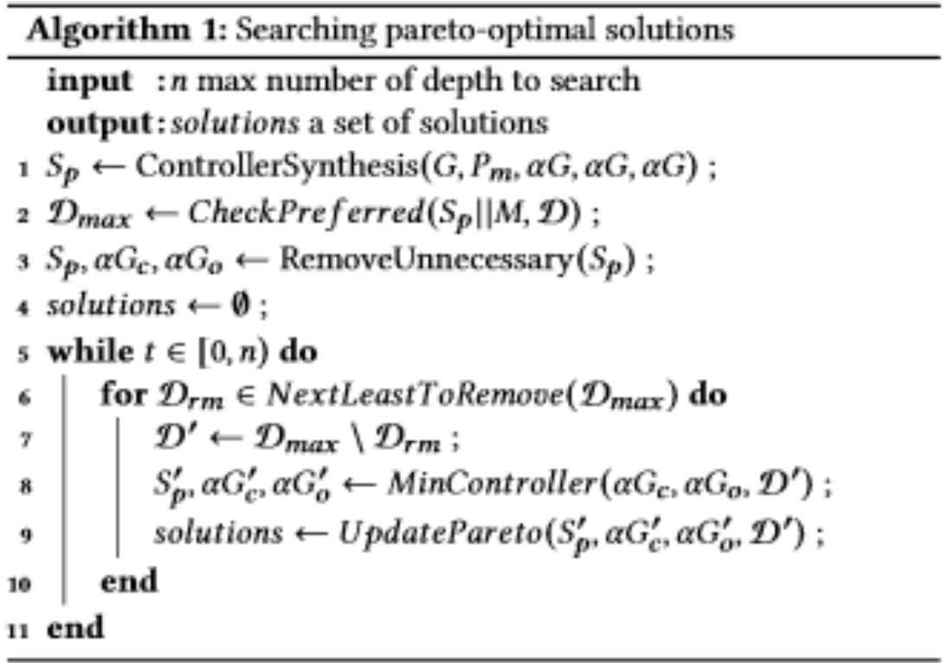
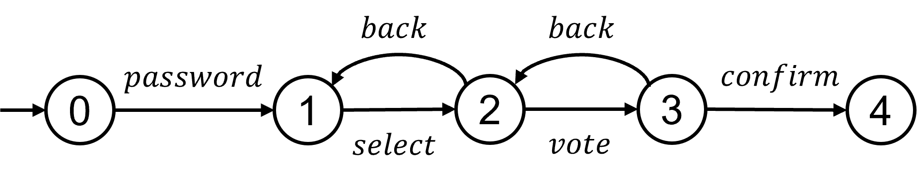
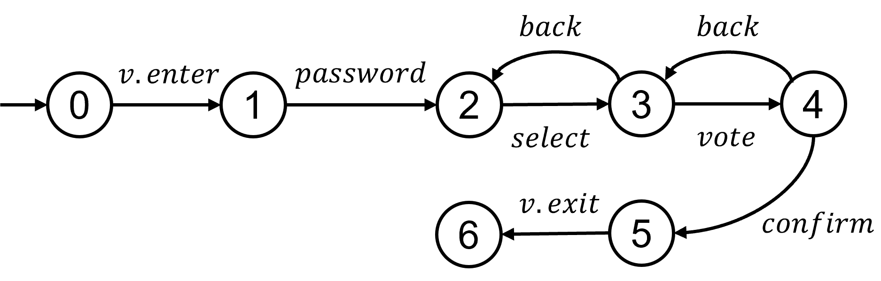
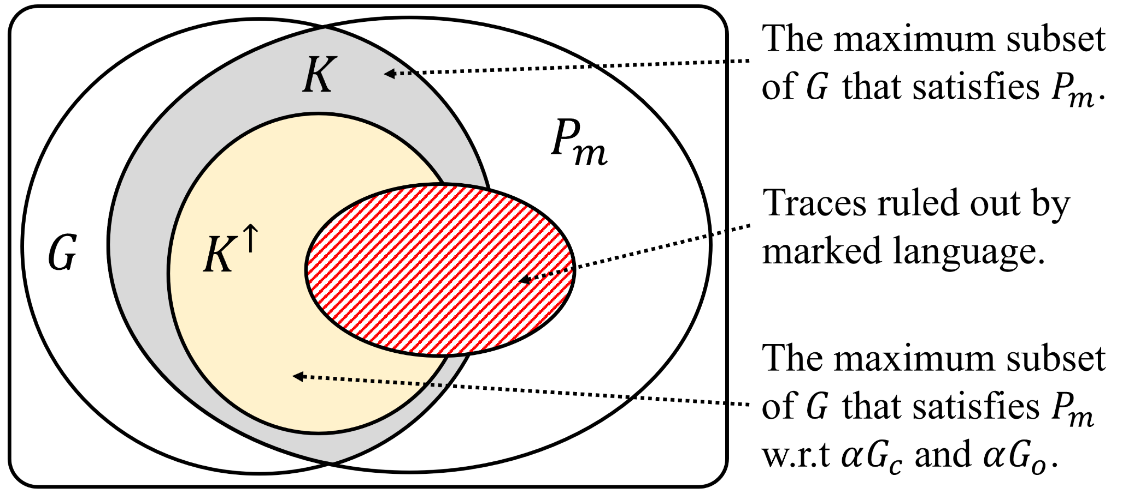
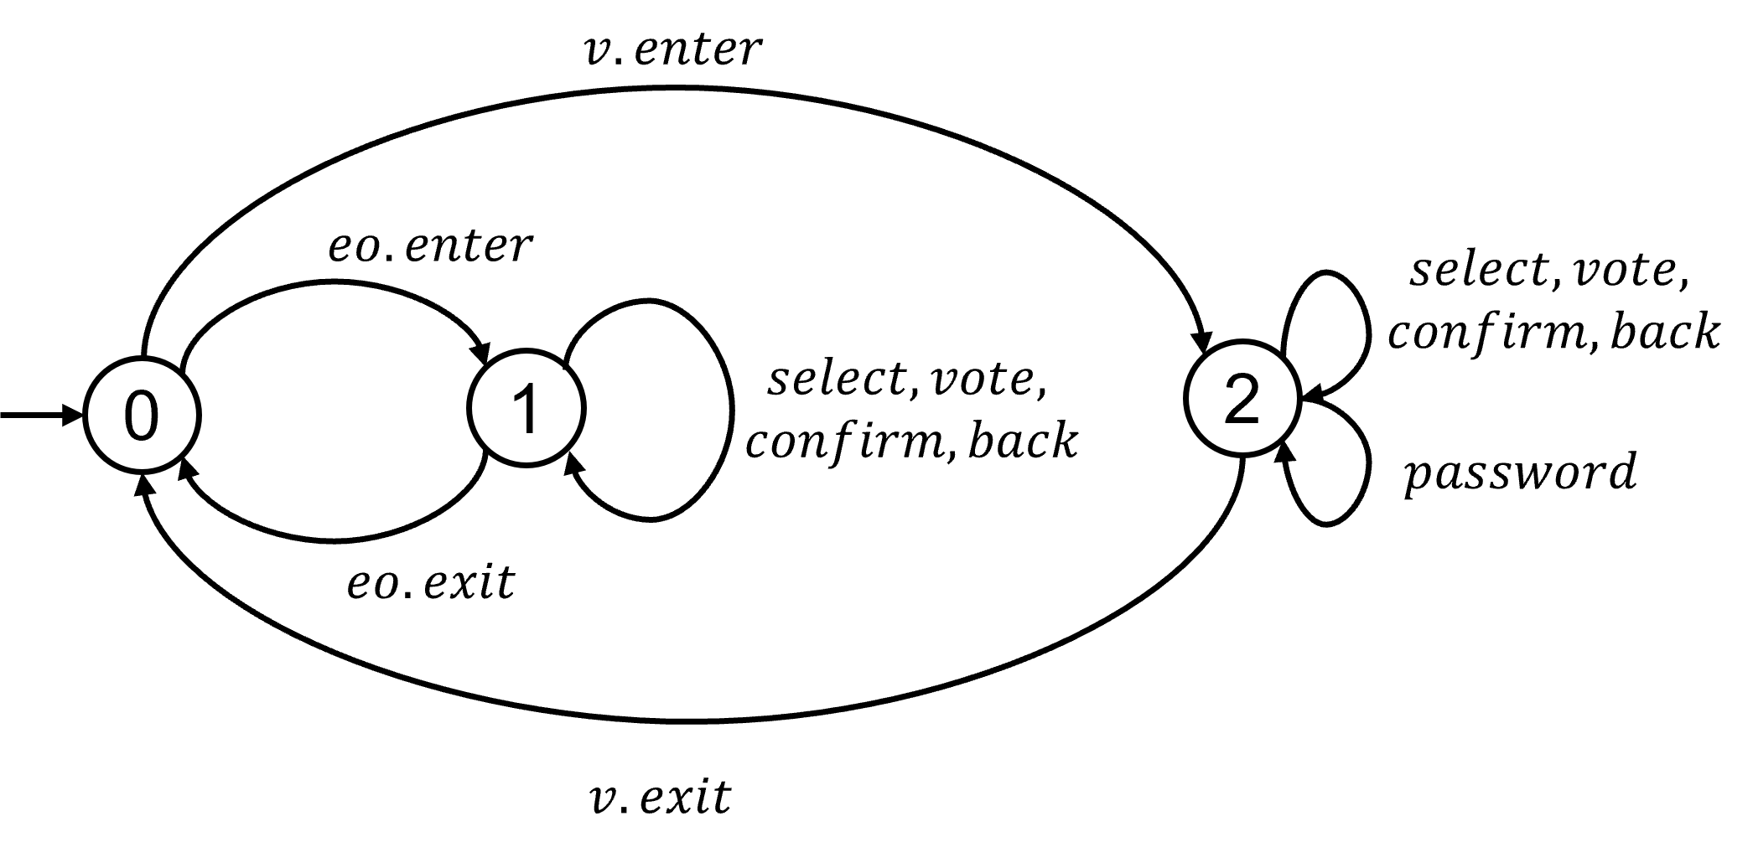
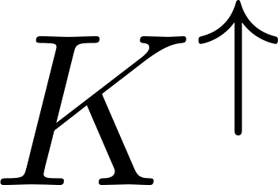
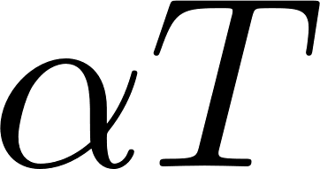
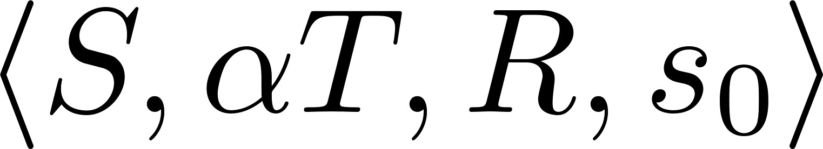
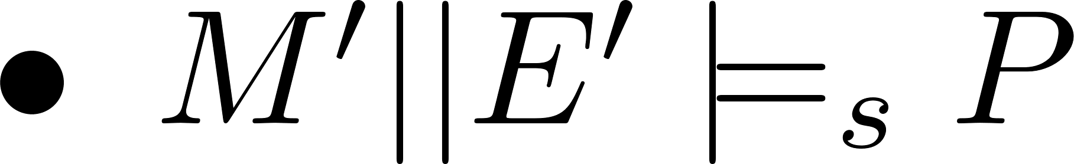
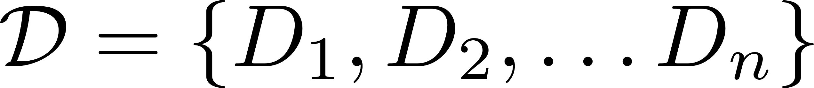
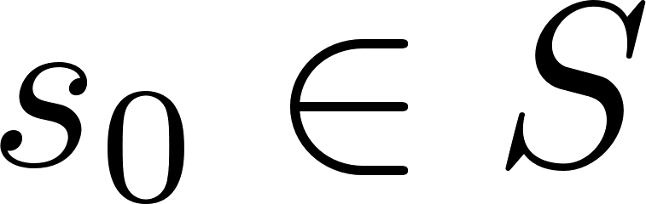
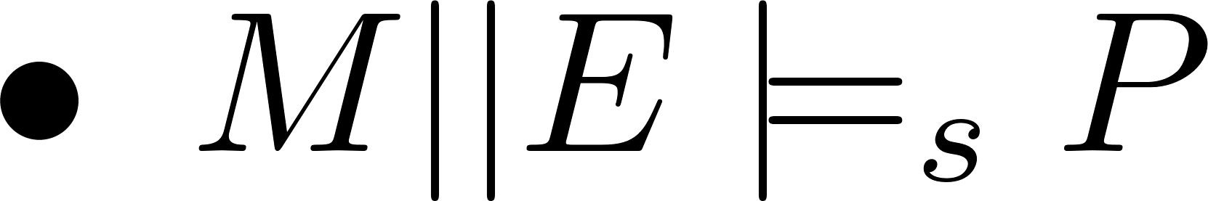
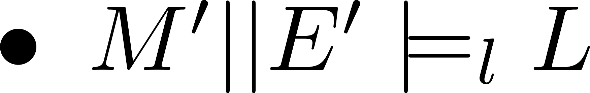
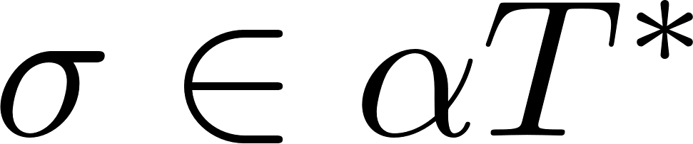

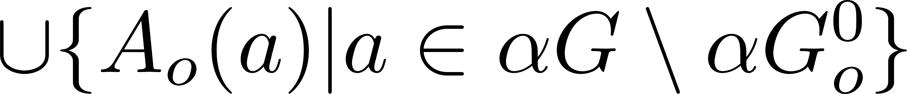
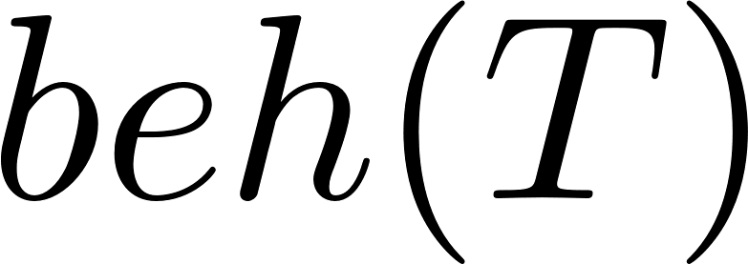
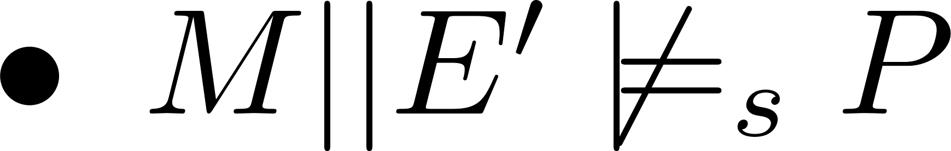
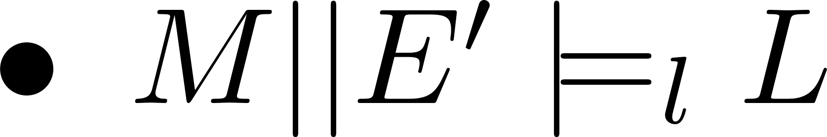
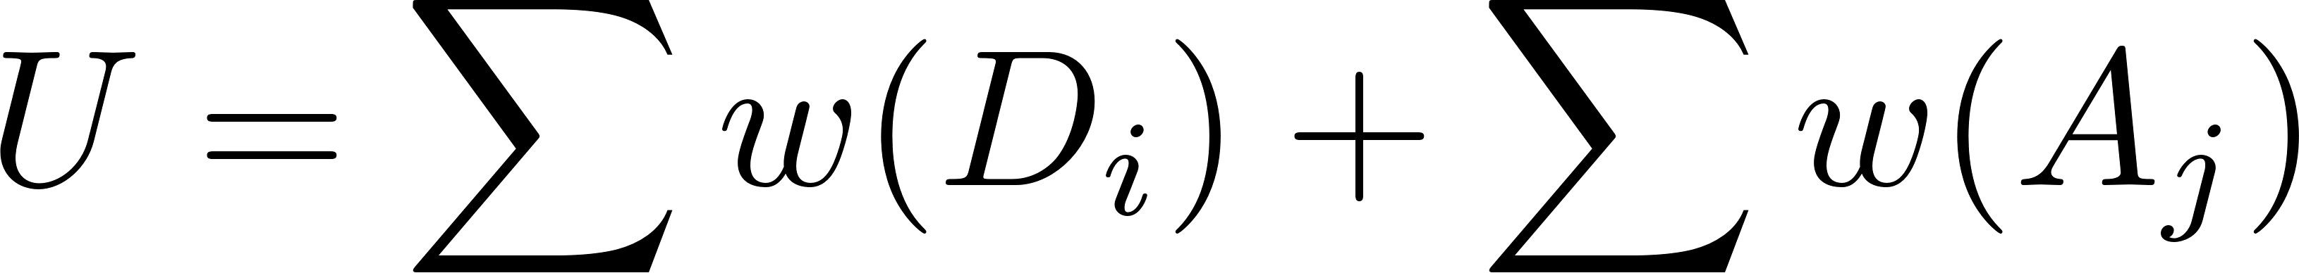
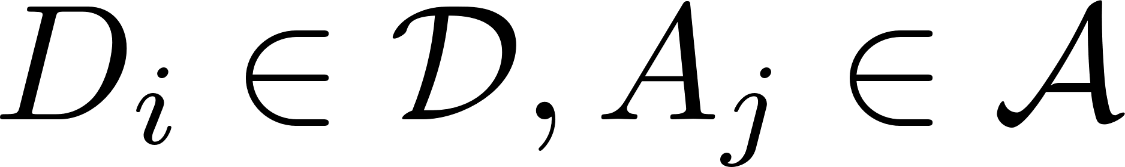
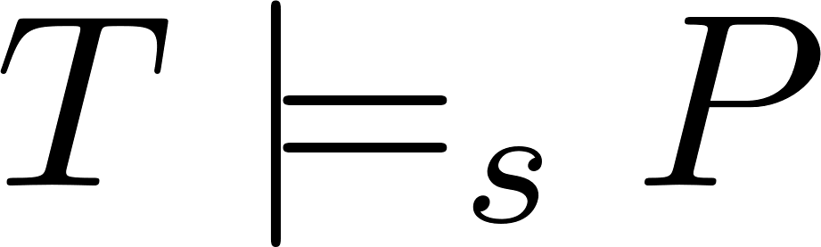

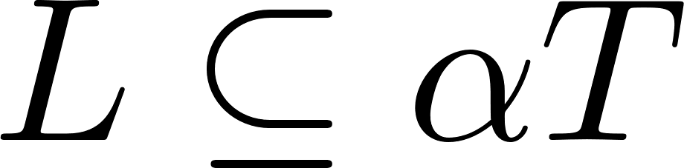
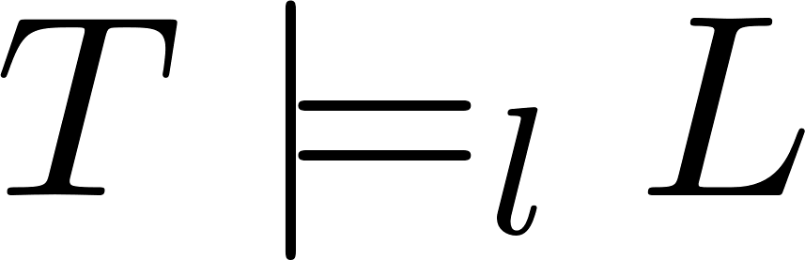
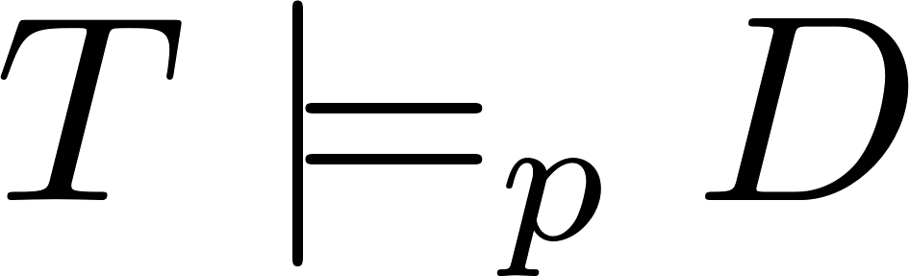
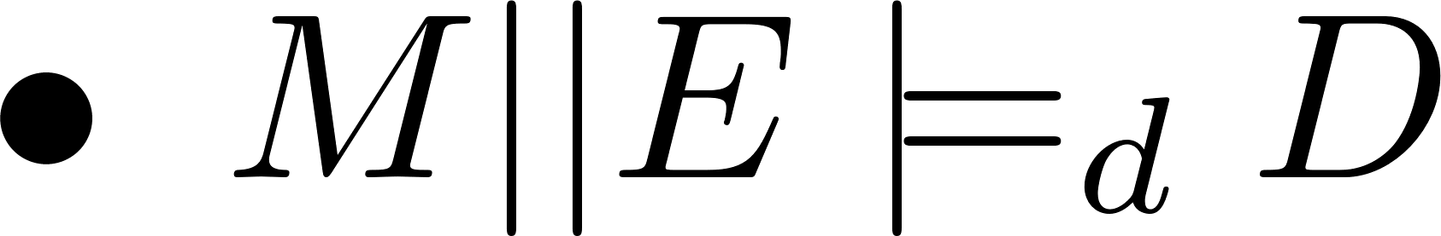
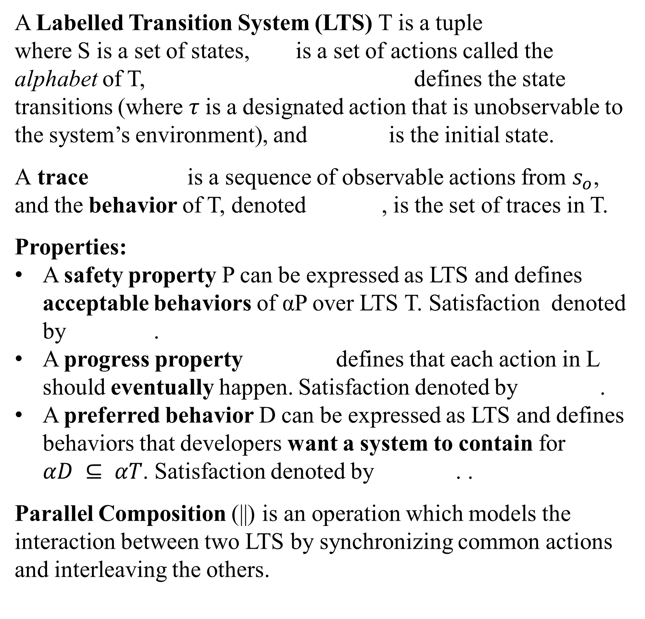
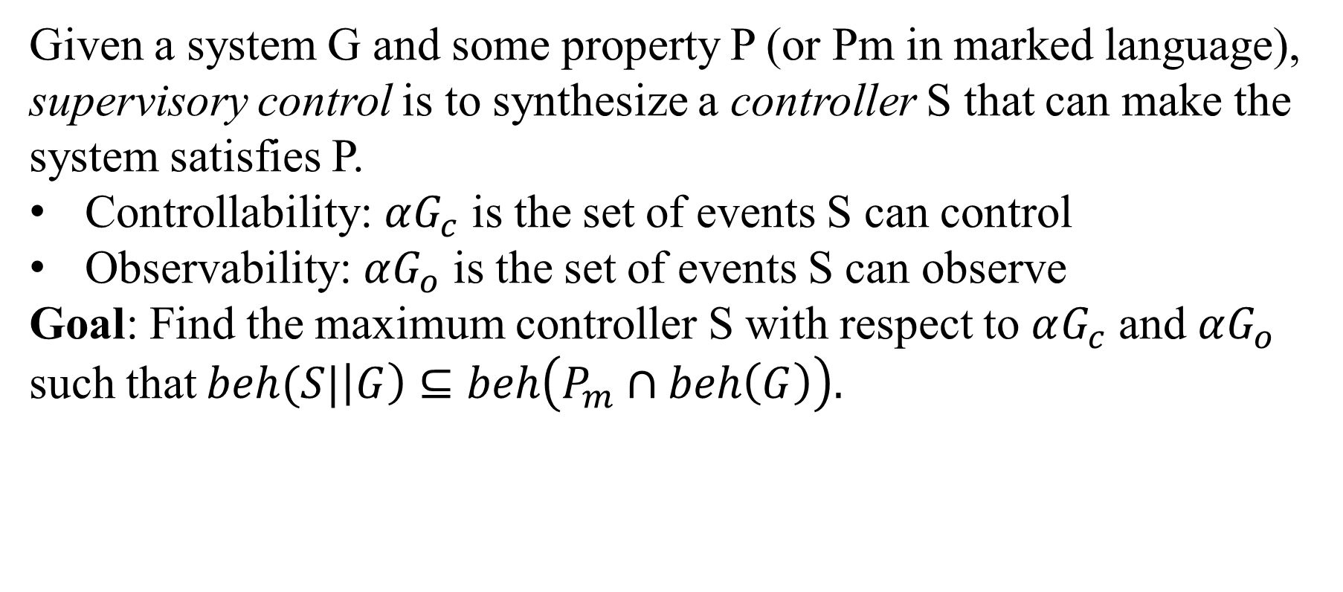
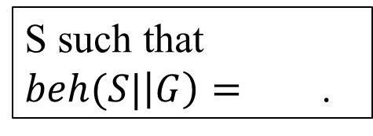
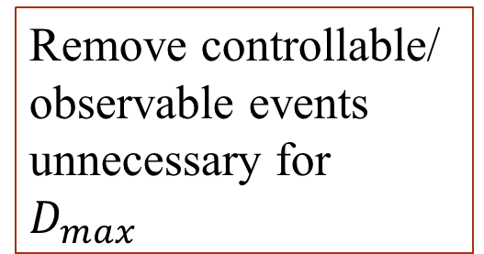
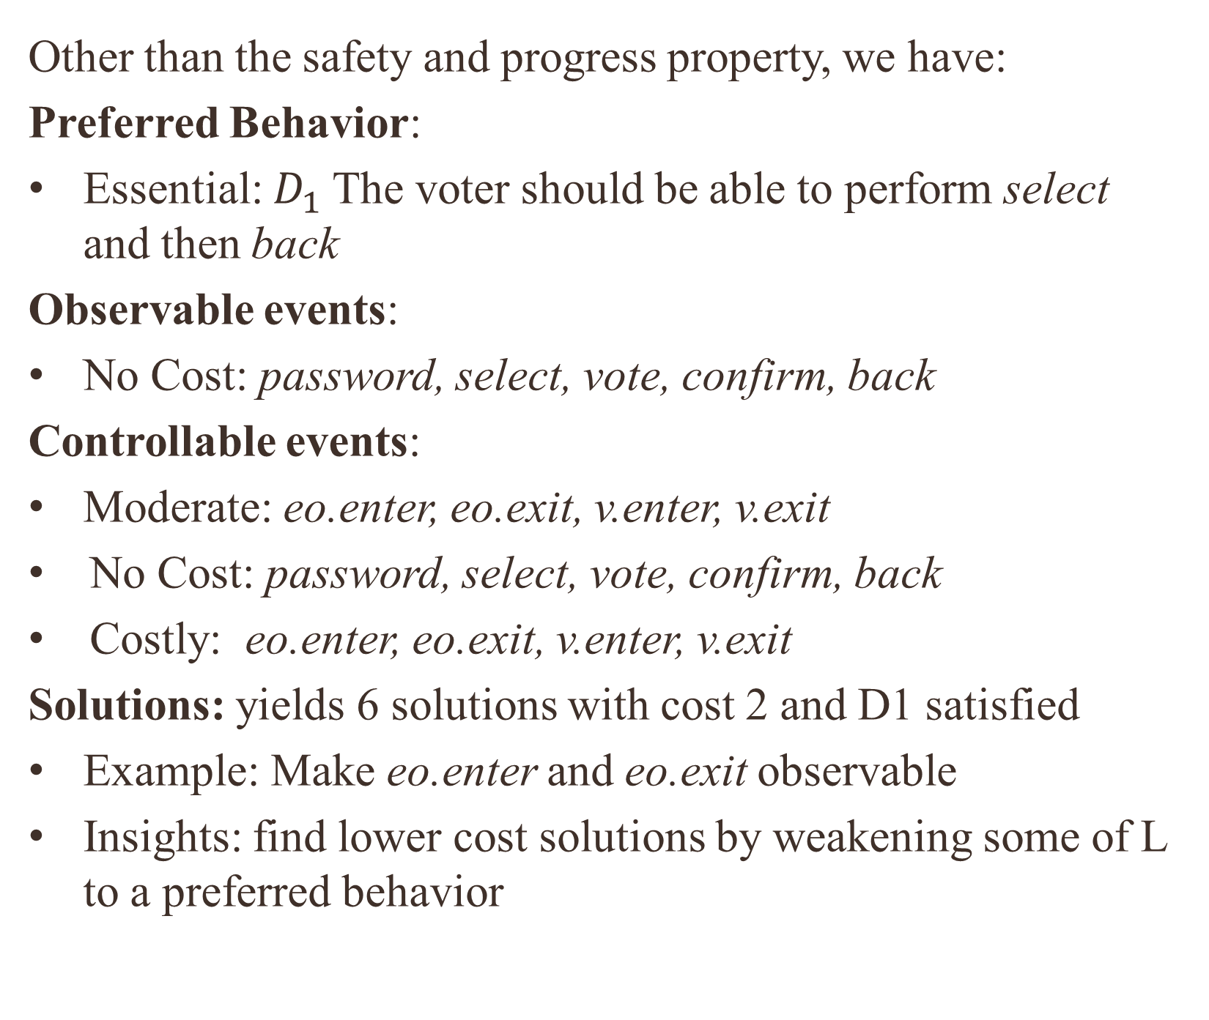
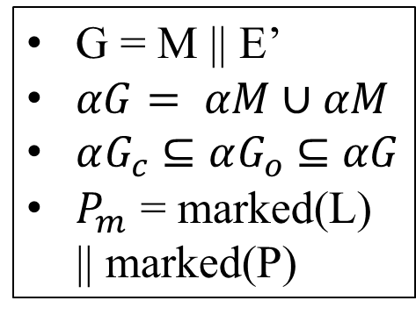
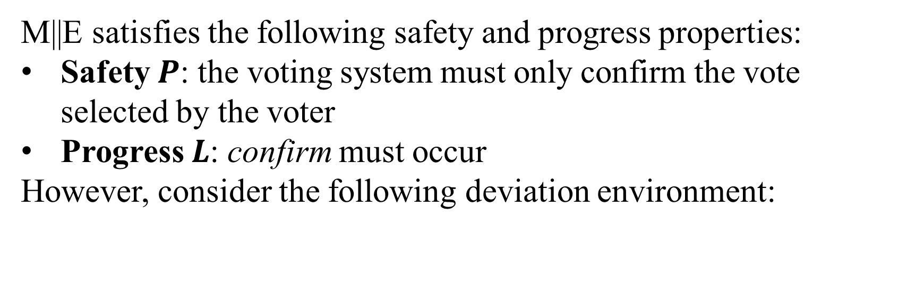
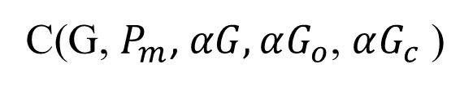
Robustification of Formal Models
Tarang Saluja, Changjian Zhang, Romulo Meira-Goes, Eunsuk Kang
Carnegie Mellon University, REUSE 2021
Introduction to Robustness
Find supervisor with assumption all events are controllable and observable
Motivating Example: Voting Booth
Supervisory Control
Algorithm
Software systems are developed with underlying assumptions:
Reliability of communication in the system.
The knowledge of the user working with the system.
General security of the system… and more!
The environment’s interaction with the system might deviate from the assumed interaction and cause unsafe behavior.
Given some property which specifies that some unsafe behavior should not occur, we define the robustness of a system as the set of deviations for which the property is satisfied.
During a 2010 election, co-conspirators were arrested for exploiting a vulnerability in the iVotronic machine to commit electoral fraud. Consider the following LTS models.
Given a system G and some property P (or Pm in marked language), supervisory control is to synthesize a controller S that can make the system satisfies P.
Controllability: $αG_{c}$ is the set of events S can control
Observability: $αG_{o}$ is the set of events S can observe
Goal: Find the maximum controller S with respect to $αG_{c}$ and $αG_{o}$ such that $beh(S|\left|G\right)⊆beh\left(P_{m}∩beh\left(G\right)\right).$
Check amount preferred behavior satisfied in such scenario
System LTS (M)
Remove controllable/ observable events unnecessary for $D_{max}$
Deviations which do cause unsafe behavior
Environment LTS (E)
Deviations which don’t cause unsafe behavior
Find minimal cost sets of controllable/ observable events needed for D’
Ideal behavior of environment
M||E satisfies the following safety and progress properties:
Safety $P$: the voting system must only confirm the vote selected by the voter
Progress $L$: confirm must occur
However, consider the following deviation environment:
Robustification of Voting Booth
Reduction from robustification to controller synthesis:
Other than the safety and progress property, we have:
Preferred Behavior:
Essential: $D_{1}$The voter should be able to perform select and then back
Observable events:
No Cost: password, select, vote, confirm, back
Controllable events:
Moderate: eo.enter, eo.exit, v.enter, v.exit
No Cost: password, select, vote, confirm, back
Costly: eo.enter, eo.exit, v.enter, v.exit
Solutions: yields 6 solutions with cost 2 and D1 satisfied
Example: Make eo.enter and eo.exit observable
Insights: find lower cost solutions by weakening some of L to a preferred behavior
Deviation
environment LTS (E’)
Contributions
Rb(M, E, E’, P, L)
Utilization of LTS to describe machine behavior and safety properties
A motivated development of the criteria used to evaluate the quality of a robustifications
A formal notion of robustification and metrics to describe characteristics of a robustification
The utilization of supervisory control to yield robustifications
A novel algorithm which computes and yields robustifications as solutions to a multi-objective optimization problem
Demonstration of approach on case study
G = M || E’
$αG= αM∪αM$
$αG_{c}$ $⊆αG_{o}$ $⊆$ $αG$
$P_{m}$ = marked(L) || marked(P)
C(G, $P_{m}$, $αG,αG_{o}$, $αG_{c}$ )
S such that $beh(S|\left|G\right)=$ .
Voter fraud trace example: <v.enter, password, select, vote, v.exit, eo.enter, back, back, select, vote, enter, confirm, eo.exit>.
Goal: Find a new M’ such that M’ || E’ satisfies both P and L. We call this process robustification.
Defining the Robustification Problem
M’ = S || M
Terminology and Formal Notions
Multi-Objective Optimization
Future Work
A Labelled Transition System (LTS) T is a tuple
where S is a set of states, is a set of actions called the alphabet of T, defines the state transitions (where $τ$is a designated action that is unobservable to the system’s environment), and is the initial state.
A trace is a sequence of observable actions from $s_{o}$, and the behavior of T, denoted , is the set of traces in T.
Properties:
A safety property P can be expressed as LTS and defines acceptable behaviors of αP over LTS T. Satisfaction denoted by .
A progress property defines that each action in L should eventually happen. Satisfaction denoted by .
A preferred behavior D can be expressed as LTS and defines behaviors that developers want a system to contain for $αD ⊆ αT$. Satisfaction denoted by . .
Parallel Composition (||) is an operation which models the interaction between two LTS by synchronizing common actions and interleaving the others.
System M
Environment E
Safety Property P
Progress Property L
Deviation Environment E’
with assumptions:
Scalability: generate benchmark problems to understand and demonstrate complexity of systems which can be robustified
Generalizability: more case studies to understand under which circumstances this tool can be used effectively
Explainability: provide the user with natural language explanations which describe the robustification
Rb(M, E, E’, P, L)
New System M’
with characteristics
’
Preferred behavior:
Making actions controllable and/or observable:
 | Behavior | Cost
P0 | N/A | No Cost
P1 | Minor | Cheap
P2 | Important | Moderate
P3 | Essential | Costly
User
References
Problems:
M’ might be substantially different from M and hence be an impractical design (in terms of “cost”) for the designers.
M’ || E might not fulfill behavior the developer prefers to see.
Solution: Frame robustification as an optimization problem:
Utility Function: for
Weights Assignment:
For action a, preferred behavior d in same priority: w(d) = - w(a)
Lexicographic weighting maintains precedence of higher priority behaviors and actions.
Pareto Front: These are solutions such that there is no other solution with less cost and more utility.
Optimization Objective: Limited (by user) search for robustifications on the Pareto Front with precedence given to preferred behavior
“Ch. 2: Languages and Automata, Ch. 3: Supervisory Control.” Introduction to Discrete Event Systems, by Christos G. Cassandras and Lafortune Stéphane, Kluwer Academic Publ, 2001.
Zhang, Changjian, et al. “A Behavioral Notion of Robustness for Software Systems.” Proceedings of the 28th ACM Joint Meeting on European Software Engineering Conference and Symposium on the Foundations of Software Engineering, 2020, doi:10.1145/3368089.3409753.
Rb(M, E, E’, P, L)
Preferred behavior D
Cost: LTS x LTS → Z
With assumptions
Opt(Rb, D, Cost)
New System M’ with characteristics
is solution to Rb
maximizes beh(D)
minimizes cost(M, M’)
Acknowledgements
This research was made possible thanks to CMU’s REUSE program and NSF Grant CCF #1918140.
Notes:
Given some LTS G, a partial supervisor ${ S}_{p}$ can be expressed as an LTS${ S}_{p}$ so that $S_{p}$ || G conditionally disables certain events in αG. Events in αG which can be enabled or disabled are controllable $(αG_{c})$and events which can be seen by the system are observable $(αG_{o})$. Given some plant G which needs control and $P_{m}$, the LTS property which defines all behavior that satisfies L and P by using an idea called marked language from supervisory control, our goal is to find ${ S}_{p}$ so that beh($S_{p}$ || G ) = ${beh(P}_{m})$ $∩beh\left(G\right)$. However, this is not always possible.
Given prioritization assigned by user, define . Based on these weights we define total utility as for . Our weights are assigned such that:
For action a, preferred behavior d in same priority: w(d) = - w(a)
Lexicographic weighting maintains precedence of higher priority behaviors and actions.
We return a subset of solutions on the Pareto Front with respect to variables cost and utilities. These are solutions such that there is no other solution with less cost and more utility.
This yields 6 solutions which have cost: -2 and satisfy the preferred behavior. Weakening preferred behavior does not yield anymore Pareto Front solutions. For example, one solution makes eo.enter and eo.exit observable. It disables confirm if select happens after eo.enter and before eo.exit but re-enables it if select occurs when the voter is inside. If the user finds -2 to be too costly, then they can demote L to a preferred behavior $D_{2}$and run again to find 3 Pareto Front solutions with all behavior fulfilled and cost -1 and one solution with just $D_{1}$fulfilled and cost 0.

