Slide 1

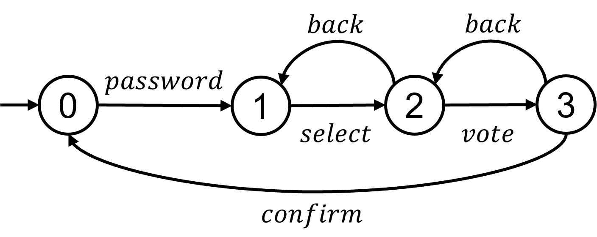
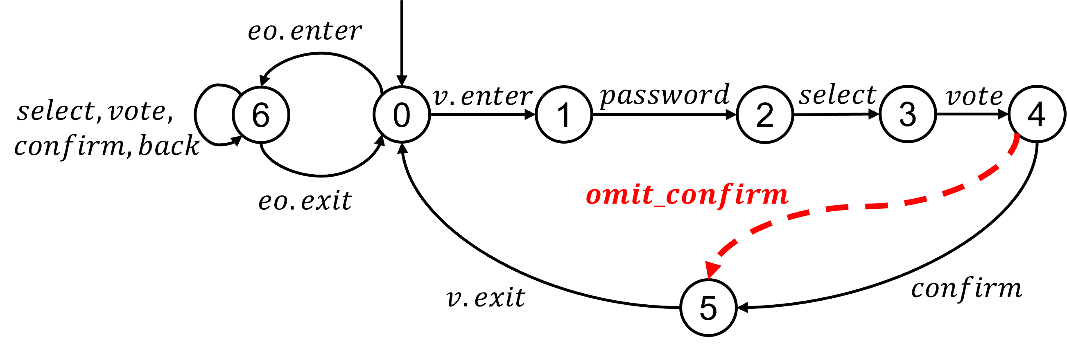
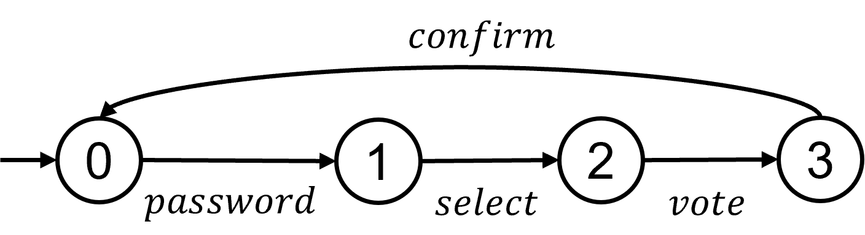
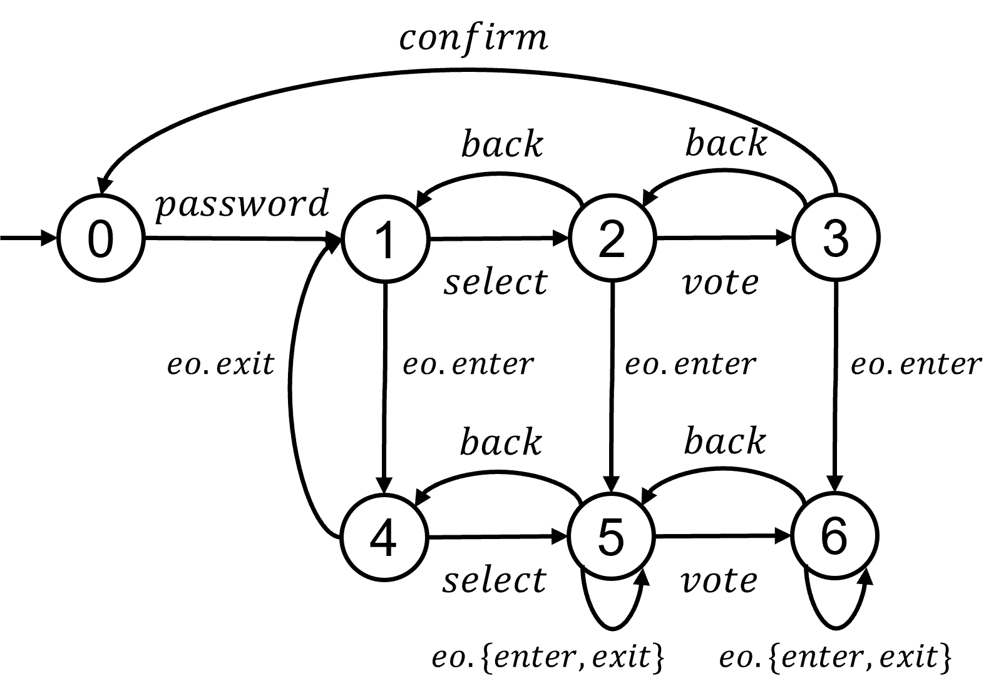


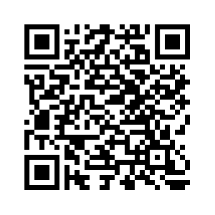


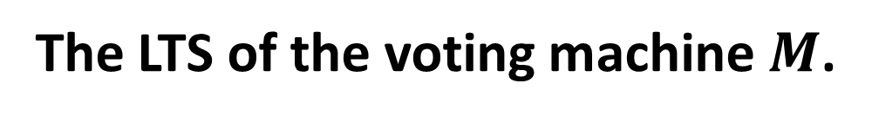
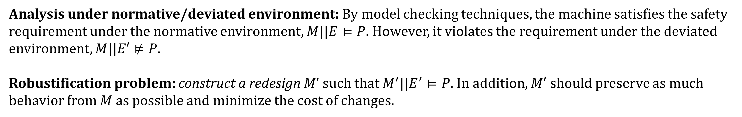
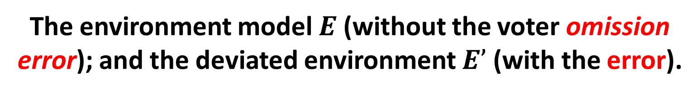
Robustification of Behavioral Designs against Environmental Deviations
Changjian Zhang¹, Tarang Saluja², Rômulo Meira-Góes³, Matthew Bolton⁴, David Garlan¹, Eunsuk Kang¹
^{1.} Carnegie Mellon University ^{2.} Swarthmore College ^{3.} The Pennsylvania State University ^{4.} University of Virginia
Introduction
In our prior work, we present a behavioral notion of software robustness. A system that is robust would ensure that a critical requirement is satisfied even under environmental deviations (i.e., traces of events). This paper addresses the opposite case that how to redesign a system when it is not robust.
We propose a technique called behavioral robustification that can systematically improve the robustness. The robustification problem is formulated as a multi-objective optimization problem, where the goal is to synthesize a redesign that satisfies a desired property, while (1) maximizing the amount of existing functionality and (2) minimizing the cost of changes.
Contributions:
A formal definition of robustification and its formulation as a multi-objective optimization problem.
A novel approach to robustification problems leveraging supervisory control theory.
A set of heuristics for efficiently generating optimal redesign.
Evaluating under three case studies and comparing with existing methods.
Approach Overview
An Illustration Example: The iVotronic Voting Machine
The LTS of the voting machine $M$.
The environment model $E$ (without the voter omission error); and the deviated environment $E’$ (with the error).
Safety Requirement
For each voter, the voting system must record the vote that was selected by that voter.
Analysis under normative/deviated environment: By model checking techniques, the machine satisfies the safety requirement under the normative environment, $M||E⊨P$. However, it violates the requirement under the deviated environment, $M||E′⊭P$.
Robustification problem: construct a redesign $M’$ such that $M^{′}||E^{′}⊨P$. In addition, $M′$should preserve as much behavior from $M$ as possible and minimize the cost of changes.
Trade-offs between preserving the old design and minimizing the cost of changes.
Approach Overview
(b) Redesign by observing additional events eo.{enter, exit}: it allows the voter to change their vote, preserving more functionalities. However, it might be more costly to monitor the official entering or leaving, potentially requiring additional ID scanners for identification.
(a) Redesign by disabling all back transitions: It might be cheaper to remove the back buttons However, no voter can ever change their vote.
Hard for developers to manually compare design trade-offs.
We leverage supervisory control synthesis and present an automated approach to generate valid redesigns and search for pareto-optimal solutions.

