Slide 1
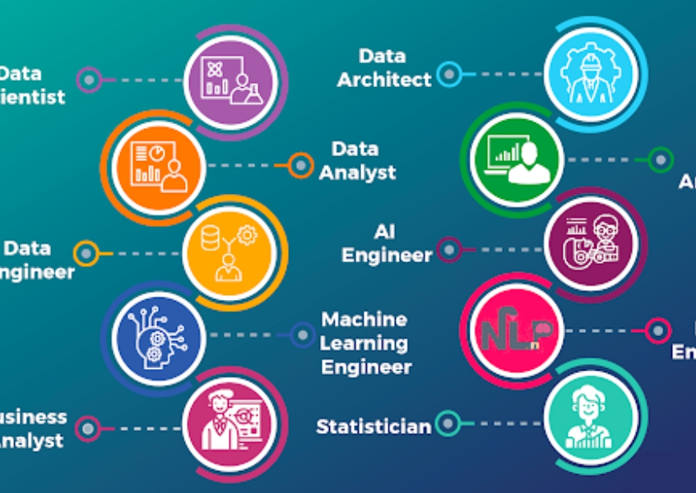
DATA608 Assignment 4
Steven Gonzalez

Slide 2
Prompt
I have introduced the term “Data Practitioner” as a generic job descriptor because we have so many different job role titles for individuals whose work activities overlap including Data Scientist, Data Engineer, Data Analyst, Business Analyst, Data Architect, etc.
For this story we will answer the question, “How much do we get paid?” Your analysis and data visualizations must address the variation in average salary based on role descriptor and state.

Slide 3
Prelude
The field of data practitioners is one that has grown in popularity over the last couple of decades. That being the case, it has become a career with many paths. In this story, we investigate several of these paths and their relative prospects to each other and across the US.
To do this, we:
Map salary expectations for data practitioners as a whole and visually assess prospects throughout the states
Take a deeper look into salary ranges for each state
Compare salary ranges amongst the different data professions
Compare salary ranges throughout the different industries

Slide 4

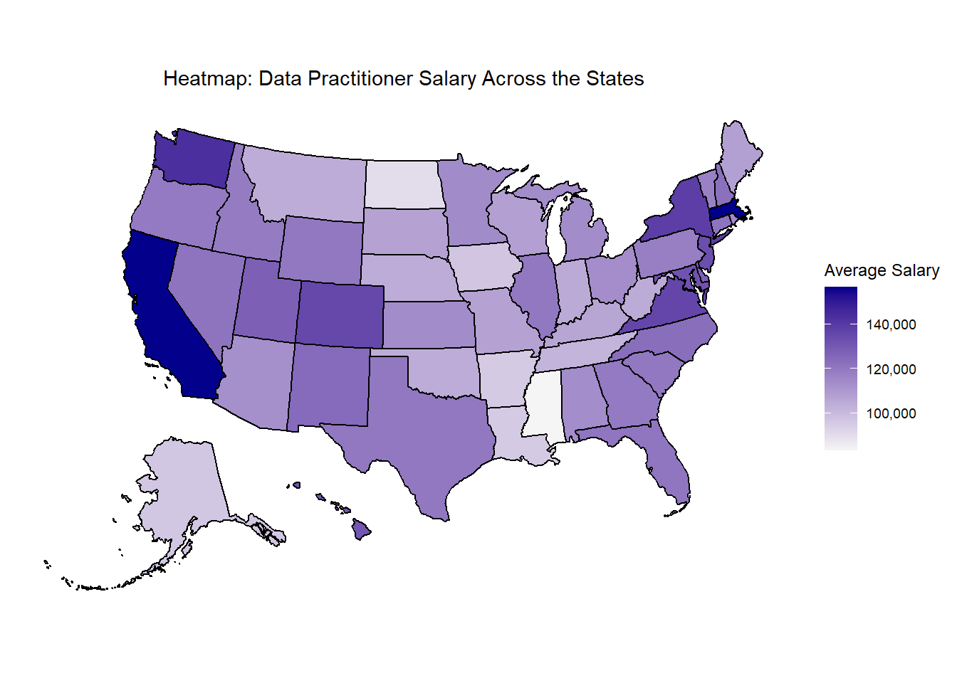

Higher paying salaries throughout the states seem to cluster around the coasts

Slide 5

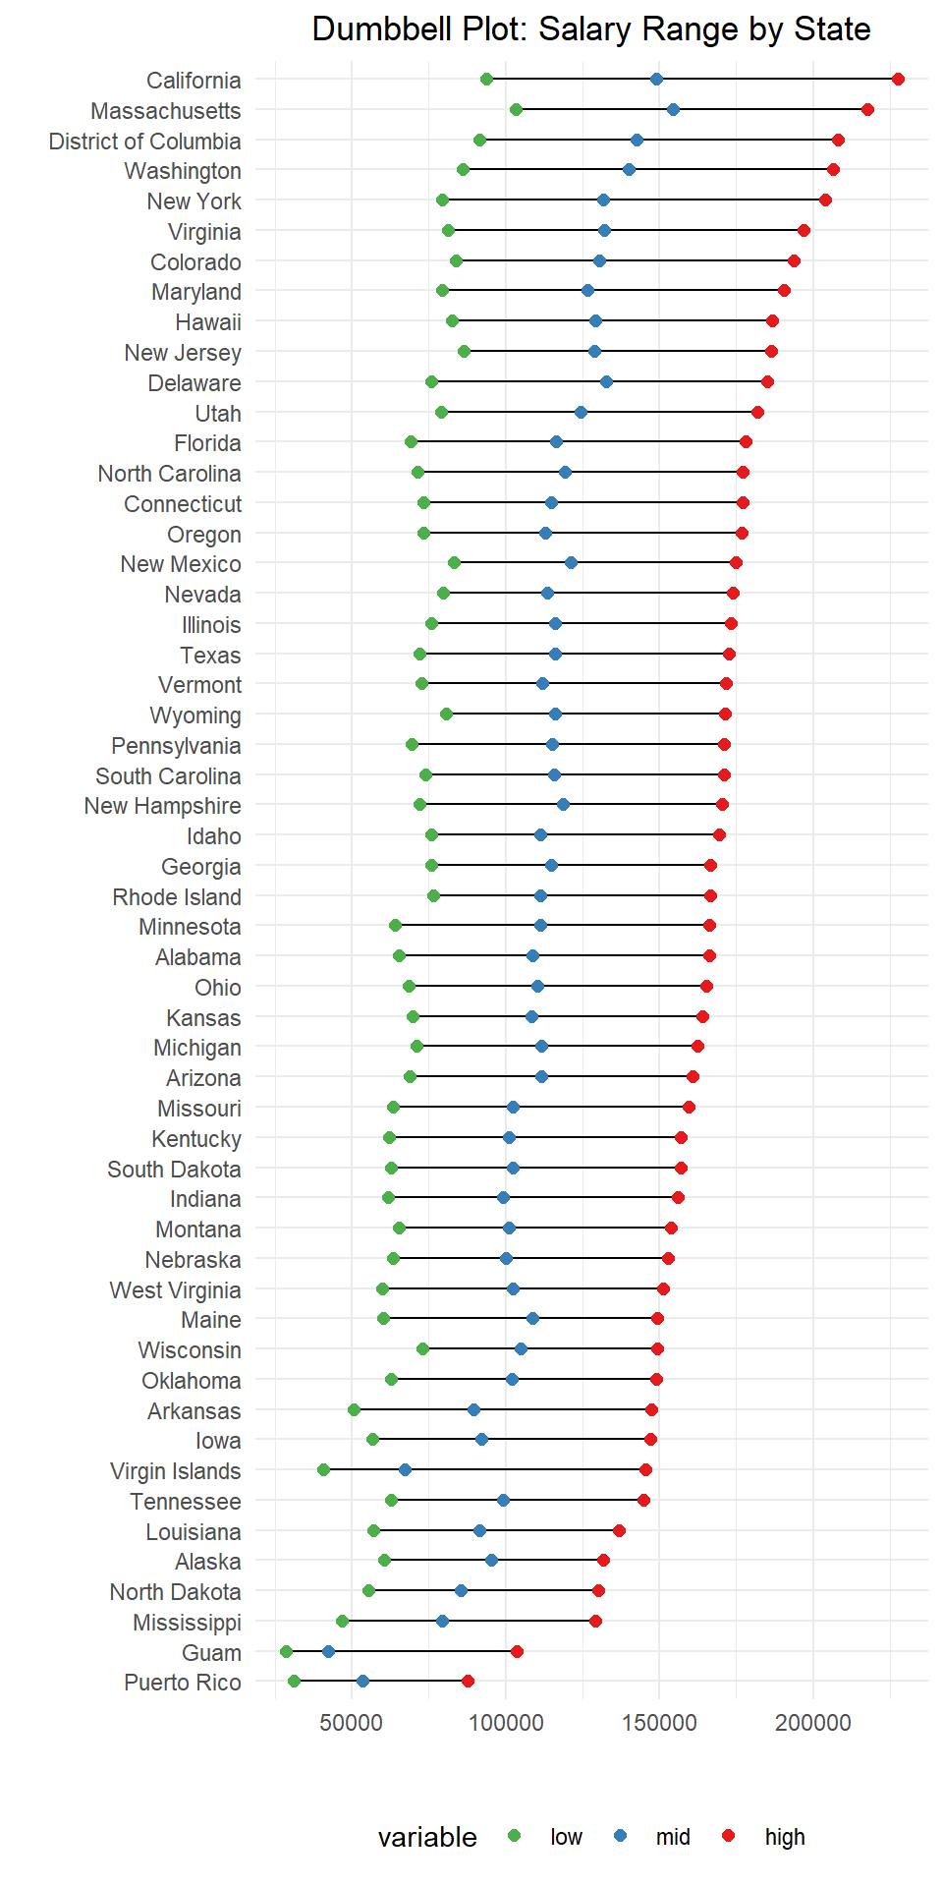
A deeper look proves this to be true with the top five states being close to the coasts
Salary

Slide 6
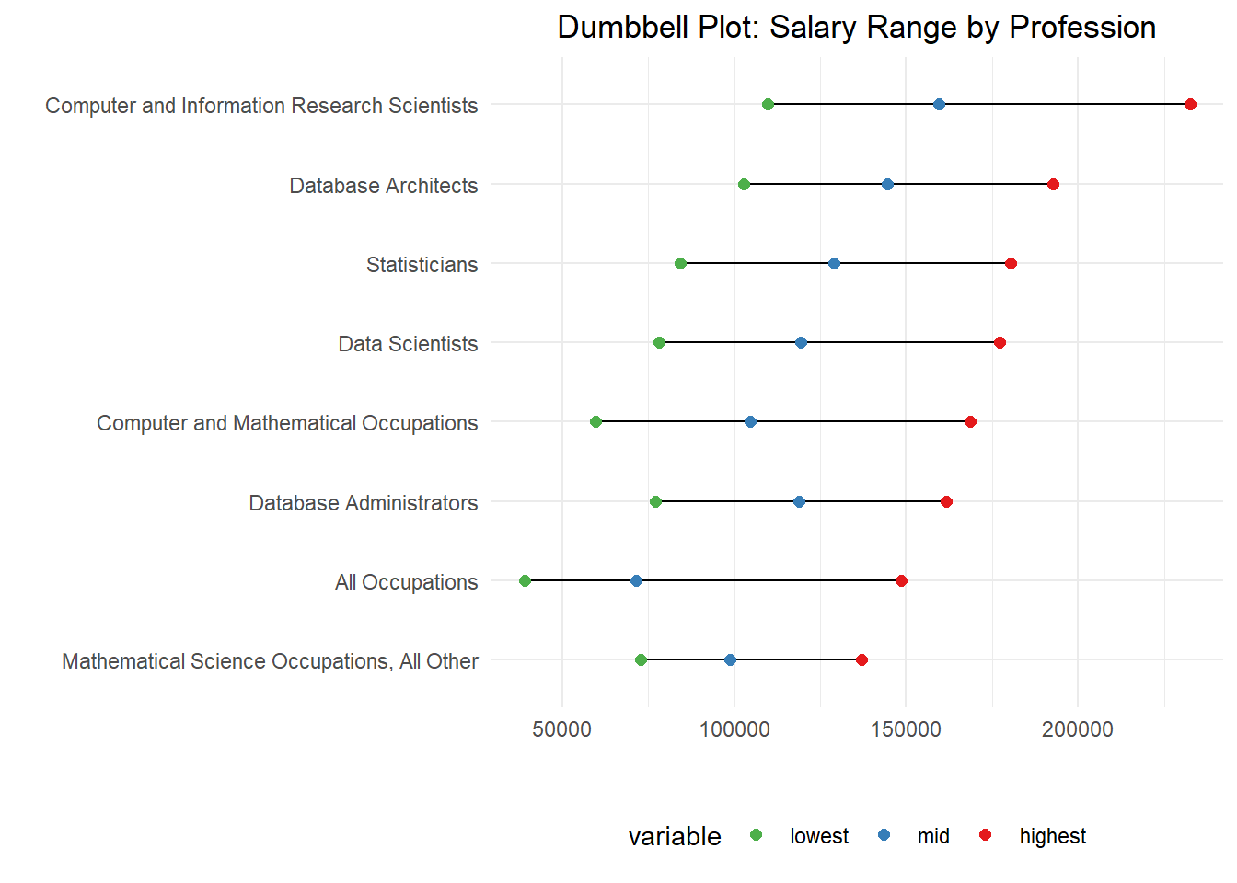
Amongst the different career paths, it seems the more mathematical and scientific the higher the salary
Salary

Slide 7
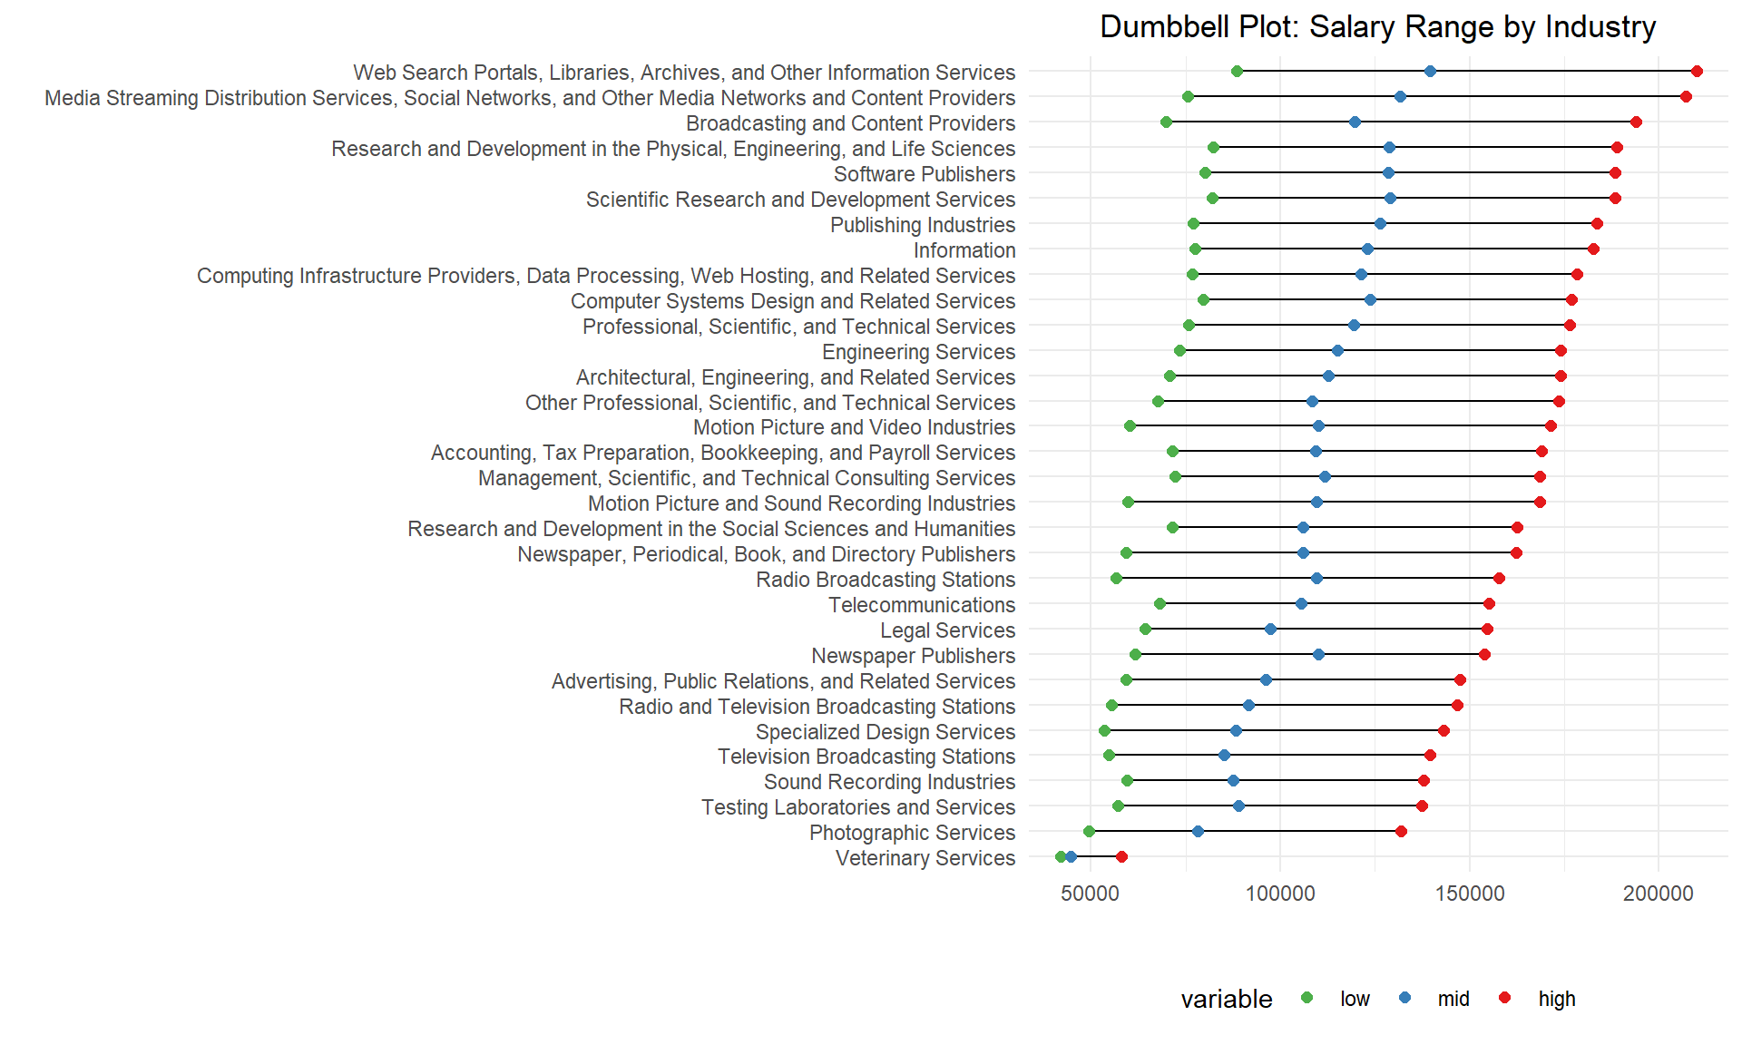
Amongst the different industries, paths heavy in digital info take the cake
Salary

Slide 8
conclusion
When presented with a heatmap of the United States, it was clear to see some clustering of high salaries in the coastal regions
Further investigation through the use of dumbbell plot, showed this to be the case with the top five states being California, Massachusetts, D.C., Washington and New York
Comparing the career paths amongst themselves showed us how jobs oriented more towards mathematics, statistics, and science had higher salary outcomes than the rest
Finally, when looking into the industries, it seems work heavy in providing and managing digital info have the highest salaries in the data field
All in all, the field of data practitioners is a very lucrative field, one must just take into consideration where they work and what industry they are in

Slide 9
sources
Salary Data:
https://www.bls.gov/oes/oes_research_2025.htm

