Slide 1
DATA608 Assignment 2
Steven Gonzalez

Slide 2
Prompt
The Federal Reserve's mandate from Congress is to control inflation and to maintain low unemployment. These seem to be contradictory objectives.
For this story you will need to source the following data for the last 25 years;
The Consumer Price Index (CPI) (Bureau of Labor Statistics)
The FED Funds Rate (FRED) (Federal Reserve Board)
Unemployment Rate (Bureau of Labor Statistics)
Your Data Visualizations should be designed to answer the question "Has the FED been able to fulfill the mandate given to it by Congress?"

Slide 3
Prelude
The Federal Reserve is the central banking system responsible for managing monetary policy within the U.S. Its main objectives include overseeing and influencing inflation and unemployment which directly impact the American consumer. One of the ways it attempts to do this is through the adjustment of its fed funds rate which affects all other borrowing and savings rates throughout the country. This in turn is meant to either encourage or deter consumer spending in hopes of driving inflation and unemployment in a more favorable direction. Therefore, changes in the fed rate are always in response to economic conditions and its effects are seen afterwards.

Slide 4
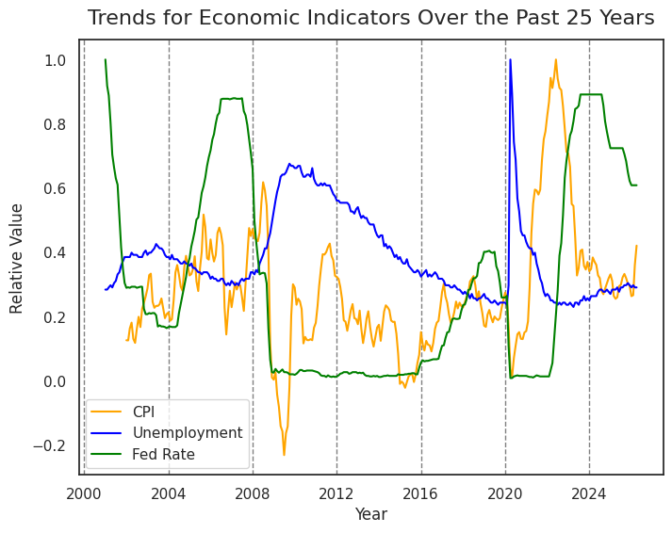
To the left is a line plot displaying the fluctuations in CPI, unemployment, and the fed rate over the past 25 years. As can be seen, there were several peaks and troughs for each of these measures with the fed rate responding to a mixture of the other two. We will zoom in on portions of this chart to get a better understanding of how the Federal Reserve handled the last 25 years of monetary policy.

Slide 5
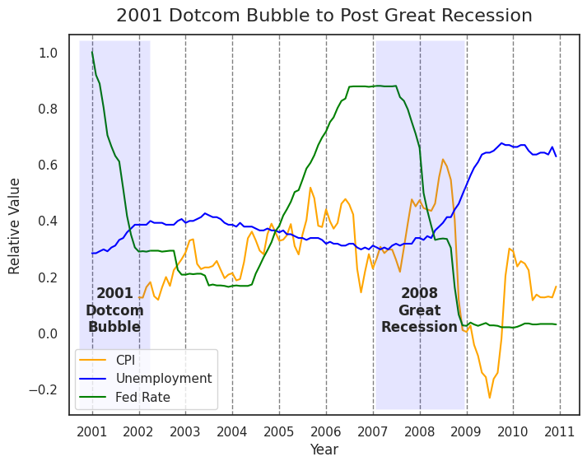
2000 – 2010
2001 dotcom bubble
2008 great recession
2001 dotcom bubble
Fed lowered rates to deter unemployment
Later raised rates to fight inflation
2008 great recession
Fed lowered rates to fight unemployment and stimulate economy
Rates remained low to assist in recovery

Slide 6
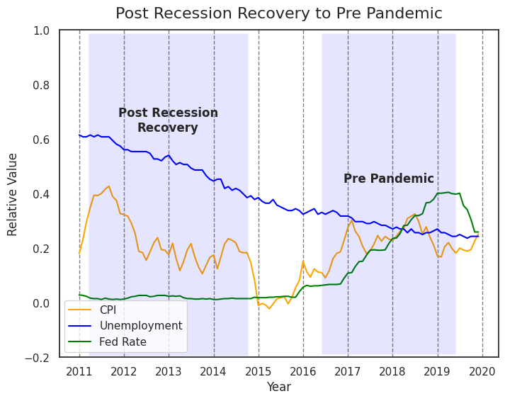
2010-2020
Post recession recovery
Pre pandemic policy
Post recession recovery
Rates remained low up until 2016 to assist in economic recovery
Pre pandemic policy
Fed raised rates to handle inflation now that unemployment had become acceptable
Rates continued to increase up until late 2019

Slide 7
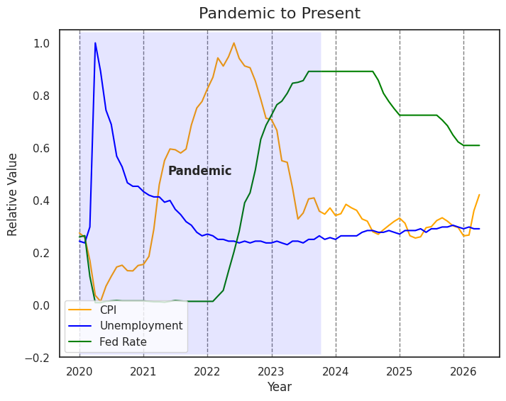
2020 – 2026
Pandemic
Post pandemic to present
Pandemic
Unemployment shoots up in 2020 and Fed lowers rates to stimulate economy
Unemployment drops and inflation kicks up in 2021 so Fed raises rates sharply in 2022
Post pandemic to present
Inflation lowered sharply in 2022 then steadily since 2023 and Feds lower rates slowly starting in 2024

Slide 8
Conclusion
The years 2000 to 2026 have been filled with several unprecedented economic events; each one affecting unemployment and inflation in its own way. In every one of them the Federal Reserve has responded in kind attempting to mitigate these two measures by adjusting the fed funds rate. As seen in the previous slides, through the use of these adjustments, the Fed has been able to lower both unemployment and inflation when these measures would get out of line. Given this, although not always a pleasant experience at the time for the average person, we can say that the Federal Reserve has been able to fulfill the mandate given to it by Congress.

