Slide 1
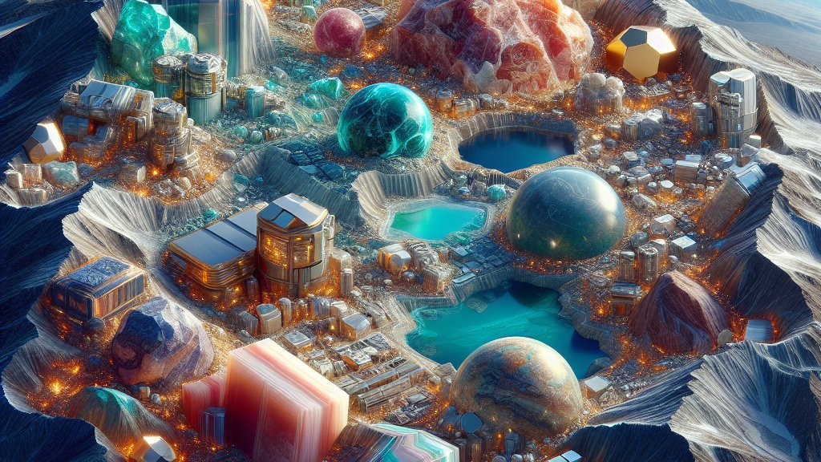
DATA608 Assignment 7
Steven Gonzalez

Slide 2
Prompt
The US Geological Survey publishes a list of Strategic Minerals (https://www.usgs.gov/news/national-news-release/us-geological-survey-releases-2022-list-critical-minerals ). Having a secure supply of these minerals is essential to our security and economic prosperity. However, many of these minerals are sourced from outside of the US. This assignment is to develop a reference catalog of the source or sources of each of these minerals and a judgement on the reliability of each source under stressed circumstance (e.g. war, economic crisis, etc.).

Slide 3
Prelude
Minerals and metal ores have always been essential for humanity. For thousands of years, we’ve collected them and molded them to our liking; whether it be for tools or for fashion. Recently, the subject of critical minerals has gained popularity mostly given to the importance of minerals and ores in modern technology. In this story, we go over the access the United States has to multiple minerals being mined across the world, paying attention to how our relationship with other nations can influence our acquisition of them or lack thereof.
We look into:
How many countries are mining each mineral
How reliable our access to these minerals are given our relationship with various countries
Finally, a snapshot at the status for each mineral given the circumstances

Slide 4
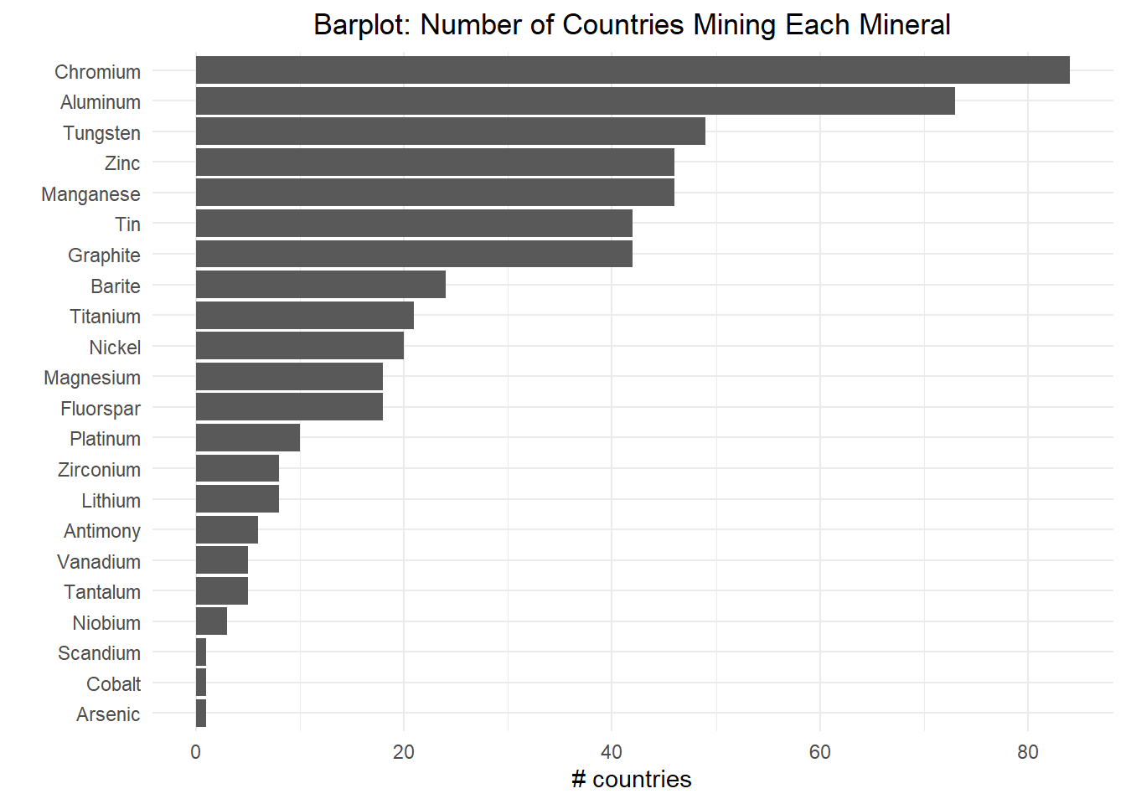
Chromium and Aluminum seem to be the minerals most countries mine after, followed by Tungsten, Zinc, and Manganese

Slide 5
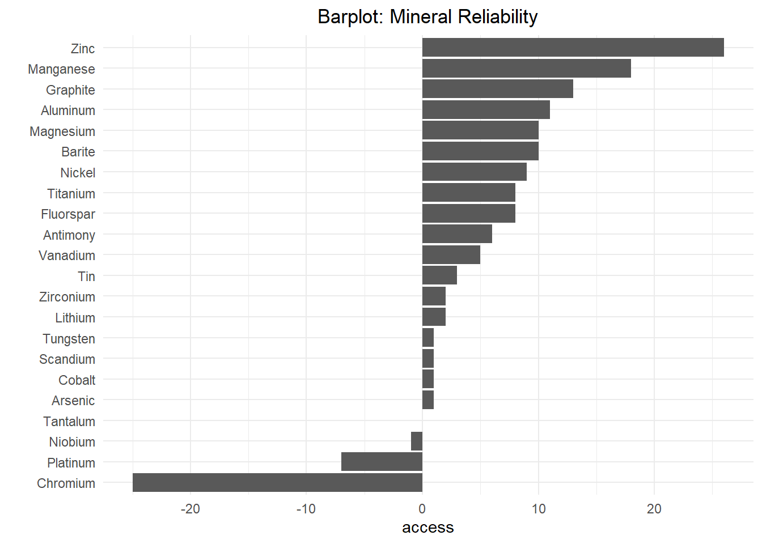
Interestingly enough, given our relationship with other countries, the least reliable mineral is also Chromium, followed by Platinum,and Niobium

Slide 6
Let’s see how all the other minerals sum up

Slide 7
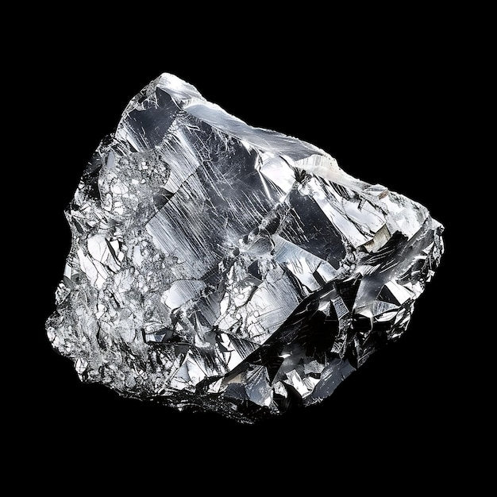
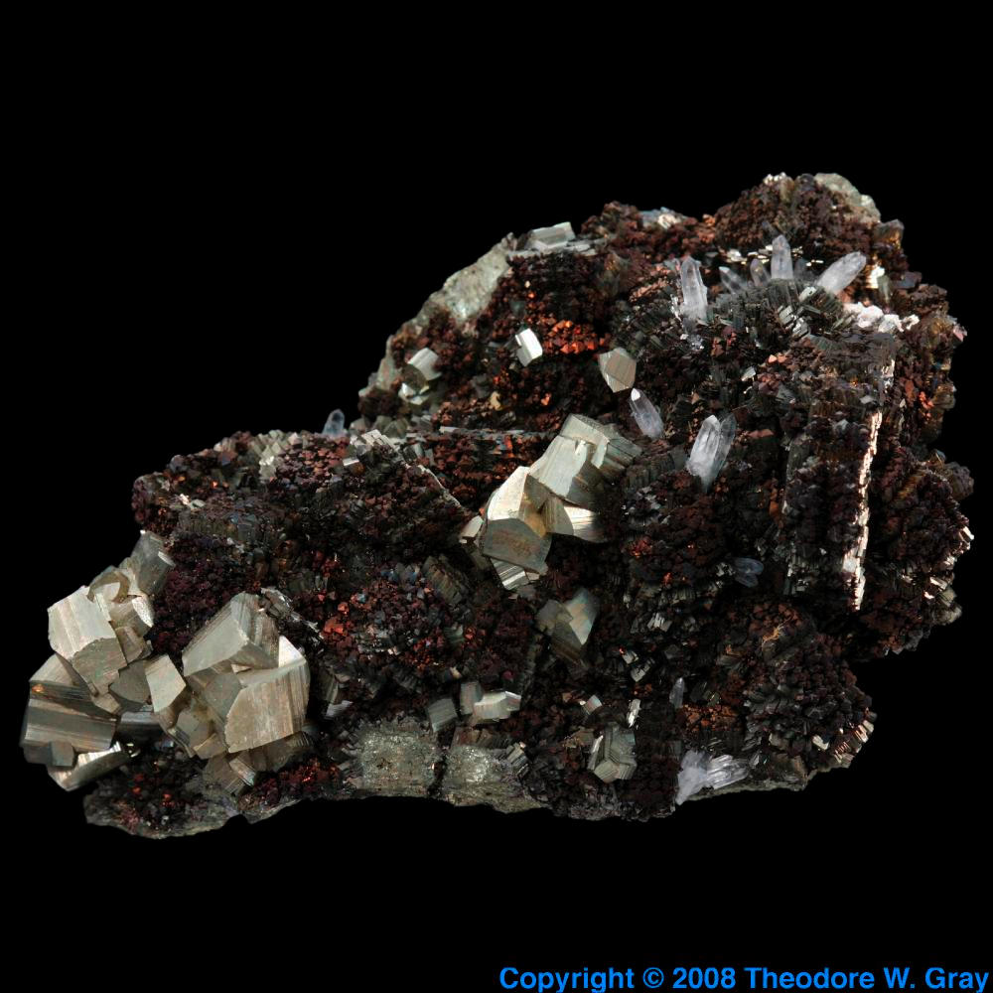
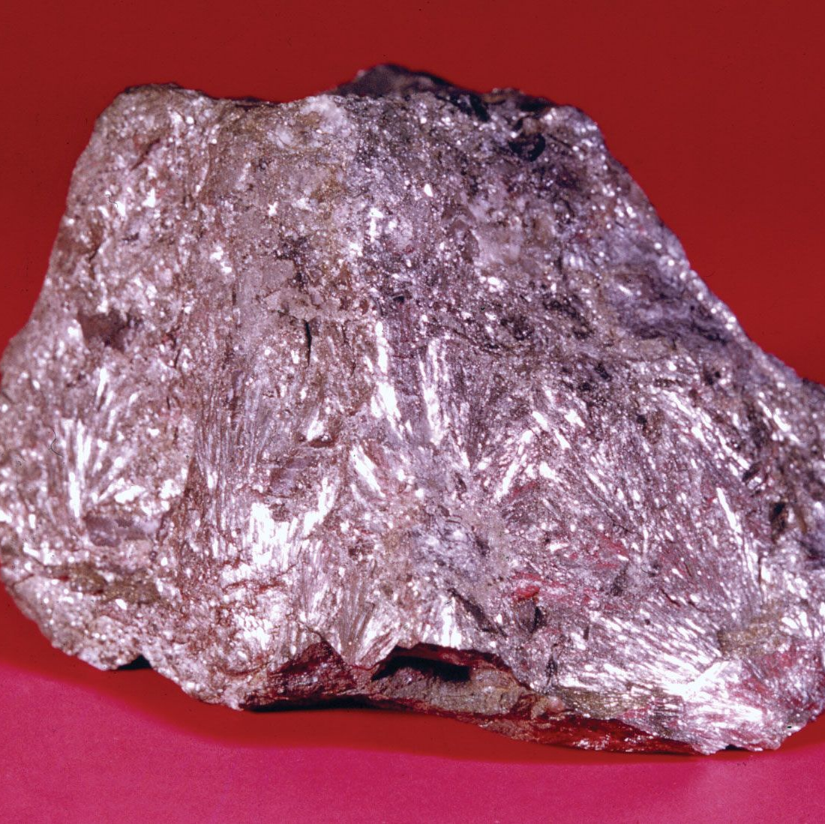
Highly sought after Reliable access
Little sought after Somewhat reliable access
ANTIMONY
ALUMINUM
ARSENIC
Little sought after Somewhat reliable access

Slide 8
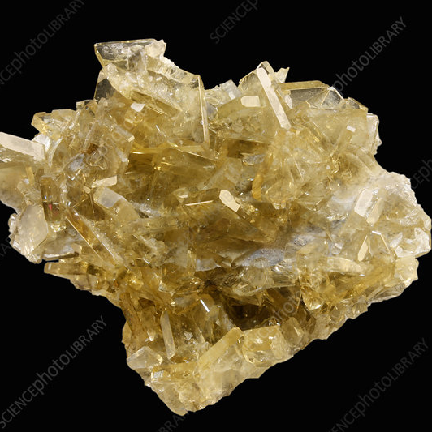
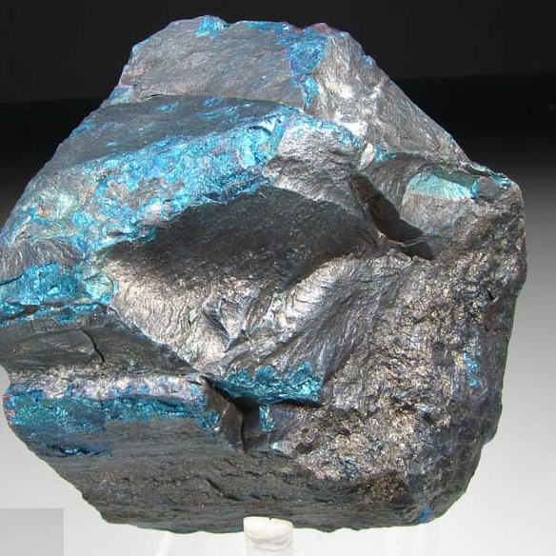
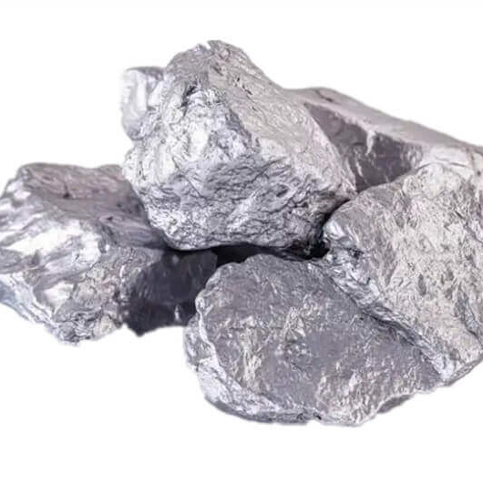
Moderately sought after Somewhat reliable access
Highly sought after
Unreliable access
CHROMIUM
BARITE
COBALT
Little sought after
Somewhat reliable access

Slide 9
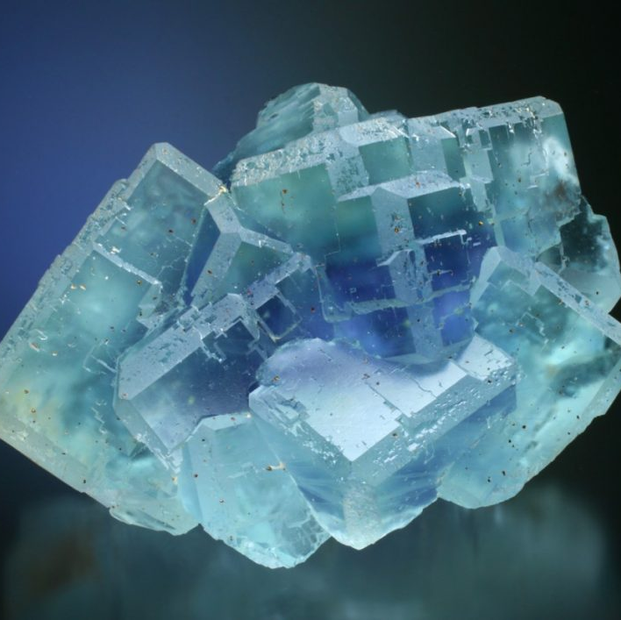
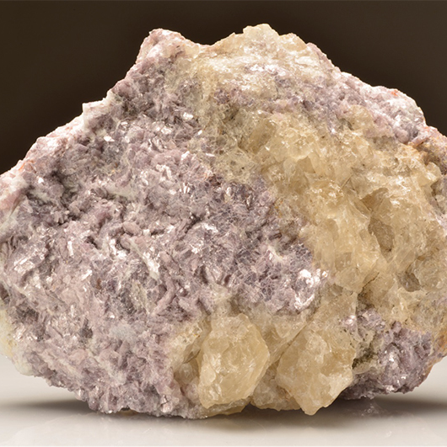
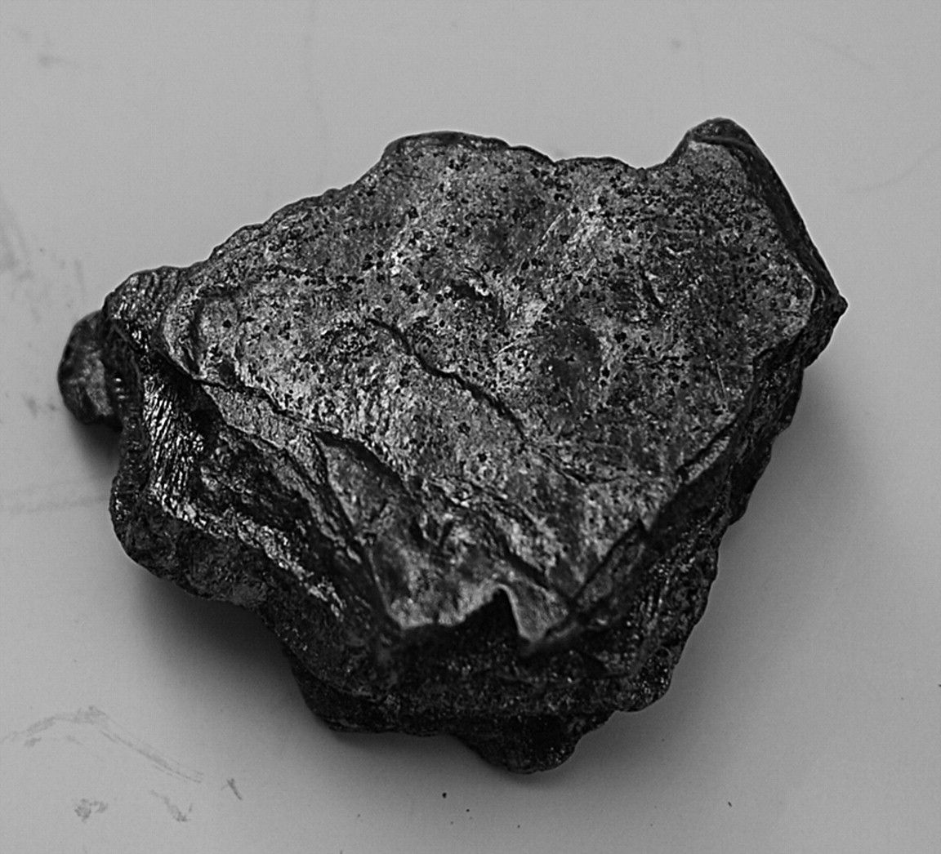
Moderately sought after
Reliable access
GRAPHITE
FLUORSPAR
LITHIUM
Little sought after
Somewhat reliable access
Little sought after
Somewhat reliable access

Slide 10
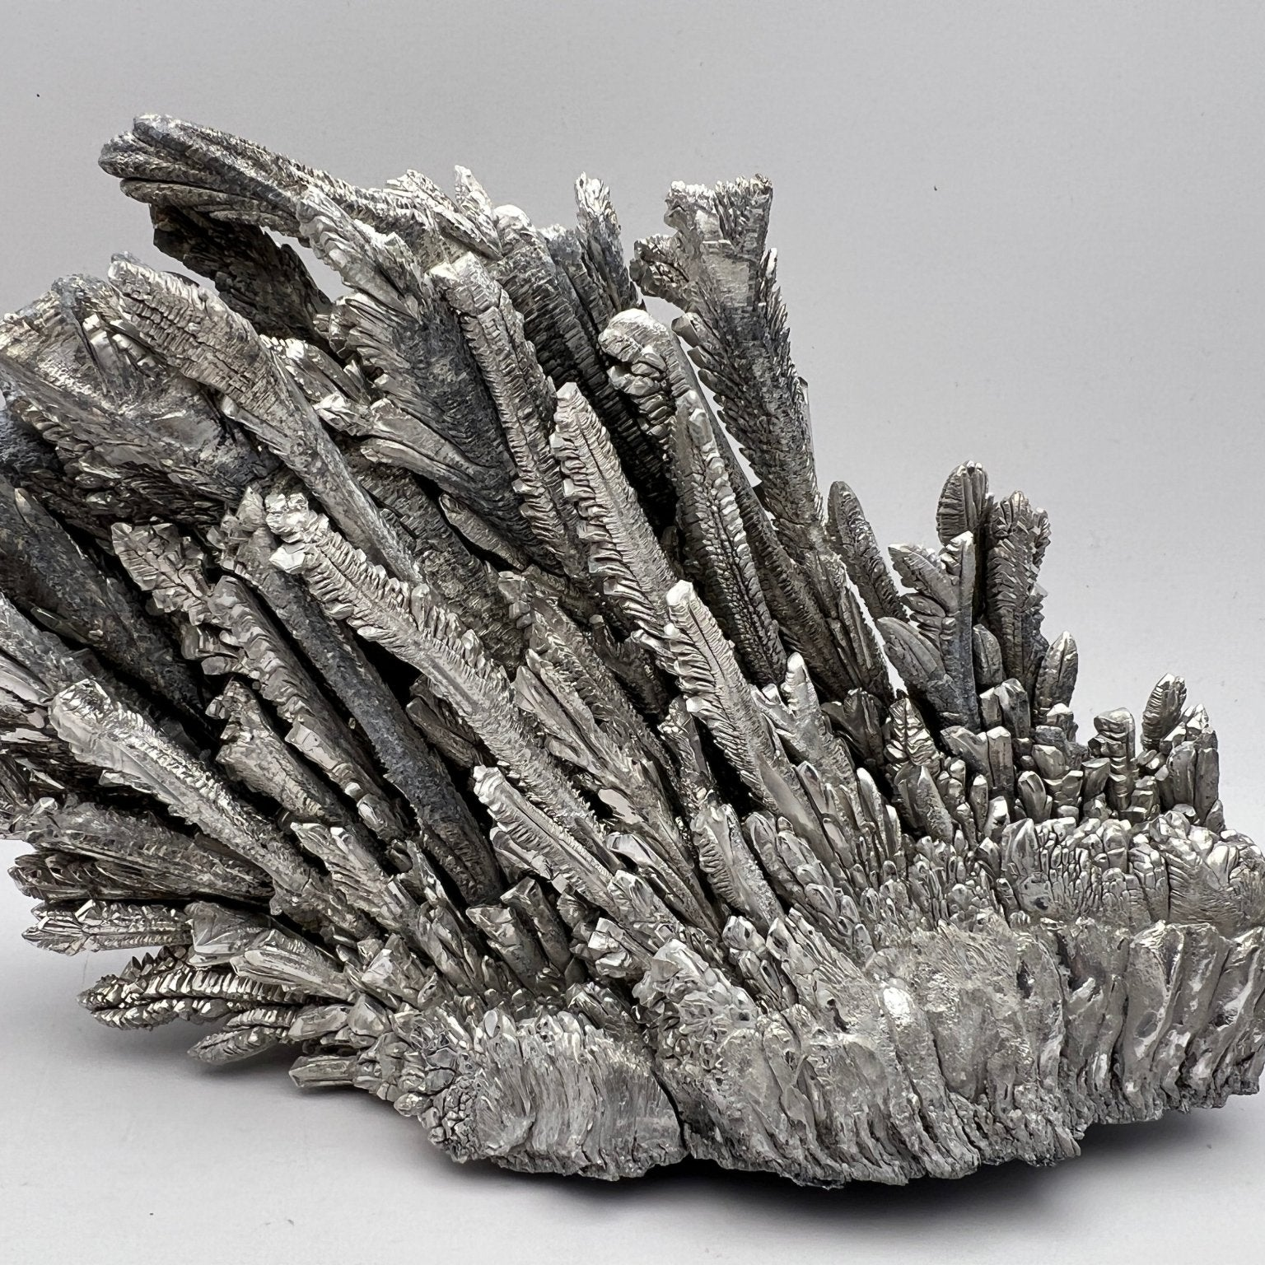
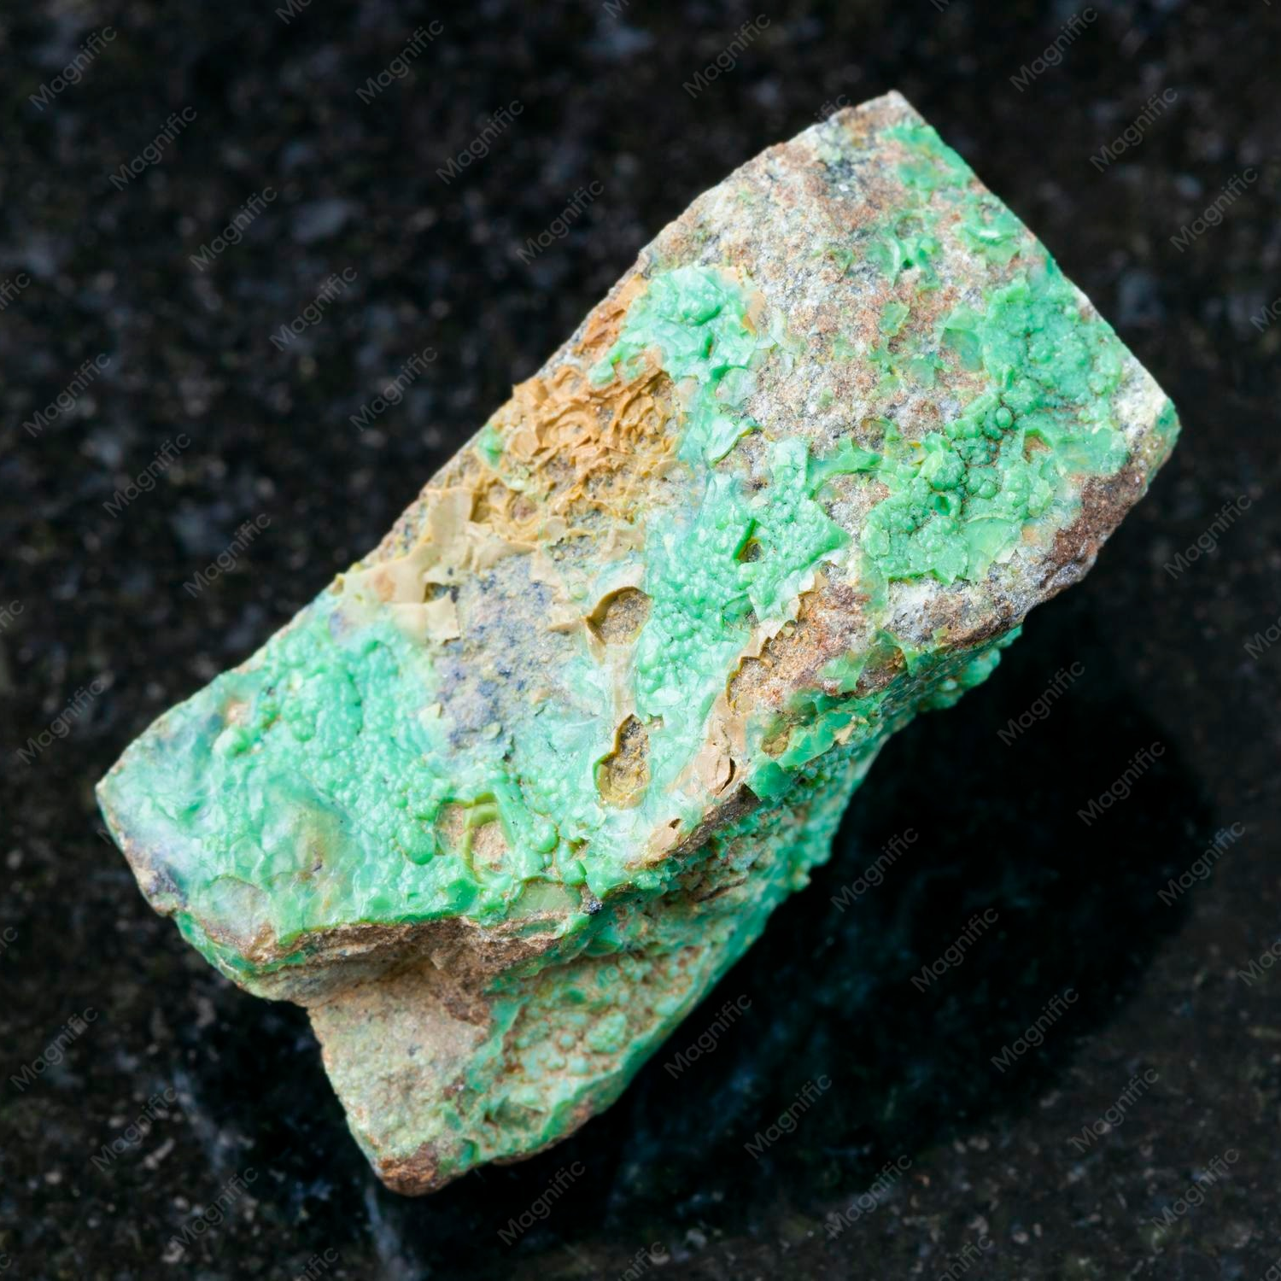
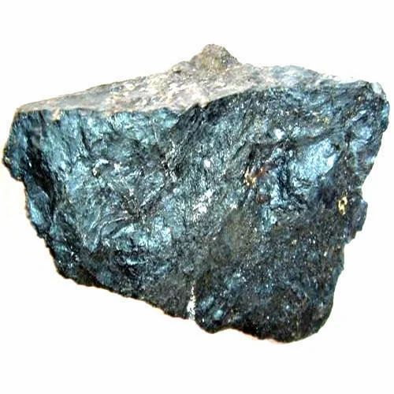
Moderately sought after
Reliable access
MANGANESE
MAGNESIUM
NICKEL
Little sought after
Somewhat reliable access
Somewhat sought after
Somewhat reliable access

Slide 11
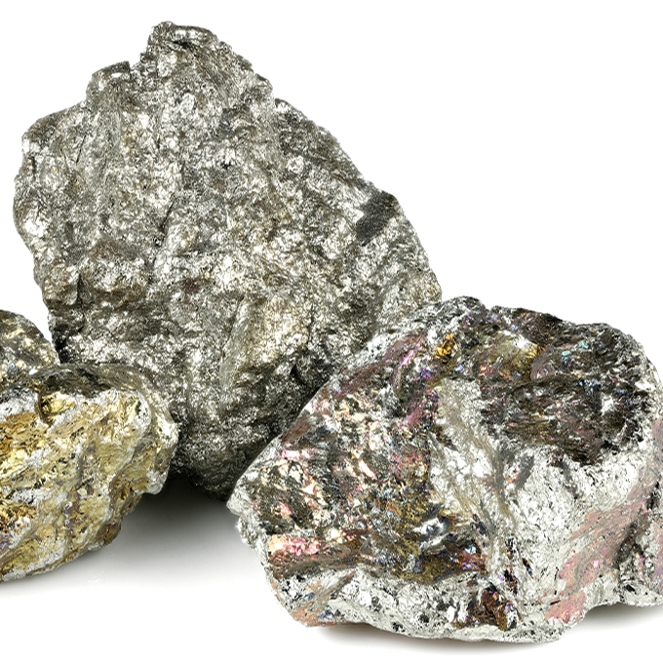
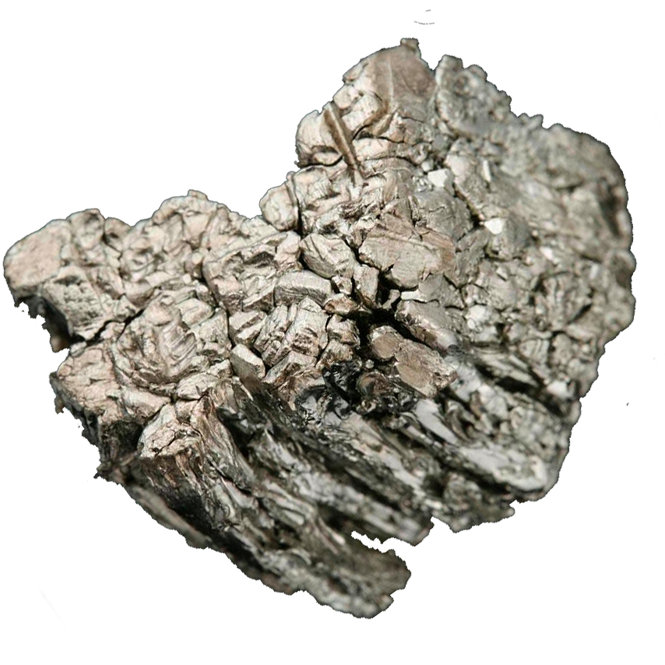
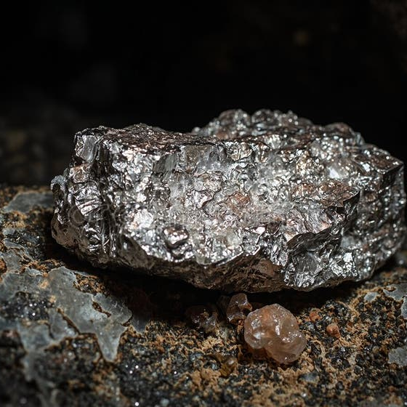
Little sought after
Somewhat unreliable access
PLATINUM
NIOBIUM
SCANDIUM
Little sought after
Somewhat unreliable access
Little sought after
Somewhat reliable access

Slide 12
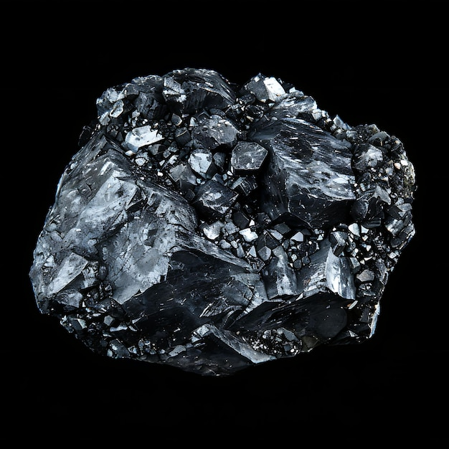
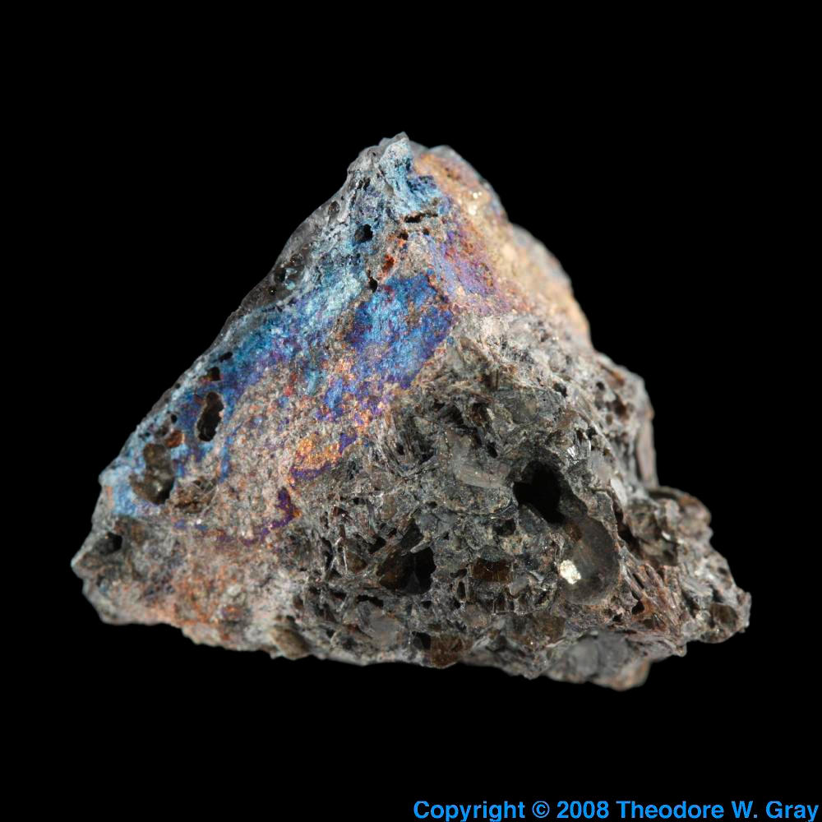
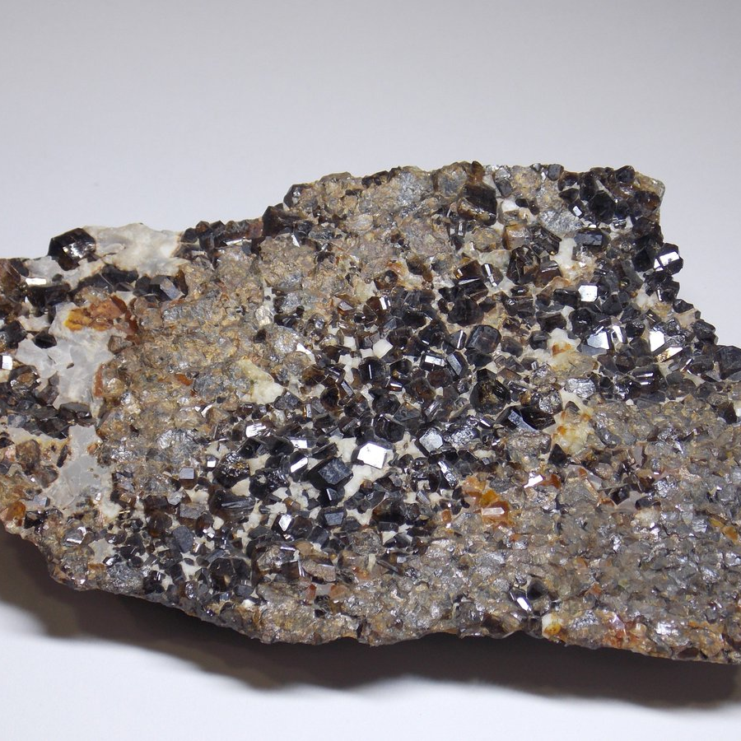
Moderately sought after Somewhat reliable access
TIN
TANTALUM
TITANIUM
Little sought after
Somewhat unreliable access
Somewhat sought after
Somewhat reliable access

Slide 13
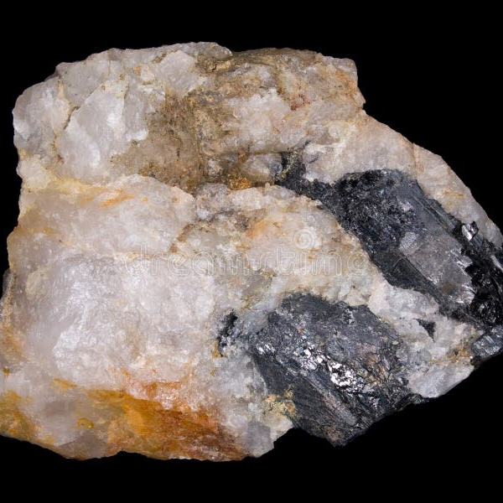
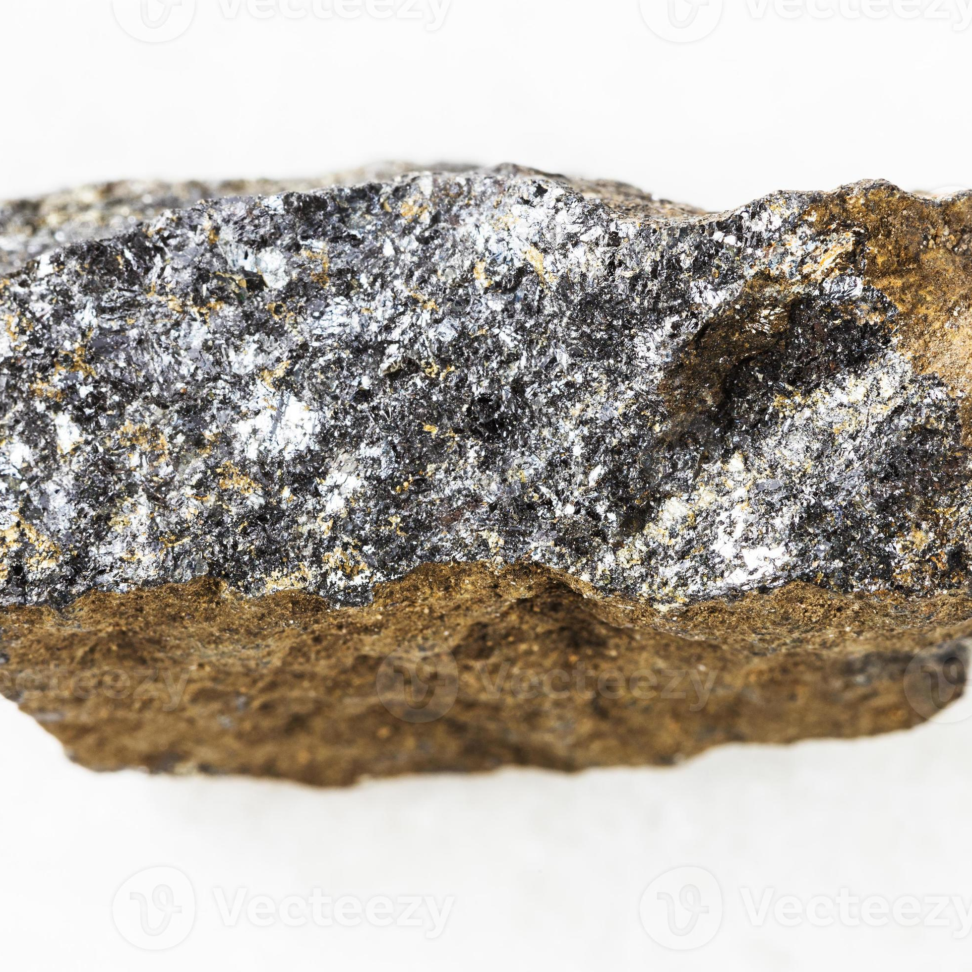
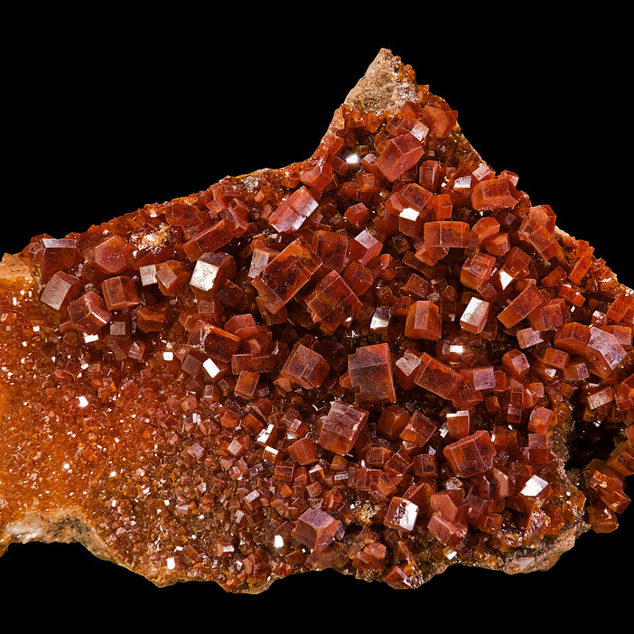
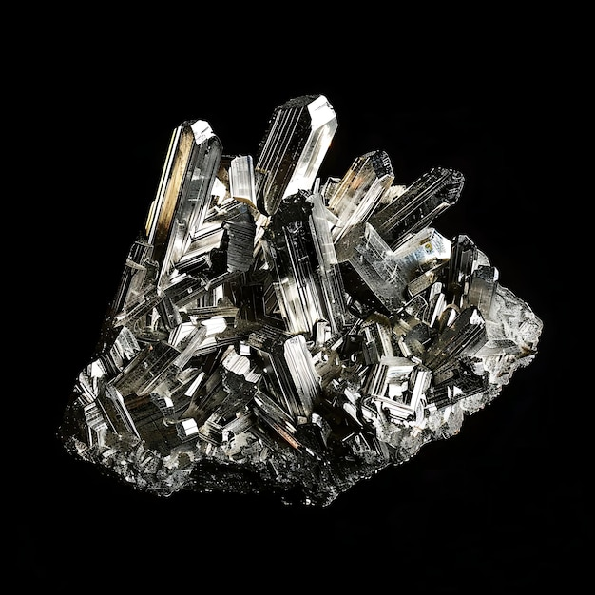
Little sought after Somewhat reliable access
Moderately sought after Somewhat reliable access
Moderately sought after Reliable access
TUNGSTEN
ZINC
Little sought after Somewhat reliable access
VANADIUM
ZIRCONIUM

Slide 14
Conclusion
As seen throughout the charts and catalogue of critical minerals, the US does not have the same level of access to all minerals across the world
Due to varying country relations, there are some minerals we have better access to than others
Chromium, Platinum, Niobium and Tantalum are such minerals that, if a war or economic hardship were to occur, the US would have would have difficulties securing supplies
Although the majority of minerals are what we would consider reliably accessible, an offset in these unreliably accessible minerals could cause a chain reaction which affects some industries directly and others later on
Taking this into consideration, it should definitely be of national importance to ensure a constant and steady supply of these minerals

Slide 15
Sources
Mineral List:
https://www.usgs.gov/news/national-news-release/us-geological-survey-releases-2022-list-critical-minerals
Mineral Data:
https://mrdata.usgs.gov/major-deposits/
Ally Data:
https://worldpopulationreview.com/country-rankings/united-states-allies
Competitor Data:
https://worldpopulationreview.com/country-rankings/us-enemy-countries

