Slide 1

DATA608 Assignment 6
Steven Gonzalez

Slide 2
Prompt
The United Nations Food and Agriculture Organization publication, The State of Food Security and Nutrition in the World 2022 (https://www.fao.org/documents/card/en/c/cc0639en) might lead one to the conclusion that it’s an elsewhere problem. That the people who are suffering malnutrition and starvation are “elsewhere”, not in our backyard. For this assignment you will need to take a closer look here at home (the US).

Slide 3
prelude
Food security concerns exist all over the globe. Even in well-developed countries, not all inhabitants have access or enjoy a safe, secure, and nutritious supply of food. In this story, we will peer into food security stats throughout the United States in order to better understand which communities and demographics are most affected.
To do this, we will assess:
Food security by state
Household composition
Child household food security type
Employment, education, and disability status

Slide 4
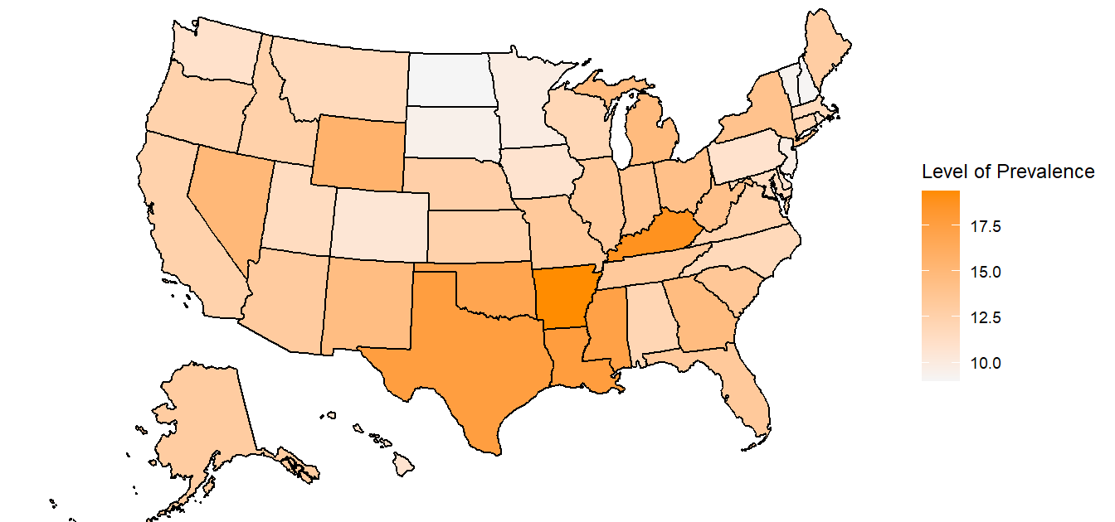
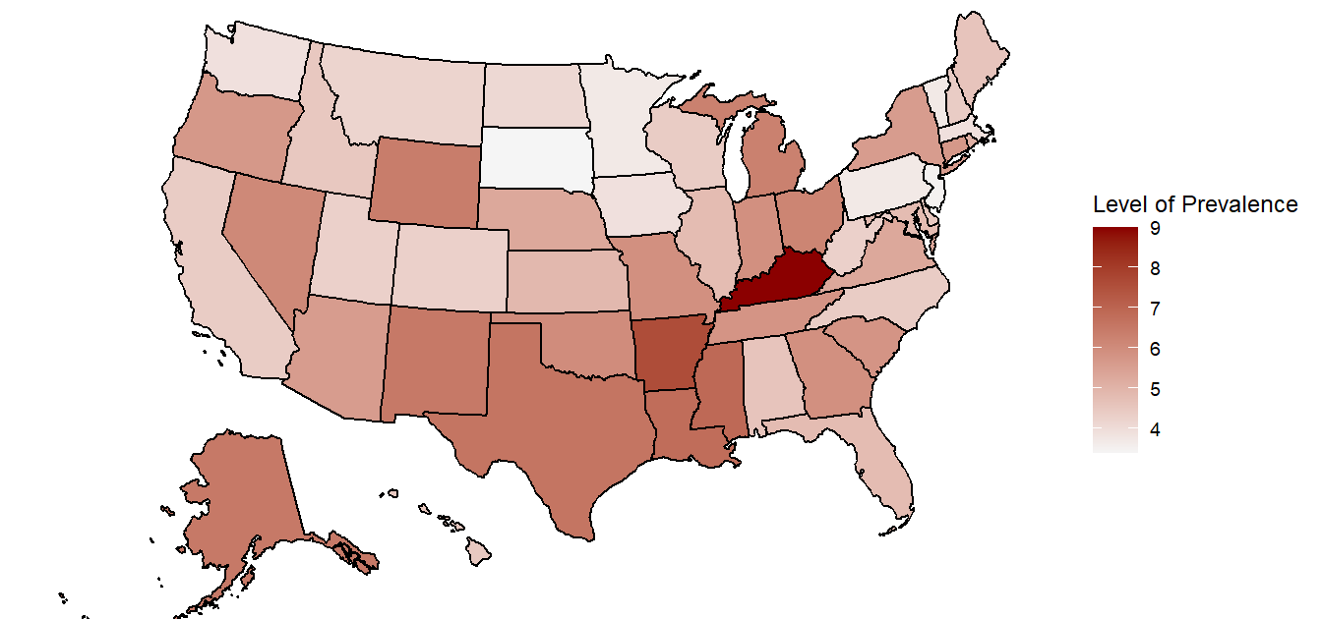
South central us shows greatest signs of food insecurity with coastal regions showing the least

Slide 5
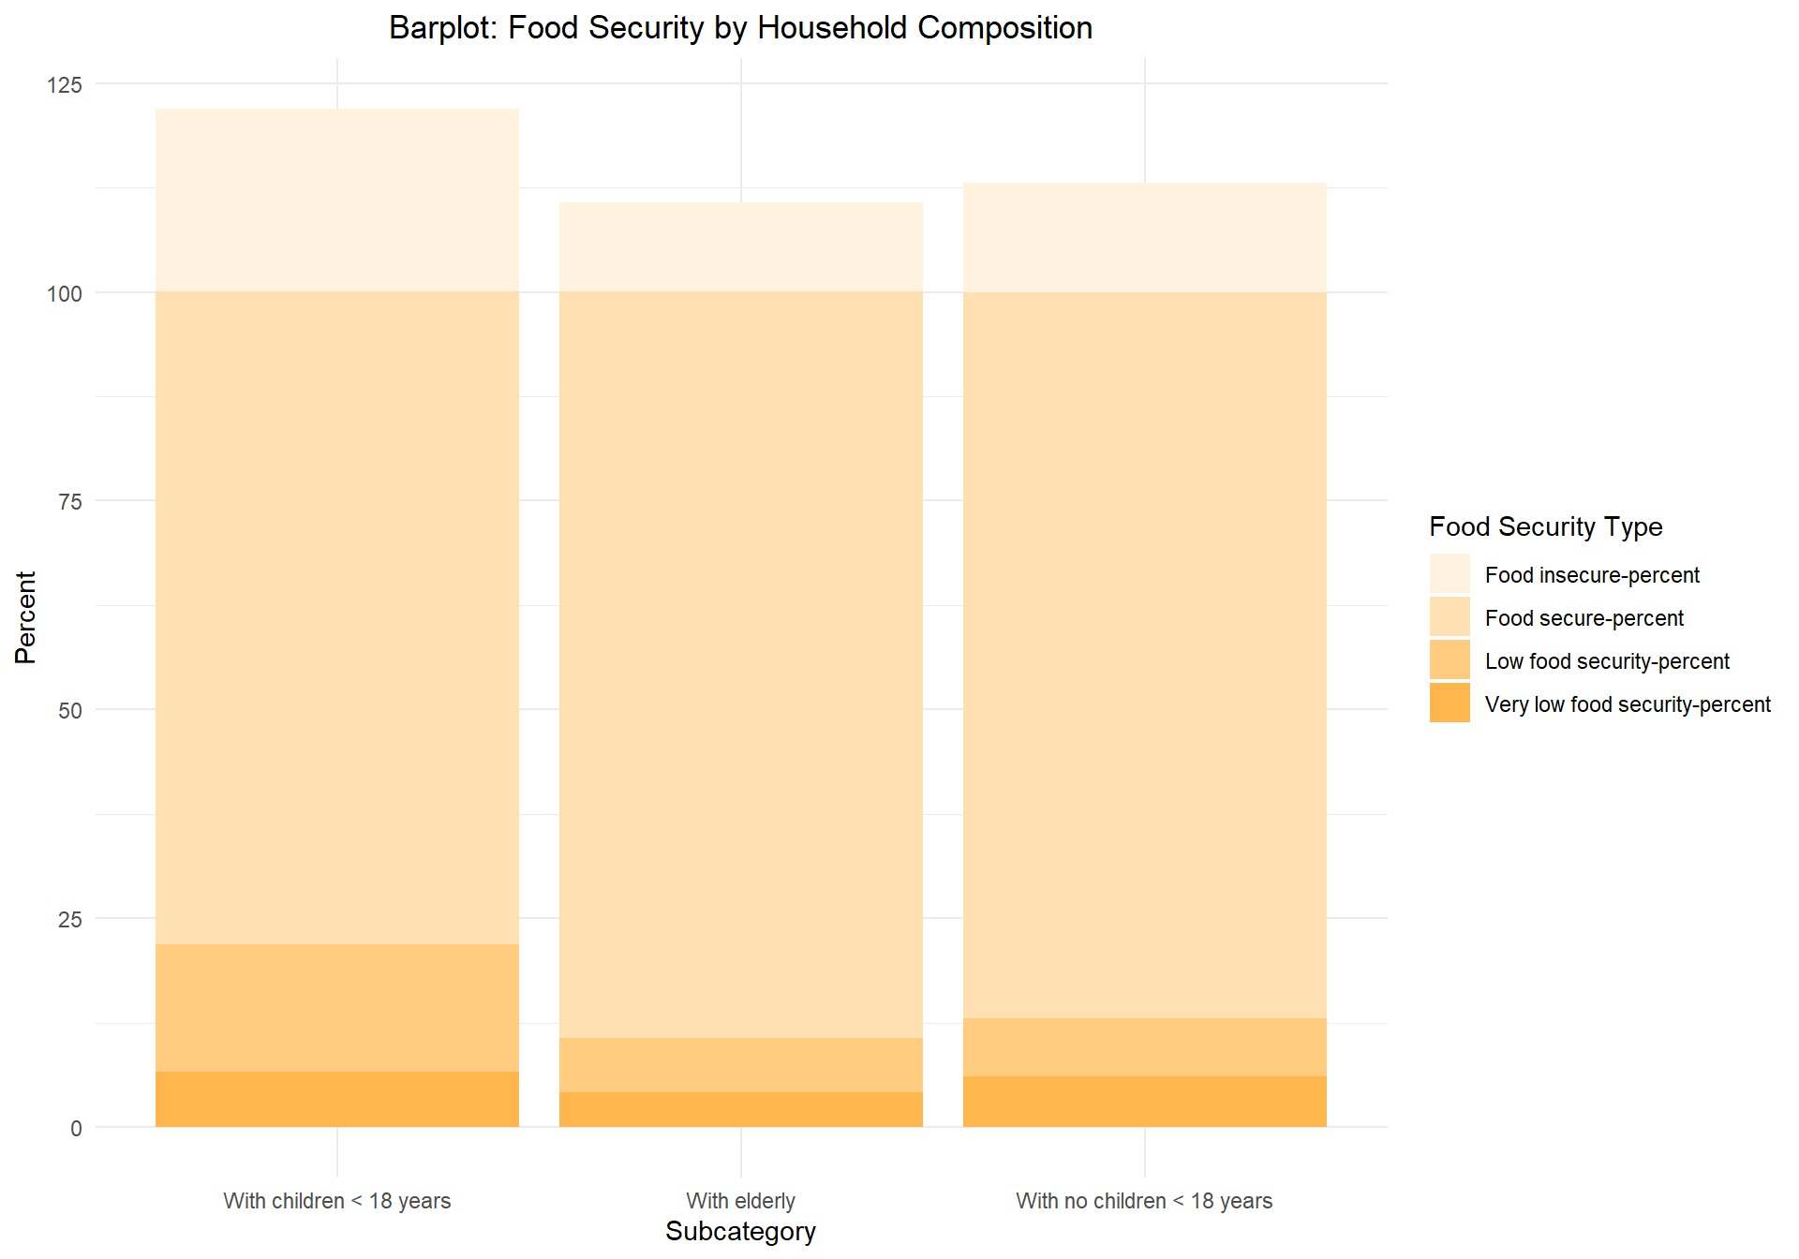
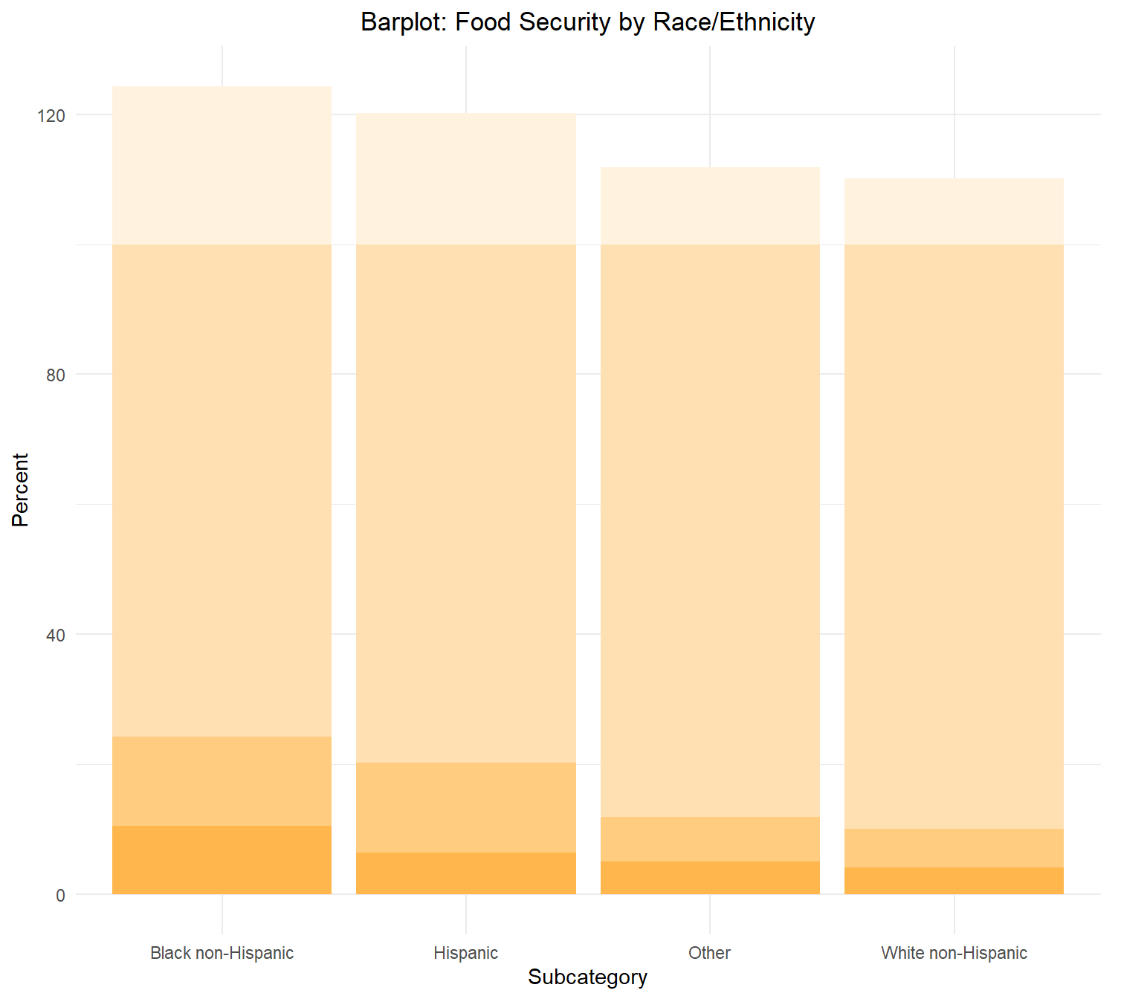
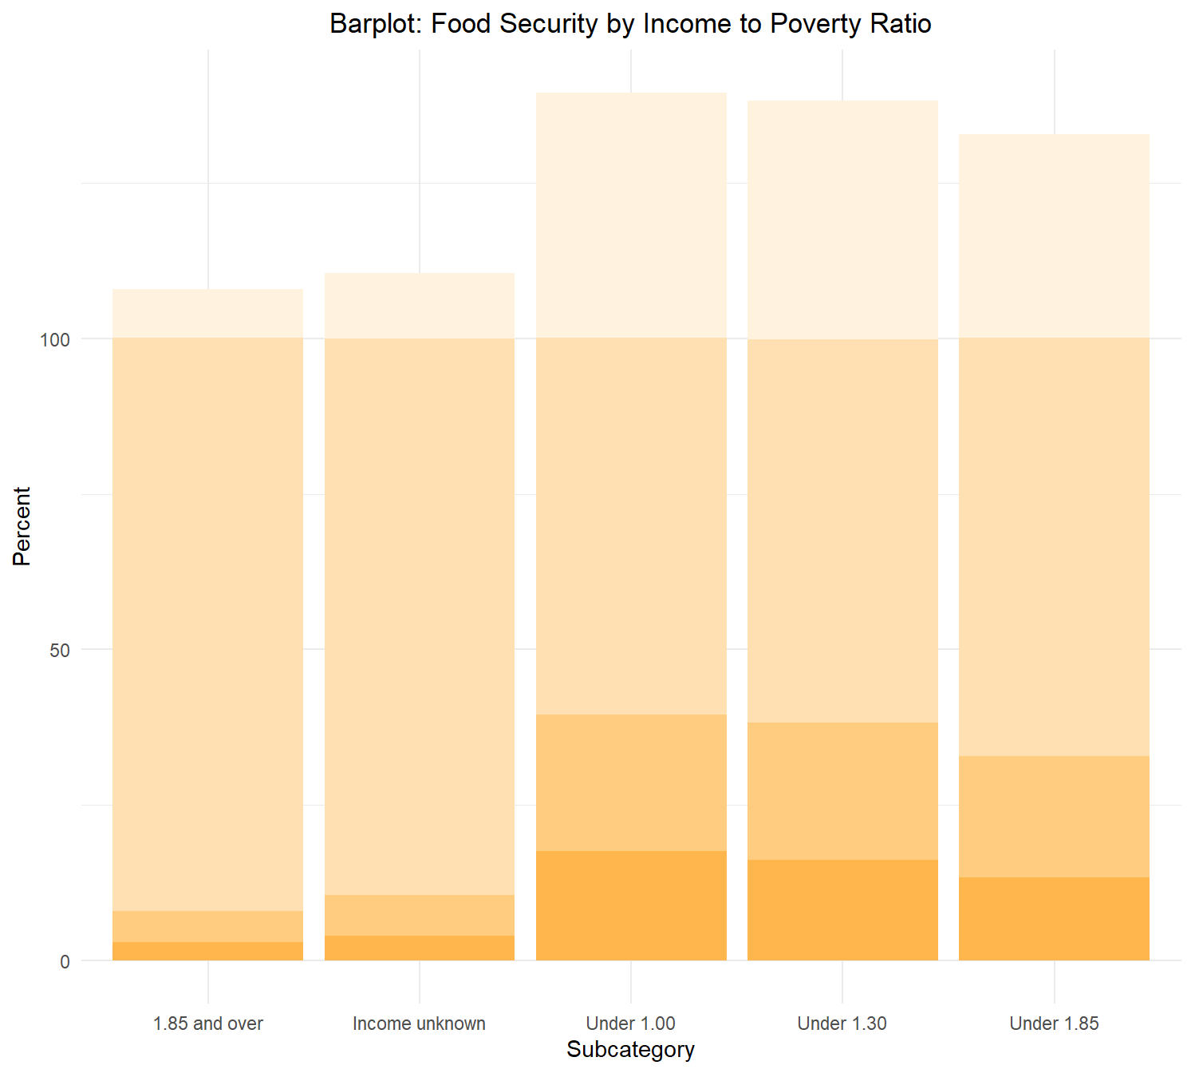
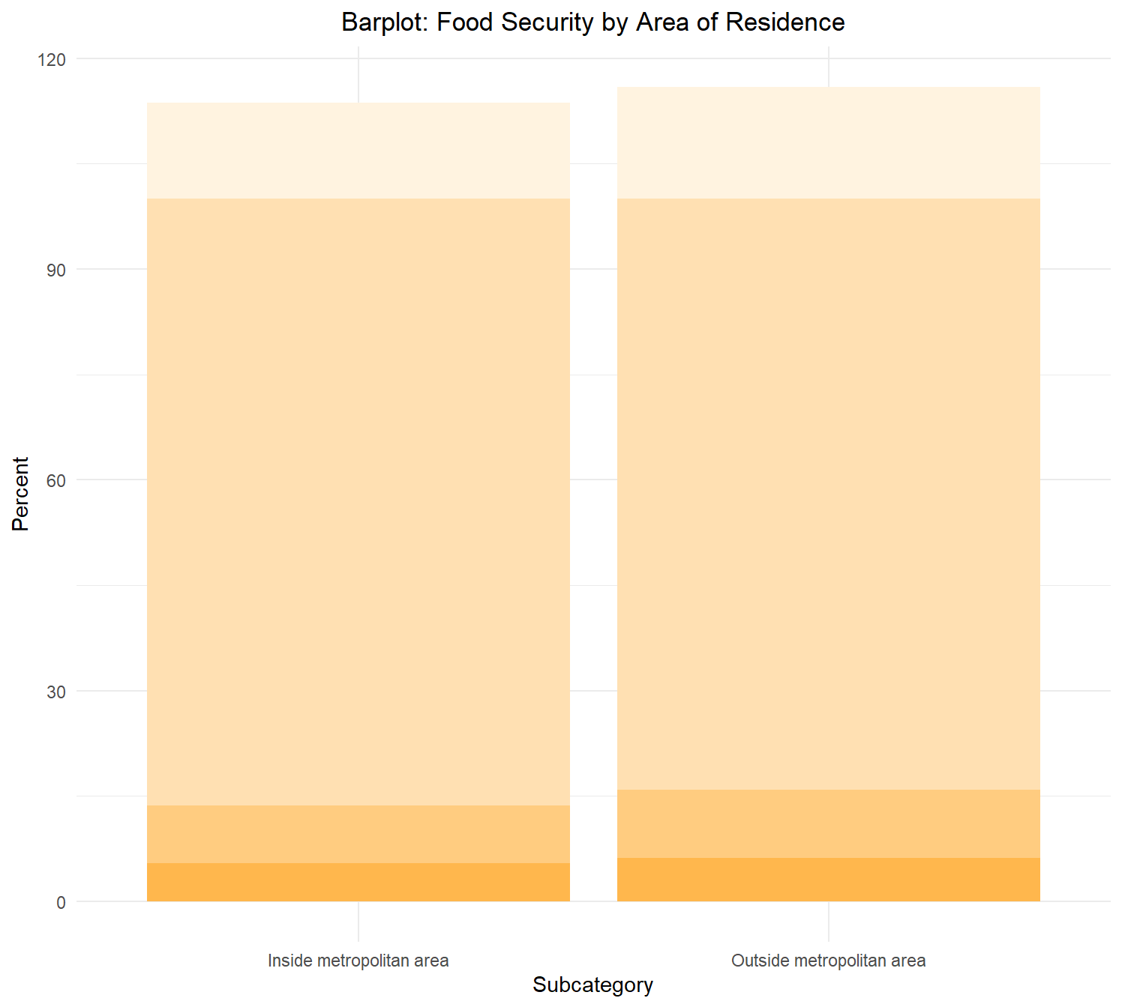
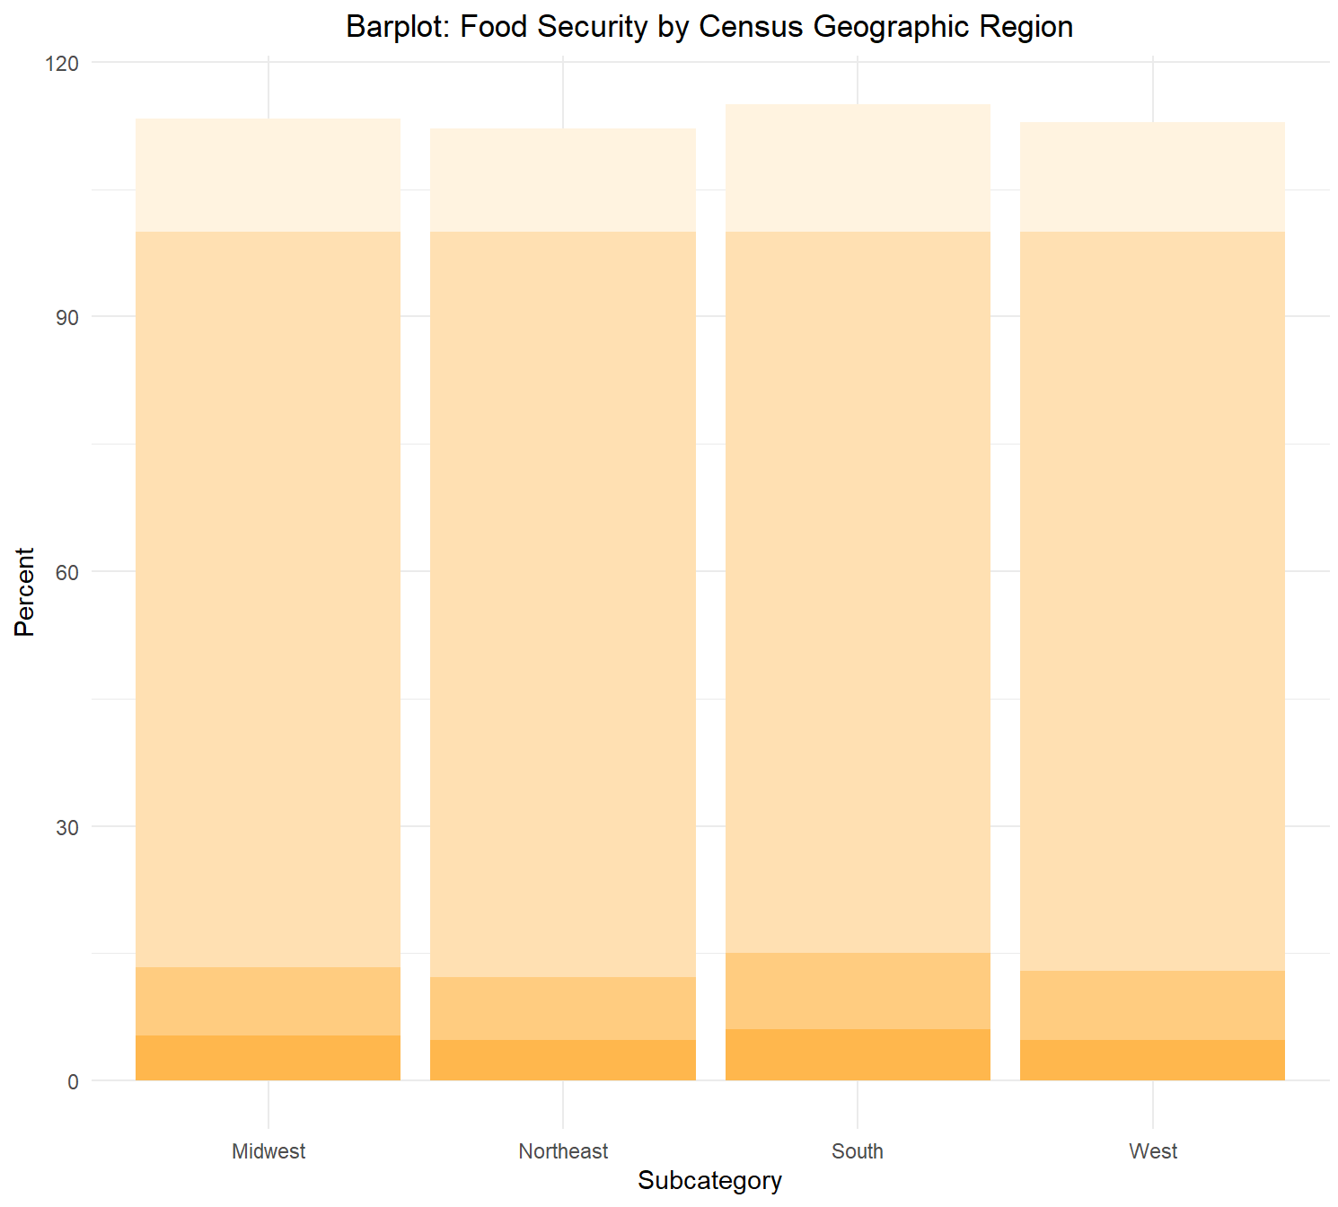
Household compositions with highest food insecurity: With children < 18; Black non-Hispanic income-poverty ratio < 1; outside metro area; southern US

Slide 6
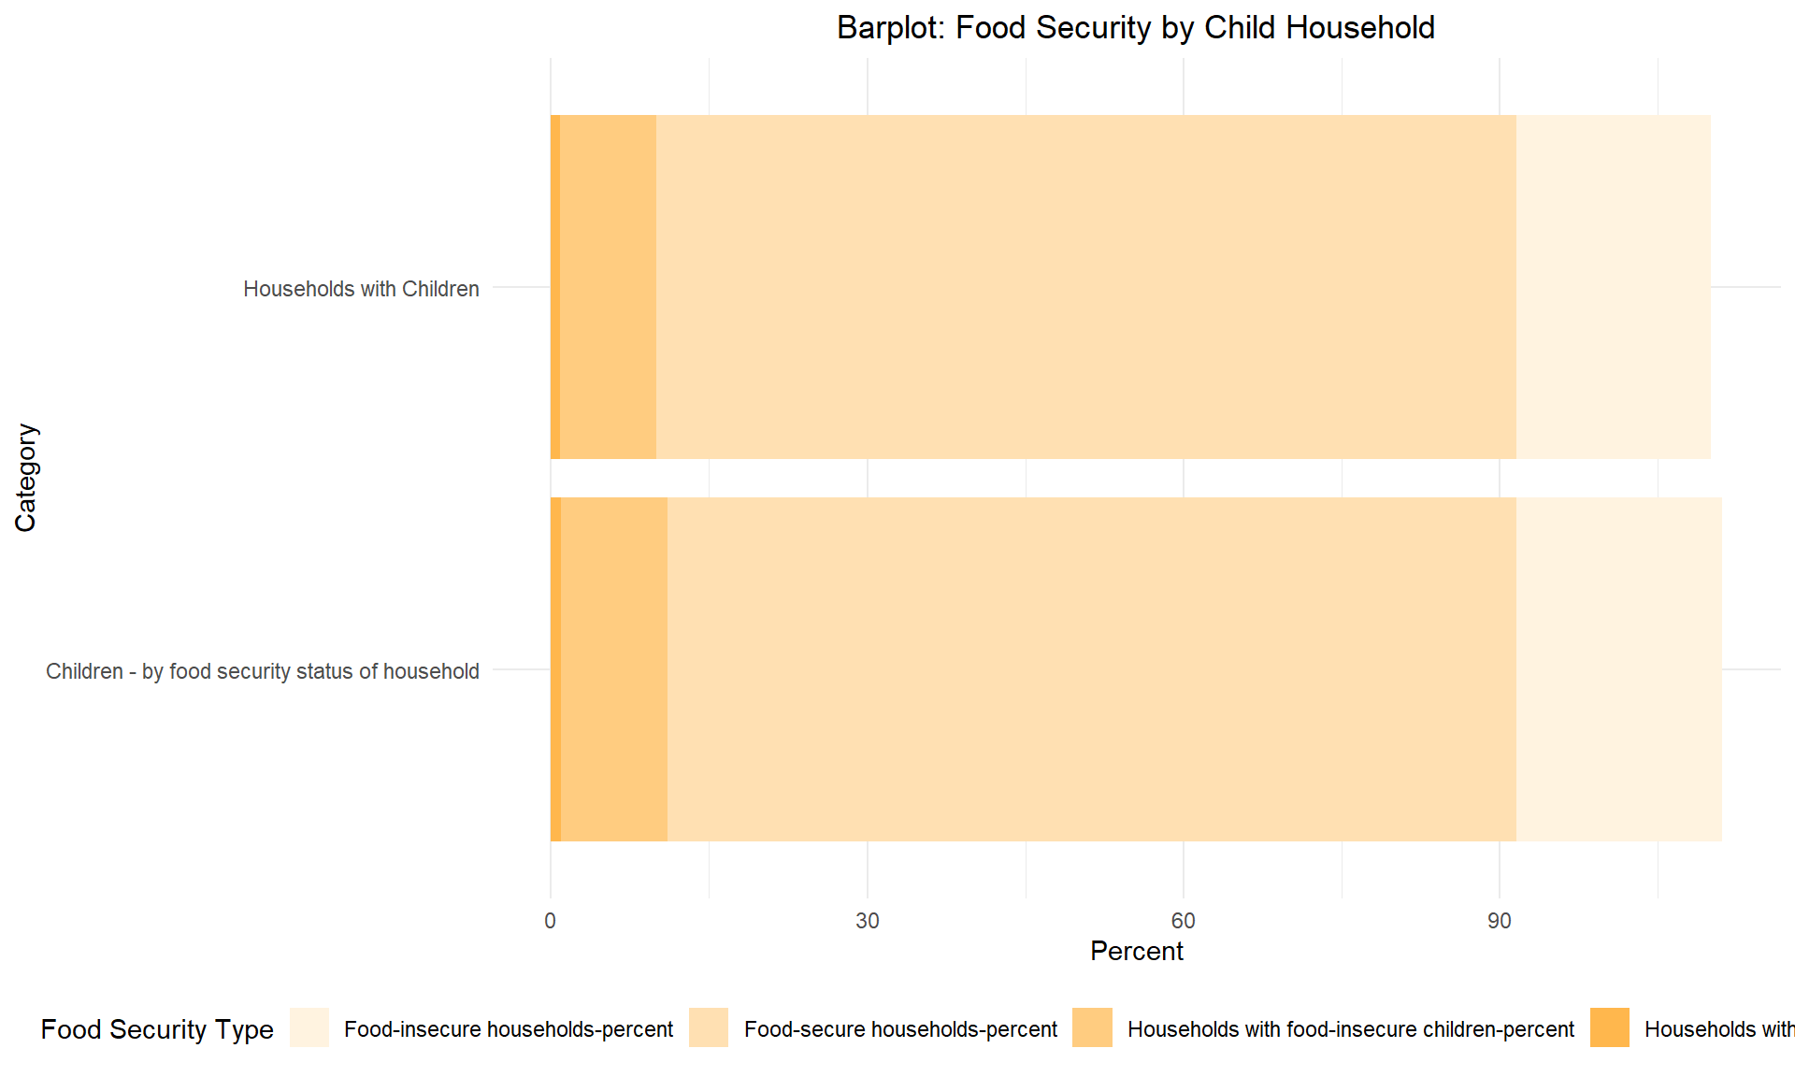
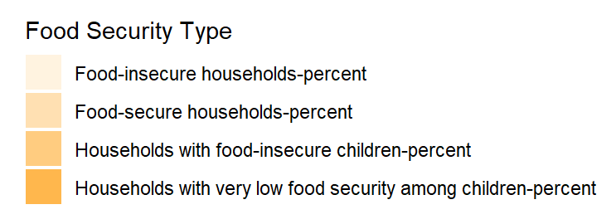
Children from low food security households suffer lower food security overall; indicating impact even outside of the household

Slide 7
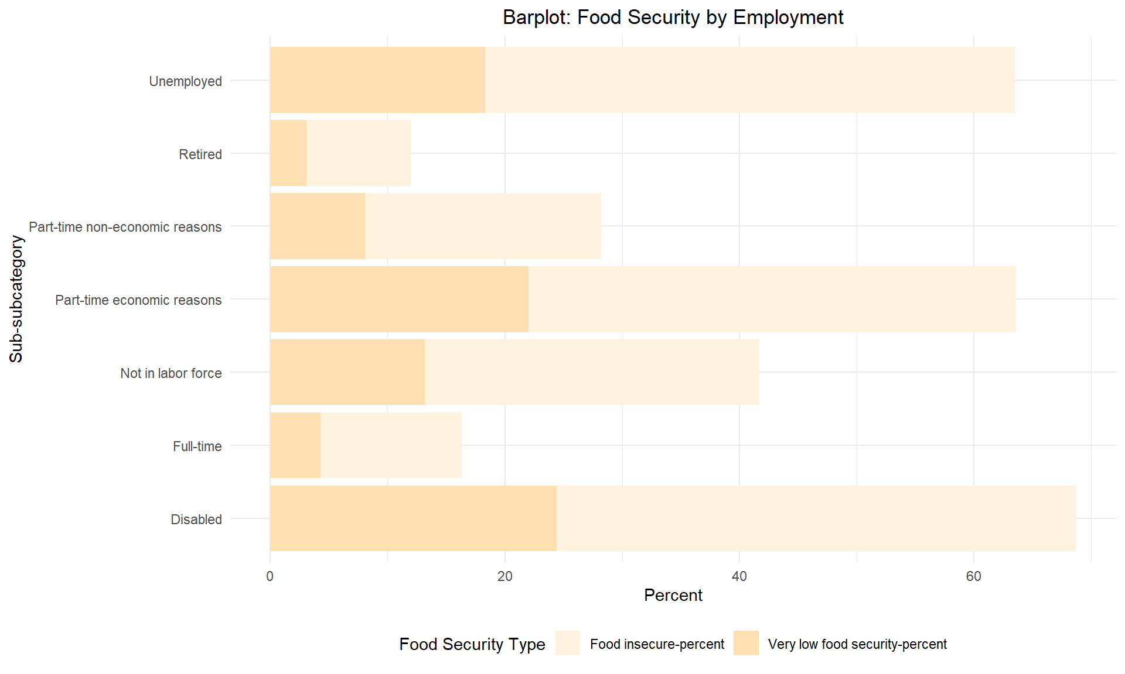
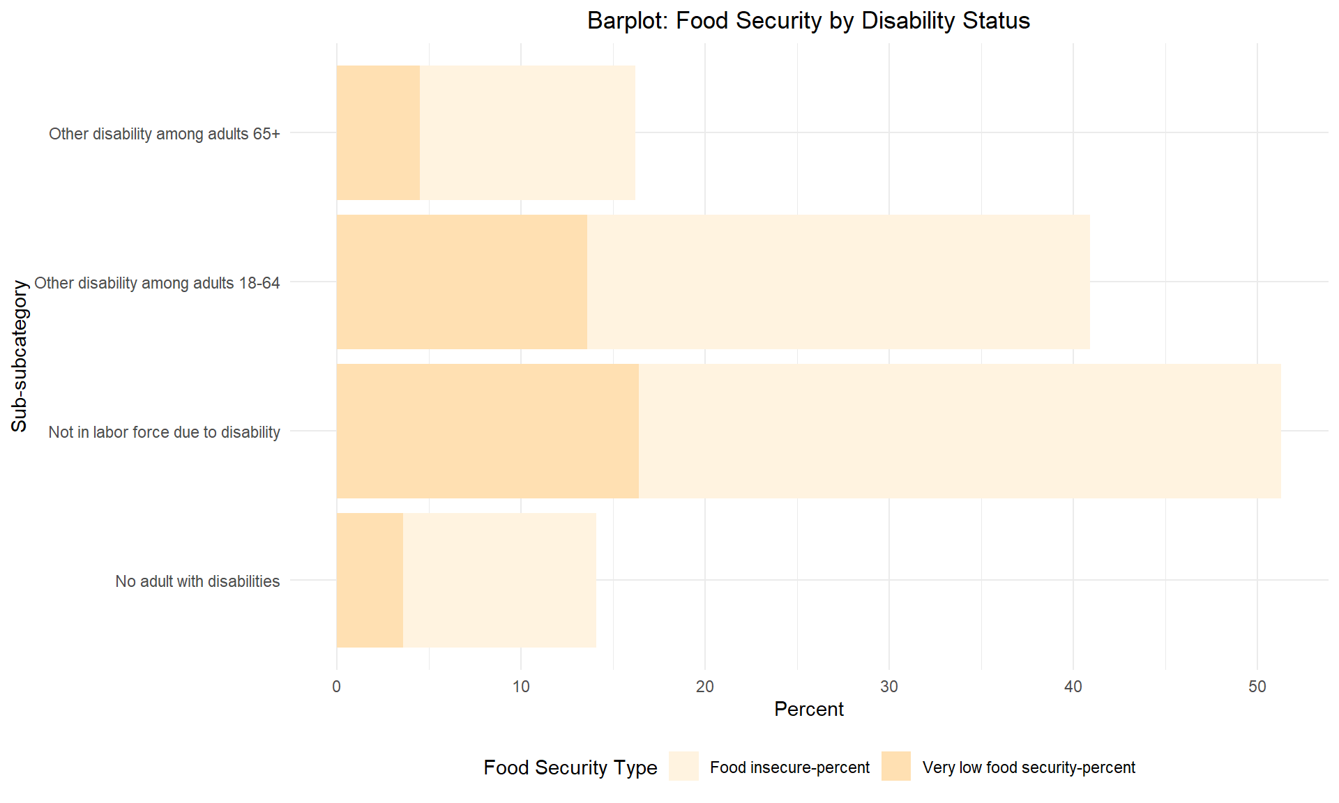
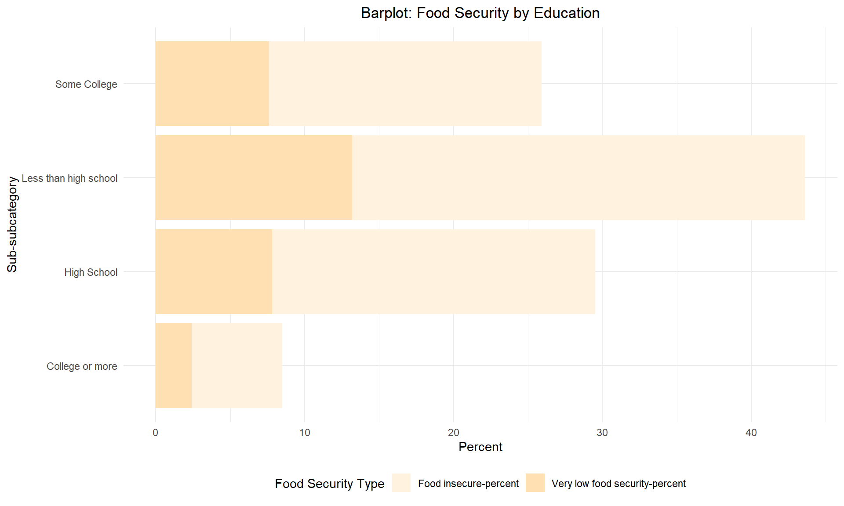
Individual status with highest food insecurity: disabled; not working because of disability; has less than a high school degree

Slide 8
Conclusion
Although developed countries, like the United States, boast in their advances in technology and way of living, they too, like all other nations, have not been able to quash the issue that is food insecurity
As we saw, there are specific individuals who suffer from food insecurity more than others; and these are the people assistance programs should be targeted towards
The south-central US
Black non-Hispanic impoverished households outside of metro areas with children under 18
Children who live in a food insecure household
Disabled individuals who do not work due to their disability
And those without a high school degree

Slide 9

Thank you for your attention and support

Slide 10
Sources
Food Insecurity Data:
https://www.ers.usda.gov/topics/food-nutrition-assistance/food-security-in-the-us/interactive-charts-and-highlights#States

