Slide 1

DATA608 Assignment 3
Steven Gonzalez

Slide 2
Prompt
The CDC publishes firearm mortality for each State per 100,000 persons (https://www.cdc.gov/nchs/state-stats/deaths/firearms.html). Each State’ firearm control laws can be categorized as very strict to very lax. The purpose of this Story is to answer the question, ” Do stricter firearm control laws help reduce firearm mortality?”
For this assignment you will need to:
Access the firearm mortality data from the CDC using an available API (https://open.cdc.gov/apis.html)
Create a 5 point Likert scale categorizing gun control laws from most lax to strictest and assign each state to the most appropriate Likert bin.
Determine whether stricter gun control laws result in reduced gun violence deaths
Present your story using heat maps

Slide 3
Prelude
In order to conclude whether or not gun law strictness has any influence over firearm mortality rates within the United States, we must assess and compare these two variables and see if there exists any correlation.
To do this, we will:
Map firearm mortality and gun law strictness throughout the country and look for any visual indicators
Produce a heatmap comparing gun law strictness to mortality to see if a trend between the two variables is noticeable
And plot out relative law quantity and quality vs mortality rates on a scatterplot to display actual correlation, if any exists

Slide 4
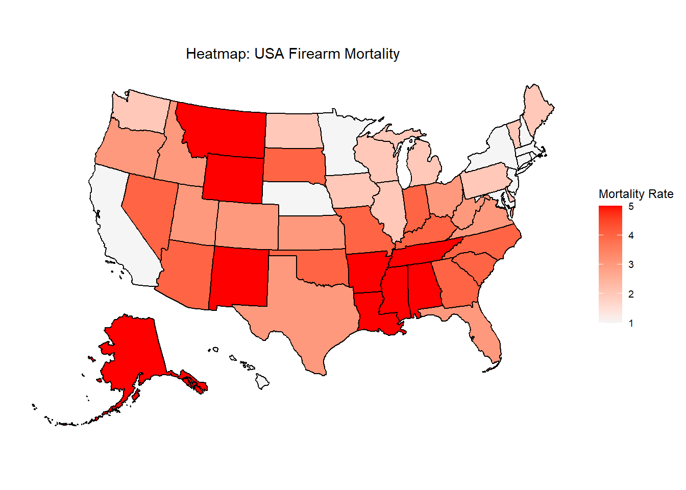
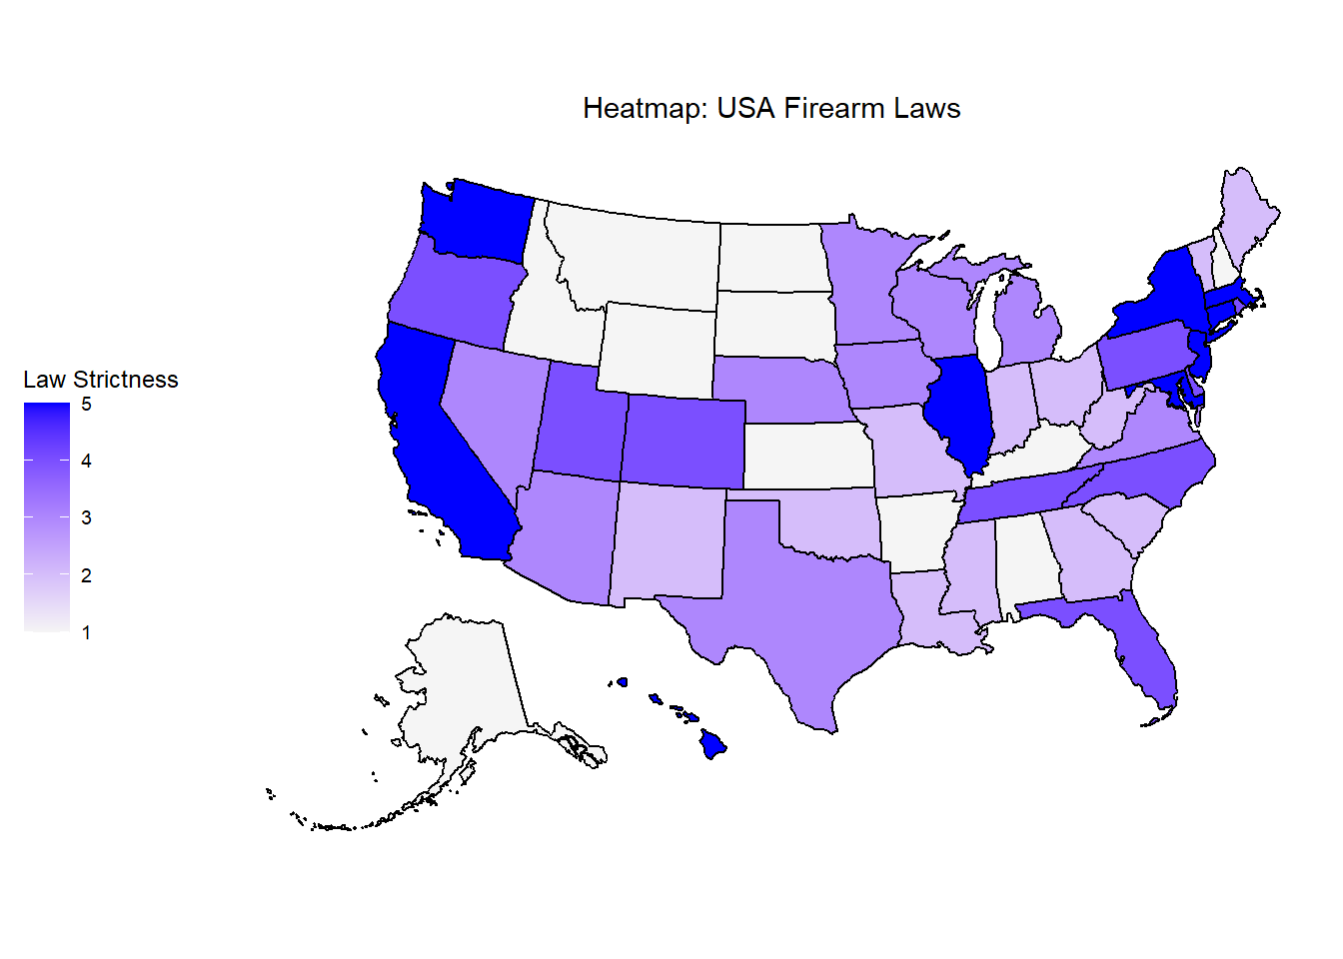
States with high mortality seem to typically have more lax gun laws and vice versa
New York
Low Mortality
Strict Gun Laws
Alaska
High Mortality
Lax Gun Laws

Slide 5
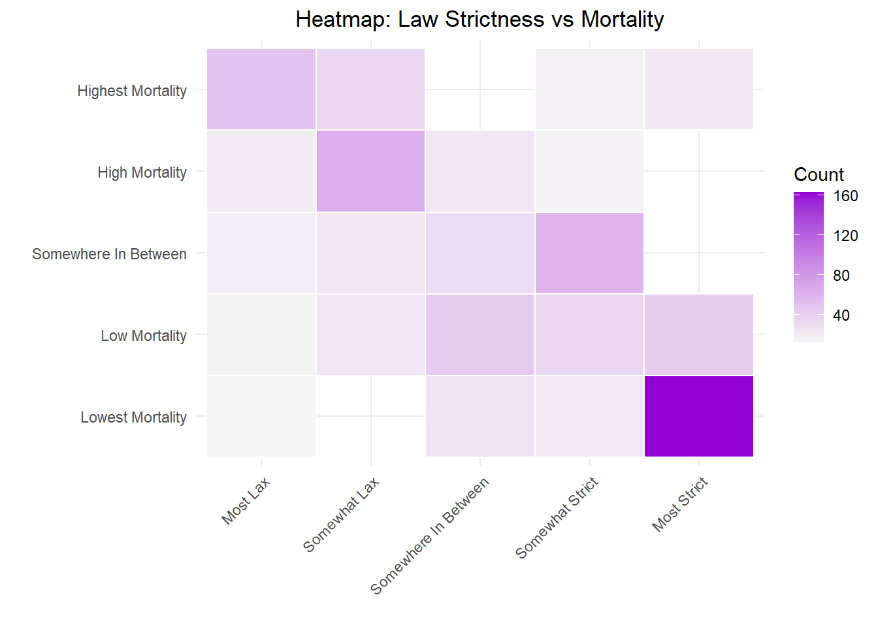
A clear connection Is seen when comparing law strictness to mortality
As Law Strictness goes UP
Mortality tends DOWN

Slide 6
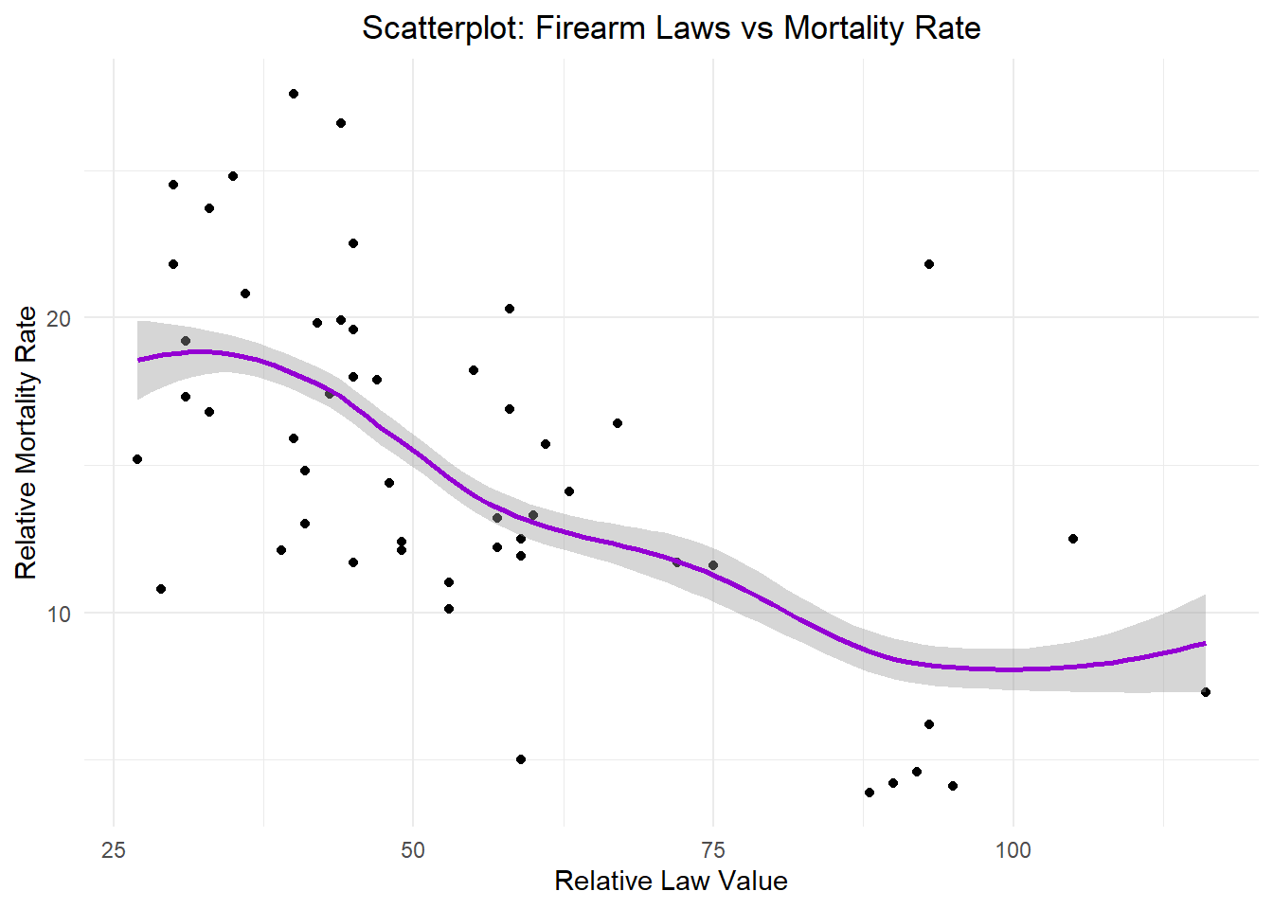
higher counts of restrictive gun laws are correlated with lower mortality rates

Slide 7
CONCLUSION
When comparing maps displaying statewide firearm mortalities and gun law strictness, we were able to clearly see how states that were high on the mortality scale were low on the law strictness scale, which indicated a possible relationship
Taking it one step further, through the use of a heatmap comparing these two categorical variables, we saw an obvious trend downward supporting what the map was showing us
Finally, we plotted out the actual numerical values for mortality rate and numbers and quality of gun laws and were able to determine that, indeed, there exists a correlation between gun law strictness and firearm mortality
However, further investigation is needed in order to see if the restrictions in place actually reduce overall mortality or if humanity simply finds alternatives to firearms

Slide 8
sources
CDC FA Mortality:
(https://data.cdc.gov/Injury-Violence/Mapping-Injury-Overdose-and-Violence-State/fpsi-y8tj/about_data)
Rand FA Laws:
(https://www.rand.org/research/gun-policy/law-navigator.html#minimum-age-for-possession)

