Slide 1
DATA608 Assignment 1
Steven Gonzalez

Slide 2
Prompt
The attached Excel file contains data on the present allocation of the Infrastructure Investment and Jobs Act funding by State and Territory.
Your story (Data Visualization(s)) should address the following questions:
Is the allocation equitable based on the population of each of the States and Territories, or is bias apparent?
Does the allocation favor the political interests of the Biden administration?

Slide 3
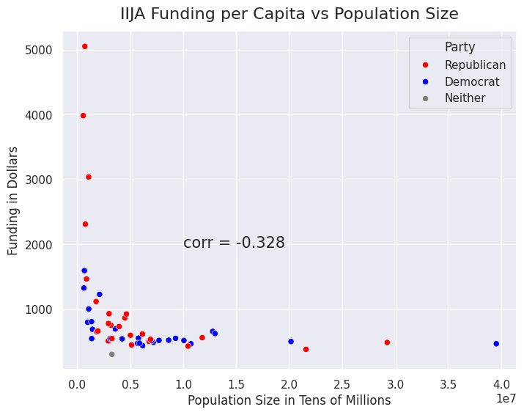
An equitable distribution of IIJA funds based solely on population size would produce a scatter plot with a strong positive correlation between the two variables. The plot to the right shows that there is a weak negative correlation, indicating funding based on more than just population size.

Slide 4
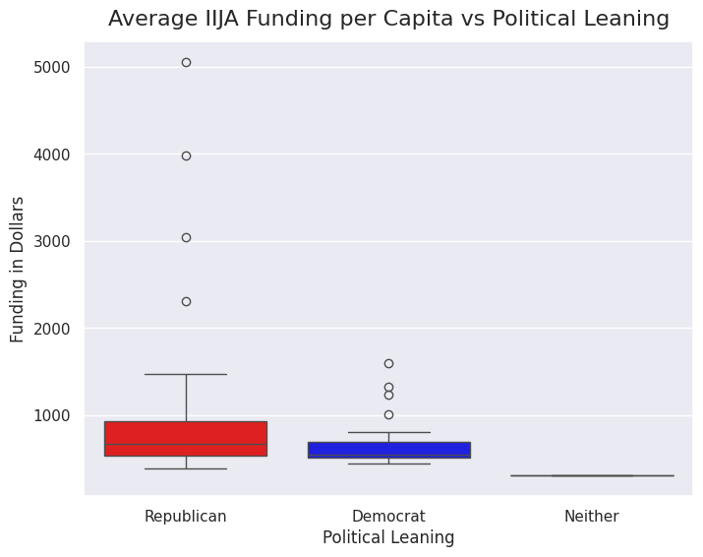
IIJA funding allocation in favor of the political interests of the Biden administration would lead to a boxplot with a higher median and overall distribution for states that leaned democrat for the 2020 election. As can be seen, this is not the case and the states that voted for Biden have a lower median and distribution.

Slide 5
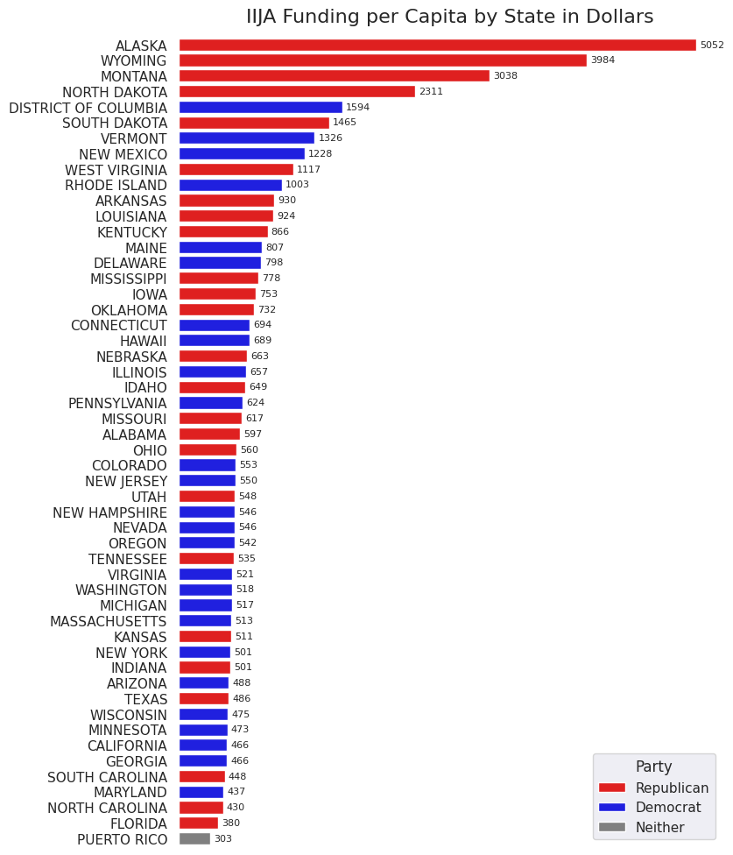
To further emphasize the lack of favoritism in IIJA funding for democratically leaning states in the 2020 election, here we have a bar chart showing that the states with the highest funding per capita were majority republican leaning.

Slide 6
Conclusion
Based on the previous visualizations, the allocation of IIJA funds is not equitable based on the population of each state or territory. Therefore, bias and/or other unconsidered variables are apparent.
Furthermore, as per the same visualizations, allocation of IIJA funds does not favor the political interests of the Biden administration.

