Slide 1
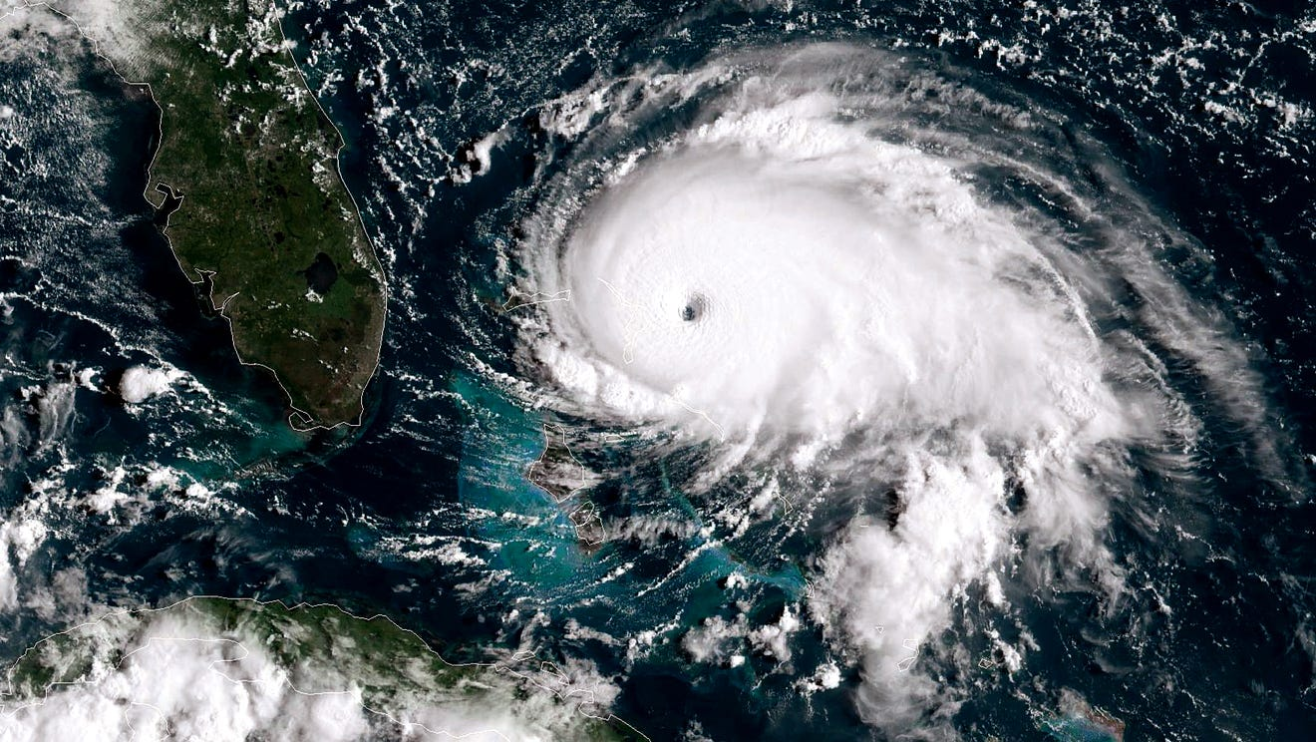
DATA608 Assignment 5
Steven Gonzalez

Slide 2
Prompt
Historic data indicates that the occurrence and intensity of cyclonic storms (Hurricanes, Typhoons and Tornadoes) increases with the increased earth temperature. For this assignment you will need to tell this story to a non-technical audience (eg: a high-school earth science class).

Slide 3
Prelude
The subject of climate change has been a popular one for quite some time now. The question at hand revolves around the possible correlation between climate change and extreme weather. Specifically, if there is a connection between rising temperatures and hurricanes.
In this story, we are going to:
Look into the change in the number of storms and hurricanes since 1950
Assimilate the fluctuations in hurricane proportion and storm speed
Look into the change in temperature throughout this same amount of time
Finally, see which variables are actually influenced by this change

Slide 4


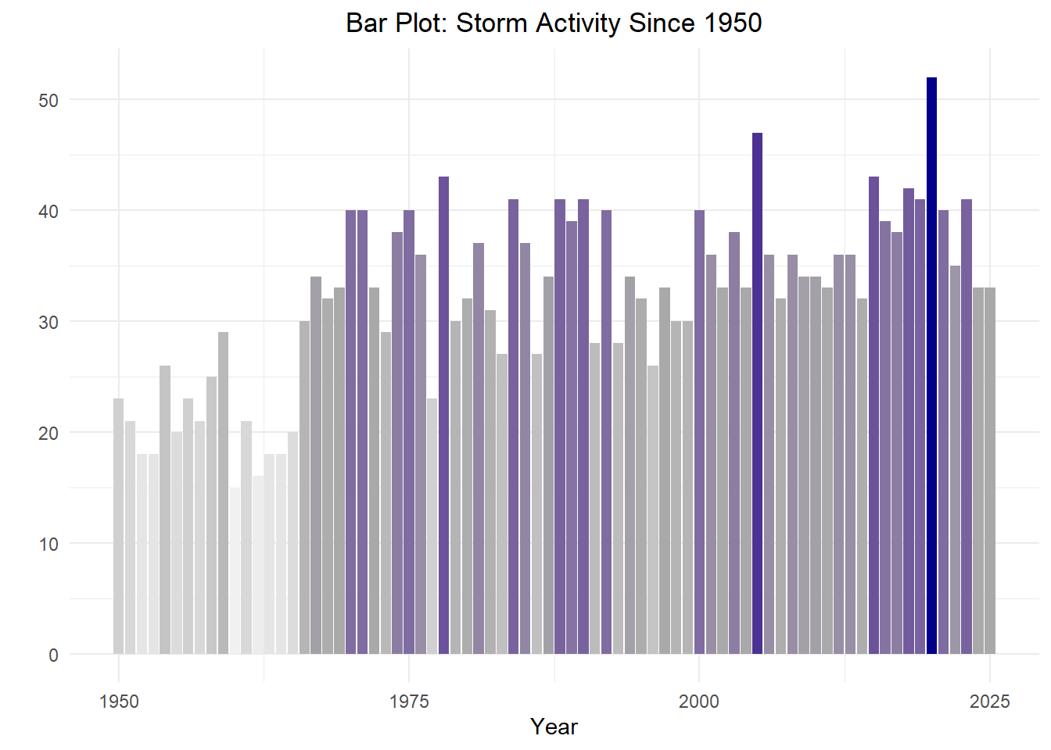
From the year 1950 to the present, storm activity has been steadily on the rise

Slide 5
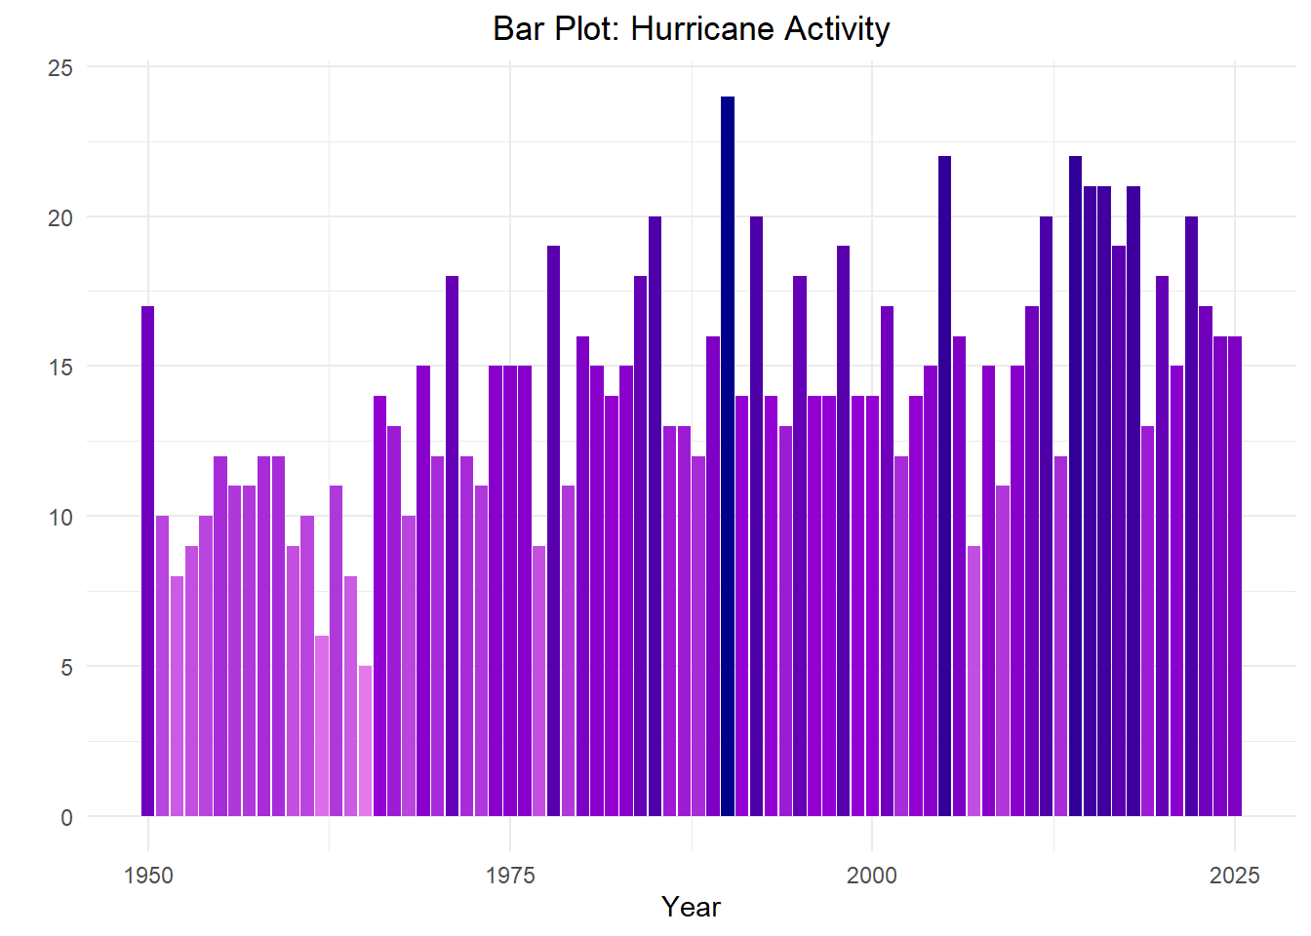
there has also been a rise in the number of hurricanes per storm season

Slide 6
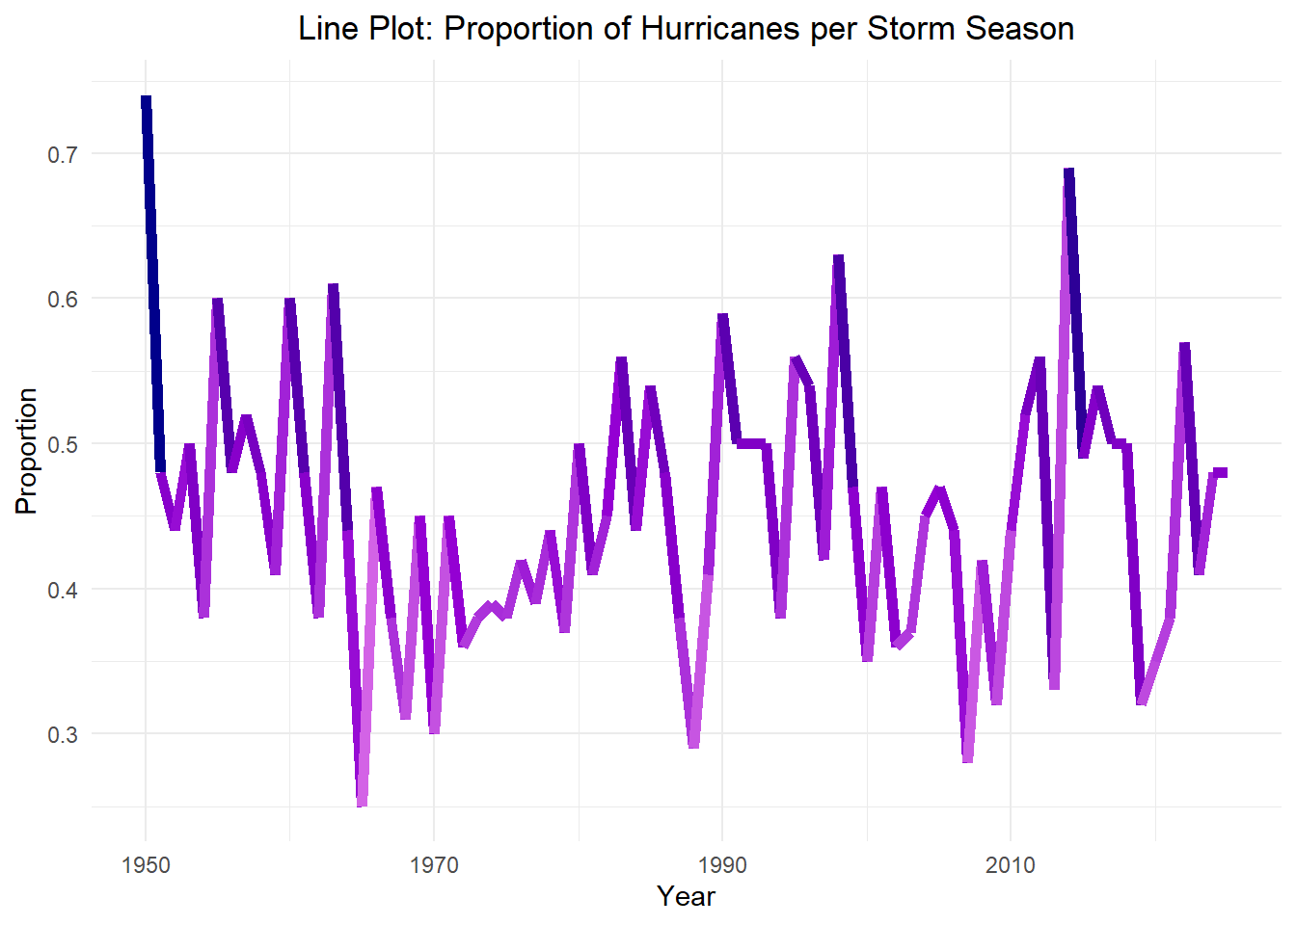
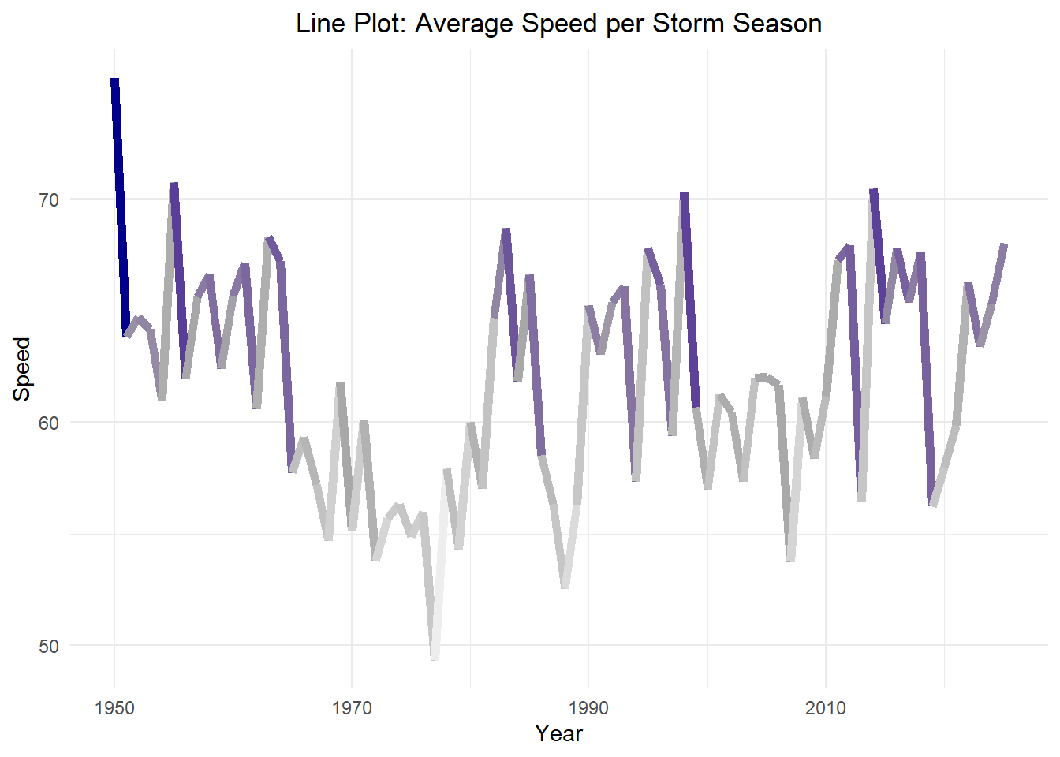
However, the proportion of hurricanes and storm speed have stayed relatively the same

Slide 7
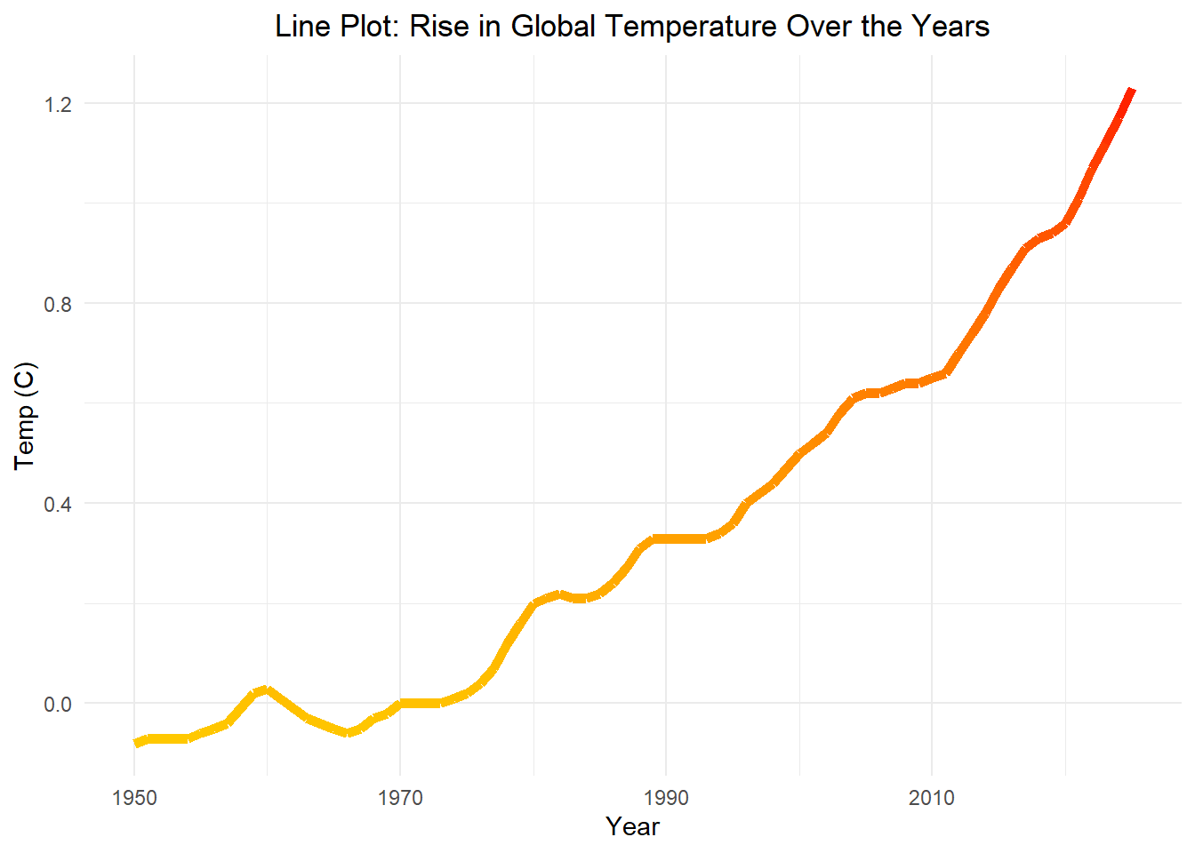
Switching our attention over to global temps, we see that there has been a gradual increase

Slide 8
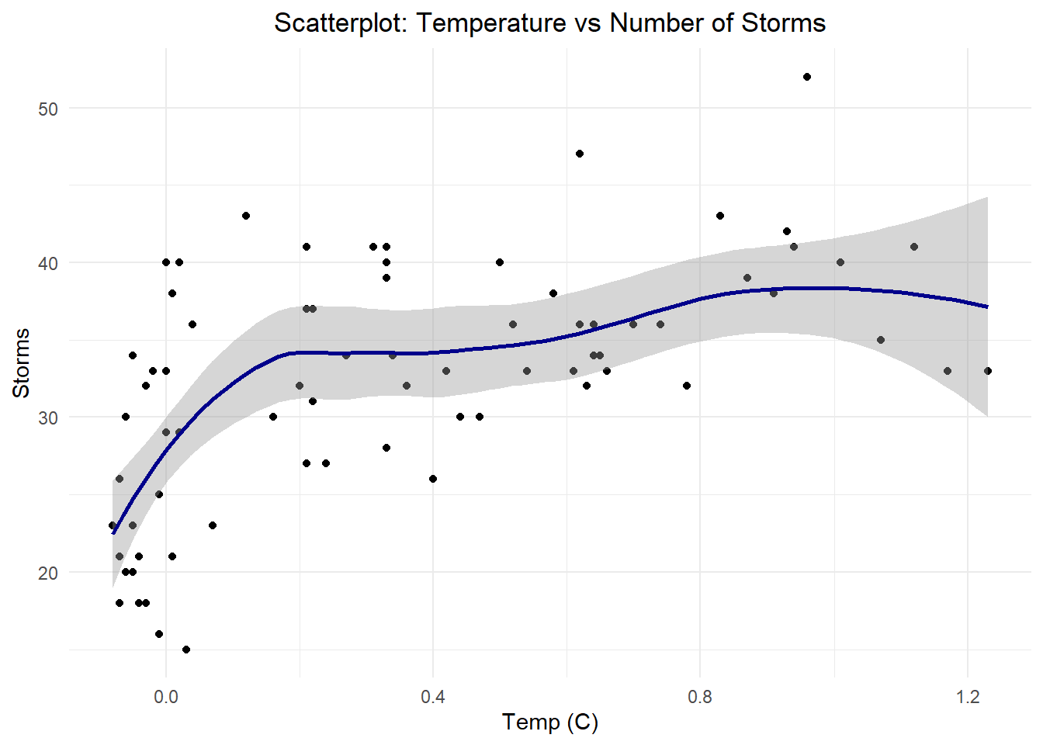
The plot to the left shows a slight but definite correlation between global temps and number of storms

Slide 9
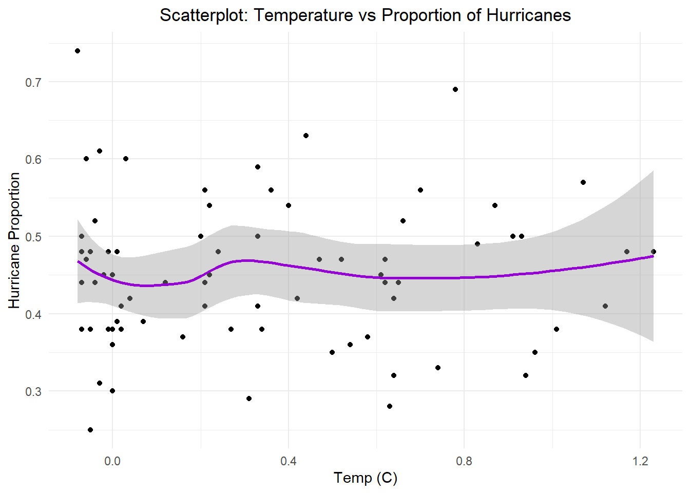
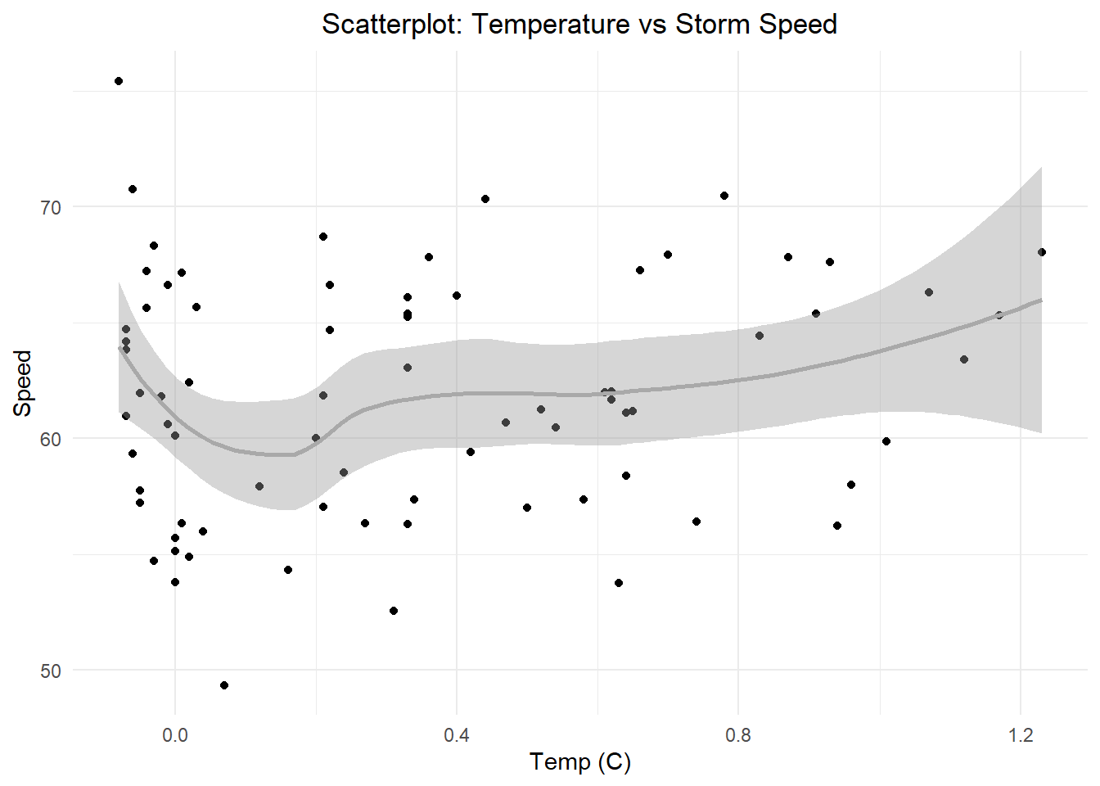
the correlation is not as strong when compared to hurricane proportion and storm speed

Slide 10
Conclusion
As seen in the previous bar charts, there is definitely a rise in seasonal storms and hurricanes
However, the proportion of hurricanes compared to overall storms and storm speed have stayed relatively the same
When looking into global temps we saw an obvious rise, accompanied by a visible correlation between it and number of storms
However, this correlation did not exist between temps and hurricane proportion nor storm speed

Slide 11
Conclusion
These findings indicate that rising temps have led to an increase in number of storms and, although not an increase in hurricane proportion or speeds, inadvertently opened a way for more hurricanes to form in the long run

Slide 12
Sources
Storm Data:
https://www.nhc.noaa.gov/data/#hurdat
Climate Data:
https://science.nasa.gov/earth/explore/earth-indicators/global-temperature/

