Slide 1
PrestaCop drone service system
GAO Xin
HAN Duqing
CHEN Mengyu
HUANG Boyu

Slide 2
Our Procedures：
Drone simulator to send messages
Handle alert messages
Store message from Kafka
Load the CSV file
Analyse stored data

Slide 3
Drone simulator to send messages
1

Slide 4
What do the messages look like?
Drone ID | Date | Time | Location | Status | Violation Code | Image ID
1 | 08/09/2019 | 0752A | 33 | 0 | null | null
2 | 09/09/2019 | 1145P | 20 | 1 | 24 | 11
3 | 10/09/2019 | 0915A | 56 | 2 | null | null
4 | 11/09/2019 | 0410P | 78 | 1 | 40 | 12
5 | 12/09/2019 | 0105P | 39 | 0 | null | null
Status 0: A regular message
Status 1: A message with violation contains Violation Code and Image ID
Status 2: An alert message which the drone cannot judge the violation

Slide 5
How to send messages?
We use Kafka producer to send massages and Kafka consumer to receive the messages.
First, we write a python script to generate the messages and write them in a txt file.
Then, we use Kafka Connect to import the txt file into Kafka producer to send the messages.

Slide 6
How to send messages?
4. Create a Worker Config File:
5. Run Kafka Connect:
6. Read from the Kafka Topic:
1 2 3 4 5 6 7 8 9 10 11 12 13 | # my-standalone.properties worker config file #bootstrap kafka servers bootstrap.servers=localhost:9092 # specify input data format key.converter=org.apache.kafka.connect.storage.StringConverter value.converter=org.apache.kafka.connect.storage.StringConverter # The internal converter used for offsets, most will always want to use the built-in default internal.key.converter=org.apache.kafka.connect.json.JsonConverter internal.value.converter=org.apache.kafka.connect.json.JsonConverter internal.key.converter.schemas.enable=false internal.value.converter.schemas.enable=false # local file storing offsets and config data offset.storage.file.filename=/tmp/connect.offsets
1. Start the Kafka and Zookeeper servers.
2. Creating a Topic to Write to:
3. Create a Source Config File:
1 2 3 4 5 6 | $KAFKA_HOME/bin/kafka-topics.sh \ --create \ --zookeeper localhost:2181 \ --replication-factor 1 \ --partitions 1 \ --topic drone-connect-test
1 2 3 4 5 6 | #my-file-source.properties config file name=local-file-source connector.class=FileStreamSource tasks.max=1 file=/tmp/drone-test.txt topic=drone-connect-test
$KAFKA_HOME/bin/connect-standalone.sh my-standalone.properties my-file-source.properties
1 2 | #read all from topic $KAFKA_HOME/bin/kafka-console-consumer.sh --bootstrap-server localhost:9092 --topic drone-connect-test --from-beginning

Slide 7
Handle alert messages
2

Slide 8
How to handle alert messages ?
We use the parameter Status to distinguish alert messages from all messages:
Status 0: A regular message
Status 1: A message with violation
Status 2: An alert message
When the Status=2, it indicates that this is an alert message which the drone cannot judge the violation and need a human to operate the drone.

Slide 9
Store message from Kafka
3

Slide 10
Connect Kafka on HDInsight to Azure Databricks
Procedures:
1. Create an HDInsight Kafka cluster.
2. Configure the Kafka brokers to advertise the correct address.
3. Create an Azure Databricks cluster.
4. Peer the Kafka cluster to the Azure Databricks cluster.
5. Validate the connection by testing the scenarios.

Slide 11
Load the CSV file
4

Slide 12
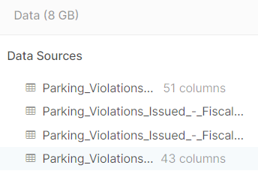
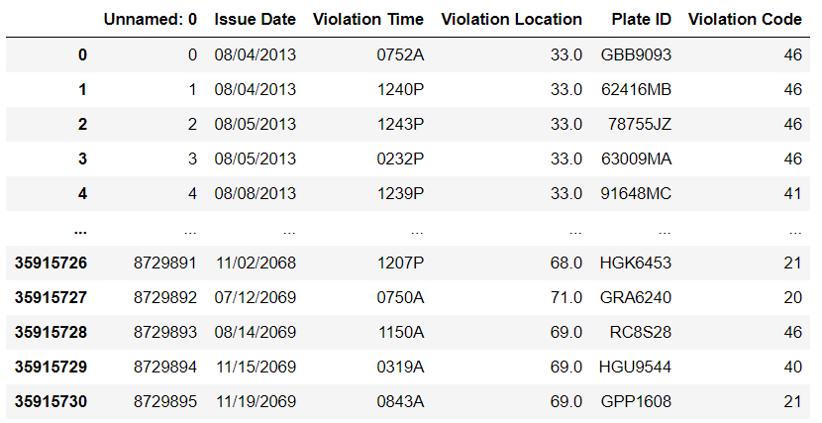
Data process before loading the CSV file
Original CSV file:
▷ 4 files
▷ More than 43 columns
▷ More than 40 million rows
Data processing:
◇ Merge 4 files together
◇ Drop unnecessary columns
◇ Clean dirty data

Slide 13
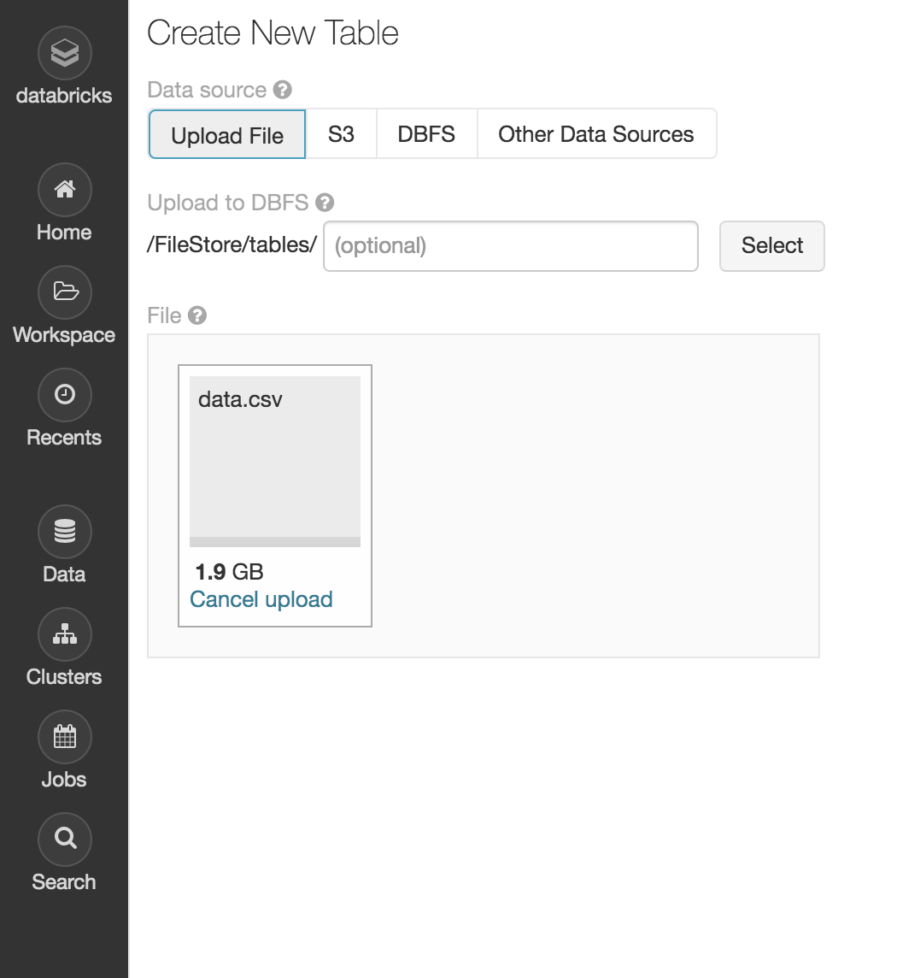
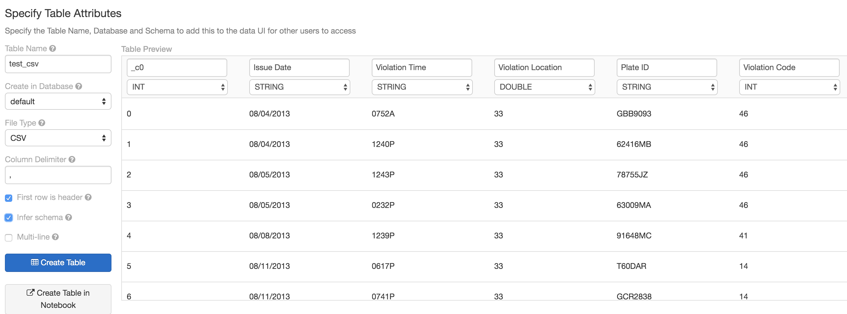
Load the CSV file into Databricks

Slide 14
Analyse stored data
5

Slide 15
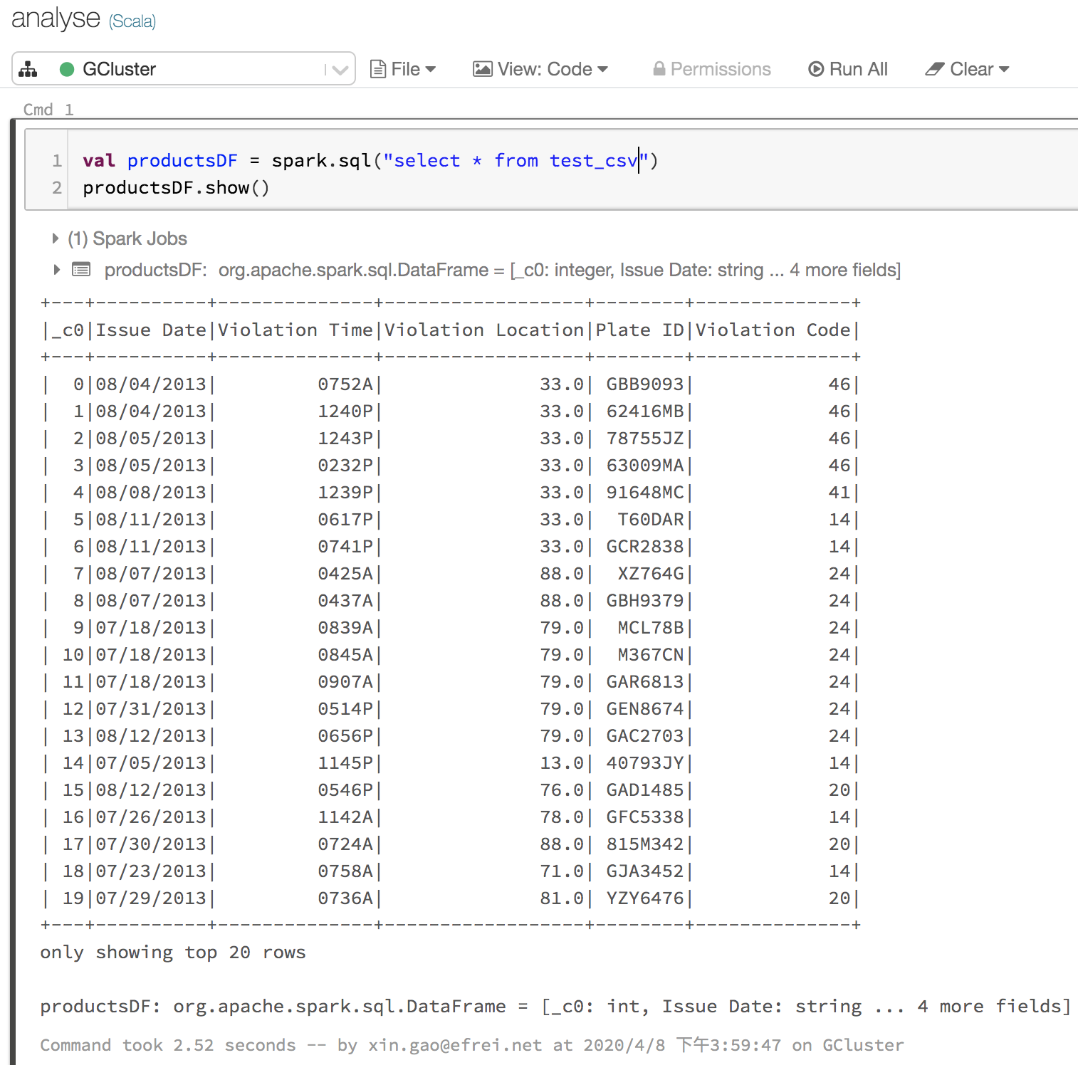
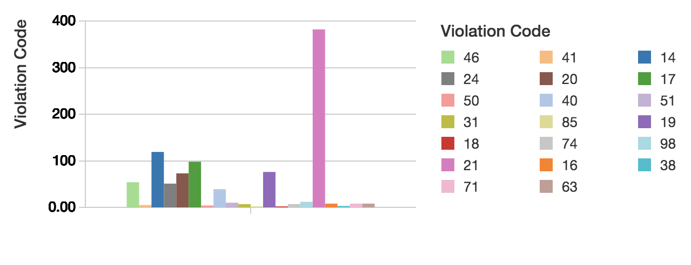
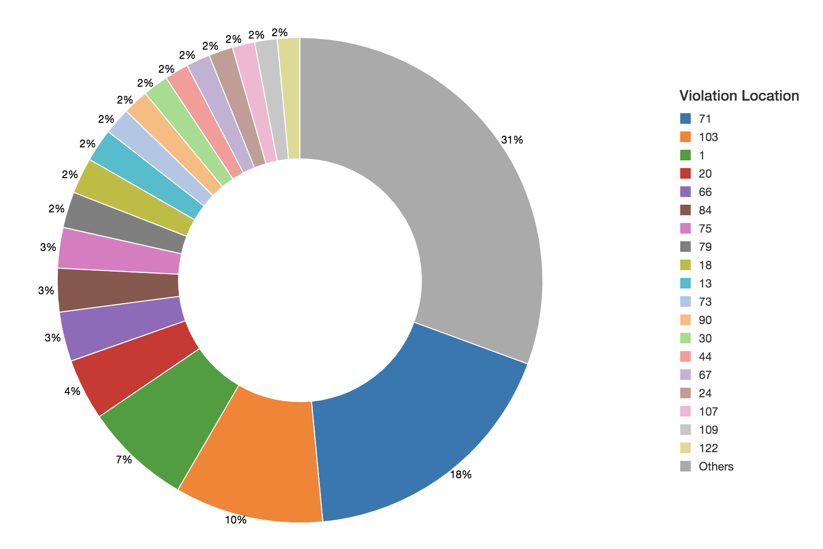
Violation Code Bar Chart:
Violation Location Pie Chart:

Slide 16
Thanks!

