Slide 1
Kinship Recognition with Deep Learning
HAN Duqing
GAO Xin
YE Runpeng

Slide 2
Content
1.
2.
3.
4.
5.
Database
Method Introduction
Experiments
Results and Analysis
Conclusion and future work

Slide 3
Database
1

Slide 4
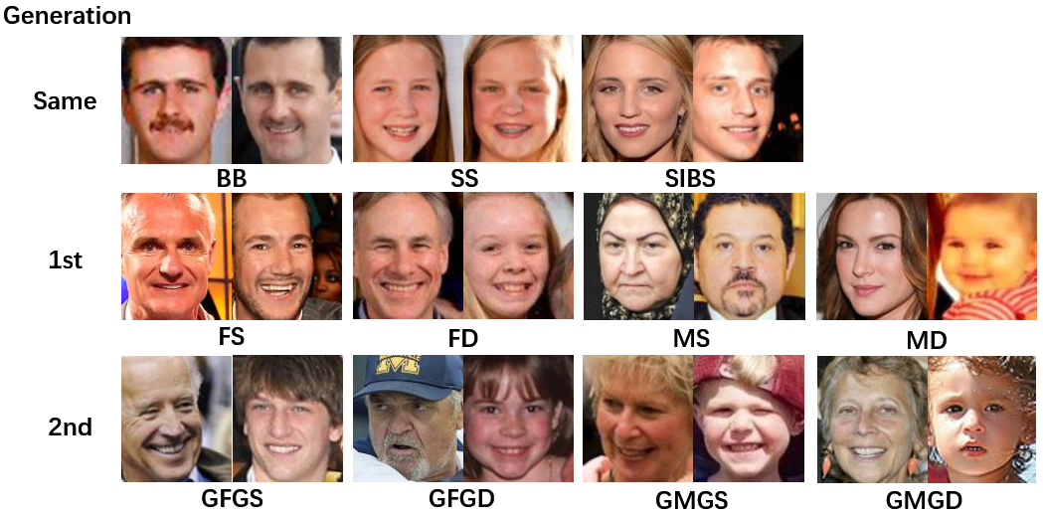
Database：
Over 11,932 family photos
From more than 1,000 families
Families In the Wild (FIW)：

Slide 5
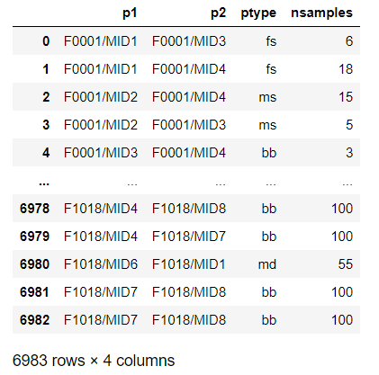
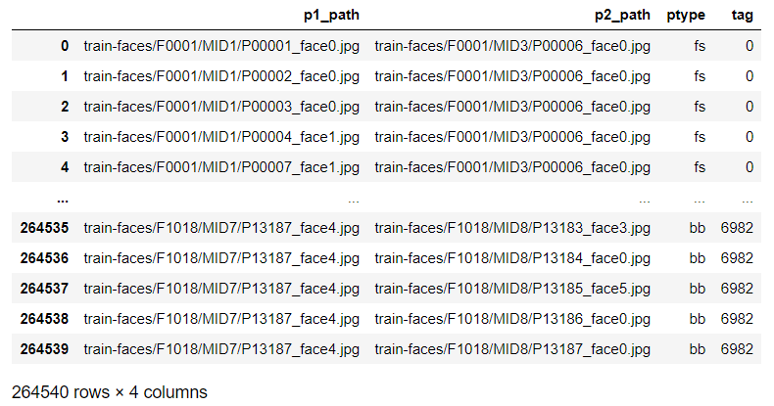
Enrich face image pairs:

Slide 6
Method Introduction
2

Slide 7
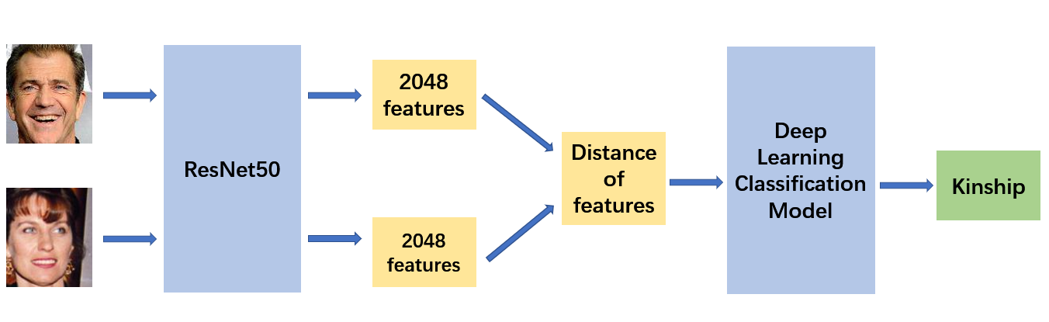
Process Flowchart:

Slide 8
Experiments
3

Slide 9
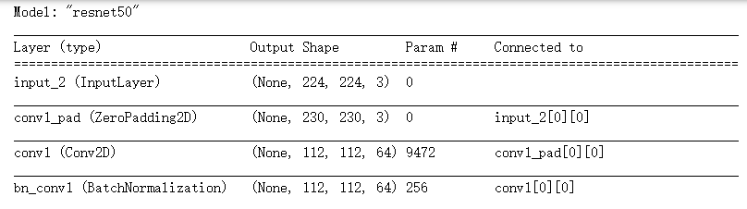
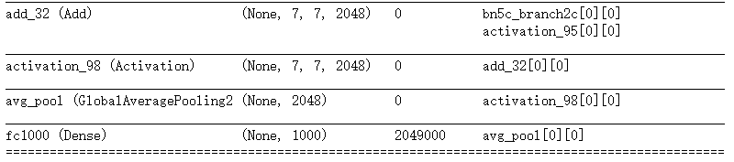
Feature extraction：
ResNet50:
……

Slide 10
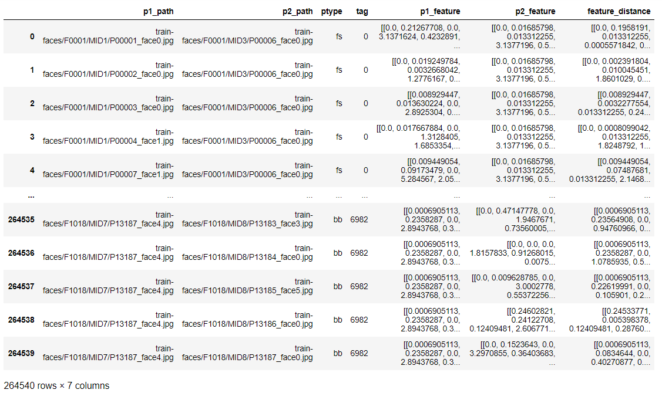
Calculate distance：

Slide 11


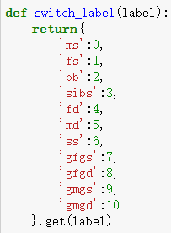

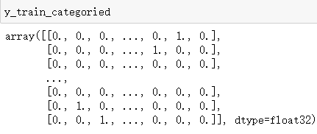
One Hot Encoding：
Keras: String labels
from keras.utils import to_categorical

Slide 12
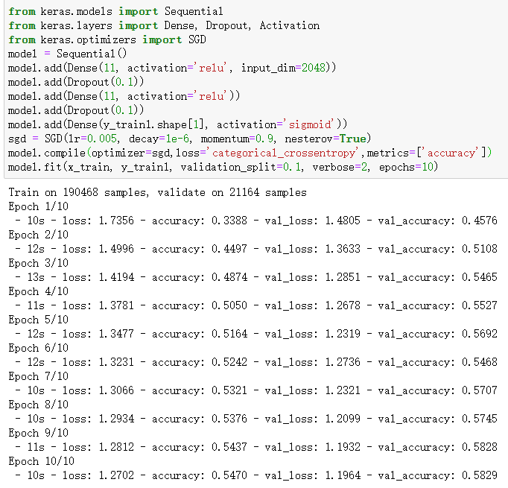

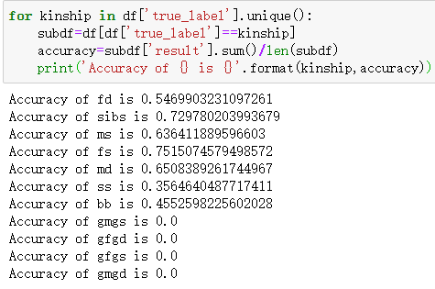
First attempt on classification model：

Slide 13
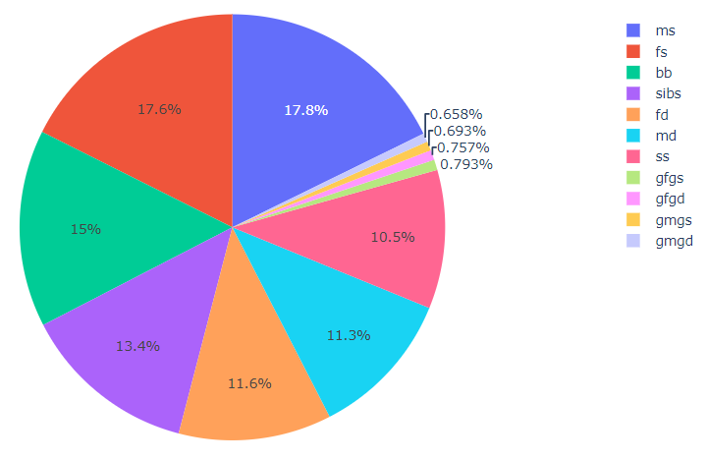
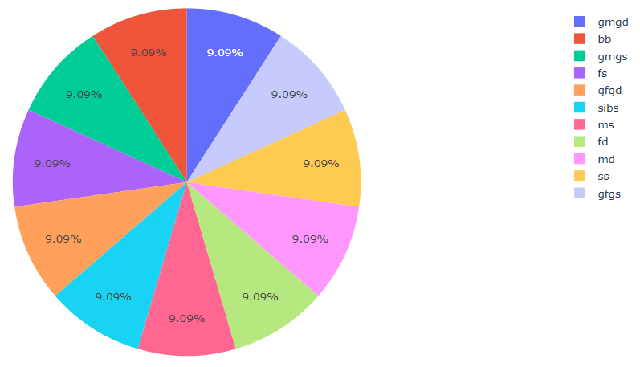
Balance samples：

Slide 14
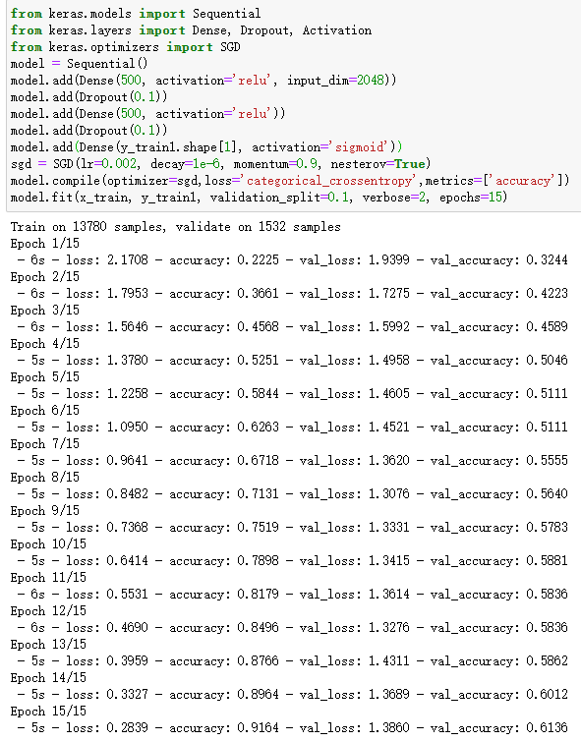
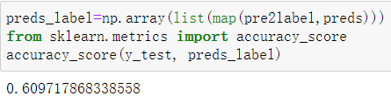
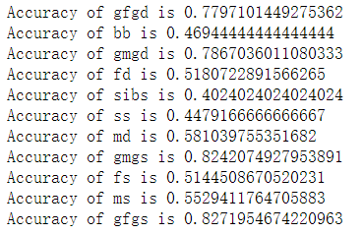
Fine-tuned classification model：

Slide 15
Results and Analysis
4

Slide 16
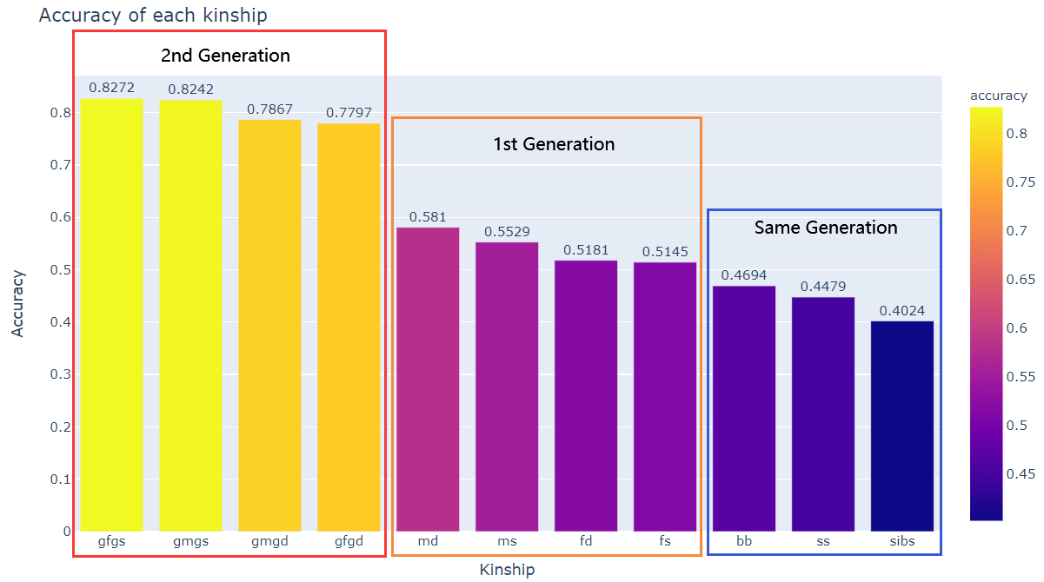
Results and analysis

Slide 17
Conclusion
5

Slide 18
Thanks!

