Slide 1
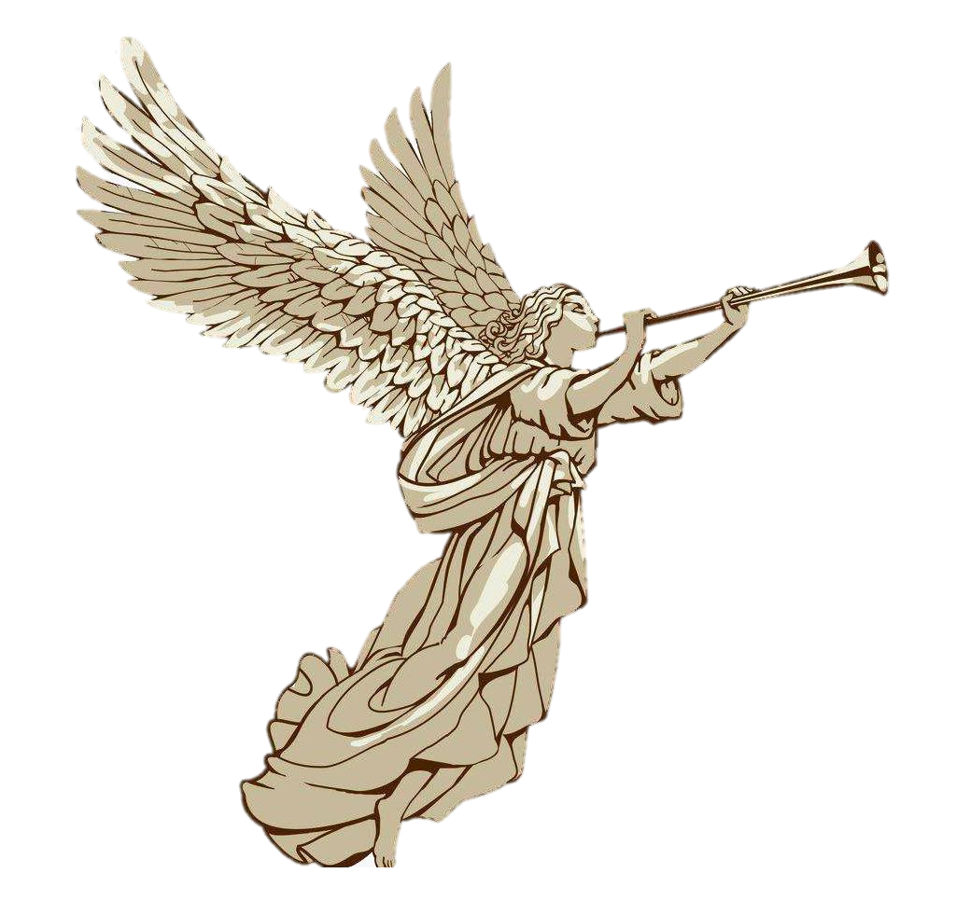
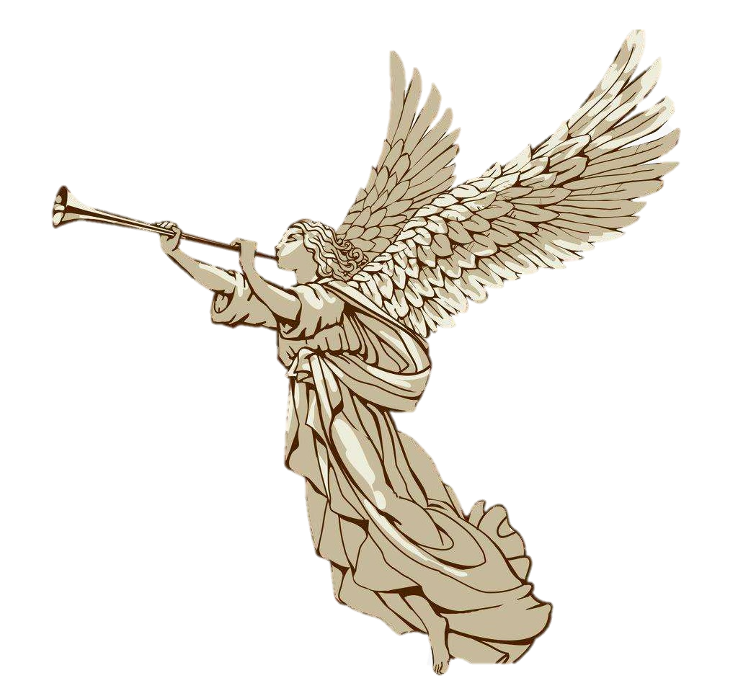
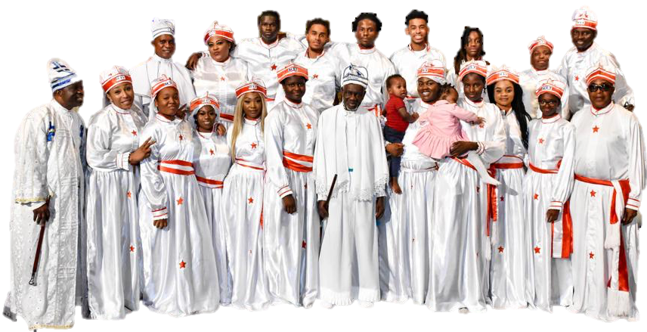
The Eternal Sacred Order Of THE MORNING STAR AND ST.MICHAEL STAR Fountain of Life - Mount Lion LONDON PROVINCE

Slide 2
THE MORNING STAR AND ST.MICHAEL STAR LONDON PROVINCE
I would like to welcome you to the warm embrace of this Family Church where; Loving God and loving one another is a cherished culture. Your peculiarity is treasured and integrated. Your spiritual life is built on the strong foundation of Faith and the power of the Holy Ghost.

Slide 3


Slide 4
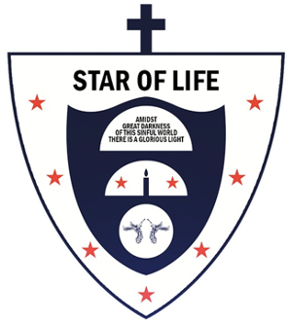
CHURCH OF THE
Eso Morningstar

Slide 5




