Slide 1

An internal solution for calculating proximity-based metrics when using PPI
Presenter:
Steven Lawrence' MS
PhD Student, NYU Grossman School of Medicine

Slide 2
Overview
Background
Objective
What is OSRM?
Proximity calculating Protocol
Challenges
Future directions

Slide 3
Background
Chronic health conditions account for 90% of health care cost in the US
Effective management of chronic disease has been shown to bring down costs
Better management has been linked to having access to pharmacy by improving one aspect of management, medication adherence
National Center for Disease Chronic Disease Prevention and health Promotion. Chronic disease facts and statistics. https://www.cdc.gov/chronic-14disease/data-research/facts-stats/?CDCAArefV al = https ://www.cdc.gov/chronicdisease/about/costs/index.htm, 2024. Accessed : 2024 − 08 − 28.
Osayi E. Akinbosoye, Michael S. Taitel, James Grana, Jerrold Hill, and Rolin L. Wade. Improving medication adherence and health care outcomes in a commercial population through a community pharmacy. Population Health Management, 19:454–461, 12 2016.
Philippe Amstislavski, Ariel Matthews, Sarah Sheffield, Andrew R. Maroko, and Jeremy Weedon. Medication deserts: survey of neighborhood disparities in availability of prescription medications. International Journal of Health Geographics, 11, 2012.

Slide 4
Background Continued
Access is most popularly defined as accessibility (proximity) and availability (density)
Examples of proximity measures are travel time or distance between locations
An example of availability is the ratio of supply to demand
Brígida Dias Fernandes, Aline Aparecida Foppa, Paulo Henrique, Ribeiro Fernandes Almeida, Ali Lakhani, Tácio De, and Mendonça Lima. Application and utility of geographic information systems in pharmacy specific health research: A scoping review. Research in Social and Administrative Pharmacy, 18:3263–3271, 2022

Slide 5
Objective
Calculate proximity metrics between patient addresses and pharmacies within NYU's firewall
Use an open source software such as the open street routing machine (OSRM) for its compatibility with R
Utilize NYU's high performance computing (HPC) resource given the memory requirements of calculating routes through a road network
Remain HIPPA compliant when using patient protected information (PPI) such as a patient's address

Slide 6
Problem
Current methods for calculating proximity through a road network require cloud usage or proprietary software
Using cloud service outside of the institutions firewall violates HIPPA regulations and using proprietary software can be limiting
Alternative methods calculate proximity metrics that use PPI by
Scattering coordinates
Use a synthetic dataset of the region
Use centroid as proxy for patient addresses
Kahn, R. M., Ma, X., Gordhandas, S., Yeoshoua, E., Ellis, R. J., Zhang, X., ... & Chi, D. S. (2024). Regionalizing ovarian cancer cytoreduction to high-volume centers and the impact on patient travel in New York State. Gynecologic Oncology, 182, 141-147.
Berenbrok, L. A., Tang, S., Gabriel, N., Guo, J., Sharareh, N., Patel, N., ... & Hernandez, I. (2022). Access to community pharmacies: A nationwide geographic information systems cross-sectional analysis. Journal of the American Pharmacists Association, 62(6), 1816-1822.

Slide 7
Open Street Routing Machine
An open street routing machine (OSRM) calculates proximity between locations using nodes in an open street map
Nodes contain information street attributes such as
legal speed,
what types of turns are allowed,
is this street a one way etc.
Project OSRM can be accessed via the cloud service platform (link) to calculate proximity metrics for driving, foot, and bicycle profiles
Route
Table
Nearest
Trip

Slide 8
OSRM service and R package
Project OSRM allows backend and frontend image to be used locally
Open Street Map extracts can be downloaded (here)
NYU uses singularity containers which required building the osrm backend from scratch
Map file is extracted, partitioned, and customized to work with the routing machine housed in a container
Start routing engine
Make http requests
Store routes in a dataframe

Slide 9
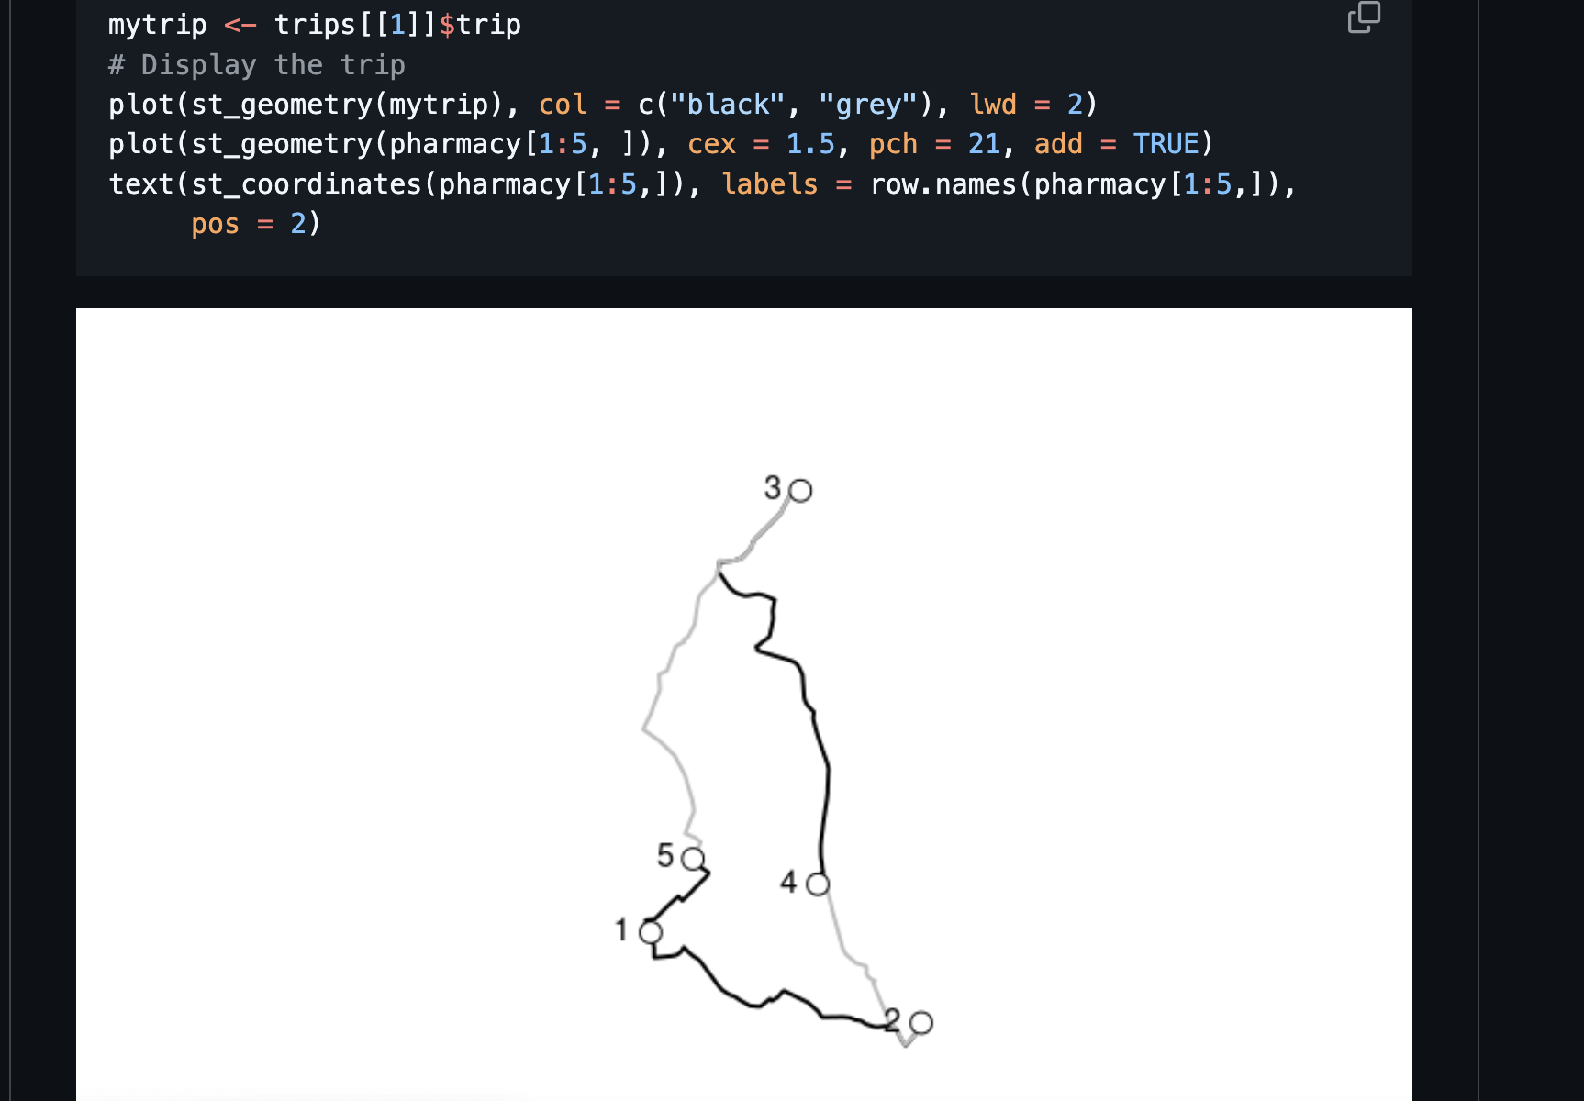
OSRM R package (there is support)
Riatelab has developed R functions that utilize the osrm service (link)
When utilizing the functions, the local container hosting the routing machine is accessed using http requests
Customize functions are also able to be created to utilize the osrm service very quickly

Slide 10
Proximity Calculation Protocol when using HPC
Load data and code into working directory
Using secure copy protocol (SCP)
Customize job specifications
Resources needed
Modules used (R, singularity)
Determines arguments to pass from slurm environment to R code
File paths and coordinate column names
Ports for singularity container
Destinations of where output should be stored
Set up job using slurm code
Allow the R code to wait until the route engine is running
Store routes in a dataframe and extract the proximity metrics

Slide 11
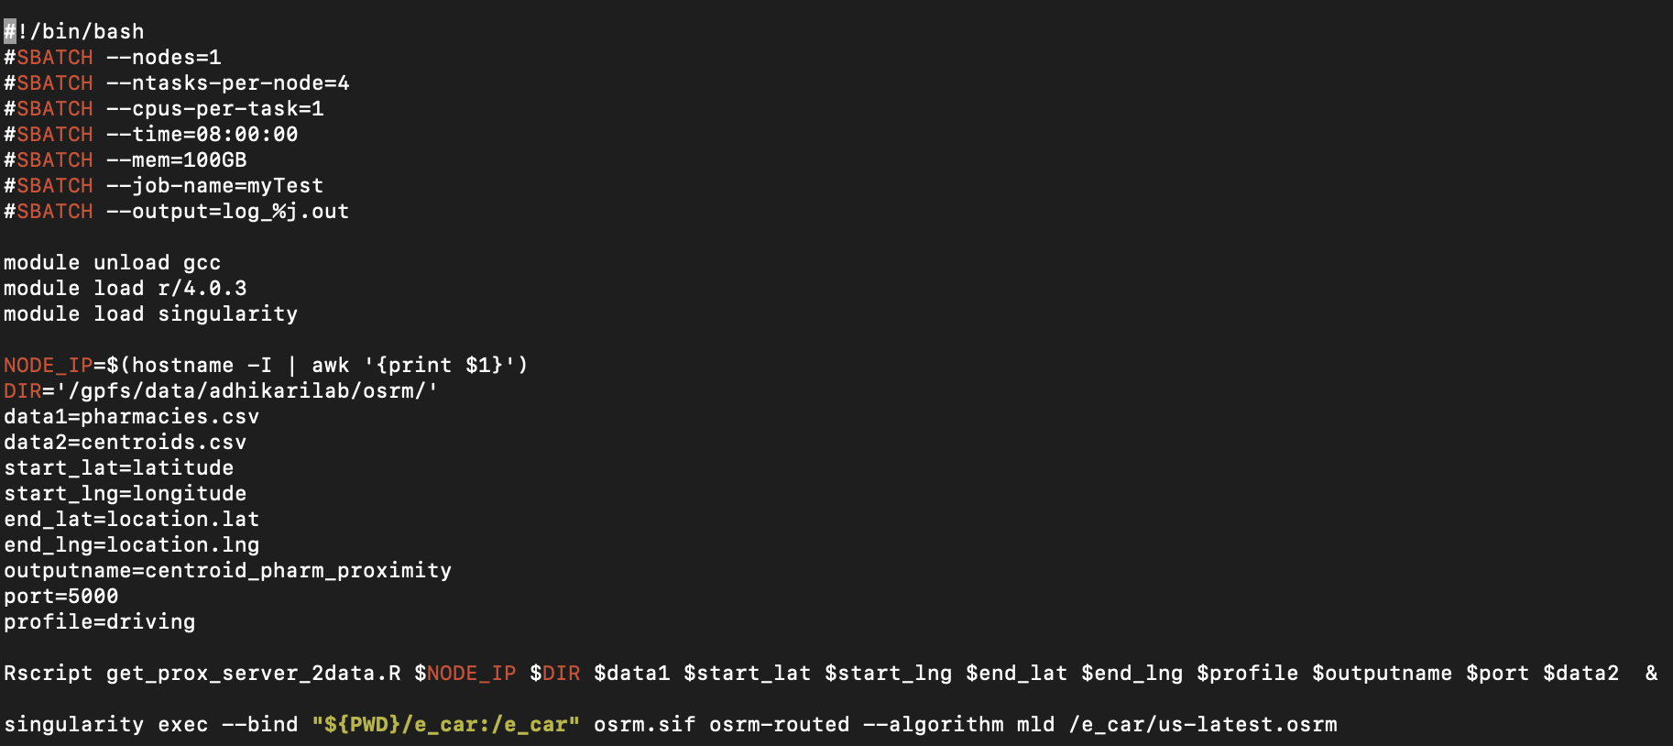
Slurm Code
Job specifications
Patient_locations.csv
pharmacy_locations.csv
Patient_to_pharmacy_proximity.csv

Slide 12
Slurm Code
Patient_locations.csv
pharmacy_locations.csv
Arguments to pass on
Patient_to_pharmacy_proximity.csv

Slide 13
Slurm Code
Patient_locations.csv
pharmacy_locations.csv
Patient_to_pharmacy_proximity.csv
R code and singularity container specifications

Slide 14
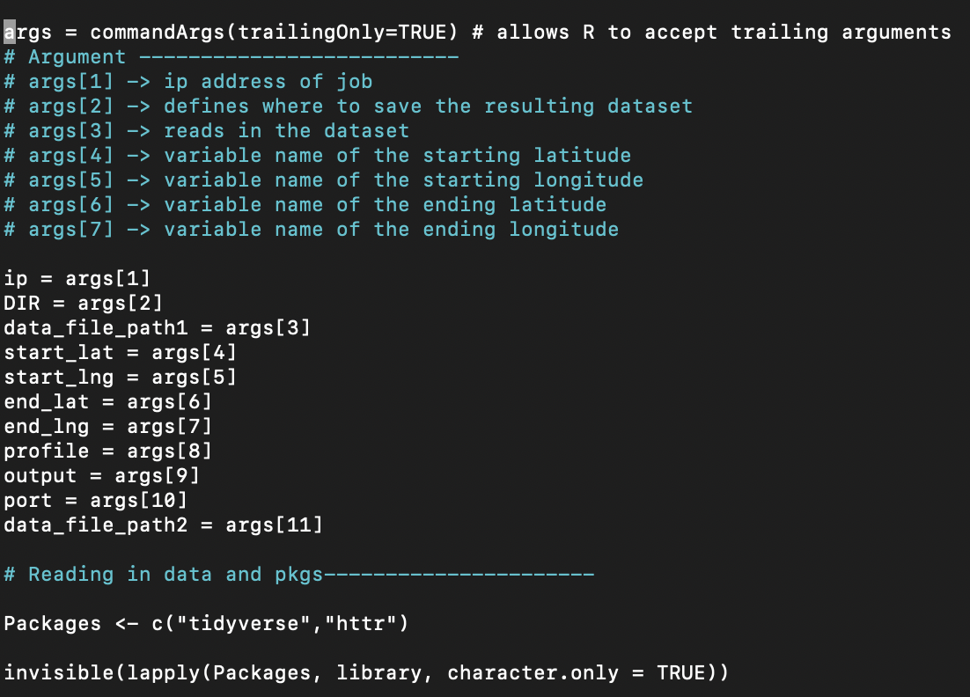
R code
Arguments to passed on

Slide 15
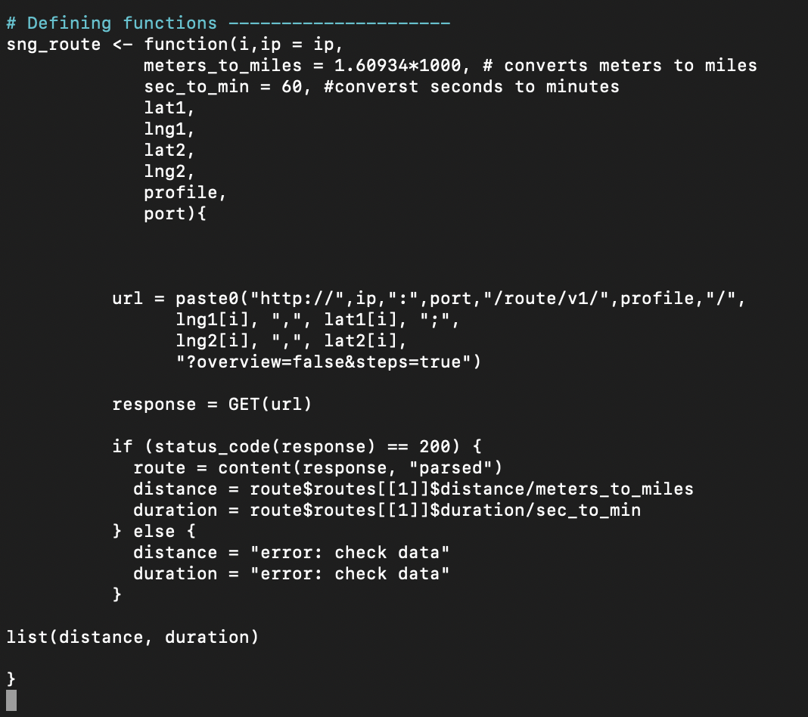
R code – user defined functions

Slide 16
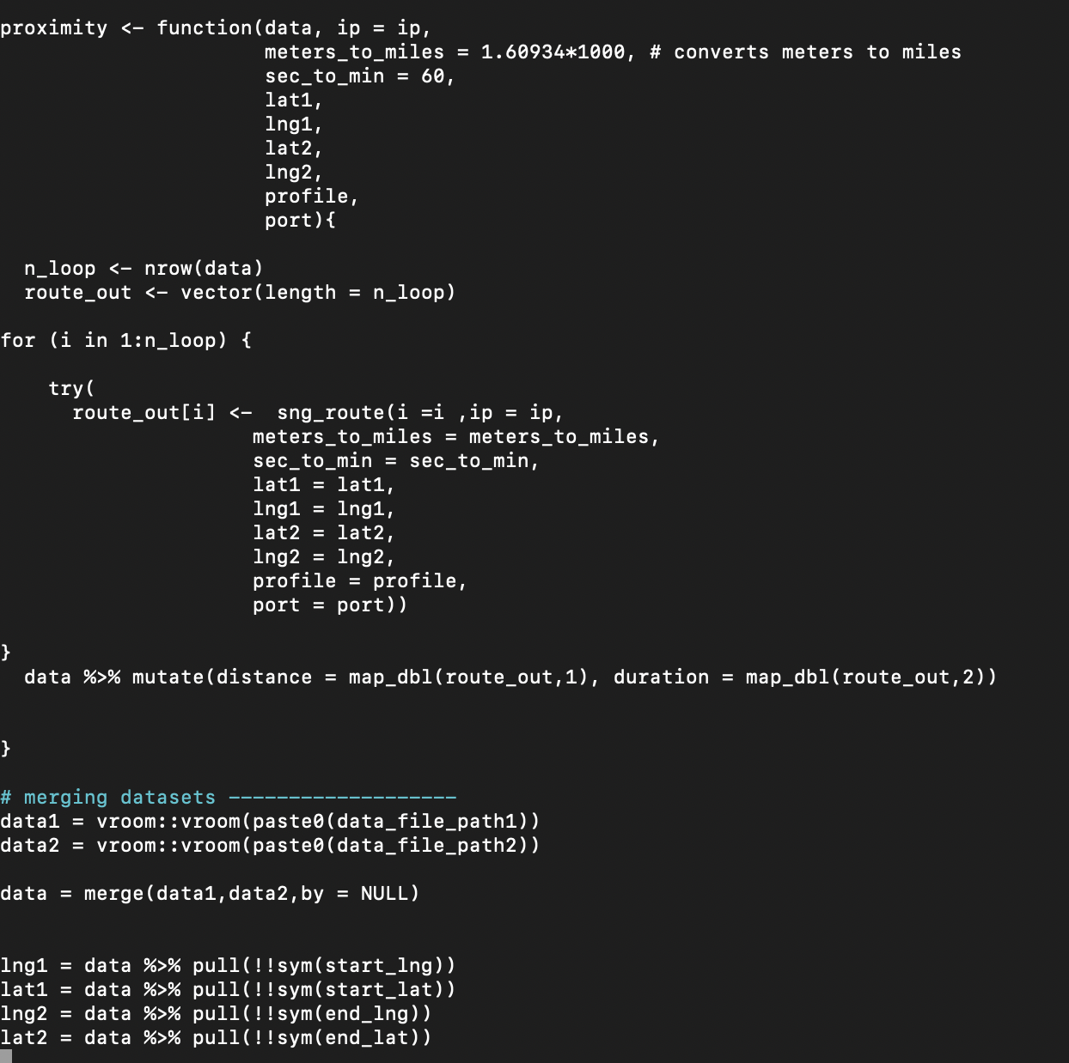
R code – user defined functions

Slide 17
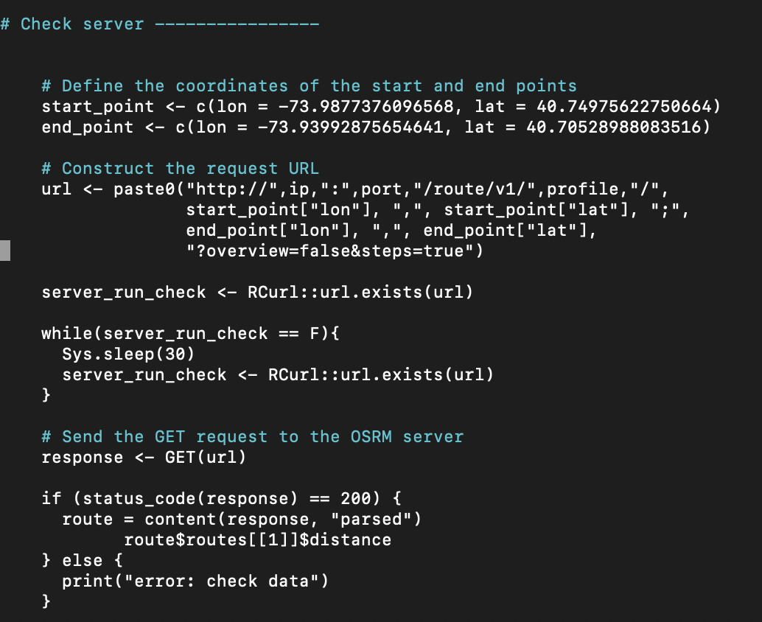
R Code – user defined functions

Slide 18
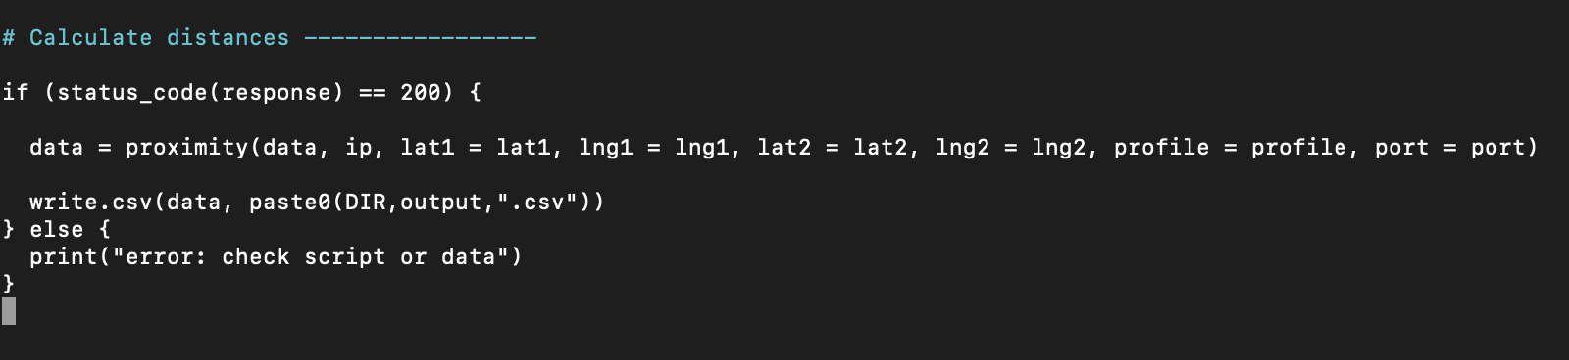
R Code – user defined functions

Slide 19
Computation challenges
Calculating proximity between two sets of locations will result in n by m number of calculations
Current OSRM threading only allows for 4 route calculations at a single time
more compute will not speed up the process

Slide 20
Future directions
Test singularity container built to run osrm r package to use isochrone/isodistance functions to reduce calculation time
Write slurm code that will spin up multiple singularity containers to utilize more compute capacity in a single job (link)
Make a copy of the OSRM singularity container widely available included the extracted map files
Add an Open Trip Planner container to work flow

Slide 21
Acknowledgements
Samrachana Adhikari
Saul B Blecker
Amrita Mukhyopadhyay
Rumi Chunara
Cassidy Fitchett
Andrew Fair
Kevin Yie
Veronika Bailey
Tyrel Stokes

Slide 22
Thank you!
Questions?
Link to example slurm code and R functions
https://github.com/SL-itw/osrm-slurm

