Slide 1
STA623 Bayesian Data Analysis
Session 4: Markov Chain Monte Carlo Marc Henrion

Slide 2

Preliminaries
These notes were written in quarto.
All examples / code in these notes is R and a combination of NIMBLE / BUGS for Bayesian model specification.
GitHub repository - will contain all course materials by the end of the week.
https://github.com/gitMarcH/UNIMA_STA623_2025

Slide 3
Preliminaries
Some references for Bayesian statistics / data analysis are:
Hoff, P.D. (2009). “A First Course in Bayesian Statistical Methods.” Springer.
Gelman, A., Carlin, J.B., Stern, H.S., Dunson, D.B., Vehtari, A., Rubin, D.B. (2014). “Bayesian Data Analysis”. 3rd ed. CRC Press.
Ramoni, M., Sebastiani, P. (2007), ‘Bayesian Methods’, in Berthold, M., Hand, D.J. (eds.). “Intelligent Data Analysis”, 2nd ed., Springer, pp.131-168
Stone, J.V. (2013). “Bayes’ Rule: A Tutorial Introduction to Bayesian Analysis”. Sebtel Press.

Slide 4
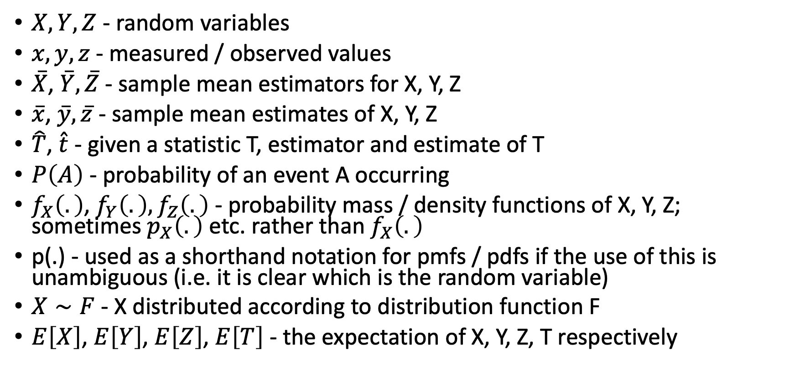
Notation
$X,Y,Z$ - random variables
$x,y,z$ - measured / observed values
$\overset{‾}{X}$, $\overset{‾}{Y},\overset{‾}{Z}$ - sample mean estimators for X, Y, Z
$\overset{‾}{x}$, $\overset{‾}{y},\overset{‾}{z}$ - sample mean estimates of X, Y, Z
$\hat{T}$, $\hat{t}$ - given a statistic T, estimator and estimate of T
$P\left(A\right)$ - probability of an event A occurring
$f_{X}\left(.\right)$, $f_{Y}\left(.\right),f_{Z}\left(.\right)$ - probability mass / density functions of X, Y, Z; sometimes $p_{X}\left(.\right)$ etc. rather than $f_{X}\left(.\right)$
p(.) - used as a shorthand notation for pmfs / pdfs if the use of this is unambiguous (i.e. it is clear which is the random variable)
$X∼F$ - X distributed according to distribution function F
$E\left[X\right]$, $E\left[Y\right]$, $E\left[Z\right]$, $E\left[T\right]$ - the expectation of X, Y, Z, T respectively

Slide 5
MONTE CARLO APPROXIMATION

Slide 6
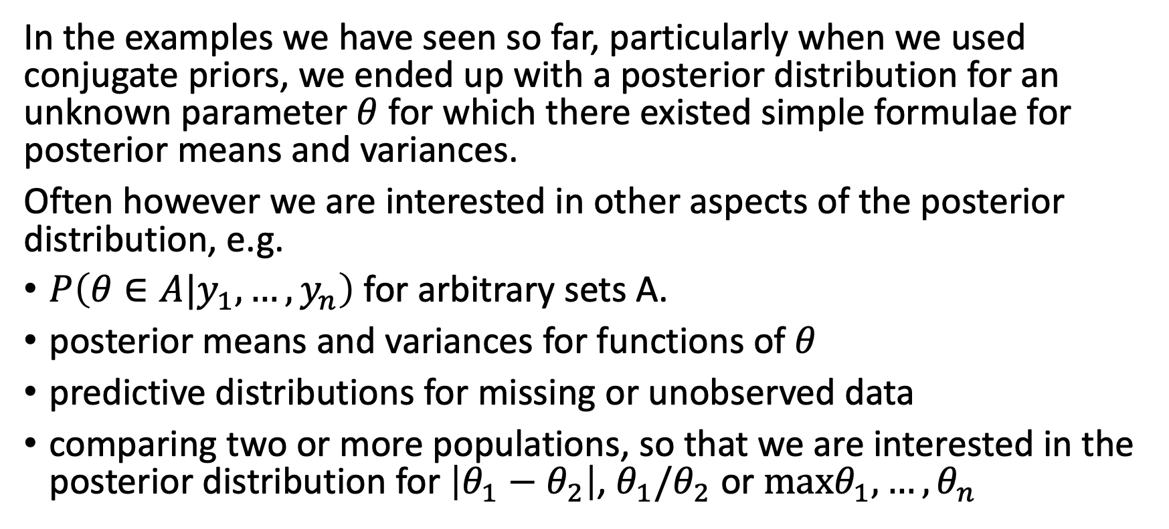
Monte Carlo
In the examples we have seen so far, particularly when we used conjugate priors, we ended up with a posterior distribution for an unknown parameter $θ$ for which there existed simple formulae for posterior means and variances.
Often however we are interested in other aspects of the posterior distribution, e.g.
$P\left(θ∈A|y_{1},…,y_{n}\right)$ for arbitrary sets A.
posterior means and variances for functions of $θ$
predictive distributions for missing or unobserved data
comparing two or more populations, so that we are interested in the posterior distribution for $\left|θ_{1}−θ_{2}\right|$, $θ_{1}/θ_{2}$ or $maxθ_{1},…,θ_{n}$

Slide 7
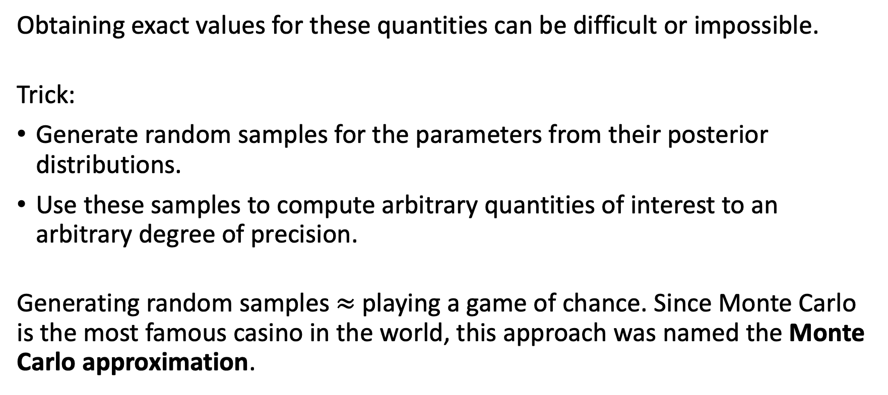
Monte Carlo
Obtaining exact values for these quantities can be difficult or impossible.
Trick:
Generate random samples for the parameters from their posterior distributions.
Use these samples to compute arbitrary quantities of interest to an arbitrary degree of precision.
Generating random samples $≈$ playing a game of chance. Since Monte Carlo is the most famous casino in the world, this approach was named the Monte Carlo approximation.

Slide 8
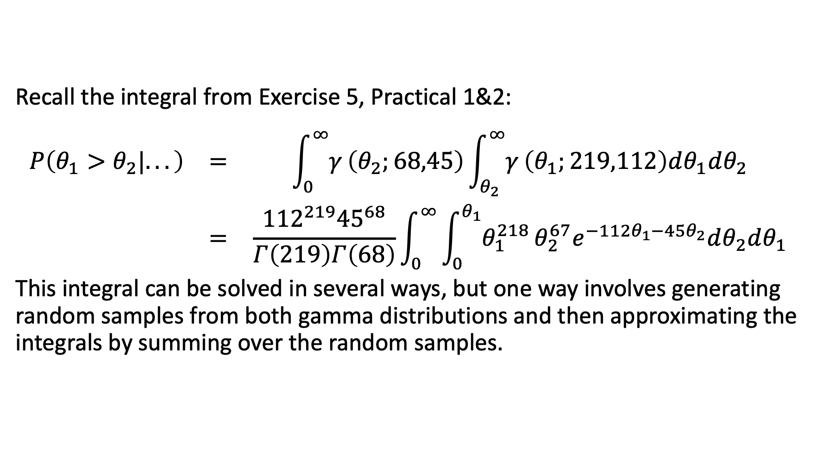
Monte Carlo
Recall the integral from Exercise 5, Practical 1&2:
$$\begin{matrix}P\left(θ_{1}>θ_{2}|...\right) & = & \int_{0}^{∞}{γ}\left(θ_{2};68,45\right)\int_{θ_{2}}^{∞}{γ}\left(θ_{1};219,112\right)dθ_{1}dθ_{2} \\ & = & \frac{{112}^{219}{45}^{68}}{Γ\left(219\right)Γ\left(68\right)}\int_{0}^{∞}{\int_{0}^{θ_{1}}{θ_{1}^{218}}}θ_{2}^{67}e^{−112θ_{1}−45θ_{2}}dθ_{2}dθ_{1}\end{matrix}$$
This integral can be solved in several ways, but one way involves generating random samples from both gamma distributions and then approximating the integrals by summing over the random samples.

Slide 9
Monte Carlo
In Exercise 5, Practical 1&2, we solved the integral analytically by doing the integral (albeit by using a computer programme to help with this) and found $P\left(θ_{1}>θ_{2}|...\right)=0.9726$.
Now let’s do it by sampling and approximating:
N<-1e5 theta1<-rgamma(n=N,shape=219,rate=112) theta2<-rgamma(n=N,shape=68,rate=45) sum(theta1>theta2)/N
[1] 0.97345

Slide 10
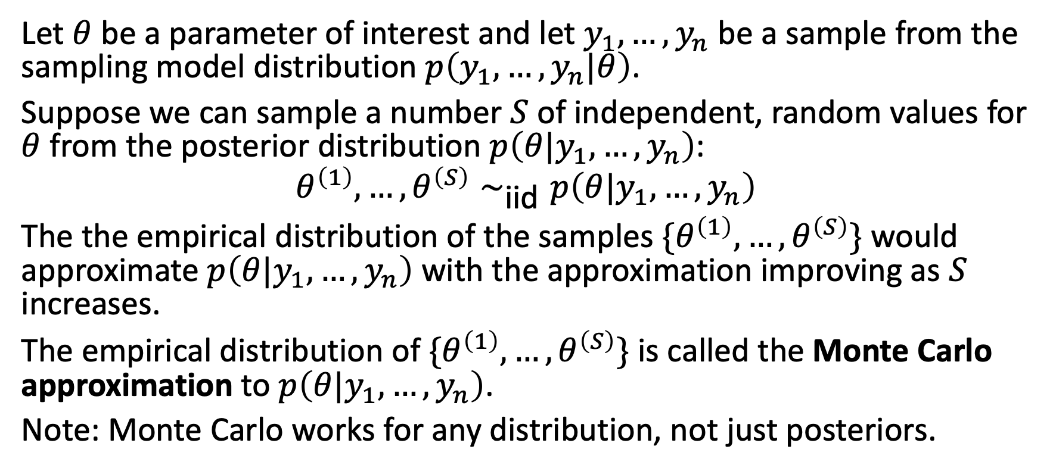
Monte Carlo
Let $θ$ be a parameter of interest and let $y_{1},…,y_{n}$ be a sample from the sampling model distribution $p\left(y_{1},…,y_{n}|θ\right)$.
Suppose we can sample a number $S$ of independent, random values for $θ$ from the posterior distribution $p\left(θ|y_{1},…,y_{n}\right)$:
$$θ^{\left(1\right)},…,θ^{\left(S\right)}∼_{\text{iid}}p\left(θ|y_{1},…,y_{n}\right)$$
The the empirical distribution of the samples $\{θ^{\left(1\right)},…,θ^{\left(S\right)}\}$ would approximate $p\left(θ|y_{1},…,y_{n}\right)$ with the approximation improving as $S$ increases.
The empirical distribution of $\{θ^{\left(1\right)},…,θ^{\left(S\right)}\}$ is called the Monte Carlo approximation to $p\left(θ|y_{1},…,y_{n}\right)$.
Note: Monte Carlo works for any distribution, not just posteriors.

Slide 11
Monte Carlo
The Law of Large Numbers (LLN) is why Monte Carlo works: by the LLN
$$\frac{1}{S}\sum_{s}^{​}{g}\left(θ^{\left(s\right)}\right)→E\left[g\left(θ\right)|y_{1},…,y_{n}\right] \text{as} S→∞$$
where $E\left[g\left(θ\right)|y_{1},…,y_{n}\right]=∫g\left(θ\right)p\left(θ|y_{1},…,y_{n}\right)dθ$.

Slide 12
Monte Carlo
For example, this means that as $S→∞$:
$\overset{‾}{θ}=\sum_{s}^{​}{θ^{\left(s\right)}}/S→E\left[θ|y_{1},…,y_{n}\right]$
$\sum_{s}^{​}{{\left(θ^{\left(s\right)}−\overset{‾}{θ}\right)}^{2}}/\left(S−1\right)→Var\left(θ|y_{1},…,y_{n}\right)$
$\#\left(θ^{\left(s\right)}≤c\right)/S→P\left(θ≤c|y_{1},…,y_{n}\right)$
the $α^{th}$ percentile of $\{θ^{\left(1\right)},…,θ^{\left(S\right)}\}→θ_{α}$
$…$
We can approximate just about any aspect of the distribution $p\left(θ|y_{1},…,y_{n}\right)$ in this way and with an arbitrary degree of precision given a large enough sample.

Slide 13
Monte Carlo - Example
Recall for a $Γ\left(a,b\right)$ prior with a $Pois\left(λ\right)$ sampling model for some data $y_{1},…,y_{n}$, the posterior distribution is $Γ\left(a+\sum_{i}^{​}{y_{i}},b+n\right)$.
In Practical 3, Exercise 3, we had $a=5,b=2,n=18,\sum_{i}^{​}{y_{i}}=40$, yielding a $Γ\left(45,20\right)$ posterior.

Slide 14
Monte Carlo - Example
Exercise:
Use Monte Carlo, with sizes $S=10,100,1000,10000$ to approximate
the posterior mean $E\left[λ|y_{1},…,y_{n}\right]$
the posterior probability $P\left(λ<2.1|y_{1},…,y_{n}\right)$
the 95% quantile-based Bayesian confidence interval

Slide 15
Monte Carlo - Example
Let’s first draw some Monte Carlo samples:
set.seed(1234) a<-5; b<-2 sy<-40; n<-18 s10<-rgamma(n=10,shape=a+sy,rate=b+n) s100<-rgamma(n=100,shape=a+sy,rate=b+n) s1000<-rgamma(n=1000,shape=a+sy,rate=b+n) s10000<-rgamma(n=10000,shape=a+sy,rate=b+n)

Slide 16
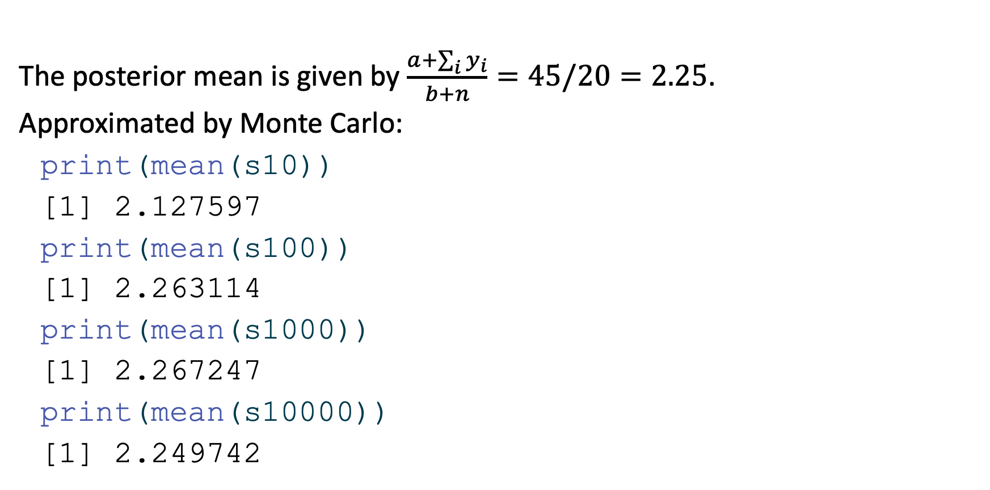
Monte Carlo - Example
The posterior mean is given by $\frac{a+\sum_{i}^{​}{y_{i}}}{b+n}=45/20=2.25$.
Approximated by Monte Carlo:
print(mean(s10))
[1] 2.127597
print(mean(s100))
[1] 2.263114
print(mean(s1000))
[1] 2.267247
print(mean(s10000))
[1] 2.249742

Slide 17
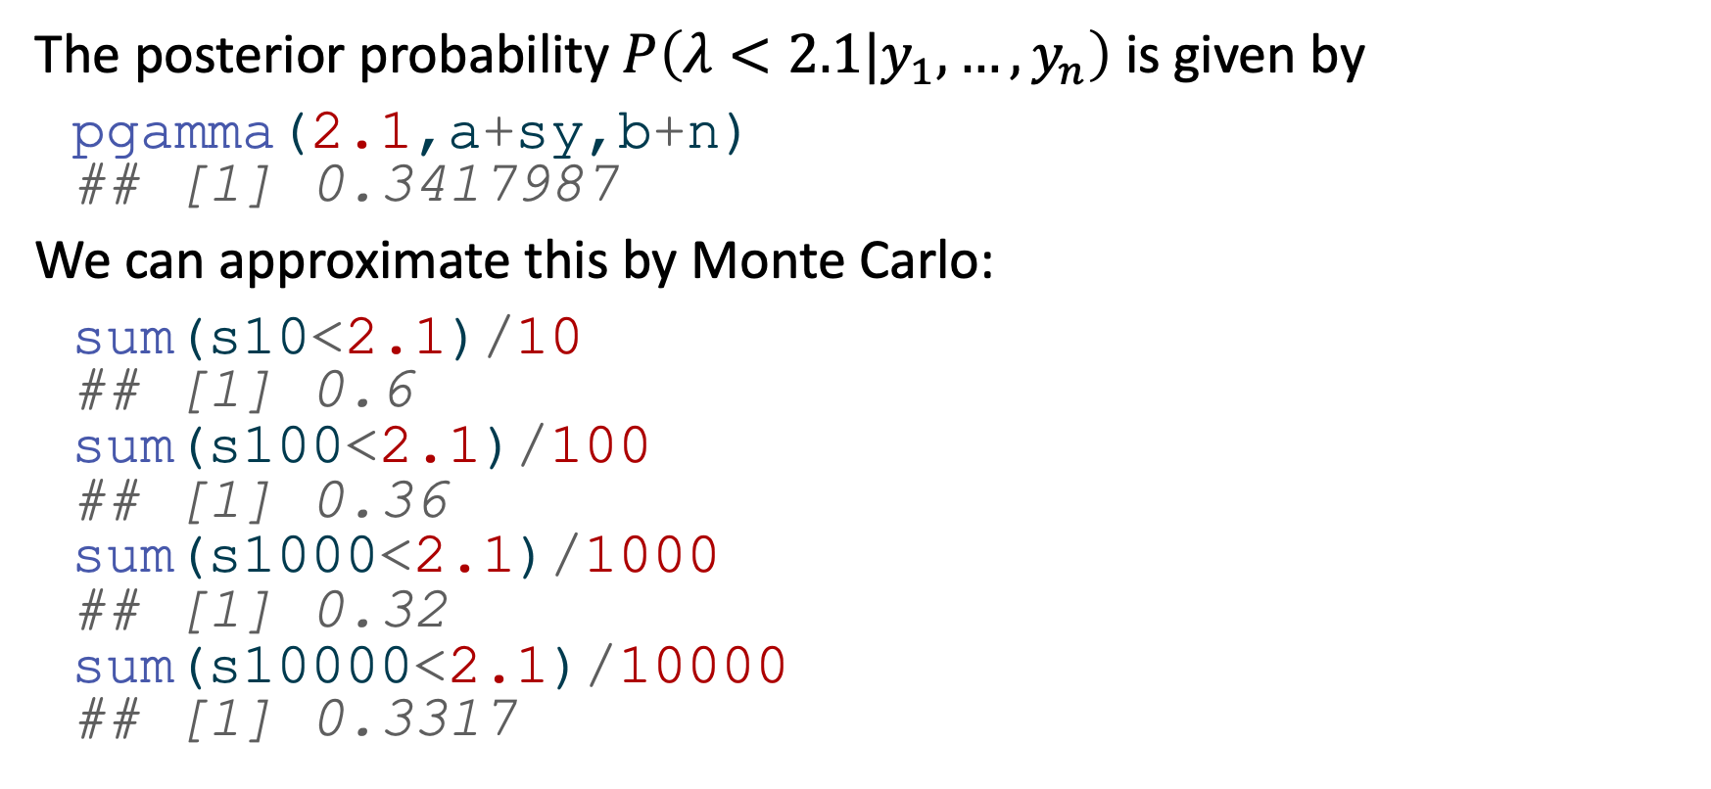
Monte Carlo - Example
The posterior probability $P\left(λ<2.1|y_{1},…,y_{n}\right)$ is given by
pgamma(2.1,a+sy,b+n) ## [1] 0.3417987
We can approximate this by Monte Carlo:
sum(s10<2.1)/10 ## [1] 0.6 sum(s100<2.1)/100 ## [1] 0.36 sum(s1000<2.1)/1000 ## [1] 0.32 sum(s10000<2.1)/10000 ## [1] 0.3317

Slide 18
Monte Carlo - Example
The quantile based 95% Bayesian confidence interval is given by:
qgamma(c(0.025,0.975),a+sy,b+n) ## [1] 1.641165 2.953397
This too we can approximate using Monte Carlo, by taking empirical quantiles of the samples:
quantile(s10,probs=c(0.025,0.975)) ## 2.5% 97.5% ## 1.715649 2.527271 quantile(s100,probs=c(0.025,0.975)) ## 2.5% 97.5% ## 1.660528 3.134632 quantile(s100,probs=c(0.025,0.975)) ## 2.5% 97.5% ## 1.660528 3.134632 quantile(s1000,probs=c(0.025,0.975)) ## 2.5% 97.5% ## 1.678758 2.961095

Slide 19
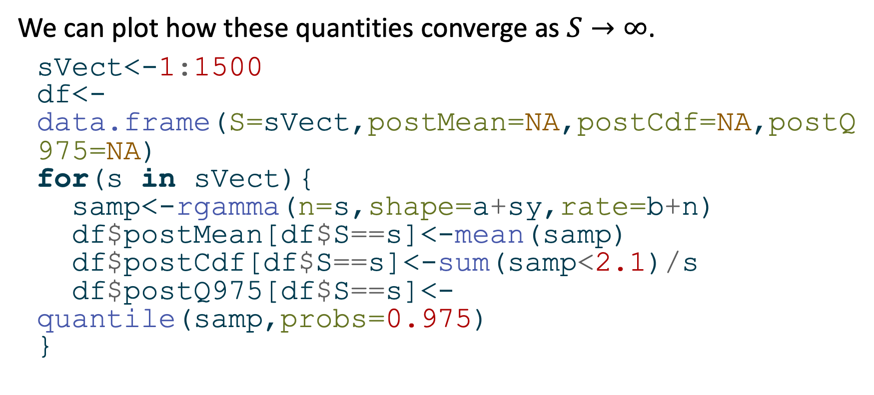
Monte Carlo - Example
We can plot how these quantities converge as $S→∞$.
sVect<-1:1500 df<-data.frame(S=sVect,postMean=NA,postCdf=NA,postQ975=NA) for(s in sVect){ samp<-rgamma(n=s,shape=a+sy,rate=b+n) df$postMean[df$S==s]<-mean(samp) df$postCdf[df$S==s]<-sum(samp<2.1)/s df$postQ975[df$S==s]<-quantile(samp,probs=0.975) }

Slide 20
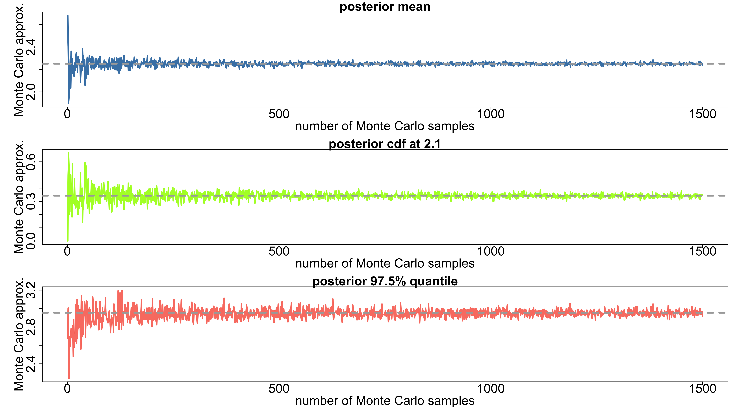
Monte Carlo - Example
titles<-paste("posterior",c("mean","cdf at 2.1","97.5% quantile")) cols<-c("steelblue","greenyellow","salmon") hVect<-c((a+sy)/(b+n),pgamma(2.1,a+sy,b+n),qgamma(0.975,a+sy,b+n)) par(mfrow=c(3,1),mar=c(5,7,2,1)) for(i in 1:3){ plot(df$S,df[,1+i],type="l",xlab="number of Monte Carlo samples",ylab="Monte Carlo approx.",cex.lab=2.5,cex.axis=2.5,cex.main=2.5,lwd=3,col=cols[i],main=titles[i]) abline(lwd=3,lty=2,h=hVect[i],col="darkgrey") }

Slide 21
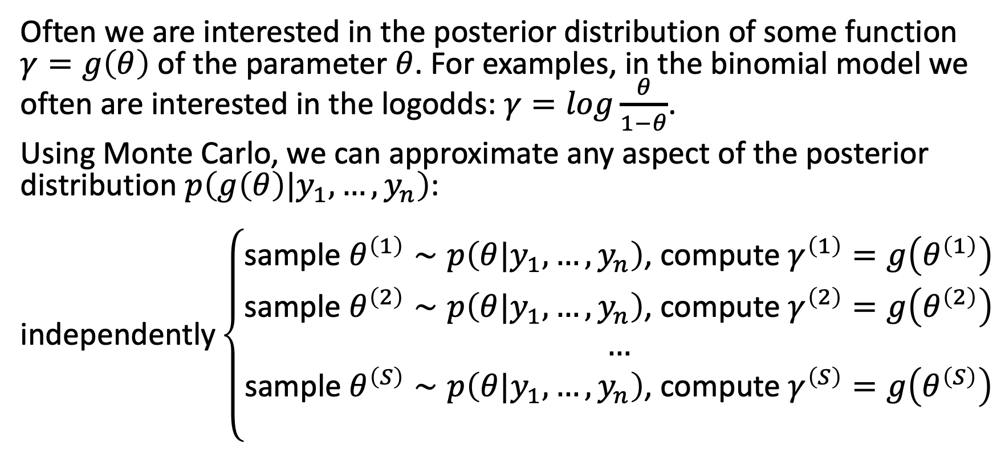
Monte Carlo - posterior inference for arbitrary functions
Often we are interested in the posterior distribution of some function $γ=g\left(θ\right)$ of the parameter $θ$. For examples, in the binomial model we often are interested in the logodds: $γ=log\frac{θ}{1−θ}$.
Using Monte Carlo, we can approximate any aspect of the posterior distribution $p\left(g\left(θ\right)|y_{1},…,y_{n}\right)$:
$$\text{independently}\left\{\begin{matrix}\text{sample} θ^{\left(1\right)}∼p\left(θ|y_{1},…,y_{n}\right)\text{, }\text{compute} γ^{\left(1\right)}=g\left(θ^{\left(1\right)}\right) \\ \text{sample} θ^{\left(2\right)}∼p\left(θ|y_{1},…,y_{n}\right)\text{, }\text{compute} γ^{\left(2\right)}=g\left(θ^{\left(2\right)}\right) \\ … \\ \text{sample} θ^{\left(S\right)}∼p\left(θ|y_{1},…,y_{n}\right)\text{, }\text{compute} γ^{\left(S\right)}=g\left(θ^{\left(S\right)}\right) \\ \end{matrix}\right.$$

Slide 22
Monte Carlo - posterior inference for arbitrary functions
Then as before, we can compute:
$\overset{‾}{γ}=\sum_{s}^{​}{γ^{\left(s\right)}}/S→E\left[γ|y_{1},…,y_{n}\right]$
$\sum_{s}^{​}{{\left(γ^{\left(s\right)}−\overset{‾}{γ}\right)}^{2}}/\left(S−1\right)→Var\left(γ|y_{1},…,y_{n}\right)$
$…$

Slide 23
Monte Carlo - sampling from predictive distributions
New data $\tilde{Y}$ are generated by the same sampling model as the observed data $y_{1},…,y_{n}$:
$$\text{SAMPLING} \text{MODEL} \tilde{Y}∼p\left(\tilde{y}|θ\right)$$
We cannot predict from this model however, as $θ$ is random: we need to integrate it out:
$$\text{PREDICTIVE} \text{MODEL} p\left(\tilde{y}\right)=∫p\left(\tilde{y}|θ\right)p\left(θ\right)dθ$$
The above is a prior predictive distribution as we have not conditioned on observed data $y_{1},…,y_{n}$.

Slide 24
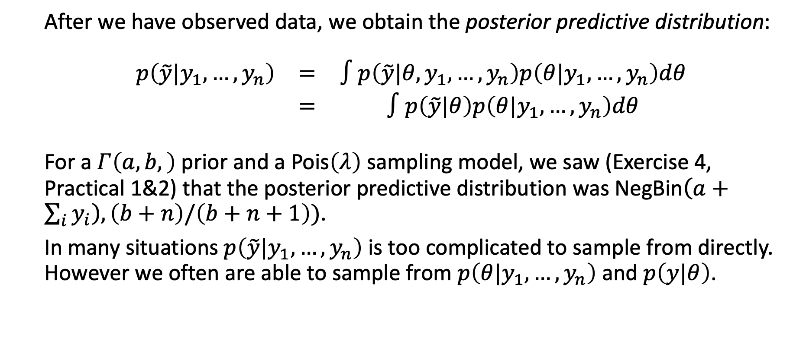
Monte Carlo - sampling from predictive distributions
After we have observed data, we obtain the posterior predictive distribution:
$$\begin{matrix}p\left(\tilde{y}|y_{1},…,y_{n}\right) & = & ∫p\left(\tilde{y}|θ,y_{1},…,y_{n}\right)p\left(θ|y_{1},…,y_{n}\right)dθ \\ & = & ∫p\left(\tilde{y}|θ\right)p\left(θ|y_{1},…,y_{n}\right)dθ\end{matrix}$$
For a $Γ\left(a,b,\right)$ prior and a $\text{Pois}\left(λ\right)$ sampling model, we saw (Exercise 4, Practical 1&2) that the posterior predictive distribution was $\text{NegBin}\left(a+\sum_{i}^{​}{y_{i}}\right),\left(b+n\right)/\left(b+n+1\right))$.
In many situations $p\left(\tilde{y}|y_{1},…,y_{n}\right)$ is too complicated to sample from directly. However we often are able to sample from $p\left(θ|y_{1},…,y_{n}\right)$ and $p\left(y|θ\right)$.

Slide 25
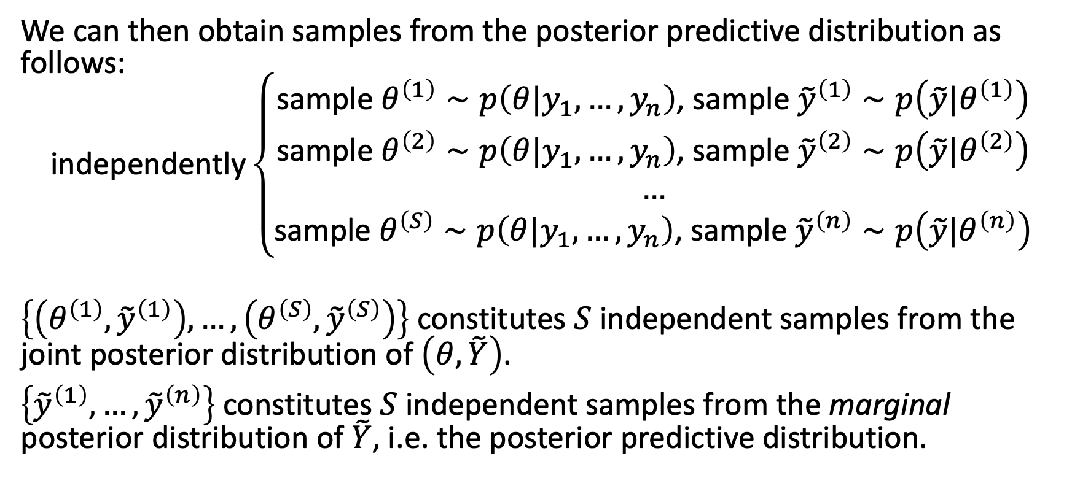
Monte Carlo - sampling from predictive distributions
We can then obtain samples from the posterior predictive distribution as follows:
$$\text{independently}\left\{\begin{matrix}\text{sample} θ^{\left(1\right)}∼p\left(θ|y_{1},…,y_{n}\right)\text{, }\text{sample} {\tilde{y}}^{\left(1\right)}∼p\left(\tilde{y}|θ^{\left(1\right)}\right) \\ \text{sample} θ^{\left(2\right)}∼p\left(θ|y_{1},…,y_{n}\right)\text{, }\text{sample} {\tilde{y}}^{\left(2\right)}∼p\left(\tilde{y}|θ^{\left(2\right)}\right) \\ … \\ \text{sample} θ^{\left(S\right)}∼p\left(θ|y_{1},…,y_{n}\right)\text{, }\text{sample} {\tilde{y}}^{\left(n\right)}∼p\left(\tilde{y}|θ^{\left(n\right)}\right)\end{matrix}\right.$$
$\left\{\left(θ^{\left(1\right)},{\tilde{y}}^{\left(1\right)}\right),…,\left(θ^{\left(S\right)},{\tilde{y}}^{\left(S\right)}\right)\right\}$ constitutes $S$ independent samples from the joint posterior distribution of $\left(θ,\tilde{Y}\right)$.
$\left\{{\tilde{y}}^{\left(1\right)},…,{\tilde{y}}^{\left(n\right)}\right\}$ constitutes $S$ independent samples from the marginal posterior distribution of $\tilde{Y}$, i.e. the posterior predictive distribution.

Slide 26
Monte Carlo - sampling from predictive distributions
An important use of sampling from the posterior predictive distribution is for assessing model fit:
Do samples from the posterior predictive distribution look like the actual observed data?
How likely are certain aspects of the observed data to be occurring under the posterior predictive distribution?

Slide 27
BAYESIAN INFERENCE: multi-parameter models

Slide 28
Bayesian inference: multi-parameter models
Bayesian inference for two or more unknown parameters is not conceptually different from the one parameter case.
E.g. for a normal sampling model with parameters $\left(μ,σ^{2}\right)$ with joint prior distribution $p\left(μ,σ^{2}\right)$, posterior inference proceeds using Bayes’ rule:
$$p\left(μ,σ^{2}|y_{1},…,y_{n}\right)=\frac{p\left(y_{1},…,y_{n}|μ,σ^{2}\right)p\left(μ,σ^{2}\right)}{p\left(y_{1},…,y_{n}\right)}$$
However, for many multiparameter models, the joint posterior distribution is non-standard and difficult to sample from directly.

Slide 29
MARKOV CHAIN MONTE CARLO

Slide 30
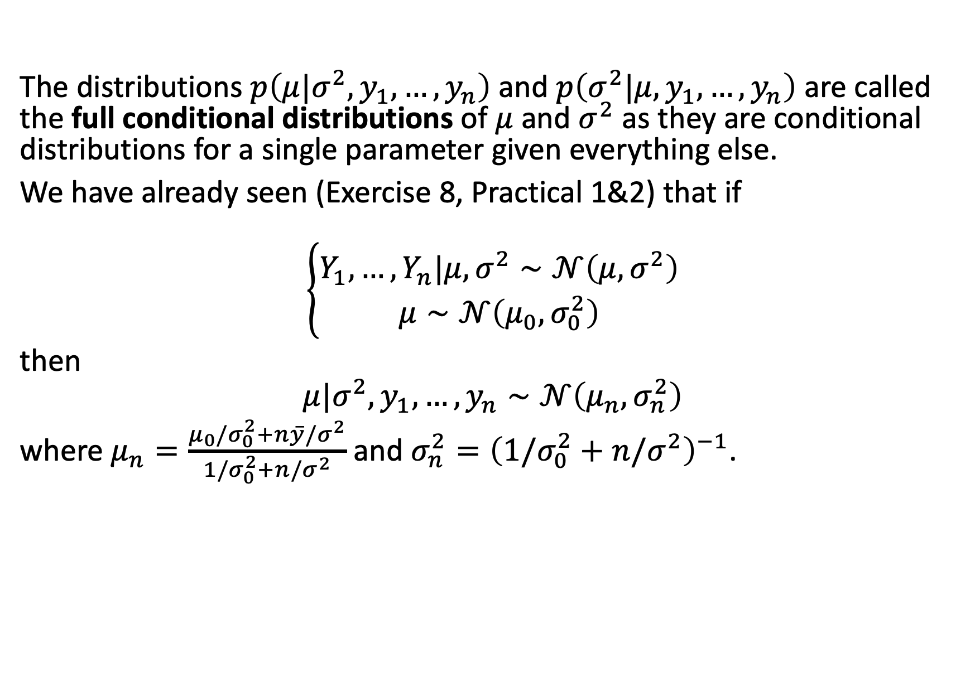
MCMC
The distributions $p\left(μ|σ^{2},y_{1},…,y_{n}\right)$ and $p\left(σ^{2}|μ,y_{1},…,y_{n}\right)$ are called the full conditional distributions of $μ$ and $σ^{2}$ as they are conditional distributions for a single parameter given everything else.
We have already seen (Exercise 8, Practical 1&2) that if
$$\left\{\begin{matrix}Y_{1},…,Y_{n}|μ,σ^{2}∼𝒩\left(μ,σ^{2}\right) \\ μ∼𝒩\left(μ_{0},σ_{0}^{2}\right)\end{matrix}\right.$$
then
$$μ|σ^{2},y_{1},…,y_{n}∼𝒩\left(μ_{n},σ_{n}^{2}\right)$$
where $μ_{n}=\frac{μ_{0}/σ_{0}^{2}+n\overset{‾}{y}/σ^{2}}{1/σ_{0}^{2}+n/σ^{2}}$ and $σ_{n}^{2}={\left(1/σ_{0}^{2}+n/σ^{2}\right)}^{−1}$.

Slide 31
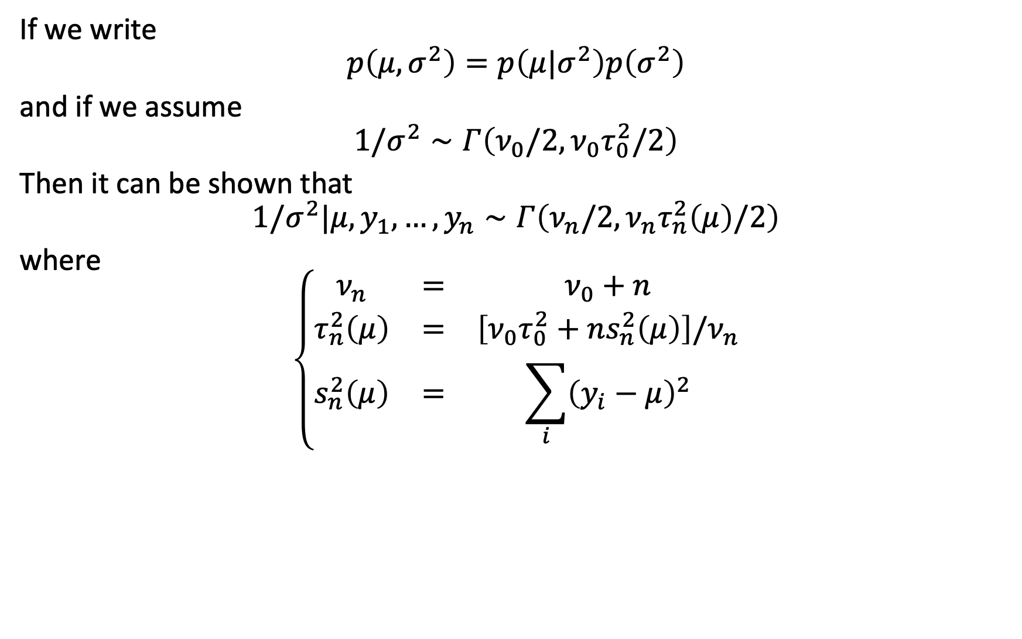
MCMC
If we write
$$p\left(μ,σ^{2}\right)=p\left(μ|σ^{2}\right)p\left(σ^{2}\right)$$
and if we assume
$$1/σ^{2}∼Γ\left(ν_{0}/2,ν_{0}τ_{0}^{2}/2\right)$$
Then it can be shown that
$$1/σ^{2}|μ,y_{1},…,y_{n}∼Γ\left(ν_{n}/2,ν_{n}τ_{n}^{2}\left(μ\right)/2\right)$$
where
$$\left\{\begin{matrix}ν_{n} & = & ν_{0}+n \\ τ_{n}^{2}\left(μ\right) & = & \left[ν_{0}τ_{0}^{2}+ns_{n}^{2}\left(μ\right)\right]/ν_{n} \\ s_{n}^{2}\left(μ\right) & = & \sum_{i}^{​}{{\left(y_{i}−μ\right)}^{2}}\end{matrix}\right.$$

Slide 32
MCMC
So to summarise, for a $𝒩\left(μ,σ^{2}\right)$ sampling model:
conditionally on $σ^{2}$, the normal distribution is a conjugate prior for $μ$
conditionally on $μ$, the inverse gamma distribution is a conjugate prior for $σ^{2}$
This is called a semi-conjugate or conditionally conjugate prior for $\left(μ,σ^{2}\right)$.
Note this does not guarantee that the resulting joint distribution $p\left(μ,σ^{2}\right)$ is conjugate for $\left(μ,σ^{2}\right)$.

Slide 33
MCMC
Note if we have
$$1/X∼Γ\left(a,b\right)$$
Then X follows an inverse Gamma distribution:
$$X∼\text{inv}\text{−}Γ\left(a,b\right)$$

Slide 34
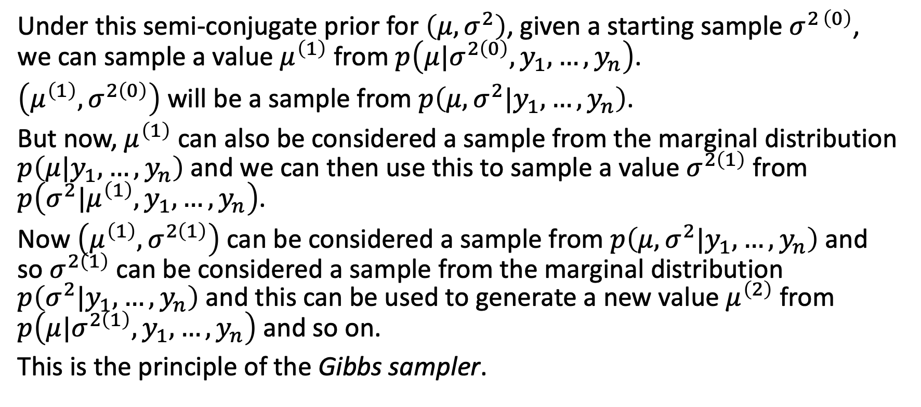
MCMC
Under this semi-conjugate prior for $\left(μ,σ^{2}\right)$, given a starting sample $σ^{2 \left(0\right)}$, we can sample a value $μ^{\left(1\right)}$ from $p\left(μ|σ^{2\left(0\right)},y_{1},…,y_{n}\right)$.
$\left(μ^{\left(1\right)},σ^{2\left(0\right)}\right)$ will be a sample from $p\left(μ,σ^{2}|y_{1},…,y_{n}\right)$.
But now, $μ^{\left(1\right)}$ can also be considered a sample from the marginal distribution $p\left(μ|y_{1},…,y_{n}\right)$ and we can then use this to sample a value $σ^{2\left(1\right)}$ from $p\left(σ^{2}|μ^{\left(1\right)},y_{1},…,y_{n}\right)$.
Now $\left(μ^{\left(1\right)},σ^{2\left(1\right)}\right)$ can be considered a sample from $p\left(μ,σ^{2}|y_{1},…,y_{n}\right)$ and so $σ^{2\left(1\right)}$ can be considered a sample from the marginal distribution $p\left(σ^{2}|y_{1},…,y_{n}\right)$ and this can be used to generate a new value $μ^{\left(2\right)}$ from $p\left(μ|σ^{2\left(1\right)},y_{1},…,y_{n}\right)$ and so on.
This is the principle of the Gibbs sampler.

Slide 35
MCMC: Gibbs sampler
Suppose you have a vector of parameters $φ=\left(φ_{1},…,φ_{p}\right)$ and a joint distribution $p\left(φ\right)$. Given a starting value $φ^{\left(0\right)}=\left(φ_{1}^{\left(0\right)},…,φ_{p}^{\left(0\right)}\right)$, the Gibbs sampler generates $φ^{\left(s\right)}$ from $φ^{\left(s−1\right)}$ as follows:
$$\left\{\begin{matrix}\text{sample} φ_{1}^{\left(s\right)}∼p\left(φ_{1}|φ_{2}^{\left(s−1\right)},φ_{3}^{\left(s−1\right)},…,φ_{p}^{\left(s−1\right)}\right) \\ \text{sample} φ_{2}^{\left(s\right)}∼p\left(φ_{2}|φ_{1}^{\left(s−1\right)},φ_{3}^{\left(s−1\right)},…,φ_{p}^{\left(s−1\right)}\right) \\ … \\ \text{sample} φ_{p}^{\left(s\right)}∼p\left(φ_{p}|φ_{1}^{\left(s−1\right)},φ_{2}^{\left(s−1\right)},…,φ_{p−1}^{\left(s−1\right)}\right)\end{matrix}\right.$$

Slide 36
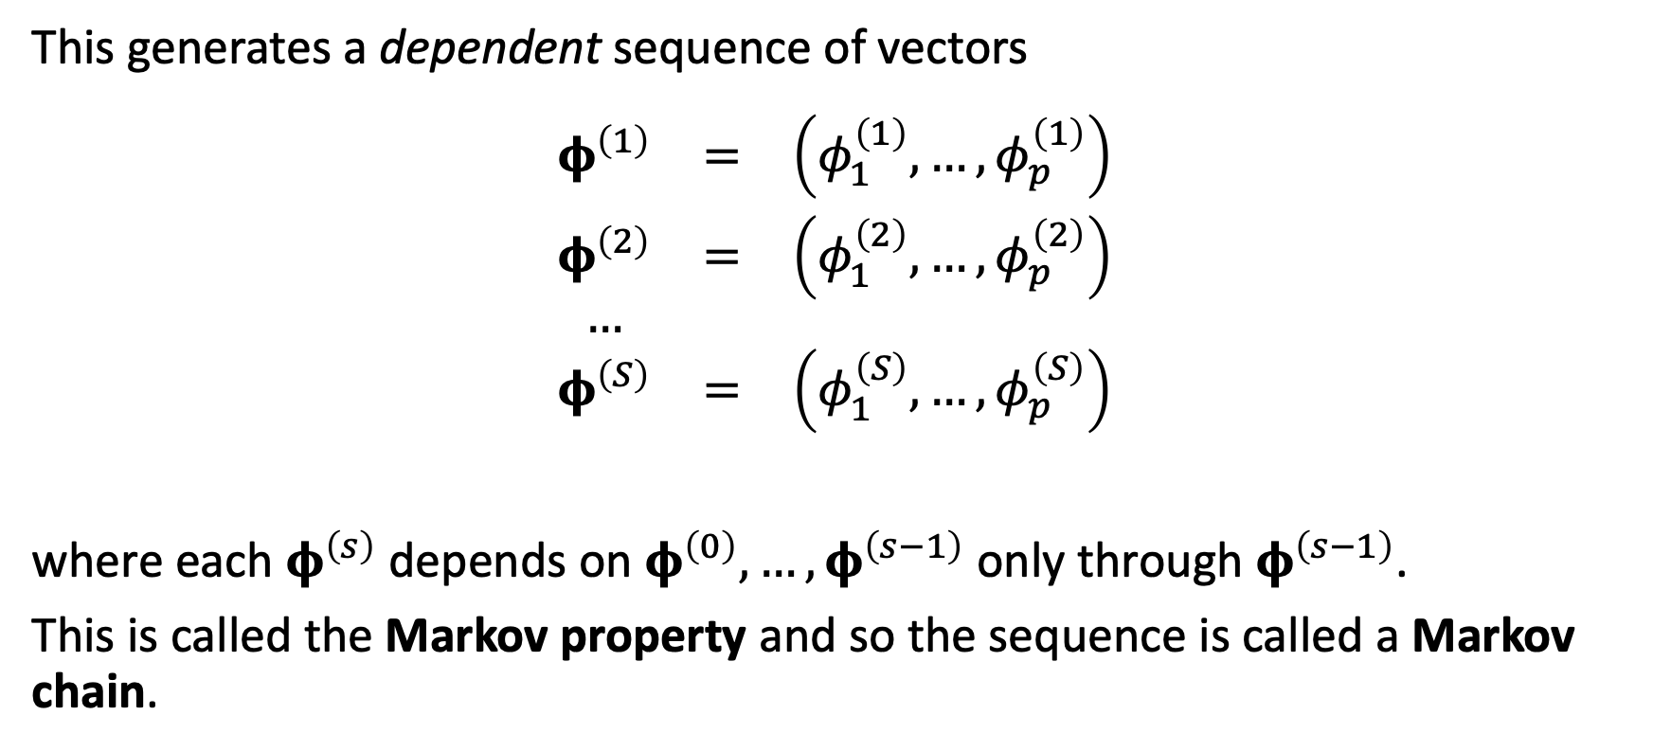
MCMC: Gibbs sampler
This generates a dependent sequence of vectors
$$\begin{matrix}φ^{\left(1\right)} & = & \left(φ_{1}^{\left(1\right)},…,φ_{p}^{\left(1\right)}\right) \\ φ^{\left(2\right)} & = & \left(φ_{1}^{\left(2\right)},…,φ_{p}^{\left(2\right)}\right) \\ … & & \\ φ^{\left(S\right)} & = & \left(φ_{1}^{\left(S\right)},…,φ_{p}^{\left(S\right)}\right) \\ & & \end{matrix}$$
where each $φ^{\left(s\right)}$ depends on $φ^{\left(0\right)},…,φ^{\left(s−1\right)}$ only through $φ^{\left(s−1\right)}$.
This is called the Markov property and so the sequence is called a Markov chain.

Slide 37
MCMC: Gibbs sampler
Under conditions met for all models discussed in this course module, for any set $A$:
$$P\left(φ^{\left(s\right)}∈A\right)→\int_{A}^{​}{p}\left(φ\right)dφ \text{as} s→∞$$
In other words, the sample distribution of $φ^{\left(s\right)}$ approaches the target distribution as $s→∞$ regardless of the starting value $φ^{\left(0\right)}$.

Slide 38
MCMC: Gibbs sampler
More importantly
$$\frac{1}{S}\sum_{s}^{​}{g}\left(φ^{\left(s\right)}\right)→E\left[g\left(φ\right)\right]=∫g\left(φ\right)p\left(φ\right)dφ \text{as} S→∞$$
This means we can approximate $E\left[g\left(φ\right)\right]$ with the sample average of $\left\{g\left(φ^{\left(1\right)}\right),…,g\left(φ^{\left(S\right)}\right)\right\}$ just as we did in Monte Carlo approximation.
For this reason, we call such approximations Markov Chain Monte Carlo (MCMC).

Slide 39
MCMC: Metropolis-Hastings
The Gibbs sample is very powerful, but:
It assumes we can sample easily from the conditional distributions. This is usually the case for textbook examples, but can be tricky in many real-world examples.
It assumes conditional independence between variables – if you have very complex dependencies between parameters, the Gibbs sampler can be difficult to implement.
The Gibbs sampler is a special case of a more general algorithm, the Metropolis-Hastings (MH) algorithm.
MH directly samples from the full joint distribution and uses an iteration of proposal and acceptance/rejection steps (the Gibbs sampler is a special case in the sense that we always accept a sampled value).

Slide 40
MCMC: Metropolis-Hastings
The Metropolis-Hastings algorithm requires:
A target density $p\left(φ\right)$.
A function $f\left(φ\right)$ that is proportional to $p\left(φ\right)$. This is key in making the algorithm feasible: we do not need to compute the normalising constant (which can be very hard for complex, high-dimensional densities).
A proposal distribution $g\left(φ^{′}|φ^{\left(k\right)}\right)$ which we use to sample a new value for the $k+1^{\text{th}}$ iteration.

Slide 41
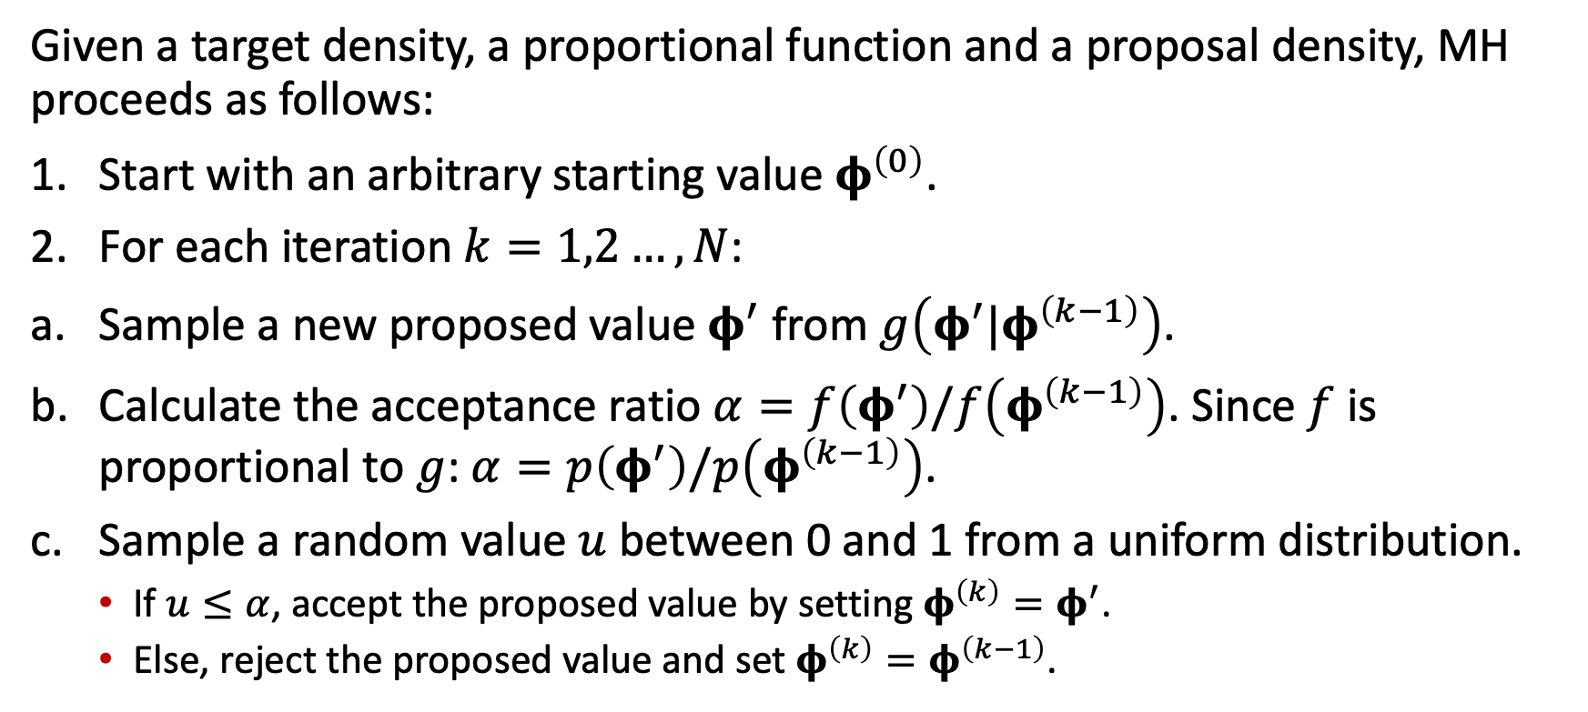
MCMC: Metropolis-Hastings
Given a target density, a proportional function and a proposal density, MH proceeds as follows:
Start with an arbitrary starting value $φ^{\left(0\right)}$.
For each iteration $k=1,2…,N$:
Sample a new proposed value $φ^{′}$ from $g\left(φ^{′}|φ^{\left(k−1\right)}\right)$.
Calculate the acceptance ratio $α=f\left(φ^{′}\right)/f\left(φ^{\left(k−1\right)}\right)$. Since $f$ is proportional to $g$: $α=p\left(φ^{′}\right)/p\left(φ^{\left(k−1\right)}\right)$.
Sample a random value $u$ between 0 and 1 from a uniform distribution.
If $u≤α$, accept the proposed value by setting $φ^{\left(k\right)}=φ^{′}$.
Else, reject the proposed value and set $φ^{\left(k\right)}=φ^{\left(k−1\right)}$.

Slide 42
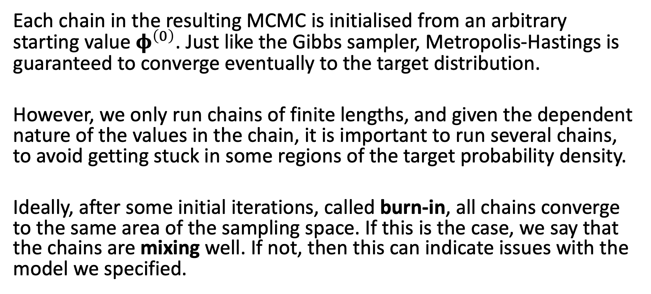
MCMC: Metropolis-Hastings
Each chain in the resulting MCMC is initialised from an arbitrary starting value $φ^{\left(0\right)}$. Just like the Gibbs sampler, Metropolis-Hastings is guaranteed to converge eventually to the target distribution.
However, we only run chains of finite lengths, and given the dependent nature of the values in the chain, it is important to run several chains, to avoid getting stuck in some regions of the target probability density.
Ideally, after some initial iterations, called burn-in, all chains converge to the same area of the sampling space. If this is the case, we say that the chains are mixing well. If not, then this can indicate issues with the model we specified.

Slide 43
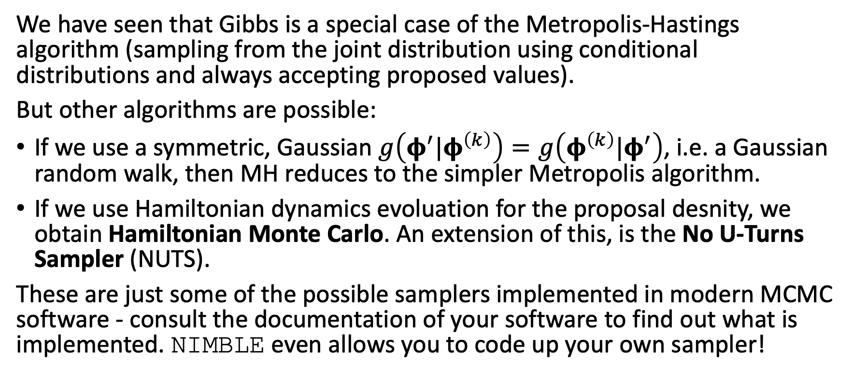
MCMC: Metropolis-Hastings
We have seen that Gibbs is a special case of the Metropolis-Hastings algorithm (sampling from the joint distribution using conditional distributions and always accepting proposed values).
But other algorithms are possible:
If we use a symmetric, Gaussian $g\left(φ^{′}|φ^{\left(k\right)}\right)=g\left(φ^{\left(k\right)}|φ^{′}\right)$, i.e. a Gaussian random walk, then MH reduces to the simpler Metropolis algorithm.
If we use Hamiltonian dynamics evoluation for the proposal desnity, we obtain Hamiltonian Monte Carlo. An extension of this, is the No U-Turns Sampler (NUTS).
These are just some of the possible samplers implemented in modern MCMC software - consult the documentation of your software to find out what is implemented. NIMBLE even allows you to code up your own sampler!

Slide 44
[end of STA623 Bayesian Data analysis Session 4]

