Slide 1
STA623 Bayesian Data Analysis
Session 1: Inference paradigms, probability theory, Bayes’ theorem Marc Henrion

Slide 2

Preliminaries
These notes were written in quarto.
All examples / code in these notes is R and NIMBLE / BUGS for Bayesian model specification.
GitHub repository - will contain all course materials by the end of the week.
https://github.com/gitMarcH/UNIMA_STA623_2025

Slide 3
Preliminaries
Some references for Bayesian statistics / data analysis are:
Hoff, P.D. (2009). “A First Course in Bayesian Statistical Methods.” Springer.
Gelman, A., Carlin, J.B., Stern, H.S., Dunson, D.B., Vehtari, A., Rubin, D.B. (2014). “Bayesian Data Analysis”. 3rd ed. CRC Press.
Ramoni, M., Sebastiani, P. (2007), ‘Bayesian Methods’, in Berthold, M., Hand, D.J. (eds.). “Intelligent Data Analysis”, 2nd ed., Springer, pp.131-168
Stone, J.V. (2013). “Bayes’ Rule: A Tutorial Introduction to Bayesian Analysis”. Sebtel Press.

Slide 4
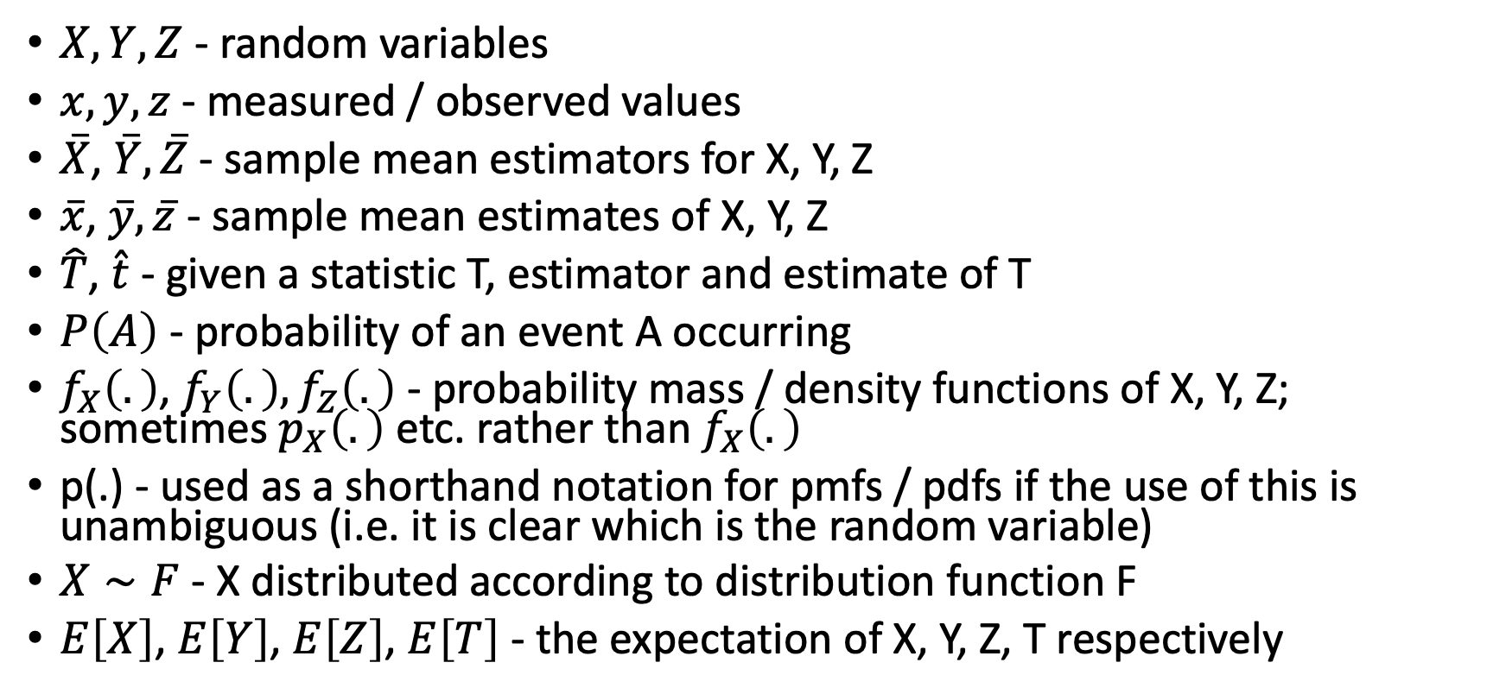
Notation
$X,Y,Z$ - random variables
$x,y,z$ - measured / observed values
$\overset{‾}{X}$, $\overset{‾}{Y},\overset{‾}{Z}$ - sample mean estimators for X, Y, Z
$\overset{‾}{x}$, $\overset{‾}{y},\overset{‾}{z}$ - sample mean estimates of X, Y, Z
$\hat{T}$, $\hat{t}$ - given a statistic T, estimator and estimate of T
$P\left(A\right)$ - probability of an event A occurring
$f_{X}\left(.\right)$, $f_{Y}\left(.\right),f_{Z}\left(.\right)$ - probability mass / density functions of X, Y, Z; sometimes $p_{X}\left(.\right)$ etc. rather than $f_{X}\left(.\right)$
p(.) - used as a shorthand notation for pmfs / pdfs if the use of this is unambiguous (i.e. it is clear which is the random variable)
$X∼F$ - X distributed according to distribution function F
$E\left[X\right]$, $E\left[Y\right]$, $E\left[Z\right]$, $E\left[T\right]$ - the expectation of X, Y, Z, T respectively

Slide 5
MORNING QUIZ

Slide 6
INTRODUCTION

Slide 7
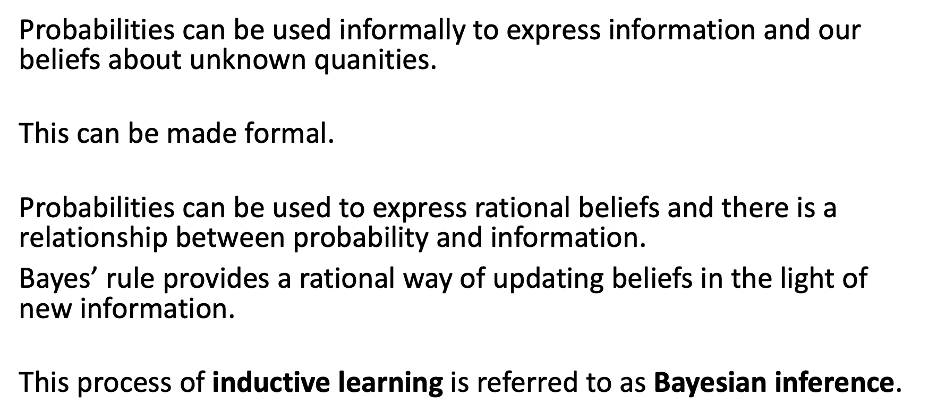
Introduction
Probabilities can be used informally to express information and our beliefs about unknown quanities.
This can be made formal.
Probabilities can be used to express rational beliefs and there is a relationship between probability and information.
Bayes’ rule provides a rational way of updating beliefs in the light of new information.
This process of inductive learning is referred to as Bayesian inference.

Slide 8
Introduction
Bayesian methods provide
Statistical estimators with desirable properties.
Parsimonious descriptions of data.
A computational framework for model estimation, selection and validation.

Slide 9
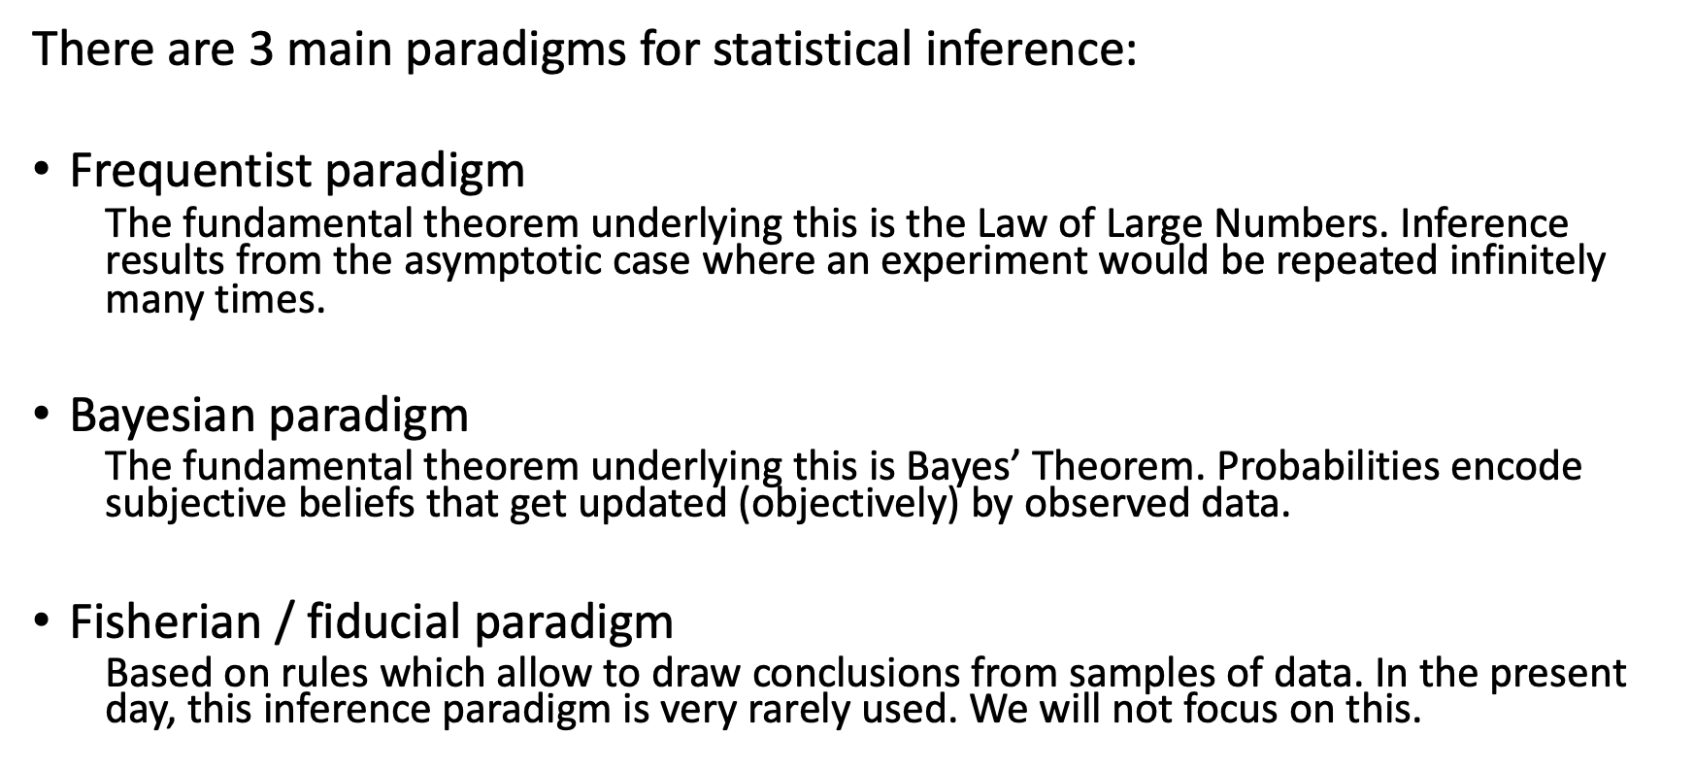
Introduction
There are 3 main paradigms for statistical inference:
Frequentist paradigm
The fundamental theorem underlying this is the Law of Large Numbers. Inference results from the asymptotic case where an experiment would be repeated infinitely many times.
Bayesian paradigm
The fundamental theorem underlying this is Bayes’ Theorem. Probabilities encode subjective beliefs that get updated (objectively) by observed data.
Fisherian / fiducial paradigm
Based on rules which allow to draw conclusions from samples of data. In the present day, this inference paradigm is very rarely used. We will not focus on this.

Slide 10
Introduction
Frequentist paradigm
Parameters are fixed but unknown.
Probabilities are always interpreted as long run relative frequency.
Procedure is judged by how well they perform in the long run over an infinite number of hypothetical repetitions of the experiment.

Slide 11
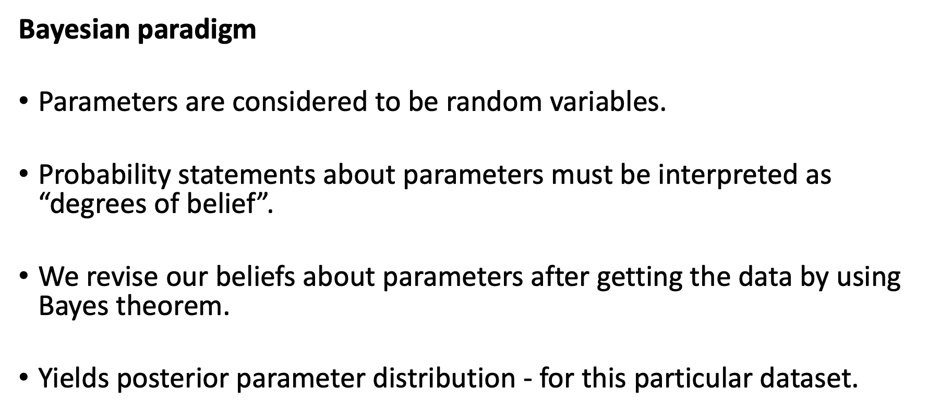
Introduction
Bayesian paradigm
Parameters are considered to be random variables.
Probability statements about parameters must be interpreted as “degrees of belief”.
We revise our beliefs about parameters after getting the data by using Bayes theorem.
Yields posterior parameter distribution - for this particular dataset.

Slide 12
PROBABILITY THEORY

Slide 13
Probability theory
This section is largely based on and in places quoted verbatim from
Feelders, Ad J. (2007), ‘Statistical Concepts’, in Berthold, M., Hand, D.J. (eds.) Intelligent Data Analysis, 2nd ed., Springer, pp.17-68

Slide 14
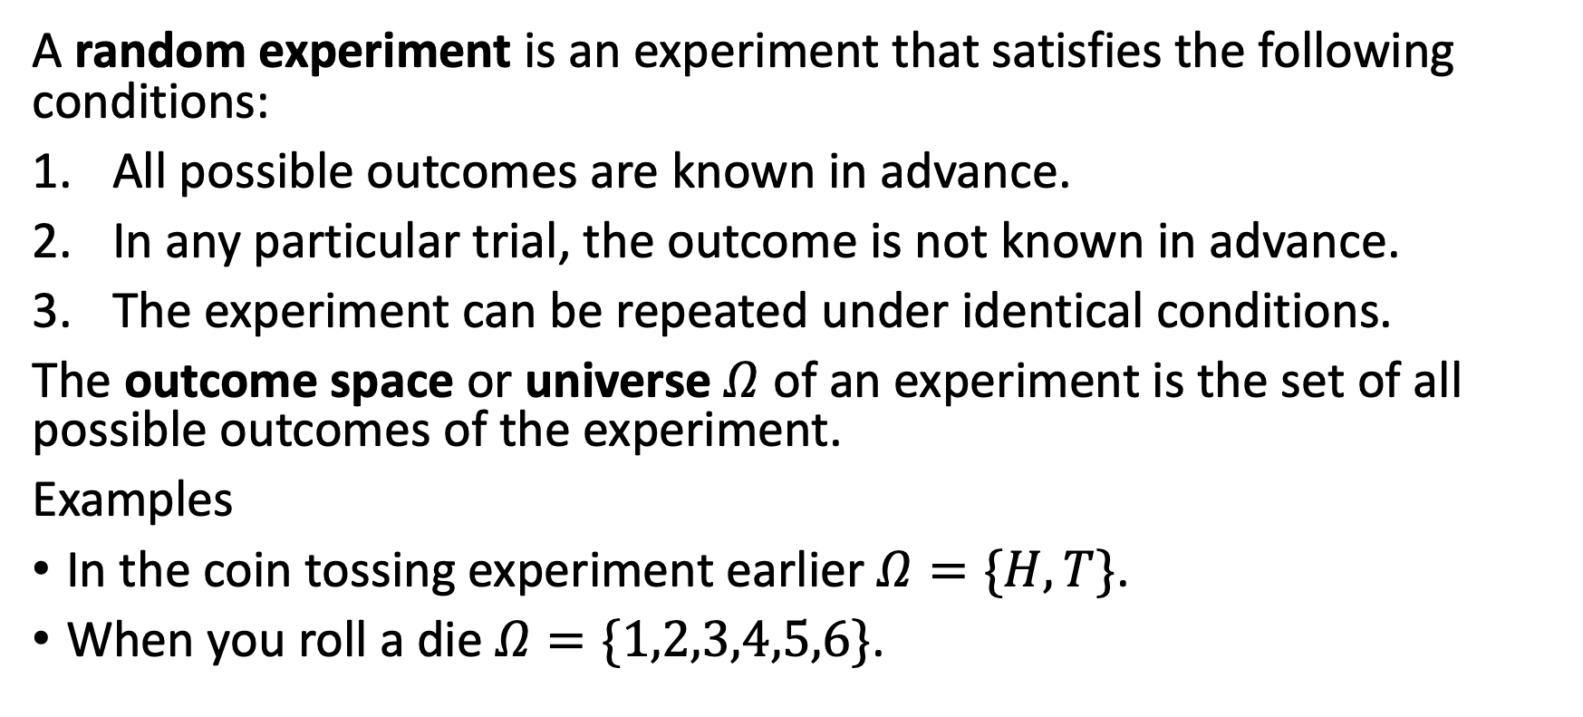
Probability theory: Random experiments
A random experiment is an experiment that satisfies the following conditions:
All possible outcomes are known in advance.
In any particular trial, the outcome is not known in advance.
The experiment can be repeated under identical conditions.
The outcome space or universe $Ω$ of an experiment is the set of all possible outcomes of the experiment.
Examples
In the coin tossing experiment earlier $Ω=\{H,T\}$.
When you roll a die $Ω=\{1,2,3,4,5,6\}$.

Slide 15
Probability theory: Random experiments
An event is a subset of the outcome space.
Examples
“Coin lands head”: $A=\{x∈Ω| x \text{is} \text{heads}\}=\{H\}$
“Die shows even number”: $B=\{x∈Ω| x \text{is} \text{even}\}=\{2,4,6\}$
Special events
Impossible / empty event: $A=∅$
Sure event / outcome space: $A=Ω$
Singleton events: $A=\{H\}$, $A=\{3\}$
The complementary event: $\overset{‾}{A}=Ω\backslash A$

Slide 16
Probability theory: Probability
Classical definition of probability:
Let $\left|.\right|$ denote the operator measuring the size of an event. The probability of an event $A⊆Ω$ is defined as
$$P\left(A\right)=\frac{\left|A\right|}{\left|Ω\right|}$$
If all outcomes in $Ω$ are equally likely, then this means the probability of $A$ is the ratio of the number of outcomes in $A$ and the number of outcomes in $Ω$.
If your outcome space is not discrete, then $\left|.\right|$ is a function mapping outcome sets to the positive real line.

Slide 17
Probability theory: Probability
Frequency definition of probability:
It is supposed an experiment is repeated $k$ times, producing an outcome $o_{i}$ during the i^{th} run. Probability is the defined as the long-run relative frequency:
$$P\left(A\right)={\text{lim}}_{k→∞}\frac{\sum_{i}^{​}{I}\left(o_{i}∈A\right)}{k}$$
where $I\left(.\right)$ is the indicator function (1 if its argument is true, 0 otherwise).

Slide 18
Probability theory: Probability
Subjective definition of probability:
According to this definition, probability is a measure of the degree of belief that an event $A$ will occur.
Degree of belief depends on the person who has the belief, so with this definition the probability $P\left(A\right)$ can be different for different people.
The subjective definition of probability allows expressing all uncertainty through probability - this is important for Bayesian statistics.

Slide 19
Probability theory: Probability
Probability as a mathematical concept was formally introduced in the 17th century by French mathematicians Blaise Pascal and Pierre de Fermat when they were discussing games of chance.
The formal, mathematical derivation of probability theory follows from set theory and measure theory.

Slide 20
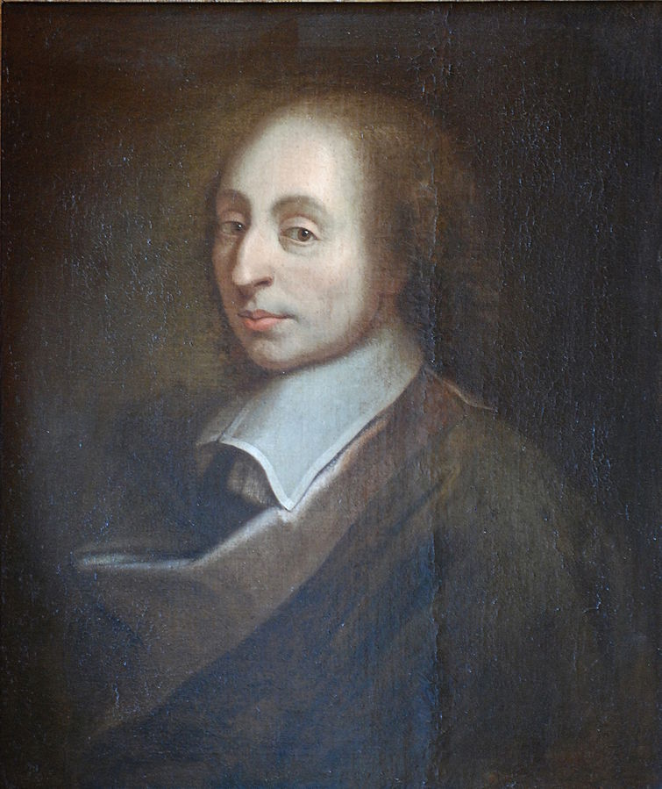
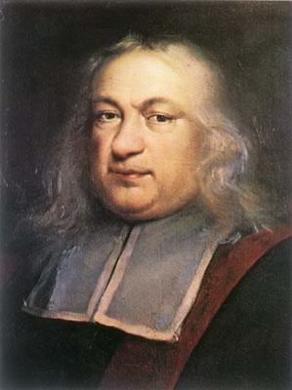
Probability theory: Probability
Blaise Pascal (public domain / Wikipedia)
Pierre de Fermat (public domain / Wikipedia)

Slide 21
Probability theory: Probability axioms
Probability (whether according to the classical, frequency or subjective definition) is a function $P\left(.\right)$ from subsets $A$ of $Ω$ to the real line satisfying the following axioms:
$P\left(A\right)≥0$, $∀A⊆Ω$
if $A∩B=∅$, then $P\left(A∪B\right)=P\left(A\right)+P\left(B\right)$, $∀A,B⊆Ω$
$P\left(Ω\right)=1$
Everything else in probability theory is derived from these 3 axioms.

Slide 22
Probability theory: Conditional probability
The probability of an event $B$ can be influenced by information about the occurrence of an event $A$. The conditional probability of $B$ given $A$, denoted $P\left(B|A\right)$, is defined as the probability of event $B$ given that $A$ has occurred. For $P\left(A\right)>0$:
$$P\left(B|A\right)=\frac{P\left(A∩B\right)}{P\left(A\right)}$$
Intuitively: $A$ is the new, reduced universe / outcome space $Ω_{r}$. The division by $P\left(A\right)$ guarantees that the conditional distribution sums / integrates to 1, i.e. is a valid probability distribution.
From the conditional probability, we can derive the multiplication rule:
$$P\left(A∩B\right)=P\left(B|A\right)⋅P\left(A\right)$$

Slide 23
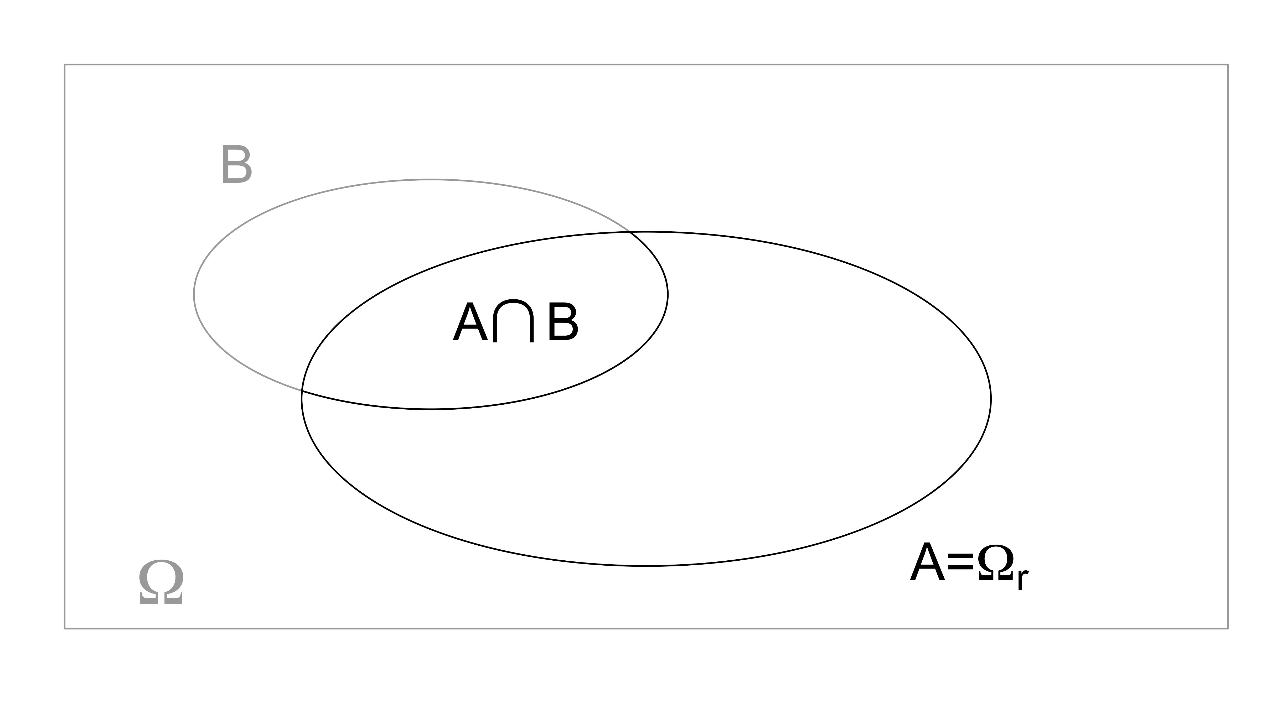
Probability theory: Conditional probability

Slide 24
Probability theory: independence
Events $A$ and $B$ are said to be independent if the occurrence of one event does not influence the probability of occurrence of the other event.
$$P\left(A|B\right)=P\left(A\right)$$
$$P\left(B|A\right)=P\left(B\right)$$
This can more concisely be expressed as:
$$P\left(A∩B\right)=P\left(A\right)P\left(B\right)$$

Slide 25
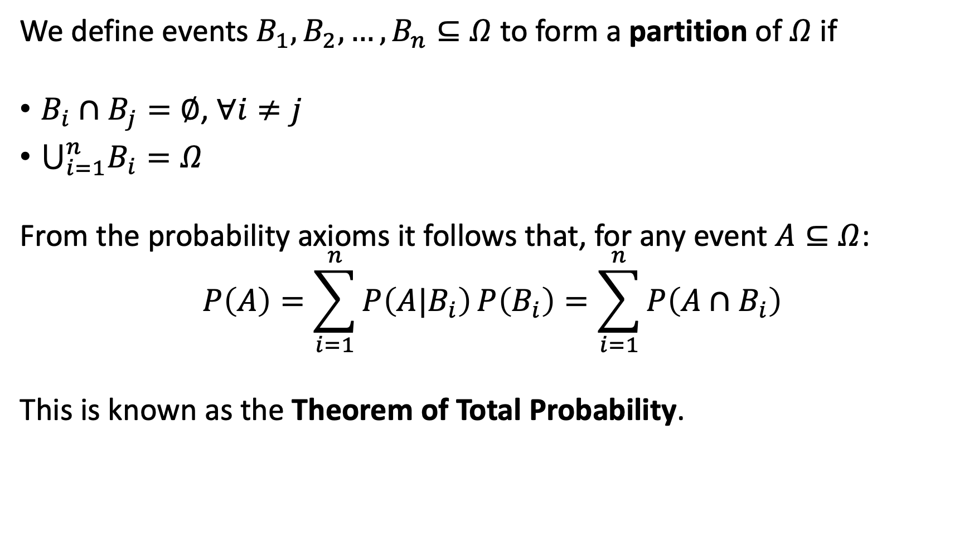
Probability theory: Law of Total Probability
We define events $B_{1},B_{2},…,B_{n}⊆Ω$ to form a partition of $Ω$ if
$B_{i}∩B_{j}=∅$, $∀i≠j$
$⋃_{i=1}^{n}B_{i}=Ω$
From the probability axioms it follows that, for any event $A⊆Ω$:
$$P\left(A\right)=\sum_{i=1}^{n}{P\left(A|B_{i}\right) P\left(B_{i}\right)}=\sum_{i=1}^{n}{P\left(A∩B_{i}\right)}$$
This is known as the Theorem of Total Probability.

Slide 26
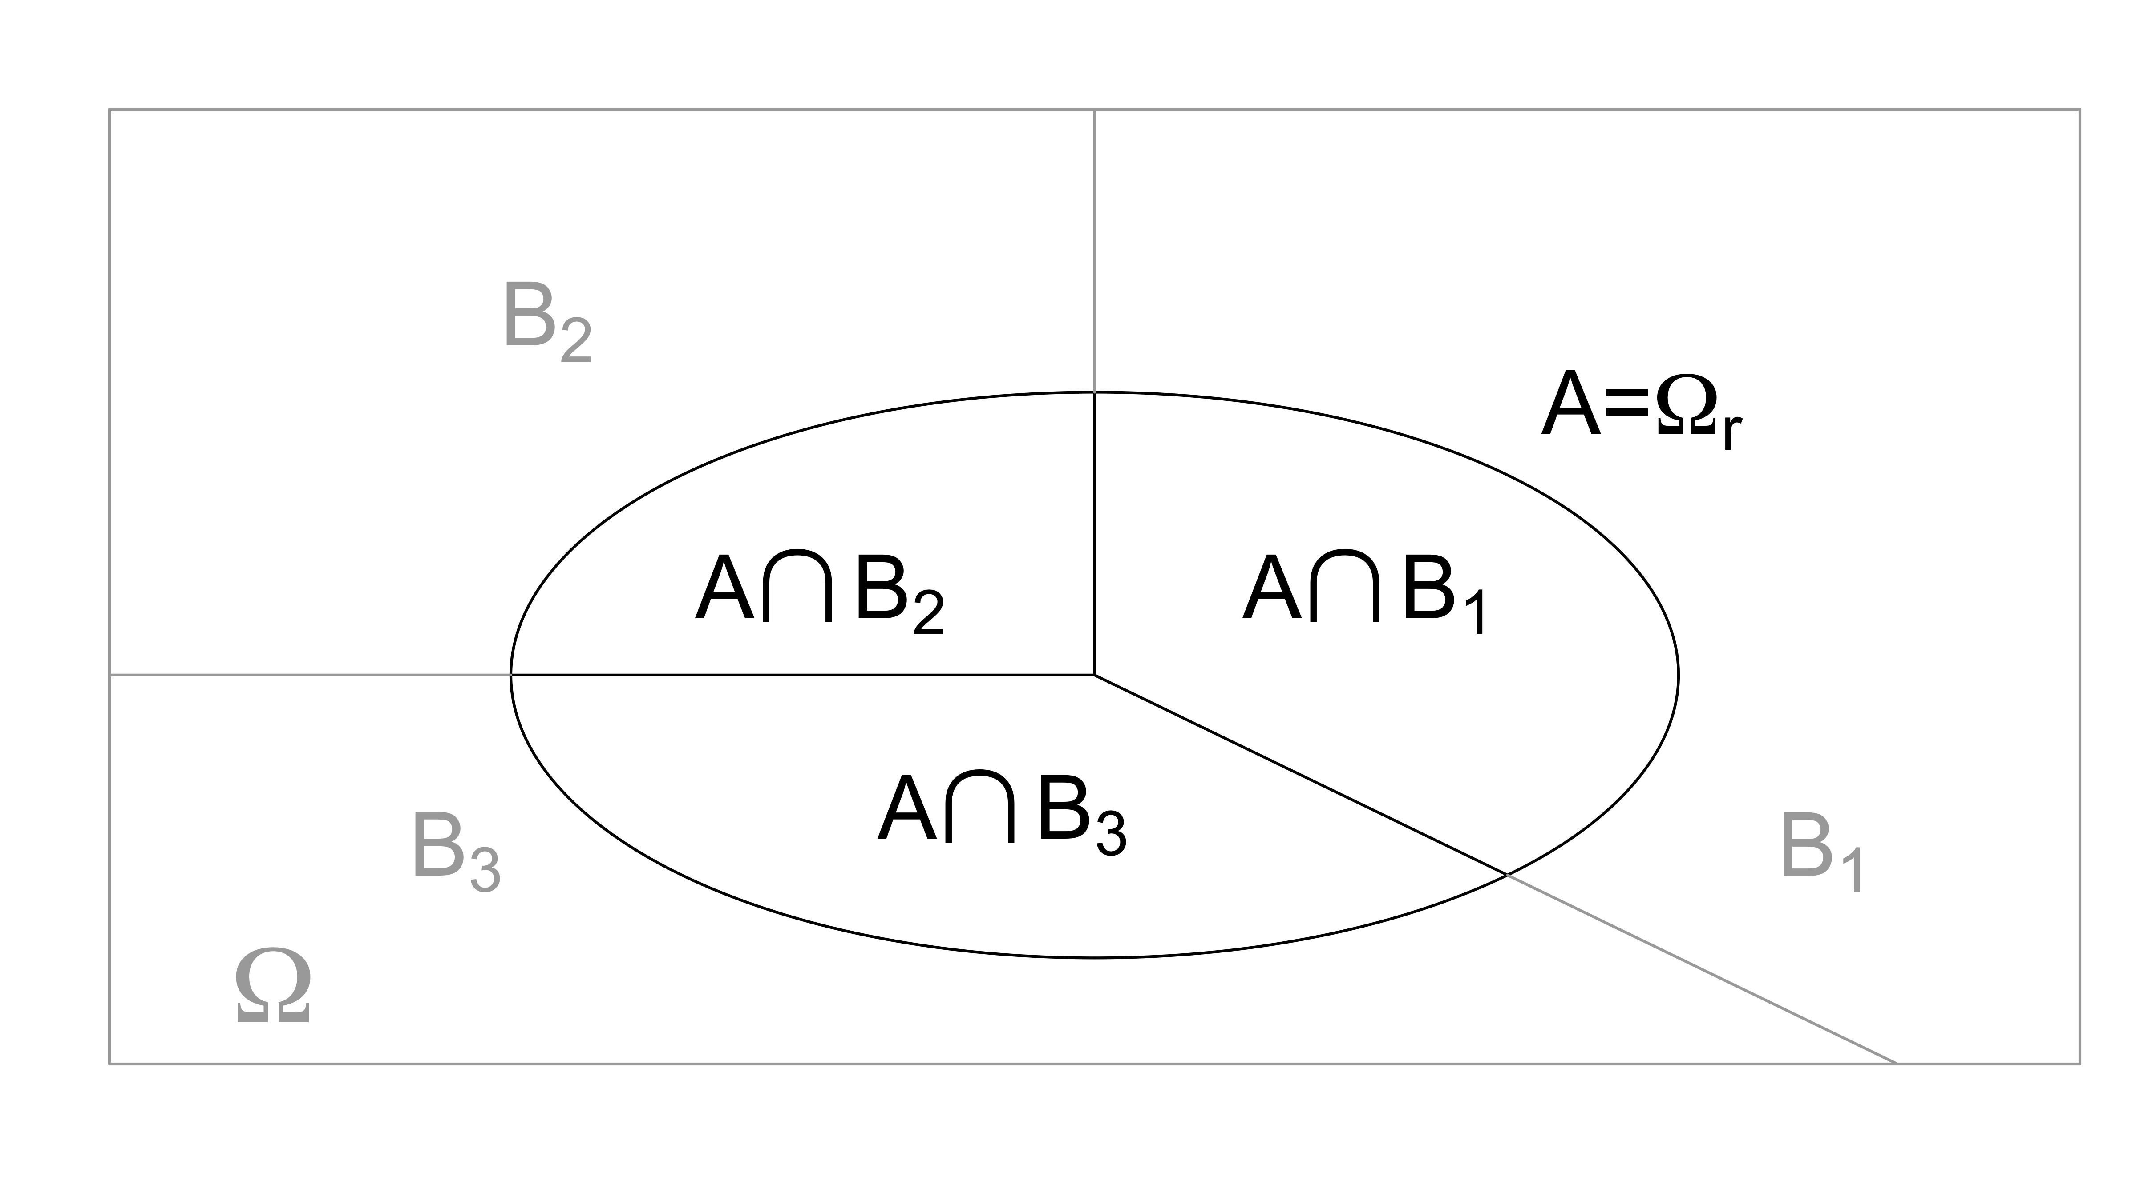
Probability theory: Law of Total Probability

Slide 27
Probability theory: Law of Total Probability
Example:
A box contains 4 balls: 3 white, 1 red.
First draw one ball at random. Then, without replacing the first ball, draw a second ball from the box.
What is the probability that the second ball is a red ball?

Slide 28
Probability theory: Law of Total Probability
This is most easily calculated using the TTP.
Let $R_{1},R_{2}$ be the event of drawing a red ball on the first / second draw, and similarly for $W_{1},W_{2}$.
Note that ${\overset{‾}{R}}_{1}=W_{1}$, and hence $R_{1},W_{1}$ form a parition of $Ω$.
$$P\left(R_{2}\right)=P\left(R_{2}|W_{1}\right)P\left(W_{1}\right)+P\left(R_{2}|R_{1}\right)P\left(R_{1}\right)=\frac{1}{3}⋅\frac{3}{4}+0⋅\frac{1}{4}=\frac{1}{4}$$

Slide 29
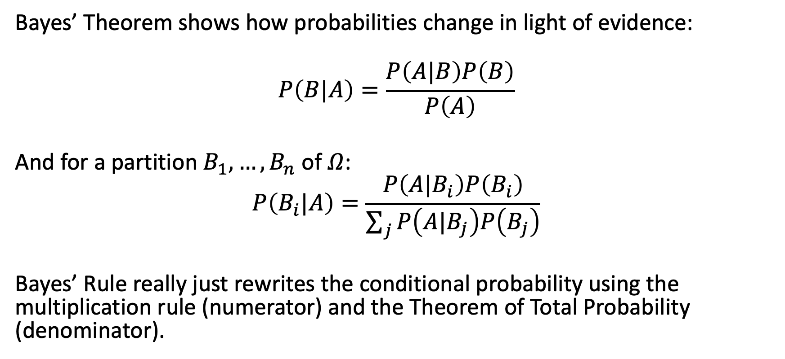
Probability theory: Bayes’ Rule
Bayes’ Theorem shows how probabilities change in light of evidence:
$$P\left(B|A\right)=\frac{P\left(A|B\right)P\left(B\right)}{P\left(A\right)}$$
And for a partition $B_{1},…,B_{n}$ of $Ω$:
$$P\left(B_{i}|A\right)=\frac{P\left(A|B_{i}\right)P\left(B_{i}\right)}{\sum_{j}^{​}{P\left(A|B_{j}\right)P\left(B_{j}\right)}}$$
Bayes’ Rule really just rewrites the conditional probability using the multiplication rule (numerator) and the Theorem of Total Probability (denominator).

Slide 30
Probability theory: Bayes’ Rule
Bayes’ Rule was first formulated by an 18th century English clergyman, Thomas Bayes, it was only published after his death.
While Bayes’ Rule is important for Bayesian statistics, it is a result from probability theory and useful win both Bayesian and frequentist statistics.

Slide 31
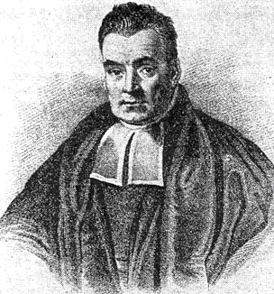
Probability theory: Bayes’ Rule
(probably not) Thomas Bayes (public domain / Wikipedia)

Slide 32
Probability theory: Bayes’ Rule
Example: diagnostic test
Disease $D$, with $P\left(D\right)=0.001$, i.e. occurs only in $0.1\%$ of the population.
There is a diagnostic test, which can give a positive ($T$) or negative ($\overset{‾}{T}$) result. The diagnostic test has $95\%$ sensitivity (i.e. $P\left(T|D\right)=0.95$) and $98\%$ specificity (i.e. $P\left(\overset{‾}{T}|\overset{‾}{D}\right)=0.98$).
What is the probability that a patient has the disease if the test result is positive?

Slide 33
Probability theory: Bayes’ Rule
Note that $D,\overset{‾}{D}$ is a partition of the outcome space.
Apply Bayes’s Rule:
$$\begin{matrix}P\left(D|T\right) & =\frac{P\left(T|D\right)P\left(D\right)}{P\left(T|D\right)P\left(D\right)+P\left(T|\overset{‾}{D}\right)P\left(\overset{‾}{D}\right)} \\ & =\frac{0.95⋅0.001}{0.95⋅0.001+\left(1−0.98\right)⋅\left(1−0.001\right)} \\ & =0.0454\end{matrix}$$

Slide 34
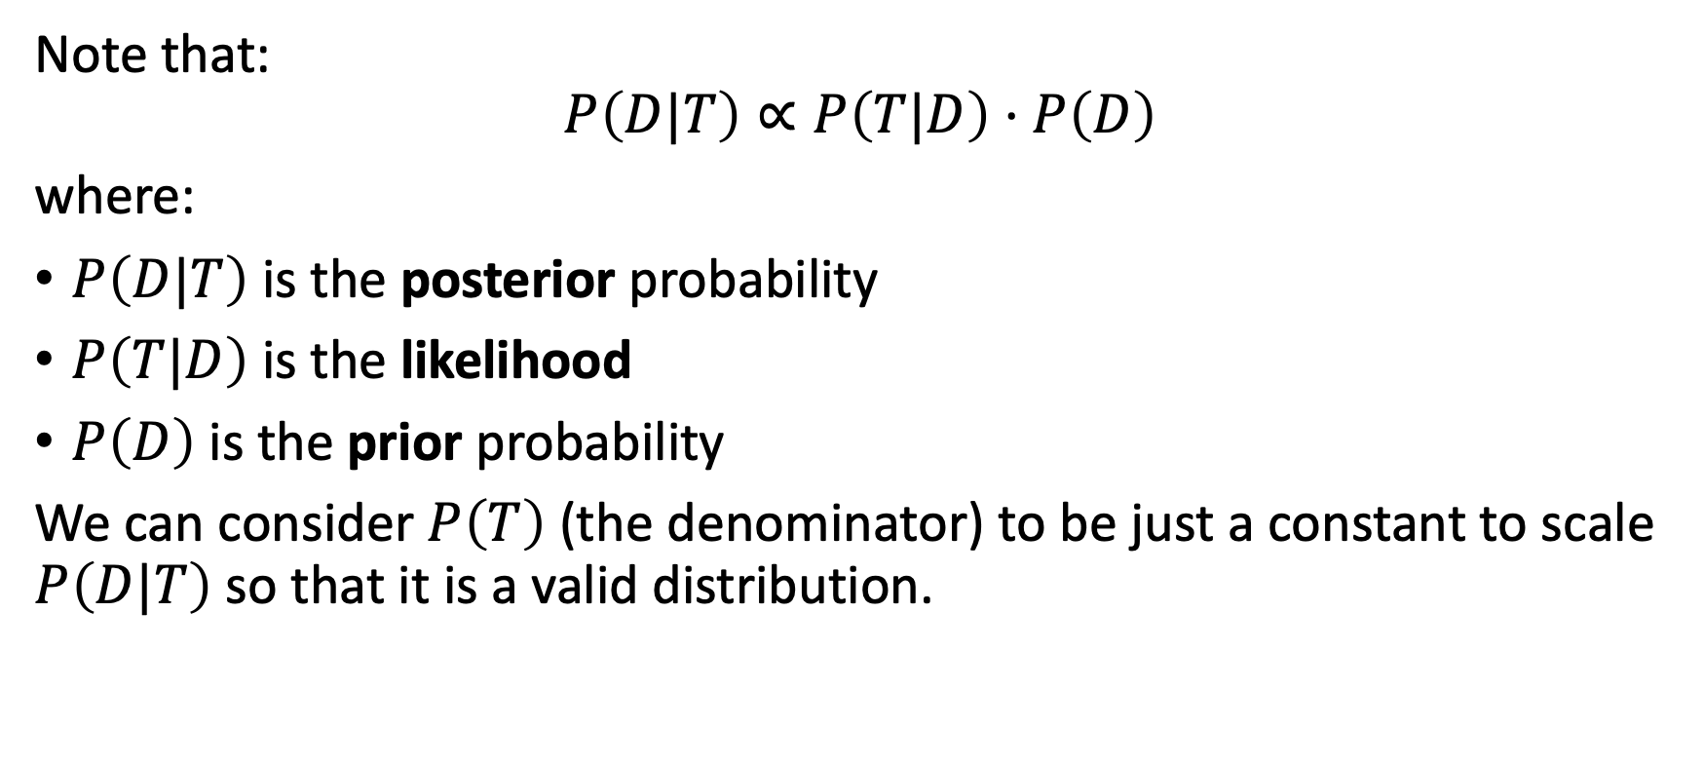
Probability theory: Bayes’ Rule
Note that:
$$P\left(D|T\right)∝P\left(T|D\right)⋅P\left(D\right)$$
where:
$P\left(D|T\right)$ is the posterior probability
$P\left(T|D\right)$ is the likelihood
$P\left(D\right)$ is the prior probability
We can consider $P\left(T\right)$ (the denominator) to be just a constant to scale $P\left(D|T\right)$ so that it is a valid distribution.

Slide 35
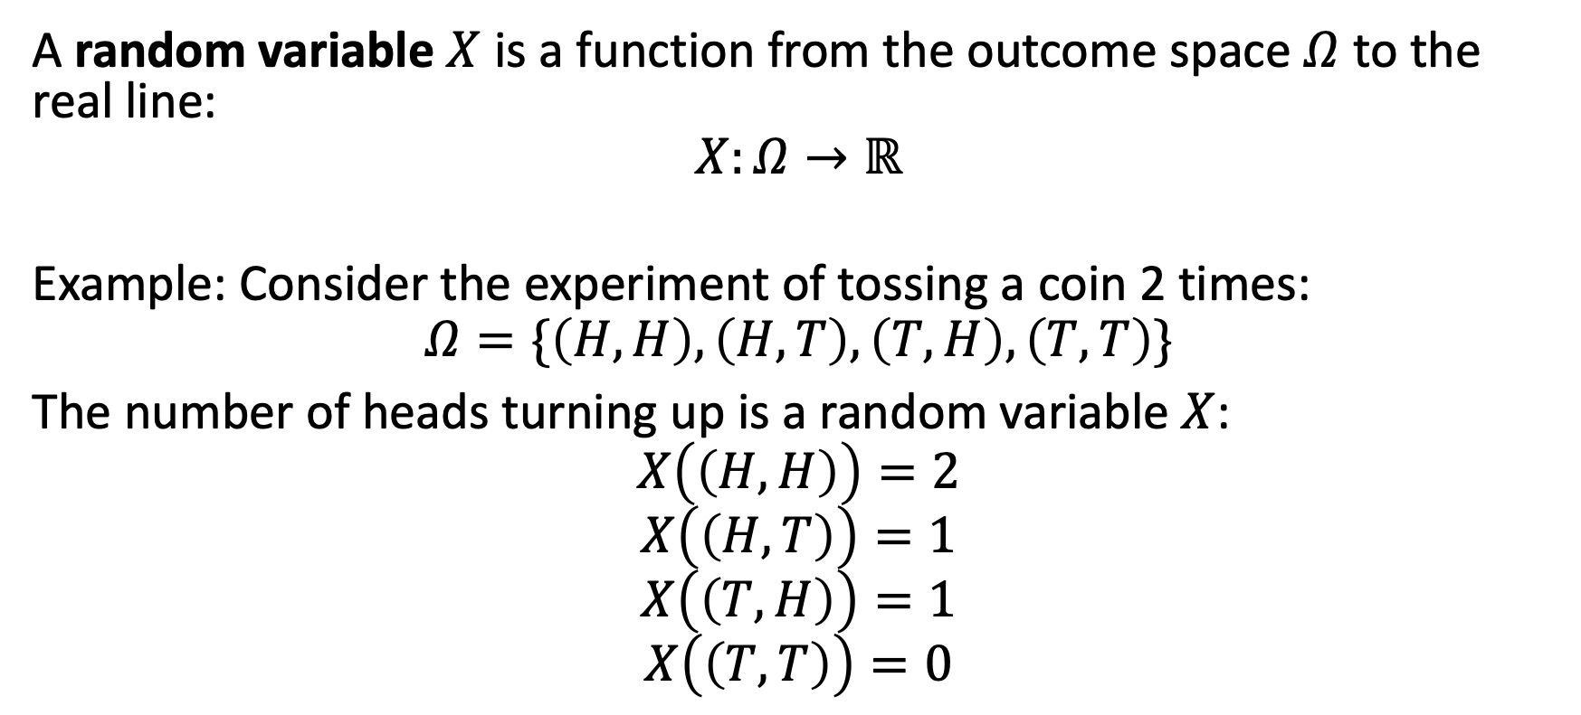
Probability theory: Random variables
A random variable $X$ is a function from the outcome space $Ω$ to the real line:
$$X:Ω→ℝ$$
Example: Consider the experiment of tossing a coin 2 times:
$$Ω=\{\left(H,H\right),\left(H,T\right),\left(T,H\right),\left(T,T\right)\}$$
The number of heads turning up is a random variable $X$:
$$X\left(\left(H,H\right)\right)=2$$
$$X\left(\left(H,T\right)\right)=1$$
$$X\left(\left(T,H\right)\right)=1$$
$$X\left(\left(T,T\right)\right)=0$$

Slide 36
Probability theory: Random variables - probability distributions
A probability mass function (pmf) $p$ assigns to each realisation $x$ of a discrete random variable X the probability $P\left(X=x\right)=p\left(x\right)$.
It follows from the axioms of probability that:
$p\left(x\right)≥0$
$\sum_{x}^{​}{p\left(x\right)}=1$.

Slide 37
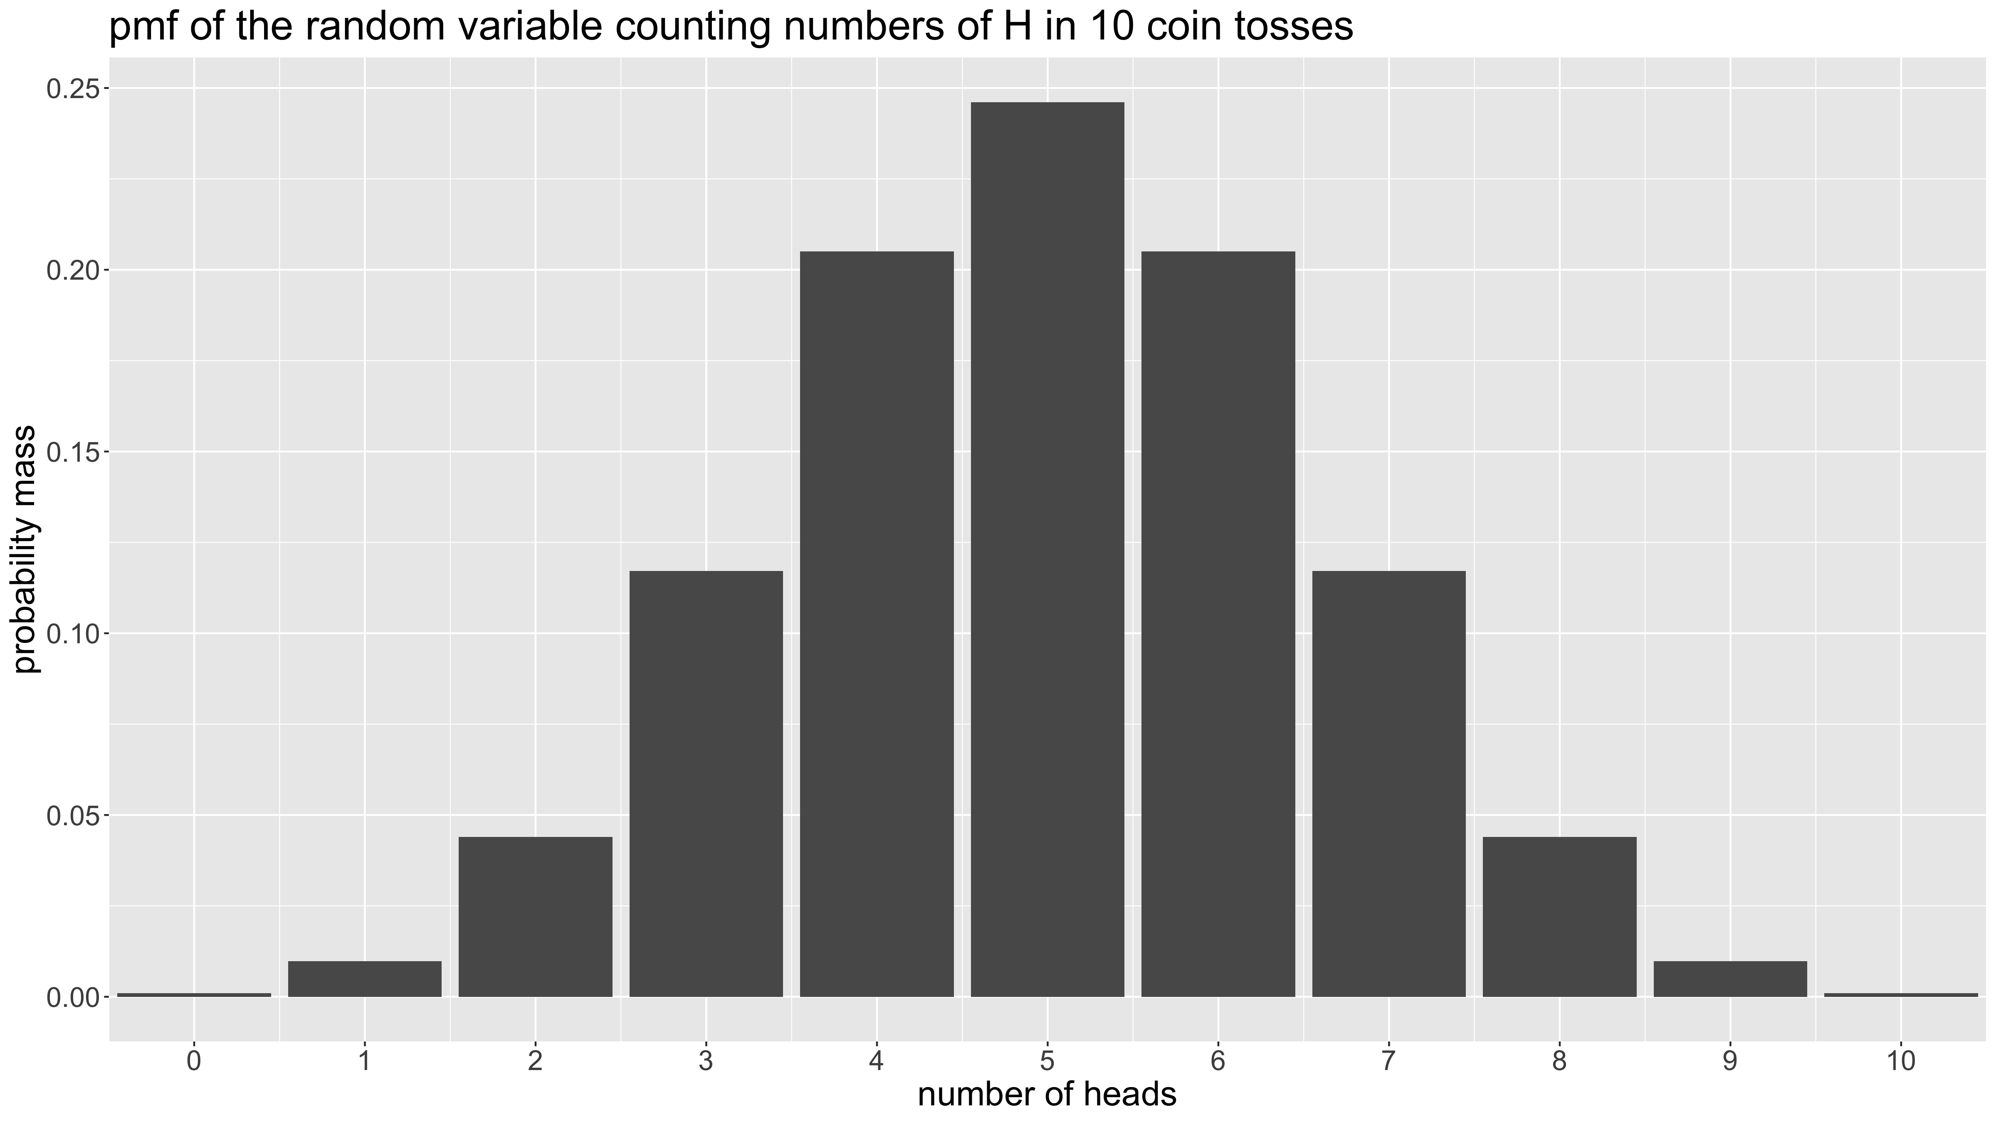
Probability theory: Random variables - probability distributions

Slide 38
Probability theory: Random variables - probability distributions
What about continuous random variables?
For a continuous random variable $X$, $P\left(X=x\right)=0$ for all values of x (the probability of exactly realising one value among an infinity of possible values is 0). Hence it makes little sense to define a pmf.
Instead, we will define probabilities as areas under a curve. A probability density function (pdf) is a function $p:ℝ→ℝ^{+}$ so that
$$P\left(a<X≤b\right)=\int_{a}^{b}{p}\left(x\right)dx$$

Slide 39
Probability theory: Random variables - probability distributions
It follows from the axioms of probability that $p\left(x\right)≥0$ and $\int_{−∞}^{∞}{p\left(x\right)dx}=1$.
Note that while the axioms of probability imply that in the discrete case, a pmf satisfies $p\left(x\right)≤1$, in the continuous case, a pdf $p\left(x\right)$ does not have to be bounded above by 1.

Slide 40
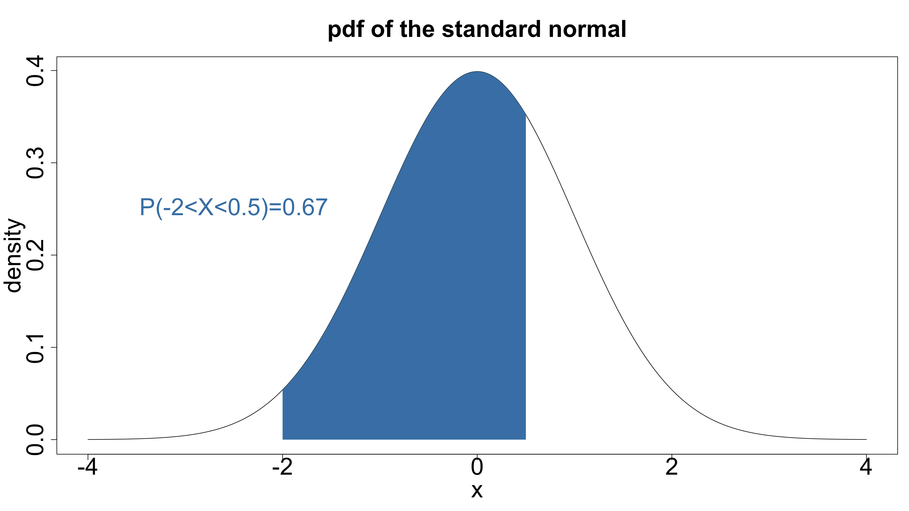
Probability theory: Random variables - probability distributions

Slide 41
Probability theory: Random variables - probability distributions
Example:
If we have the pdf given by
$$p\left(x\right)=\left\{\begin{matrix}2 & \text{for} 0≤x≤0.5 \\ 0 & \text{otherwise}\end{matrix}\right.$$
Then it follows that
$$P\left(0.1<X≤0.3\right)=\int_{0.1}^{0.3}{2}dx={\left[2x\right]}_{0.1}^{0.3}=0.6−0.2=0.4$$

Slide 42
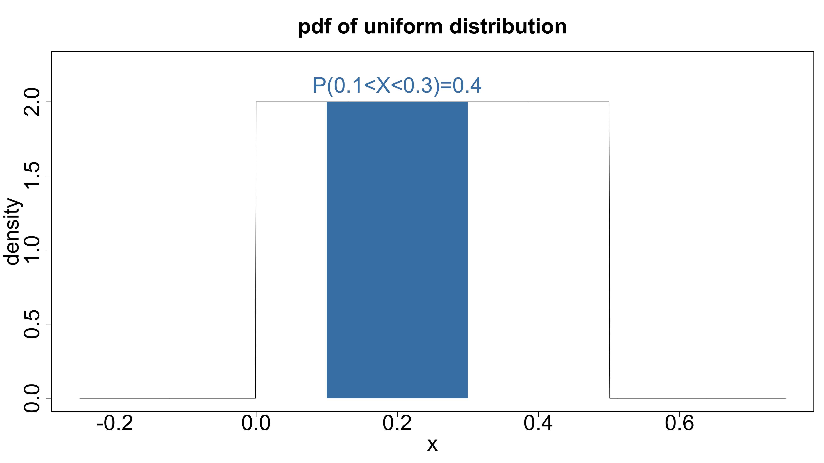
Probability theory: Random variables - probability distributions

Slide 43
Probability theory: Random variables - expectation & variance
What is the expected or average / mean value for a given distribution? Let us define the expectation or the mean of a random value.
Discrete random variables:
$$E\left(X\right)=\sum_{x}^{​}{x p\left(x\right)}$$
Continuous random variables:
$$E\left(X\right)=\int_{−∞}^{∞}{x p\left(x\right) dx}$$
Notation:
$$μ=E\left(X\right)$$

Slide 44
Probability theory: Random variables - expectation & variance
We can also compute expectations for arbitrary functions $h:ℝ→ℝ$ of a random variable:
$$E\left(h\left(X\right)\right)=\left\{\begin{matrix}\sum_{x}^{​}{h\left(x\right) p\left(x\right)} & \text{if} x \text{is} \text{discrete} \\ \int_{−∞}^{∞}{h\left(x\right) p\left(x\right) dx} & \text{if} x \text{is} \text{continuous}\end{matrix}\right.$$

Slide 45
Probability theory: Random variables - expectation & variance
One special case of such a function $h$ is $h\left(x\right)={\left(x−μ\right)}^{2}$ and is used to define the variance of a random variable.
The variance $Var\left(X\right)=σ^{2}$ of a random variable $X$ is defined as spread around the mean and obtained by averaging the squared differences ${\left(x−μ\right)}^{2}$.
$$\begin{matrix}σ^{2} & = & E\left[{\left(X−μ\right)}^{2}\right] \\ & = & E\left[{\left(X−E\left(X\right)\right)}^{2}\right]\end{matrix}$$
The standard deviation $σ$ has the advantage of being on the same scale as $X$.

Slide 46
Probability theory: Random variables - conditional distributions
Discrete case:
$$p\left(x|C\right)=P\left(X=x|C\right)=\frac{P\left(\{X=x\}∩C\right)}{P\left(C\right)}$$
Continuous case:
$$p\left(x|C\right)=\left\{\begin{matrix}p\left(x\right)/P\left(C\right) & \text{for} x∈C \\ 0 & \text{otherwise}\end{matrix}\right.$$

Slide 47
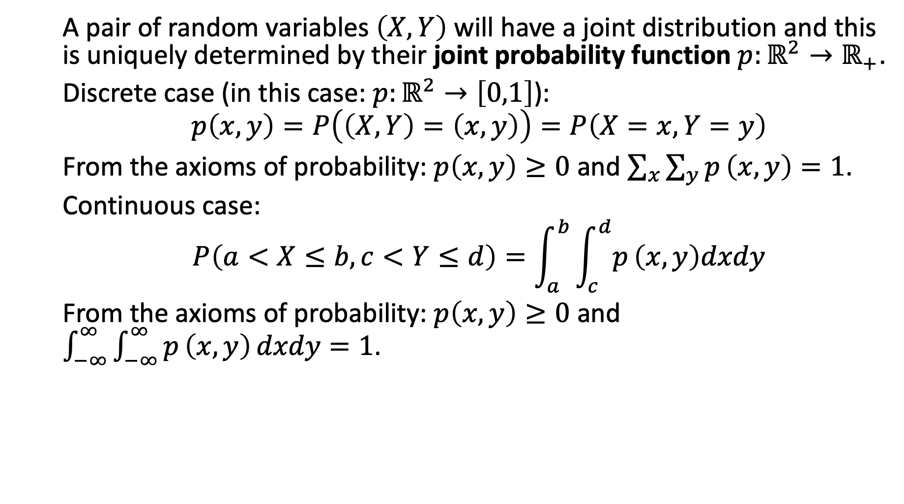
Probability theory: Random variables - joint distributions
A pair of random variables $\left(X,Y\right)$ will have a joint distribution and this is uniquely determined by their joint probability function $p:ℝ^{2}→ℝ_{+}$.
Discrete case (in this case: $p:ℝ^{2}→\left[0,1\right]$):
$$p\left(x,y\right)=P\left(\left(X,Y\right)=\left(x,y\right)\right)=P\left(X=x,Y=y\right)$$
From the axioms of probability: $p\left(x,y\right)≥0$ and $\sum_{x}^{​}{\sum_{y}^{​}{p}}\left(x,y\right)=1$.
Continuous case:
$$P\left(a<X≤b,c<Y≤d\right)=\int_{a}^{b}{\int_{c}^{d}{p}}\left(x,y\right)dxdy$$
From the axioms of probability: $p\left(x,y\right)≥0$ and $\int_{−∞}^{∞}{\int_{−∞}^{∞}{p}}\left(x,y\right) dxdy=1$.

Slide 48
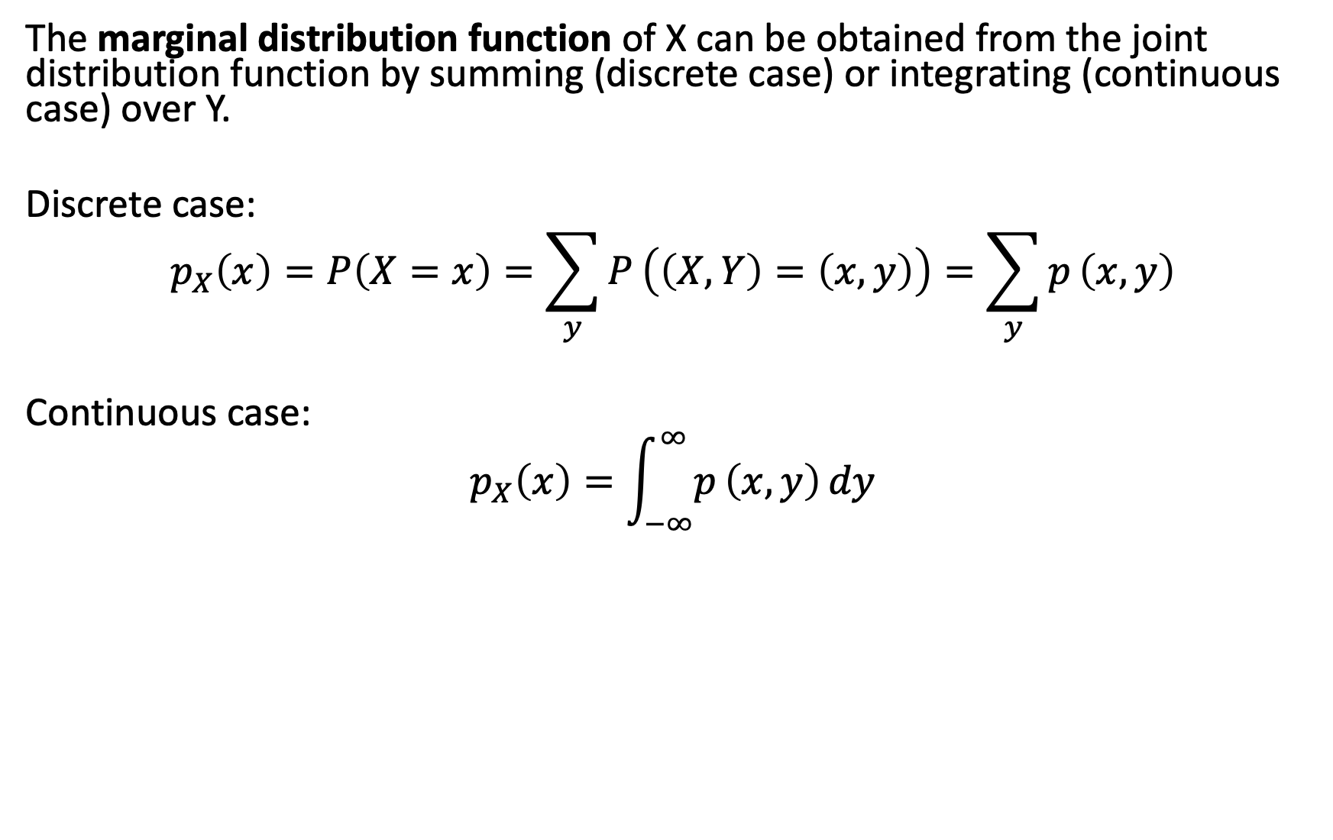
Probability theory: Random variables - marginal distribution
The marginal distribution function of X can be obtained from the joint distribution function by summing (discrete case) or integrating (continuous case) over Y.
Discrete case:
$$p_{X}\left(x\right)=P\left(X=x\right)=\sum_{y}^{​}{P}\left(\left(X,Y\right)=\left(x,y\right)\right)=\sum_{y}^{​}{p}\left(x,y\right)$$
Continuous case:
$$p_{X}\left(x\right)=\int_{−∞}^{∞}{p}\left(x,y\right) dy$$

Slide 49
Probability theory: Random variables - conditional distribution
We can define the conditional distribution function of X given Y.
$$p\left(x|y\right)=\frac{p\left(x,y\right)}{p_{Y}\left(y\right)}$$
As before for events, we define random variables $X,Y$ to be independent if
$$p\left(x,y\right)=p_{X}\left(x\right)p_{Y}\left(y\right) \text{for} \text{all} \left(x,y\right)$$

Slide 50
Probability theory: Random variables
All the previous definitions and theorems also apply to probability mass and density functions.
For discrete random variables, this is obvious as the probability mass function simply specifies probabilities.
For continuous random variables, these follow from the definitions of joint, conditional and marginal distribution functions.

Slide 51
Probability theory: Bayes’ Rule
Let $X,Y$ be 2 random variables. Then
$$p_{X|Y=y}\left(x|y\right)=\frac{f_{Y|X=x}\left(y|x\right)f_{X}\left(x\right)}{f_{Y}\left(y\right)}$$

Slide 52
Probability theory: exchangability & independence
Given a dataset $\{x_{1},…,x_{n}\}$, let $p\left(x_{1},…,x_{n}\right)$ be the joint probability density or mass function of $X_{1},…,X_{n}$.
If $p\left(x_{1},…,x_{n}\right)=p\left(x_{π_{1}},…,x_{π_{n}}\right)$ for all permutations $π$ of $1,…,n$, then $X_{1},…,X_{n}$ are exchangeable.
The subscript contains no information about the outcomes.

Slide 53
Probability theory: exchangability & independence
An important result is
$$X_{1},…,X_{n} \text{are} \text{exchangeable} \text{for} \text{all} n⇔\left\{\begin{matrix} & X_{1},…,X_{n}|θ \text{are} \text{i}\text{.}\text{i}\text{.}\text{d}\text{.} \\ & θ∼p\left(θ\right)\end{matrix}\right.$$
Unless specified otherwise we will always assume exchangeability.

Slide 54
[end of STA623 Bayesian Data analysis Session 1]

