Slide 1
STA623 Bayesian Data Analysis
Session 3: Bayesian estimation Marc Henrion

Slide 2

Preliminaries
These notes were written in quarto.
All examples / code in these notes is R and a combination of NIMBLE / BUGS for Bayesian model specification.
GitHub repository - will contain all course materials by the end of the week.
https://github.com/gitMarcH/UNIMA_STA623_2025

Slide 3
Preliminaries
Some references for Bayesian statistics / data analysis are:
Hoff, P.D. (2009). “A First Course in Bayesian Statistical Methods.” Springer.
Gelman, A., Carlin, J.B., Stern, H.S., Dunson, D.B., Vehtari, A., Rubin, D.B. (2014). “Bayesian Data Analysis”. 3rd ed. CRC Press.
Ramoni, M., Sebastiani, P. (2007), ‘Bayesian Methods’, in Berthold, M., Hand, D.J. (eds.). “Intelligent Data Analysis”, 2nd ed., Springer, pp.131-168
Stone, J.V. (2013). “Bayes’ Rule: A Tutorial Introduction to Bayesian Analysis”. Sebtel Press.

Slide 4
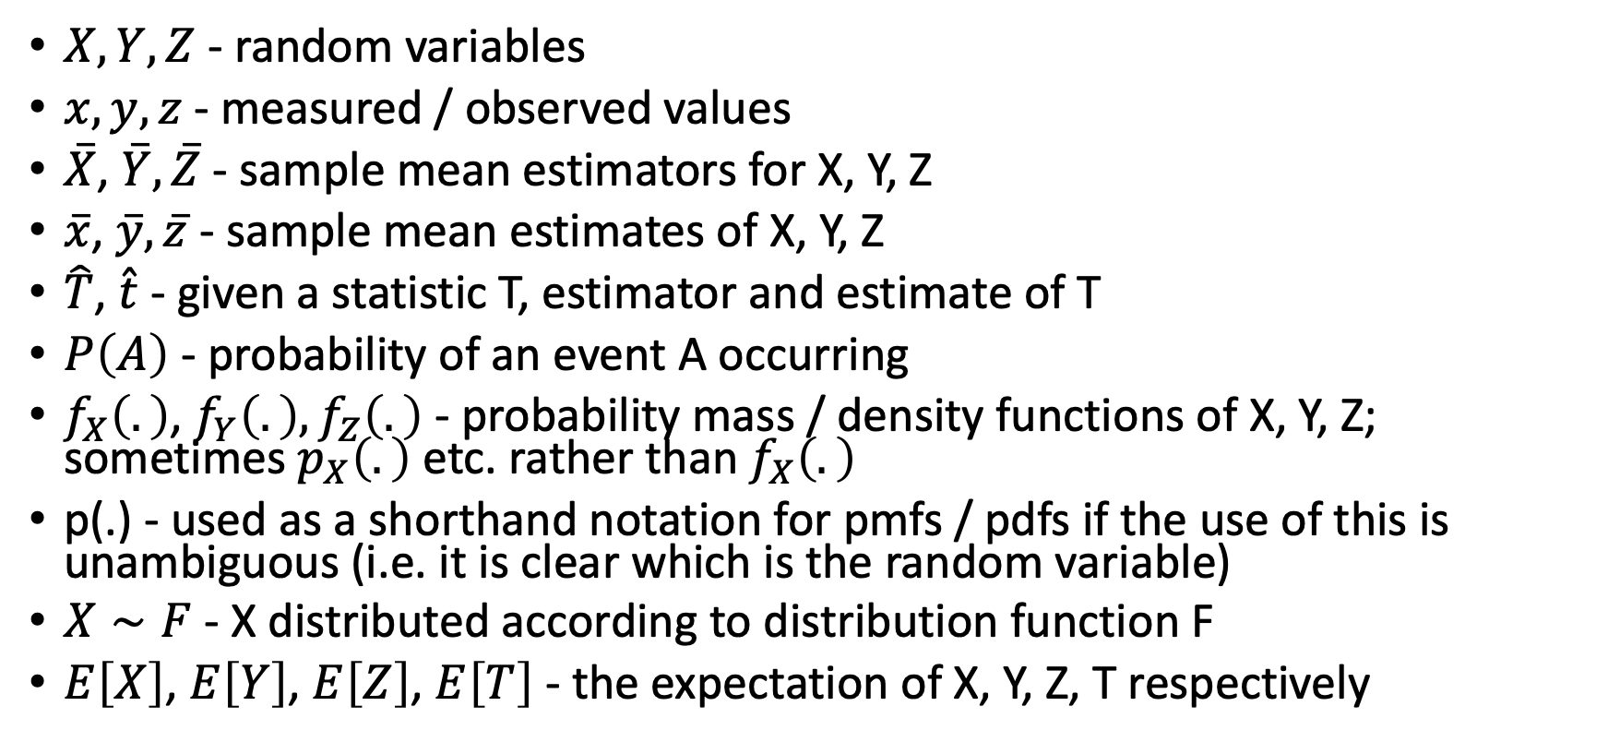
Notation
$X,Y,Z$ - random variables
$x,y,z$ - measured / observed values
$\overset{‾}{X}$, $\overset{‾}{Y},\overset{‾}{Z}$ - sample mean estimators for X, Y, Z
$\overset{‾}{x}$, $\overset{‾}{y},\overset{‾}{z}$ - sample mean estimates of X, Y, Z
$\hat{T}$, $\hat{t}$ - given a statistic T, estimator and estimate of T
$P\left(A\right)$ - probability of an event A occurring
$f_{X}\left(.\right)$, $f_{Y}\left(.\right),f_{Z}\left(.\right)$ - probability mass / density functions of X, Y, Z; sometimes $p_{X}\left(.\right)$ etc. rather than $f_{X}\left(.\right)$
p(.) - used as a shorthand notation for pmfs / pdfs if the use of this is unambiguous (i.e. it is clear which is the random variable)
$X∼F$ - X distributed according to distribution function F
$E\left[X\right]$, $E\left[Y\right]$, $E\left[Z\right]$, $E\left[T\right]$ - the expectation of X, Y, Z, T respectively

Slide 5
THE NORMAL MODEL

Slide 6
The normal model
So far we have studied one-parameter distributions.
What about two-parameter distributions?
For example the normal distribution $𝒩\left(μ,σ^{2}\right)$ with pdf
$$φ\left(x|μ,σ^{2}\right)=\frac{1}{\sqrt{2πσ^{2}}}exp\left(−\frac{1}{2}{\left(\frac{x−μ}{σ}\right)}^{2}\right)$$

Slide 7
The normal model
To be able to do joint inference for $\left(μ,σ^{2}\right)$, we can break the problem into 2 one-parameter problems.
For example, for the prior:
$$p\left(μ,σ^{2}\right)=p\left(μ|σ^{2}\right)⋅p\left(σ^{2}\right)$$
And, after observing data $\{y_{i}\}_{i=1}^{n}$ with $Y_{i}∼_{\text{iid}}𝒩\left(μ,σ^{2}\right)$, similarly for the posterior distribution:
$$p\left(μ,σ^{2}|y_{1},…,y_{n}\right)∝p\left(μ|σ^{2},y_{1},…,y_{n}\right)p\left(σ^{2}|y_{1},…,y_{n}\right)$$
The above results follow straight from the definition of conditional probability: $P\left(A∩B\right)=P\left(A|B\right)⋅P\left(B\right)$.

Slide 8
The normal model
One can show (Practicals 1 & 2, Exercise 8) that assuming $σ^{2}$ to be fixed, i.e. by conditioning on $σ^{2}$, then a conjugate prior distribution for the mean $μ$ is the normal distribution itself:
$$\left\{\begin{matrix}M|σ^{2} & ∼ & 𝒩\left(μ_{0},σ_{0}^{2}\right) & \text{(}\text{prior}\text{)} \\ Y_{1},…,Y_{n}|μ,σ^{2} & ∼ & 𝒩\left(μ,σ^{2}\right) & \text{(}\text{sampling} \text{model}\text{)}\end{matrix}\right.$$
Then the posterior is also a normal distribution:
$$M|σ^{2},y_{1},…,y_{n}∼𝒩\left(μ_{n},σ_{n}^{2}\right)$$

Slide 9
The normal model
Where
$$\left\{\begin{matrix}μ_{n} & = & \frac{\frac{1}{σ_{0}^{2}}}{\frac{1}{σ_{0}^{2}}+\frac{n}{σ^{2}}}μ_{0}+\frac{\frac{n}{σ^{2}}}{\frac{1}{σ_{0}^{2}}+\frac{n}{σ^{2}}}\overset{‾}{y} \\ & & \\ σ_{n}^{2} & = & \frac{1}{\frac{1}{σ_{0}^{2}}+\frac{n}{σ^{2}}}\end{matrix}\right.$$

Slide 10
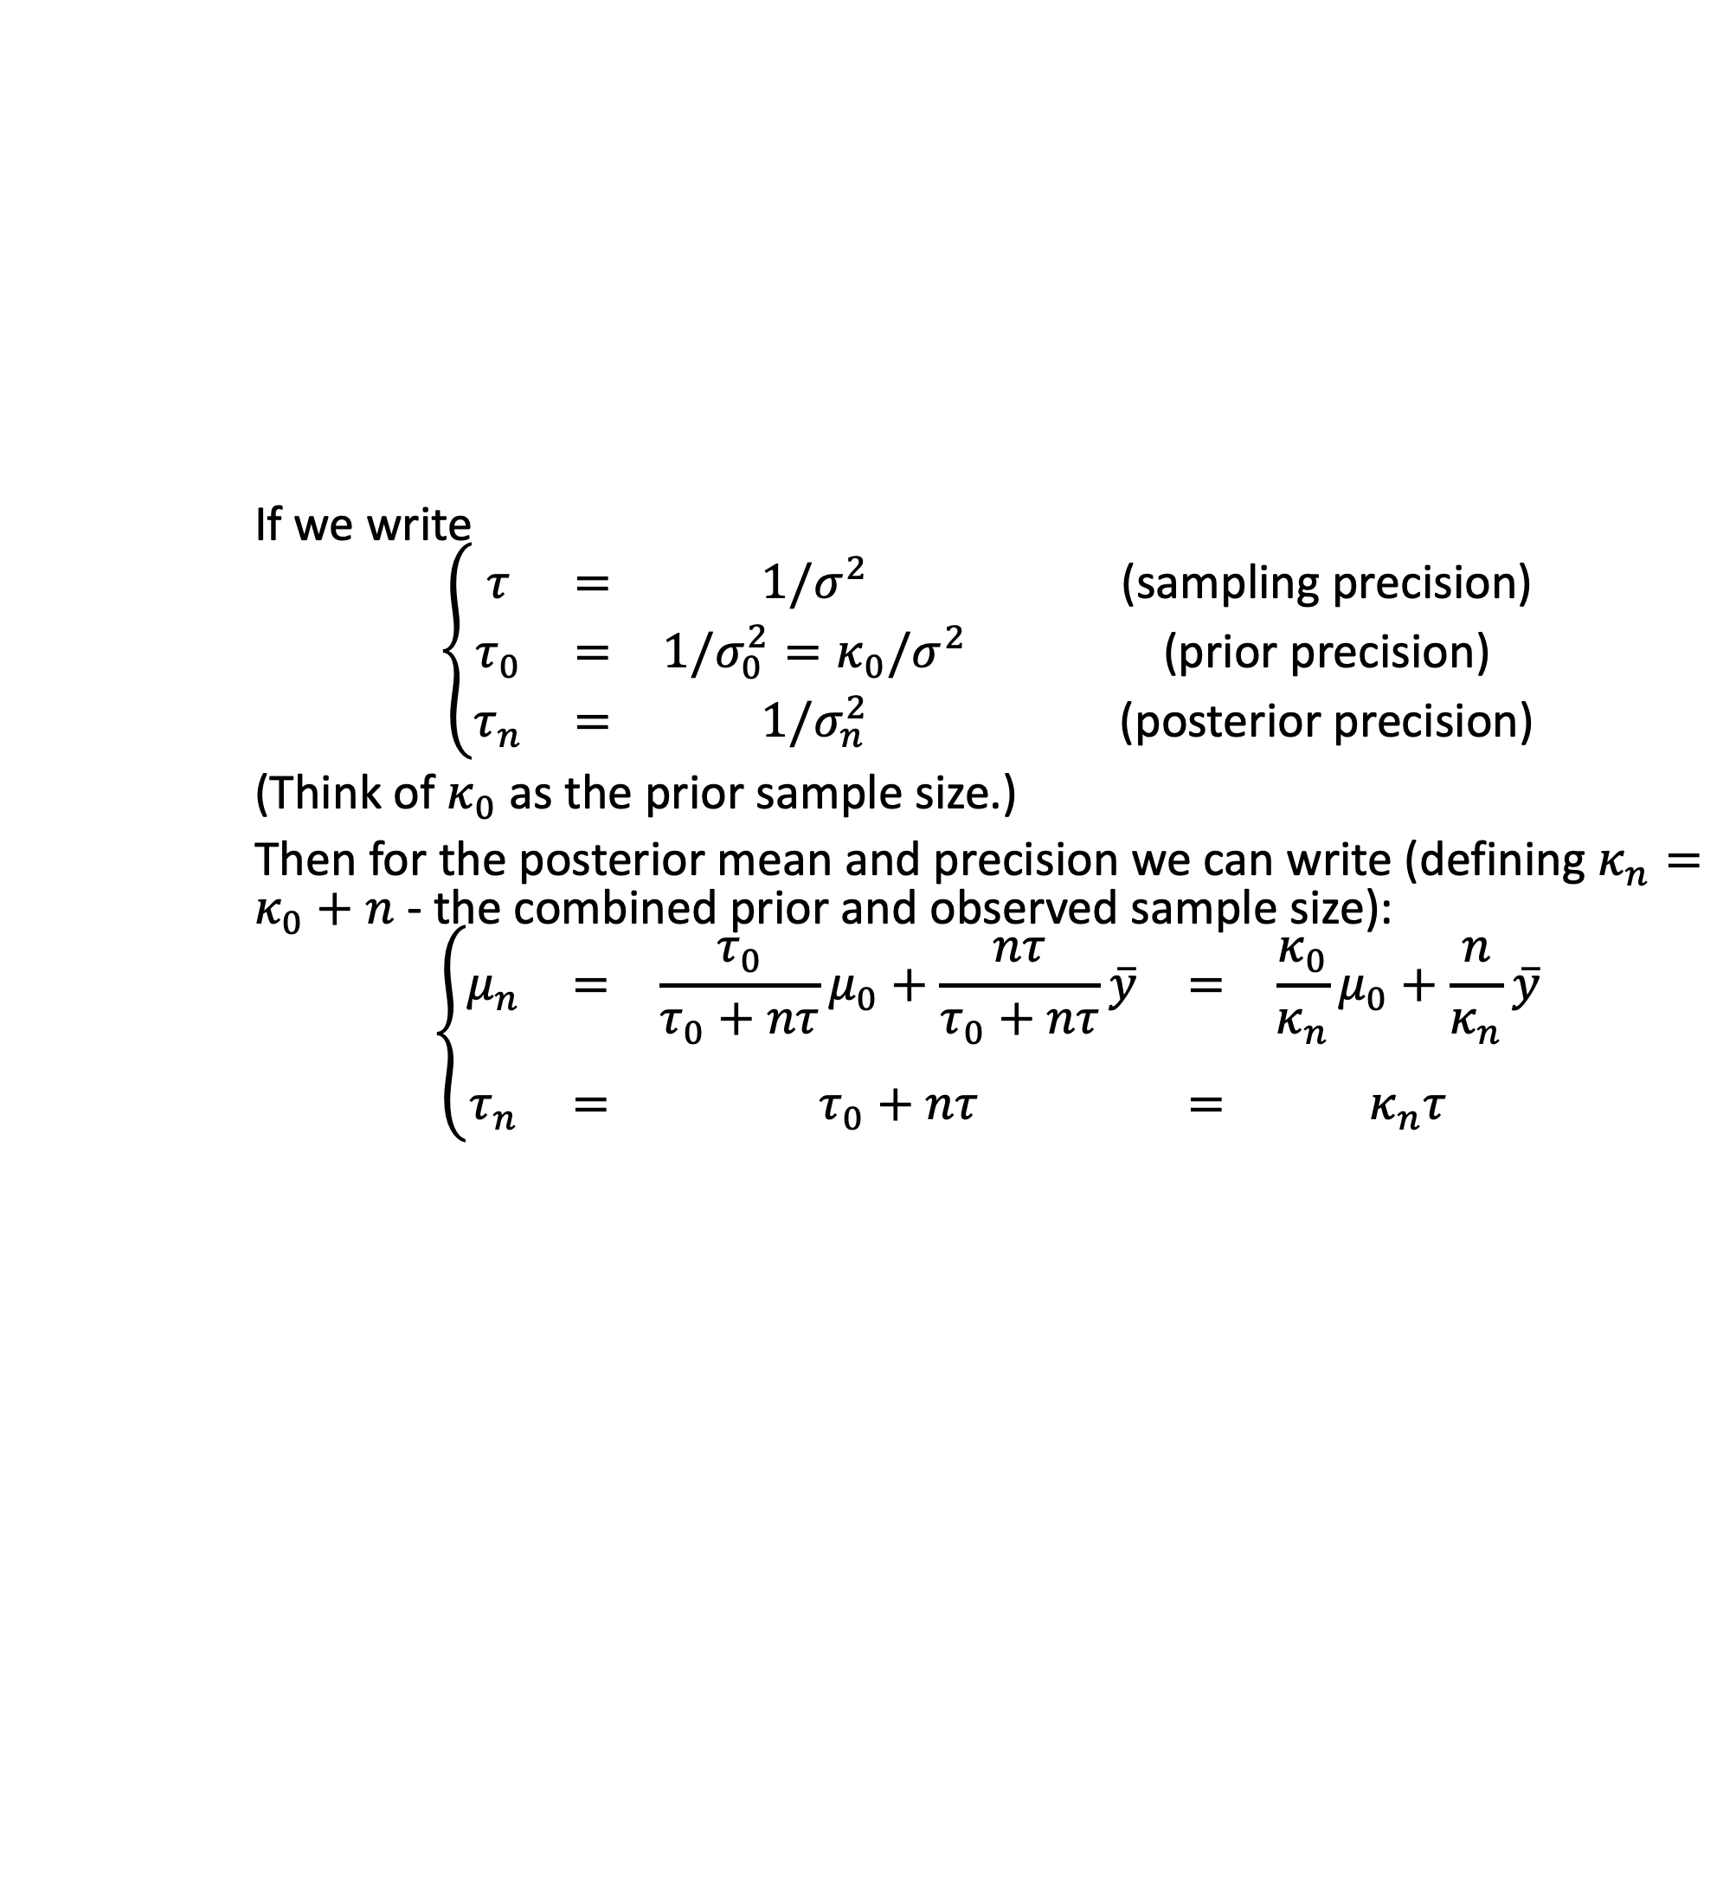
The normal model
If we write
$$\left\{\begin{matrix}τ & = & 1/σ^{2} & \text{(}\text{sampling} \text{precision}\text{)} \\ τ_{0} & = & 1/σ_{0}^{2}=κ_{0}/σ^{2} & \text{(}\text{prior} \text{precision}\text{)} \\ τ_{n} & = & 1/σ_{n}^{2} & \text{(}\text{posterior} \text{precision}\text{)}\end{matrix}\right.$$
(Think of $κ_{0}$ as the prior sample size.)
Then for the posterior mean and precision we can write (defining $κ_{n}=κ_{0}+n$ - the combined prior and observed sample size):
$$\left\{\begin{matrix}μ_{n} & = & \frac{τ_{0}}{τ_{0}+nτ}μ_{0}+\frac{nτ}{τ_{0}+nτ}\overset{‾}{y} & = & \frac{κ_{0}}{κ_{n}}μ_{0}+\frac{n}{κ_{n}}\overset{‾}{y} \\ & & & & \\ τ_{n} & = & τ_{0}+nτ & = & κ_{n}τ\end{matrix}\right.$$

Slide 11
The normal model
In other words, for inference for $μ$ conditional on $σ^{2}$:
The posterior mean is a weighted average of the prior mean and the sample mean (with the weights determined by the prior and sample precisions and the number of observed data points).
The posterior precision is a sum of the prior precision and the sample precision, with the latter weighted by the number of observations.

Slide 12
The normal model
We now need a prior for the variance $σ^{2}$. This needs to have support on $\left(0,∞\right)$ as it is for a variance parameter. The gamma distribution would be a candidate, but it turns out not to be conjugate for the normal sampling model. However, the gamma is conjugate for the precision $τ=1/σ^{2}$; or in other words, the inverse-gamma distribution is a conjugate prior for the variance $σ^{2}$ of a normal sampling model:
$$\left\{\begin{matrix}\text{precision}: & τ=1/σ^{2} & ∼ & Γ\left(a,b\right) \\ \text{variance}: & σ^{2} & ∼ & \text{inv}\text{−}Γ\left(a,b\right)\end{matrix}\right.$$

Slide 13
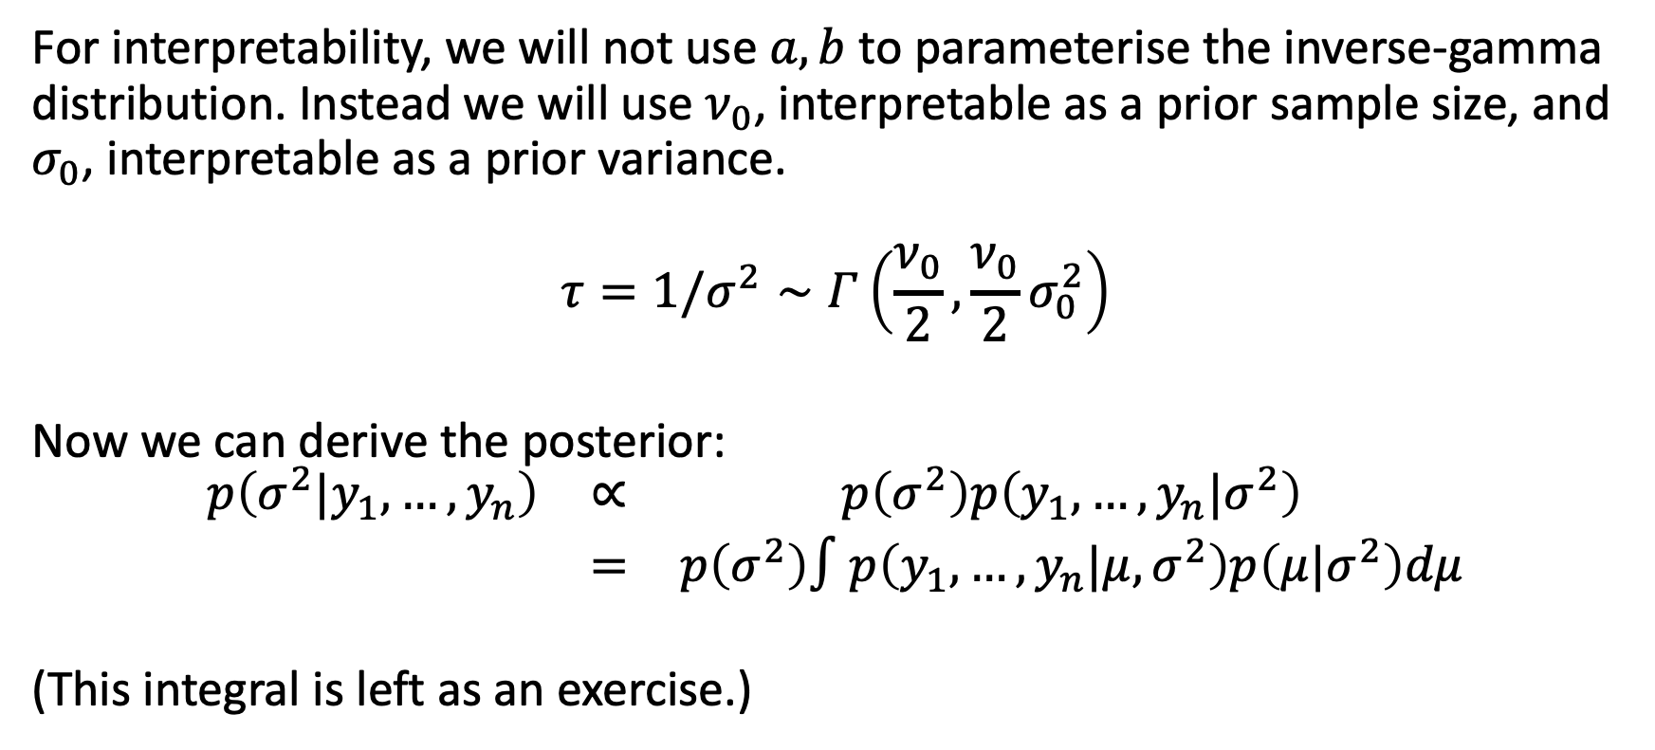
The normal model
For interpretability, we will not use $a,b$ to parameterise the inverse-gamma distribution. Instead we will use $ν_{0}$, interpretable as a prior sample size, and $σ_{0}$, interpretable as a prior variance.
$$τ=1/σ^{2}∼Γ\left(\frac{ν_{0}}{2},\frac{ν_{0}}{2}σ_{0}^{2}\right)$$
Now we can derive the posterior:
$$\begin{matrix}p\left(σ^{2}|y_{1},…,y_{n}\right) & ∝ & p\left(σ^{2}\right)p\left(y_{1},…,y_{n}|σ^{2}\right) \\ & = & p\left(σ^{2}\right)∫p\left(y_{1},…,y_{n}|μ,σ^{2}\right)p\left(μ|σ^{2}\right)dμ\end{matrix}$$
(This integral is left as an exercise.)

Slide 14
The normal model
The solution is that
$$1/σ^{2}|y_{1},…,y_{n}∼Γ\left(\frac{ν_{n}}{2},\frac{ν_{n}}{2}σ_{n}^{2}\right)$$
where
$$\left\{\begin{matrix}ν_{n} & = & ν_{0}+n \\ σ_{n}^{2} & = & \frac{1}{ν_{n}}\left[ν_{0}σ_{0}^{2}+\left(n−1\right)s^{2}+\frac{κ_{0}n}{κ_{n}}\left(\overset{‾}{y}−μ_{0}^{2}\right)\right]\end{matrix}\right.$$
and $s^{2}=\frac{1}{n−1}\sum_{i=1}^{n}{{\left(y_{i}−\overset{‾}{y}\right)}^{2}}$ is the usual sample variance.

Slide 15
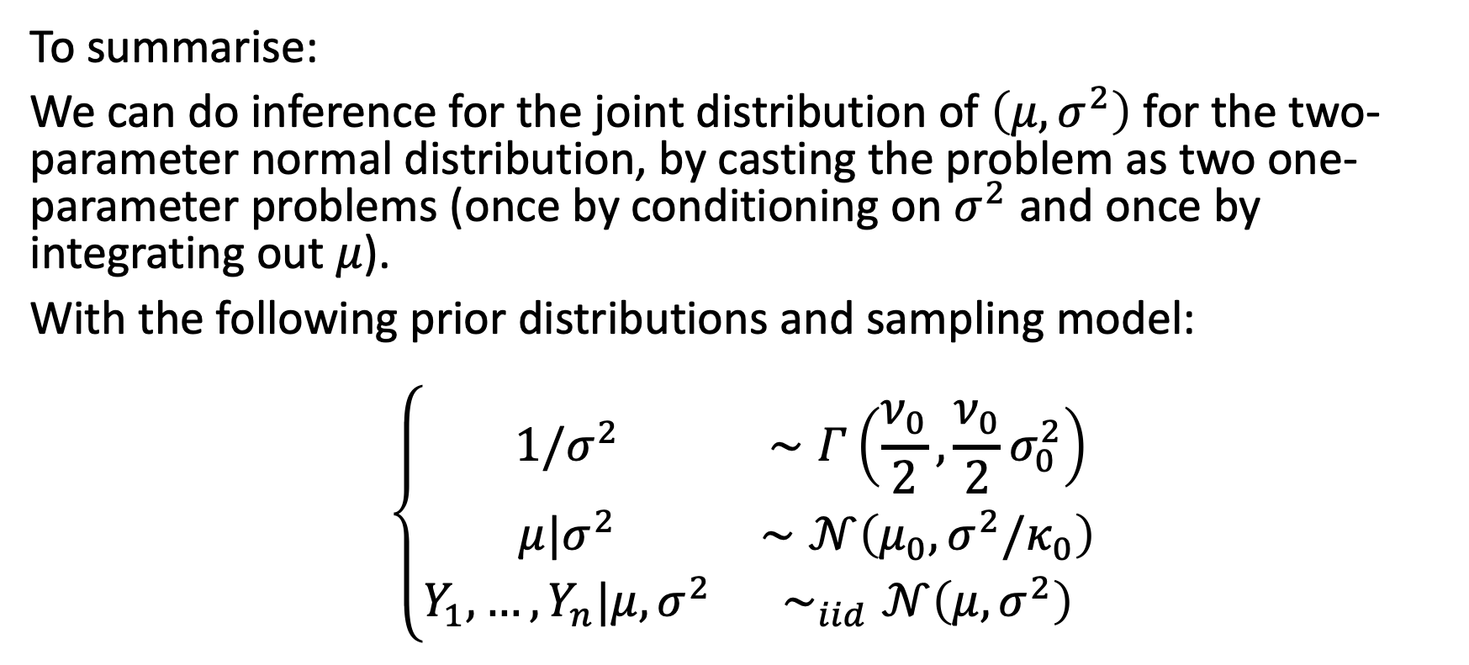
The normal model
To summarise:
We can do inference for the joint distribution of $\left(μ,σ^{2}\right)$ for the two-parameter normal distribution, by casting the problem as two one-parameter problems (once by conditioning on $σ^{2}$ and once by integrating out $μ$).
With the following prior distributions and sampling model:
$$\left\{\begin{matrix}1/σ^{2} & ∼Γ\left(\frac{ν_{0}}{2},\frac{ν_{0}}{2}σ_{0}^{2}\right) \\ μ|σ^{2} & ∼𝒩\left(μ_{0},σ^{2}/κ_{0}\right) \\ Y_{1},…,Y_{n}|μ,σ^{2} & ∼_{iid}𝒩\left(μ,σ^{2}\right)\end{matrix}\right.$$

Slide 16
The normal model
We can do inference for $μ$ and $σ^{2}$ using the following posterior distributions:
$$\left\{\begin{matrix}μ|y_{1},…,y_{n},σ^{2} & ∼𝒩\left(μ_{n},σ^{2}/κ_{n}\right) \\ 1/σ^{2}|y_{1},…,y_{n} & ∼Γ\left(\frac{ν_{n}}{2},\frac{ν_{n}}{2}σ_{n}^{2}\right)\end{matrix}\right.$$

Slide 17
BAYESIAN ESTIMATION

Slide 18
Bayesian estimation
The main focus of inference in Bayesian statistics are
the posterior distribution of the parameter $θ$ given the data $y$: $p\left(θ|y\right)$
the posterior predictive distribution of new data $\tilde{y}$ given observed data $y$: $p\left(\tilde{y}|y\right)$
Often we will look at the distributions of functions of $θ$, $\tilde{y}$.

Slide 19
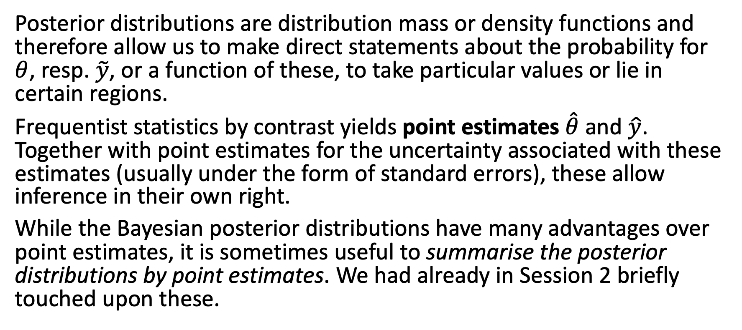
Bayesian estimation
Posterior distributions are distribution mass or density functions and therefore allow us to make direct statements about the probability for $θ$, resp. $\tilde{y}$, or a function of these, to take particular values or lie in certain regions.
Frequentist statistics by contrast yields point estimates $\hat{θ}$ and $\hat{y}$. Together with point estimates for the uncertainty associated with these estimates (usually under the form of standard errors), these allow inference in their own right.
While the Bayesian posterior distributions have many advantages over point estimates, it is sometimes useful to summarise the posterior distributions by point estimates. We had already in Session 2 briefly touched upon these.

Slide 20
Bayesian estimation: Bayes estimator
A Bayes estimator ${\hat{θ}}_{B}$ is an estimator that minimses the posterior expected value of a loss function (i.e. the posterior expected loss).
Mathematically:
$${\hat{θ}}_{B}=arg\min_{\hat{θ}}\int_{𝒴}^{​}{\int_{Θ}^{​}{𝒞}}\left(θ−\hat{θ}\right)p\left(θ,y\right)dθdy$$
where $𝒞\left(.\right)$ is a cost function.
Note that the integration is over both $θ$ and $y$.

Slide 21
Bayesian estimation: Bayes estimator
We can use any cost function, but the most commonly used ones include:
quadratic loss: $𝒞\left(x\right)=x^{2}$
absolute loss: $𝒞\left(x\right)=\left|x\right|$
0-1 loss: $𝒞\left(x\right)=\left\{\begin{matrix}0 \text{if} \left|x\right|<ε \\ 1 \text{if} \left|x\right|≥ε\end{matrix}\right.$

Slide 22
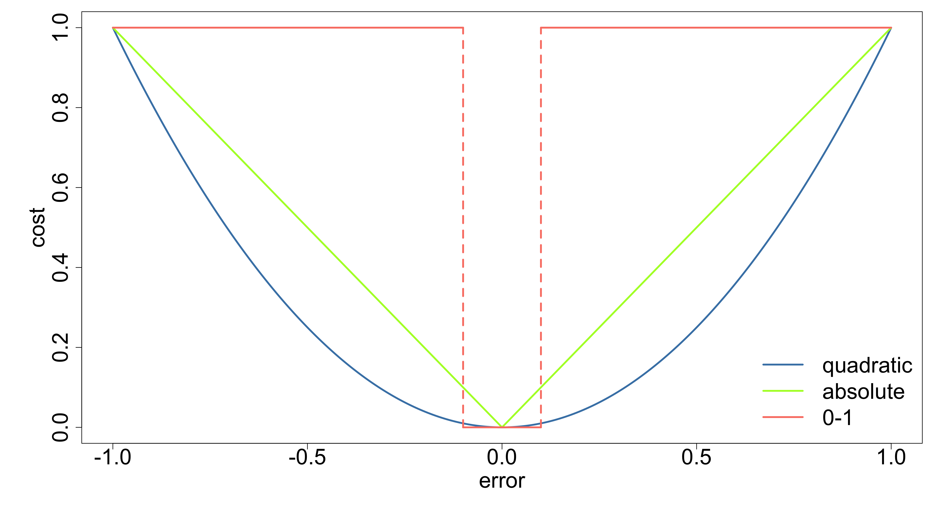
Bayesian estimation: Bayes estimator

Slide 23
Bayesian estimation: Bayes estimator
We will see that:
quadratic loss $⇒$ posterior mean
absolute loss $⇒$ posterior median
0-1 loss $⇒$ posterior mode

Slide 24
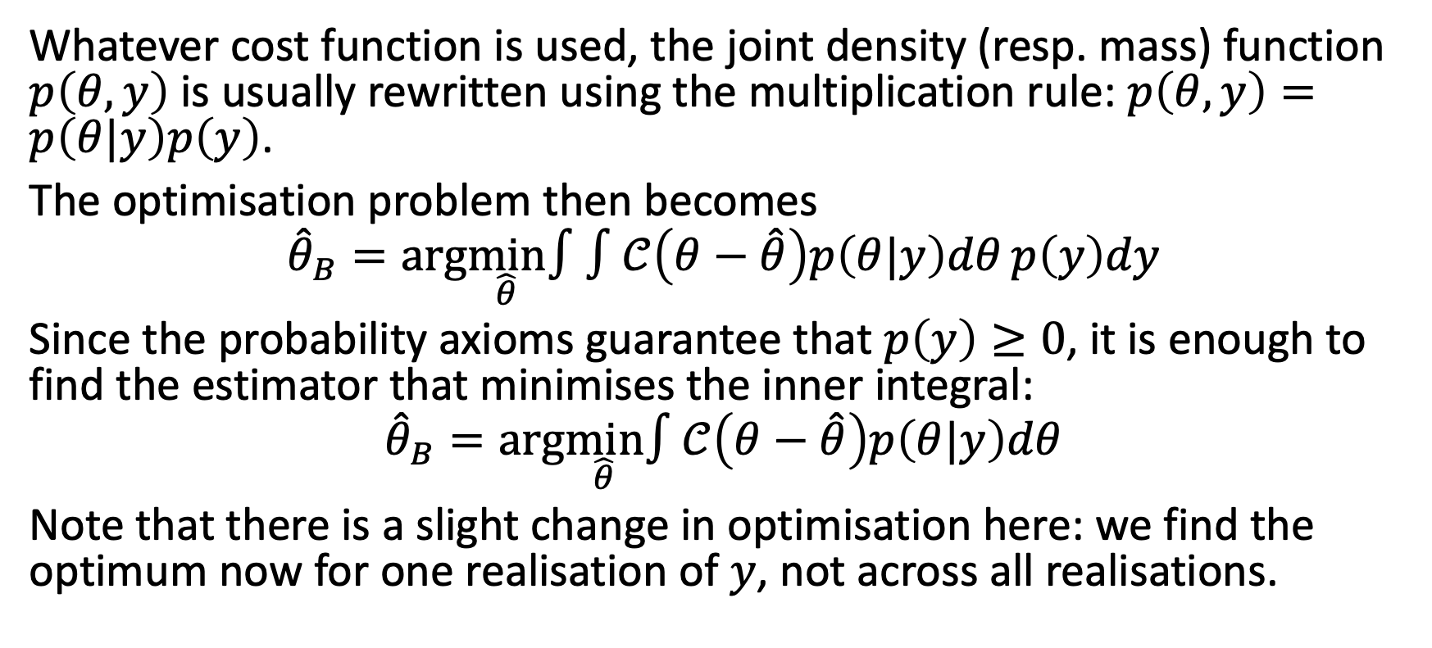
Bayesian estimation: Bayes estimator
Whatever cost function is used, the joint density (resp. mass) function $p\left(θ,y\right)$ is usually rewritten using the multiplication rule: $p\left(θ,y\right)=p\left(θ|y\right)p\left(y\right)$.
The optimisation problem then becomes
$${\hat{θ}}_{B}=arg\min_{\hat{θ}}∫∫𝒞\left(θ−\hat{θ}\right)p\left(θ|y\right)dθ p\left(y\right)dy$$
Since the probability axioms guarantee that $p\left(y\right)≥0$, it is enough to find the estimator that minimises the inner integral:
$${\hat{θ}}_{B}=arg\min_{\hat{θ}}∫𝒞\left(θ−\hat{θ}\right)p\left(θ|y\right)dθ$$
Note that there is a slight change in optimisation here: we find the optimum now for one realisation of $y$, not across all realisations.

Slide 25
Bayesian estimation: Bayes estimator
Quadratic loss function
See Practical 3 for the derivation of this estimator:
$${\hat{θ}}_{B}=∫θp\left(θ|y\right)dθ=E\left[θ|y\right]$$
This particular estimator is also called the minimum mean squared error estimator (MMSE) and is the most widely used point estimate for posterior distributions.

Slide 26
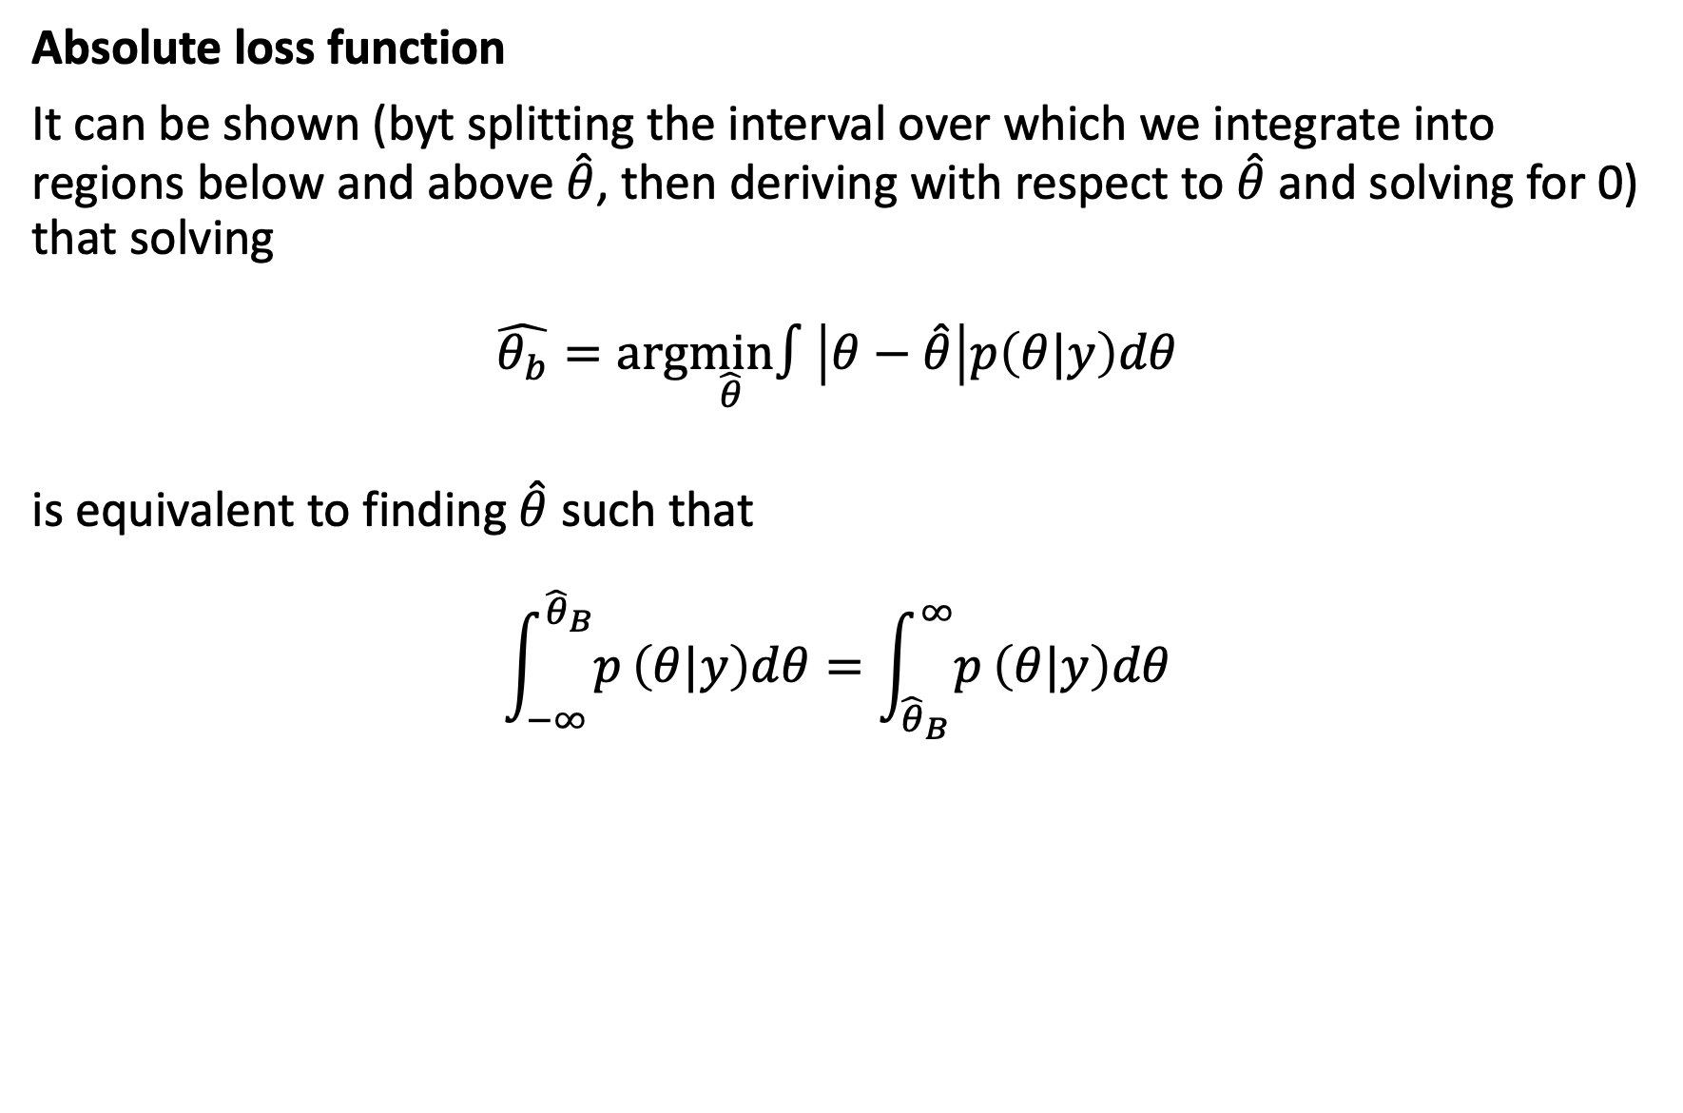
Bayesian estimation: Bayes estimator
Absolute loss function
It can be shown (byt splitting the interval over which we integrate into regions below and above $\hat{θ}$, then deriving with respect to $\hat{θ}$ and solving for 0) that solving
$$\hat{θ_{b}}=arg\min_{\hat{θ}}∫\left|θ−\hat{θ}\right|p\left(θ|y\right)dθ$$
is equivalent to finding $\hat{θ}$ such that
$$\int_{−∞}^{{\hat{θ}}_{B}}{p}\left(θ|y\right)dθ=\int_{{\hat{θ}}_{B}}^{∞}{p}\left(θ|y\right)dθ$$

Slide 27
Bayesian estimation: Bayes estimator
Absolute loss function
In other words, we need to find ${\hat{θ}}_{B}$ that divides the posterior probability density into 2 regions with equal probability mass:
$$\int_{−∞}^{{\hat{θ}}_{B}}{p}\left(θ|y\right)dθ=\int_{{\hat{θ}}_{B}}^{∞}{p}\left(θ|y\right)dθ=\frac{1}{2}$$
This is the definition of the posterior median.

Slide 28
Bayesian estimation: Bayes estimator
0-1 loss function (sometimes called hit-or-miss loss function)
We need to find ${\hat{θ}}_{B}$ such that
$${\hat{θ}}_{B}=arg\min_{\hat{θ}}∫𝒞\left(θ−\hat{θ}\right)p\left(θ|y\right)dθ$$
where
$$𝒞\left(x\right)=\left\{\begin{matrix}0 \text{if} \left|x\right|<ε \\ 1 \text{if} \left|x\right|≥ε\end{matrix}\right.$$
for some $ε>0$.

Slide 29
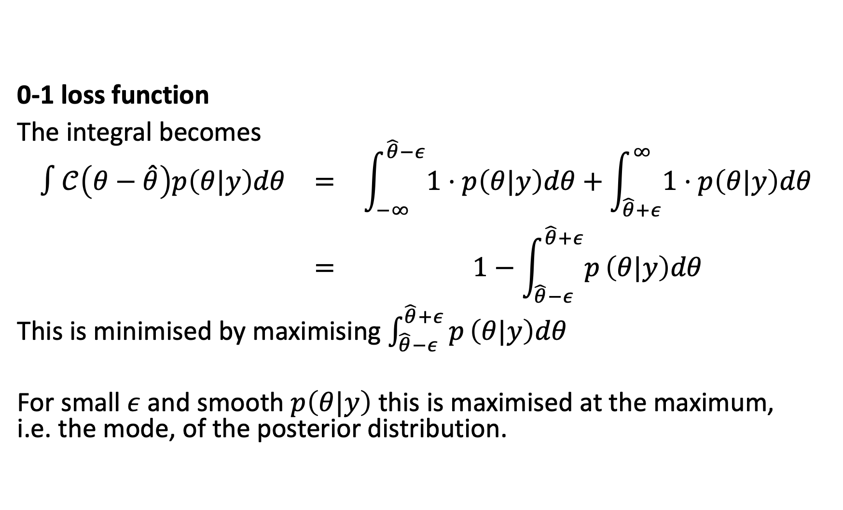
Bayesian estimation: Bayes estimator
0-1 loss function
The integral becomes
$$\begin{matrix}∫𝒞\left(θ−\hat{θ}\right)p\left(θ|y\right)dθ & = & \int_{−∞}^{\hat{θ}−ε}{1}⋅p\left(θ|y\right)dθ+\int_{\hat{θ}+ε}^{∞}{1}⋅p\left(θ|y\right)dθ \\ & = & 1−\int_{\hat{θ}−ε}^{\hat{θ}+ε}{p}\left(θ|y\right)dθ\end{matrix}$$
This is minimised by maximising $\int_{\hat{θ}−ε}^{\hat{θ}+ε}{p}\left(θ|y\right)dθ$
For small $ε$ and smooth $p\left(θ|y\right)$ this is maximised at the maximum, i.e. the mode, of the posterior distribution.

Slide 30
Bayesian estimation: Bayes estimator
Note that the last of these estimator is usally not considered to be Bayes estimator since it requires (fairly mild) conditions to exist ($p\left(θ|y\right)$ smooth and existence of a single mode) and is a limiting case ($ε→0$).
For this reason, maximum a posterior density estimation is often considered an alternative to Bayes estimation.

Slide 31
CREDIBLE INTERVALS

Slide 32
Bayesian estimation: Credible intervals
It is often desirable to identify regions of the parameter space that have a high probability of containing the parameter. To do this we can construct, after observing some data $y$, an interval (say) $\left[l\left(y\right),u\left(y\right)\right]$ such that the probability that $θ∈\left[l\left(y\right),u\left(y\right)\right]$ is high.

Slide 33
Bayesian estimation: Credible intervals
Bayesian coverage
An interval based on observed data $Y=y$ has $100×\left(1−α\right)\%$ Bayesian coverage for $θ$ if
$$P\left(l\left(y\right)<θ<u\left(y\right) | Y=y\right)=1−α$$
Note that here $θ$ is random, the interval is fixed.

Slide 34
Bayesian estimation: Credible intervals
Frequentist coverage
An random interval $[l\left(Y\right),u\left(Y\right)$ has $100×\left(1−α\right)\%$ frequentist coverage for $θ$ if, before the data are collected,
$$P\left(l\left(Y\right)<θ<u\left(Y\right) |θ\right)=1−α$$
Note that here $θ$ is fixed, the interval is random.

Slide 35
Bayesian estimation: Credible intervals
Bayesian intervals are usually called credible intervals and frequentist intervals are called confidence intervals.
However, Bayesian confidence interval and frequentist confidence interval are also in use.
Bayesian confidence intervals also have frequentist coverage – see Hoff P. D. (2009), Sections 3.1.2 and 3.4 for a comment on this.

Slide 36
Bayesian estimation: Credible intervals
Frequentist confidence intervals are often centered on the point estimate. If not centered on the point estimate, they at the very least contain it and so anchor the interval.
In a Bayesian setting this is a bit less straightforward: we could pick any interval along the support to get an interval with the desired coverage.
We could simply center the interval on a chosen posterior point estimate such as the posterior mean. There are other ways to construct such intervals though.

Slide 37
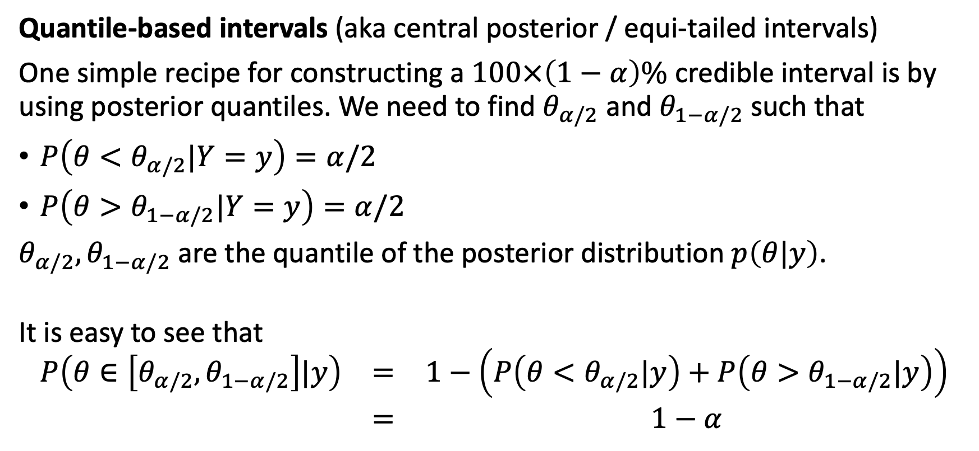
Bayesian estimation: Credible intervals
Quantile-based intervals (aka central posterior / equi-tailed intervals)
One simple recipe for constructing a $100×\left(1−α\right)\%$ credible interval is by using posterior quantiles. We need to find $θ_{α/2}$ and $θ_{1−α/2}$ such that
$P\left(θ<θ_{α/2}|Y=y\right)=α/2$
$P\left(θ>θ_{1−α/2}|Y=y\right)=α/2$
$θ_{α/2},θ_{1−α/2}$ are the quantile of the posterior distribution $p\left(θ|y\right)$.
It is easy to see that
$$\begin{matrix}P\left(θ∈\left[θ_{α/2},θ_{1−α/2}\right]|y\right) & = & 1−\left(P\left(θ<θ_{α/2}|y\right)+P\left(θ>θ_{1−α/2}|y\right)\right) \\ & = & 1−α\end{matrix}$$

Slide 38
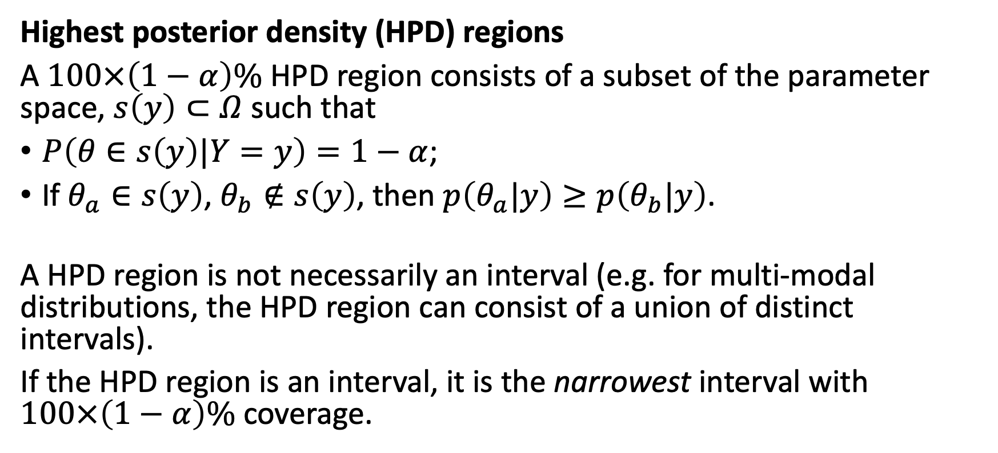
Bayesian estimation: Credible intervals
Highest posterior density (HPD) regions
A $100×\left(1−α\right)\%$ HPD region consists of a subset of the parameter space, $s\left(y\right)⊂Ω$ such that
$P\left(θ∈s\left(y\right)|Y=y\right)=1−α$;
If $θ_{a}∈s\left(y\right)$, $θ_{b}∉s\left(y\right)$, then $p\left(θ_{a}|y\right)≥p\left(θ_{b}|y\right)$.
A HPD region is not necessarily an interval (e.g. for multi-modal distributions, the HPD region can consist of a union of distinct intervals).
If the HPD region is an interval, it is the narrowest interval with $100×\left(1−α\right)\%$ coverage.

Slide 39
Bayesian estimation: Credible intervals - example
Suppose the posterior distribution $p\left(θ|y\right)$ is Beta$\left(5,2\right)$.
95% quantile-based interval:
$q_{0.025;β\left(5,2\right)}=0.3588$ and $q_{0.975;β\left(5,2\right)}=0.9567$
$$⇒\text{ 95\% }\text{quantile}\text{−}\text{based} \text{interval} =\left[0.3588,0.9567\right]$$
The width of this interval is $q_{0.975;β\left(5,2\right)}−q_{0.025;β\left(5,2\right)}=0.5980$

Slide 40
Bayesian estimation: Credible intervals - example
Suppose the posterior distribution $p\left(θ|y\right)$ is Beta$\left(5,2\right)$.
95% HPD interval:
There’s no formula to find this; has to be found empirically by sliding a line down the y-axis on a graph of the density. In R, you can use the function hdi() from the HDInterval package (for example).
$$⇒\text{ 95\% }\text{HPD} \text{interval} =\left[0.4094,0.9822\right]$$
The width of this interval is $0.9822−0.4094=0.5728$.
Note that this is (slightly) narrower than the quantile-based interval.

Slide 41
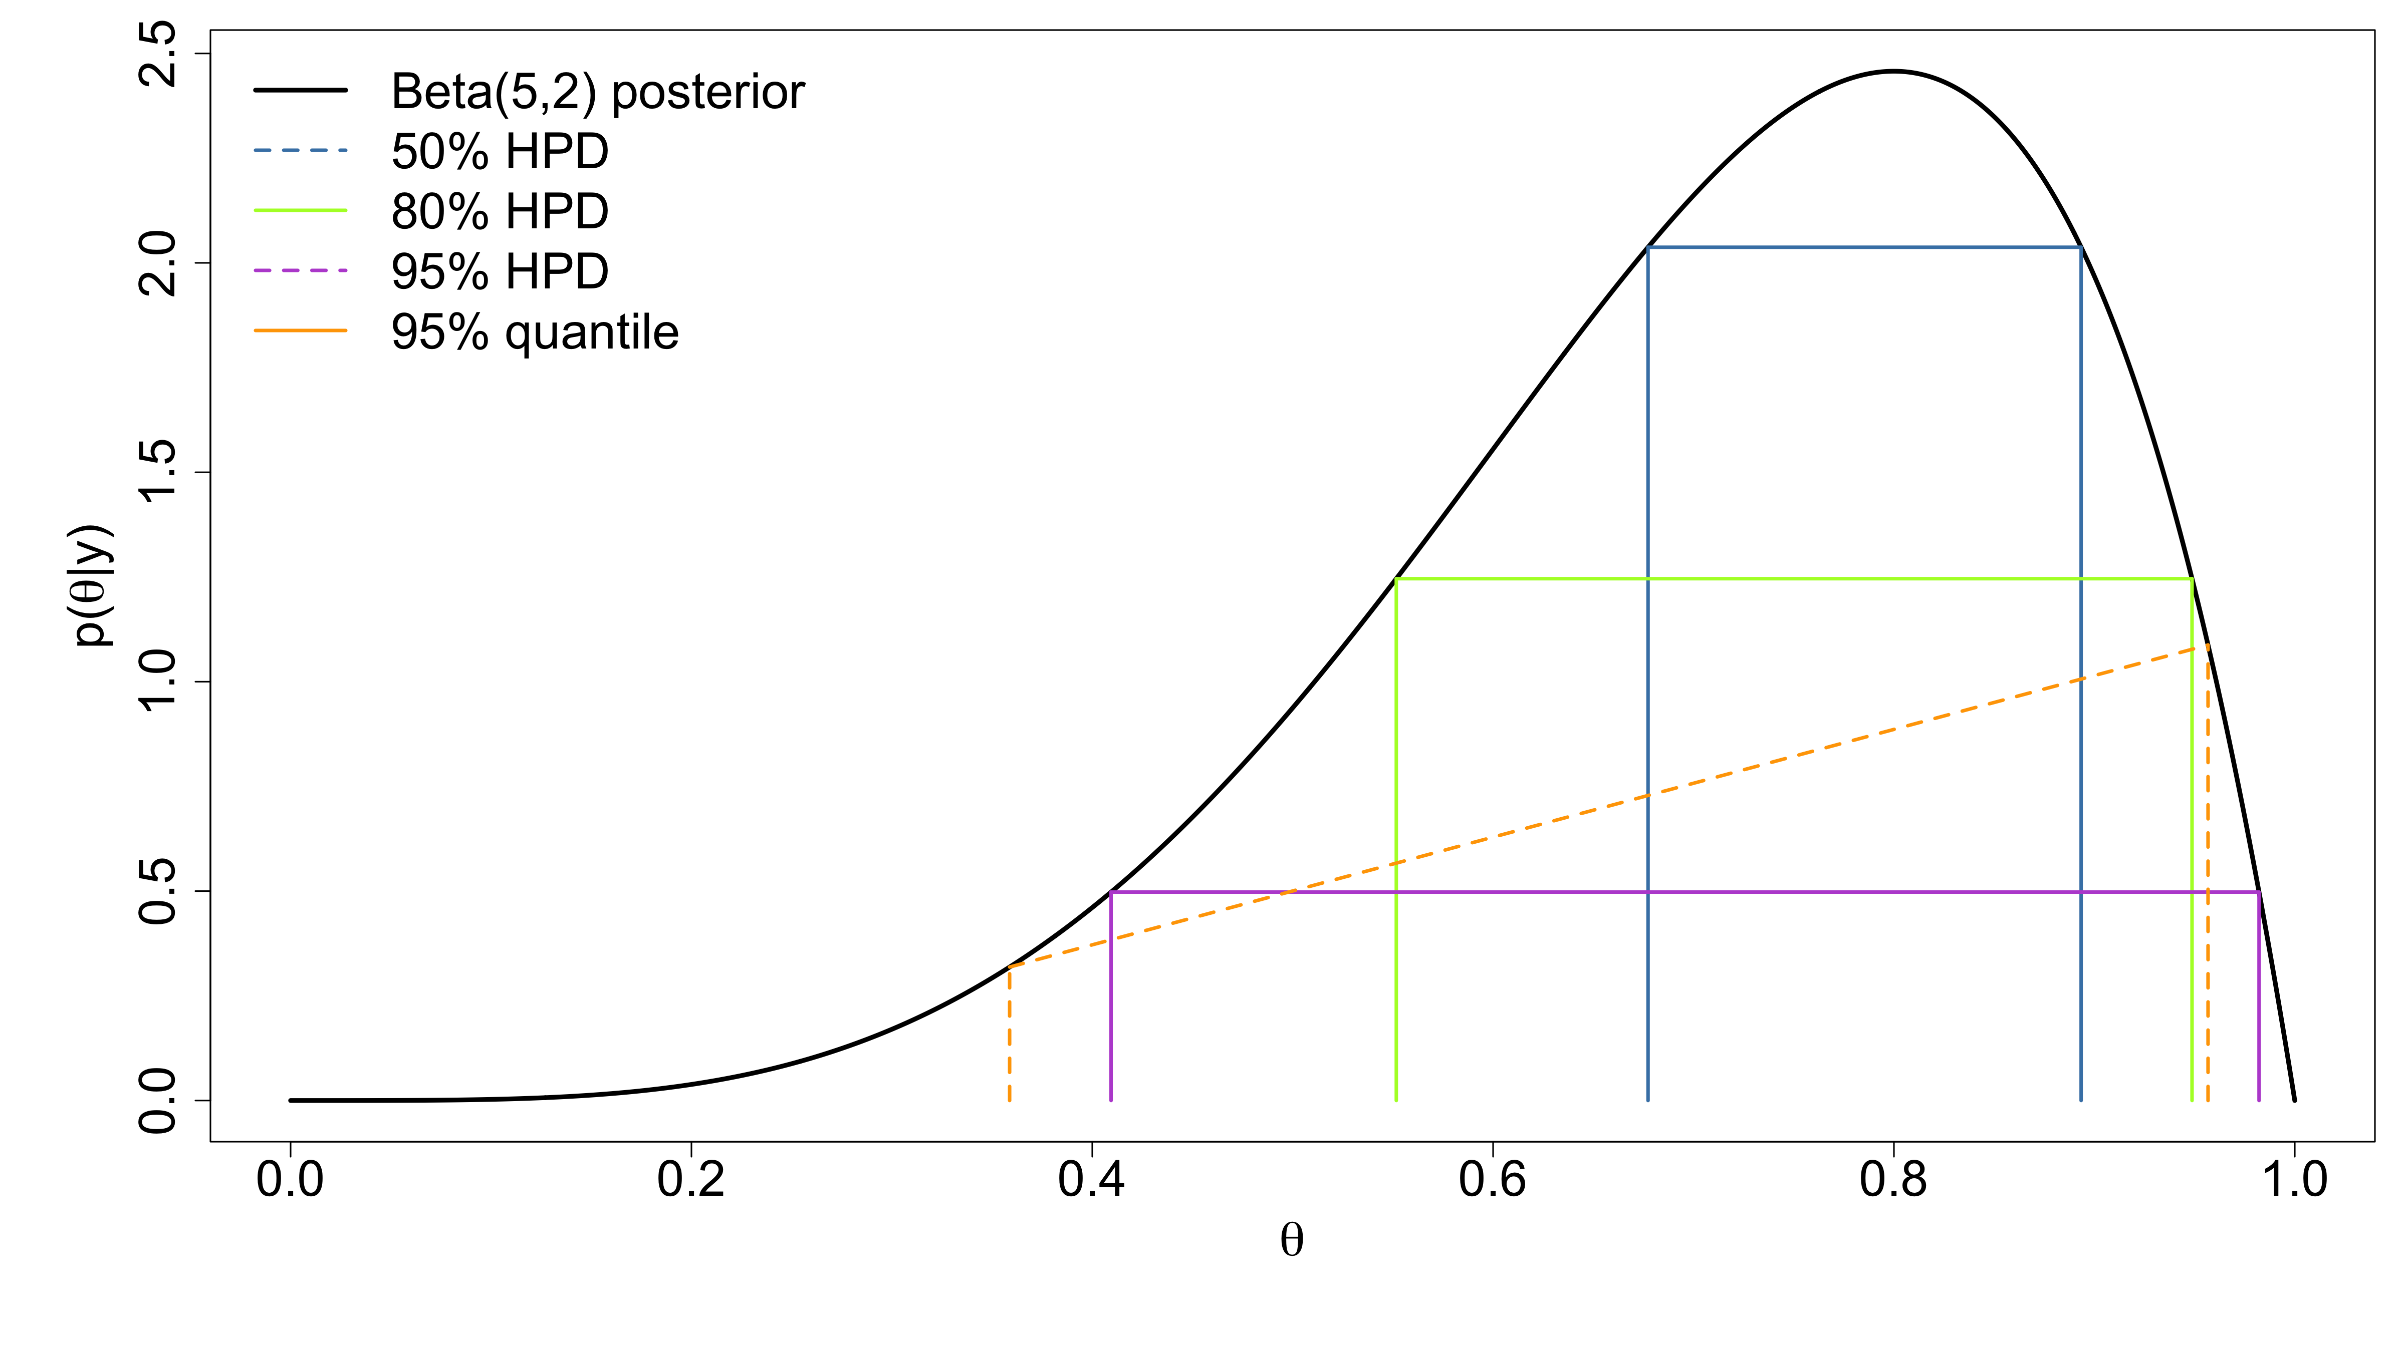
Bayesian estimation: Credible intervals - example

Slide 42
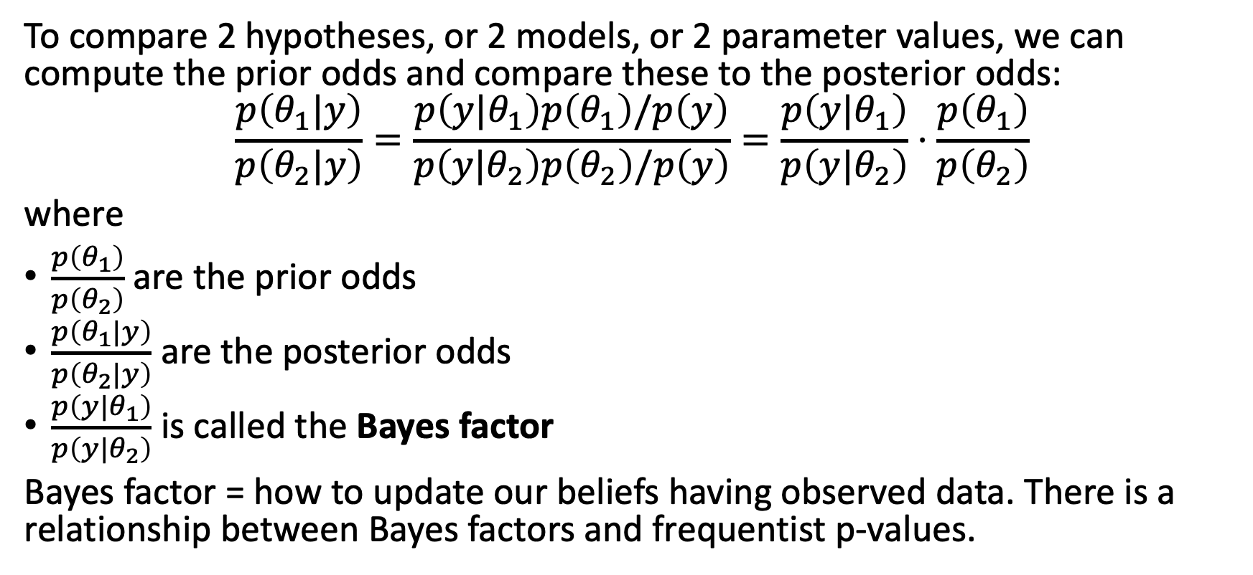
Bayesian estimation: Bayes factor
To compare 2 hypotheses, or 2 models, or 2 parameter values, we can compute the prior odds and compare these to the posterior odds:
$$\frac{p\left(θ_{1}|y\right)}{p\left(θ_{2}|y\right)}=\frac{p\left(y|θ_{1}\right)p\left(θ_{1}\right)/p\left(y\right)}{p\left(y|θ_{2}\right)p\left(θ_{2}\right)/p\left(y\right)}=\frac{p\left(y|θ_{1}\right)}{p\left(y|θ_{2}\right)}⋅\frac{p\left(θ_{1}\right)}{p\left(θ_{2}\right)}$$
where
$\frac{p\left(θ_{1}\right)}{p\left(θ_{2}\right)}$ are the prior odds
$\frac{p\left(θ_{1}|y\right)}{p\left(θ_{2}|y\right)}$ are the posterior odds
$\frac{p\left(y|θ_{1}\right)}{p\left(y|θ_{2}\right)}$ is called the Bayes factor
Bayes factor = how to update our beliefs having observed data. There is a relationship between Bayes factors and frequentist p-values.

Slide 43
[end of STA623 Bayesian Data analysis Session 3]

