Slide 1
Playfair Cryptanalysis
CST 407 – Cryptography
Randall Mackin and Steven reeves

Slide 2
Introduction
Goal: Break Playfair encryption with narrowly-focused brute force method using an annealing algorithm
Inspiration: Randall used a great analyzing algorithm in first assignment and we wanted to build around that
Agenda
High level explanation
Class functionality
Analyzing algorithm
Road blocks
Demo

Slide 3
High Level Design
Technologies used: C#
Ciphertext
Mutation Algorithm
Decrypt
Analysis
Final translation
Key
Fitness score

Slide 4
Class Functionality
Program.cs
Console I/O, looping for input
Playfair
Char arrays, Encrypt, Decrypt, building playfairArray, cleaning input
Analysis
Compare text to trigraphs and digraphs, score accordingly
“the”, “and”, “ent”, “tio”; “th”, “ea”, “in”, “nd”, “an”
AnnealingAlgorithm
Named after the annealing of metal

Slide 5
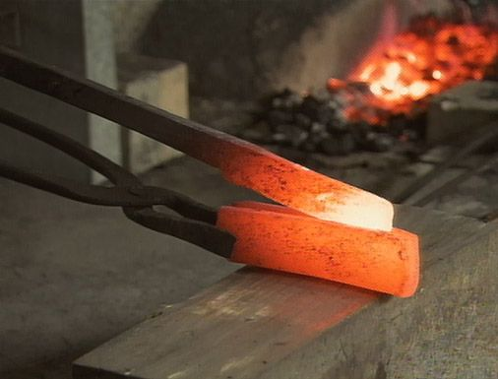
AnnealingAlgorithm
”Hill climbing algorithm”
Base decryption with random key
Scores with analysis
Mutate key
Score again
If score is higher than previous, keep key
Mutate key
Score again

Slide 6
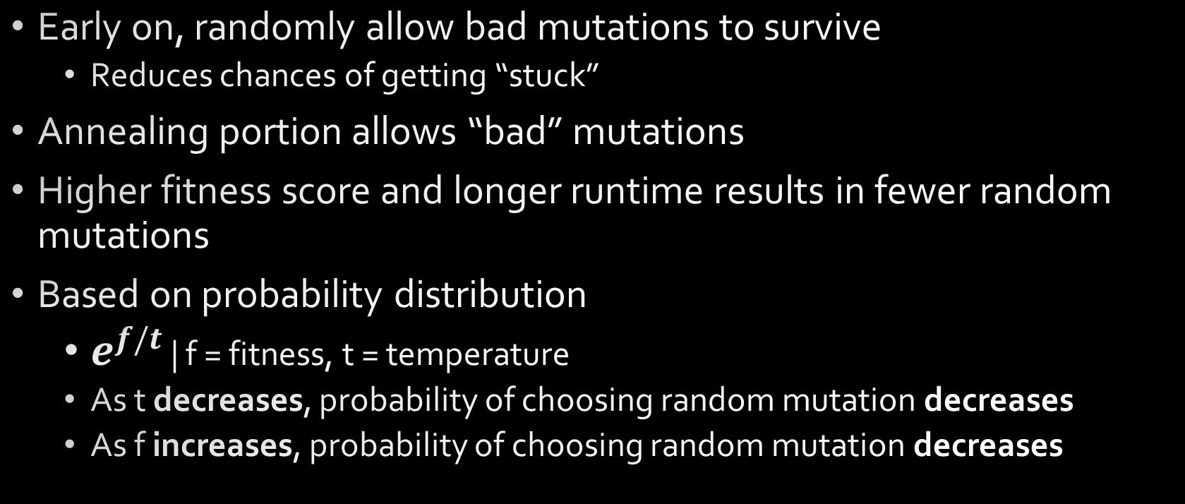
AnnealingAlgorithm
Early on, randomly allow bad mutations to survive
Reduces chances of getting “stuck”
Annealing portion allows “bad” mutations
Higher fitness score and longer runtime results in fewer random mutations
Based on probability distribution
$e^{f/t}$ | f = fitness, t = temperature
As t decreases, probability of choosing random mutation decreases
As f increases, probability of choosing random mutation decreases

Slide 7
Road Blocks
Fitness = 0
Not updating key upon mutation
Comparing uppercase to lowercase
Low fitness scores
Adjusting temperature and iterations between mutation
Adjusting key length
High iteration count ineffective
90-minute test

Slide 8
Demo
Screenshots of output (long vs short) time
Run a short version of console
Translation
Key
Fitness

Slide 9
Conclusion
What we would have done different
Different breaking techniques
Same algorithm, different encryption method
What technologies would help
Tensorflow
A.I. seems to be the choice here
Lessons learned
Playfair implementation, annealing algorithm, ease of Playfair use versus difficulty to crack, analysis of decryption, character frequency use

Slide 10
Thank you!
Questions?

