Slide 1
Semesterprojekt Mobile Anwendungen
von
Steven Bradley und Tobias Kolb

Slide 2
6LoWPAN
IPv6 over Low power Wireless Personal Area Network

Slide 3
THE TASK
Find a way to program a CC2531 and set it up as a node in a 6LoWPAN multi-Hop Network

Slide 4
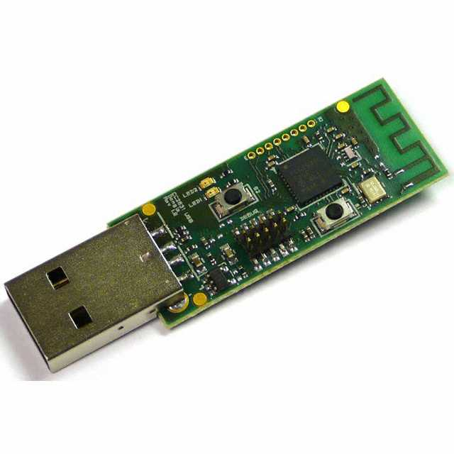
TI CC2531 USB dongle

Slide 5
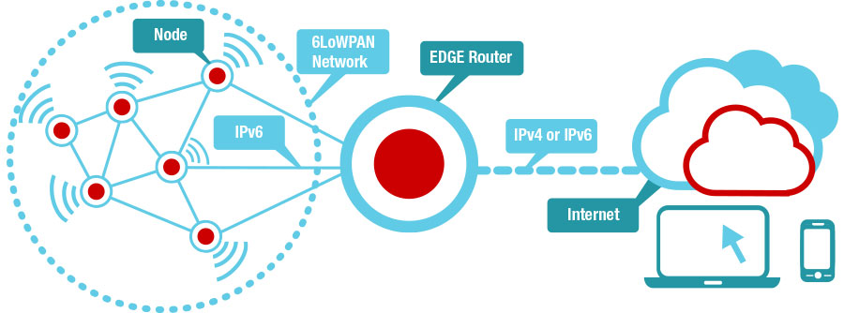
6LoWPAN Multi-Hop Network

Slide 6
Network Stack
Layer | Protocoll
Application | -
Transport | udp-socket.c (simple-udp.c)
Network, Routing | uip6.c, rpl.c
Adaptation | sicslowpan.c
Mac Layer | csma.c
RDC Layer | nullrdc.c
radio | cc2530-rf.c

Slide 7
The Toolchain
Idea 1:
Q: Is there proprietary software that we can use?
A: Yes (IAR Embedded Workbench), but it's 3000 per license , per machine. So no.

Slide 8
The Toolchain
Idea 2:
Q: Is there Open Source Software we can use?
A: Yes (SDCC - Small device c compiler). However we needed a custom version, not the standard issue SDCC.

Slide 9
The Toolchain
Idea 3:
Q: If these approaches did not yield any results: are there others who might have tried and developed software for this purpose?
A: Yes (Contiki). It does use the SDCC, but embedded in a working, pre-made toolchain. When setup manually SDCC has to be compiled, which we did, later on.

Slide 10
Contiki Sensinode
Operating system for networked, memory-constrained systems with a focus on low-power wireless IoT devices.
Extant uses for Contiki include systems for street lighting, sound monitoring for smart cities, radiation monitoring, and alarms.
Open-source software released under a BSD license.
ARM accquided Sensinode, the developer of Contiki Sensinode in Aug 2013.

Slide 11
AT Commands
AT commands are instructions used to control a modem
AT – short for Attention
answers with OK or FAIL
AT+PID 1024
AT: prefix that informs the modem about the start of a command line
+PID 1024: sets the current pan_id to 1024
+PID: shows the current pan_id

Slide 12
IEEE 802.15.4 Radio settings
Command | Parameters | Range | Description | Result
AT+TXPWR | [TX_POWER] | 5 to 28 | Sets or shows the current TX_Power. | [TX_POWER] OK
AT+SCH | [CHANNEL] | 11 to 26 | Sets or shows the current RF channel. | [CHANNEL] OK
AT+PID | [PAN_ID] | 0 to 65535 | Sets or shows the current pan_id. | [PAN_ID] OK
AT+RSSI | - | - | Returns the current received signal strength indicator (RSSI) | {RSSI} OK/FAIL

Slide 13
The way ahead
Get multiple nodes to communicate to each other
Build app that uses a serial interface to exchange data with the dongle via an OTG-adapter

Slide 14
Repository
https://github.com/BlkPingu/zigPAN

