Slide 1
Behavior-Driven Development
Steve Coffman
gears@umich.edu
August 6, 2013

Slide 2
Behavior-Driven Development
Define BDD
Clarify Types of Tests
Explain Process
Show Examples
Answer Questions

Slide 3
What is BDD?
Collaborate to create specification
Specify behavior with examples of behavior
Write “specification by example” in a ubiquitous language
Automate feature tests to make specification executable
Use feature tests to drive development of low-level unit tests
Use unit tests to drive actual development

Slide 4
BDD Advantages
Improves collaboration between BAs, Devs, and QAs
Promotes commitment and buy-in
Increases understanding of domain and organizational complexity
Focuses unit and integration tests on building the thing right
Concentrates story acceptance tests on building the right thing
Eliminates specification rot
Frees developers to focus on design

Slide 5
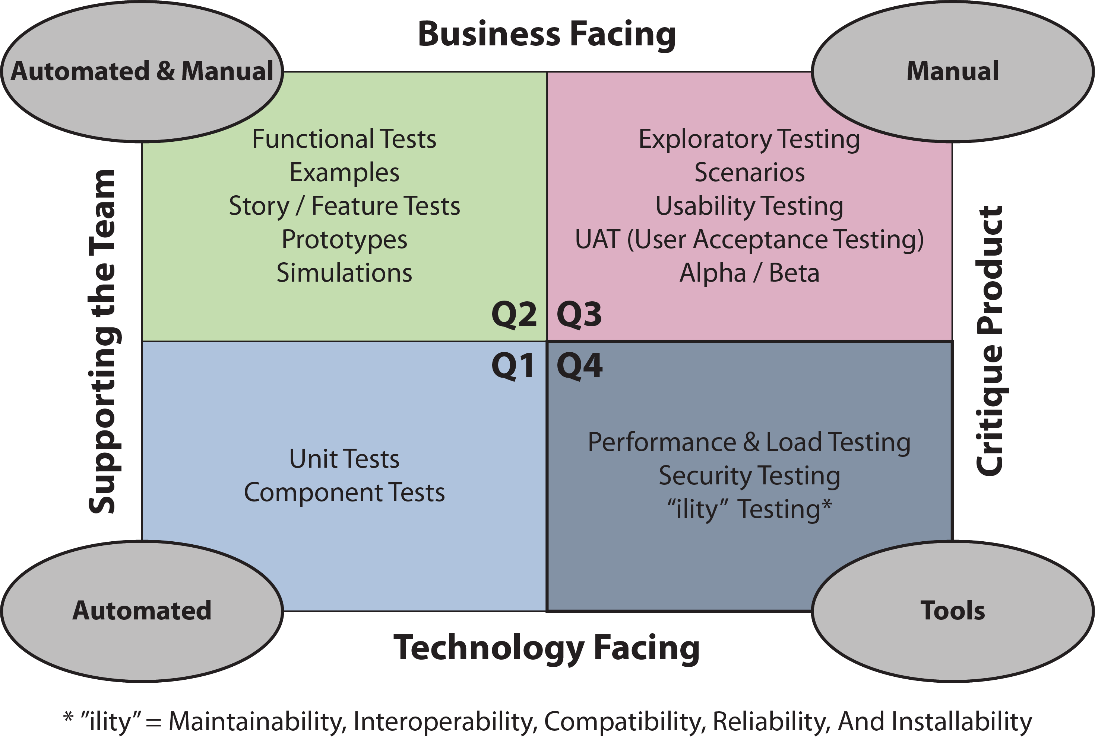
Testing Quadrants

Slide 6
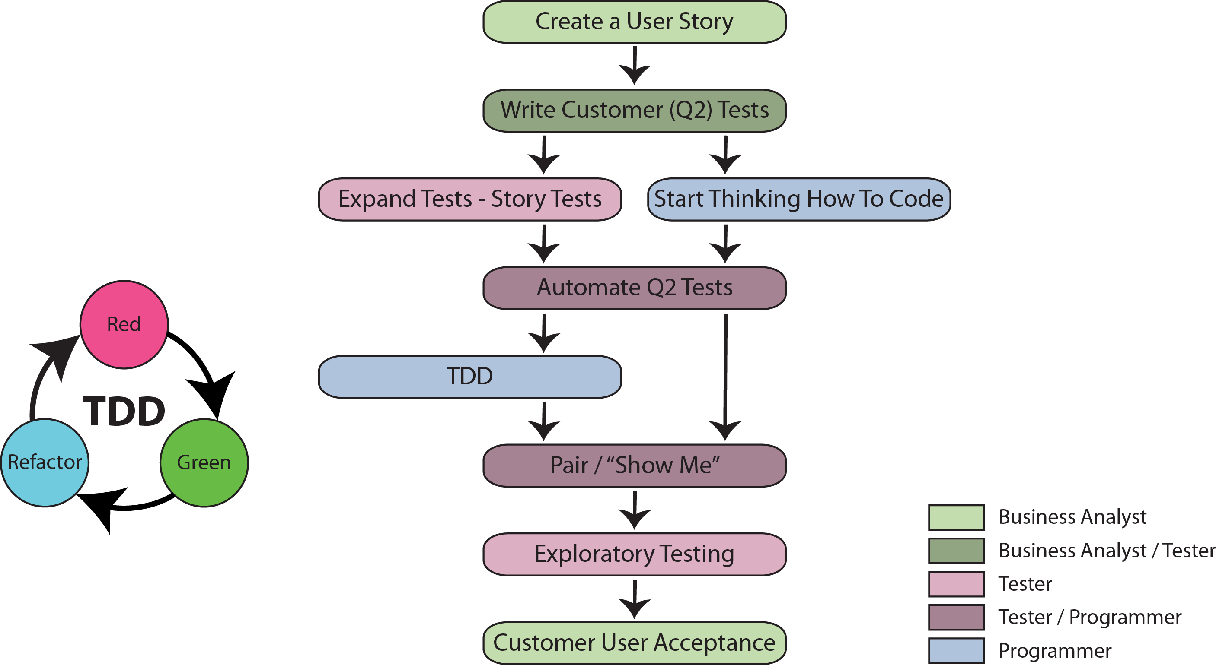
BDD Process

Slide 7
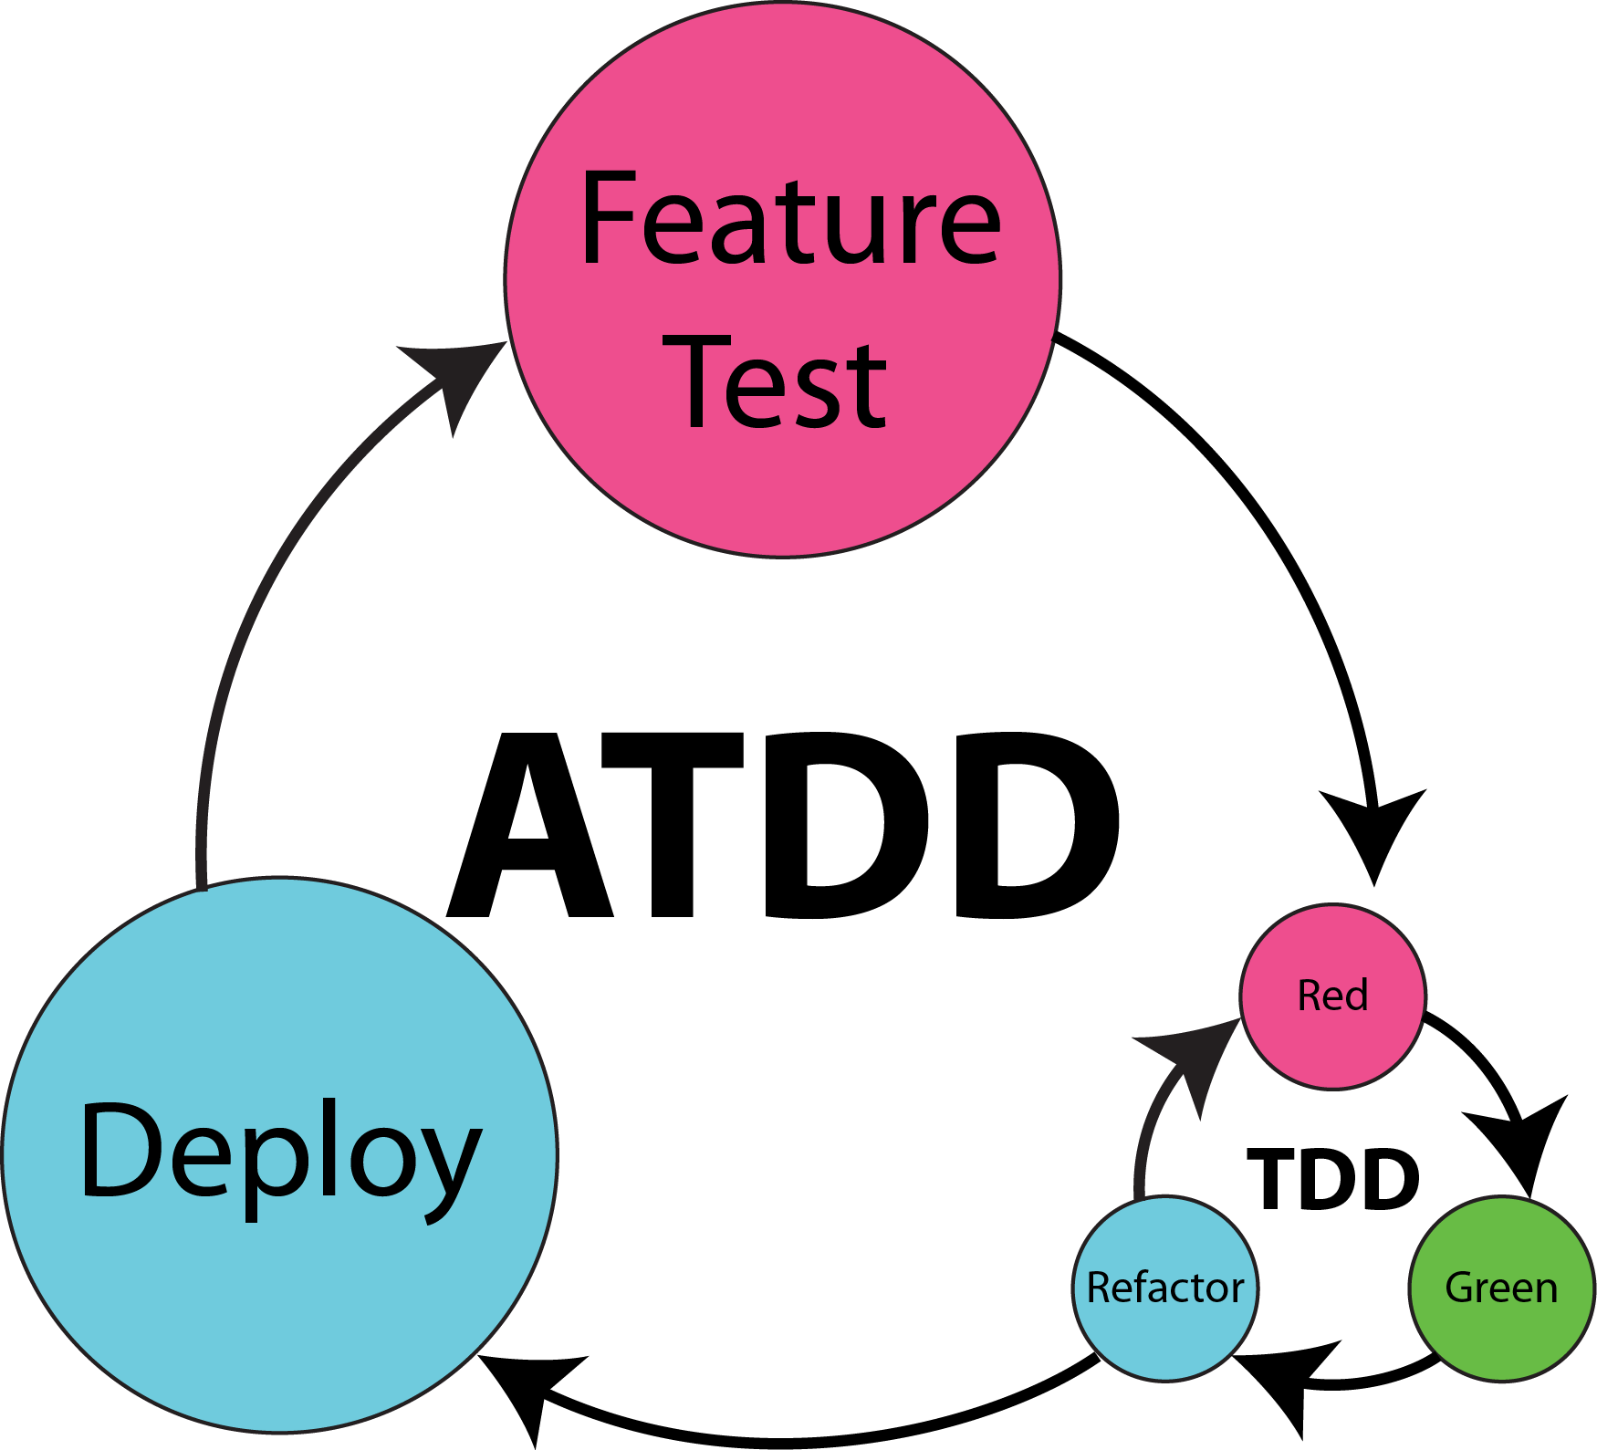
Acceptance Test-Driven Development Process

Slide 8
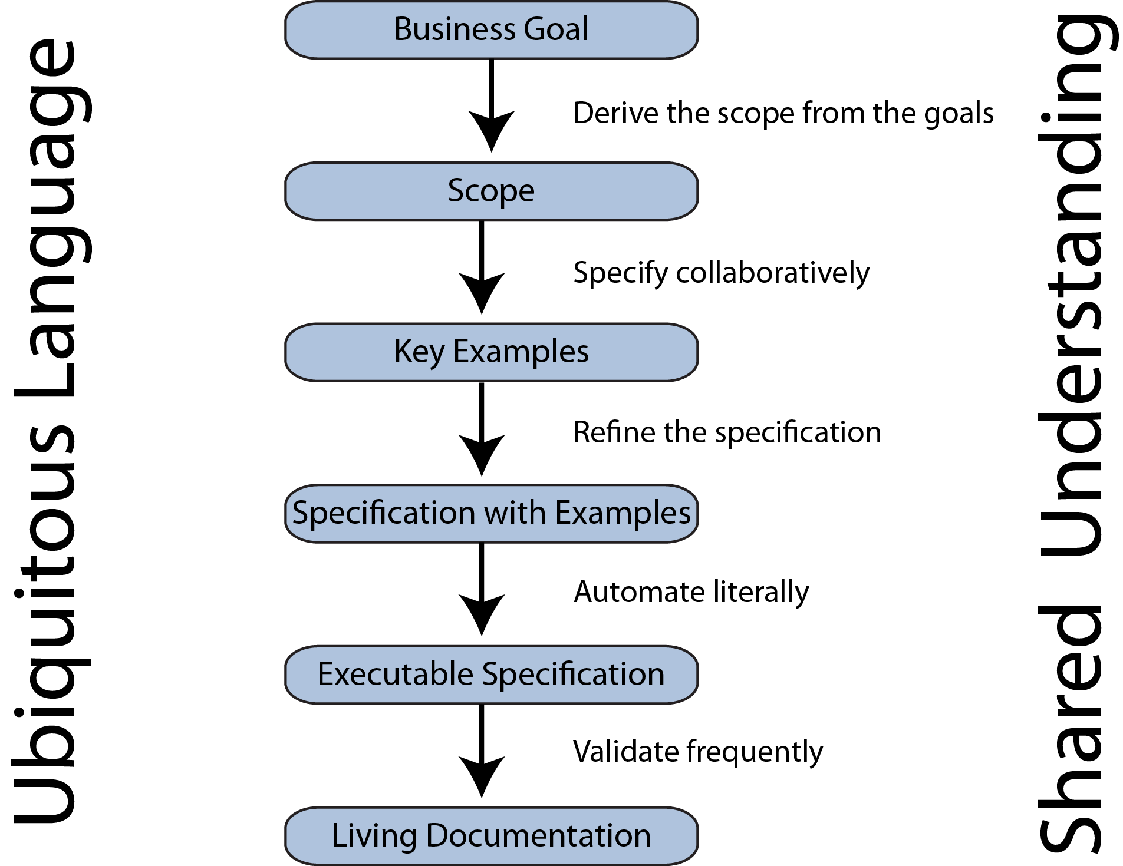
Specification by Example

Slide 9
Cucumber Feature File
Feature: Basic Arithmetic
In order to avoid silly mistakes,
As a cashier,
I want to accurately calculate basic arithmetic.
Scenario: Addition
Given a calculator I just turned on
When I add 4 and 5
Then the result is 9

Slide 10
Cucumber Generated JUnit
@Given("^a calculator I just turned on$") throws Throwable
public void a_calculator_I_just_turned_on() {
// Express the Regexp above with the code you wish you had
throw new PendingException();
}
@When("^I add (\\d+) and (\\d+)$")
public void adding(int arg1, int arg2) throws Throwable {
// Express the Regexp above with the code you wish you had
throw new PendingException();
}
@Then("^the result is (\\d+)$")
public void the_result_is(double arg1) {
// Express the Regexp above with the code you wish you had
throw new PendingException();
}

Slide 11
Completed JUnit Feature Test
@Then("^the result is (\\d+)$")
public void the_result_is(double expected) {
assertThat(calc.value(), is(expected));
}

Slide 12
Questions?

