Slide 1

CATERING SERVICES
OFFER

Slide 2
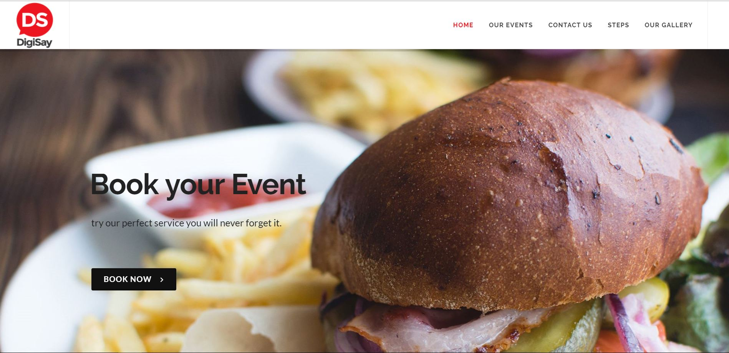
Simple and attractive slider

Slide 3
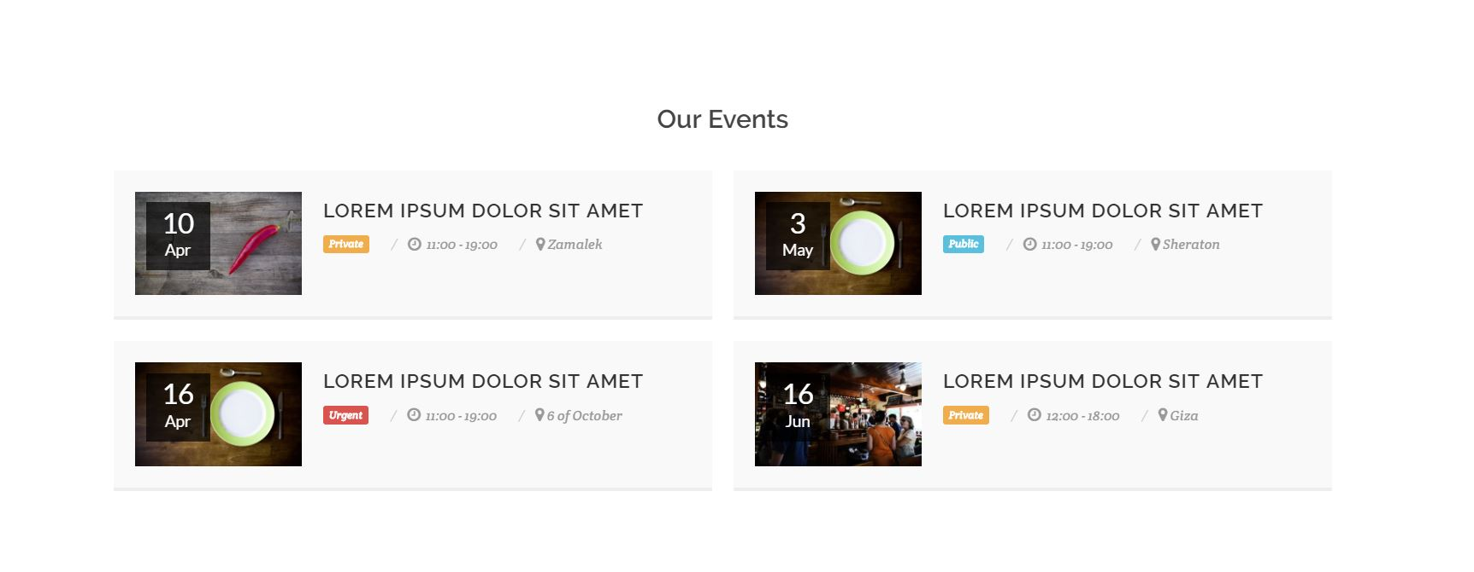
User can know our next events and it’s date , time and location

Slide 4
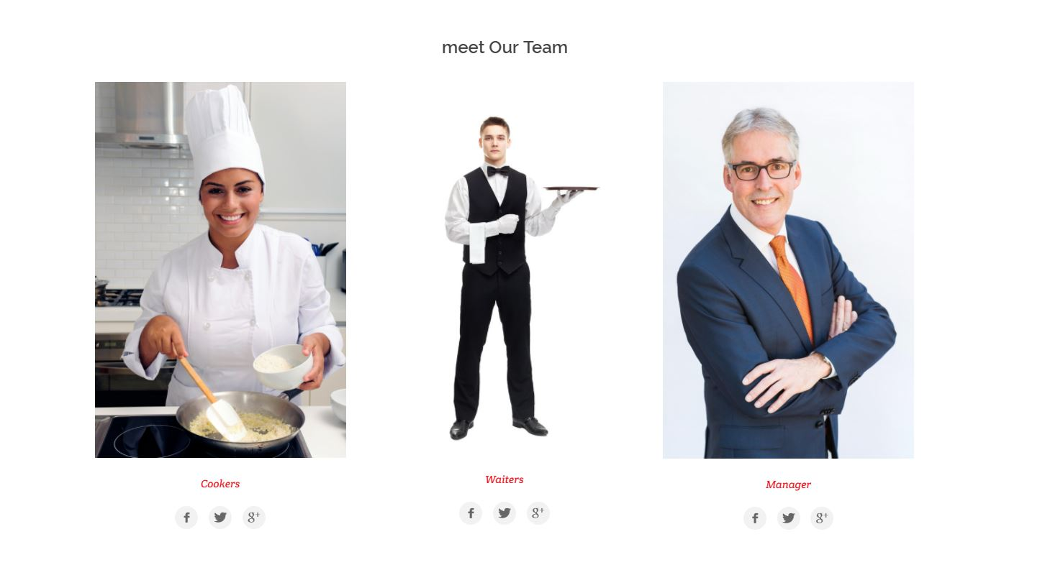
User can also meet our team (cookers , waiter and manager)

Slide 5
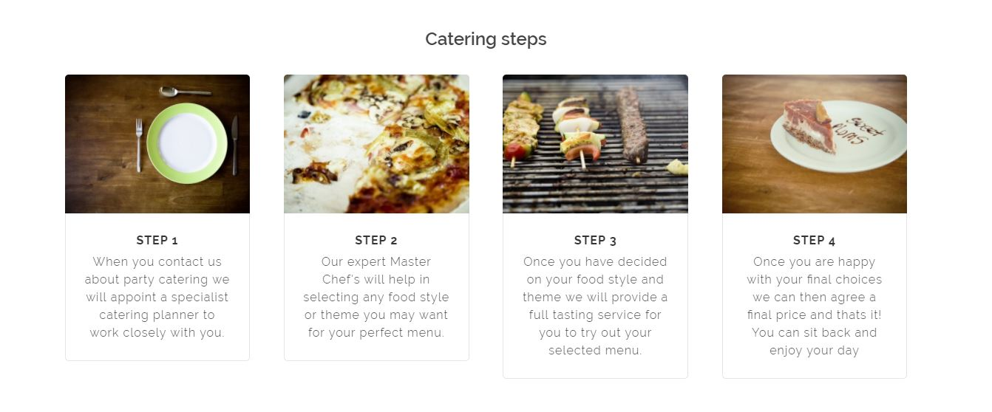
Catering Steps
Step 1 :
When you contact us about party catering we will appoint a specialist catering planner to work closely with you.
STEP 2 :
Our expert Master Chef's will help in selecting any food style or theme you may want for your perfect menu
STEP 3 :
Once you have decided on your food style and theme we will provide a full tasting service for you to try out your selected menu.
STEP 4 :
Once you are happy with your final choices we can then agree a final price and thats it! You can sit back and enjoy your day

Slide 6
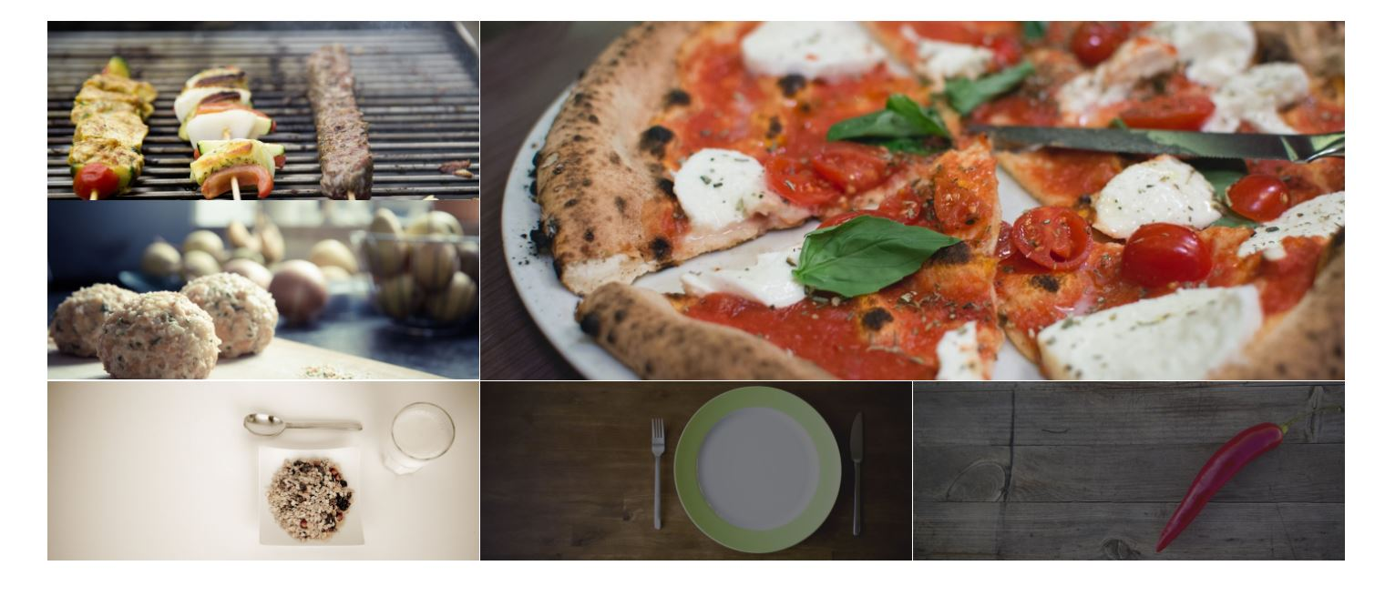

Slide 7
THANKS …

