Slide 1
Navigating speedy success
How to grow annual members?
February 2022
Steven Bontius

Slide 2
Goals for todays presentation:
How do annual members and casual riders use Cyclistics bikes differently?
Cyclistics data from jan 2021 to dec 2021

Slide 3
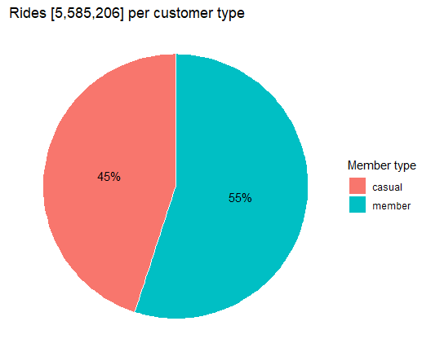
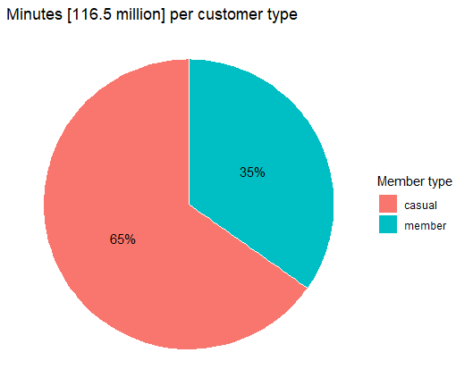
How often and how long?
Members ride more often
Casual riders ride longer

Slide 4
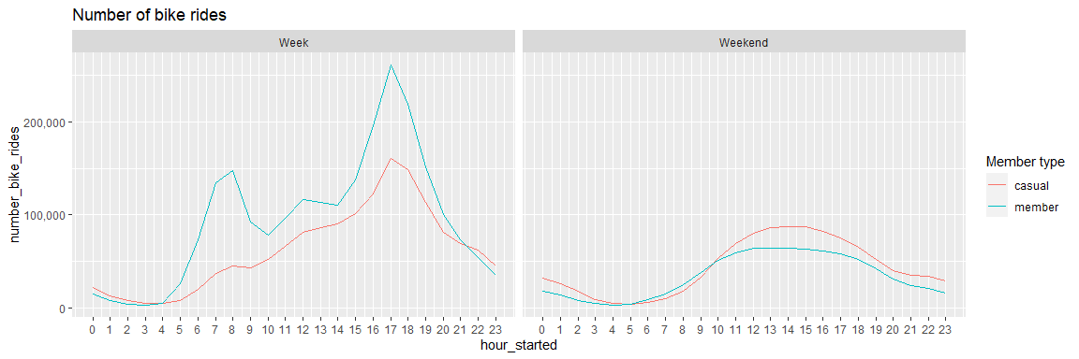
When does the ride start?
Members show clear morning and evening rush hour pattern

Slide 5
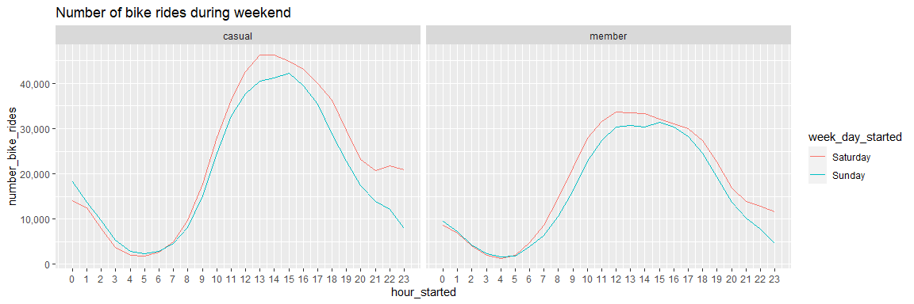
When does the ride start?
Casual rides ride more in the weekend

Slide 6
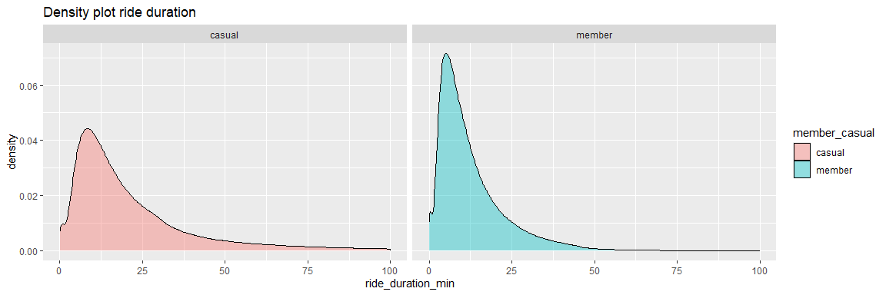
How long does the ride take?
Casual riders : 15 minutes
Member riders : 10 minutes

Slide 7
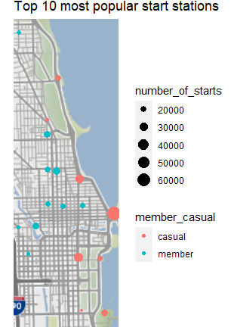
Where does the trip start?
Casual riders go to the pier, parks and musea
Member riders go to residential and office areas

Slide 8


Commuting vs Leisure
Member
Casual

Slide 9
Recommendations
Discover why casual riders buy Cyclistic annual memberships
Discover how Cyclistic could use digital media to influence casual riders to become members

Slide 10
Thank You

