Slide 1
Group 2
Sigmoid Freud

Slide 2
Experiments part 1
Regex → Added more rules
FixedPadding → Tried a HeadTailPadding that uses the begin and end of the data for making chunks.
→ More chunks = better results
AggregationLayer → Experimented with different options
Model architecture → Experimented with attention

Slide 3
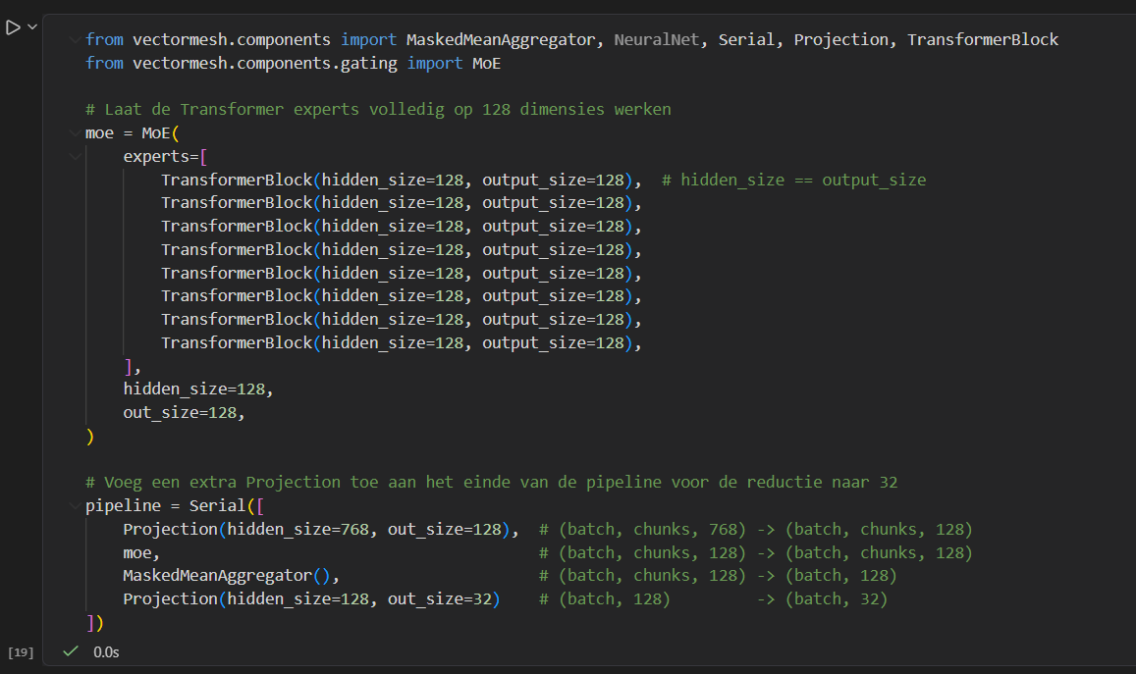

Slide 4
Experiments part 2
Projection
786 to 128
Chunks 40
Mixture of experts
8 TransformerBlocks
8 Heads
HeadTailPadding vs. FixedPadding = No difference
Unstable behavior during training
Learning rate?

Slide 5
