Slide 1

UniversaLegal
Democratizing Legal Services through an AI-Powered Three-Sided Marketplace
2025 Mar 2

Slide 2
The Legal Services Crisis
Trend
Description
70%
of individuals cannot access legal services
77%
Boutiques Law Firms can’t get enough clients…
71 %
Law students are in debt of an avg of $130,000,
while having to go through through 10+ years of school and work to finally become an attorney…

Slide 3
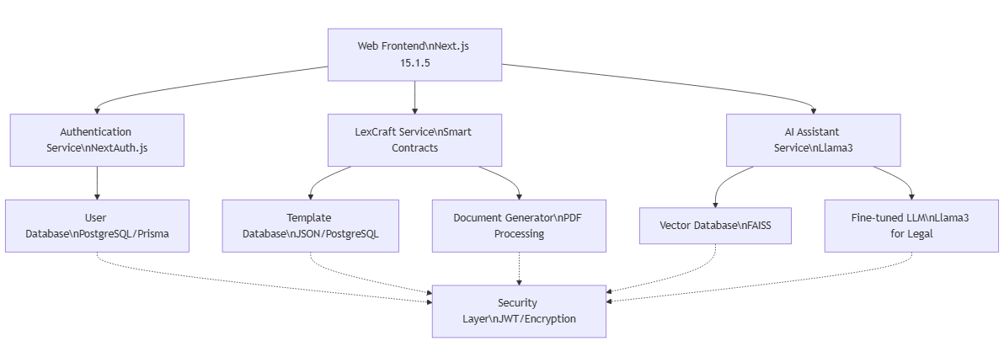
Architecture

Slide 4

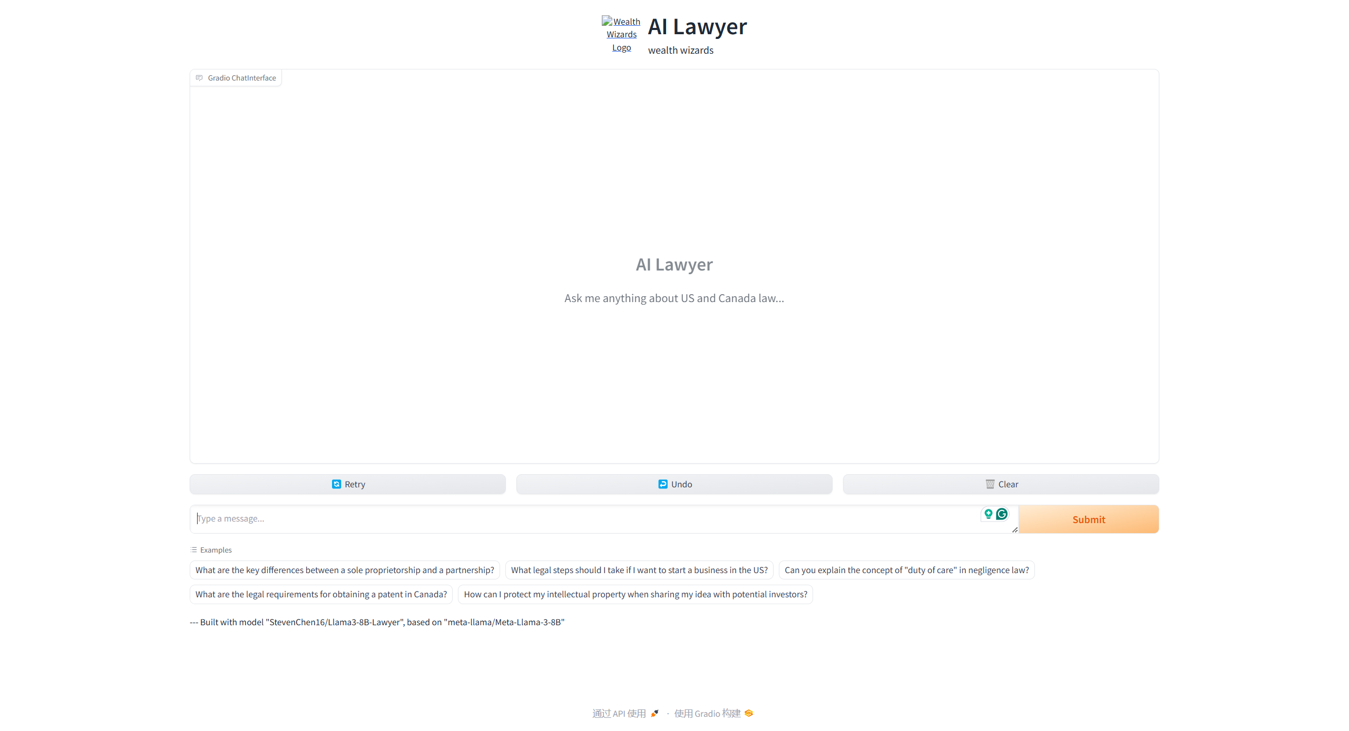
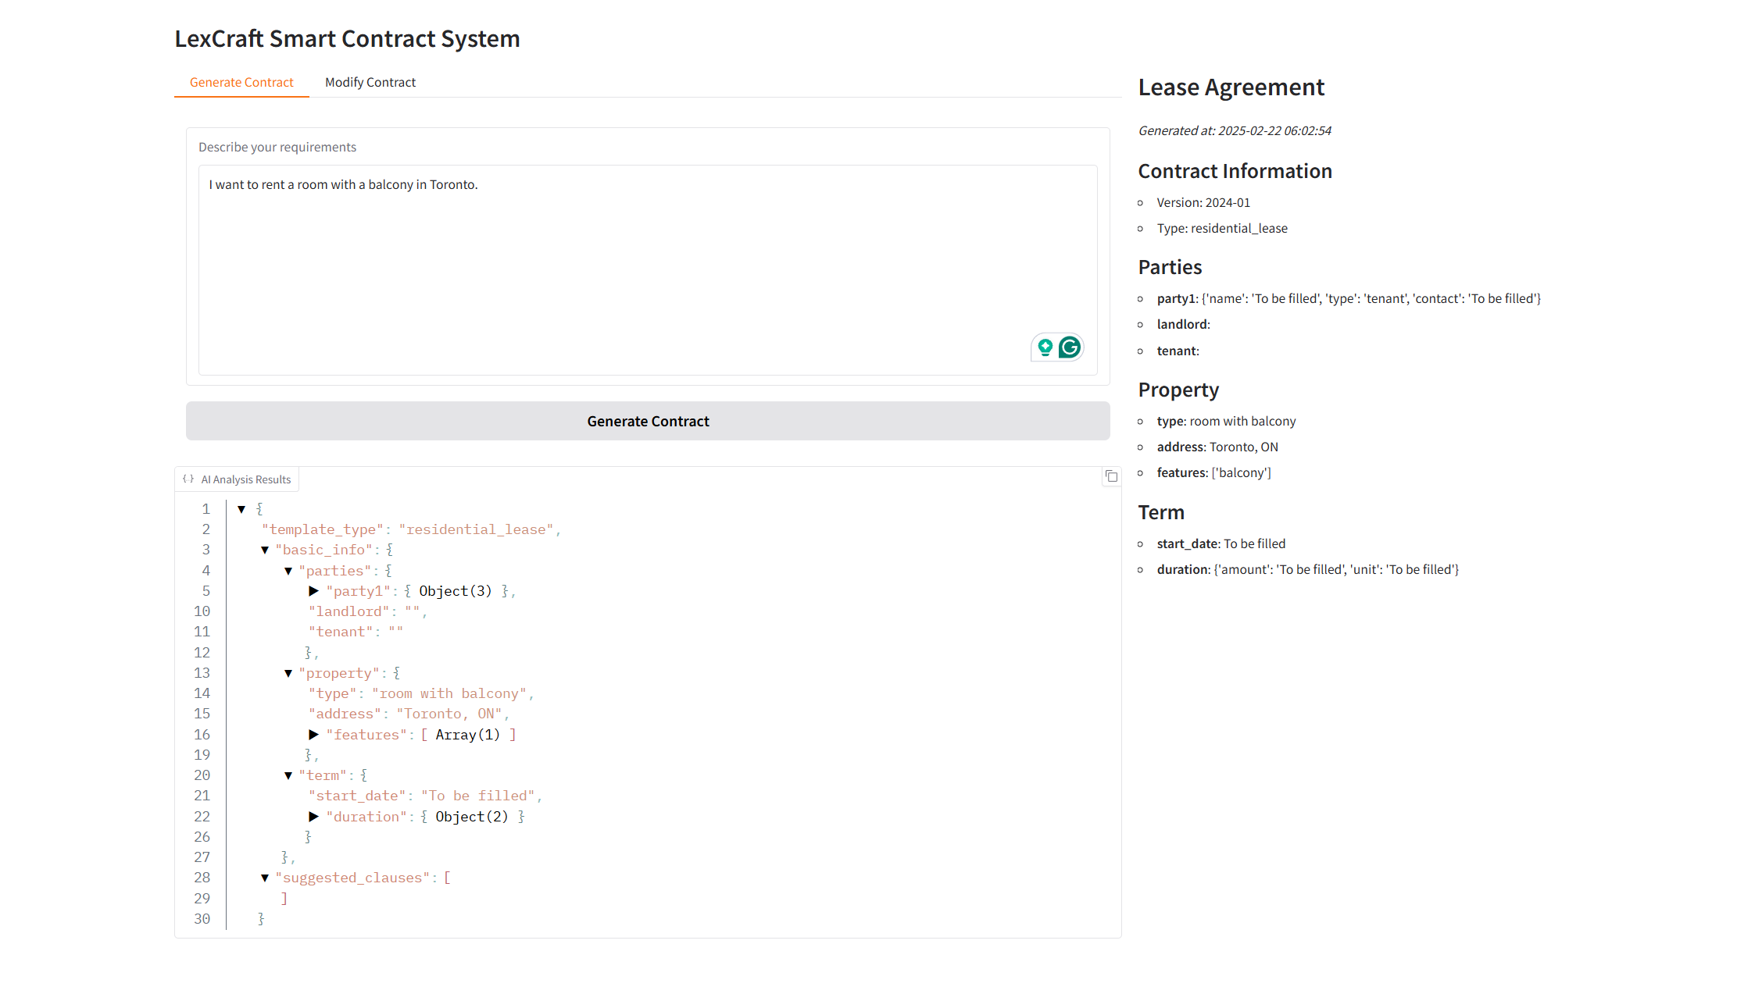
Our Product and Scenario
Jus - AI Legal Chatbot
Your 24/7 Legal Advisor. Professional legal consultation through natural conversation, powered by advanced AI technology.
LexCraft - Smart Contract Automated contract generation platform. Standardized templates meet customization capabilities, delivering efficiency without compromising expertise.
Legal HQ
Data Intelligence Center
Centralizing legal data to power AI-driven insights and value creation.
3

Slide 5
Try It!
UniversaLegal Website

Slide 6
Q & A

