Slide 1
Travel Elves
(Your personal travel secretary)
Presented by :Kuo-Che Chiu

Slide 2
Outline
Issues and Idea
Technologies for Our Travel Elves
Demo Scenario

Slide 3






Issues and Idea
In every weekend, People want to go outside of their city for traveling, but sometimes they put lots of effort to search where the cities are good spots.
Although they arrange their schedule really well, it may also be delayed by traffic jams or canceled by the weather.

Slide 4




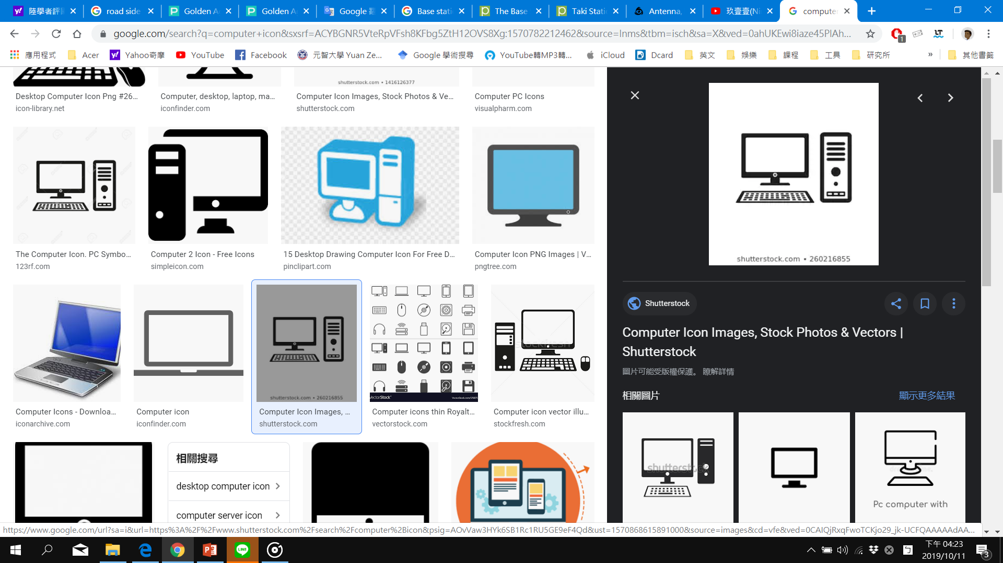


Issues and Idea
Because of above reasons, I come up with a new idea call “travel Elves”
Nowadays, there are lots of new applications work with 5G communication.
Autonomous driving are a hot topic in 5G application, so I want to combine Autonomous cars and edge devices to cater people’s need for traveling
I can help you
Cloud

Slide 5


Issues and Idea
We use edges devices and cloud server to provide travel information and road condition
Travel information:
Cloud server provides famous spots and local foods which attract lots of crowds
Depends on different people’s requirement, customizes the travel schedule
Road condition:
Devices analyze various routes to the destination and choose a suitable path for customers

Slide 6

Technologies for Our Travel Elves
For cloud:
Cloud server:
Use crawlers to collect each city’s popular spots data from Internet and process the data to unfiled format
Use AI to update spots and customize personal travel schedule
For edge devices:
BSs:
Get travel schedule from cloud server, and provide suitable path to driver
Road Monitors:
Provide real time road situations to RSUs
RSUs:
Analyze data from Road Monitors, original route will be changed at any time by choosing smooth route without traffic jams
Monitors:
Monitor real time road situation
Cloud
Cloud
BS
RSU
Monitor

Slide 7
The Information of Different Devices
Devices | Functions | Ability
Cloud server | 1. Cache global hot spots information. 2. Recommend trip schedule with user’s requirement 3. Compute the task which BSs cannot afford. | Level: High
Monitor | 1. Cache road information 2. Compute the easy task 3. Track real time road situation | Level: simple
Base station (BS) | 1. Cache road information (big area). 2. Provide network services to cars. 3. Compute the task which RSUs cannot afford. 4. Provide travel schedule to the car. | Level: Medium
Roadside unit (RSU) | 1. Cache road information (small area). 2. Provide network services to cars. 3. Compute the task which cars cannot afford. 4. Help the car to change the path according to road situation | Level: Low
Tier4: Terrestrial (Car) | 1. Cache instant road information (specific area). 2. Compute real time data. 3. Identify traffic light and safe car distance. | Level: Low
Cloud

Slide 8
System Process
According travel requirement, User sends the information to BS
BS
Cloud
1
Analyze the information
Send the information
2
Request the newest data
Automatic car
Cloud
Generate
Requirement for trip
Choose the optimal route and schedule
Collect All popular spots
4
Send the route and schedule
3
Renew the driving route
RSU
Send schedules and spots
Provide several trip schedules
Monitor
instant road situation
5
Analyze the information
Renew the route(if needed)
Continuously
Send to RSU
Track real time road situation
Monitor

Slide 9
System Process
BSs get the information from users and request Cloud get the newest data.
BS
Cloud
1
Analyze the information
Send the information
2
Request the newest data
Automatic car
Cloud
Generate
Requirement for trip
Choose the optimal route and schedule
Collect All popular spots
4
Send the route and schedule
3
Renew the driving route
RSU
Send schedules and spots
Provide several trip schedules
Monitor
instant road situation
5
Analyze the information
Renew the route(if needed)
Continuously
Send to RSU
Track real time road situation
Monitor

Slide 10
System Process
Cloud send and spots and corresponding schedules back to the BS
BS
Cloud
1
Analyze the information
Send the information
2
Request the newest data
Automatic car
Cloud
Generate
Requirement for trip
Choose the optimal route and schedule
Collect All popular spots
4
Send the route and schedule
3
Renew the driving route
RSU
Send schedules and spots
Provide several trip schedules
Monitor
instant road situation
5
Analyze the information
Renew the route(if needed)
Continuously
Send to RSU
Track real time road situation
Monitor

Slide 11
System Process
BS analyzes the data and find a best choice to match user’s need
RSU helps to renew the route if there has a traffic jams or accident at any time
BS
Cloud
1
Analyze the information
Send the information
2
Request the newest data
Automatic car
Cloud
Generate
Requirement for trip
Choose the optimal route and schedule
Collect All popular spots
4
Send the route and schedule
3
Renew the driving toute
RSU
Send schedules and spots
Provide several trip schedules
Monitor
instant road situation
5
Analyze the information
Renew the route(if needed)
Continuously
Send to RSU
Track real time road situation
Monitor

Slide 12
System Process
In our proposal, we want to display the whole system by simulation
Cloud:
Use network crawler to catch online user’s recommendation spots
Use AI to filter not reality data and also generate several trip schedules
BS:
Match user’s need and provide suitable schedule and travel route
RSU:
Renew the route which BS provide according to real time road situation
Monitor:
Provide RSU real time road situation
Autonomous Car:
Get the information from BS and RSU and drive

