Slide 1

East Scarborough Storefront Calendar
Scheduling software

Slide 2


The East Scarborough Storefront
A partnership of
community members
and services working
together to create a
thriving community
in East Scarborough.

Slide 3
Motivation for the Storefront Calendar
Current System
- A client emails the Storefront with a request
- An administrator then books a room for the client
- Storefront uses a 3rd party, off-line scheduler
Problems
- Clients cannot see the current schedule
- Storefront staff must add all events for clients
- Scheduling system can only be accessed in-house

Slide 4
Our Solution
Storefront Calendar is an on-line scheduling system that allows clients to request room bookings.
It is a streamlined version of the current system, except it is entirely on-line.
Advantages
- Both staff and clients can access the schedule
- Clients can request their own bookings
- The Calendar can be accessed from any computer
Administrators have full control of the system.

Slide 5
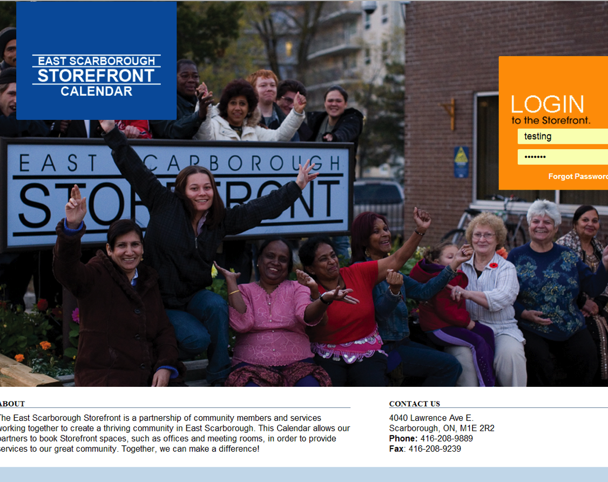
Technical Details
Website URL: http://thestorefront.cloudapp.net/
Web Technologies:
- HTML / CSS / JSON
- PHP, with CodeIgniter
- Qtip and FullCalendar APIs
Development Strategy:
- Agile / Scrum

