Slide 1
Fullstack JavaScript
Tamas Piros

Slide 2
Agenda
Jsconf asia 2018
Fullstack JavaScript
REST APIs with Restify
NoSQL 101
Angular5

Slide 3
Hello
Principal Technical Instructor @ MarkLogic (https://marklogic.com)
Fullstack Developer Academy (https://fullstack-developer.academy)
Twitter: @tpiros / @owlbertthedev
GitHub: tpiros

Slide 4
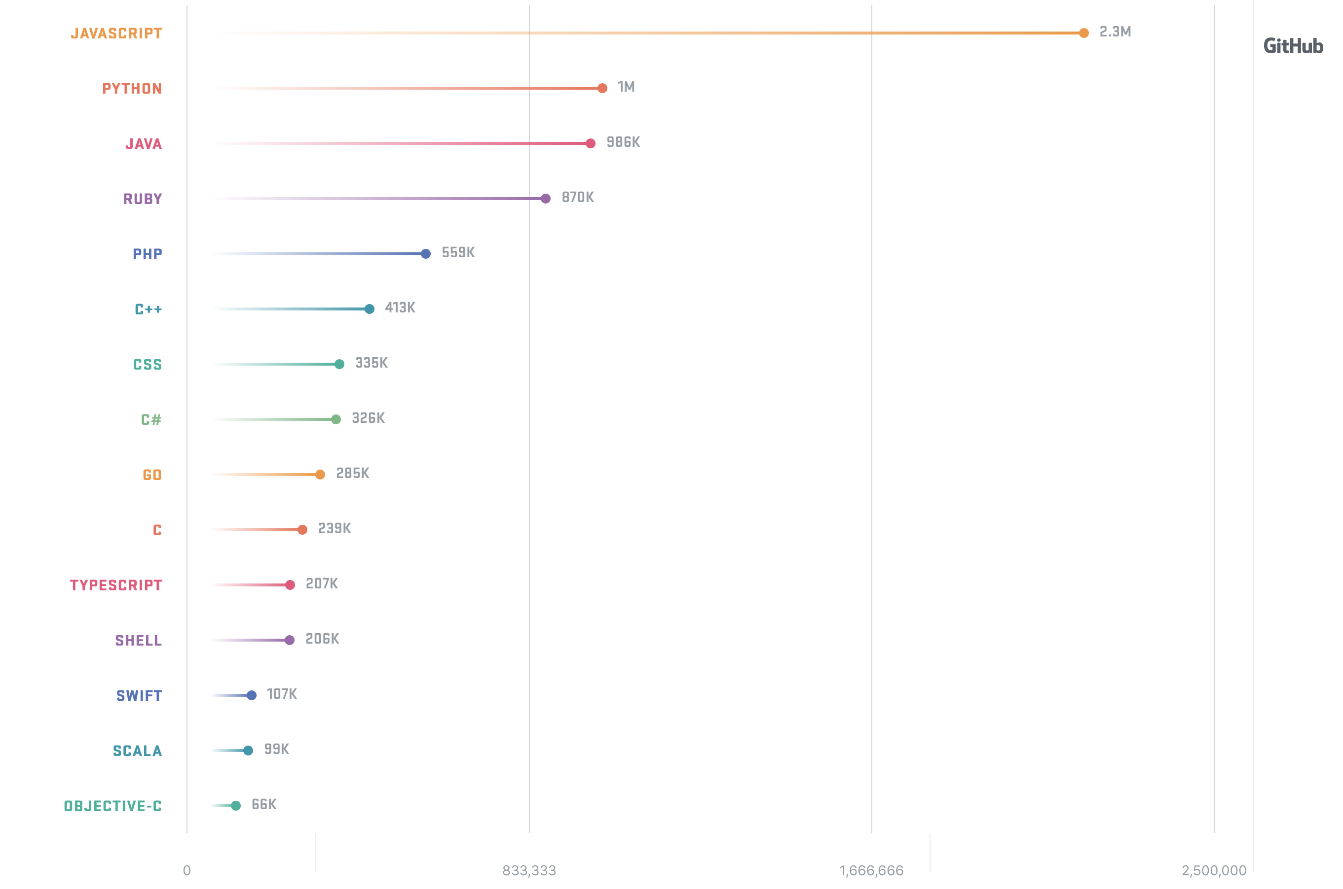
Fullstack JavaScript
You already know this, but …

Slide 5
JavaScript Today
ES2015
ES2016
TypeScript

Slide 6
NoSQL vs Relational
Collection: Products
URI: /product/tshirt.json
Table consists of rows and columns
ID is used to uniquely identify data
A document represents a row of data
URI is used to uniquely identify data
{
“name”: “t-shirt”,
“price”: 15.99
}
Table: Products
URI: /product/shoe.json
id | name | price
001 | T-shirt | 15.99
002 | shoe | 28.00
{
“name”: “shoe”,
“price”: 28.00
}

Slide 7
Key problems with RDBMS
Not designed the handle change
Not design for heterogeneous data
Not designed for scale
Mismatch for modern application development
Please don’t get me wrong, relational still has some great use-cases
Notes:
heterogeneous data – data variety (Different ways of representing and storing the same data)

Slide 8
NoSQL
Designed to handle change
Designed for scale
Easy to utilise in modern application development

Slide 9
Enterprise NoSQL
ACID compliance
Security features
Built-in search features
Multi-model database

Slide 10
REST API
REpresentational State Transfer
Architectural style to design distributed systems
Stateless interface
Resources exposed via URIs and HTTP methods

Slide 11
Designing a REST API
Resource - represents an entity (like Product, Car etc)
Endpoints define actions, using HTTP methods and CRUD
HTTP methods map to CRUD tasks
HTTP Method | CRUD task
GET | Read
POST | Create (new URI)
PUT | Update (existing URI)
DELETE | Delete

Slide 12
Node.js
Asynchronous, event driven JavaScript framework
JavaScript for the server side
LTS vs Current

Slide 13
Packages
Available via npm
Express
HAPI
Koa
Resitfy

Slide 14
Restify
Allows for the creation of semantically correct RESTful web services

Slide 15
Frontend
Displaying information for the user
The era of web based frontend frameworks
Angular, Vue, Aurelia, React*

Slide 16
Angular5
Latest version of the popular frontend framework by Google
Best used with a CLI
Components, Services, Pipes, Modules, Directives
TypeScript

Slide 17





Architecture
GUI
Same language
Same datatype
ACID properties
Built-in security
Flexible / schema agnostic data-structure
Index support
JSON over HTTP
Middle-ware
JSON over HTTP
NoSQL
Database

Slide 18
We are hiring http://www.marklogic.com/careers

Slide 19
Let’s do this!

Slide 20
Resources
Node.js Client API – free training
MarkLogic – free training
Enterprise Fullstack JavaScript Developer: Zero to Hero (course)
Upgrade your JavaScript to ES2015 (course)
Articles on ES2015, TypeScript, Node.js, Marklogic, NoSQL

Slide 21
Thank you

