Slide 1
Pneumonia Detection
Steven Guo, Yucong Zhang
{hg138, yz646}@duke.edu

Slide 2
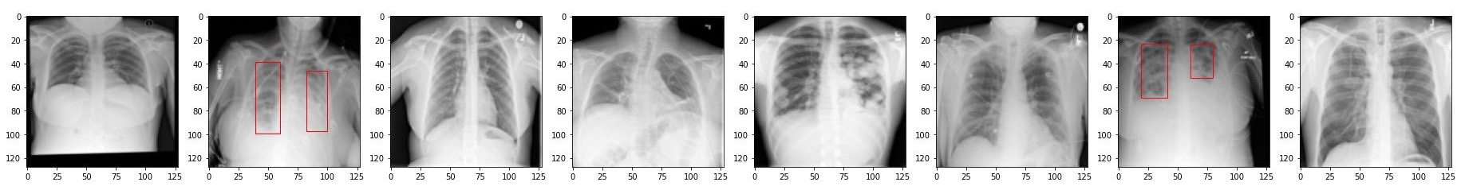
Background & Related Work
One-stage Detection
YOLO [1]
Two-stage Detection
Region-based CNN (R-CNN) [2]
[1] Redmon, Joseph, et al. "You only look once: Unified, real-time object detection." Proceedings of the IEEE conference on computer vision and pattern recognition. 2016.
[2] Girshick, Ross. "Fast r-cnn." Proceedings of the IEEE international conference on computer vision. 2015.

Slide 3
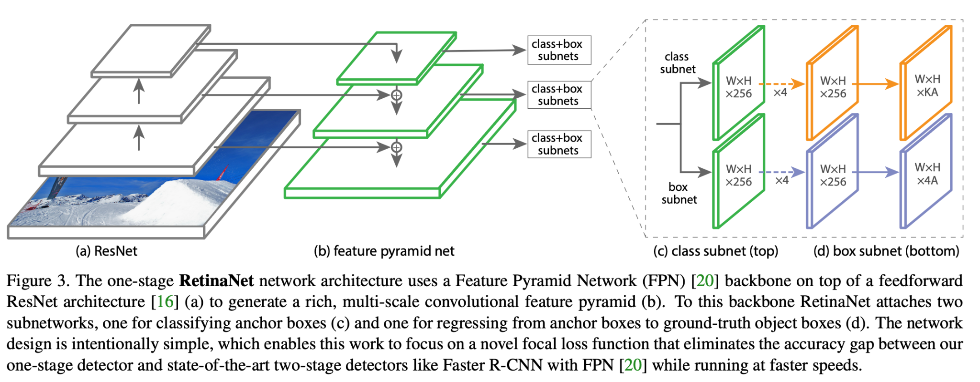
Method - RetinaNet [3]
[3] Lin, Tsung-Yi, et al. "Focal loss for dense object detection." Proceedings of the IEEE international conference on computer vision. 2017.

Slide 4
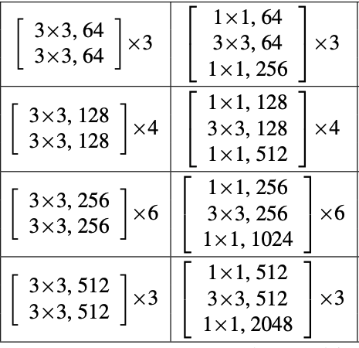
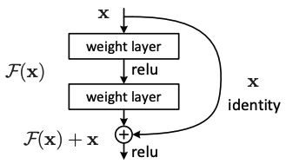
Method - Backbone
ResNet34 & ResNet50
Pre-trained on two datasets
ImageNet dataset
RSNA kaggle dataset
Fig 2 ResNet34 and ResNet50 Architecture [2]
Fig 1 Residual Structure [2]
[4] He, Kaiming, et al. "Deep residual learning for image recognition." Proceedings of the IEEE conference on computer vision and pattern recognition. 2016.

Slide 5
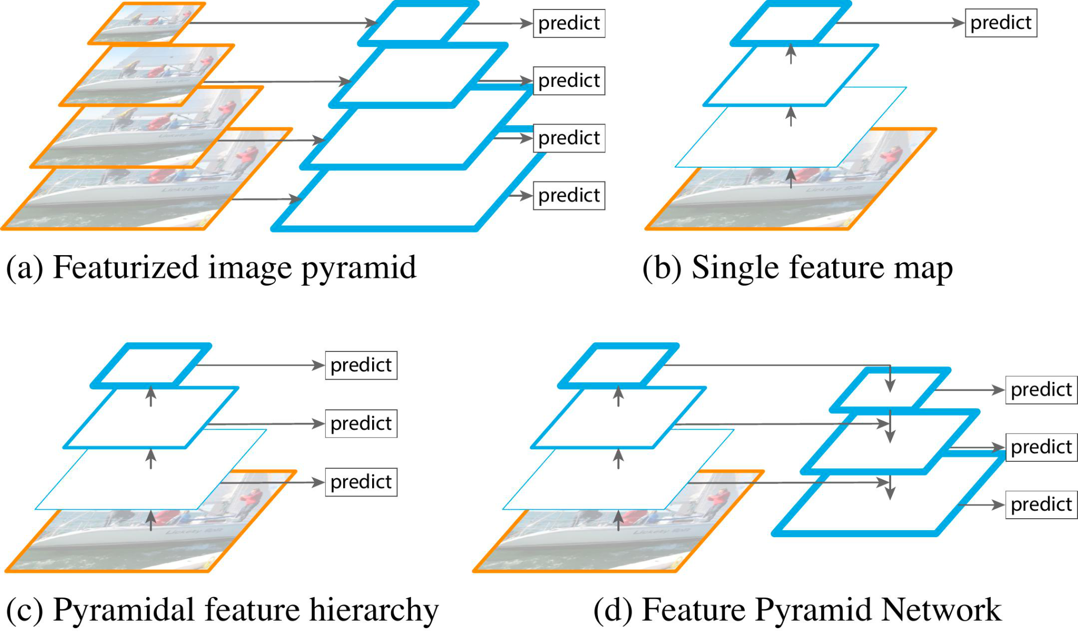
Method - Feature Pyramid Network [5]
Fig 3 FPN Structure [1]
[5] Lin, Tsung-Yi, et al. "Feature pyramid networks for object detection." Proceedings of the IEEE conference on computer vision and pattern recognition. 2017.

Slide 6
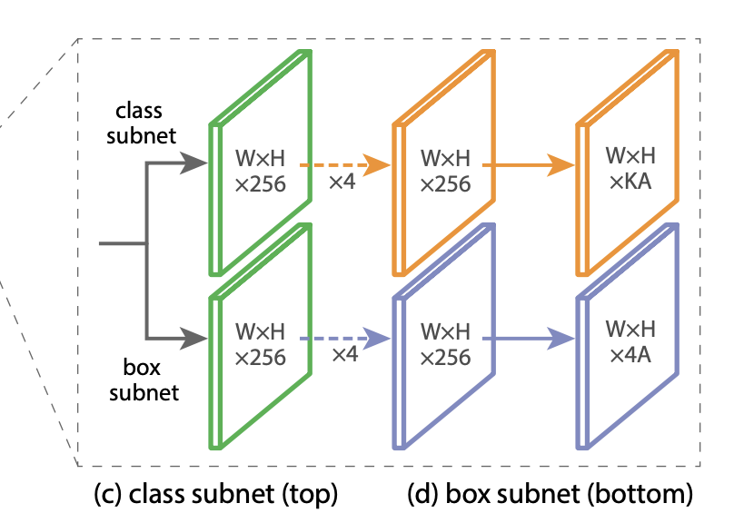
Method - Classification & Regression Subnet
Classification Subnet
CNN with 5 convolutional layers
output channel = num_anchors * num_classes
Regression Subnet
CNN with 5 convolutional layers
output channel = num_anchors * 4
Fig 4 Subnets Structure [3]
[3] Lin, Tsung-Yi, et al. "Focal loss for dense object detection." Proceedings of the IEEE international conference on computer vision. 2017.

Slide 7


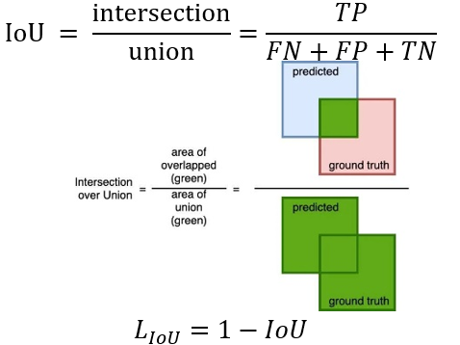

Method - Loss functions
Binary Cross Entropy
Focal Loss
Compound Loss
[4]Ma, J. (2020). Segmentation loss odyssey. arXiv preprint arXiv:2005.13449

Slide 8
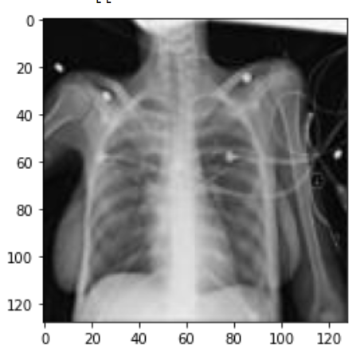
Experiment Settings
train test split
image downsizing 1024 => 128
hyperparameters
epoch = 15
lr = 0.0001
confidence score > 0.05

Slide 9
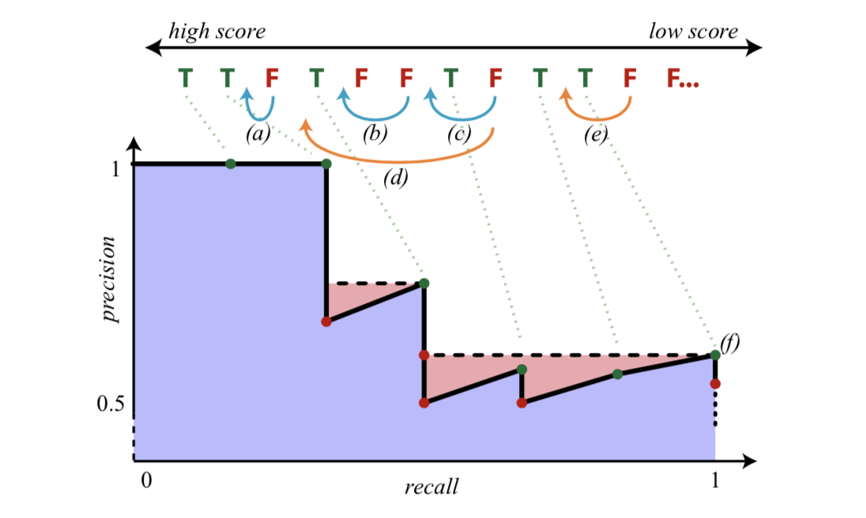
Metric
Average Precision (AP)
AUC of the precision and recall curve
need smoothing
mean AP (mAP)

Slide 10
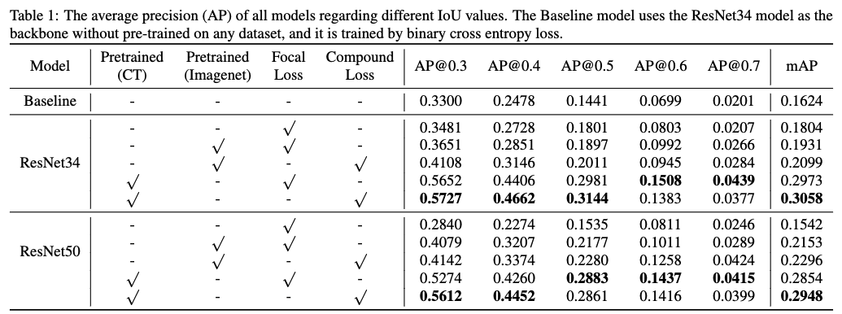
Results

Slide 11
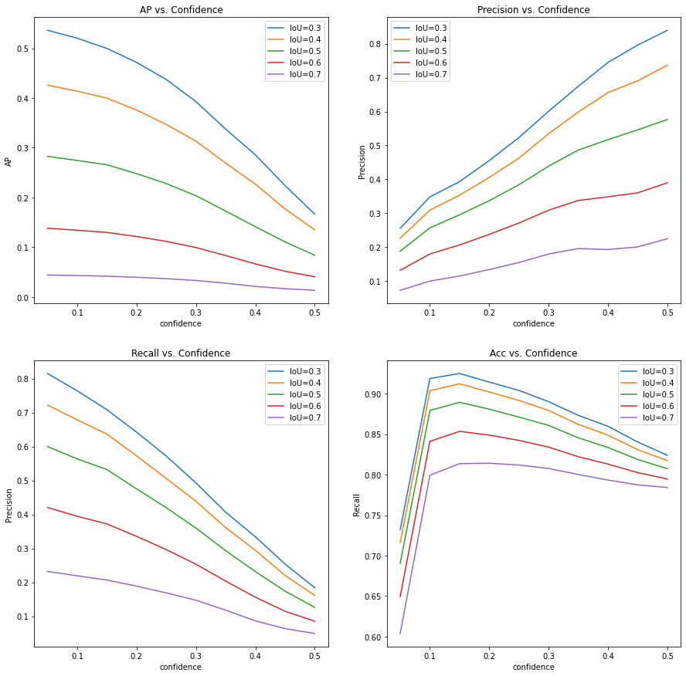
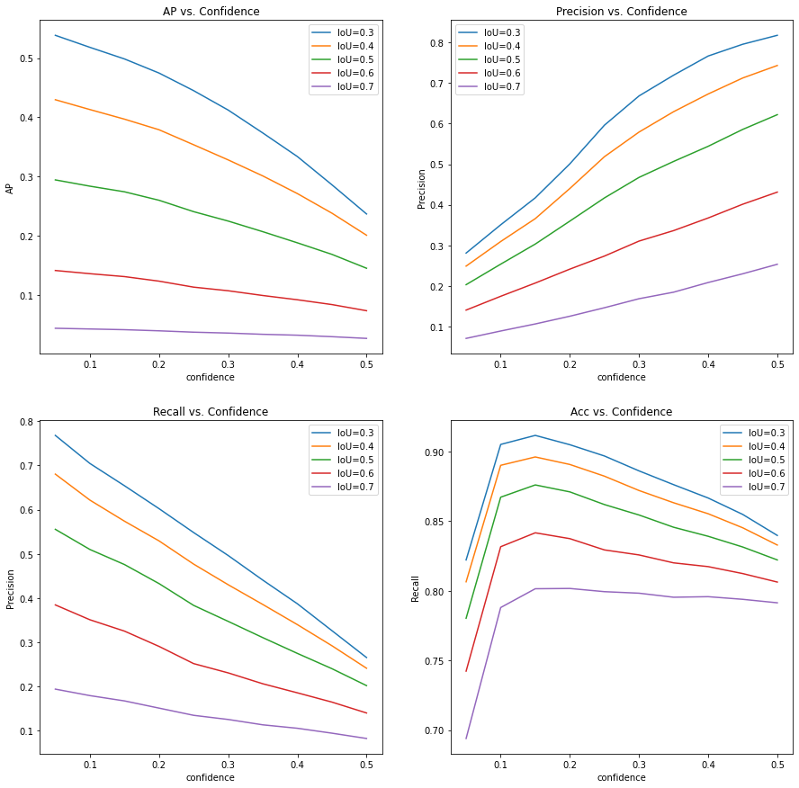
Discussions - Regarding the Confidence Level
epoch=6
epoch=9

Slide 12
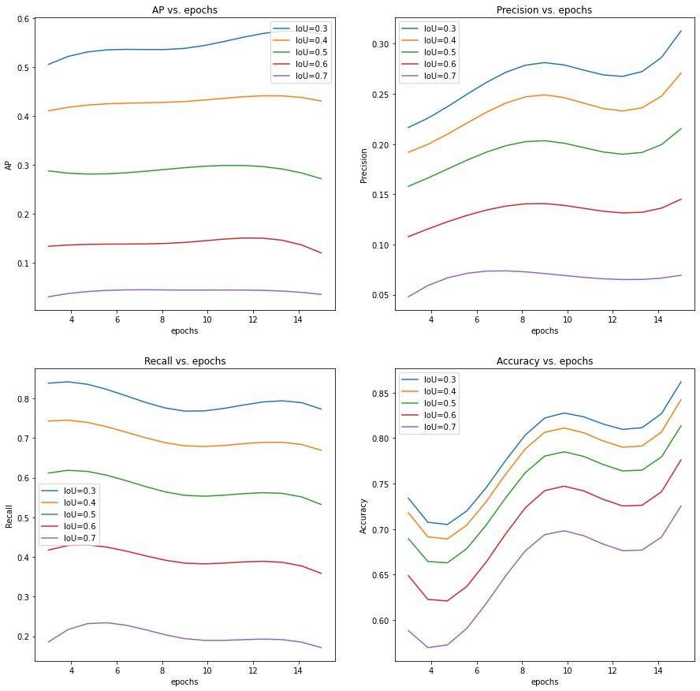
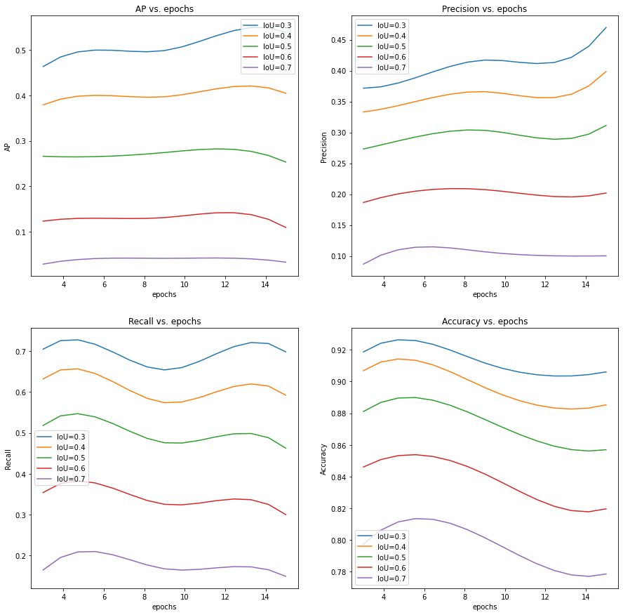
Discussions - Regarding the Training Epochs
confidence > 0.05
confidence > 0.15

Slide 13
Q&A

Slide 14
Thank you!

