Slide 1
Unclassified
Platform Distributed Services Milestone 1 Architecture
Milestone 1: Platform Distributed Services
Eric Sowell, Joe Zaleski, Sydney Igbokwe
08/16/2024
Unclassified

Slide 2
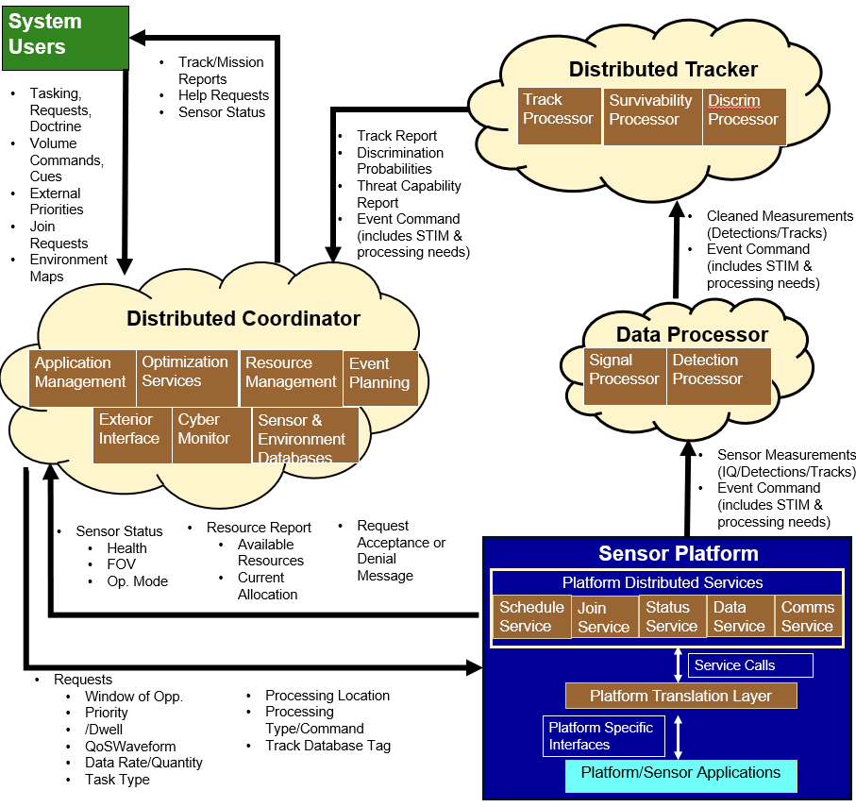
DSC Architecture Long Term Vision
UNCLASSIFIED
Distributed Sensor Control (DSC): Distributed cloud based software designed to coordinate sensors for joint operations
Cloud software can be hosted anywhere on network, multiple instantiations per processor
Distributed Coordinator (DC): Takes in system user requests and commands and current mission status and builds sensor level waveform requests – one instantiation per assigned platform group (controlled by BM)
Distributed Tracker (DT): Takes in post-processed sensor measurements and builds relevant track/mission reports – instantiation per track group
Data/Signal Processor: Takes raw sensor measurements and processes as commanded for DT – instantiation per event
Platform Distributed Services (PDS): Provides various services to support unique sensors
Platform Translation Layer (PTL): Transforms requests to sensor specific language
UNCLASSIFIED

Slide 3
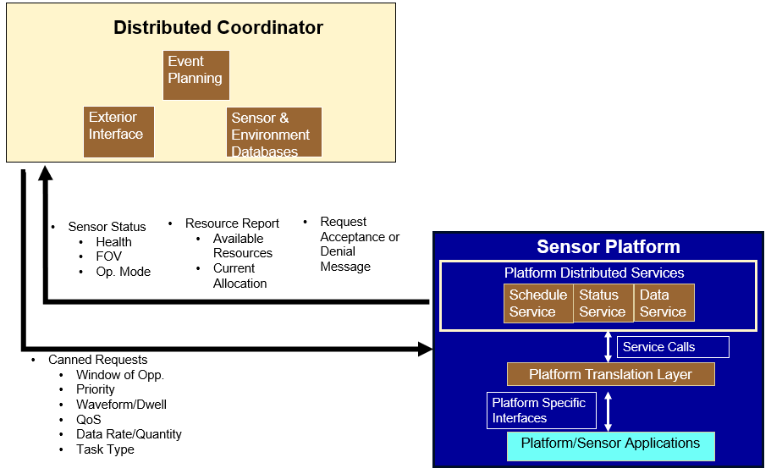
Distributed Coordinator Milestone 1 Overview
Unclassified
Provide a minimal distributed services component
Schedule requests
Produce sensor event data
Create a standard message interface
Create a translation layer for event data and event cue
Send canned scheduling to the platform
Collect and convert event data
Send converted event data to external source
Goal: Verify that event requests can be received/honored, and event data can be transmitted by the local sensor
Unclassified

Slide 4
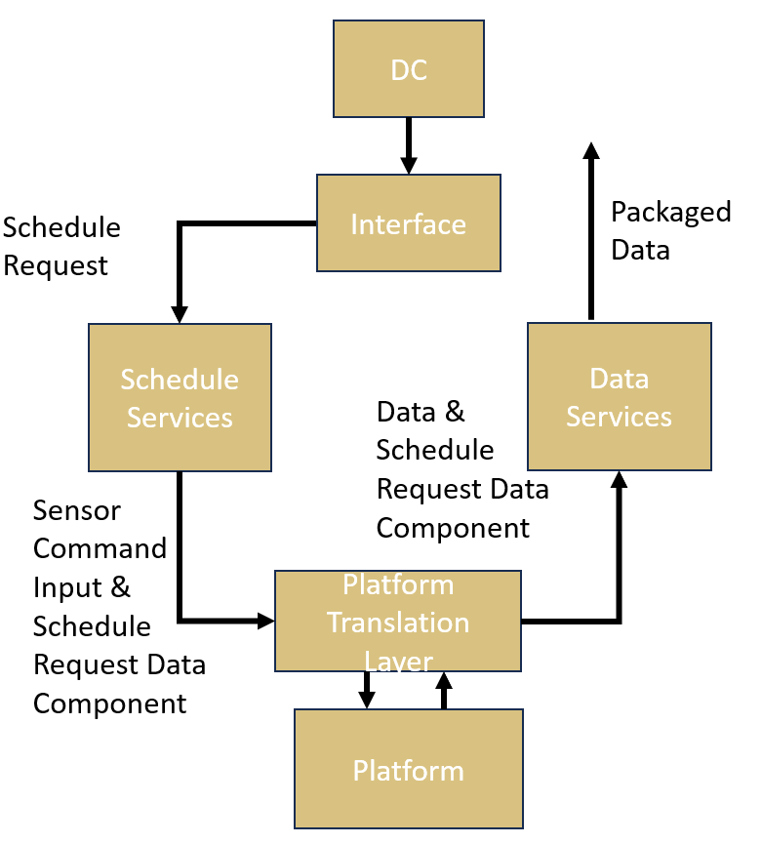
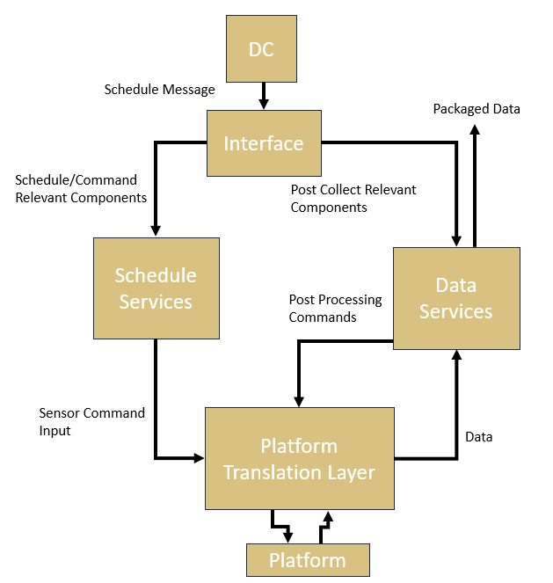
Data/Schedule Services Options
UNCLASSIFIED
Option 1: Schedule services acts as interface for all schedule requests.
Schedule service alone generates all inputs needed for radar STIM command and timeline input along with post event recorded platform software actions (i.e. signal processing commands) and executes on platform via PTL
Schedule service collects non-platform related inputs (i.e. need coordinate conversions) and sends those inputs along with event ID into PTL message (which is carried through the event)
PTL sends sensor command input to front end for sensor event execution
PTL holds non-platform related inputs to be packaged later with sensor event data via sensor event ID
Platform via PTL sends data at appropriate point to data services and additional messaging components who packages and sends the data
In this configuration the schedule service is entirely responsible for request inputs and data services is entirely responsible for output
Pros/cons: High burden on schedule services, single message carries irrelevant information to PTL (likely simpler but wasteful)
Option 2: Interface intakes schedule request message from the DC and parses out relevant commands for both schedule and data services
Schedule service writes the inputs for the STIM command related to the radar event (Tx & Rx) only – data services provides (and stores) input for the software commands to be run on platform
PTL combines input from schedule services and data services – allowing event execution prior to derivation of all signal processing command input
Platform receives either separated command to perform signal processing for each event via data services – result is extracted and packaged via data service
Boundary between schedule and data services are more well defined
Processing loop is now complex and timing may not always be beneficial
UNCLASSIFIED

Slide 5
LoR Data/Schedule Services Recommendation
UNCLASSIFIED
Scoring criteria (1-3) 3 being the highest
Metrics – arch. Simplicity, Flow, Future Extensibility, Flexibility
Option 2 provides the most straightforward approach for defining responsibility of Data & Schedule services
Option | Simplicity | Flow | Future Extensibility | Flexibility
1 | No required messaging between DC/PSS and PDS | Continuous messaging scheme for full event | Requires all platform post processing decisions made by schedule services prior to sensor event command execution – typical | Requires STIM command to grow with needed DS input
2 | Requires a unique interface that sends multiple messages to services then requires PTL logic to either combine DS and SS messages or pair them for different executions of event activity | Requires PTL to also know whether STIM must contain sig pro commands and requires PTL to receive input from both SS and DS for some STIM events | Allows separation of event commands and sig pro inputs on the platform – could allow unique integration approaches, but unlikely to exceed capability from a distributed sig pro | Little benefit to flexibility, decoupling sig pro command could allow different types than normally commanded, but that can be controlled by sched. services
Option | Arch. Simplicity | Flow | Future Extensibility | Flexibility | Total
1 | 3 | 3 | 1 | 1 | 8
2 | 1 | 1 | 1.5 | 1.5 | 5
UNCLASSIFIED

Slide 6
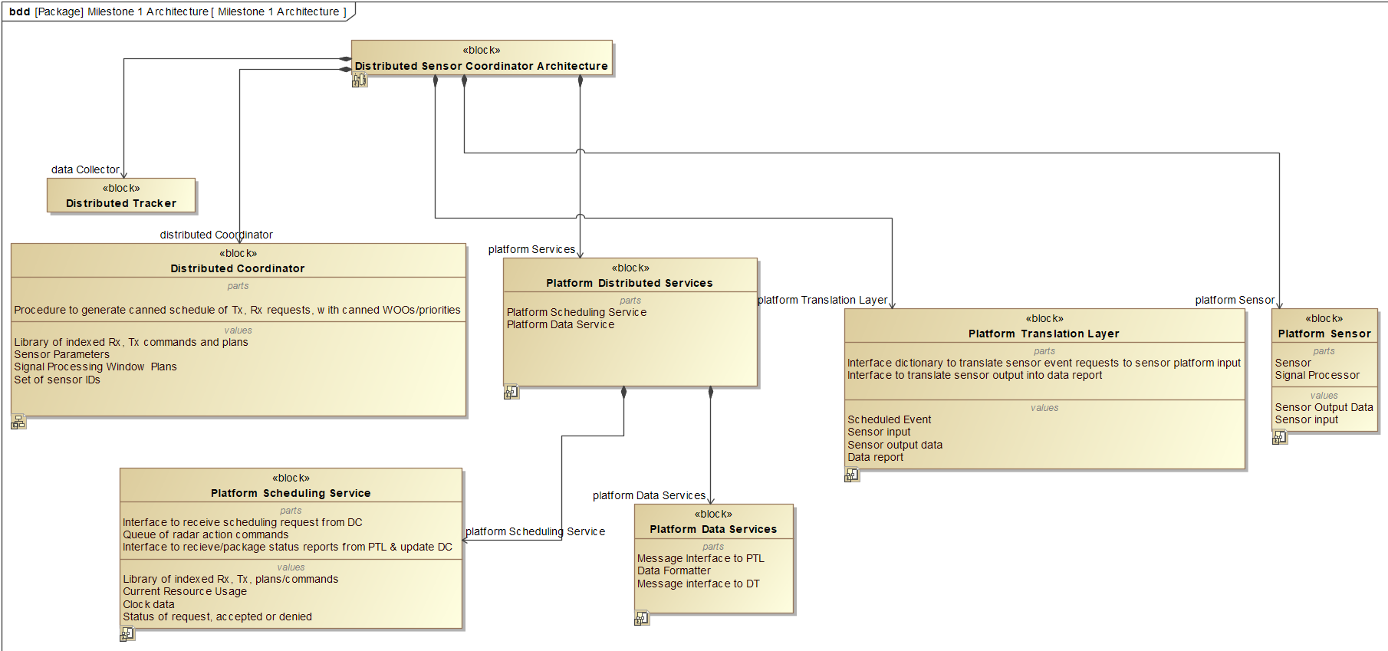
Milestone 1 Architecture
UNCLASSIFIED
Milestone 1 Goals
Provide a minimal distributed services component
Canned requests
Schedule requests
Receive event data
Standard Message Interface
Translation layer for event cue and event data
Verify that event requests can be received/honored and event data can be transmitted by the local sensor
Data Recording Verification
UNCLASSIFIED

Slide 7
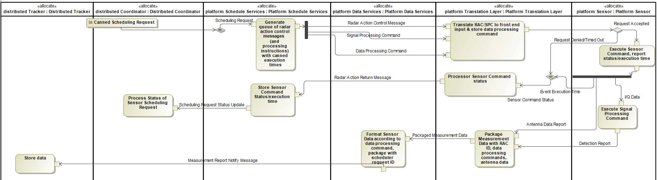
Milestone 1 Platform Services Activity Diagram
unclassified
Platform scheduler translates DC scheduling request into a queue of Radar Action Control Messages (RAC), Signal Processing Commands (SPC), data processing commands (e.g. coordinate conversions) with canned execution times and WOO.
Platform scheduler sends RAC message with associated signal/data processing commands to platform translation layer; platform translation layer translates messages into appropriate sensor commands and stores data processing command to package with the return Rx data to send to platform data services.
Platform translation layer sends a radar action return message (RAR) conveying the resulting status of the radar action and the actual execution time when the sensor event began to the platform scheduler; platform scheduler forms and sends status of original scheduling request back to the DC.
If event request is accepted, sensor platform executes sensor event and associated Signal Processing Command and creates Detection Report.
Platform translation layer receives Antenna Data Report and packages with detection report to be sent to Platform Data Services
Antenna Data Report contains sensor position at measurement time in LatLongAlt, commanded beam position in RAE coordinates
Detection Report contains position for each measurement in RAE coordinate frame and measurement accuracy metric
Platform Data Services receives packaged measurement data from the PTL and performs coordinate conversions (if relevant to milestone). Formatted measurement report is sent to the Distributed Tracker.
Measurement Report contains sensor position at the measurement time in LatLongAlt, commanded beam position in RAE coordinate frame, position for each measurement in RAE coordinate frame, measurement accuracy metric
unclassified

Slide 8
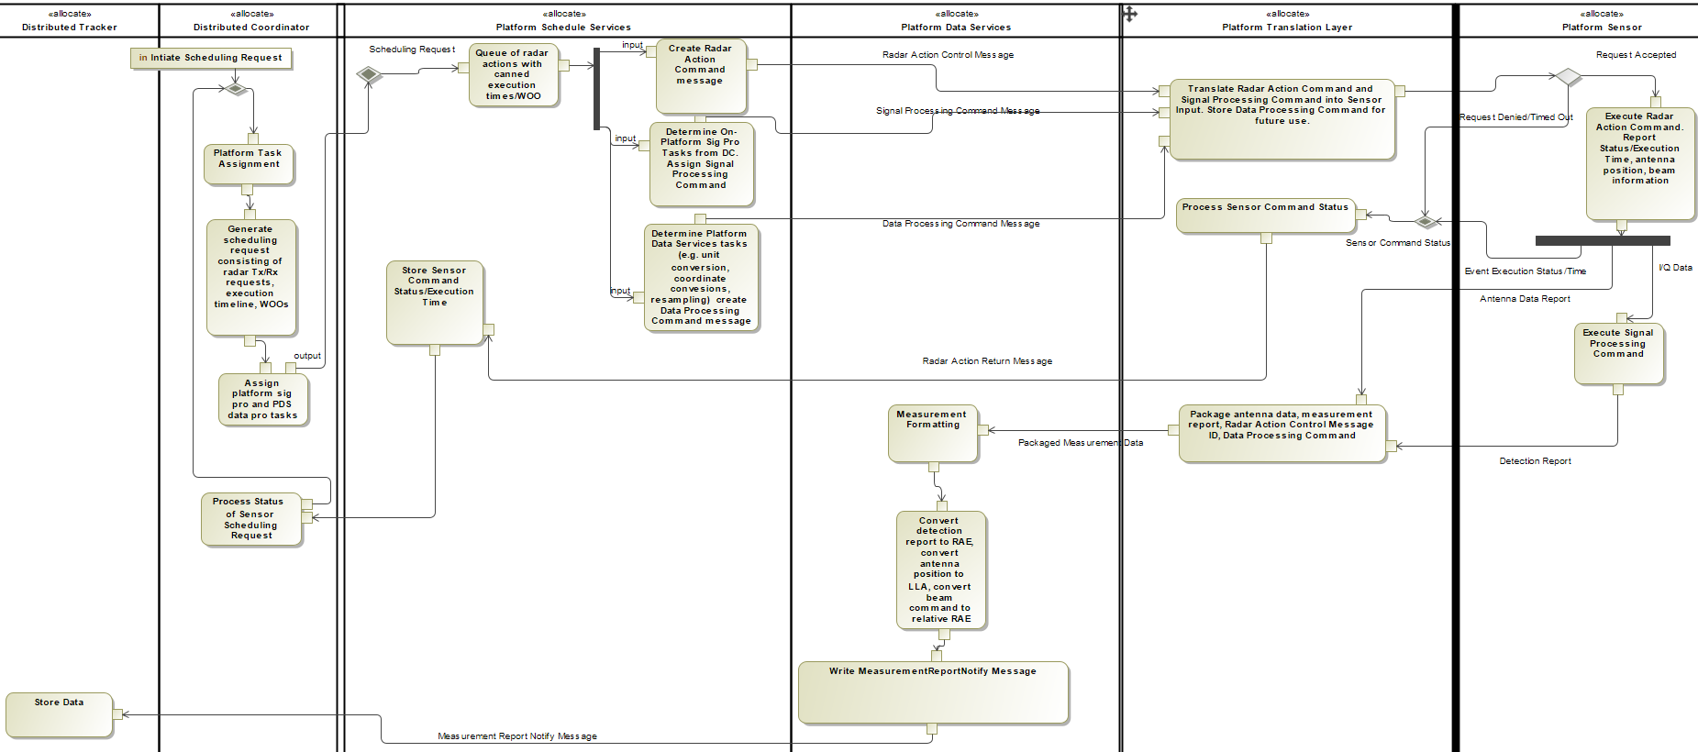
UNCLASSIFIED
Milestone 1 Platform Services Activity Diagram (Breakdown)
UNCLASSIFIED

Slide 9
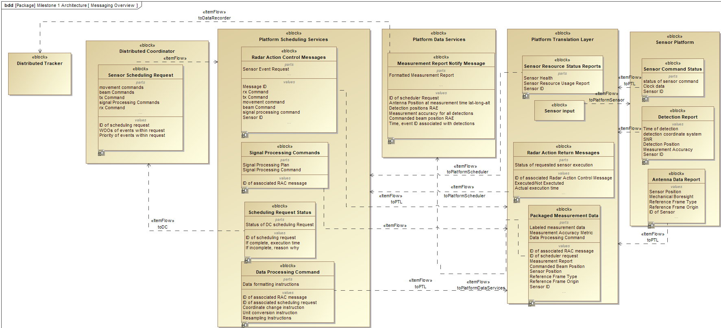
Milestone 1 Messaging Description
unclassified
A specific Sensor Scheduling Request can be organized as a collection of at least one of the following Rx, Tx, beam, element and signal processing commands (described in backup)
Platform Scheduler translates scheduling request into Radar Action Control Messages (RAC), Signal Processing Commands (SPC), Data Processing Commands for associated sensor events
Platform Translation Layer communicates sensor commands to front end and sends associated Data Processing Commands to Platform Data Services, and Radar Action Return (RAR) status/execution time updates to Platform Scheduler
Platform Data Services formats data from the translation layer into Measurement Report Notify Message to send to the distributed tracker.
unclassified

Slide 10
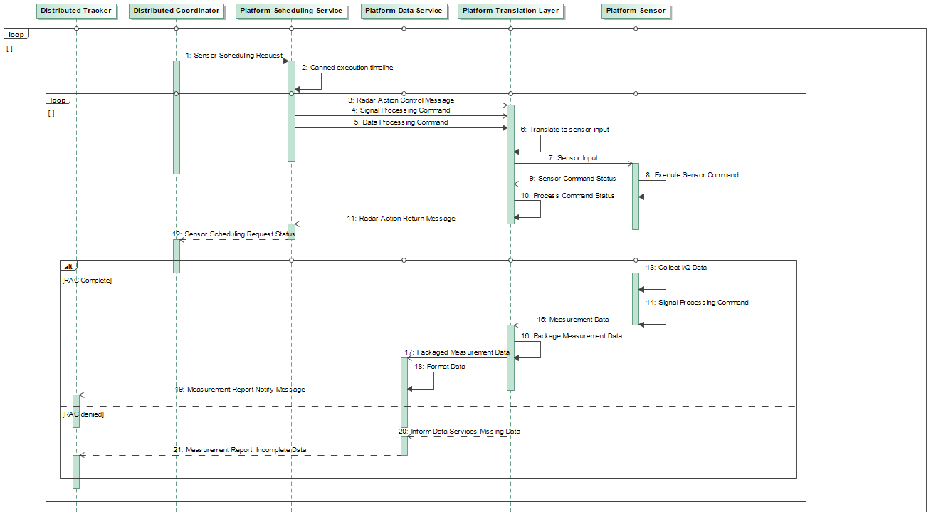
Milestone 1 Platform Services Architecture
unclassified
1: DC specifies ID of sensor to be commanded. DC selects set of ID’s from library of element commands, beam commands, tx-rx commands and signal processing commands for canned scheduling request with canned windows of opportunity.
2-5: Platform Scheduling service translates scheduling request into a series of radar action control messages, labeled by ID. Execution times are set to be the time requested by the DC; signal/data processing commands for associated radar action messages are attached.
6-7: Platform Translation Layer translates radar action control message and signal processing message into sensor command (e.g. STIM) using a stored dictionary. Platform Translation Layer stores relevant data processing commands for future data processing to be sent to Platform Data Services with the sensor’s return data in step 15.
8-9: Sensor reports back status, antenna data and execution time of sensor command (if accepted) or updates status (if denied).
10-12: Platform Translation Layer reports status, execution time and ID of RAC message back to platform scheduling service. Platform scheduler reports status of original scheduling request ID to distributed coordinator.
13-14: Sensor platform outputs I/Q data and host computer performs signal processing (TBD).
15-17: Platform Translation Layer extracts sensor data and packages with RAC/data processing message ID within the translation layer and sends to platform data services.
18-19: Platform data services receives and formats data according to the instruction from the platform translation layer and sends sensor data report to data recorder.
20-21: If the sensor command was denied, report of denial is sent to the distributed tracker.
unclassified

Slide 11
Distributed Coordinator Milestone 1 Requirements
unclassified
The DC and Platform Scheduler Services shall each have access to a common set of pre-defined system waveform (s).
The DC and Platform Scheduler Services shall each have access to set of sensor IDs.
The DC shall select a pre-defined waveform per scheduled event request and the Platform Scheduler Services shall interpret the message and load the correct waveform information.
The DC and Platform Scheduler Services shall each have access to a common indexed set of beam commands.
The DC and Platform Scheduler Services shall have access to common movement commands to set antenna orientation (i.e. boresight angle).
The DC and Platform Scheduler Services shall each have access to a common indexed set of signal processing commands.
The DC and Platform Scheduler Services shall have access to common set of time and repetition plans defining Rx-Tx windows. Canned time plans with specified duration/execution shall be selected at the DC level.
The DC shall contain canned sequences of plan IDs to coordinate a series of multiple sensor event requests.
The DC shall assign a WOO and priority for a given scheduling request.
The DC shall have access to front end (FE) specific parameters documented within a central file.
The DC shall contain a GUI displaying list of sensor IDs and status of connectivity to each sensor.
unclassified

Slide 12
Platform Scheduling Service Milestone 1 Requirements
unclassified
Platform Scheduling Services shall communicate sequence of plans and desired execution time for the sensor event to the platform translation layer within a standard messaging structure.
Milestone 1: Platform Scheduling Services will use execution times set by the DC.
Platform Scheduling Services shall receive the status of event execution (accepted or denied, execution time at platform level) from the platform translation layer.
Platform Scheduling Services shall send signal processing commands and data processing commands associated with scheduled windows to the platform translation layer.
Platform Scheduling Services will send beam commands, within the local coordinate frame (RAE) that the sensor reports in, to the Platform Translation Layer.
Platform Scheduling Services will send Signal Processing Commands associated with a given Rx window command to the Platform Translation Layer; Platform Translation Layer shall package commands as sensor input.
Platform Scheduling Services shall send data processing commands to the Platform Translation Layer to be packaged with incoming detection report and sent to Platform Data Services for further unit/coordinate changes.
Detection report (containing detection positions in RAE, accuracy measurements, detection times) will be formed using associated signal processing commands on the sensor platform.
Platform Translation Layer shall tag incoming detection reports from the sensor platform with the units the measurements are reported in, ID of associated RAC message, and with the data processing commands from Platform Scheduling Services to be sent to Platform Data Services.
Data Processing Commands shall include instruction for Platform Data Services to perform coordinate conversion (not required for ms-1) on all measurements within the detection report to the RAE coordinate frame.
Platform Scheduling Services will send a sensor command prior to the beginning of the scheduling periodic in which that command (e.g. STIM) would be processed.
Platform Scheduling Services shall receive tasks/commands, window of opportunity (WOO) and event priority from the DC.
Platform Scheduling Services shall report acceptance or denial of tasks to DC based on sensor status, resource availability and priorities within the scheduling request. (milestone 1 stretch goal)
unclassified

Slide 13
Platform Translation Layer Milestone 1 Requirements
unclassified
The platform translation layer shall receive radar action control messages/signal processing commands/data processing commands from the platform scheduler within a standard messaging format.
The platform translation layer shall translate radar action control messages/signal processing commands and execution time into an appropriate sensor execution command (e.g. a STIM) within the framework of the front end software/hardware (e.g. GNU radio, UHD-USRP or similar software for milestone 1). The platform translation layer shall communicate the sensor execution command to the appropriate sensor identified in the in the request.
The platform translation layer shall store the ID’s of incoming radar action control message, signal and data processing commands for labeling corresponding return data from the sensor platform.
The platform translation layer shall receive status updates of the sensor platform executing or denying a sensor event, along with the time of execution. The platform translation layer shall package status update with original radar action control message ID and send to the platform scheduler.
The platform translation layer shall extract sensor measurement report and package with original radar action control message ID and data processing commands (e.g. instructions for unit conversion, coordinate transformation, resampling) to be sent to platform data services for further formatting.
unclassified

Slide 14
Platform Data Services Milestone 1 Requirements
unclassified
Platform Data Services shall have an interface to extract packaged measurement reports from the platform translation layer.
Platform Data Services shall perform data processing commands (unit conversion, resampling tasks, coordinate change) as instructed by the platform scheduler/platform translation layer for the specific sensor event in question.
Platform Data Services shall package processed measurement report from the platform translation layer with the ID of the original scheduling request and front end values associated with the specific sensor event.
The measurement report from data services shall include the Latitude, Longitude and Altitude of the sensor position at the time of measurement.
The measurement report from data services shall include the commanded beam position in an RAE coordinate frame.
The measurement report from data services shall include the measurement position in the RAE coordinate frame from all reported detections.
The measurement report from data services shall include the measurement accuracy from all reported detections.
The measurement report will include the time of the event and the event ID.
Platform Data Services shall send formatted and packaged measurement report to the distributed tracker.
unclassified

Slide 15
UNCLASSIFIED
Backup Slides
UNCLASSIFIED

Slide 16
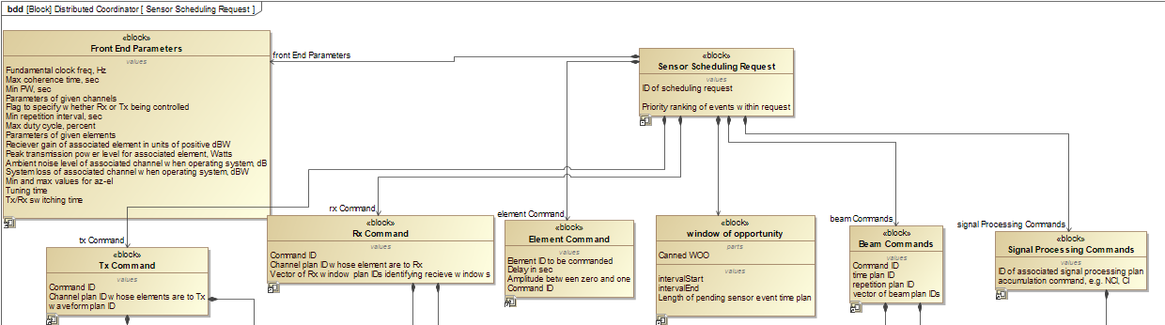
Scheduling Request Structure: Indexed Commands
UNCLASSIFIED
A specific sensor scheduling request can be organized as a collection of at least one of the following Rx, Tx, beam, element and signal processing commands, along with a window of opportunity (WOO) and list of priorities of events within scheduling request.
Commands are referenced by ID number and are stored in separate libraries within the distributed coordinator and platform distributed services
Specific commands are formed by selecting from an indexed library of time, repetition, window and beam plans (back up slides)
Plans and commands are assumed to be stored within or linked through the DC
Platform Services Scheduler/Translation Layer are assumed to have access to same indexed library of plans as the DC
Red components beyond scope of milestone 1; to be developed in future milestones
UNCLASSIFIED

Slide 17
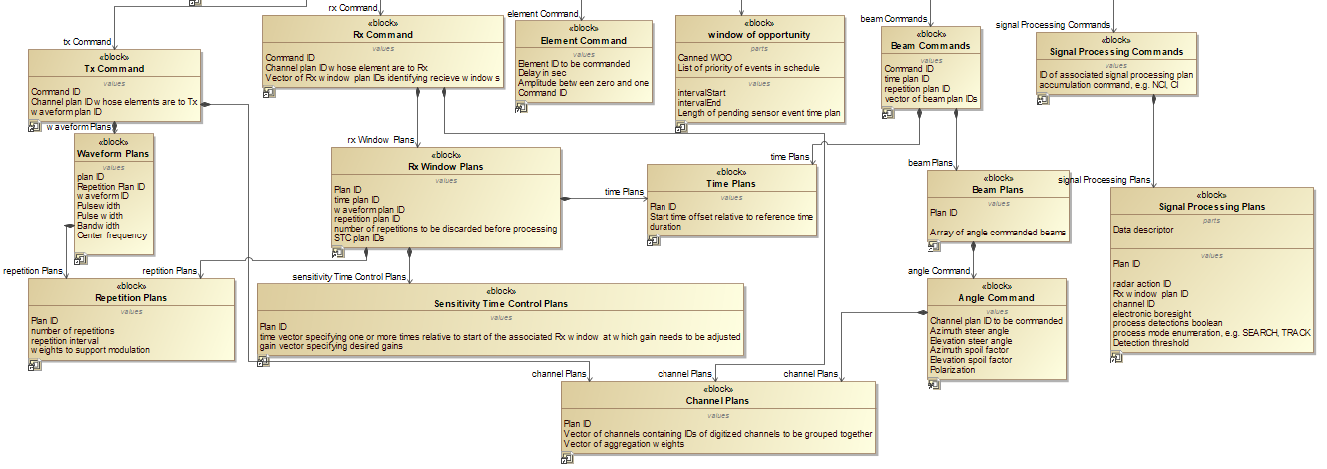
Scheduling Request Structure: Indexed Plans
UNCLASSIFIED
Plans dictating various time, waveform, channel and beam scenarios are stored within indexed libraries on the distributed coordinator and platform distributed services
Specific Rx-Tx commands (previous slide) are formed by selecting ID’s of time, waveform, repetition, sensitivity time control, channel, beam and signal processing plans
Red components beyond scope of milestone 1; milestone 1 will default to a preconfigured value for block if relevant (or empty value if irrelevant)
UNCLASSIFIED

Slide 18
Sensor Scheduling Request Structure
UNCLASSIFIED
A sensor scheduling request can be organized as a collection of at least one of the following plans and commands. Plans and commands are assumed to be stored or linked within the cloud/DC; libraries of plans and commands are indexed by specific plan ID number.
Plan | Minimum information required to define | Description | FROST Context
Time Plans | Plan ID, start time offset relative to reference time (populated at Platform Scheduler Services level), duration | Defines timeline of request | Fundamental Plans, Mission Data File
Repetition Plans | Plan ID, repetition interval, number of repetitions, array of weights to support modulation | Defines repetition window of request | Fundamental Plans, Mission Data File
Waveform Plans | Plan ID, repetition plan ID, waveform ID | Assumed that DC, platform services have access to same library of waveforms | Combination of Pulse and Frequency Plans to form waveforms, Mission Data File
Channel Plans | Plan ID, vector of channels containing IDs of digitized channels to be grouped together, vector of aggregation weights | Defines digital channels of request | RAC message, channel plans
Rx Window Plans | Plan ID, time plan ID, waveform plan ID, repetition plan ID, number of repetitions to be discarded before processing, STC plans | Defines breakdown of timeline into receive windows | RAC message, Rx window plans
Sensitivity Time Control Plans | Plan ID, time vector specifying one or more times relative to start of the associated Rx window at which gain needs to be adjusted , gain vector specifying desired gain | Default STC plan ID zero, time of zero, gain of one to ignore attenuation | RAC message, STC plans
Angle Command | Channel plan ID to be commanded, azimuth steer angle, elevation steer angle, azimuth spoil factor, elevation spoil factor, polarization | Defines beam angle of request. The FE will convert these steering angles and spoil factors into per-element delays and amplitudes | RAC message, angle command
Element Command | Element ID to be commanded, delay in seconds, amplitude between zero and one | Specifies antenna elements | RAC message, element command
Beam Plans | Plan ID, array of angle commanded beams | Command to assign specific sequence of beam commands for execution | RAC message, beam plans
Beam Command | Command ID, time plan ID, repetition plan ID, vector of beam plan IDs | Defines sequence of beams within a time duration | RAC message, beam command
Tx Command | Command ID, channel plan ID whose elements are to Tx, waveform plan ID | Defines a transmit command (to be synchronized with given time plan) | RAC message, Tx command
Rx Command | Command ID, channel plan ID whose elements are to Rx, vector of Rx window plan IDs identifying receive windows | Loads antenna channels and sequence of time windows for execution of a specific receive event | RAC message, Rx command
UNCLASSIFIED

Slide 19
Signal Processing Commands
UNCLASSIFIED
For scheduling requests requiring signal processing, the platform scheduler sends an associated signal processing plan/command listing the Rx windows associated with the relevant data to be processed.
Plan | Minimum information required to define | Description | FROST Context
Signal Processing Plan | Plan ID, Data descriptor (identifies data to be processed, contains radar action ID, Rx window plan ID of window associated with the radar action, channel ID associated with radar action, electronic boresight), process detections Boolean, process mode enumeration (e.g. SEARCH, TRACK) | Structure to indicate to data extractor module how data will be processed, and store Rx window requiring processing | SPC message
Signal Processing Command | ID of associated Signal Processing Plan, accumulation command (e.g. NCI, CI) | Command to assign specific signal processing plan for execution | SPC message
Data Processing
Message | Minimum information required to define | Description | FROST Context
Measurement Report Notify Message | Local track ID, Detection report ID, ambiguity type (ambiguity dimension, specifies where the measurements are valid in the state space), detection type (contains set of detections), reference frame type (defines a reference frame for detection kinematic states. Can be any frame that is specified within an ECEF frame), ID of associated signal processing plan, accumulation command ID, time associated with the detections in the report, list of local track IDs that were cued in detection report | Message to notify modules of a detection and the measurements of the detected object. | DetectionReportNotify, MeasurementReportNotify
UNCLASSIFIED

Slide 20
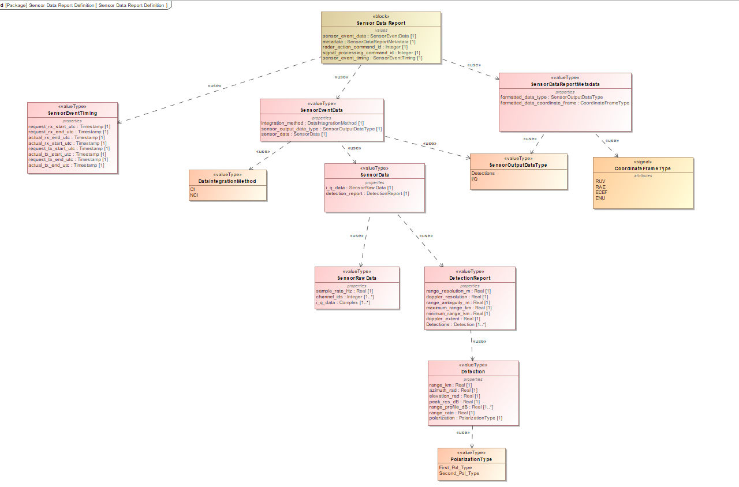
Measurement Report Notify
unclassified
unclassified

Slide 21
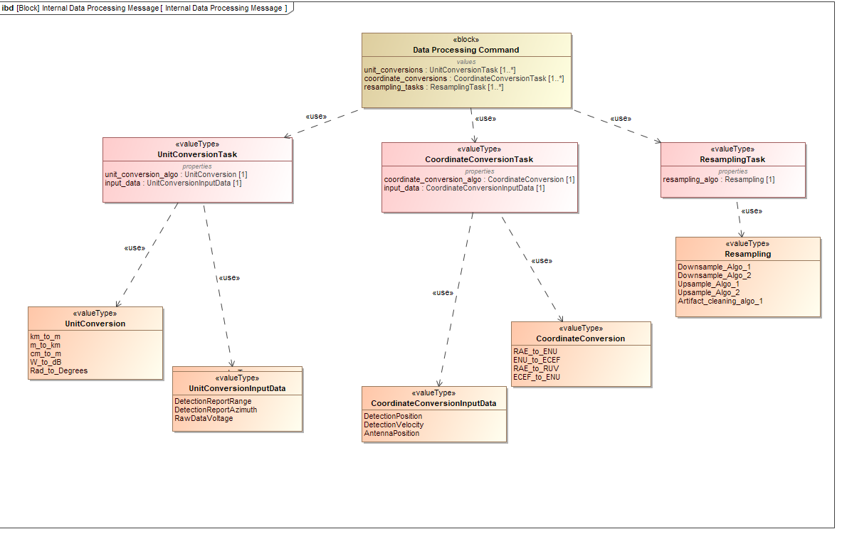
Data Processing Command
unclassified
unclassified

Slide 22
Sensor/Front End Parameters (TBD)
UNCLASSIFIED
General Description
FROST Context
Parameters are stored on central Mission Data File (MDF) which all back end software modules are to have access to throughout timeline of operation.
Fundamental clock frequency of FE (Hz)
Maximum coherence time of FE in (sec)
Maximum duty cycle of FE (%)
Minimum PW of FE (sec)
Minimum repetition interval of FE (sec)
Flag to specify whether Tx and Rx amplitude is being controlled
Parameters of given elements
Parameters of given channels
Receiver gain of associated element in units of positive dBW
Peak transmission power level for associated element (Watts)
Ambient noise level of associated channel when operating system in units of dB
System loss of associated channel when operating system in units dBW
Minimum and maximum values for azimuth and elevation
Tuning time
Rx-Tx switching time
fundamental_clock_ frequency
maximum_coherence _time
maximum_duty_cycle
minimum_pulse_width
minimum_repetition_interval
tx_rx_amplitude_control _flag
element_parameters
channel_parameters
rx_gain
tx_power_level
noise_figure
system_loss
MinMaxAeType
UNCLASSIFIED

