Slide 1
Software Design Review Template
Copy this ppt before you edit
SPY7-XXXXX
Presenter Name
Date Posted

Slide 2
Date.Rev | Description | Reviewer Initials | Reviewer Status
2025.08.19 | Initial Design |  | <Reviewed with Comments to Address on ____>
 | Address Comments on ____

Slide 3
Task Description
Creating a standalone DataLogger component to handle text logging, binary trace logging, and DXR
What is driving this change?
Technical Debt
RSG/RTG and SMS each have their own implementation of logging components using old libraries and designs
Creating a new library allows for modernization
Performance
Comprehensive unit testing and benchmarking
~1000 ns per log including thread safety and process safety through file locks
300-500 ns per binary payload for ‘local dxr’ logging
No DXR benchmarks currently due to the dxr daemon and lrc setup
What is the minimal definition of done?
Is this part of a larger feature/improvement?
How does this fit in with know ongoing/future work?

Slide 4
Task Description
What is the minimal definition of done?
DataLogger component implemented on the unclass side and can compile on the class side
Coverage as close to 100% as feasible
DXR unit test and benchmarks investigated
Is this part of a larger feature/improvement?
Ongoing implementation of common libraries within the platform
How does this fit in with know ongoing/future work?

Slide 5
Software Design Details
Description of the intended software change
TextLogger, TraceLogger, DXRLogger base logging classes created
DataLogger static façade created
ProcessLock implemented using fcntl(file locking) to allow safe locking cross process and cross node on NFS mounts

Slide 6
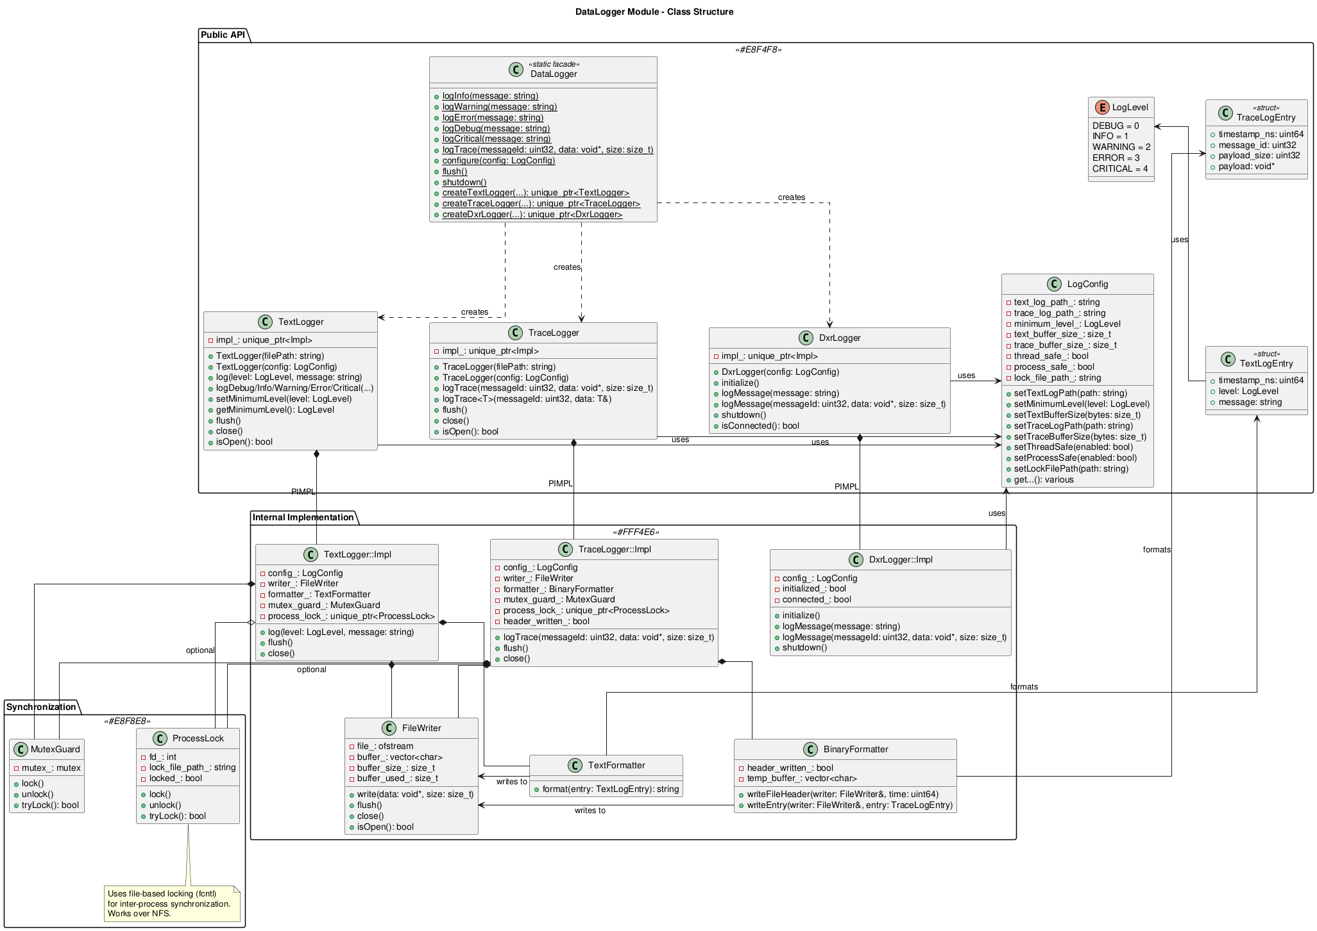

Slide 7
Test Plan
Automated tests
L1 tests – unit tests
L2 tests – test of component through its public API
Existing tests leveraged?
None existing
Test coverage expected?
80-100% pending DXR unit-test capabilities
Desktop test
TBD – DXR test procedure
Test shot
N/A

Slide 8
Estimate of Complexity
Estimated timeline
Identify blockers or unknowns
Platform repo is not currently part of the CM/LSWE space, it will need to undergo QA/BR process before code can be used
Identify potential risk areas
Changing public API of the logging library could lead to a large refactor when implementing in the products
Describe risk mitigations
Implementation of multiple different entry points(static façade, creational methods, etc) should allow products to continue to use the DataLogger in the same way they currently log

