Slide 1
A study of synchronization and concurrency issue in the dining philosophers problem
Group: Rochelle Mullen, Steven Kelly, Habiba Nour, Piotr Momat

Slide 2


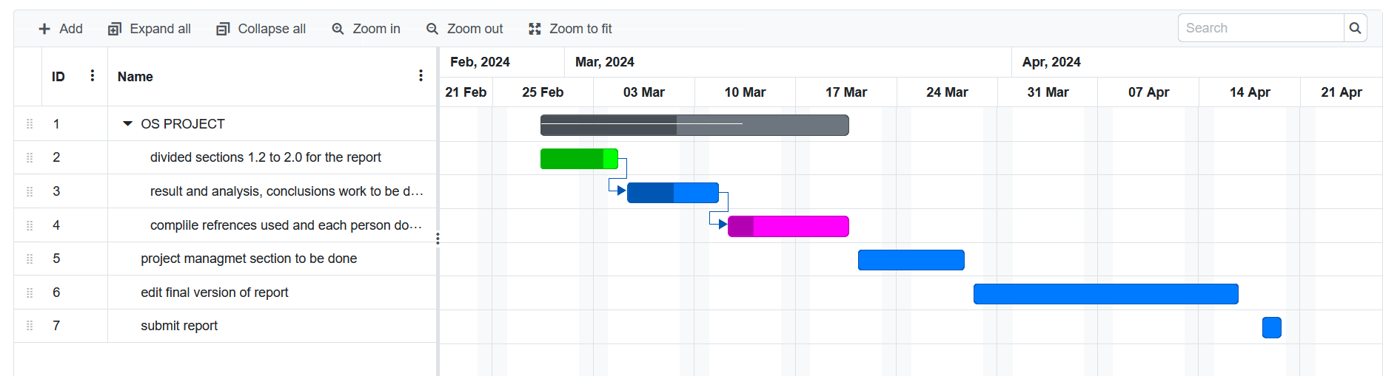
Introduction
Dining philosopher problem
Semaphores
Four chairs solution

Slide 3
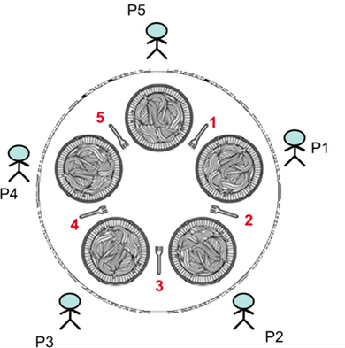
Dining philosophers' problem
5 philosopher, 5 chopsticks
Philosophers are thing or eating
They need 2 chopsticks to eat
Only 2 can eat at one time
Can cause starvation
Source: https://miro.medium.com/v2/resize:fit:662/1*bBGR80ixw0l6ZELyNh7fxw.png

Slide 4
Semaphores
Extension to mutex locks
2 methods: wait() and signal()
Binary semaphores i.e wait is 0 and cannot execute release if 0
No interruptions

Slide 5
Tags used in ThreadMentor when run
JN – Join: This Thread has joined with another thread.
SW – Semaphore Wait: This thread is waiting on semaphore.
SE – Semaphore Enter: This thread has been let through a semaphore.
SS – Semaphore Signal: This Thread has signalled a semaphore.
MW – Mutex Wait: This thread is waiting to obtain(lock) a mutex.
ML – Mutex Lock: This thread has obtained(locked) a mutex.
MU – Mutex Unlock: This thread has obtained(locked) a mutex.

Slide 6
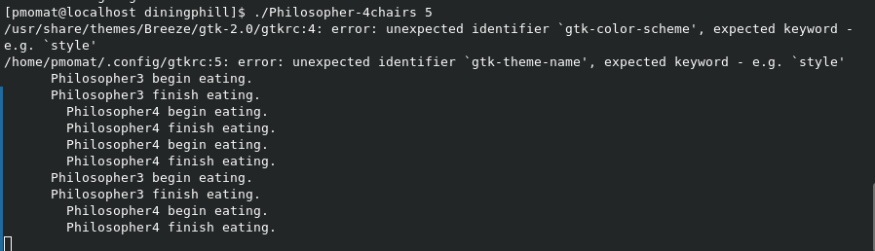


Starting threadmentor

Slide 7
Four chairs Solution
Prevent deadlock
Reduces chairs at table but keeps the amount of chopsticks

Slide 8
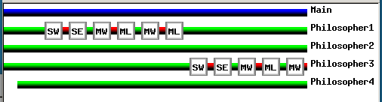
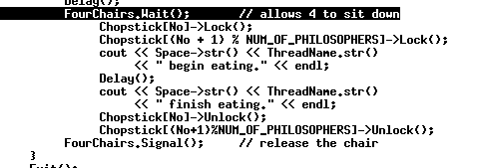
Running 4 chair solutions
Wait() is SW tag
Lock() is ML tag
Unlock() is MU tag
Signal() is releasing chair

Slide 9
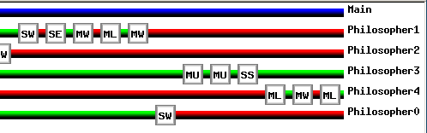

Philosopher 3 leaves table
Philosopher 0 waits to join

Slide 10
References
Dining Philosophers Problem. 2020, miro.medium.com/max/662/1*bBGR80ixw0l6ZELyNh7fxw.png. Accessed 13 Feb. 2024.
Dr. C.-K. Shene. Multithreaded Programming with ThreadMentor. Aug. 2001, COMP H2014 KF: ThreadMentor E-Book (tudublin.ie). Accessed 31 Jan. 2024.
Neso Academy. “The Dining Philosophers Problem.” https://www.youtube.com/watch?v=FYUi-u7UWgw, Neso Academy, 13 July 2021, . Accessed 1 Mar. 2024.
Carr, S., Mayo, J., & Shene, C. (January 2003) "ThreadMentor: A pedagogical tool for multithreaded programming". Available at URL: https://www.researchgate.net/publication/220094570_ThreadMentor_A_pedagogical_tool_for_multithreaded_programming.

