Slide 1


INTERACTING WITH SMARTPHONES USING VOICE
THE FINAL THESIS
Project:
Student: NGUYỄN DUY BÌNH
Class: P.F.I.E.V C53 – Industrial Informatics Instructor: Dr.TRẦN ĐỖ ĐẠT
06-2013

Slide 2
CONTENTS
INTRODUCTION OF PROJECT
INFRASTRUCTURE OF VIVA SYSTEM
IMPLEMENTING SMS FUNCTIONAL MODULE
AUTOMATIC DIACRITICS RESTORATION FOR VIETNAMESE TEXTS
SUMMARY

Slide 3
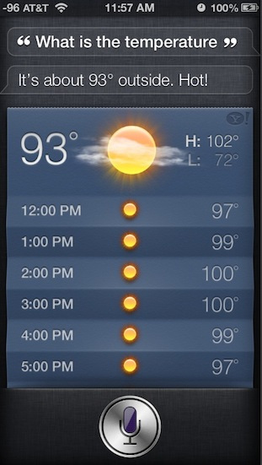
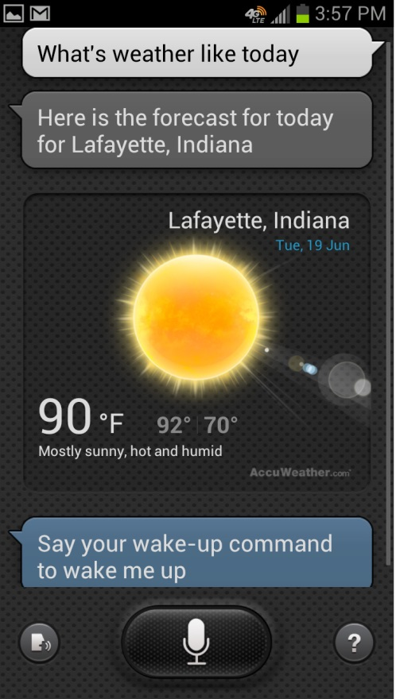
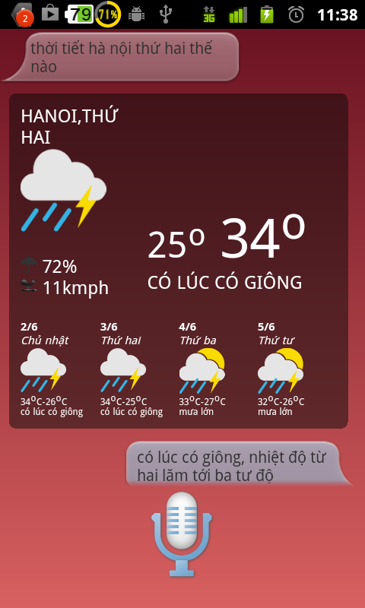

INTRODUCTION OF PROJECT
Vietnamese
SIRI English, French, German, Japanese, Chinese, Korean, Italian, Spanish
S-VOICE English, Arabic, French, Spanish, Korean, Italian, German
VIVA Vietnamese Voice Assistant

Slide 4
OBJECTIVES
Building the VIVA application on Android OS with abilities:
Recognize Vietnamese speech
Understand users’ commands
Perform functions: SMS, answer information
Respond to users with voice

Slide 5
MY TASKS
Nguyễn Duy Bình | Design the infrastructure of VIVA Implement the functional module about SMS Resolve the problem: automatic diacritics restoration for SMS content
Nguyễn Hữu Hiển | Voice Automatic Detection Recording module
Nguyễn Thanh Tùng | Speech recognition module
Nguyễn Văn Hiếu | Command understanding module
Nguyễn Văn Bảo | Improve quality of text to speech module Implement the functional module about responding information

Slide 6
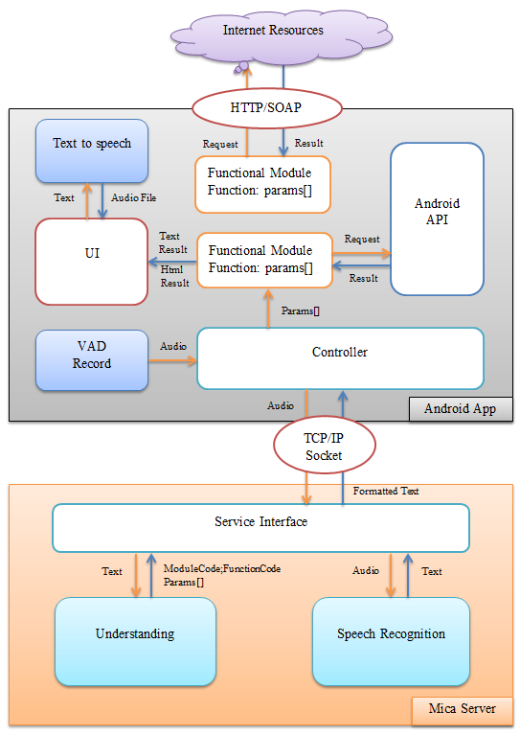

VIVA INFRASTRUCTURE

Slide 7
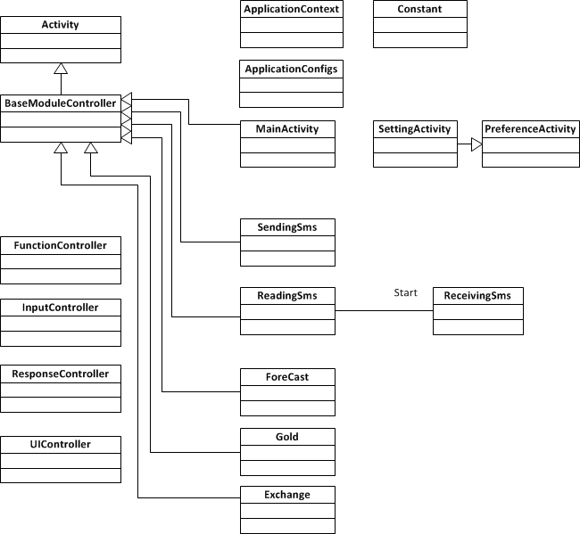
CLASS DIAGRAM (main classes)

Slide 8
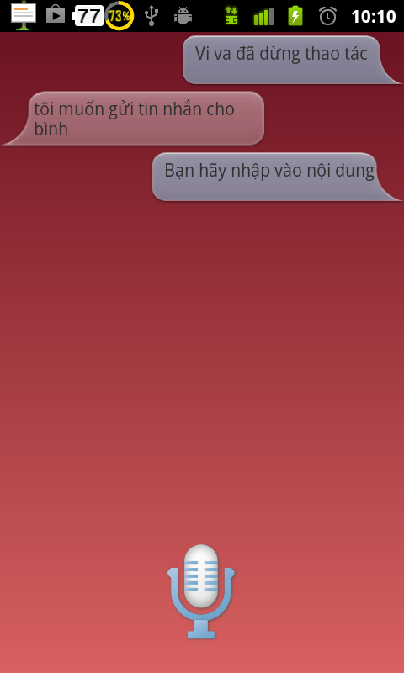
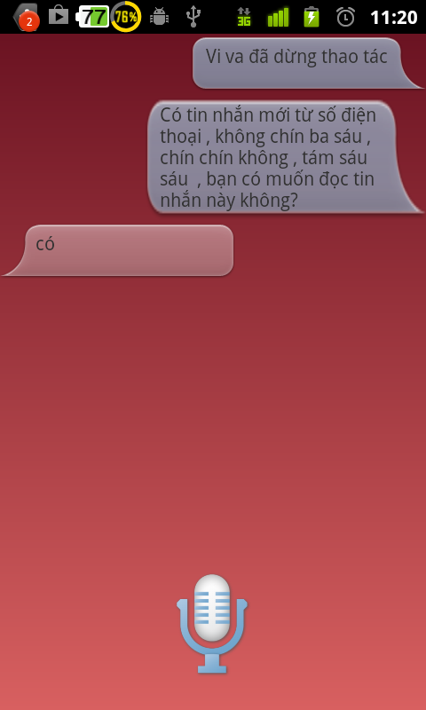
FUNCTIONAL MODULE SMS
Sending a SMS
Notice, read an incoming SMS

Slide 9
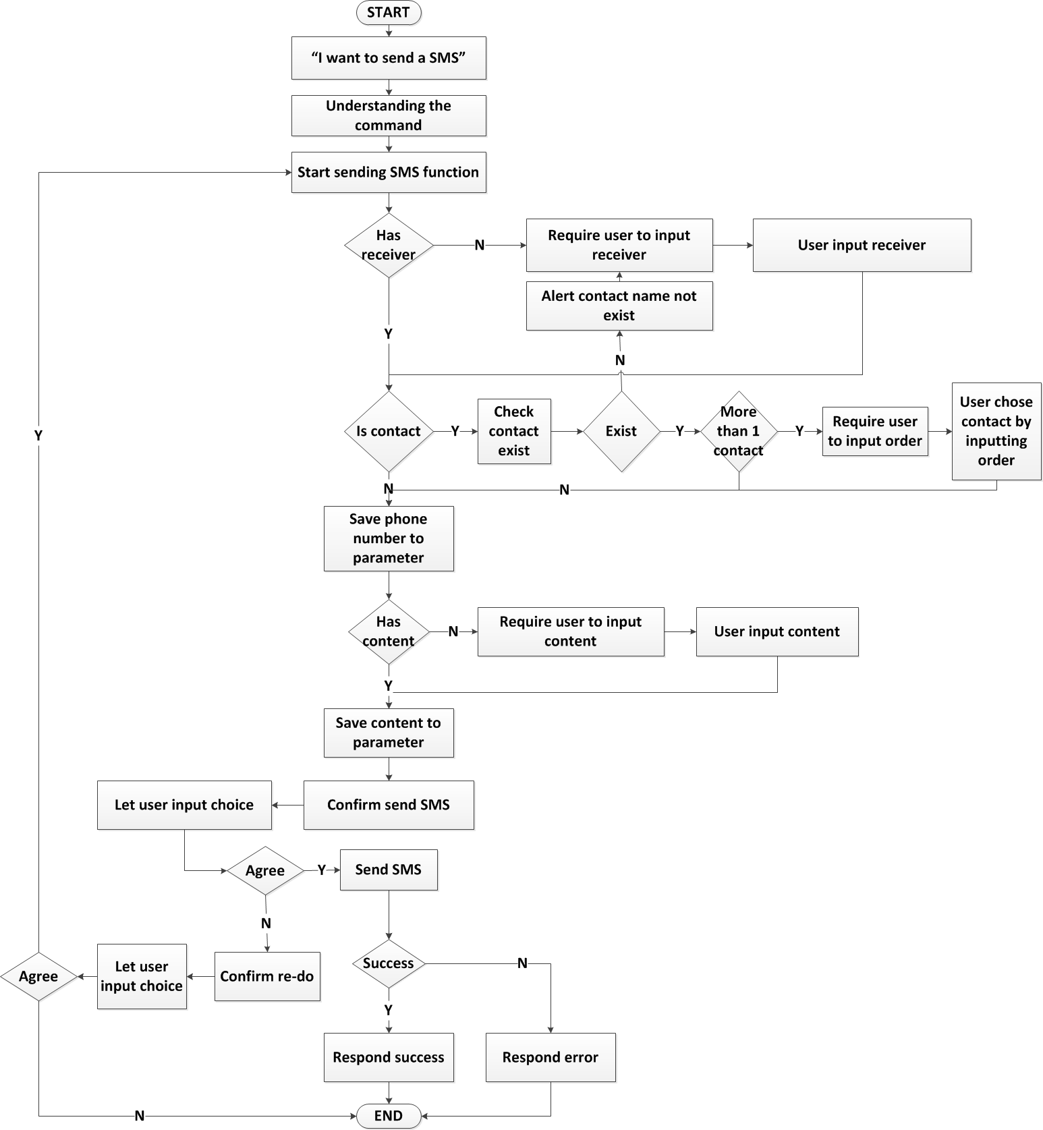
SENDING A SMS

Slide 10
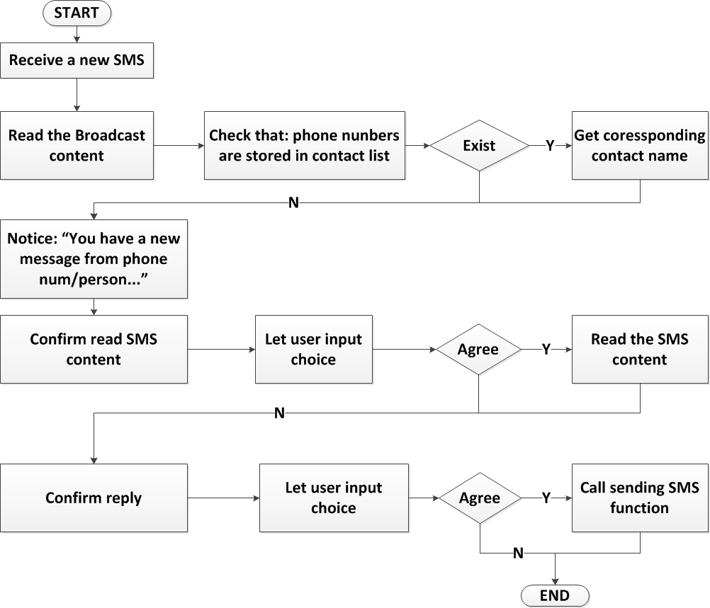
READ THE INCOMING SMS

Slide 11
AUTOMATIC RESTORATION DIACRITICS FOR VIETNAMESE TEXTS
IMPORTANT
>36 languages have diacritics: French, Croatian, Romanian, Sindhi…Vietnamese
Many missing diacritic texts in the internet (email, chat, comment), mobile phone (SMS, Note)
DIFFICULT
So many words contain diacritics: 95% words in Vietnamese, whereas 15% in French, 35% in Romanian.
So ambiguous: 80% of missing diacritics are ambiguous in Vietnamese, whereas 50% in French, 25% in Romanian

Slide 12
STANDARD APROARCHES
WORD-BASES
Based on language models, words processing tasks: tokenization, tagging…
Advantage: high accuracy rate
Disadvantage:
Language dependent
Required large lexical corpus
Slowly
CHARACTER-BASES
Based on statistical information on n-gram extracted from the training corpus.
Advantage:
Language independent
Required simple corpus
Very fast
Disadvantage: low accuracy rate for languages which diacritics depend on sematic roles

Slide 13
MACHINE TRANSLATION (MT) APPROACH
Basic Idea: consider non-diacritics Vietnamese as a new language, use a MT system to translate texts in this language to standard Vietnamese.
MT system: MOSES – the open source statistical MT (ww.statmt.org/moses/)

Slide 14
STATISTICAL MACHINE TRANSLATION

Slide 15

EXPERIMENT
Internet resources
Crawler
SETUP MOSES
70.000 Vietnamese sentences
Training corpus 60.000
TRAINING
Parallel Corpus
Remove diacritics
TESTING
Test 10.000
70.000 non-diacritic sentences
BUILD MOSES SERVER
LINUX SERVER
“xin chao”
“xin chào”
Socket
Package com.mica.viva.diacritic

Slide 16
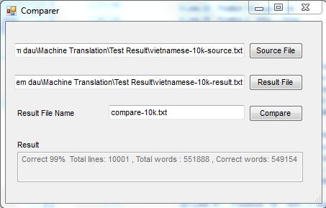
EVALUATION
Comparison WORD-BY-WORD: 99.5%
BLEU Score: 97.49
Vietnamese-10k-source
Vietnamese-10k-test
MOSES
Vietnamese-10k-result
VIVA | 99.5%
VIETMARKER | 93%
LƯU TUẤN ANH | 91.4%
compare-10k

Slide 17
EVALUATION
Main Goals:
Highest accuracy rate ever published
Implement for other languages easily
Extend MT approach for recover abbreviations and misspellings texts
Limitation:
Current corpus is missing conversation data: chat, SMS…
Cumbersome, Client-Server model → required internet, respond slowly for many request from many clients at the same time.

Slide 18
SUMMARY
Developed VIVA demo version with abilities:
Speech recognition
Understand users’ command
Perform functions: SMS, answer information
Response to users by voice
DEVELOPMENT:
Extend speech recognition & understanding modules
Develop more functions
Add conversation data into training corpus of MT system
Read SMS content that contains abbreviations and misspellings texts: experiment the MT approach.

Slide 19
REFERENCES
[1] Do Thi Ngoc Diep, Nguyen Duy Binh, Tran Do Dat, Mac Dang Khoa, “Machine Translation Approach for Vietnamese Diacritic Restoration”, IALP, 2013.
[2] http://en.wikipedia.org/wiki/Siri_(software) truy cập lần cuối ngày 01/06/2013.
[3] http://www.statmt.org/moses truy cập lần cuối ngày 01/06/2013.
[4] Philipp Koehn, Franz Josef, Daniel Marcu. “Statistical Phrase-Based Translation”, Conference of the North American, Chapter of the Associat ion for Computational Linguist ics on Human Language technology - Volume 1, 2003
[5] Tufiş, D., Chiţu, A. “Automatic Insertion of Diacritics in Romanian Texts”. Proceedings of the 5th Int ernat ional Workshop on Comput at ional Lexicography COMP LEX, P ecs, Ungaria, 1999,185-194
[6] Rada Mihalcea, Vivi Nastase, “Letter Level Learning for Language Independent Diacrit ics Restoration ”, In: P roceedings of CoNLL 2002.
[7] Simard, M. “Automatic Insertion of Accents in French Texts”. In Ide & Vuotilainen (eds) P roceedings of the Third Conference on Empirical Methods in Natural Language Processing, Granada, Spain, 27-35, 1998
[8] Luu Tuan Anh, Kazuhide Yamamoto , “A P oint wise Approach for
Viet namese Diacritics Rest oration”, in proceedings of IALP, 2012

Slide 20
THANKS FOR YOUR ATTENTION

