Slide 1

NYU TANDON CAREER HUB · FALL 2026
Data Science Bootcamp
Week 4 · SQL Fundamentals
Instructor: Angelin Ann Jacob
Section 1 · Tue Oct 20
Section 2 · Thu Oct 22
Notes:
Welcome to Week 4. Last week we explored one table with pandas. Real data usually lives in a database, spread across many connected tables, and SQL is how we ask it questions. Today's data: every LEGO set, theme, part and color. Same format as last week: predict, write the query, post in the Zoom chat.

Slide 2
Useful Links
Zoom
Brightspace
GitHub
All sessions are virtual. Use ONLY your NYU SSO Login to be considered for attendance
Assignments, submissions and the discussion board, monitored Monday to Thursday.
Slides and Colab notebooks for every session.
Email
1:1 coaching
datasciencebootcamp@nyu.edu for questions, extensions and attendance approvals.
Optional 30-minute technical interview prep. Book it through Handshake.
Data Science Bootcamp · Fall 2026
2
Notes:
Quick reminder: log in to Zoom with your NYU SSO so attendance counts. Slides and the Colab notebook are on GitHub; the take-home is submitted on Brightspace.

Slide 3
SQL Fundamentals
Ask a database a question, get a table back!
Data Science Bootcamp · Fall 2026
Notes:
SQL is the most requested skill in data job postings after Python. Almost every company keeps its data in a database, and SQL is the shared language for reading it: SQLite, PostgreSQL, BigQuery, Snowflake all speak it.

Slide 4
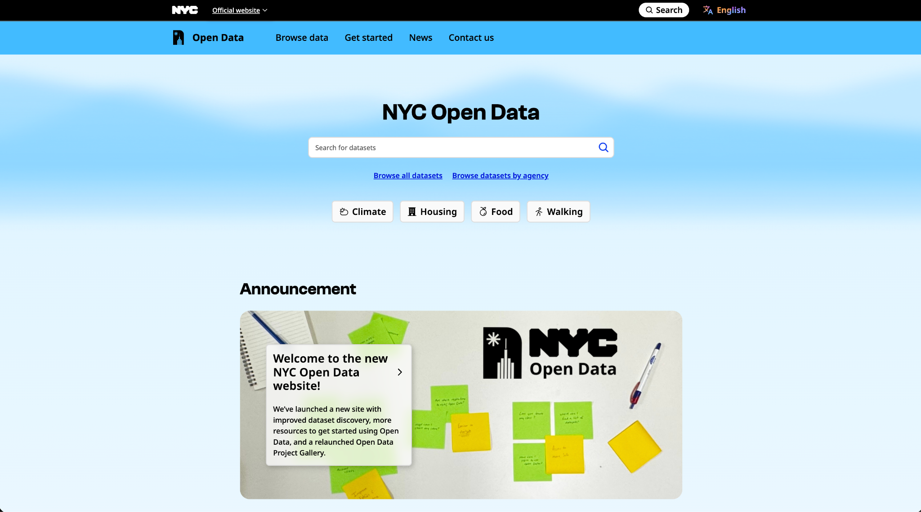
LEGO
Database
kaggle.com/datasets/rtatman/lego-database
Dataset name: LEGO Database, 8 connected tables (Kaggle, Rachael Tatman)
Data Provided By:
Rebrickable, a community catalog of every official LEGO set
Size: 11,673 sets, 614 themes, 135 colors, 580,251 part rows, 1950 to 2017
Visit: rebrickable.com/downloads
4
Data Science Bootcamp · Fall 2026
Notes:
Our dataset: the LEGO Database on Kaggle, collected by Rebrickable. Eight tables: sets, themes, parts, colors and the inventories that link them. The chart is sets released per year: from a handful in the 1950s to a peak of 713 in 2014. The orange bar, 2017, looks like a crash, but the snapshot was taken during 2017. Keep that in mind: it comes back in Data Story 2.

Slide 5
HOW TO READ TODAY'S SESSION
Predict, code, share
PREDICT
YOUR TURN
Guess before you run
Write the query, then share
Post your guess in the Zoom chat, then run the cell and compare.
How many sets have more than 5,000 parts? Which theme has the most sets?
Post your answer in the Zoom chat.
Hint open it if you are stuck
Answer open it only to check
EXAMPLE
SELECT name FROM sets
ORDER BY num_parts DESC LIMIT 1
Story: Which set has the most parts?
Data Science Bootcamp · Fall 2026
‹#›
Notes:
Same routine as last week. Predict: post a guess in the chat before running. Your turn: write the query in the empty cell and post your answer. Hints and answers are hidden in collapsible tags. Insights stay hidden until you have posted your own. Every query goes inside run(""" ... """).

Slide 6
Today's plan: from one table to many
1 · Databases
2 · Select & filter
3 · Summarize
4 · Join
5 · Put together
Tables, keys and the LEGO map. Loading the data.
SELECT, WHERE, ORDER BY. Data Story 1: the largest sets.
GROUP BY, HAVING, CASE WHEN. Data Story 2: are sets getting bigger?
Combine tables. Data Stories 3 and 4: themes and colors.
WITH, the order SQL runs in, common mistakes.
Data Science Bootcamp · Fall 2026
Notes:
Five short parts. Each starts with one slide, then we switch to the notebook and write the queries. Four Data Stories run through it. Exercises at the end of each section are the take-home.

Slide 7
SECTION 1 · RELATIONAL DATABASES
Eight tables, linked by keys
themes
sets
inventories
PRIMARY KEY
id name
parent_id
set_num year
theme_id num_parts
id version
set_num
sets.set_num
one unique value per row
FOREIGN KEY
part_categories
parts
inventory_parts
sets.theme_id → themes.id
id name
part_num name
part_cat_id
inventory_id
part_num color_id
points to a row in another table
THE TOOL
23
sets point to one theme row: Sculptures
Store once, link many times.
colors
SELECT name, year
FROM sets
LIMIT 5 -- say what, not how
id name
rgb is_trans
Data Science Bootcamp · Fall 2026
‹#›
Notes:
Section 1. A relational database splits data into tables that point to each other. Each table has a primary key, one unique value per row, like set_num. A foreign key, like theme_id, points to the primary key of another table. The arrows on the map go from the foreign key to the key it points to. Why split? The theme name Sculptures is stored once, and 23 sets just store its id. SQL is declarative: you say what you want, the database works out how. Switch to the notebook: Section 1, load the tables.

Slide 8
SECTION 2 · SELECTING AND FILTERING
Pick the columns, then keep the rows
SELECT keeps columns WHERE keeps rows
THE TOOL
name
year
num_parts
theme_id
SELECT name, year, num_parts
FROM sets
WHERE num_parts > 5000
-- 4 sets
Taj Mahal
2008
5,922
276
Black Seas Barracuda
1989
915
148
Window Exploration Bag
2010
5,200
507
Train
1964
253
380
WHERE TOOLKIT
Millennium Falcon - UCS
2007
5,195
174
= <> >=
AND OR
BETWEEN
Big Ben
2016
4,166
43
IN (...)
LIKE '%Train'
IS NULL
Real rows from sets. Only 4 of 11,673 sets have more than 5,000 parts.
Text goes in 'single quotes'.
Missing values: IS NULL, never = NULL.
Data Science Bootcamp · Fall 2026
‹#›
Notes:
Section 2. Every query starts with SELECT, which columns, and FROM, which table. WHERE then keeps only the rows that pass a test. On the left: purple columns are selected, orange rows pass the filter. Only 4 sets have more than 5,000 parts. The toolkit chips are the operators we use today. LIKE uses % for any characters. NULL means unknown, so nothing equals it: always IS NULL. Ask: how many sets have more than 5,000 parts? Then notebook Section 2, Your turn 1 to 3.

Slide 9
SECTION 2 · SORTING · DATA STORY 1
The largest LEGO sets ever made
THE STORY
Which set has the most parts?
Taj Mahal: 5,922 parts, one of only 4 sets above 5,000.
THE TOOL
SELECT name, year, num_parts
FROM sets
ORDER BY num_parts DESC
LIMIT 10
READ THE ROWS
2 of the top 3 are bags of bricks.
Data Science Bootcamp · Fall 2026
‹#›
Notes:
Data Story 1. ORDER BY sorts, DESC puts the largest first, and LIMIT keeps the top rows: that is every top N question. Before showing the chart, ask for guesses in the chat. The Taj Mahal wins with 5,922 parts. But read the rows: the gray bars are a promotional mosaic, a classroom bag of bricks and a custom mosaic. A sorted list is only the start. Notebook: Data Story 1 and Your turn 4, the 1980s.

Slide 10
SECTION 3 · SUMMARIZING · DATA STORY 2
Are LEGO sets getting bigger?
Every set
GROUP BY year
COUNT(*), AVG(num_parts)
one row = one set
split into 66 groups, one per year
one summary row per year
4,425
sets in the 2010s, up from 132 in the 1950s
296
sets in 2017: an incomplete year, not a real drop
Data Science Bootcamp · Fall 2026
‹#›
Notes:
Section 3. Aggregates like COUNT and AVG turn many rows into one number. GROUP BY does it once per group, the same idea as groupby in pandas. Rule: every column in SELECT is either grouped or aggregated. Data Story 2: ask for a prediction first. Sets per decade went from 132 to 4,425, and the average set grew from 33 to 194 parts. But 2017 shows only 296 sets: the data was collected during 2017. Notebook: Data Story 2, Your turns 5 and 6.

Slide 11
SECTION 3 · SUMMARIZING
Filter groups, build categories
WHERE
filters rows, before grouping
WHERE num_parts > 0
HAVING
filters groups, after grouping
HAVING COUNT(*) > 500
YEARS WITH MORE THAN 500 SETS
THE TOOL
CASE WHEN num_parts < 100 THEN 'Small'
WHEN num_parts < 500 THEN 'Medium'
ELSE 'Large' END AS size
2011
2012
2013
2014
2015
2016
Peak: 713 sets in 2014
Data Science Bootcamp · Fall 2026
‹#›
Notes:
Two more tools. WHERE filters rows before they are grouped; HAVING filters the groups after they are counted, so any condition on COUNT or AVG goes in HAVING. Only six years have more than 500 sets, all from 2011 to 2016. CASE WHEN works like if, elif, else: it turns a number into a label. Most sets are small: 7,241 have fewer than 100 parts. Notebook: HAVING and CASE WHEN, then Exercises 3 and 4 for homework. Good moment for a short break.

Slide 12
SECTION 4 · COMBINING TABLES
JOIN: follow the key to the other table
sets AS s
themes AS t
result
name
theme_id
id
name
set
theme
Taj Mahal
276
174
Star Wars Episode 4/5/6
Taj Mahal
Sculptures
Tower Bridge
276
276
Sculptures
Tower Bridge
Sculptures
Millennium Falcon - UCS
174
507
Educational and Dacta
Millennium Falcon - UCS
Star Wars Ep. 4/5/6
Window Exploration Bag
507
36
Fire
Window Exploration Bag
Educational and Dacta
Fire: no sets attached
JOIN
keeps rows that match in both
LEFT JOIN
keeps every left row
FROM sets AS s
JOIN themes AS t
ON s.theme_id = t.id
FROM themes AS t
LEFT JOIN sets AS s ON ...
WHERE s.set_num IS NULL -- 39
Data Science Bootcamp · Fall 2026
‹#›
Notes:
Section 4. sets only stores a theme_id like 276. The name lives in themes. JOIN matches rows where s.theme_id equals t.id: follow the colors. Two sets can match the same theme. The aliases s and t say which table each column comes from, since both tables have a name column. A plain JOIN drops rows with no match, like the Fire theme. LEFT JOIN keeps every row of the left table and fills the gaps with NULL: that is how we find the 39 themes with no sets. Notebook: Section 4, INNER JOIN, then Data Story 3.

Slide 13
SECTION 4 · DATA STORIES 3 AND 4
What LEGO builds most: themes and colors
DATA STORY 3
DATA STORY 4
JOIN themes AS t ON s.theme_id = t.id
GROUP BY t.name -- Technic: 435
JOIN colors AS c ON ip.color_id = c.id
SUM(ip.quantity) -- Black: 391,036
Data Science Bootcamp · Fall 2026
‹#›
Notes:
Data Story 3: JOIN plus GROUP BY ranks the themes. Ask for guesses first. The winner, Supplemental, is packs of spare bricks, not a product line; Technic, City and Friends are the largest real lines. A ranking is only as good as its categories. Data Story 4: joining inventory_parts to colors. Black wins by far. The chart uses the rgb column, so every bar is its real LEGO color. In the notebook we then follow four tables to count colors per decade: 15 in the 1950s, 117 in the 2000s. Your turns 7 and 8.

Slide 14
SECTION 5 · PUTTING IT TOGETHER
SQL runs in a different order than you write it
YOU WRITE
SELECT
FROM
WHERE
GROUP BY
HAVING
ORDER BY
LIMIT
SQL RUNS
1 FROM
2 WHERE
3 GROUP BY
4 HAVING
5 SELECT
6 ORDER BY
7 LIMIT
SELECT runs fifth, so WHERE cannot use COUNT(*): the groups do not exist yet.
WITH: NAME A STEP
SPOT THE BUG
WITH yearly AS (
SELECT year, COUNT(*) AS n
FROM sets GROUP BY year
)
SELECT AVG(n) FROM yearly -- 177
SELECT year, COUNT(*)
FROM sets
WHERE COUNT(*) > 500
GROUP BY year
Error: misuse of aggregate. Fix: move it to HAVING.
Data Science Bootcamp · Fall 2026
‹#›
Notes:
Section 5. We write SELECT first, but the database runs FROM first and SELECT fifth. That one fact explains the most common SQL error: a COUNT in WHERE. WITH, a common table expression, lets you name a step at the top and use it like a table, so a long query reads top to bottom like a script. Ask: what is wrong with the query on the right? Notebook: Section 5, Your turns 9 and 10.

Slide 15
SECTION 5 · DRAWING INSIGHTS
What we learned today
THE INSIGHT
THE EVIDENCE
The biggest sets are not always models
Taj Mahal: 5,922 parts; 2 of the top 3
are bags of bricks
LEGO makes more sets, and bigger ones
132 sets in the 1950s, 4,425 in the 2010s;
average size 33 to 194 parts
Always check where the data ends
2017 has only 296 sets:
the snapshot stops mid-year
Black is LEGO's most used color
391,036 pieces; the palette grew
from 15 to 117 colors
Data Science Bootcamp · Fall 2026
‹#›
Notes:
Wrap-up. Ask: which insight surprised you most? One sentence in the chat. Each insight is short and backed by a number from a query we wrote. Limitation: this snapshot ends in 2017 and counts sets, not sales, so it tells us what LEGO released, not what people bought.

Slide 16
Before next week
Take-home
Feedback form
Week 5: Presentations
Exercises 1 to 6 in today's notebook. Submit on Brightspace within one week, by 11:59 PM.
Fill it out after today's session. It counts toward your credential.
Mid-program project presentations and feedback. Tue Oct 27 / Thu Oct 29.
Data Science Bootcamp · Fall 2026
Notes:
Take-home: Exercises 1 to 6 in the notebook, due on Brightspace within one week. Exercise 6 is your own LEGO question with at least one JOIN and one GROUP BY. Please fill out the feedback form. Next week: mid-program project presentations.

