Slide 1
Predicting Heart Disease
Metis Data Science Bootcamp Pilot 2
Lucas Barros
Jeff Carpenter
Steven Li
Yun Zeng

Slide 2
We started with data from 4 different hospitals, with different missing data distribution
Location | # Obs | # Healthy | Notes
Cleveland | 303 | 164 | Almost no missing data
VA | 200 | 51 | ‘ca’ and ‘thal’ feature data is mostly missing; several other predictors have high missing rates
Switzerland | 123 | 8 | ‘ca’ and ‘thal’ feature data is mostly missing ‘chol’ feature is unary (at zero)
Hungary | 294 | 188 | ‘ca’ and ‘thal’ are mostly missing

Slide 3
We considered different options for dealing with missing data
Option 1: Impute missing data points to mean or zero
Maximizes the number of data points available
Low confidence in accuracy of imputations
Option 2: Drop ‘ca’ and ‘thal’ as features, and use all observations that are non-missing on the remaining predictors
Yields a large number of data points
Sacrifices any predictive power carried by ‘ca’ and ‘thal’
Option 3: Drop observations with any missing values
Includes a very small number of observations from locations outside cleveland
Uncertain as to consistency of interpretation across locations
Option 4: Use Cleveland data only
Option yields fewest observations
High confidence in interpretability of inputs
Precedent in existing research for using Cleveland data only
Selected approach

Slide 4
Initial feature evaluation showed that the ‘ca’ and ‘thal’ features may have significant predictive value
Feature | Description | chi² | P-value
age | Age in years | 22.9177 | 1.69E-06
sex | Sex (1=male; 0=female) | 7.444195 | 0.006364
cp | Chest pain type (1,2,3=chest pain; 4=no chest pain) | 14.59159 | 0.000134
trestbps | Resting blood pressure | 16.70746 | 4.36E-05
fbs | Fasting blood sugar > 120 mg/dl (1=yes; 0=no) | 0.002547 | 0.959747
restecg | Resting ECG results (0=normal; 1,2=abnormal) | 8.134652 | 0.004343
thalach | Maximum heart rate achieved | 187.0531 | 1.40E-42
exang | Exercise-induced angina (1=yes; 2=no) | 35.50809 | 2.54E-09
oldpeak | ST depression induced by exercise relative to rest | 68.57053 | 1.22E-16
slope | Slope of peak exercise ST segment (1=upsloping; 2=flat; 3=downsloping | 7.828836 | 0.005142
ca | Number of major vessels colored by flourosopy | 82.73061 | 9.40E-20
thal | Thal (3=normal; 6=fixed defect; 7=reversable defect) | 65.22109 | 6.69E-16
treated_chol | Serum cholesterol in mg/dl (floored at 190) | 21.08863 | 4.39E-06
low_chol_ind | Cholesterol <190 mg/dl (1=yes; 0=no) | 0.62677 | 0.428543

Slide 5
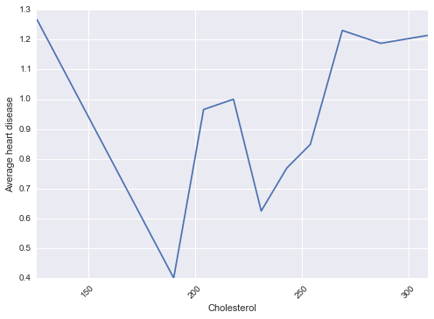
After viewing univariate view of cholesterol against heart disease, we floored cholesterol at 190 and created a “chol<190” indicator

Slide 6
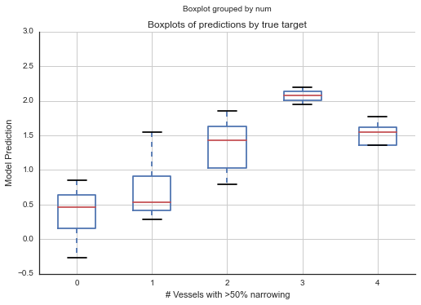
After initial modeling results, we decided to focus on identifying heart disease, regardless of severity
Make our target whether the patient has heart disease (1, 2, 3, 4) or not (0) for “num” (i.e. classification instead of regression)
We felt it was most important to be correct on predicting whether a patient had heart disease or not rather than the severity of their heart disease

Slide 7
Logistic Regression Model Coefficients
Feature | Description | Coefficient
age | Age in years | -0.03731
sex | Sex (1=male; 0=female) | 0
cp | Chest pain type (1,2,3=chest pain; 4=no chest pain) | 0.417361
trestbps | Resting blood pressure | 0.016247
fbs | Fasting blood sugar > 120 mg/dl (1=yes; 0=no) | 0
restecg | Resting ECG results (0=normal; 1,2=abnormal) | 0.310341
thalach | Maximum heart rate achieved | -0.03585
exang | Exercise-induced angina (1=yes; 2=no) | 0
oldpeak | ST depression induced by exercise relative to rest | 0.110894
slope | Slope of peak exercise ST segment (1=upsloping; 2=flat; 3=downsloping | 0
ca | Number of major vessels colored by flourosopy | 0.990362
thal | Thal (3=normal; 6=fixed defect; 7=reversable defect) | 0.494825
treated_chol | Serum cholesterol in mg/dl (floored at 190) | 0.000999
low_chol_ind | Cholesterol <190 mg/dl (1=yes; 0=no) | 0
Lasso regularization (optimal parameter 0.19 chosen by 4-fold cross-validation)

Slide 8
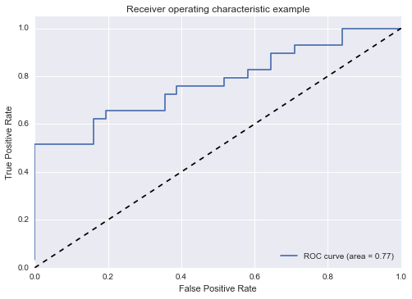
Logistic Regression ROC curve

Slide 9
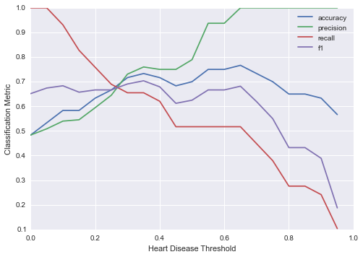
We can adjust our decision threshold depending on how we weight accuracy vs. recall importance; optimal accuracy is around 0.75

Slide 10
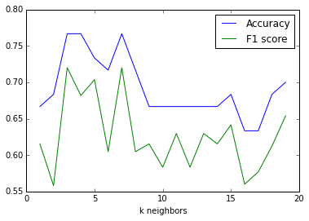
K nearest neighbors performance by parameter k

Slide 11
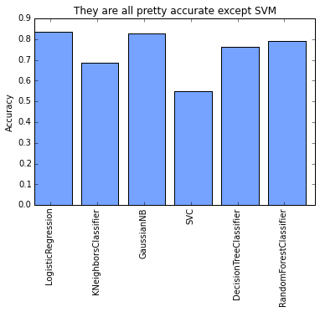
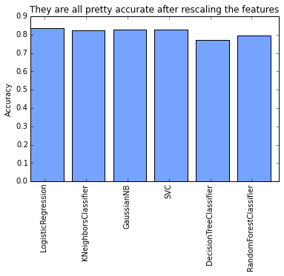
Feature scaling has a large impact on model performance
Without scaling
With scaling
Low SVM performance may be due to not having enough time to properly tune the model parameters

