Slide 1
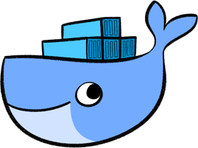
DOCKER
Container as a service

Slide 2
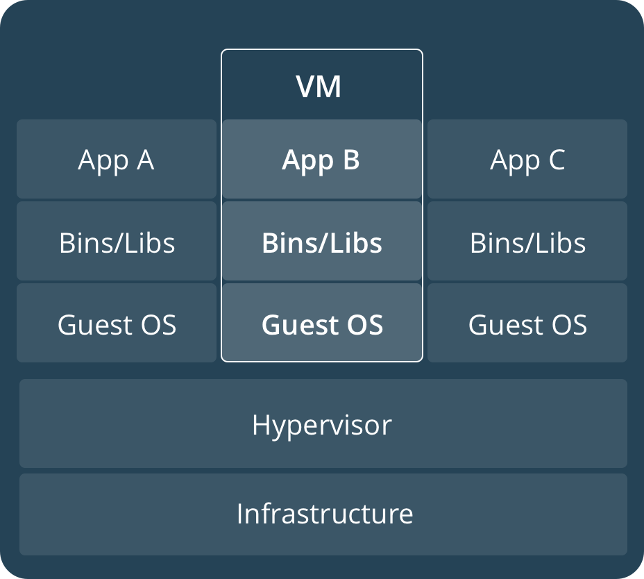
What is a VM?
Virtual machines (VMs) are an abstraction of physical hardware turning one server into many servers. The hypervisor allows multiple VMs to run on a single machine.
Each VM includes a full copy of an operating system, one or more apps, necessary binaries and libraries - taking up tens of GBs. VMs can also be slow to boot.

Slide 3
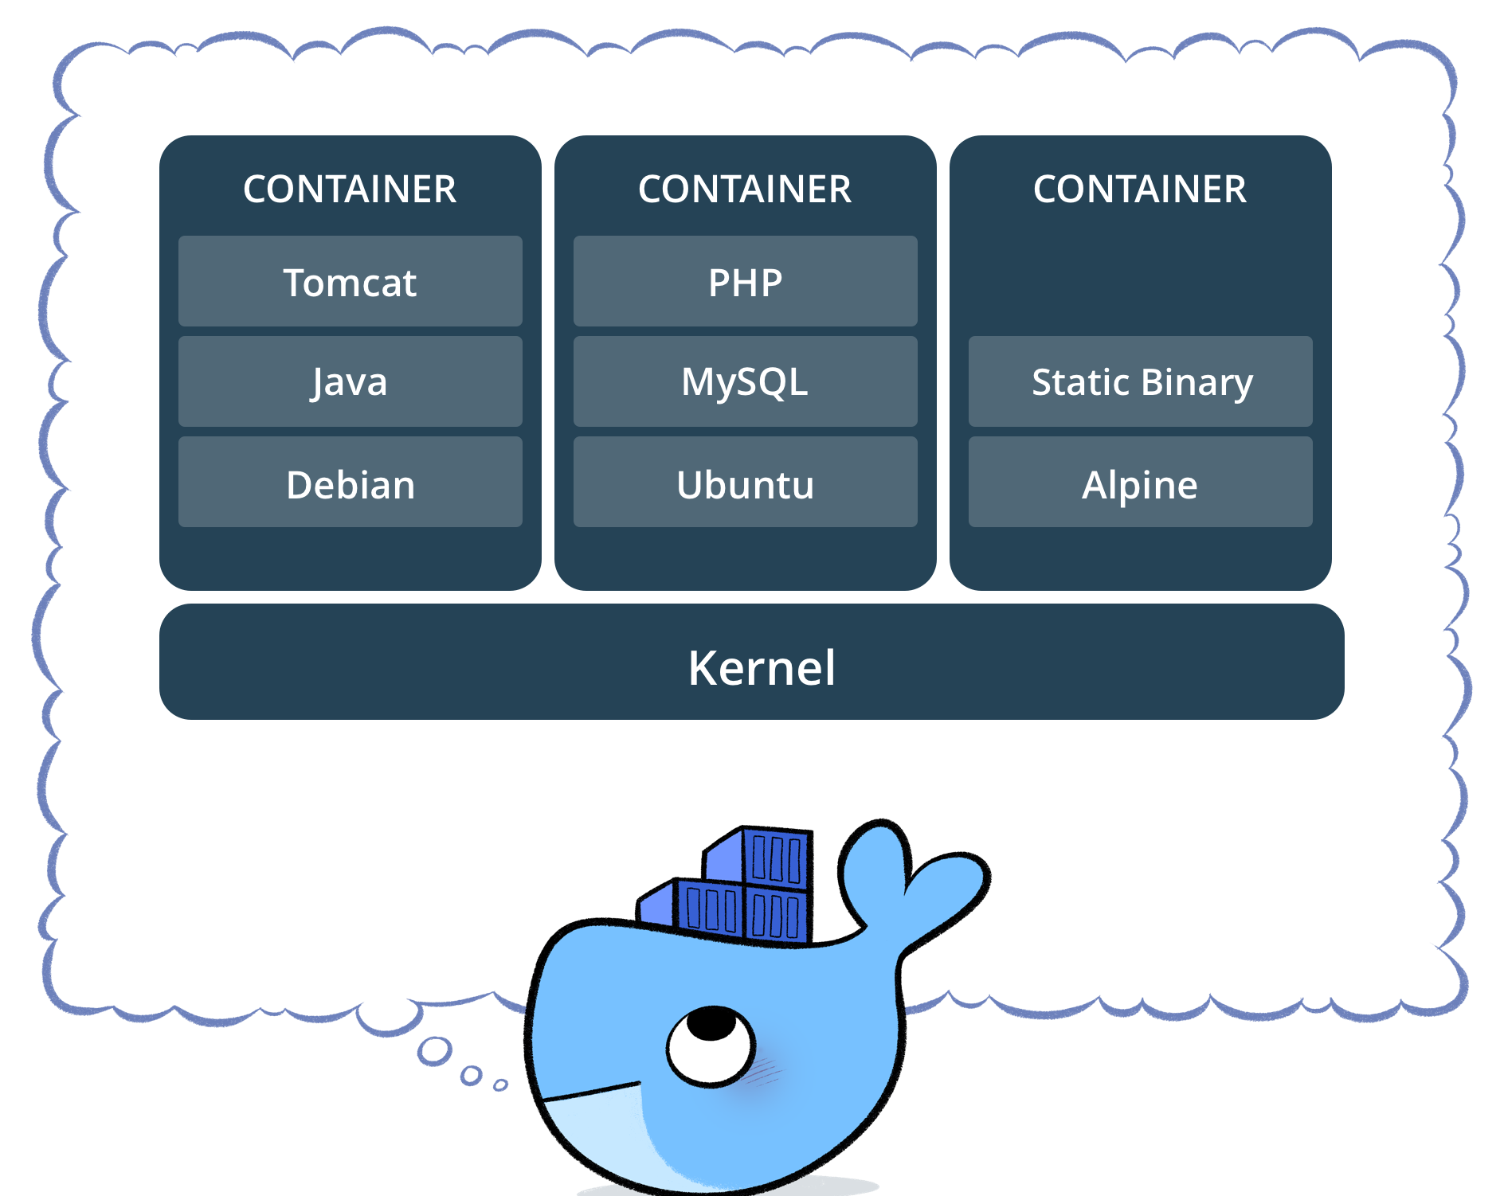
What are Containers?
Containers are an abstraction at the app layer that packages code and dependencies together.
Multiple containers can run on the same machine and share the OS kernel with other containers, each running as isolated processes in user space.
Containers take up less space than VMs (container images are typically tens of MBs in size), and start almost instantly.
Notes:
Containers are a very old concept. Unix V7, FreeBSD, Linux Vserver, Solaris Containers, LXC…
LXC(Linux containers was the first, most complete implementation of Linux container manager

Slide 4
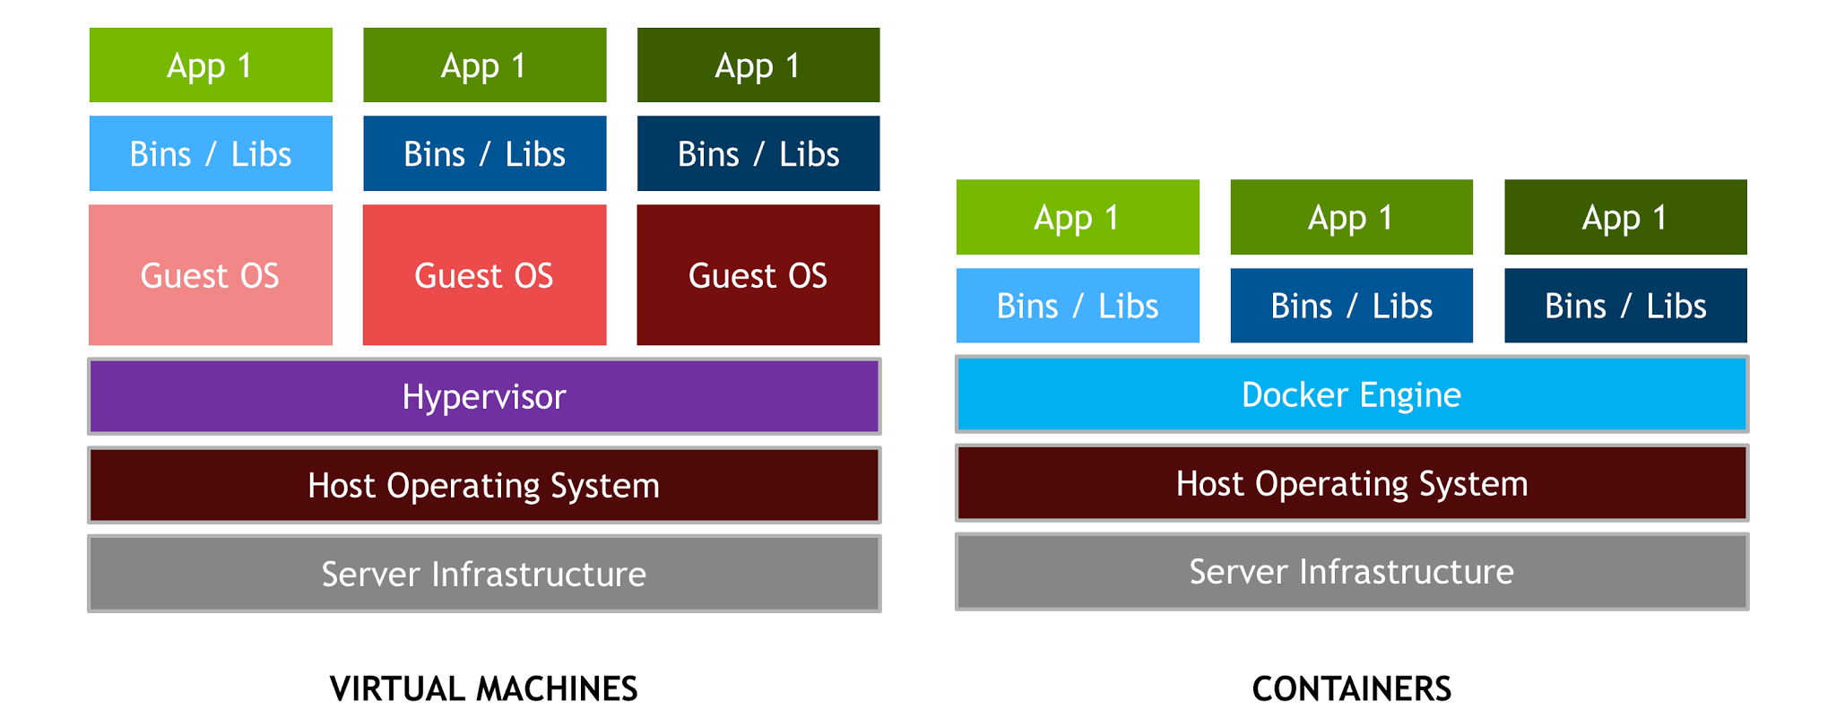
Containers vs Virtual Machines

Slide 5

HMB. We are just getting started...
Thing you should know about docker.
Image
Container
Docker CMD
Docker hub
Docker store

