Slide 1


Microsoft TokenTV
Microsoft .NET meets TV

Slide 2
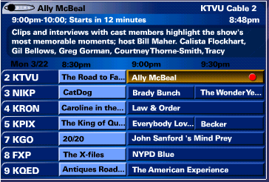


1st Generation PVR’s
Grid based EPG
Remote
Closed proprietary box

Slide 3
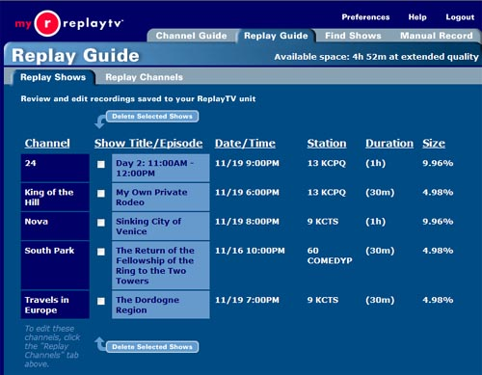
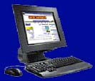
2nd Generation: Web Portals for PVR’s
My Replay.com
Web EPG
Closed proprietary box
Web enabled
programming

Slide 4
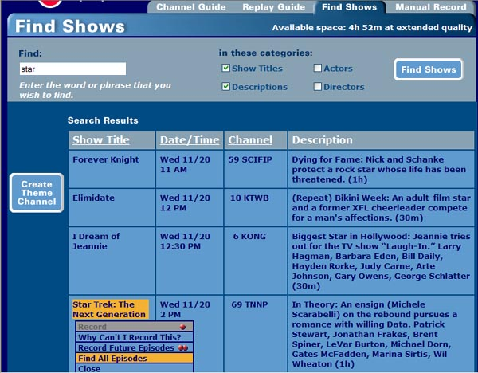
2nd Generation: Web Portals for PVR’s
Web EPG
Closed proprietary box
Web enabled
programming

Slide 5
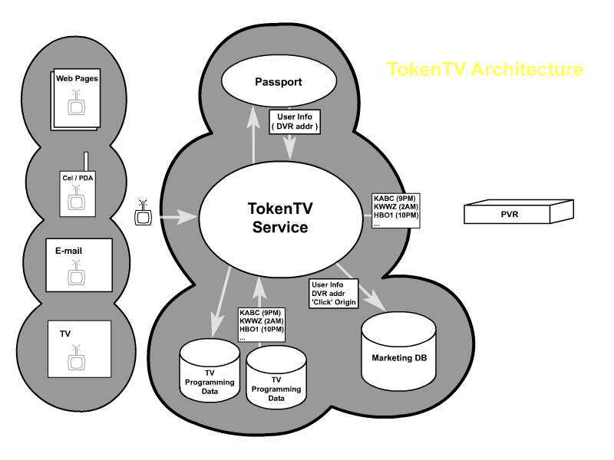
3rd Generation PVRs: Token TV Platform
.NET TokenTV service creates platform for 3rd parties to build Internet/TV program services on top of this platform

Slide 6
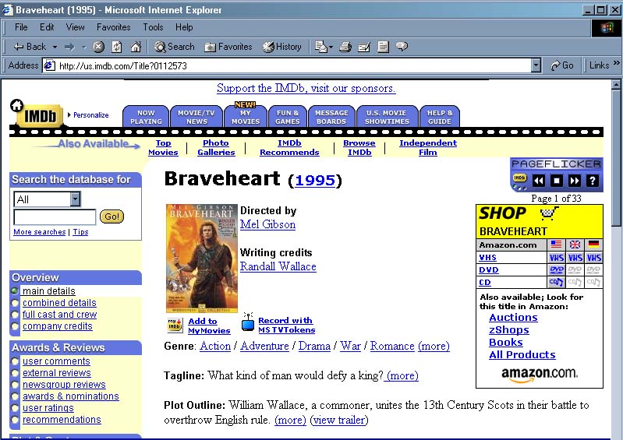
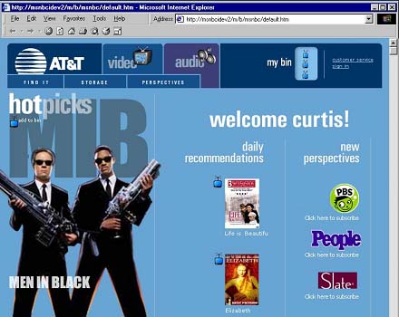
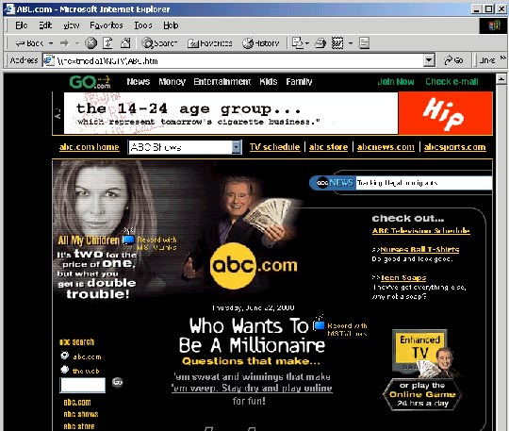
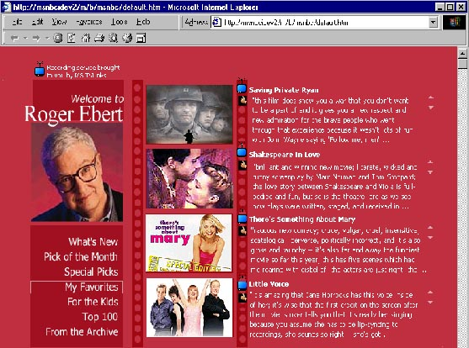
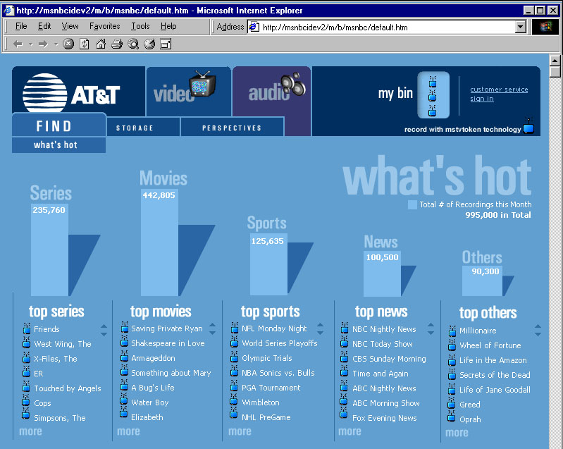
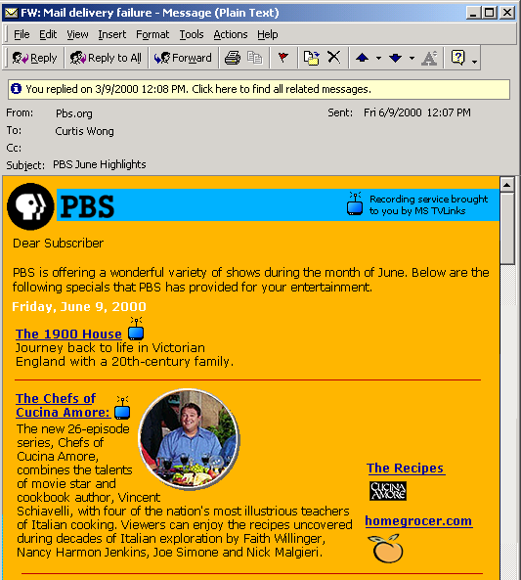
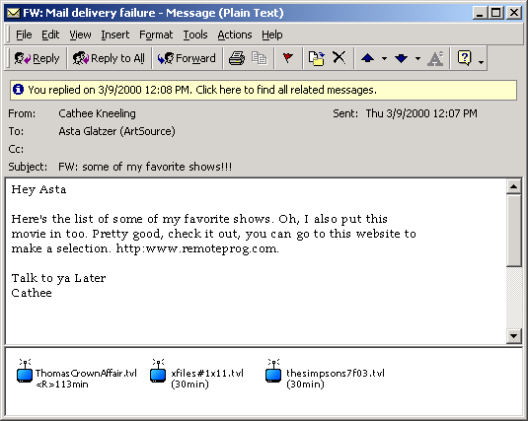
Benefits of Microsoft TokenTV
3rd Party Sites
MSO’s
Networks
Consumers

Slide 7
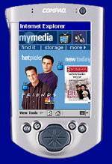

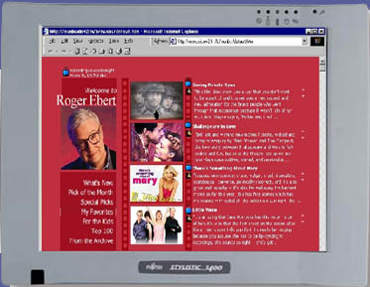
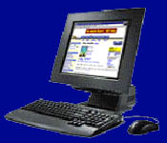
Scenarios – Cable providers
Program recommendation service
Branded MSO TV Website
  Show recommendations
Personalized content
  Collaborative filtering
  User modeling
Access via any device:
  Web PC
  Pocket PC
  Webphone
  Handheld wireless
New MSO service revenue
opportunities
Demo
Demo

Slide 8
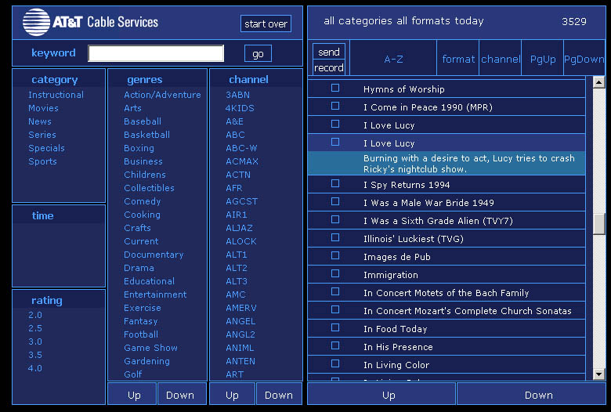
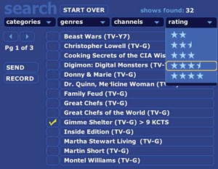
Scenarios – Cable provider benefits
New service opportunities
TV viewing statistics
  demographics
  content preferences
MSO Walled Garden
  Focused advertising
  Cross selling opportunities
    Direct marketing
    Related content sales
Next Generation PVR EPG
  Token enabled
  Non-grid/time based
  Designed for PVR program
  selection
  TV & PC Web UI prototypes
Demo

Slide 9
Scenarios – Broadcaster Audience Acquisition
Establishing a Direct Relationship with Viewer
Register to receive show
tokens in advance of air
  Movies
  Specials
  Series
Viewers can schedule shows
for entire season in advance
Sending promos with a token
Direct marketing for specific
TV shows
Customized “lead-in” slots
via Tokens instead of show
line-ups

Slide 10
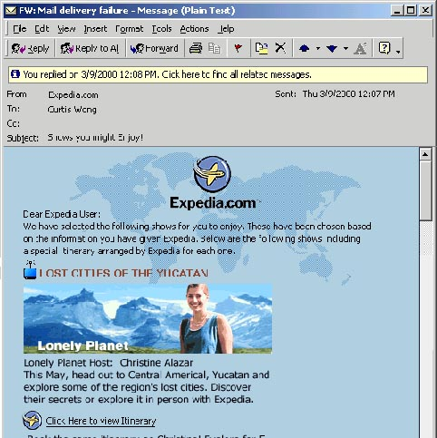
Scenarios – Broadcasters Revenue Opportunities
New revenue opportunities
Email about TV show with:
  TV Token
  Streaming preview
  Related content
  E commerce links

Slide 11
Broadcaster Benefits
Direct connection with viewers
  Knowing who they are, demographics,
  programs of interest
  Viewer direct program delivery
  Bridge to content delivery on demand
eCommerce opportunities
  Show related services
Advance viewer demographics
  Advance Neilsen ratings
New programming opportunities
  Enabling custom delivery of related shows

Slide 12
Scenarios - 3rd Party Opportunities
Empowering content sites with TokenTV
Empowering content
sites to deliver
  content via
  MS Tokens
  content related
  services and
  commerce
Any trusted source
can be a network
  Film Critics
  Friends
  Family
  Affinity groups
  Fan clubs

Slide 13
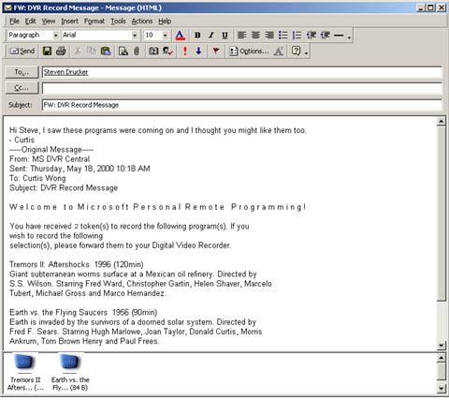
Scenarios - Consumer TV Program Sharing
Viral Marketing
TV programs can be
shared like Web links
Non-token enabled customers
can receive signup info
User share Tokens with
friends and family
Fan websites can enable
TV recording selections

Slide 14
Consumer Benefits
Simple “one click recording”
  From any MS TokenTV powered site
  Accessible by web or email device
Easy program sharing with family and friends
  No copyright issues from sharing
  Ease of use like web links
  Enabling anyone to be a “network”
  Enable others to recommend and deliver programming for you
New content selection/delivery services
  Commercial 3rd party TV program recommendation services
  Delivery of more relevant advertising and services

Slide 15
Microsoft Token TV system
MS TokenTV components
  1) Microsoft TV Tokens
  2) TokenTV Service
  3) TokenTV transport
  4) TokenTV enabled client

Slide 16
1) TV Tokens
A TV token is an object described in XML that contains a unique program ID (UPID) and a description for a specific TV show that is transportable by web and email
3rd parties can add tokens to their site by
  Getting them directly from MS TokenTV Service
  Authoring them using a standard schema
  Using a 3rd party automated Token creation tool

Slide 17
What is a TVToken?
Transportable object containing enough program information needed to record a TV show
Token Format
XML schema for uniquely identifying a television show
  Combination of data-provider/MSO ID and Program ID/data.
  Scheduled show will only require a UPID-Unique Program ID if show already exists in the broadcast database.
  Unscheduled show will require additional basic program data to match an unscheduled show (title, date, episode title, number, etc.)
  Extra fields for authentication, encryption, service hooks, etc.
  Define an independent standard schema so different sites do not need to query a central database of unique ID’s.
  Work with TVAnytime consortium on standard.
URL form: http://www.tokentv.microsoft.com?UPID=34f1c35ab3e?source=ms
XML form: Link to token specs and explanations of tradeoffs and choices

Slide 18
2) Token TV Service
Associates users with their PVR, their TV service provider and available channels
(can use Passport to store this information to allow for access by any device)
Translates the TVTokens into local program recording instructions
(can use existing TMS/TvData services for translation)
Enables enhanced services via TVTokens
(such as collaborative filtering, subscription management, collision resolution)
Creates individual and aggregate usage information
(program preferences, Token sources, user demographics)

Slide 19
3) Token TV Transport
Transport of the TVToken from the Web to the Service
  HTTP from Website to service
Transport of the record instruction (translated TV Token) from TokenTV Service down to the PVR
  Client specific communication:
  Different boxes need different communication strategies
    Intermittent connectivity via telephony
    Broadband data channel for Satellite, Cable Ops.
    TCP/IP over cable-modem/DSL for others

Slide 20
4) Token TV Enabled Clients
Want this to be in as many clients as possible
  WebTV boxes first target
    – Mercury 1.5 or Hollywood
  All MSTV PVR boxes
  Whistler – PC TV tuner card
Possible Third party client boxes
  Replay?
  TiVo?
  Others?

Slide 21
Microsoft Benefits
A new Microsoft.net TV platform opportunity
  Enabling 3rd party services using TokenTV technology
  Ties the TV platform to other MS.net strategies
  Opens delivery of TV programs to everyone
  Reason for choosing MSTV STB platform
  Enables TV program acquisition to anytime/any device
  Opportunities for TV related service revenue
  Leverages what Microsoft is good at – Building a platform
TokenTV enhanced services licensing revenue
  Broadcasters
  Advertisers
  Other PVR manufacturers

Slide 22


MS TokenTV Roadmap
Intellectual Property
6 Patents filed
PC prototype built
™ Search for TokenTV name
Enable Clients Side Remote PVR Programming
Announce TokenTV
Discovery
TokenTV service
Alliance w/ EPG data providers
Tribune Data
TV Data
Dogfood MS sites
Expedia
Carpoint
NYT.COM
TV Guide.COM
ABC
Charter
PBS
IMDB.COM
CBS
Rogers
HBO
NBC
ATT
FOX
Sign TokenTV Partners
Broadcasters
Web content sites
MSO’s

Slide 23
What can Microsoft do to get there first?
Platform Capability
    Build Token TV STB prototype – Mercury or Whistler STB
    Build remote programming capabilities into Microsoft TV platform roadmap
    Ease third party inclusion of tokens into websites (examples, specs, apps)
    Secure rights for EPG data from TV Data & Tribune
  Specs for Tokens, Client Transport and Service
    Work with standards groups for Content Reference ID
    Develop XML schema and architectures for tokens and transport
  TokenTV Service
    Create a Token TV service that allows registration of PTV specific information online (PVR ID, Zip code, cable system) similar to Passport Wallet
  Enable Microsoft Properties
    Enable Microsoft properties using Token TV – Car Point, MSN
  Licensing
    Secure licensing deals with broadcasters and content web sites to use Microsoft Token TV to enable “one click recording” and services

Slide 24
Background information

Slide 25
Next Media Token TV & PVR Timeline
Microsoft
March 30, 2000
Provisional Token TV
umbrella patent filed
Sept 18,1999
Remote PVR
First conception
MSR Next Media
August 28, 2000
7 Token TV patent applications filed
March 9, 2000
Token TV PC
XML PVR EPG prototype completed
July 21, 2000
Token TV gets green light from Jon DeVaan & Phil Goldman
Jan 15,2000
NGPTV 1.0 paper describing Token TV
May 25, 2000
First demonstration of working Token TV PC prototype
Jan
Feb
Mar
Apr
May
Jun
Jul
Aug
Sep
Oct
2000
June 30, 2000
AOL invests $200 million in TiVo
April 6, 2000
AOL publicly announces email remote VCR programming
August 8, 2000
Replay TV announces Web remote programming
Fall 2000
August 9, 2000
TiVo announces Web remote programming and services in 2001
Competition

Slide 26
PVR Related Patent Applications
Filed
149506.1 - NGPTV
(provisional - filed 3/30/00)
149506.2 - NGPTV
(full application)
150957.1 - Nielsen Ratings
150958.1 - Network Programming
150959.1 - PVR Functionality
(f/k/a Interactive/Personalized Advertising)
155613.1 - PC Filtering EPG
155614.1 - Standard Token Schema

Slide 27
Future MSR TV Opportunities
Token TV data mining
  Collaborative filtering API
  Targeted advertising
  Real time Neilsens
TV Program metadata
  Collaborative annotation
  Dynamic commercial insertion/deletion
  Auto summarization/indexing
  Rapid TV program browsing

