Slide 1
Data Presentations (or why data doesn’t speak for themselves)
Steven M. Drucker
Principal Researcher
Microsoft Research

Slide 2
Information Overload
5 billion videos watched per day on YouTube (2017) (2B in 2010)
350 million photos per day (2017) (100M in 2010)
74 trillion emails sent annually, 205B per day (2017)
4.62 billion pages (2016)

Slide 3
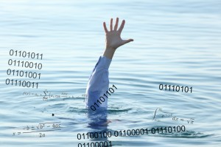
Drowning in data

Slide 4
Information Overload
Opportunity
5 billion videos watched per day on YouTube (2017) (2B in 2010)
350 million photos per day (2017) (100M in 2010)
74 trillion emails sent annually, 205B per day (2017)
4.62 billion pages (2016)

Slide 5
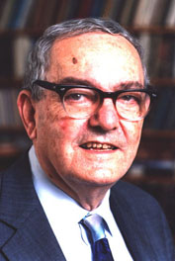
“What information consumes is rather obvious: it consumes the attention of its recipients. Hence a wealth of information creates a poverty of attention, and a need to allocate that attention efficiently among the overabundance of information sources that might consume it.”
Herb Simon
As quoted by Hal Varian
Scientific American, 1995
Adapted from Maneesh Agrawala, 2011

Slide 6
Information Visualization
the art and science of representing abstract information in an interactive, visual form that enables people to more easily gain insights through their perceptual and cognitive capabilities

Slide 7


Slide 8


Slide 9
EXPLORATION
COMMUNICATION

Slide 10
How many 3’s?
1281768756138976546984506985604982826762
9809858458224509856458945098450980943585
9091030209905959595772564675050678904567
8845789809821677654876364908560912949686

Slide 11
How many 3’s?
1281768756138976546984506985604982826762
9809858458224509856458945098450980943585
9091030209905959595772564675050678904567
8845789809821677654876364908560912949686

Slide 12
How many 3’s?
1281768756138976546984506985604982826762
9809858458224509856458945098450980943585
9091030209905959595772564675050678904567
8845789809821677654876364908560912949686

Slide 13
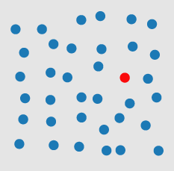

Preattentive Processing
http://www.csc.ncsu.edu/faculty/healey/PP/index.html

Slide 14
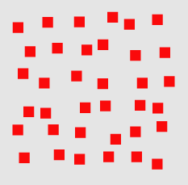
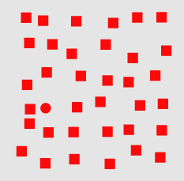
Preattentive
http://www.csc.ncsu.edu/faculty/healey/PP/index.html

Slide 15
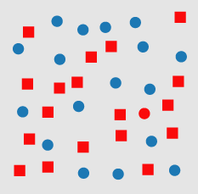
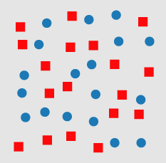

Slide 16
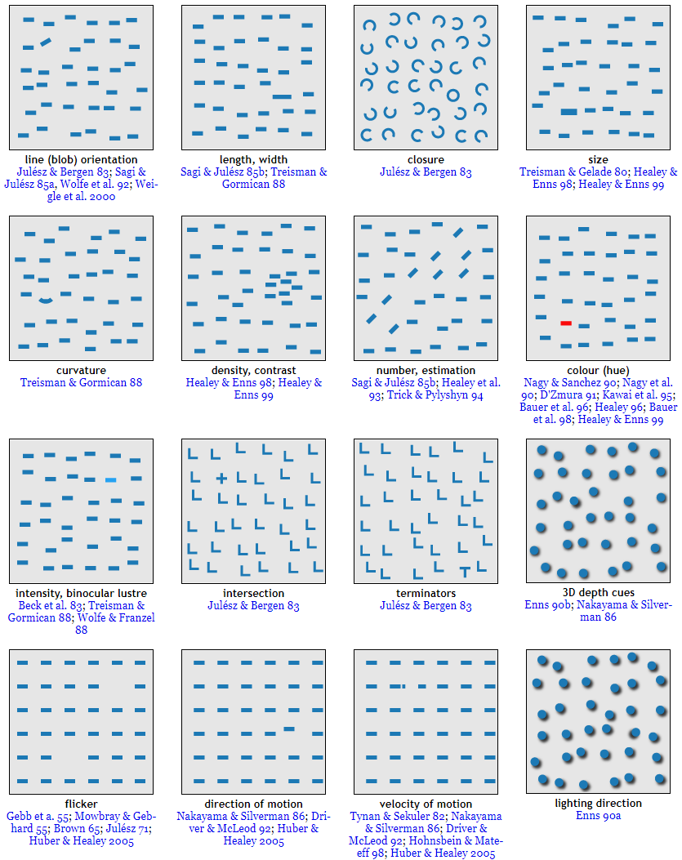

Slide 17
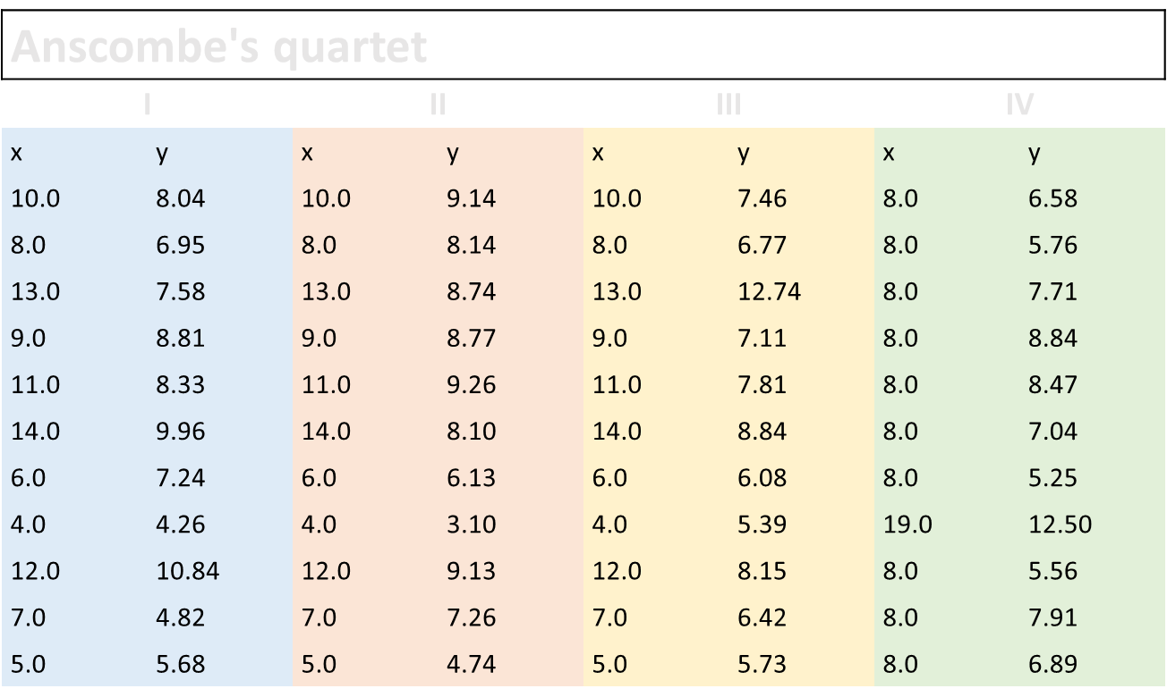

Slide 18
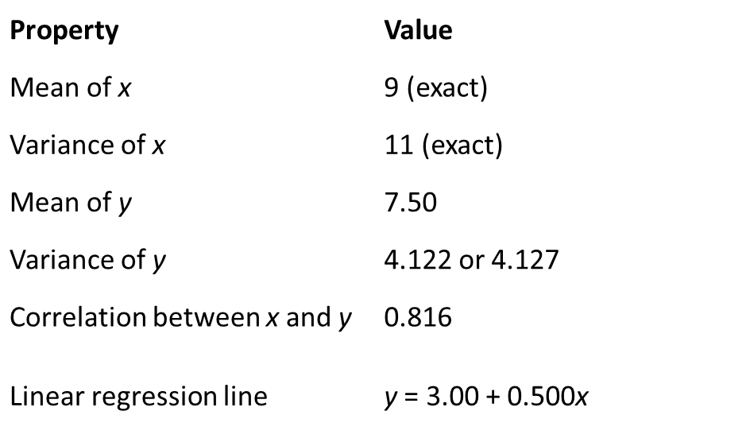

Slide 19
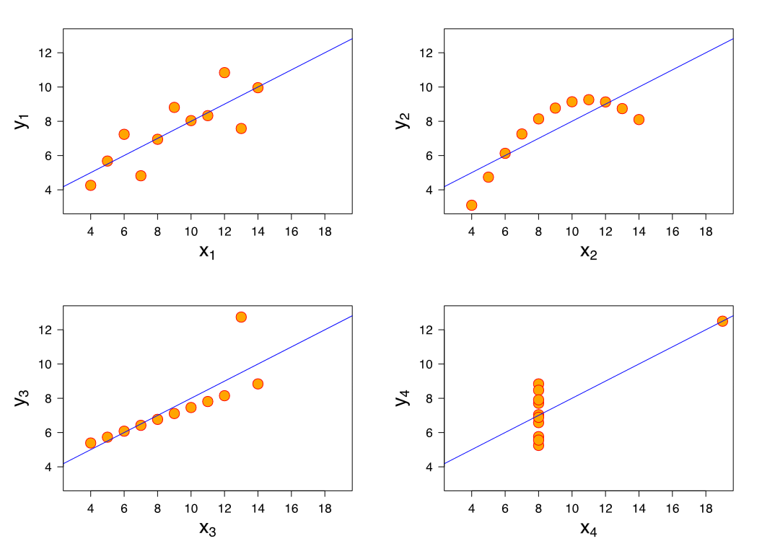

Slide 20
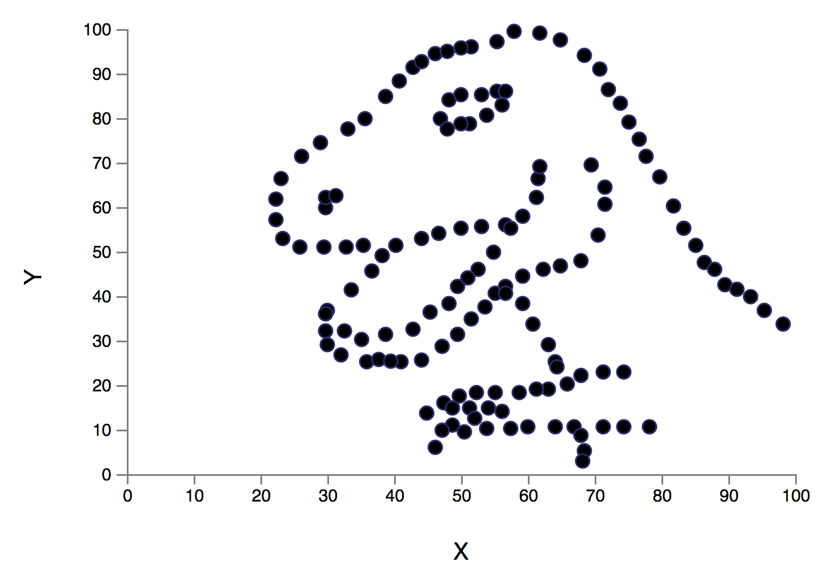
Alberto Cairo

Slide 21
“Let the data speak for themselves”
Notes:
3.5 M results in Google (vs. 1.5 M for let the data speak for itself)

Slide 22
“Let the data speak for themselves”
Notes:
3.5 M results in Google (vs. 1.5 M for let the data speak for itself)

Slide 23
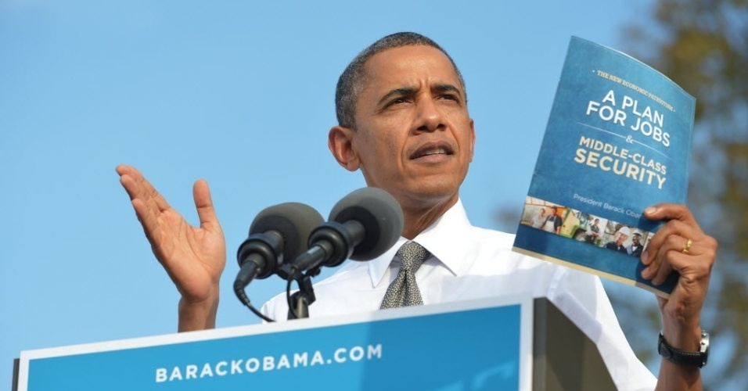
Notes:
Hm.

Slide 24
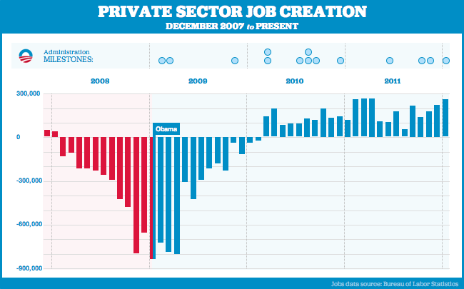
Notes:
The “Bikiin graph”
http://www.youtube.com/watch?v=NJoE0ZJ7Rn8

Slide 25
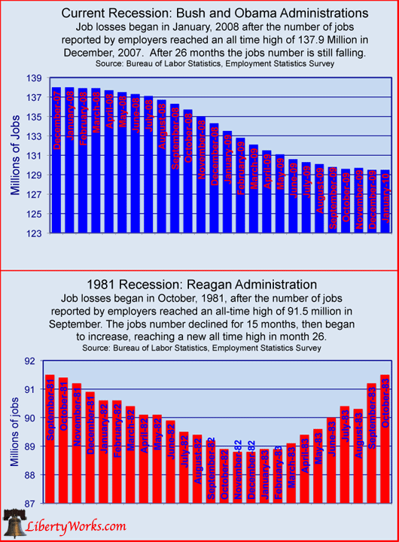

Slide 26
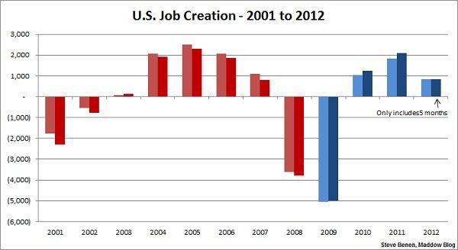
Notes:
Variant of the Bikini graph
(The lighter color refers to the overall jobs picture, while the darker color points only to the private sector.)
http://thepoliticalcarnival.net/2012/08/03/bikini-graph-time-job-growth-far-exceeds-expectations-more-created-since-jan-than-in-5-of-the-8-bush-years/
This is seem as a pro-Dem chart: shows growth year over year

Slide 27
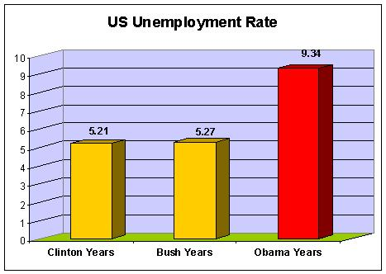

Slide 28
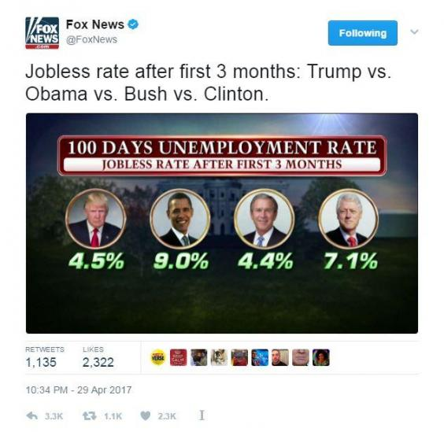

Slide 29
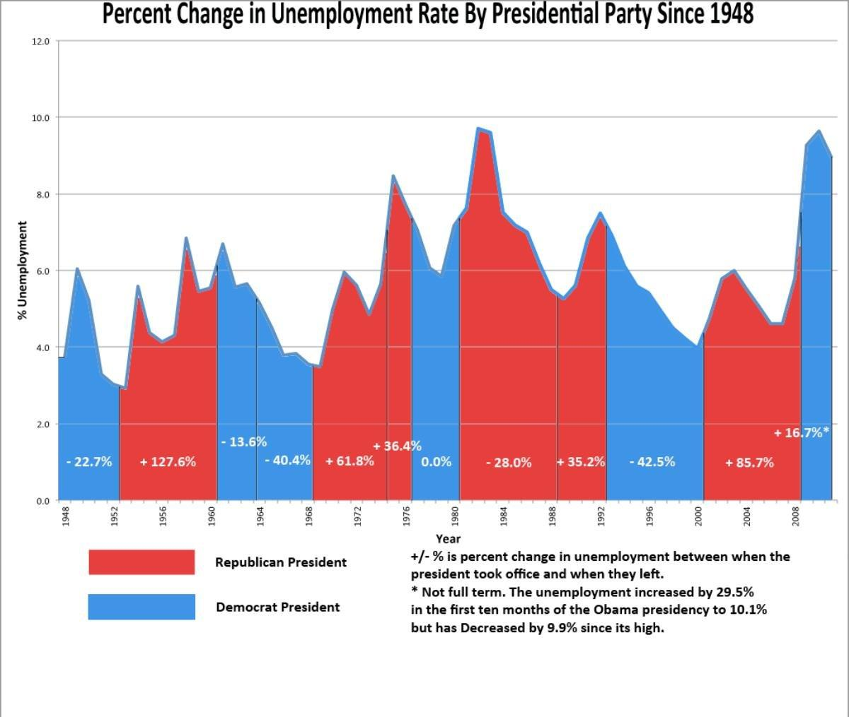

Slide 30
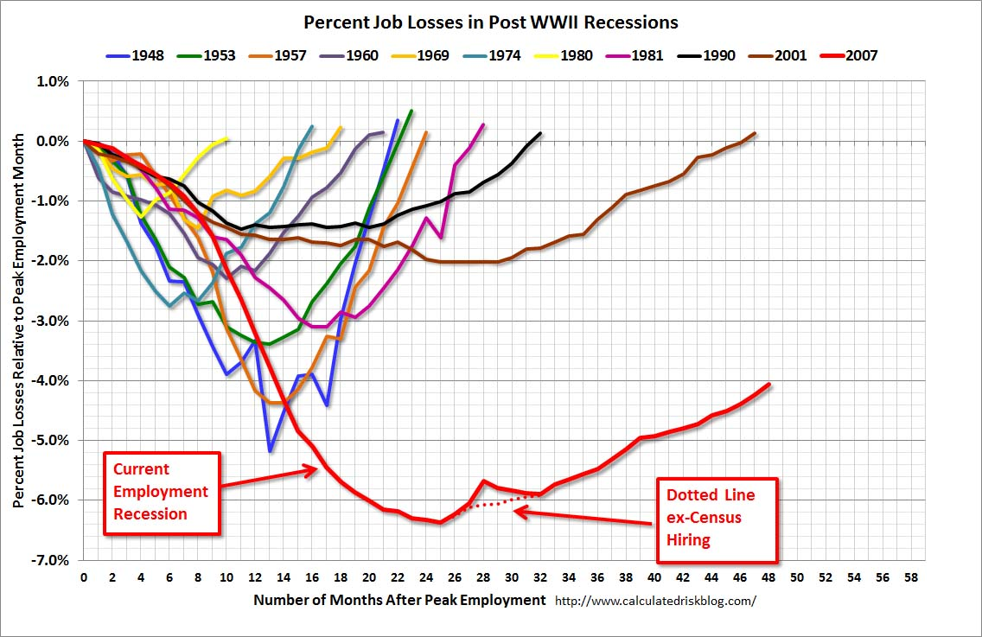

Slide 31
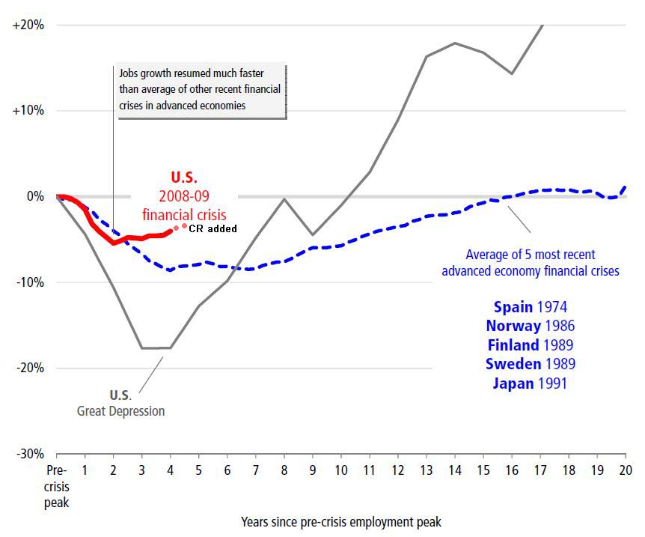

Slide 32
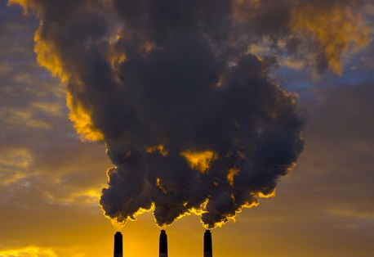

Slide 33
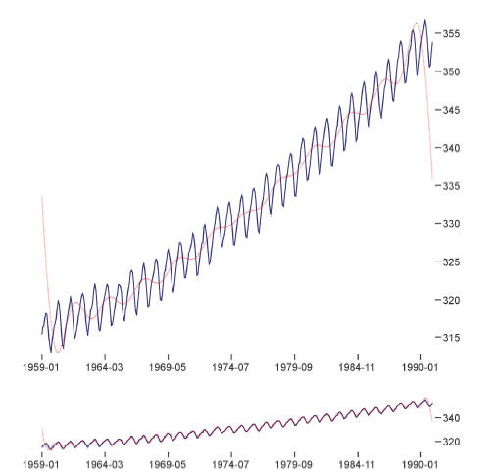
Multi-Scale Banking to 45 Degrees
Jeffrey Heer, Maneesh Agrawala

Slide 34
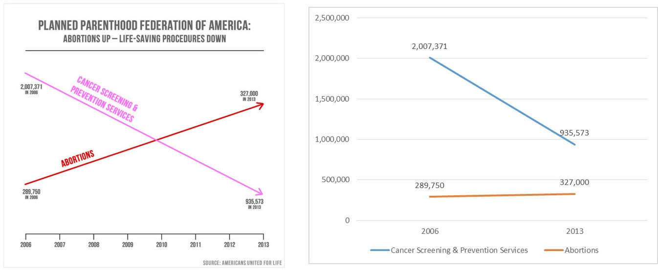
Intentional Deception!

Slide 36
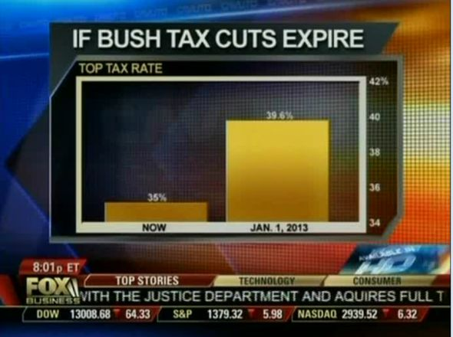
Intentional Deception!

Slide 37
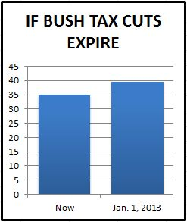

Slide 38
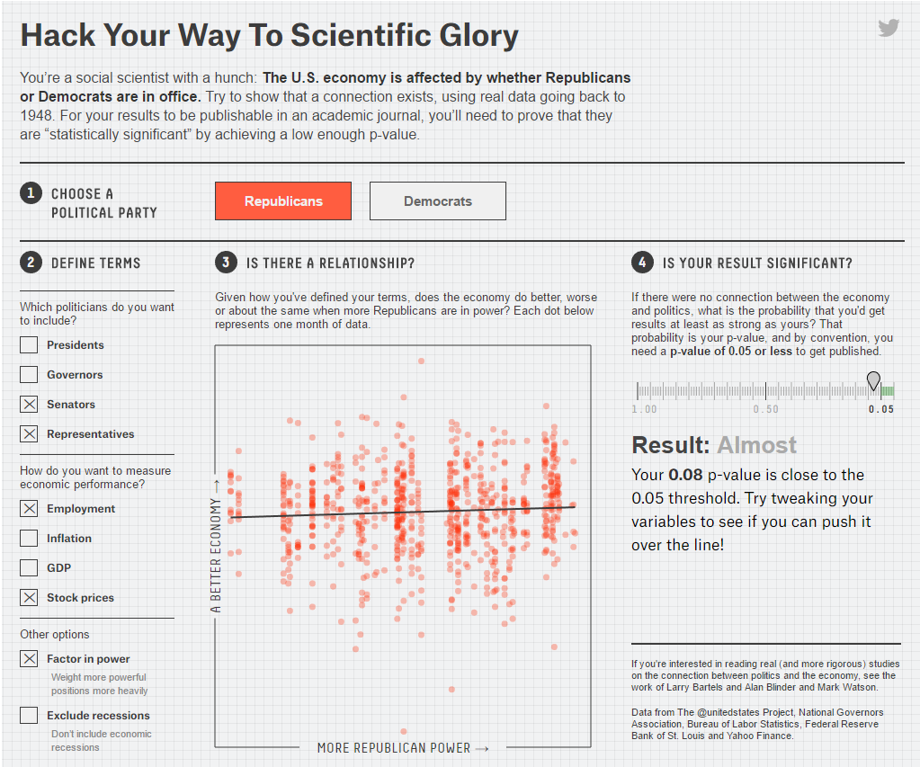
Bias in variable selection (p-hacking)
https://fivethirtyeight.com/features/science-isnt-broken/#part1

Slide 39
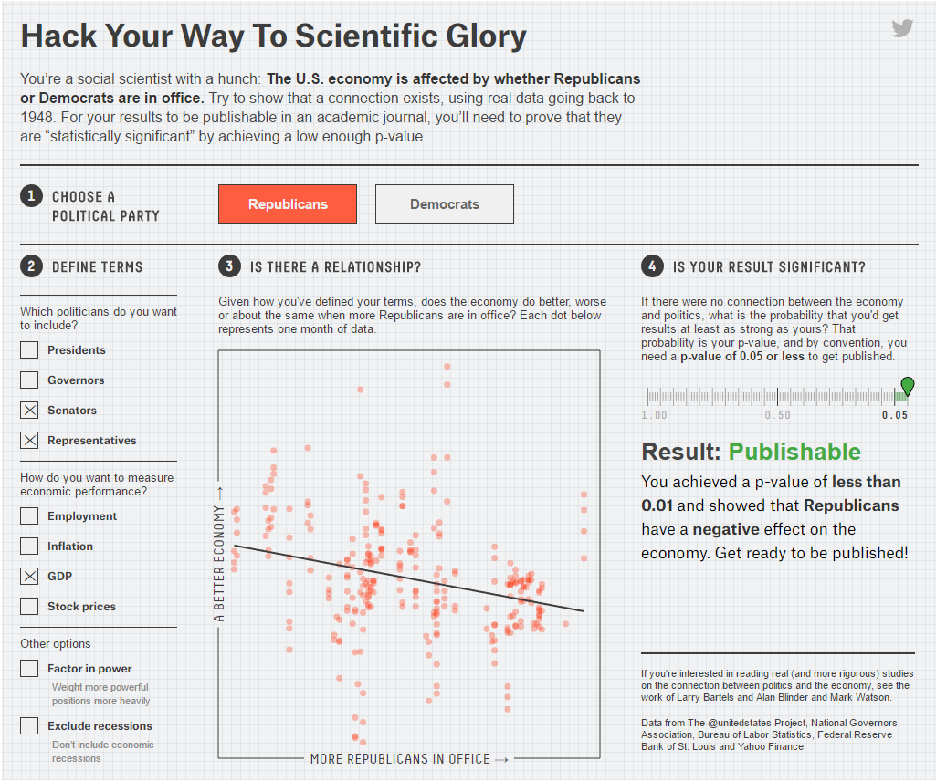
The important lesson here is that a single analysis is not sufficient to find a definitive answer. Every result is a temporary truth, one that’s subject to change when someone else comes along to build, test and analyze anew.

Slide 40
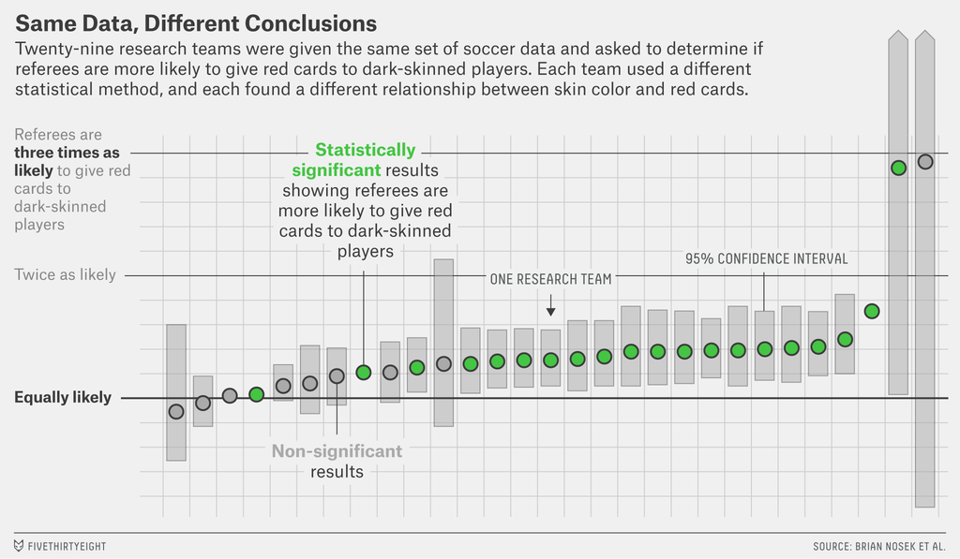

Slide 41
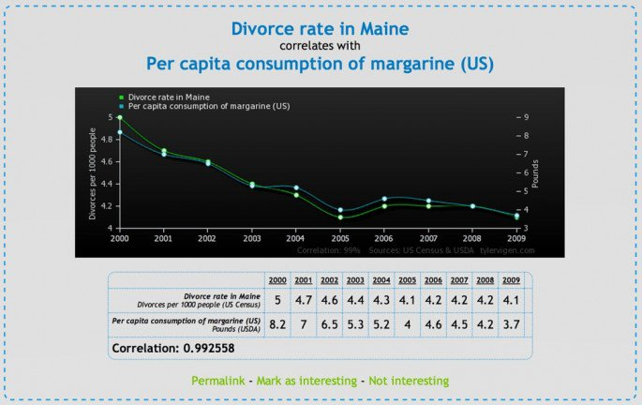
Datamining cautionary tale

Slide 42
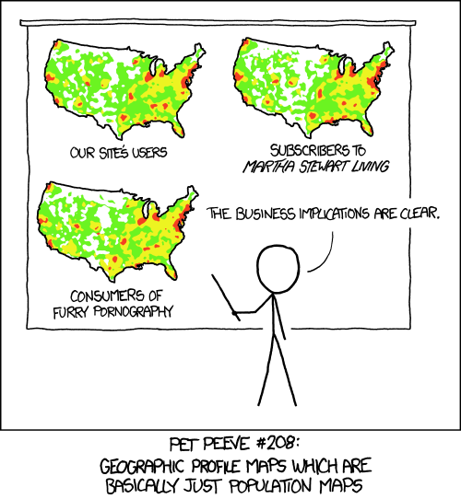
Patterns where patterns don’t exist

Slide 43
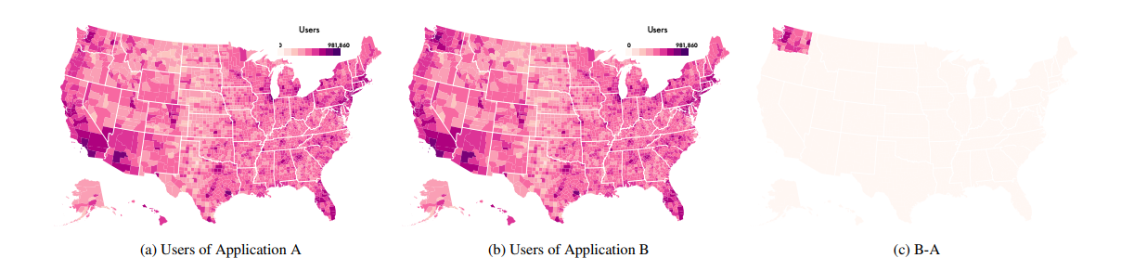
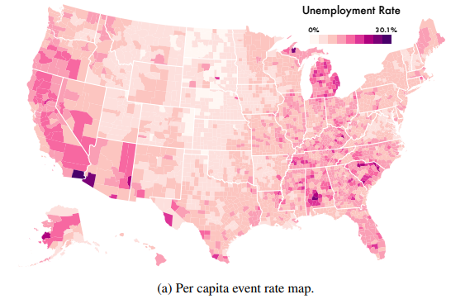
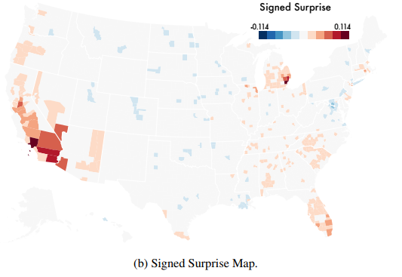
Bayesian Surprise
Correll, Michael, and Jeffrey Heer. "Surprise! Bayesian Weighting for De-Biasing Thematic Maps." IEEE transactions on visualization and computer graphics 23.1 (2017): 651-660.
Notes:
Choropleth maps illustrating the base rate bias. By encoding only the unweighted density of events, the base rate or population rate of event occurrence is the dominant visual signal, making spatial comparisons difficult. These choropleth maps visualize the location of users of two fictional software applications, A and B. The usage patterns look very similar at a glance, but that is because usage largely follows population (a U.S. citizen is 10% likely to use either application). An interesting spatial pattern— B has twice as many users in Washington state as A — is all but drowned out by the spatially complex, but largely task-irrelevant, signal of U.S. population density.

Slide 44
Simpson’s Paradox
WOMEN
MEN
http://vudlab.com/simpsons/

Slide 45
W M
W M
W M
W M
W M
W M

Slide 46
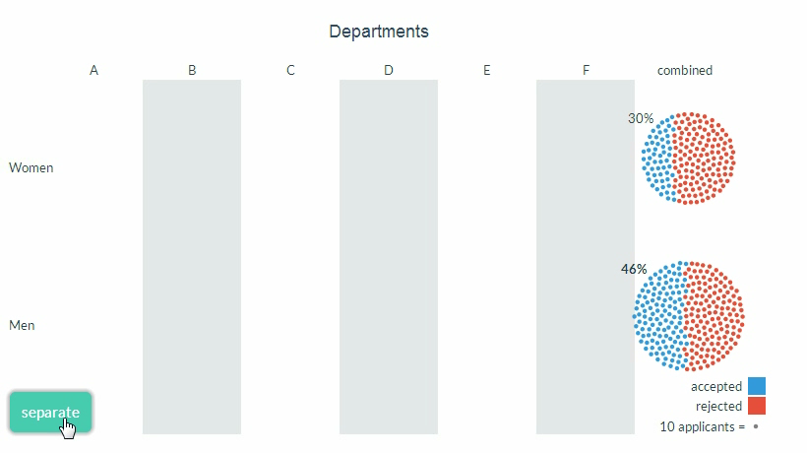

Slide 47
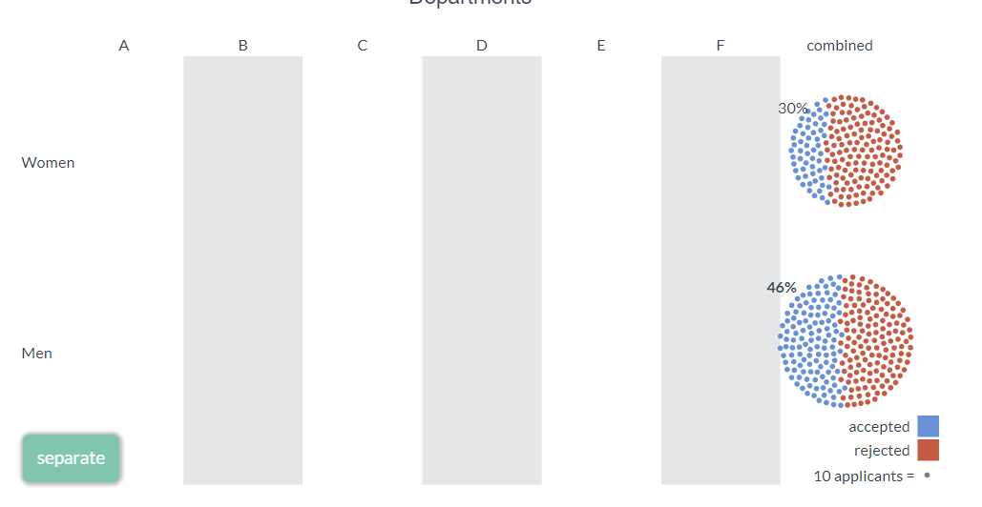
Simpson’s Paradox Explanation

Slide 48
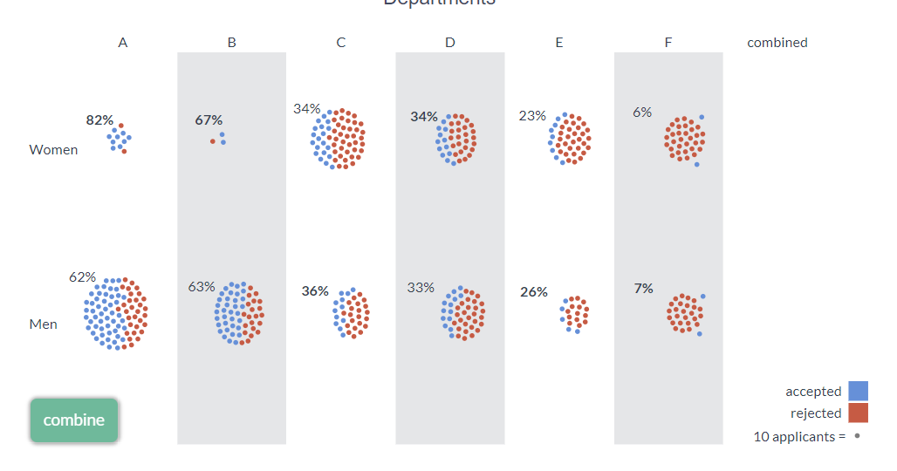
Simpson’s Paradox Explanation (cont’d)

Slide 49
Bayes Rule: Simple problem
1% of women at age forty who participate in routine screening have breast cancer.
80% of women with breast cancer will get positive mammograms.
9.6% of women without breast cancer will also get positive mammograms.
A woman in this age group had a positive mammography in a routine screening. What is the probability that she actually has breast cancer?
0-30%
30-60%
60-100%

Slide 50

Baye’s Rule

Slide 51
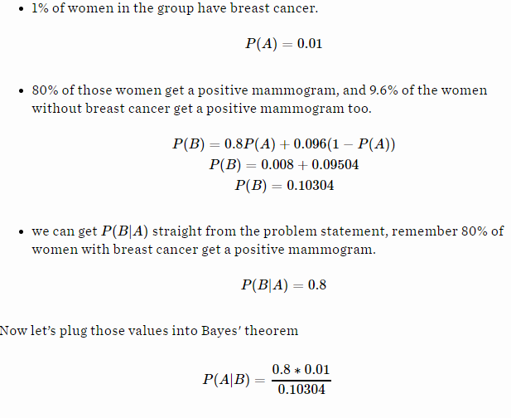
7.76%
95% of doctors said it’s between 70-80%

Slide 52
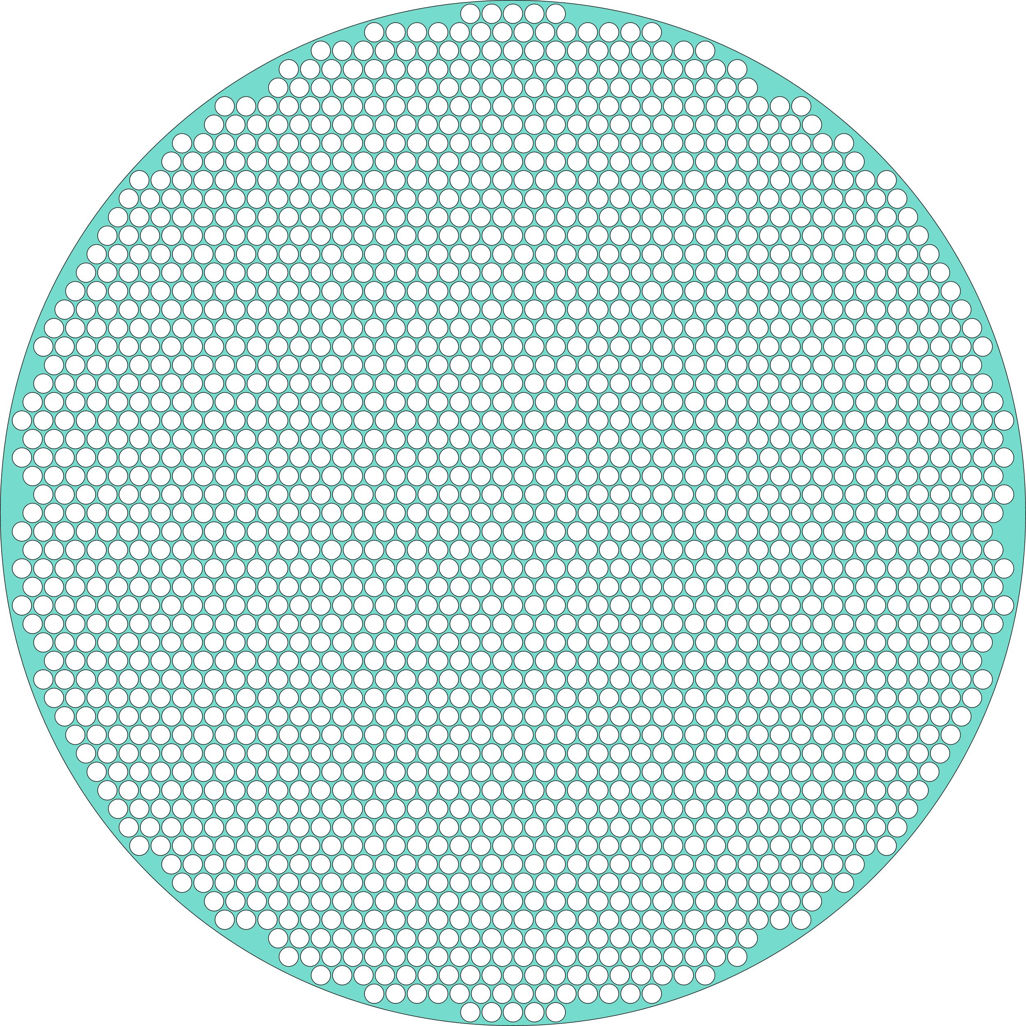

Slide 53
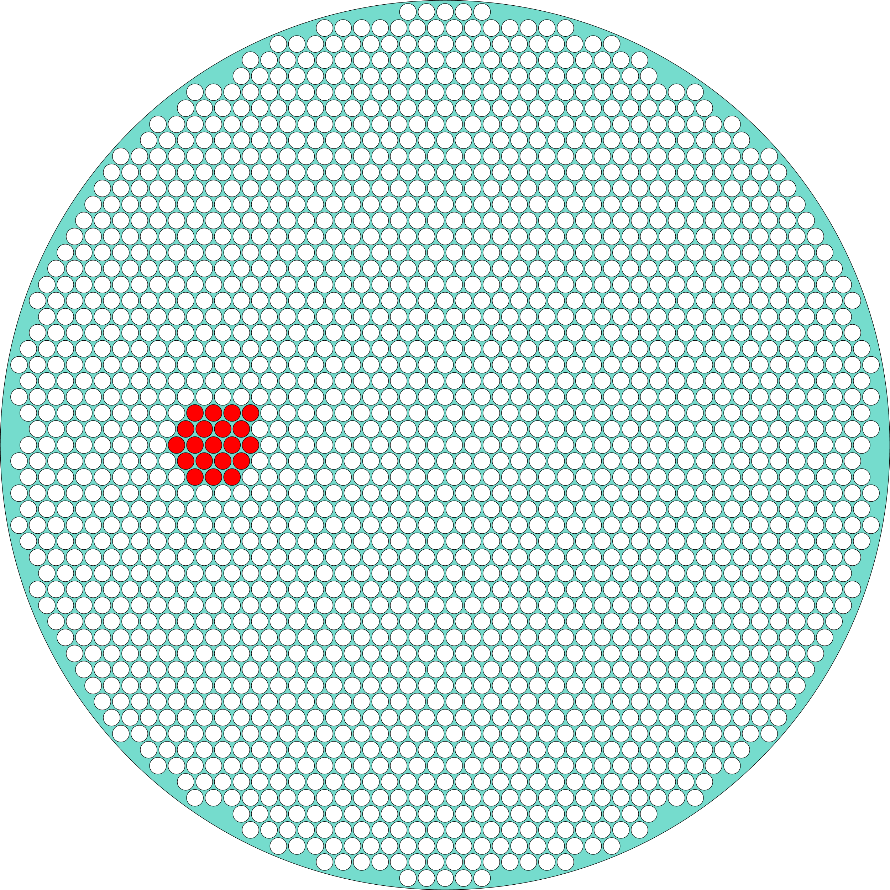

Slide 54
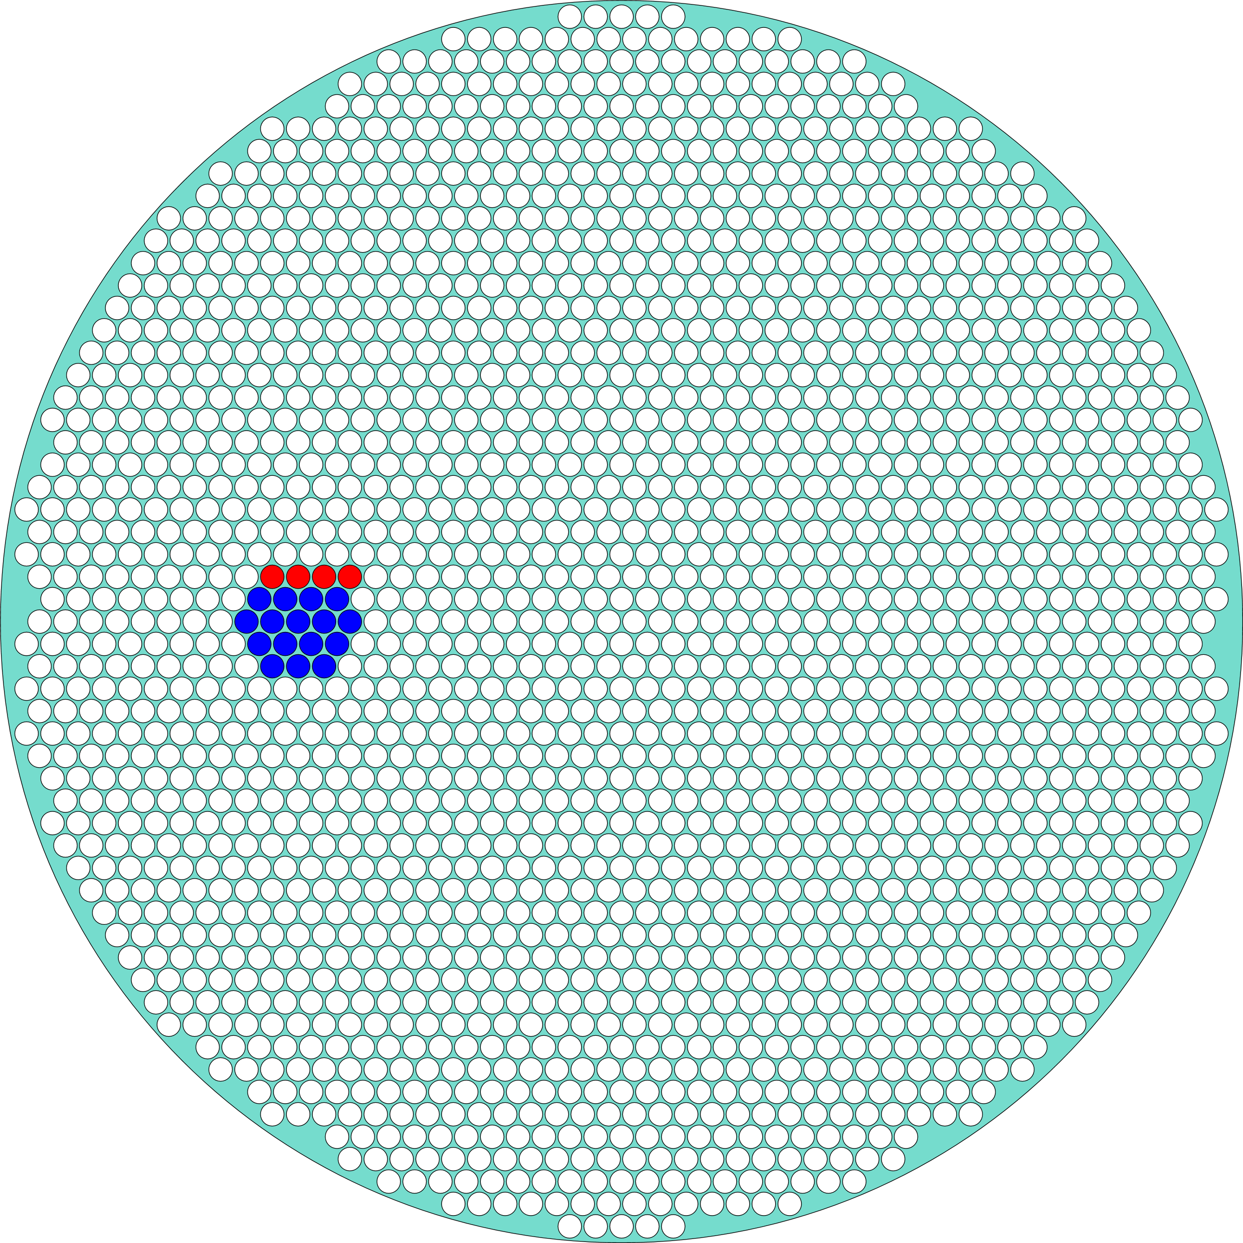

Slide 55
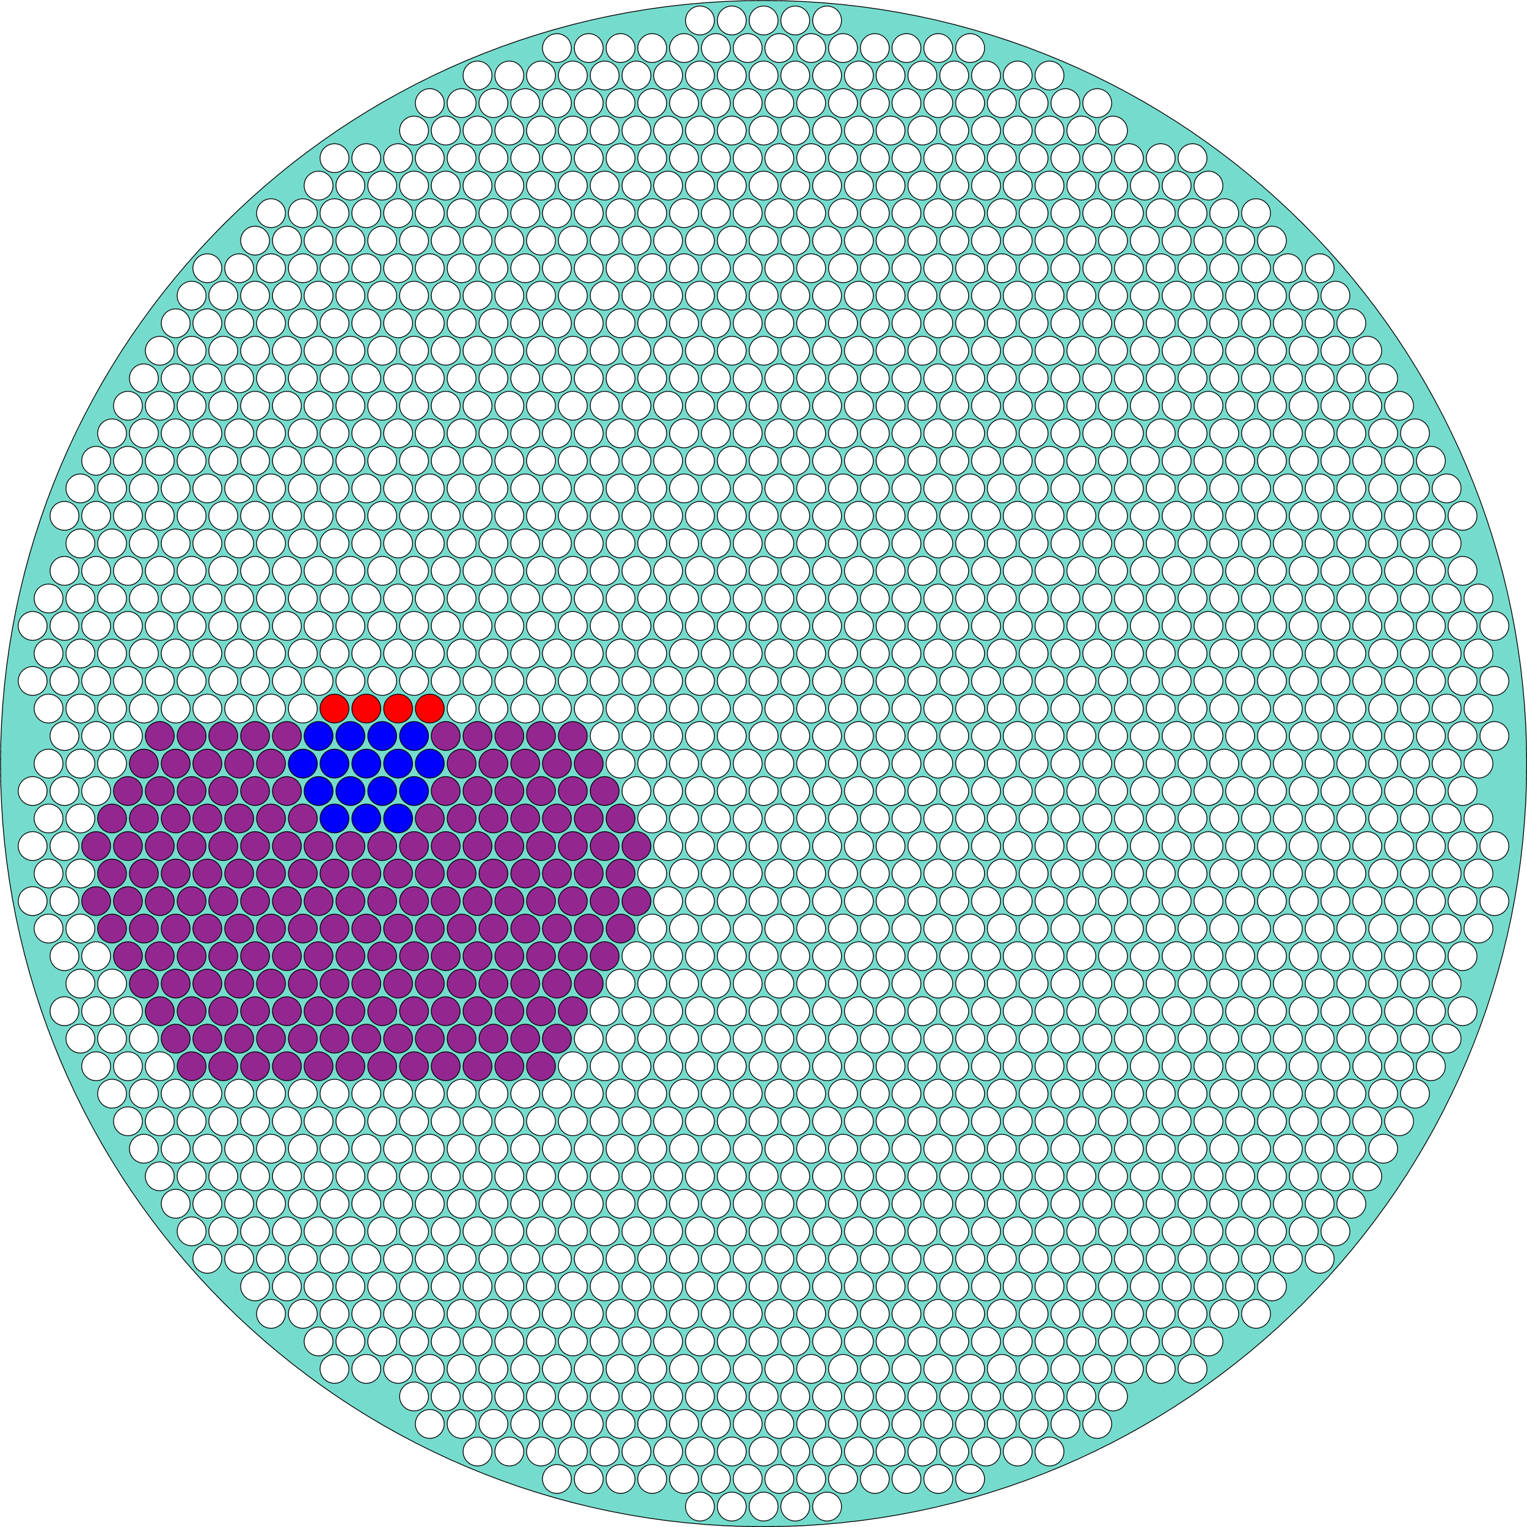

Slide 56
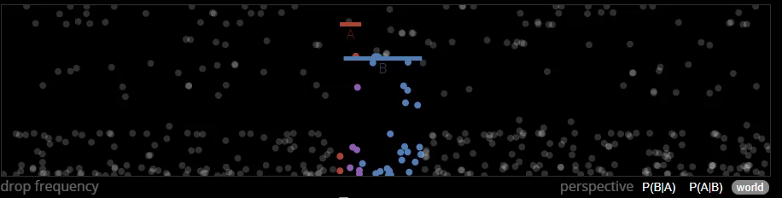

Slide 57
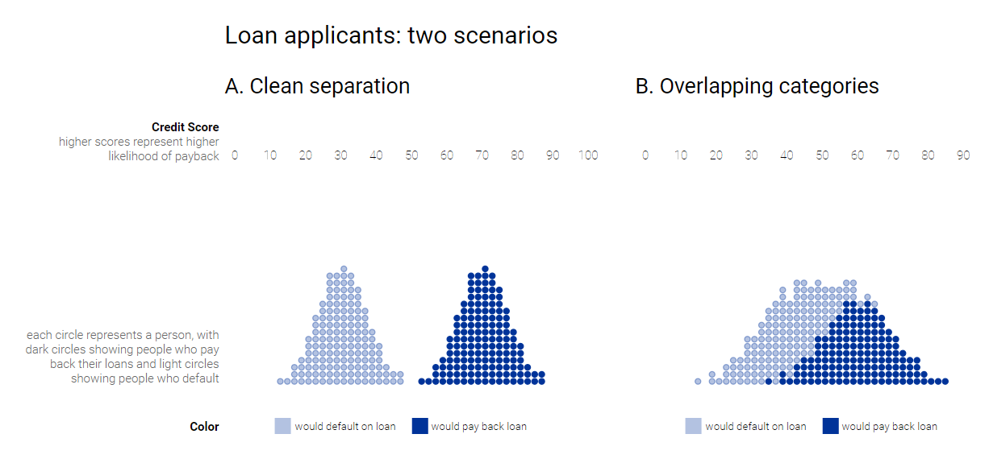
https://research.google.com/bigpicture/attacking-discrimination-in-ml/

Slide 58
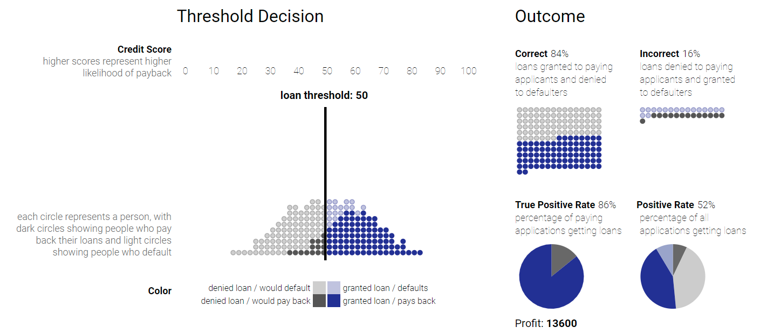

Slide 59
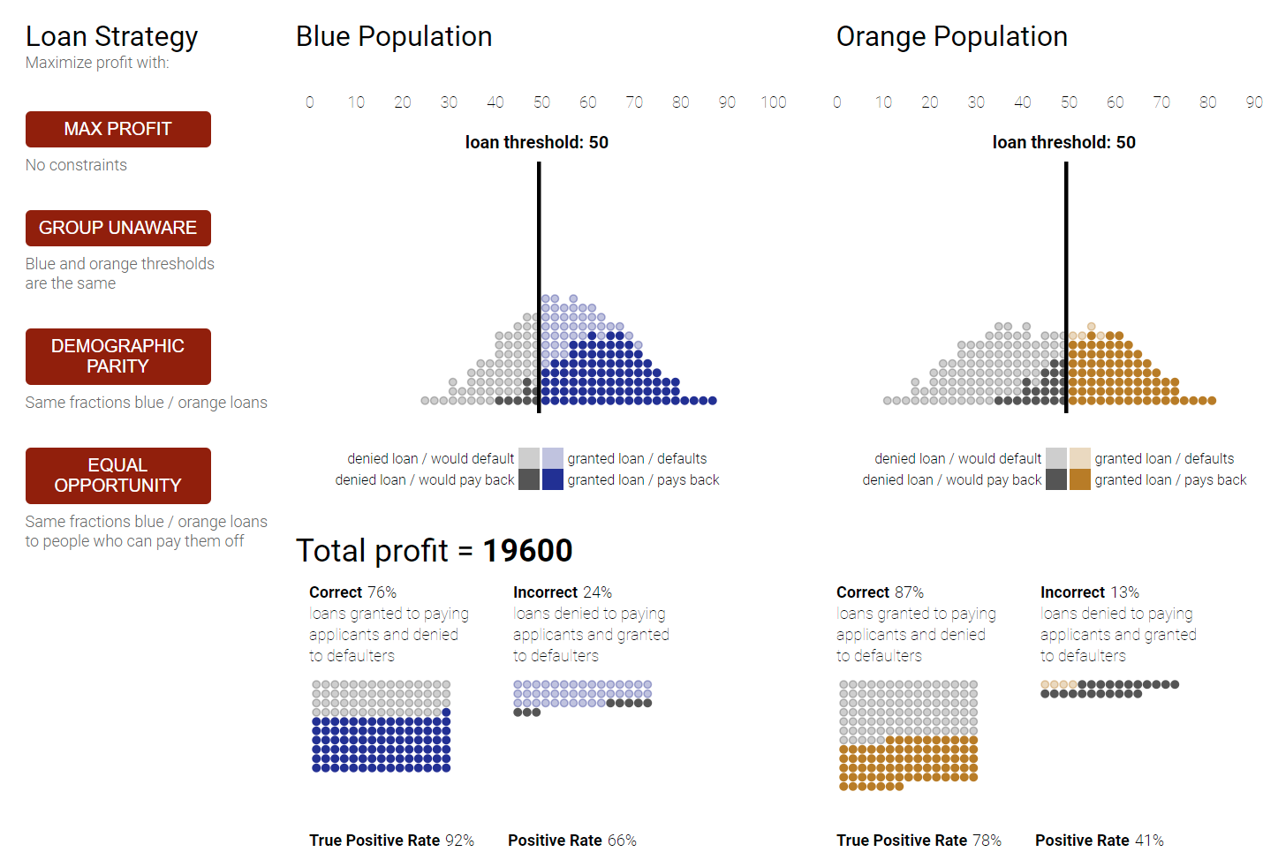

Slide 60
Data Storytelling

Slide 61
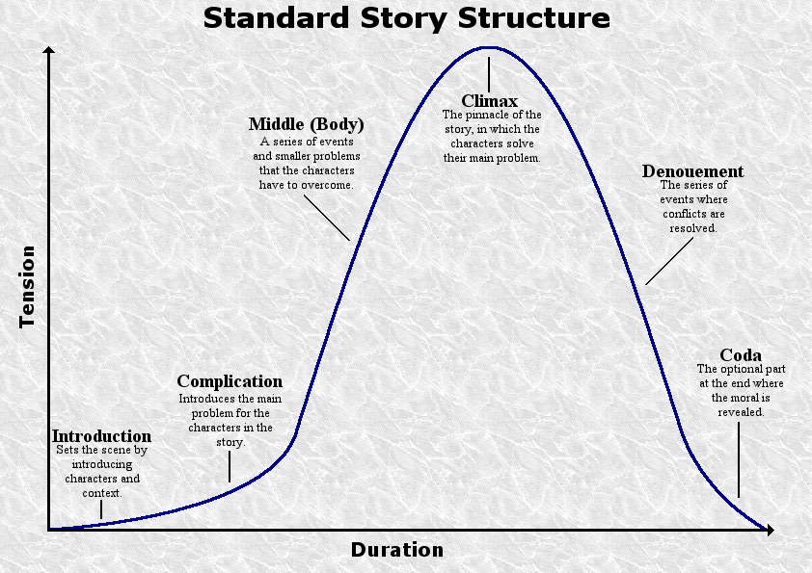
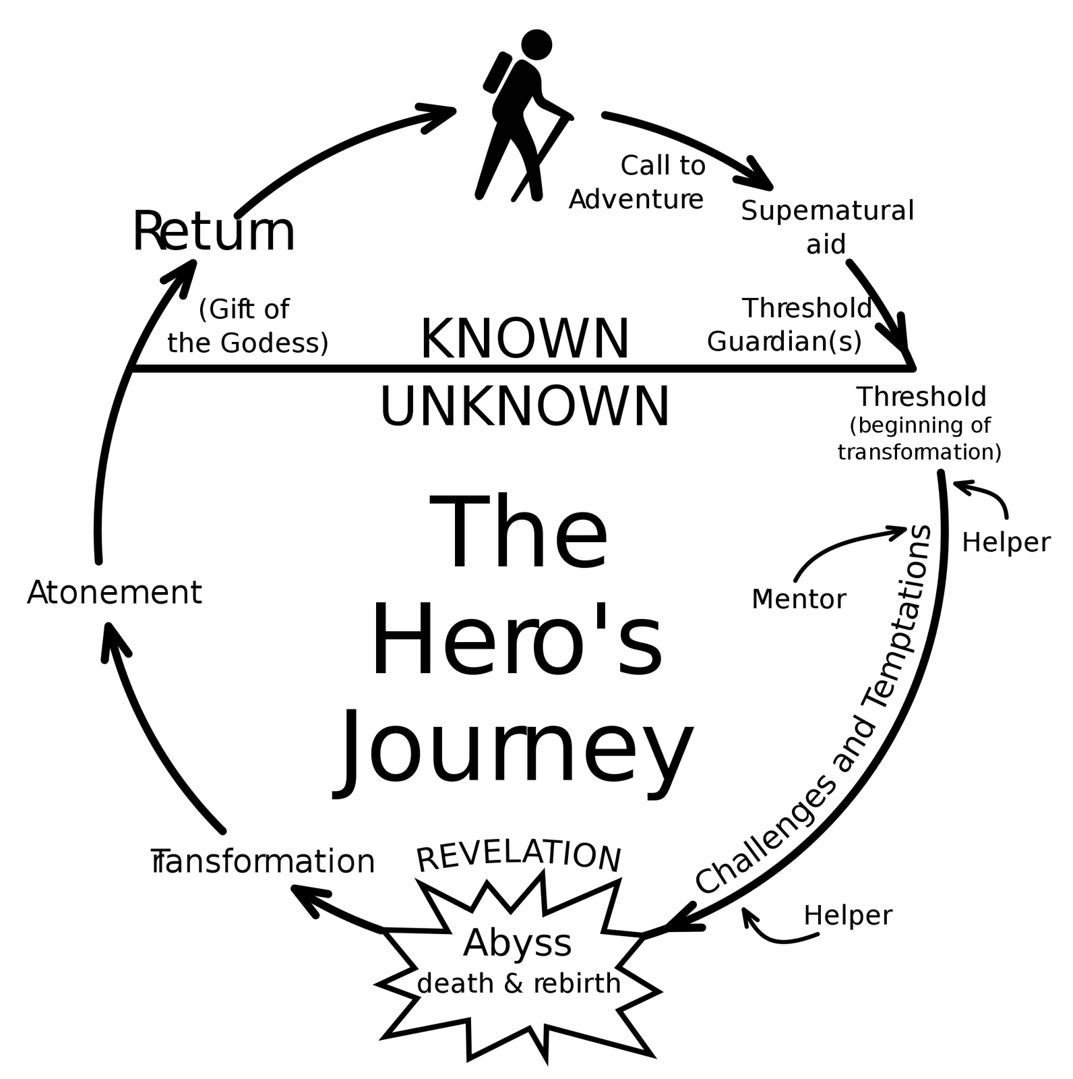
Data Storytelling

Slide 62
Data Storytelling

Slide 63

Data lacks context

Slide 64
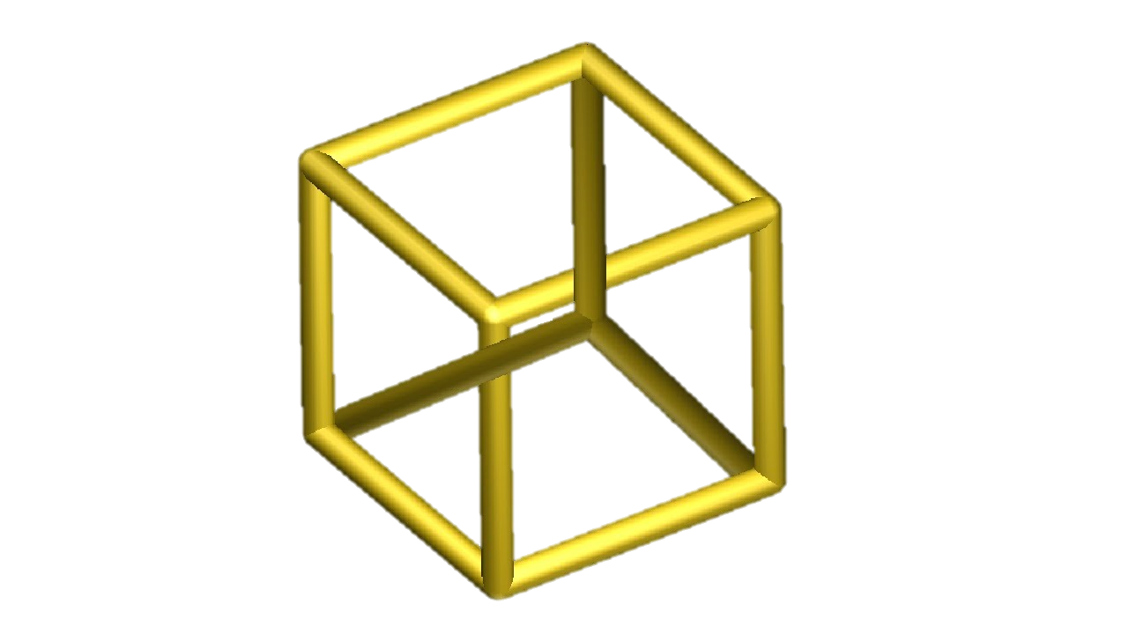
Subject to ambiguity

Slide 65
Narrative reduces ambiguity, connects data with context, and describes a specific interpretation.
From: Dave Wells: http://tdan.com/data-storytelling-its-more-than-visualization

Slide 66
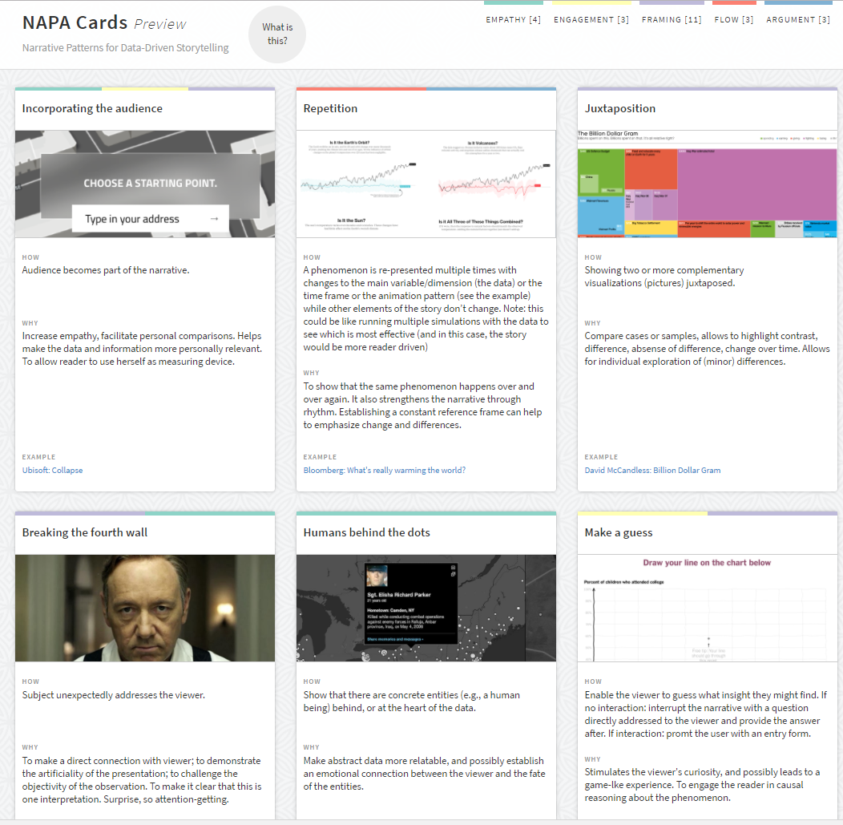
http://napa-cards.net/
Each card represents a specific narrative technique, pattern or "trick" you can apply to effect flow, empathy, argumentation… in a data story. We tried to find a representative example for each technique, but of course, there will be many different instantiations of the same underlying principle. These patterns are also not mutually exclusive — rather, they can often be combined to great effect.

Slide 67
Multiple, related views
SandDance Demos

Slide 68
Data Presentation
Know what you want to communicate
Always know why you want to make a chart!
Find ways to connect with audience
Make it something they care about (Give actionable insights)
Make it easy for your audience
Choose effective representations carefully
Be ethical!

Slide 69
Ethical Visualization
Therefore, it is the obligation of the designer of visualizations to create graphics that
(a) are intended to bring attention to relevant matters,
(b) are based on a thorough analysis of the information,
(c) are built in ways that enable comprehension.
To do this, designers ought to base their decisions on scientific evidence or, in case that this is not available, on judgments derived from their experience and personal observations.
- Alberto Cairo
See also Visual.ly code of ethics: https://visual.ly/blog/a-code-of-ethics-for-data-visualization-professionals/

Slide 70
Summary/Future Work
Data presentation does not obviate the need for:
Education
Skepticism
Curiosity
What is the ‘right answer’?
What is the ‘right question’?
Use and grammar of unit visualizations (TVCG article in progress)
Interpretability of ML (Explanations)
See http://www.sanddance.ms
See http://www.steven-drucker.com/

