Slide 1
Data Presentations
Steven M. Drucker Danyel Fisher

Slide 2

Notes:
f The purpose of visualization is insight, not numbers
The purpose of exploratory visualization is finding insight

Slide 3

Notes:
The purpose of presentation visualization is communicating insight

Slide 4
Exploration
Communication

Slide 5
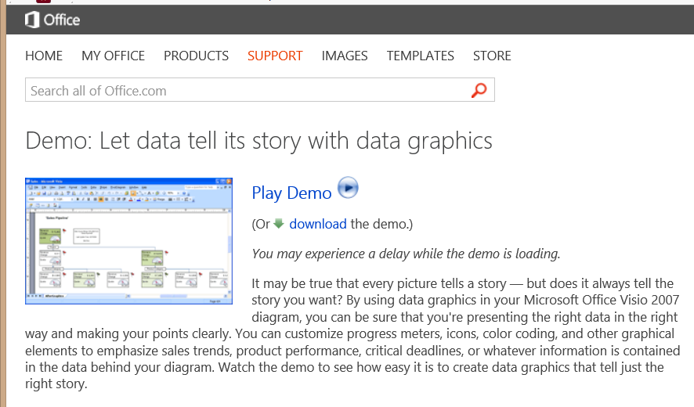
Data speaks for itself

Slide 6
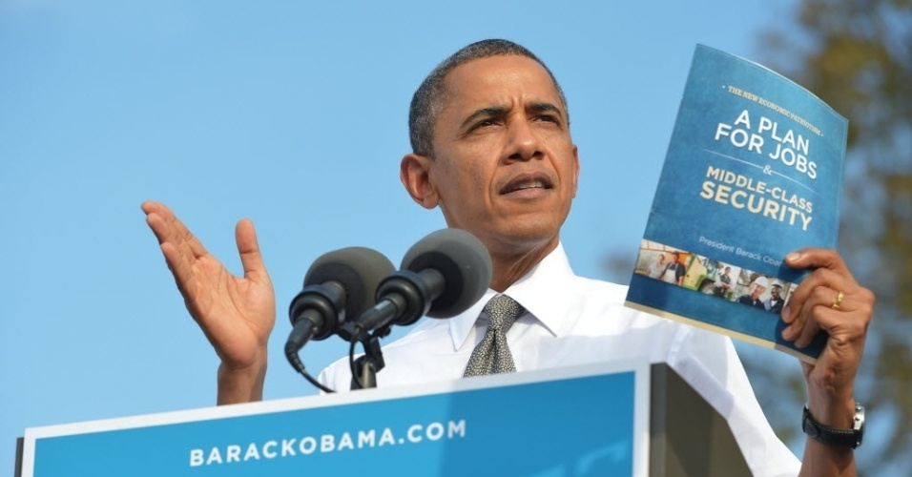
Notes:
Hm.

Slide 7
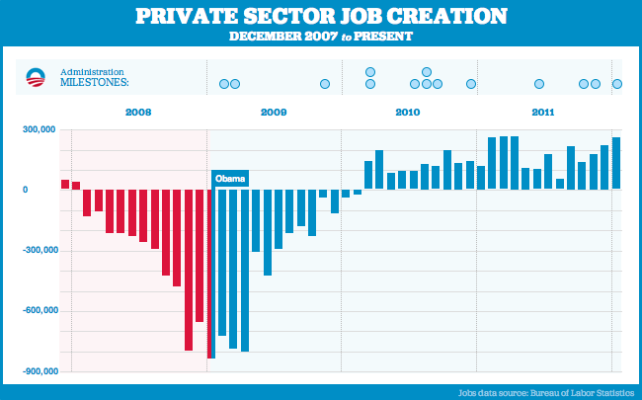
Notes:
The “Bikiin graph”
http://www.youtube.com/watch?v=NJoE0ZJ7Rn8

Slide 8
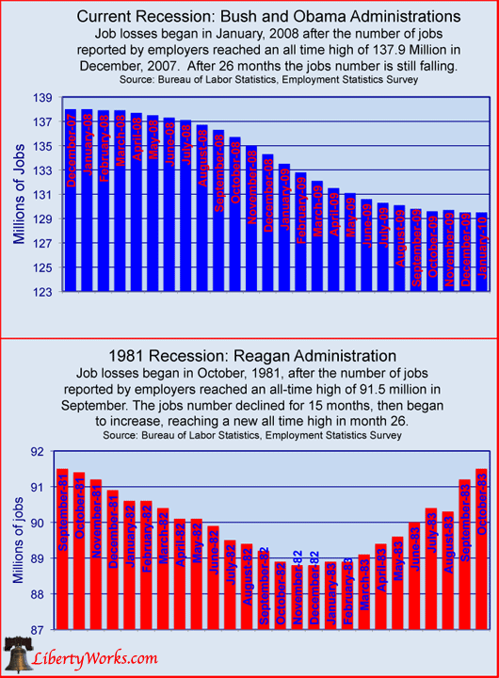

Slide 9
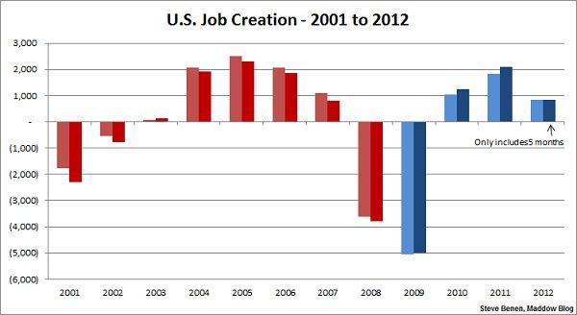
Notes:
Variant of the Bikini graph
(The lighter color refers to the overall jobs picture, while the darker color points only to the private sector.)
http://thepoliticalcarnival.net/2012/08/03/bikini-graph-time-job-growth-far-exceeds-expectations-more-created-since-jan-than-in-5-of-the-8-bush-years/
This is seem as a pro-Dem chart: shows growth year over year

Slide 10
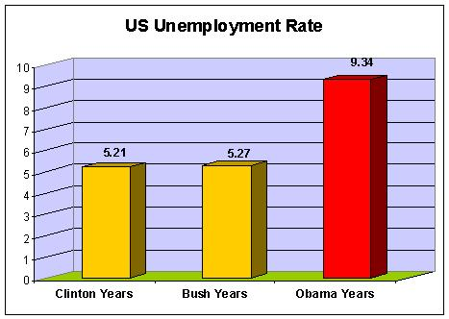

Slide 11
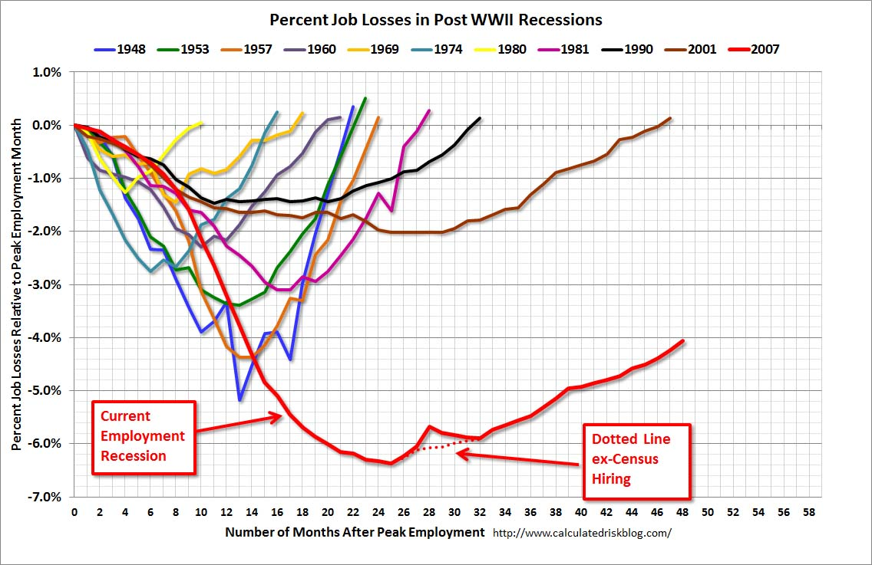

Slide 12
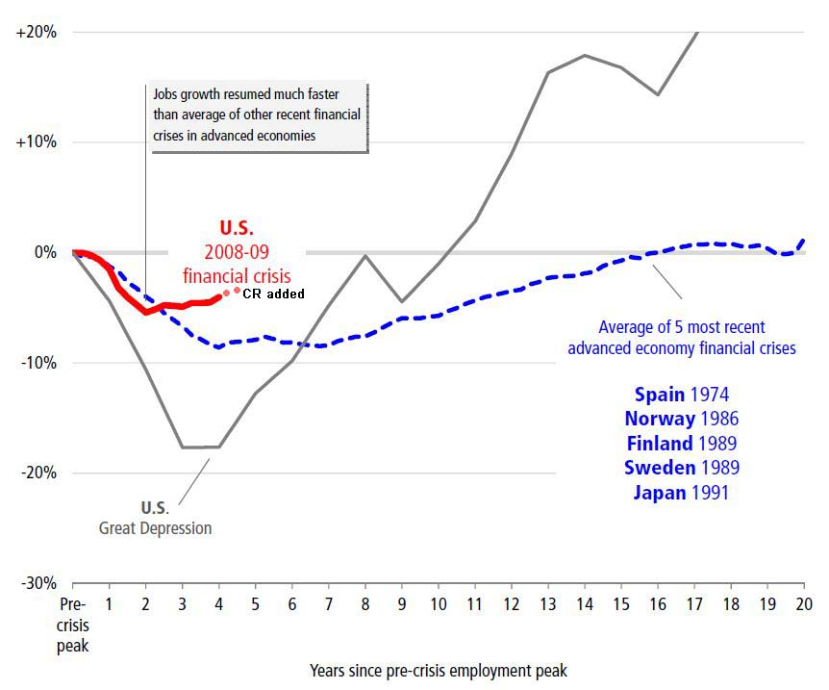

Slide 13
Data speaks for itself

Slide 14


Slide 15
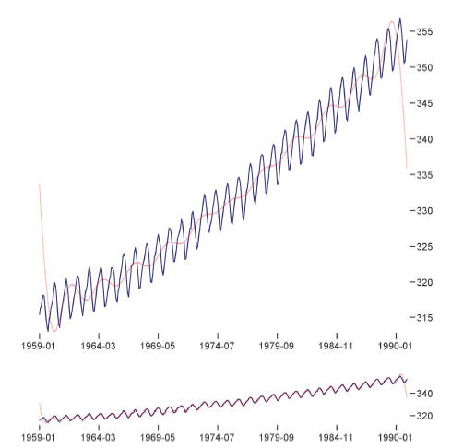
Multi-Scale Banking to 45 Degrees
Jeffrey Heer, Maneesh Agrawala
Notes:
Two plots of monthly atmospheric carbon dioxide measurements, taken from 1959 to 1990. The first plot, with an aspect ratio of 1.17, reveals an accelerating increase in CO₂ levels. The second plot, with an aspect ratio of 7.87, facilitates closer inspection of seasonal fluctuations, revealing a gradual attack followed by a steeper decay. These aspect ratios were automatically determined using multi-scale banking.
Multi-Scale Banking to 45 Degrees
Jeffrey Heer, Maneesh Agrawala
Abstract
In his text Visualizing Data, William Cleveland demonstrates how the aspect ratio of a line chart can affect an analyst's perception of trends in the data. Cleveland proposes an optimization technique for computing the aspect ratio such that the average absolute orientation of line segments in the chart is equal to 45 degrees. This technique, called banking to 45 degrees, is designed to maximize the discriminability of the orientations of the line segments in the chart. In this paper, we revisit this classic result and describe two new extensions. First, we propose alternate optimization criteria designed to further improve the visual perception of line segment orientations. Second, we develop multi-scale banking, a technique that combines spectral analysis with banking to 45 degrees. Our technique automatically identifies trends at various frequency scales and then generates a banked chart for each of these scales. We demonstrate the utility of our techniques in a range of visualization tools and analysis examples.

Slide 16
Exploration
Communication

Slide 17
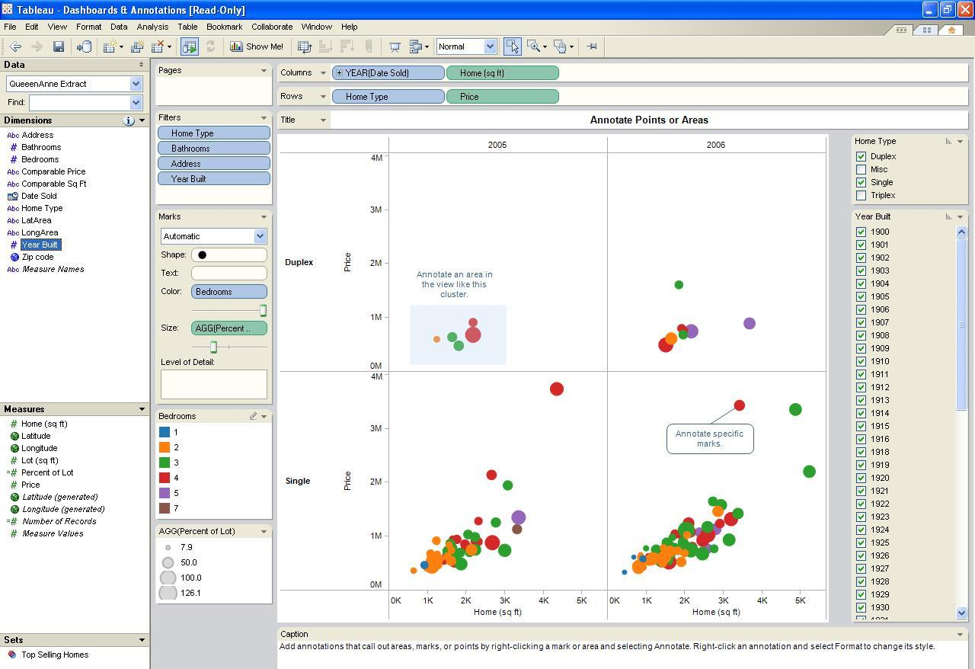
Not analytical tools (like Tableau)
OUT!

Slide 18
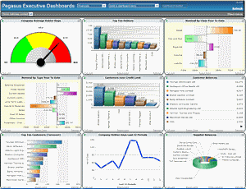
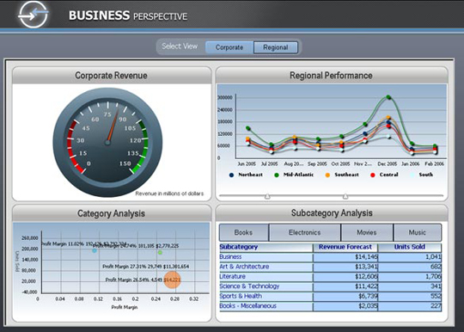
Not Information Dashboard
OUT!

Slide 19
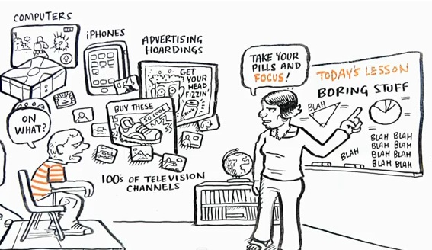
NOT visual storytelling (need data)
OUT!

Slide 20
But it is…
Speaker-Driven | Reader-Driven
Data driven | Data Driven
Linear ordering of scenes | No prescribed ordering
Heavy messaging | No messaging
No or limited interactivity | Free interactivity
Adapted from:
Edward Segel, Jeffrey Heer, Narrative Visualization: Telling Stories with Data. IEEE Trans. Visualization & Comp. Graphics (Proc. InfoVis), 2010.

Slide 21
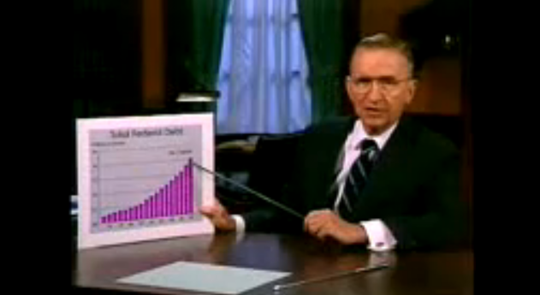
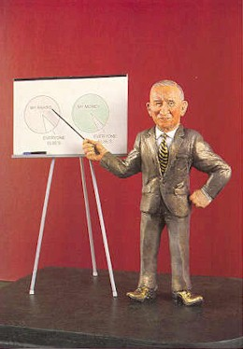
Notes:
Historical presentations with data have not changed much since flip chart days

Slide 22
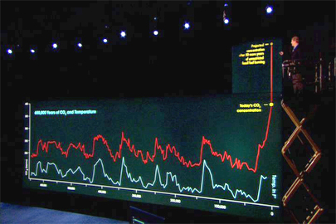

Slide 23

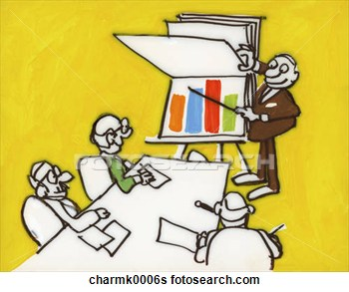
Too many are:

Slide 24
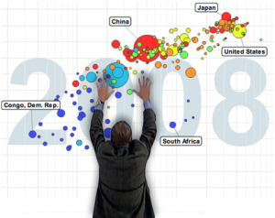
Notes:
Some recent presentations

Slide 25

DEMO: Income disparity

Slide 26
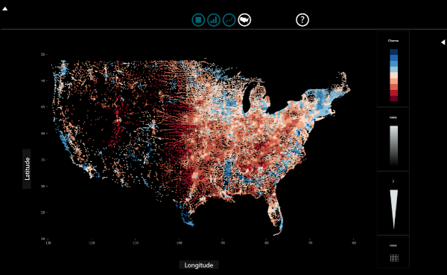
SandDance DEMO

Slide 27
INTENT
TECHNIQUE SELECTION
PRESENTATION
TOOLS

Slide 28
INTENT
Intent Guides Data Selection and Presentation
Persuade
Inform
Entertain
Inspire/Motivate
Instruct
Activate/Stimulate
http://www.westsidetoastmasters.com/resources/powerspeak/lib0026.html

Slide 29
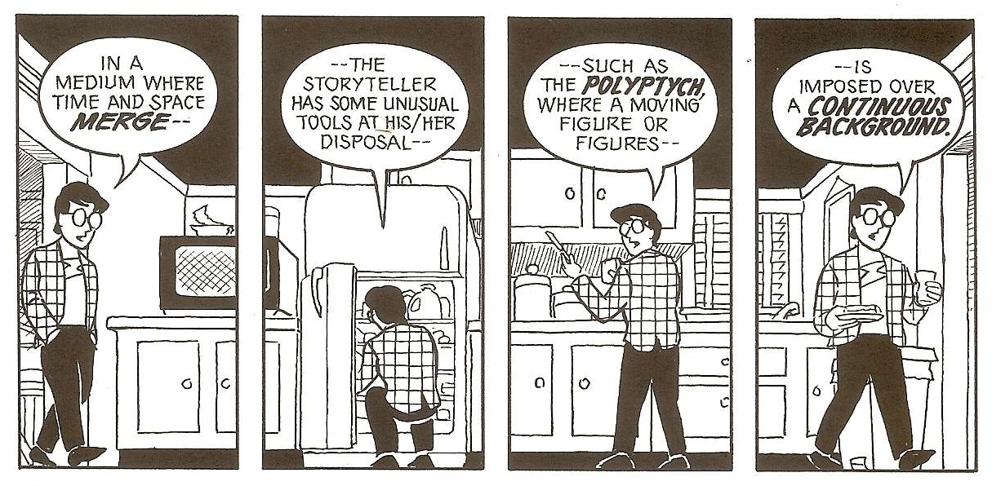


Can draw from related areas:
Comics
Storytelling
Cinematography
No characters, no 4 part structure (rising action, climax, falling action, denouement), but should be engaging.
May borrow techniques, like establishing shots, transitions, but no characters, dialog, etc.
Linear, visual presentation, but can be dynamic, data driven.
Notes:
No characters, no 4 part structure (rising action, climax, falling action, denouement)

Slide 30
INTENT
Intent Guides Data Selection and Presentation
Persuade
Inform
Entertain
Inspire/Motivate
Instruct
Activate/Stimulate
http://www.westsidetoastmasters.com/resources/powerspeak/lib0026.html

Slide 31

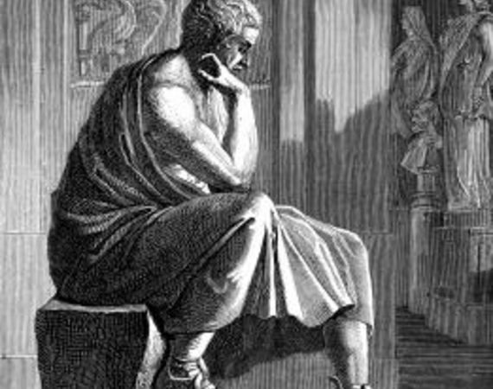
Rhetoric
Hullman & Diakopoulos. Framing Effects in Narrative Visualization, IEEE Transactions on Visualization and Computer Graphics - TVCG, vol. 17, no. 12, pp. 2231-2240, 2011.

Slide 32
INTENT
TECHNIQUE SELECTION
PRESENTATION
TOOLS

Slide 33

Show extremes/outliers

Slide 34

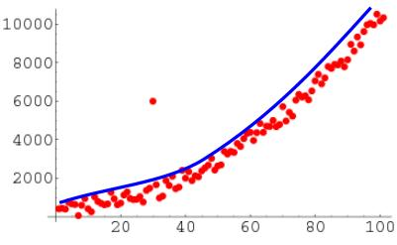
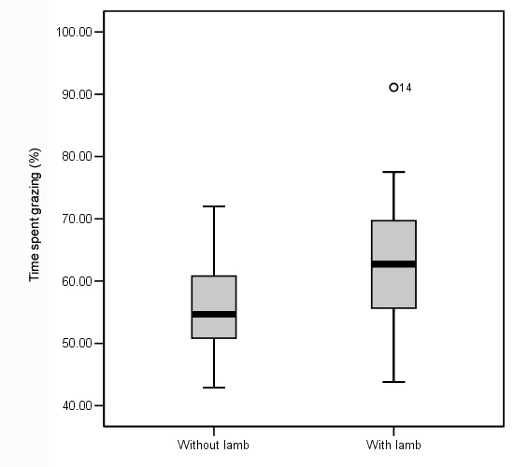
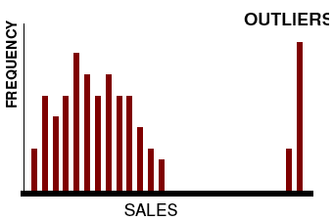
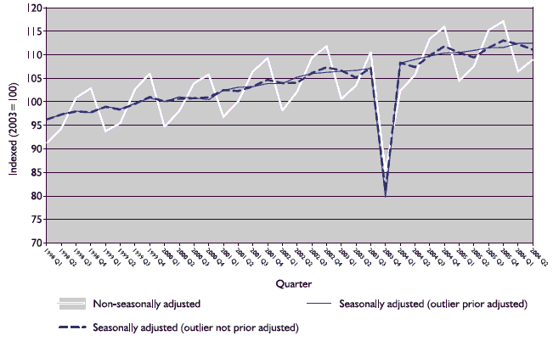
Show extremes/outliers

Slide 35

Compare/Contrast

Slide 36
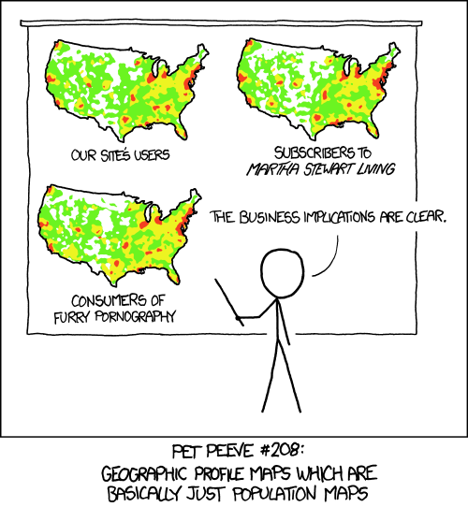
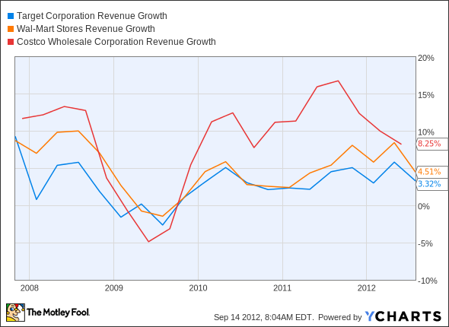
Compare and contrast
Overlay
Small multiples

Slide 37
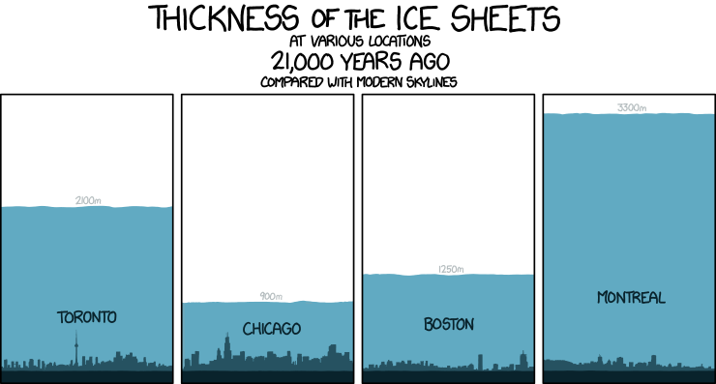
Compare and contrast
Small multiples
Overlay & Small multiples
Notes:
Obviously can combine

Slide 38
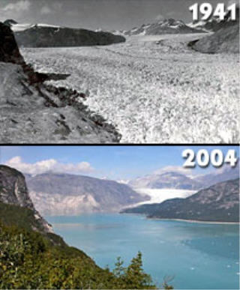
Show change over time

Slide 39
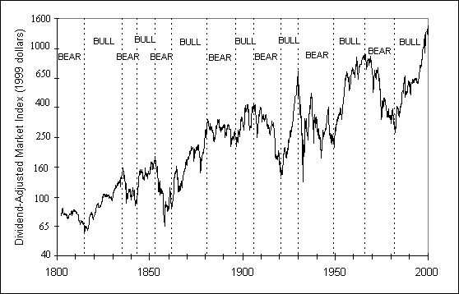
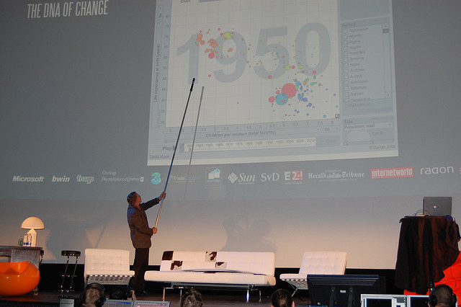
Show change over time

Slide 40

Surprise endings

Slide 41

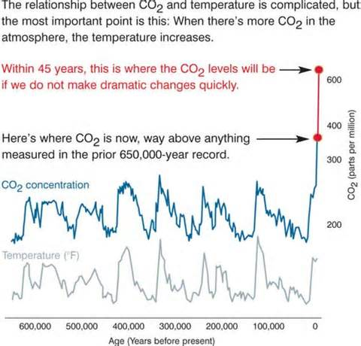
Surprise endings
Notes:
Annotation and surprise ending

Slide 42
Surprise endings
Notes:
Annotation and surprise ending

Slide 43

Technique Selection
Show Extremes
Compare and Contrast
Show Change in Time
Surprise Endings
Notes:
Show extremes/outliers? Compare and Contrast? Show trends over time? Use Surprise? Exploratory discovery? Show how hidden patterns reveal themselves?
How do we keep audience engaged?
How do we maintain context for audience?

Slide 44
INTENT
TECHNIQUE SELECTION
PRESENTATION
TOOLS

Slide 45
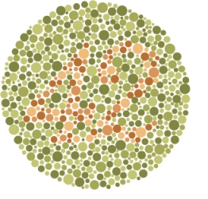
Focus attention

Slide 46
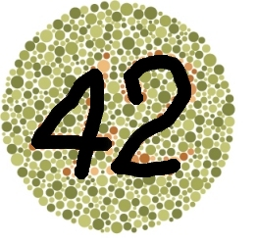
Focus attention

Slide 47
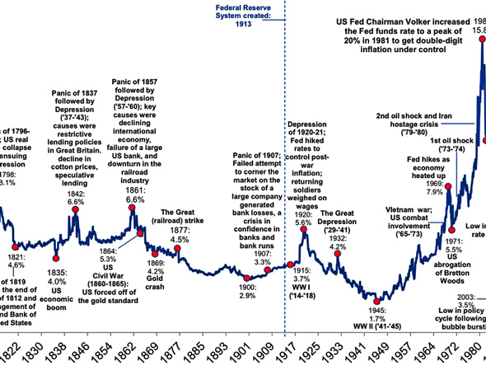
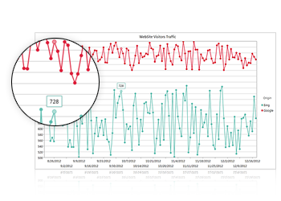
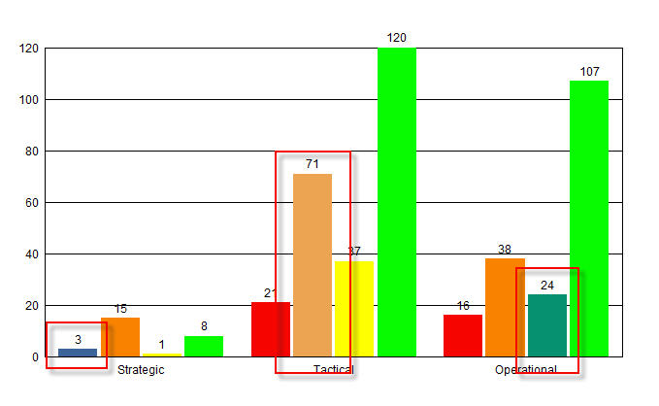
Focus attention (highlighting/annotation/zooming)

Slide 48

Visual Structuring

Slide 49
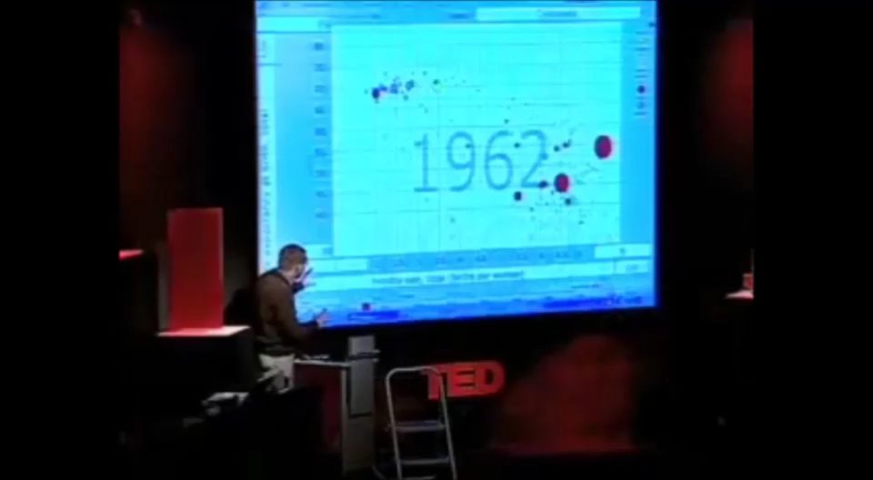
Visual Structuring

Slide 50

Transition guidance

Slide 51
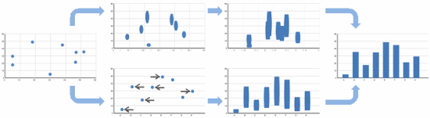
Transition Guidance

Slide 52
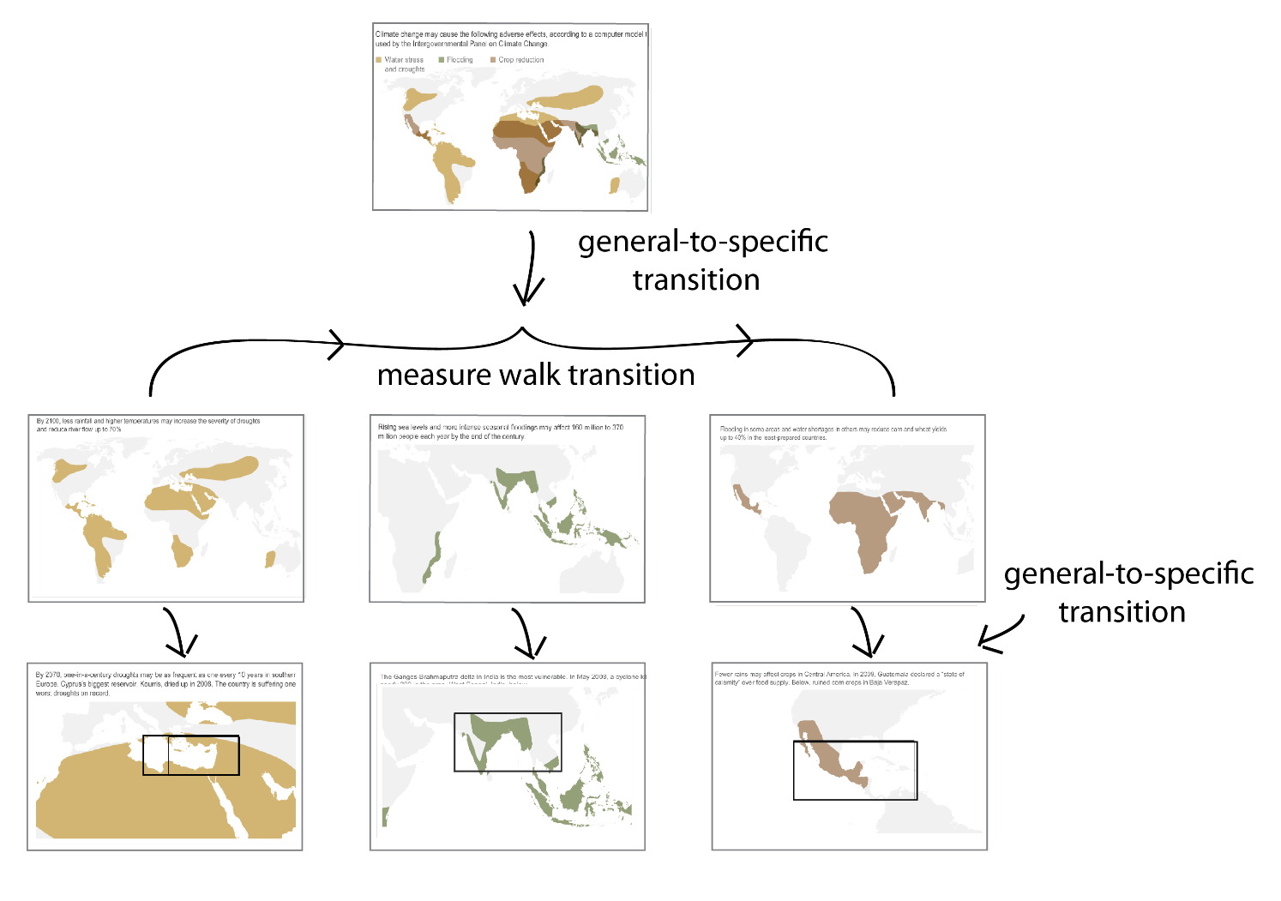
Transition guidance
Hullman, Drucker, Riche, Lee, Fisher, Adar, A Deeper Understanding of Sequence
In Narrative Visualization, To Appear, TVCG, 2013.

Slide 53
PRESENTATION
Focus Attention
Context/Order
Transitions

Slide 54



Summary
TECHNIQUE SELECTION
Show Extremes
Compare and Contrast
Show Change in Time
Surprise Endings
PRESENTATION GUIDANCE
Focus Attention
Context /Order
Transitions

Slide 55
INTENT
TECHNIQUE SELECTION
PRESENTATION
TOOLS

Slide 56
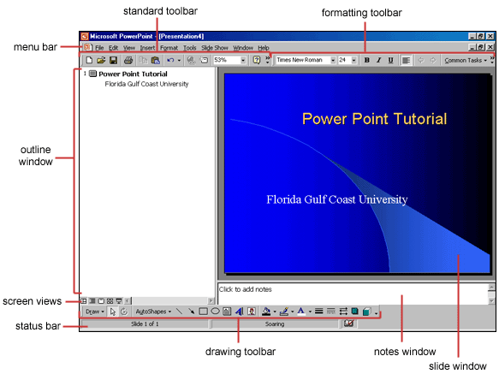
TOOLS: ‘conventional’ approach
Analytic Software
Presentation Software
Notes:
Even have systems like Heer, Mackinlay Graphical Histories, but limited styling support so…

Slide 57
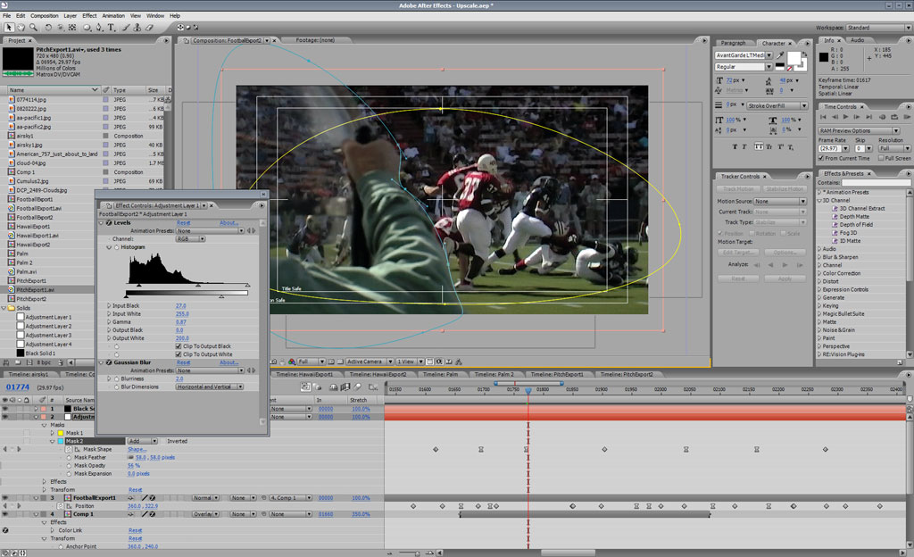
TOOLS:
Analytic Software
Video Editing Software
Notes:
Use animation software, but not well matched input/output, AND data is not alive, changes, etc.

Slide 58
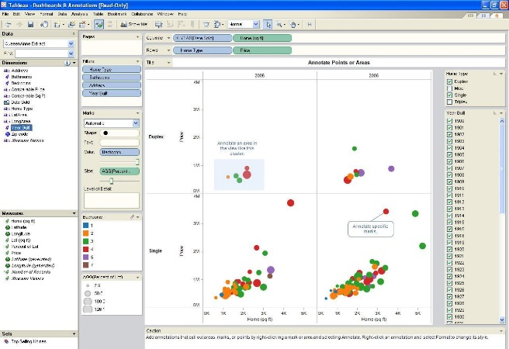
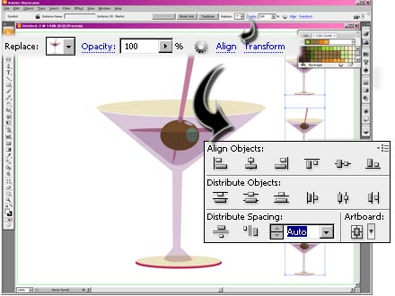
TOOLS:
Analytic Software
Illustration Software
Presentation Software
Notes:
Sometimes move through illustration software, but results are static, so…

Slide 59

Data Binding: Keeping Data Alive
Notes:
This is internal data binding: the chart is bound to itself and its values

Slide 60
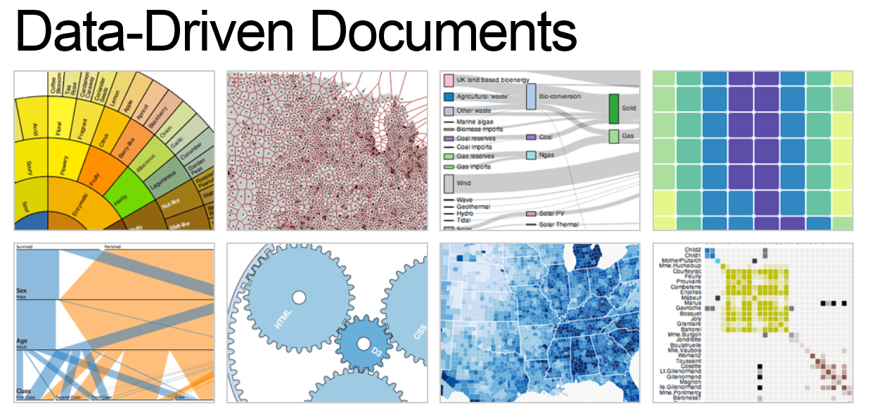

TOOLS: program your own
Bostock & Heer
Fry & Rees

Slide 61
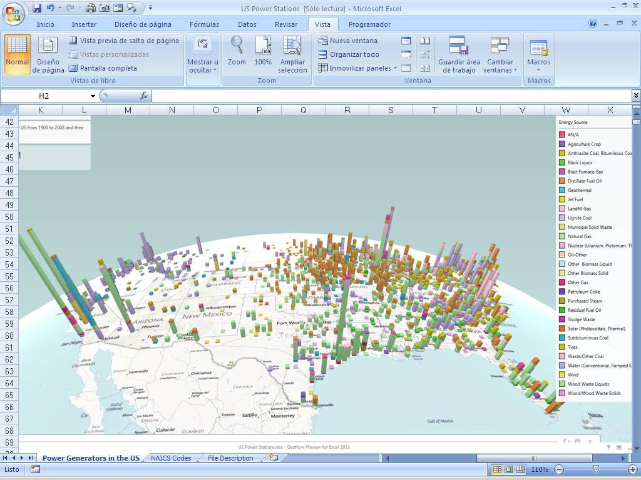
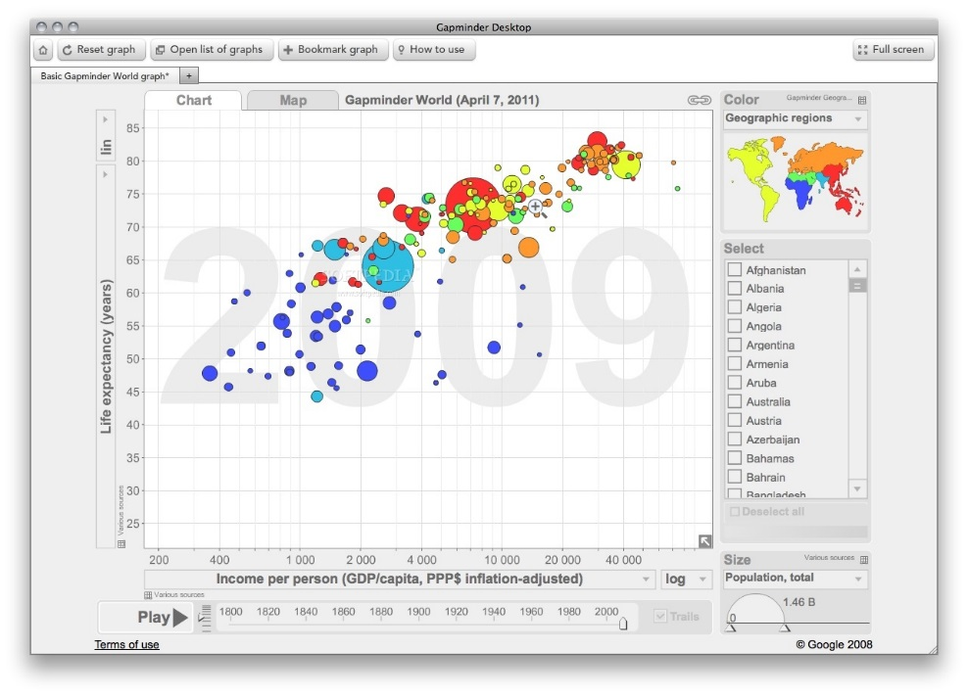
TOOLS: Vertical domains
GeoFlow
Gapminder

Slide 62
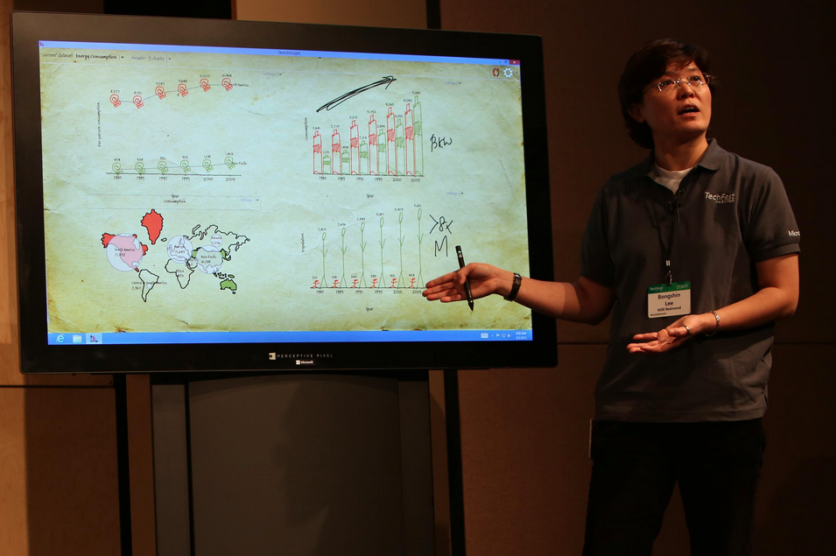
Tools: stylized
SketchStory: Telling More Engaging Stories with Data through Freeform Sketching
Bongshin Lee, Rubaiat Habib Kazi, Greg Smith
SandDance, http://research.Microsoft.com/projects/sanddance
Drucker et al.

Slide 63
A Research Agenda Between the layers
TECHNIQUE SELECTION
PRESENTATION
TOOLS
INTENT
Techniques: Taxonomy, and how they map to intent
Presentation: Taxonomy, and how they map to techniques
Tools: What tools support these techniques?

Slide 64
Research Agenda (cont’d)
What’s the best way to STUDY effectiveness of presentations?
HEART acronym from Rodden?
(Happiness, Engagement, Adoption, Retention, Task Success)
Engagement? Entertaining? Effectiveness? Educational?
(EEEE acronym?)

Slide 65
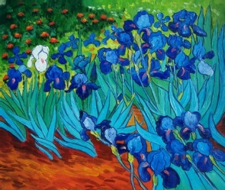
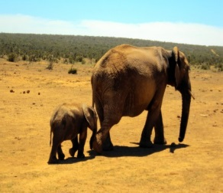



CONCLUSION
TECHNIQUE SELECTION
Show Extremes
Compare and Contrast
Show Change in Time
Surprise Endings
Exploration
Communication
PRESENTATION GUIDANCE
Focus Attention
Context /Order
Transitions
TECHNIQUE SELECTION
PRESENTATION
TOOLS
INTENT
RESEARCH AGENDA

