Slide 1

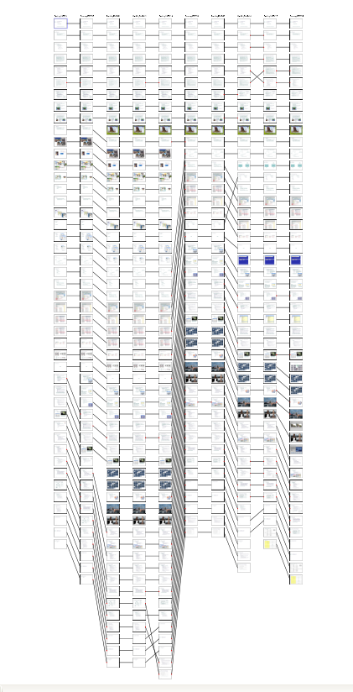
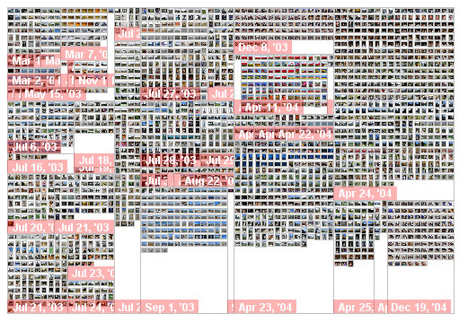
Information Overload meets
Information Visualization:
Building user interfaces to deal with too much information
Steven M. Drucker

Slide 2
Introduction: Information Overload
Digital storage and communications makes an unprecedented amount of material available to people today.
  Email, photos, music, web pages, documents, presentations
More information in a single Sunday New York Times then people encountered in the entire life in the middle ages. §
Estimated 5 exabytes (1 billion gigabytes) of information a year produced in 2003*
Estimated 30 million PowerPoint presentations created per day**
Digital Images, Web pages increasing exponentially
We’re going to focus on subsets of information that we’ve already determined interest us (not addressing search/IR problems)
§ http://www.useit.com/papers/information_overload/
* http://www2.sims.berkeley.edu/research/projects/how-much-info-2003/execsum.htm
** Absolute PowerPoint, New Yorker, 2001.
Notes:
Need to fill in numbers for digital images and web pages

Slide 3
Introduction: Design Iteration
Sketches
Storyboards
Videos
Prototypes
Evaluation
Novel Experiences
Cull
Evaluate
Pick
Iterative Design
Adapted from Bill Buxton: www.billbuxton.com

Slide 4
Introduction: Design Inspiration
Information Visualization Techniques
(adapt UI for specific application or scenario)
Extract features (metadata)
Compute metrics
Redisplay
Show correspondences (Clustering, connecting, selecting)
Label
Filter

Slide 5
Examples
We’ll illustrate this in 3 very different UI’s
in 3 different domains:
PowerPoint Presentations
Web Pages
Digital Photographs

Slide 6
Comparing and Managing Multiple PowerPoint Presentations
(presented at UIST 2006)
Steven M. Drucker (Microsoft Research/LiveLabs)
Maneesh Agrawala (UC Berkeley)
Georg Petschnigg (Microsoft Research)
Notes:
Need to add reference

Slide 7
PowerPoint Presentations
Lots of people have lots of presentations
  Estimated 30 million PowerPoint presentations created per day
Multiple versions of presentations:
  Different audiences
  Different iterations
  Working with collaborators
No good tools for working with multiple presentations
  Reuse slides
  Find differences between versions
We set out to create tools for visually comparing and managing multiple versions of presentations

Slide 8
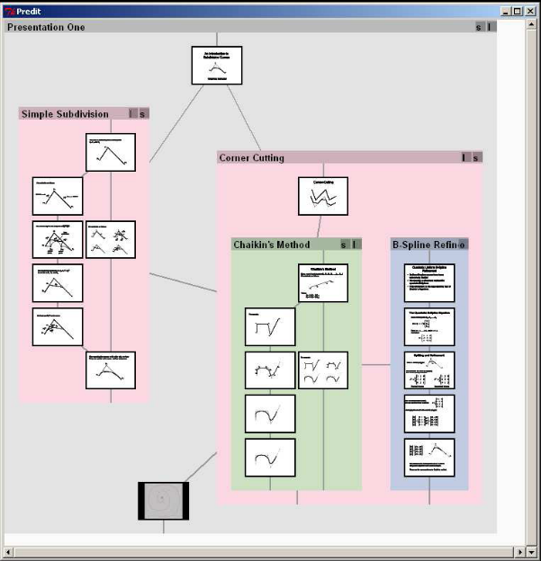
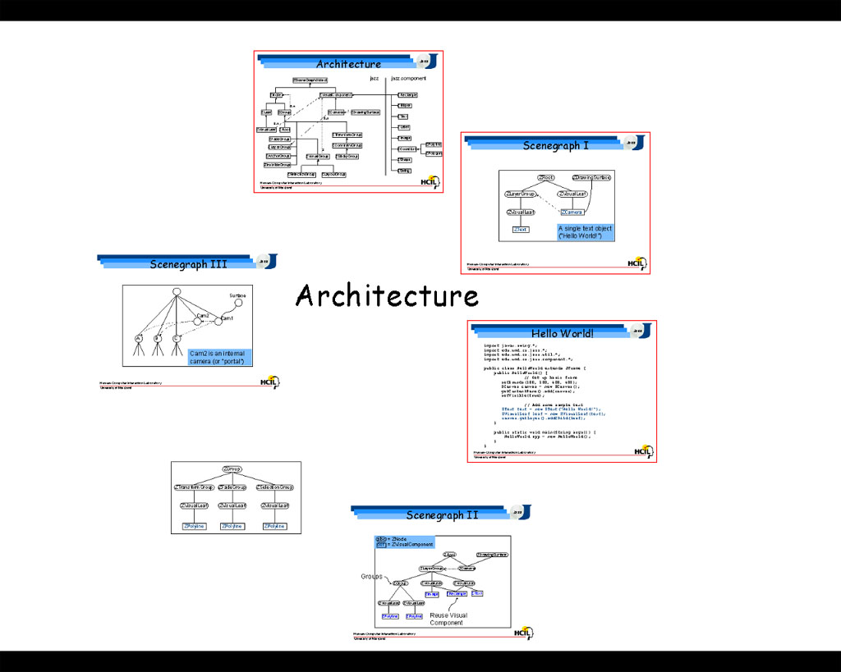
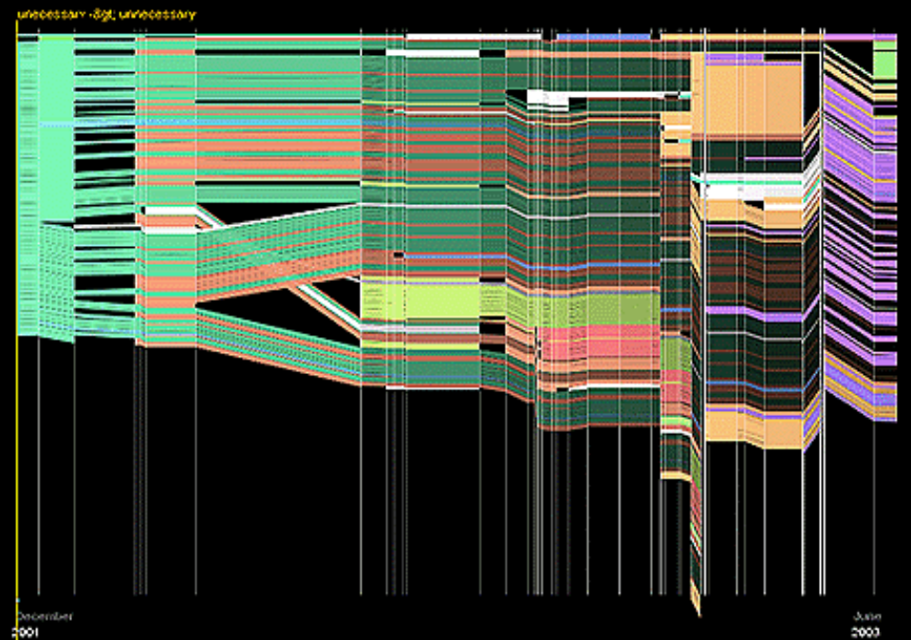
Related work:
Good and Bederson, Counterpoint, 2002
Moscovich et al. Customizable presentations, 2004
Viégas et al. History Flow, 2004.

Slide 9
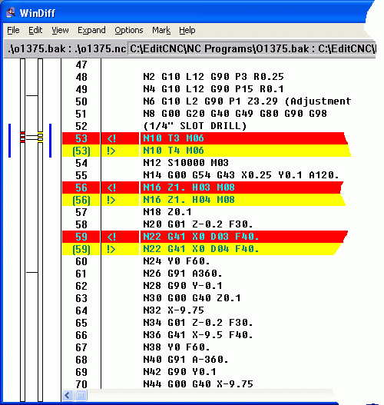
WinDiff
, but for Presentations
Presentations can differ in many ways
  Slide order
  Style Change
  Text change: title, body, footer.
  Changes in diagrams or pictures on slides
What slides correspond with each other from one presentation to the next?
How do we show those changes to users?
Myers, E. W. [1986]. An O(ND) difference algorithm and its variations, Algorithmica 1

Slide 10
Framework for comparing presentations
Input
Presentations
Extract Features
from Slides
Compute Distances
Between Slides
Compute
Corresponding
Slides
Display
Results

Slide 11

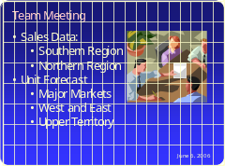
Slide features:
Extract Features from Slides
Slide Title
Team Meeting
Body Text
Sales Data:
  Southern Region
  Northern Region
Unit Forecast
  Major Markets
  West and East
  Upper Territory
Slide ID
Picture ID
Bitmap
Footer
June 6, 2006

Slide 12
Framework for comparing presentations
Input
Presentations
Extract Features
from Slides
Compute Distances
Between Slides
Compute
Corresponding
Slides
Display
Results

Slide 13
Distance computation:
Compute Distances Between Slides
A
B
Compute distances between features between every slide of presentation A with every slide of presentation B
Image Distance
Text Distance
Slide ID and Picture ID distances
Composite Distances
.
.
.

Slide 14
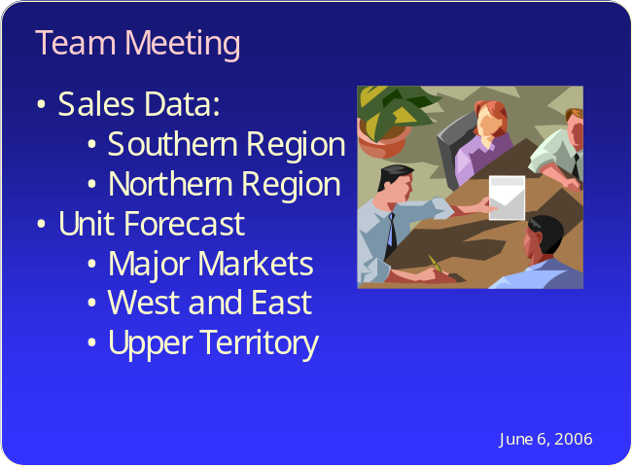
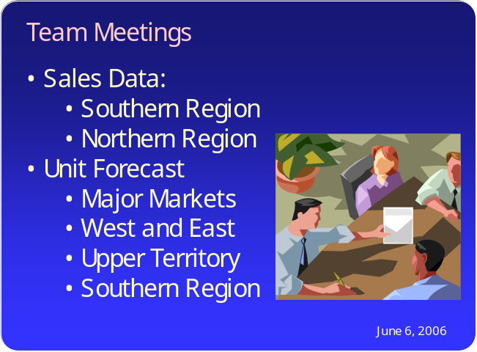
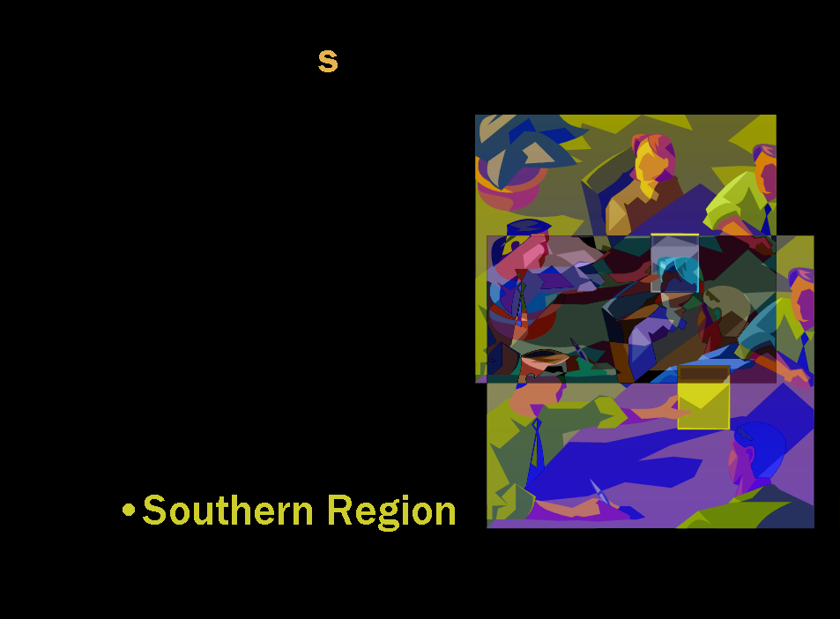
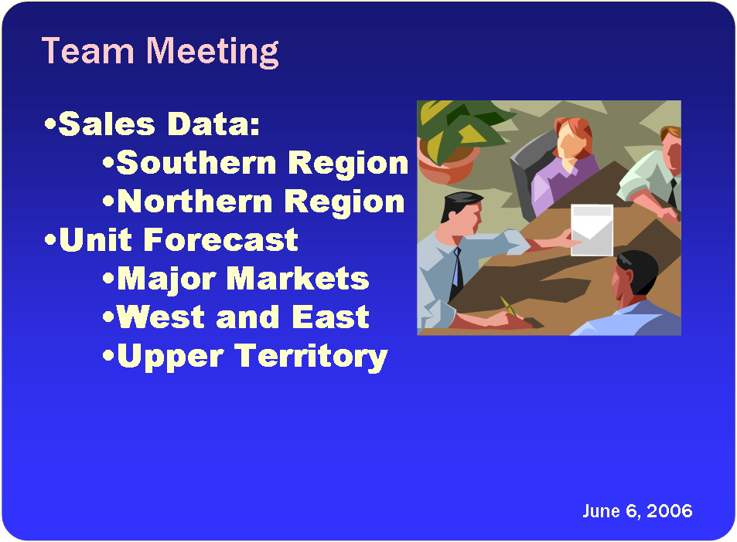
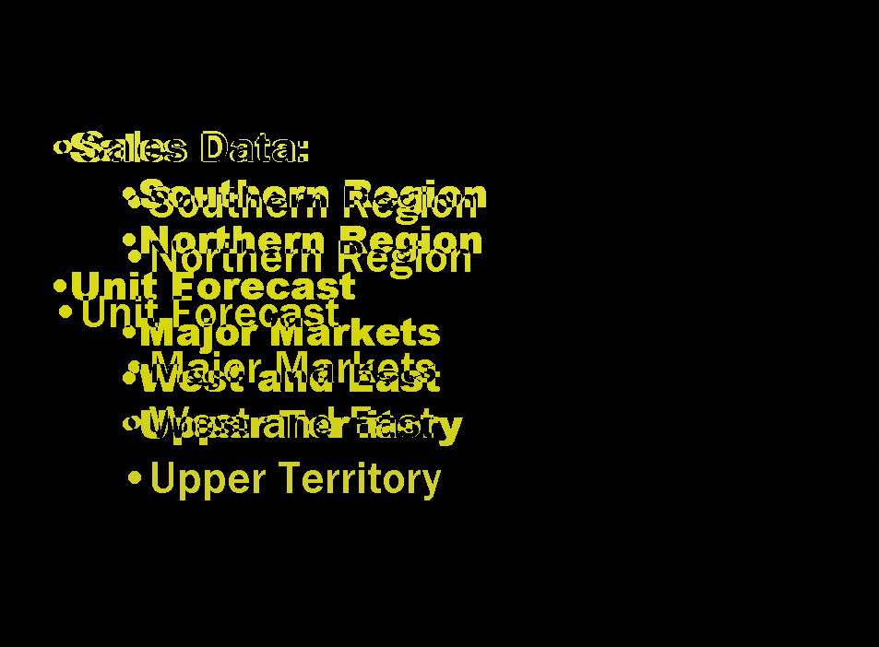
Image distances
Compute Distances Between Slides
MSE: 145
MSE: 121

Slide 15
Text Distances
Compute Distances Between Slides
Use String Edit Distance (Levenshtein) to find distance between sequences of characters (count the number of insertions, deletions, and replacements to go from one string to another)
Treat Title Text, Body Text and Footer Text separately
String Edit Distance algorithms also useful for calculating optimal alignment
SURGERY -> SURVEY
S
U
R
G
E
R
Y
String Edit Distance of 2
S
U
R
V
E
Y

Slide 16
Other distances
Compute Distances Between Slides
Slide ID Distance: Matching Slide IDs = 0
  Based on when slides were created.
  Similar to track changes
Picture ID Distance:
  Number of matching pictures between slides
  Useful when pictures are moved or resized, but not changed

Slide 17
Framework for comparing presentations
Input
Presentations
Extract Features
from Slides
Compute Distances
Between Slides
Compute
Corresponding
Slides
Display
Results

Slide 18
Greedy thresholded
Compute Corresponding Slides
Create a correspondence between the minimum distance pair subject to a distance threshold.
Remove both slides from further consideration.
Repeat until no more correspondences can be found.
6
5
7
3
9
1
4
6
3
Heckel, P. 1978. A technique for isolating differences between files.
Comm. of the ACM 21, 4. pp. 264–268.

Slide 19
Greedy thresholded
Compute Corresponding Slides
Create a correspondence between the minimum distance pair subject to a distance threshold.
Remove both slides from further consideration.
Repeat until no more correspondences can be found.
7
9
6
Heckel, P. 1978. A technique for isolating differences between files.
Comm. of the ACM 21, 4. pp. 264–268.

Slide 20
Framework for comparing presentations
Input
Presentations
Extract Features
from Slides
Compute Distances
Between Slides
Compute
Corresponding
Slides
Display
Results

Slide 21
Visualizing correspondences
Display Results
Image correspondences
slideID correspondences
text correspondences

Slide 22
Aligning correspondences
Display Results
Image correspondences

Slide 23
Multiple presentations
Display Results

Slide 24
Aligning correspondences
Display Results

Slide 25
Aligning correspondences
Display Results

Slide 26
Aligning correspondences
Display Results

Slide 27
Hiding visually similar slides
Display Results

Slide 28
Emphasizing differences
Display Results

Slide 29
Emphasizing differences
Display Results

Slide 30
1 to many comparisons
Display Results
v 1
v 2
v 3

Slide 31
DEMO

Slide 32
Future work:
Incorporate into better assembly workflow
Work with animations and other types of comparisons
Automatic clustering for directories of many presentations
Deploy and study

Slide 33
PowerPoint Visualization Conclusions
Useful features to extract:
  Slide appearance
  Slide ID
  Slide Text (keep different text separate – body, titles, footers)
  Combinations (text staying same while visual appearance changes)
Create framework for adding incorporating new features and distances
Use extracted features and calculated distances to layout many simultaneous presentations

Slide 34
Summarizing Personal Web Browsing Sessions (presented at UIST 2006)
Mira Dontcheva: University of Washington
Steven M. Drucker: Microsoft Research/LiveLabs
Michael Cohen: Microsoft Research
David Salesin: University of Washington/Adobe
Geraldine Wade: Microsoft
Notes:
Add reference

Slide 35
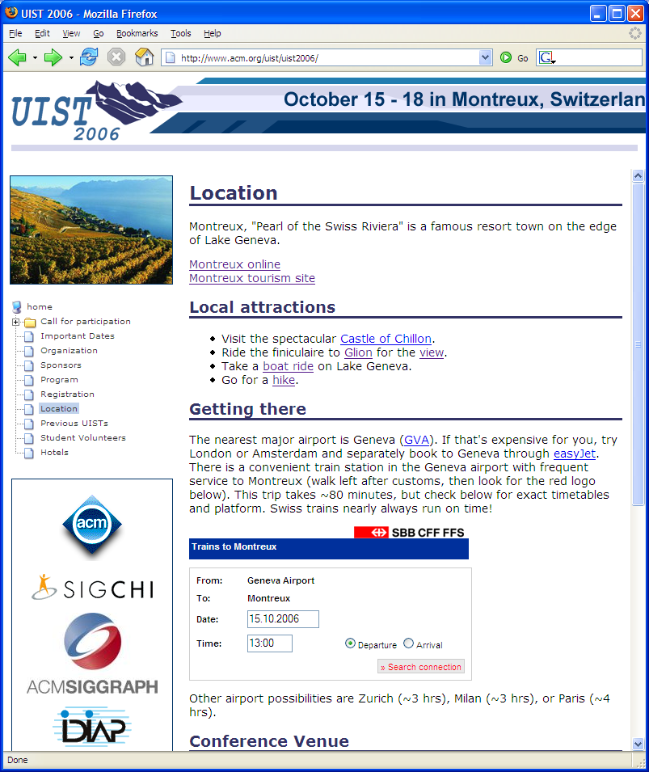

Slide 36
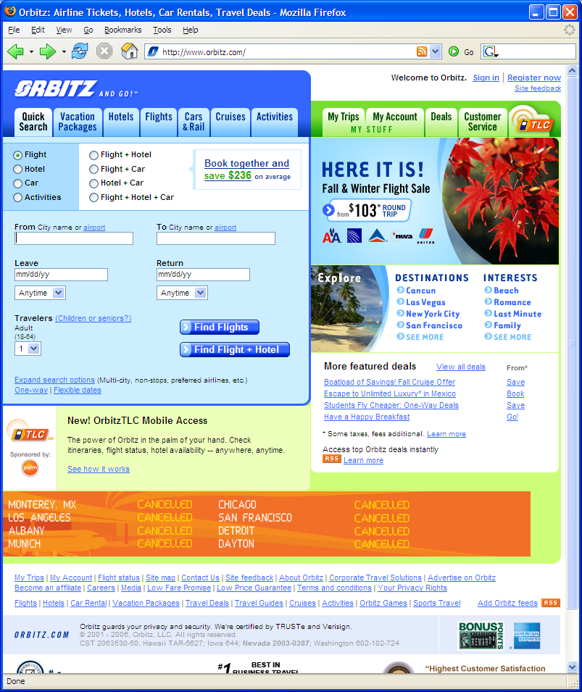
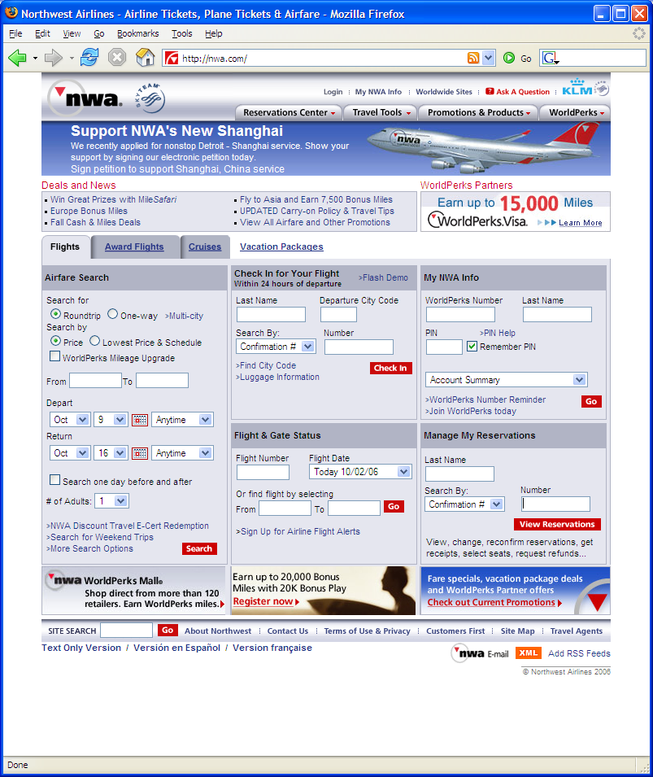
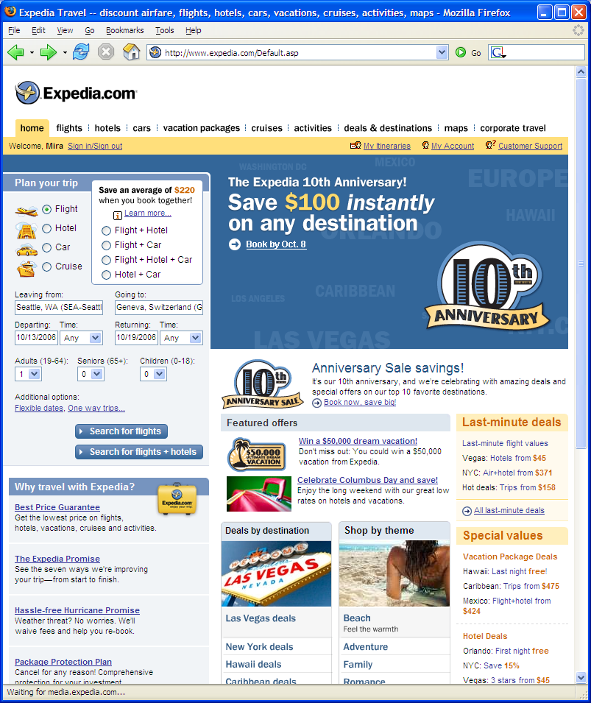

Slide 37
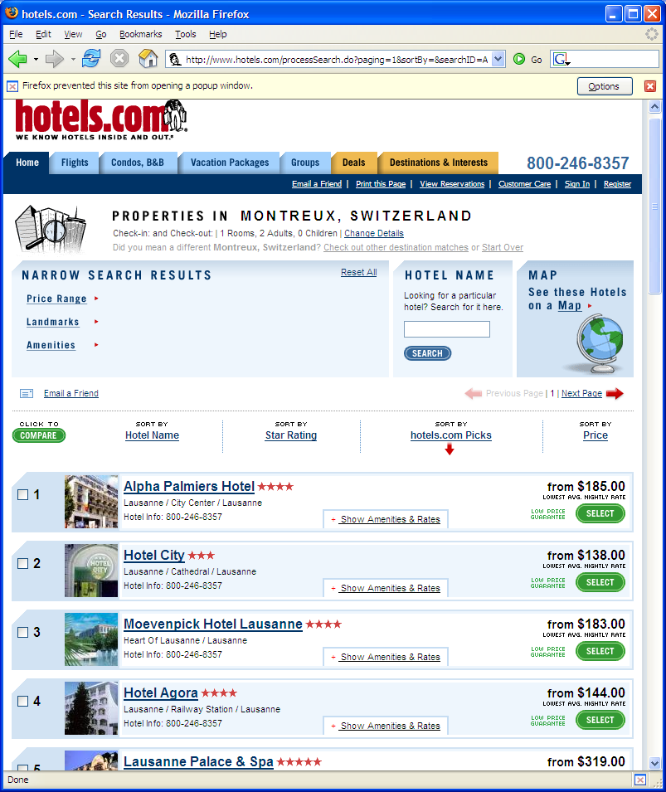
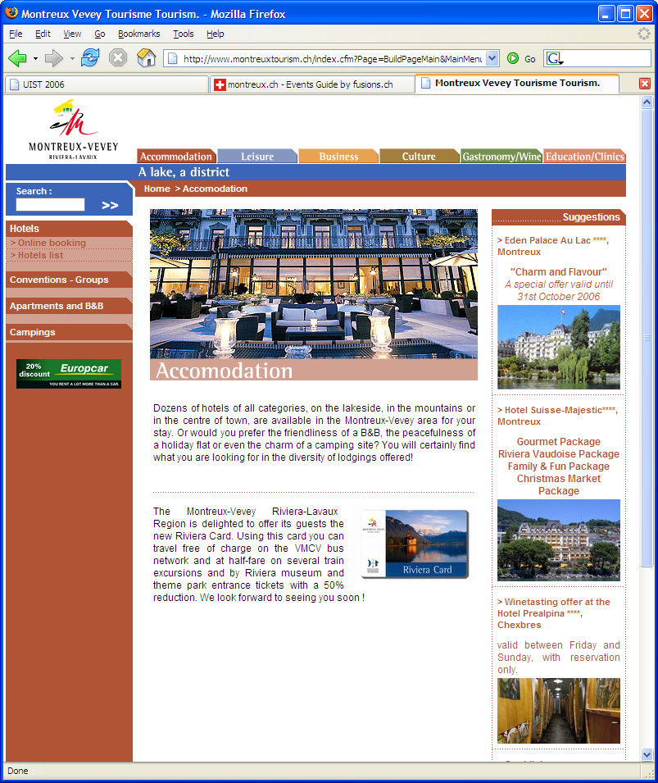
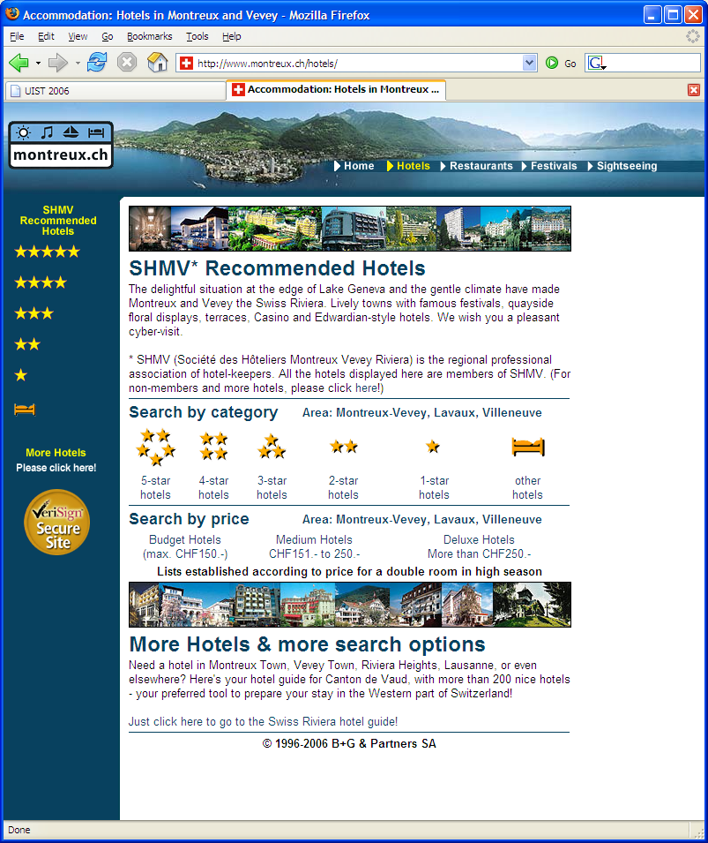

Slide 38
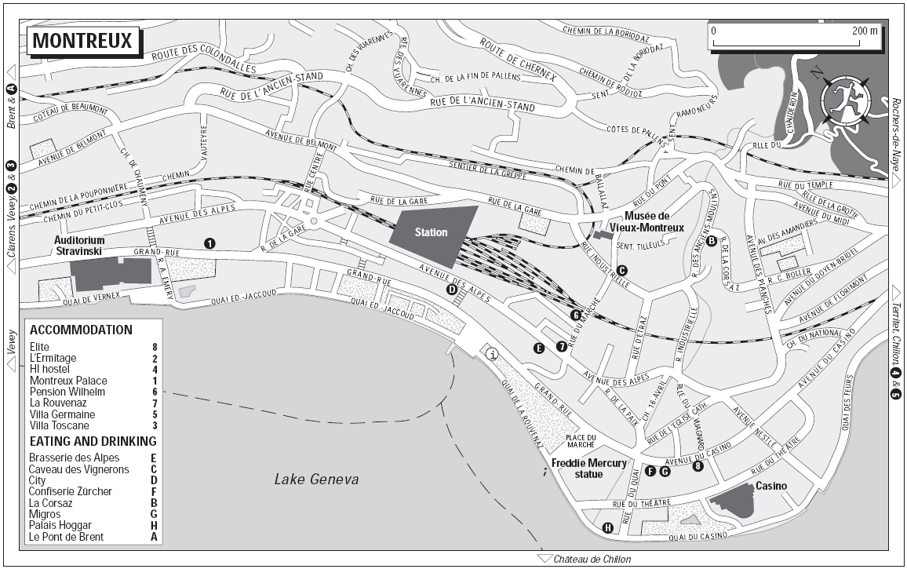

Slide 39
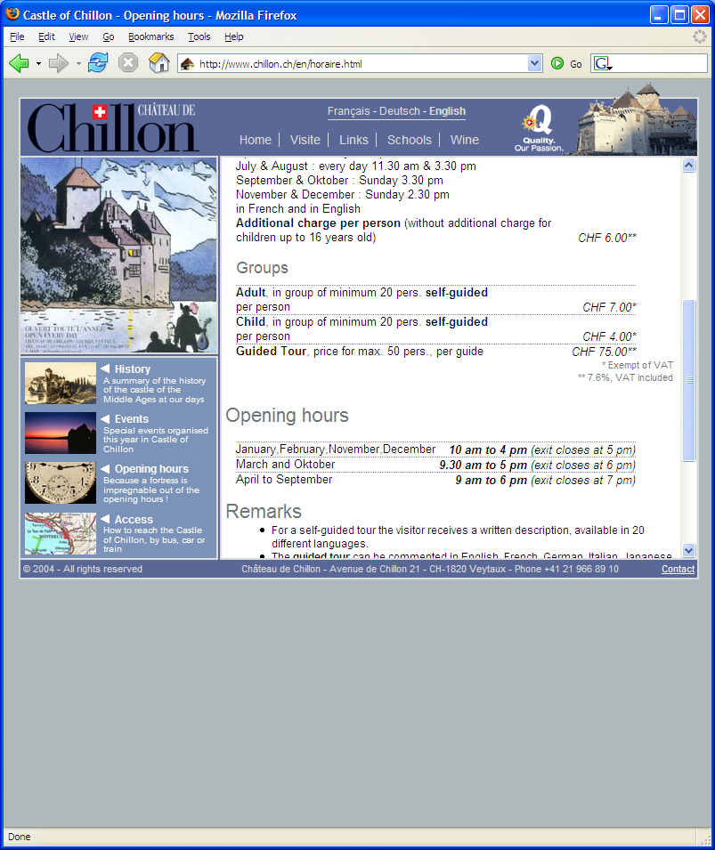
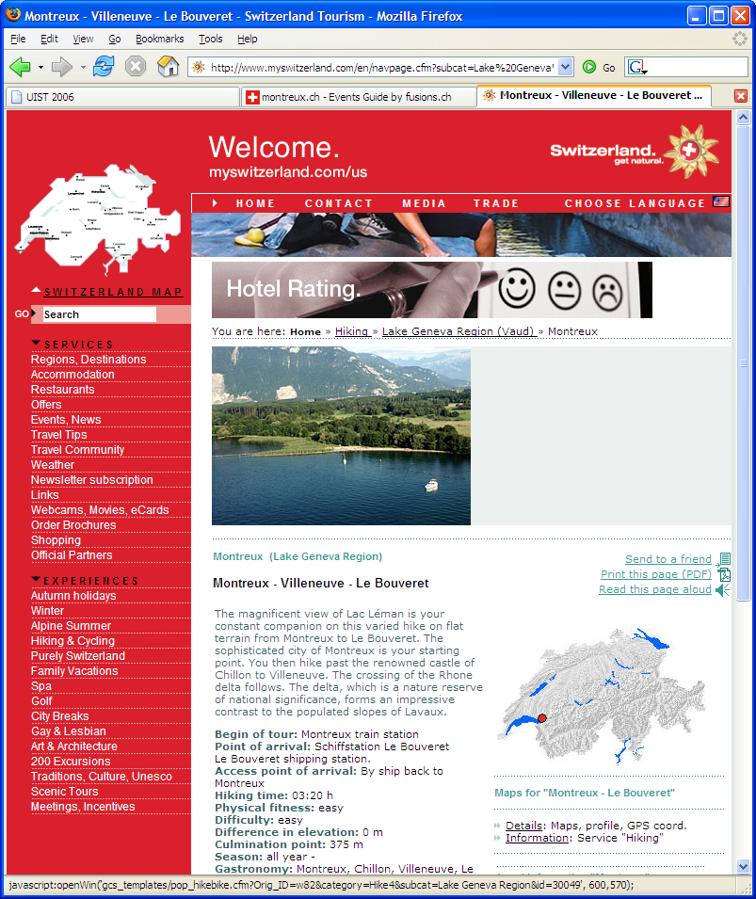
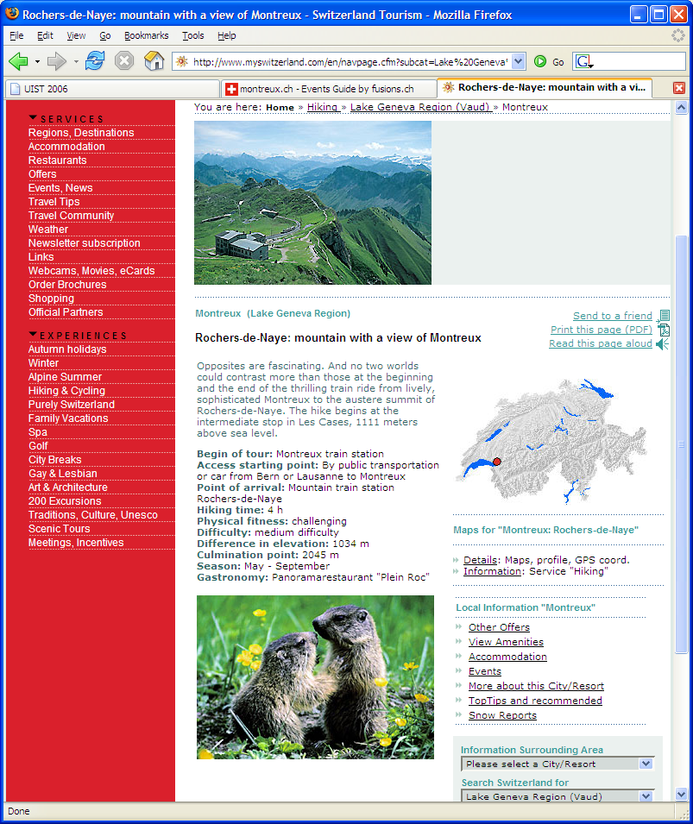

Slide 40
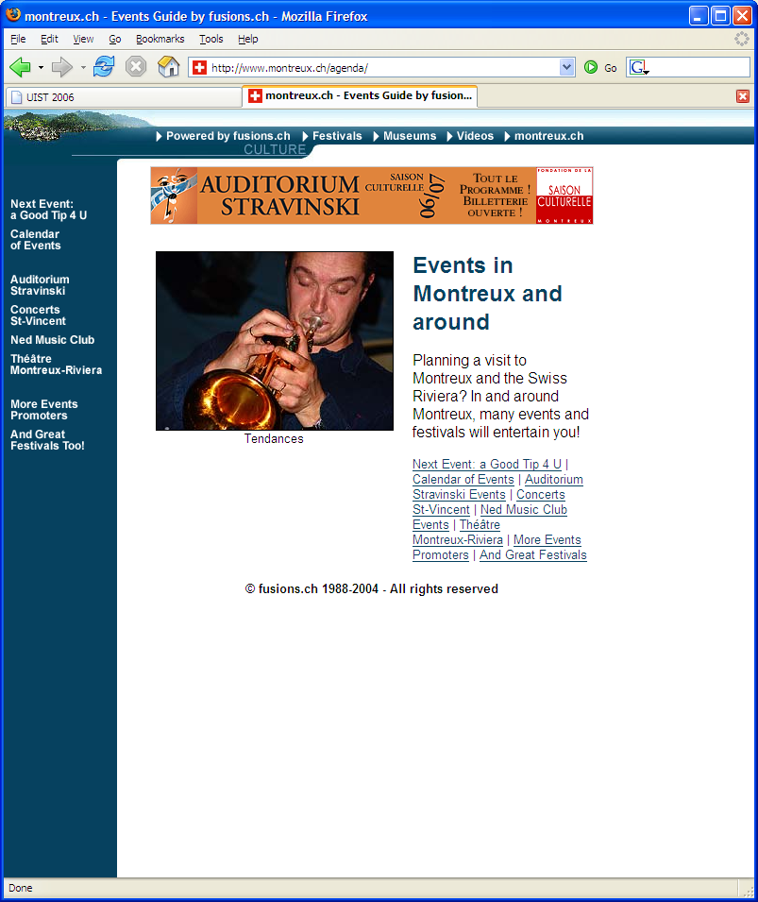
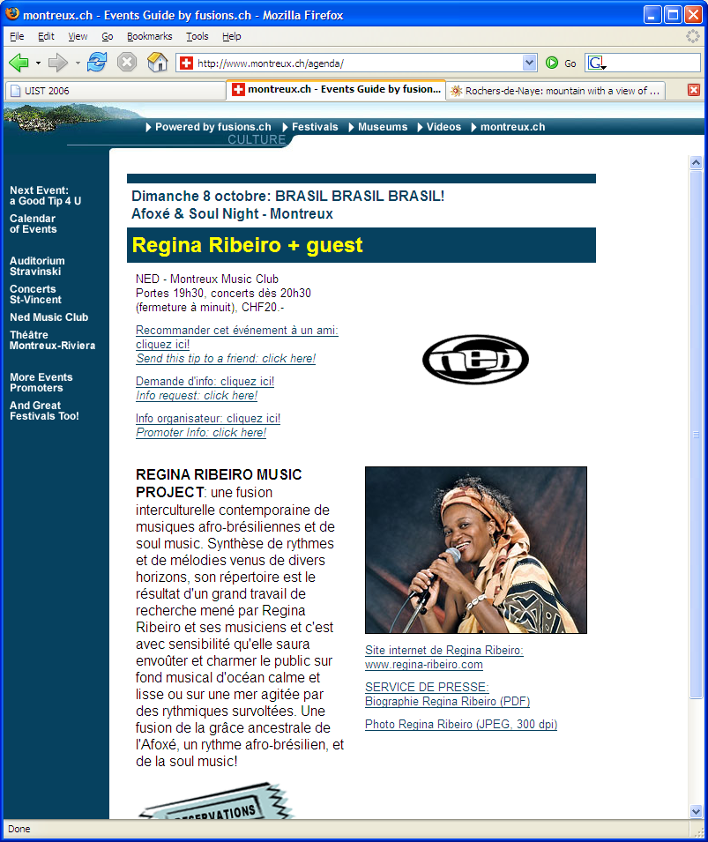

Slide 41
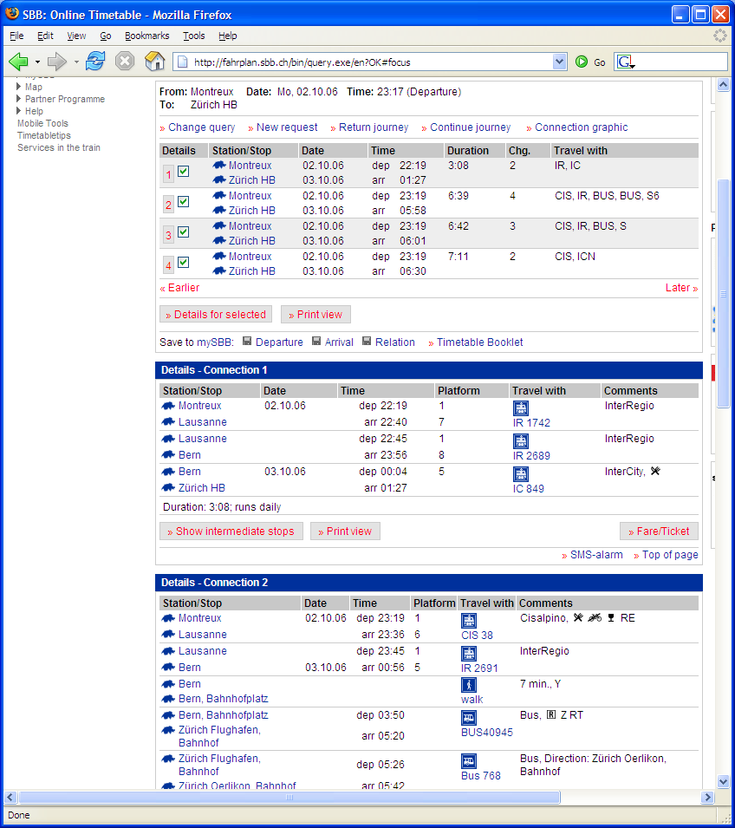
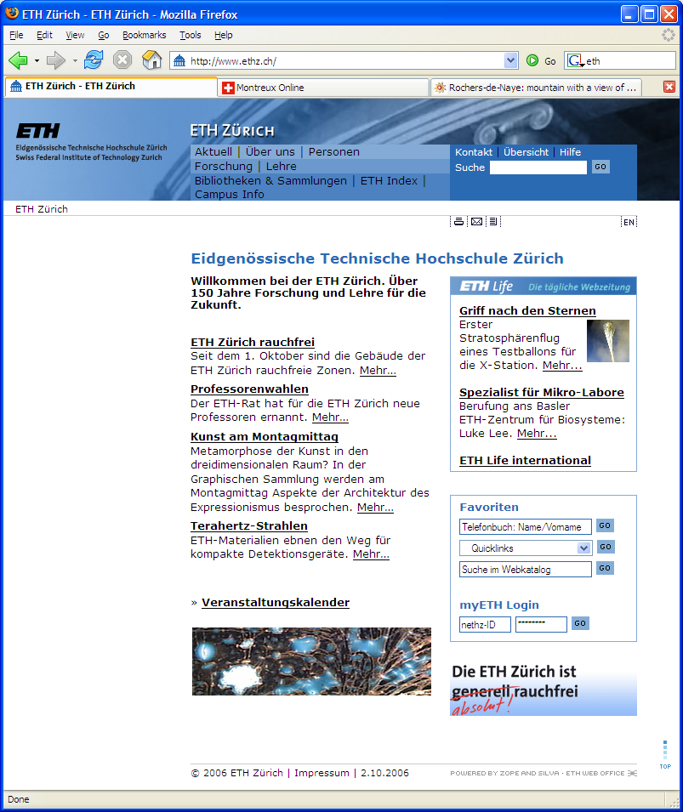

Slide 42
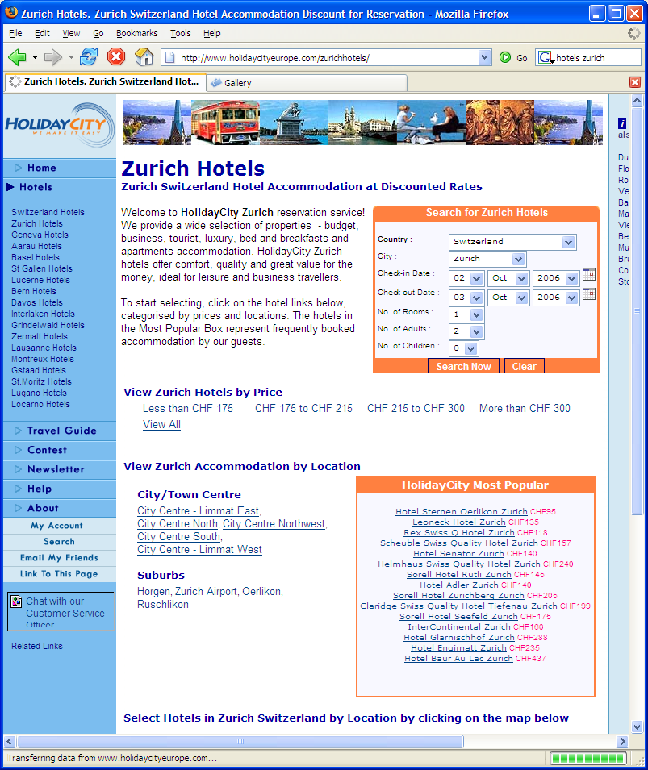
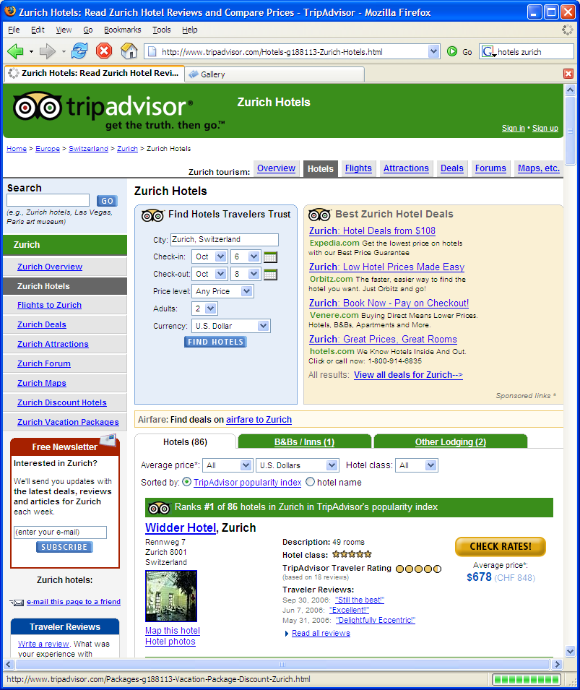

Slide 43
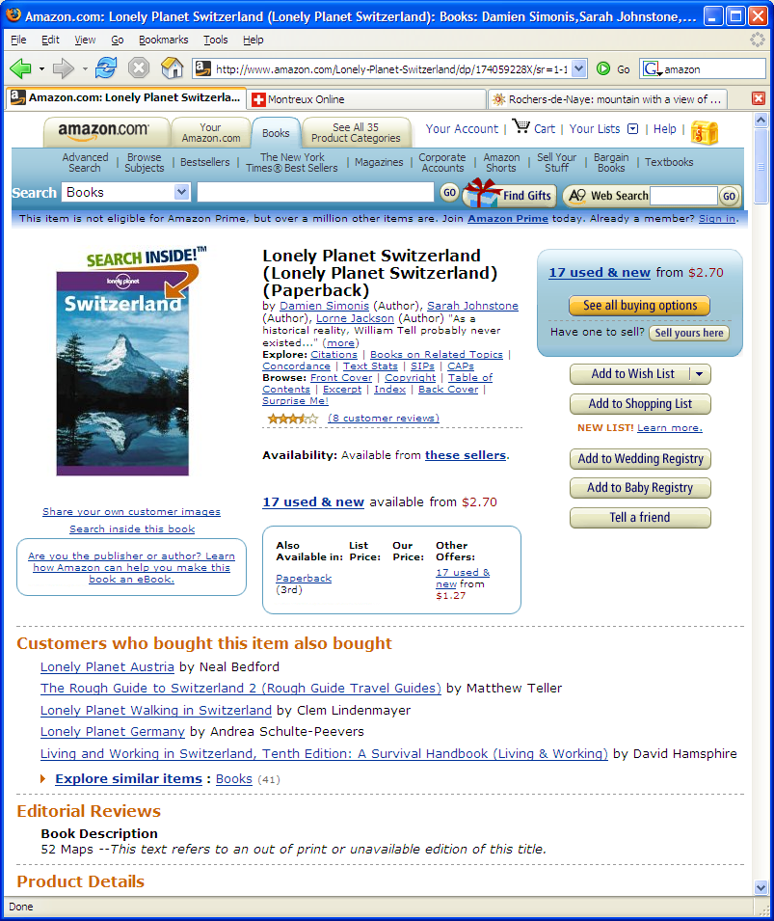

Slide 44
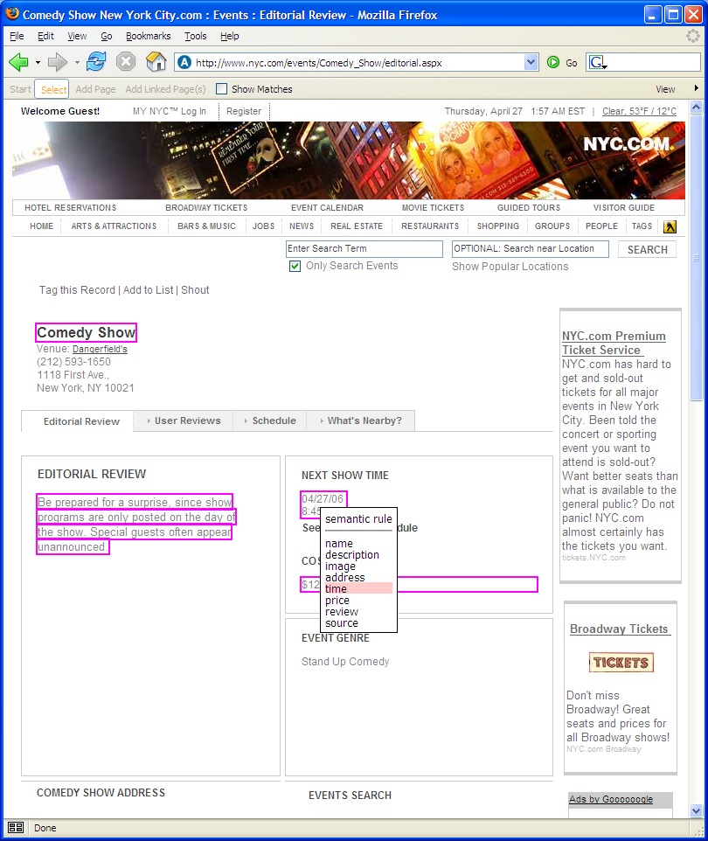
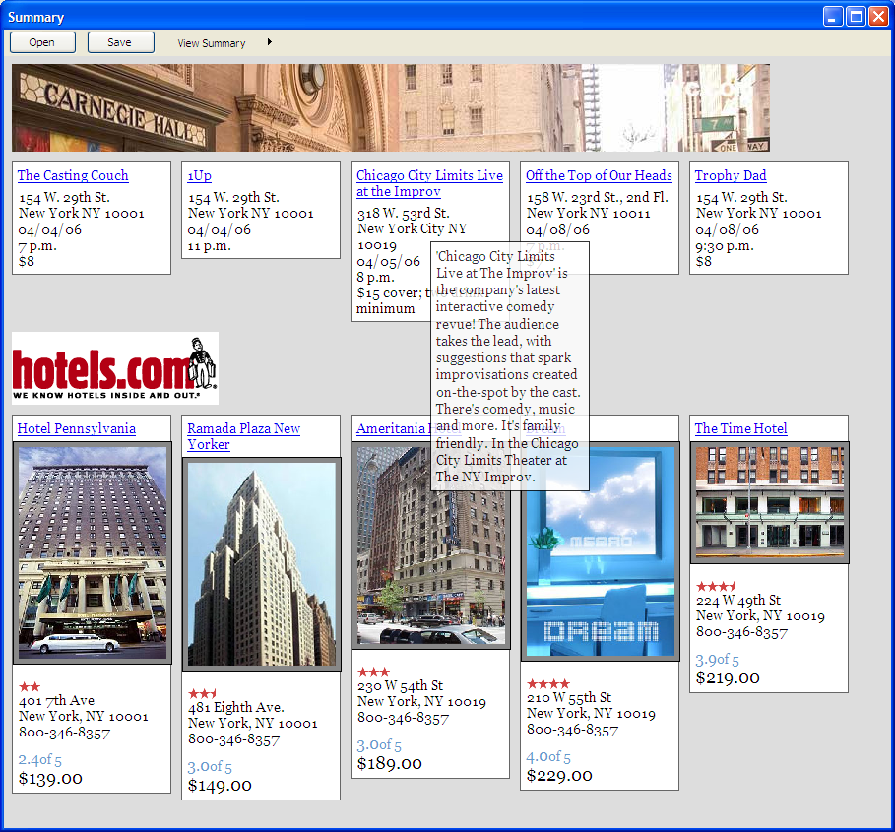
Our Approach
Notes:
Our approach comes in two steps. First we provide a semi-automatic mechanism for collecting web content. The user can specify the information he cares and and given this specification we can then automatically extract similar content. Second through the use of layout templates we create visual summaries of the content. So first let’s take a look at the extraction part. Since we are already here in Montreux and we have all already done our planning, let’s now plan next year’s UIST, which will be in Boston.

Slide 45
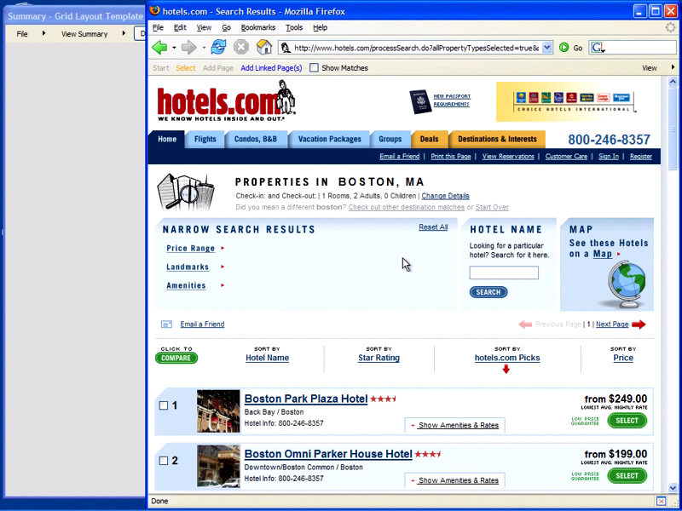
video
Notes:
So first let’s take a look at some possible hotels. First let me say that our system lives as a browser extension and is available to the user through a toolbar and this toolbar opens a window where the user can collect content. So this hotel looks good. To save this hotel I press the select button start selecting webpage elements. You notice that as I move the mouse over the webpage different webpage elements become selectable. To select a webpage element I just click and then tag the element with the appropriate label. In this way I select the name, address, image, description and price of this hotel. When I am done, I press select again and now the information is stored in my summary. Now, when I go to a new hotel page and I want to save this hotel, all I have to do is say “Add Page” and the content is automatically added to my summary. Even better, I don’t have to visit actual webpages. With the “Add Linked Pages” button, I can select any number of hyperlinks and the content from the subsequent pages will be added to my summary. The content is being displayed through the user of a layout template, which is why the description for each hotel is only available through mouse-over. I will show you more layout templates a little bit later but first let’s take a closer look at how we make this happen.
Now I know next year’s UIST is still a ways away but those of you who are planning to go, know that is in Boston, and so to make my demo a little bit more intersting
Demo
Add hotels
Add some hikes
Show that both are in the same format although from different webpages
Define terminology
Extraction patterns
Webpage element
Layout templates

Slide 46
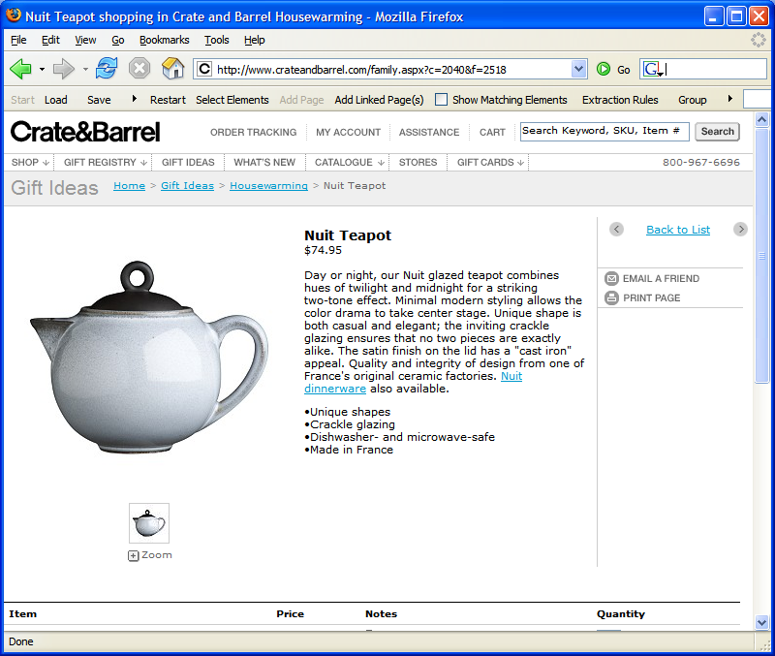
Notes:
Every webpage is represented by a tree of html nodes. And this tree can be accessed through the Document Object Model. Every node in the tree then corresponds to a selectable element in a webpage. We use this DOM structure to provide selectable elements to the user. For a given selection, we build an extraction rule that corresponds to the path from the corresponding node to the root of the tree and store the rule and corresponding page element. We build extraction rules for all selected elements and store the rules and page elements locally. The page elements are stored in a database according to the labels specified by the user. When the user goes to a new webpage, each rule is matched against the new DOM tree. If there is a match, the matching page element can be stored. If there isn’t a matching element, the rule is not used. We group the extraction rules into extraction patterns and as the user creates new patterns, we apply the pattern that matches the highest number of page elements. To compose the gathered content into a visual summary, we use layout templates. The templates are defined with respect to the labels assigned by the user. Each layout template specifies how the elements are organized, the element formatting, and a set of interactions that define how the user can interact with the summary.

Slide 47
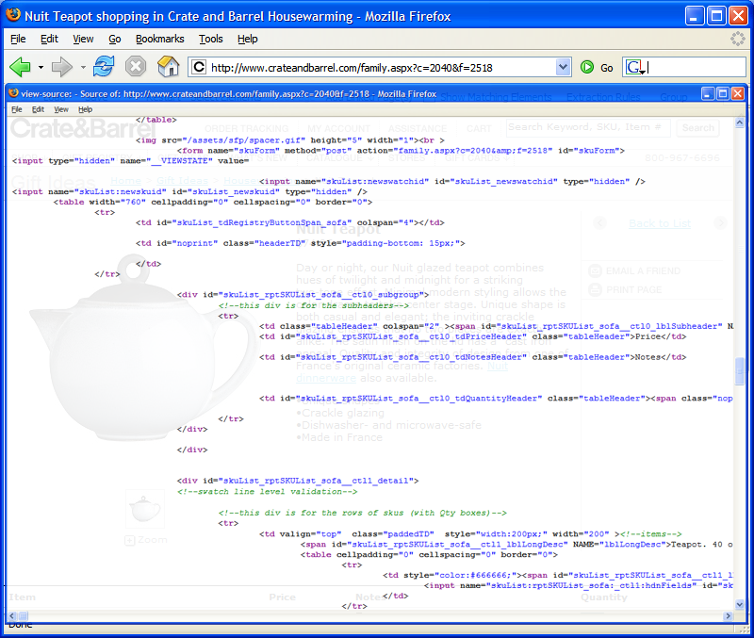
Notes:
Every webpage is represented by a tree of html nodes. And this tree can be accessed through the Document Object Model. Every element in a webpage than corresponds to a node in the tree. We use this DOM structure to provide selectable elements to the user. For a given selection, we build an extraction rule that corresponds to the path from the corresponding node to the root of the tree and store the rule and corresponding page element. We build extraction rules for all selectable elements and store the rules and page elements locally. The page elements are stored in a database according to the labels specified by the user. When the user goes to a new webpage, each rule is matched against the new DOM tree. If there is a match, the matching page element can be stored. If there isn’t a matching element, the rule is not used. We group the extraction rules into extraction patterns and as the user creates new patterns, we apply the pattern that matches the highest number of page elements. To compose the gathered content into a visual summary, we use layout templates. The templates are defined with respect to the labels assigned by the user. Each layout template specifies how the elements are organized, the element formatting, and a set of interactions that define how the user can interact with the summary.

Slide 48
Document Object Model
<html>
<body>
...
<table>
<p>
<tr>
<br>
<table>
...
<td>
<td>
<td>
<td>
<input>
<p>
<i>
<span>
<image>
Notes:
Every webpage is represented by a tree of html nodes. And this tree can be accessed through the Document Object Model. Every element in a webpage than corresponds to a node in the tree. We use this DOM structure to provide selectable elements to the user. For a given selection, we build an extraction rule that corresponds to the path from the corresponding node to the root of the tree and store the rule and corresponding page element. We build extraction rules for all selectable elements and store the rules and page elements locally. The page elements are stored in a database according to the labels specified by the user. When the user goes to a new webpage, each rule is matched against the new DOM tree. If there is a match, the matching page element can be stored. If there isn’t a matching element, the rule is not used. We group the extraction rules into extraction patterns and as the user creates new patterns, we apply the pattern that matches the highest number of page elements. To compose the gathered content into a visual summary, we use layout templates. The templates are defined with respect to the labels assigned by the user. Each layout template specifies how the elements are organized, the element formatting, and a set of interactions that define how the user can interact with the summary.

Slide 49
<html>
<head>
<body>
<br>
<table>
<table>
<tr>
<tr>
<img>
<p>
<td>
<table>
<table>
<span>
<tr>
<tr>
<tr>
<tr>
<img>
<td>
<td>
<div>
<p>
<div>
<span>
<div>
<b>
<i>
<img>
<p>
<i>
<i>
Notes:
Every webpage is represented by a tree of html nodes. And this tree can be accessed through the Document Object Model. Every element in a webpage than corresponds to a node in the tree. We use this DOM structure to provide selectable elements to the user. For a given selection, we build an extraction rule that corresponds to the path from the corresponding node to the root of the tree and store the rule and corresponding page element. We build extraction rules for all selectable elements and store the rules and page elements locally. The page elements are stored in a database according to the labels specified by the user. When the user goes to a new webpage, each rule is matched against the new DOM tree. If there is a match, the matching page element can be stored. If there isn’t a matching element, the rule is not used. We group the extraction rules into extraction patterns and as the user creates new patterns, we apply the pattern that matches the highest number of page elements. To compose the gathered content into a visual summary, we use layout templates. The templates are defined with respect to the labels assigned by the user. Each layout template specifies how the elements are organized, the element formatting, and a set of interactions that define how the user can interact with the summary.

Slide 50
<html>
<head>
<body>
<br>
<table>
<table>
<tr>
<tr>
<img>
<p>
<td>
<table>
<table>
<span>
<tr>
<tr>
<tr>
<tr>
<img>
<td>
<td>
<div>
<p>
<div>
<span>
<div>
<b>
<i>
<img>
<a>
<p>
<i>
<i>
Notes:
Every webpage is represented by a tree of html nodes. And this tree can be accessed through the Document Object Model. Every element in a webpage than corresponds to a node in the tree. We use this DOM structure to provide selectable elements to the user. For a given selection, we build an extraction rule that corresponds to the path from the corresponding node to the root of the tree and store the rule and corresponding page element. We build extraction rules for all selectable elements and store the rules and page elements locally. The page elements are stored in a database according to the labels specified by the user. When the user goes to a new webpage, each rule is matched against the new DOM tree. If there is a match, the matching page element can be stored. If there isn’t a matching element, the rule is not used. We group the extraction rules into extraction patterns and as the user creates new patterns, we apply the pattern that matches the highest number of page elements. To compose the gathered content into a visual summary, we use layout templates. The templates are defined with respect to the labels assigned by the user. Each layout template specifies how the elements are organized, the element formatting, and a set of interactions that define how the user can interact with the summary.

Slide 51
<html>
<head>
<body>
<br>
<table>
<table>
<tr>
<tr>
<img>
<p>
<td>
<table>
<table>
<span>
<tr>
<tr>
<tr>
<tr>
<img>
<td>
<td>
<div>
<p>
<div>
<span>
<div>
<b>
<i>
<img>
<a>
<p>
<i>
<i>
Notes:
Every webpage is represented by a tree of html nodes. And this tree can be accessed through the Document Object Model. Every element in a webpage than corresponds to a node in the tree. We use this DOM structure to provide selectable elements to the user. For a given selection, we build an extraction rule that corresponds to the path from the corresponding node to the root of the tree and store the rule and corresponding page element. We build extraction rules for all selectable elements and store the rules and page elements locally. The page elements are stored in a database according to the labels specified by the user. When the user goes to a new webpage, each rule is matched against the new DOM tree. If there is a match, the matching page element can be stored. If there isn’t a matching element, the rule is not used. We group the extraction rules into extraction patterns and as the user creates new patterns, we apply the pattern that matches the highest number of page elements. To compose the gathered content into a visual summary, we use layout templates. The templates are defined with respect to the labels assigned by the user. Each layout template specifies how the elements are organized, the element formatting, and a set of interactions that define how the user can interact with the summary.

Slide 52
<html>
<head>
<body>
<br>
<table>
<table>
<tr>
<tr>
<img>
<p>
<td>
<table>
<table>
<span>
<tr>
<tr>
<tr>
<tr>
<img>
<td>
<td>
<div>
<p>
<div>
<span>
<div>
<b>
<i>
<img>
<a>
<p>
<i>
<i>
Notes:
Every webpage is represented by a tree of html nodes. And this tree can be accessed through the Document Object Model. Every element in a webpage than corresponds to a node in the tree. We use this DOM structure to provide selectable elements to the user. For a given selection, we build an extraction rule that corresponds to the path from the corresponding node to the root of the tree and store the rule and corresponding page element. We build extraction rules for all selectable elements and store the rules and page elements locally. The page elements are stored in a database according to the labels specified by the user. When the user goes to a new webpage, each rule is matched against the new DOM tree. If there is a match, the matching page element can be stored. If there isn’t a matching element, the rule is not used. We group the extraction rules into extraction patterns and as the user creates new patterns, we apply the pattern that matches the highest number of page elements. To compose the gathered content into a visual summary, we use layout templates. The templates are defined with respect to the labels assigned by the user. Each layout template specifies how the elements are organized, the element formatting, and a set of interactions that define how the user can interact with the summary.

Slide 53
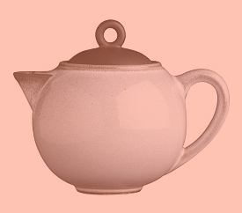

<html>
<head>
<body>
<br>
<table>
<table>
<tr>
<tr>
<img>
<p>
<td>
<table>
<table>
<span>
<tr>
<tr>
<tr>
<tr>
<img>
<td>
<td>
<div>
<p>
<div>
<span>
<div>
<b>
<i>
<img>
<a>
<p>
<i>
<i>
Notes:
Every webpage is represented by a tree of html nodes. And this tree can be accessed through the Document Object Model. Every element in a webpage than corresponds to a node in the tree. We use this DOM structure to provide selectable elements to the user. For a given selection, we build an extraction rule that corresponds to the path from the corresponding node to the root of the tree and store the rule and corresponding page element. We build extraction rules for all selectable elements and store the rules and page elements locally. The page elements are stored in a database according to the labels specified by the user. When the user goes to a new webpage, each rule is matched against the new DOM tree. If there is a match, the matching page element can be stored. If there isn’t a matching element, the rule is not used. We group the extraction rules into extraction patterns and as the user creates new patterns, we apply the pattern that matches the highest number of page elements. To compose the gathered content into a visual summary, we use layout templates. The templates are defined with respect to the labels assigned by the user. Each layout template specifies how the elements are organized, the element formatting, and a set of interactions that define how the user can interact with the summary.

Slide 54
<html>
<head>
<body>
<br>
<table>
<table>
<tr>
<tr>
<img>
<p>
<td>
<table>
<table>
<span>
<tr>
<tr>
<tr>
<tr>
<img>
<td>
<td>
<div>
<p>
<div>
<span>
<div>
<b>
<i>
<img>
<a>
<p>
<i>
<i>
Notes:
Every webpage is represented by a tree of html nodes. And this tree can be accessed through the Document Object Model. Every element in a webpage than corresponds to a node in the tree. We use this DOM structure to provide selectable elements to the user. For a given selection, we build an extraction rule that corresponds to the path from the corresponding node to the root of the tree and store the rule and corresponding page element. We build extraction rules for all selectable elements and store the rules and page elements locally. The page elements are stored in a database according to the labels specified by the user. When the user goes to a new webpage, each rule is matched against the new DOM tree. If there is a match, the matching page element can be stored. If there isn’t a matching element, the rule is not used. We group the extraction rules into extraction patterns and as the user creates new patterns, we apply the pattern that matches the highest number of page elements. To compose the gathered content into a visual summary, we use layout templates. The templates are defined with respect to the labels assigned by the user. Each layout template specifies how the elements are organized, the element formatting, and a set of interactions that define how the user can interact with the summary.

Slide 55
<html>
<head>
<body>
<br>
<table>
<table>
<tr>
<tr>
<img>
<p>
<td>
<table>
<table>
<span>
<tr>
<tr>
<tr>
<tr>
<img>
<td>
<td>
<div>
<p>
<div>
<span>
<div>
<b>
<i>
<img>
<a>
<p>
<i>
<i>
Notes:
Every webpage is represented by a tree of html nodes. And this tree can be accessed through the Document Object Model. Every element in a webpage than corresponds to a node in the tree. We use this DOM structure to provide selectable elements to the user. For a given selection, we build an extraction rule that corresponds to the path from the corresponding node to the root of the tree and store the rule and corresponding page element. We build extraction rules for all selectable elements and store the rules and page elements locally. The page elements are stored in a database according to the labels specified by the user. When the user goes to a new webpage, each rule is matched against the new DOM tree. If there is a match, the matching page element can be stored. If there isn’t a matching element, the rule is not used. We group the extraction rules into extraction patterns and as the user creates new patterns, we apply the pattern that matches the highest number of page elements. To compose the gathered content into a visual summary, we use layout templates. The templates are defined with respect to the labels assigned by the user. Each layout template specifies how the elements are organized, the element formatting, and a set of interactions that define how the user can interact with the summary.

Slide 56
<html>
<html>
<body>
<body>
<table>
<table>
<tr>
<tr>
<td>
<td>
Summary Database
Extraction Rules
Notes:
Every webpage is represented by a tree of html nodes. And this tree can be accessed through the Document Object Model. Every element in a webpage than corresponds to a node in the tree. We use this DOM structure to provide selectable elements to the user. For a given selection, we build an extraction rule that corresponds to the path from the corresponding node to the root of the tree and store the rule and corresponding page element. We build extraction rules for all selectable elements and store the rules and page elements locally. The page elements are stored in a database according to the labels specified by the user. When the user goes to a new webpage, each rule is matched against the new DOM tree. If there is a match, the matching page element can be stored. If there isn’t a matching element, the rule is not used. We group the extraction rules into extraction patterns and as the user creates new patterns, we apply the pattern that matches the highest number of page elements. To compose the gathered content into a visual summary, we use layout templates. The templates are defined with respect to the labels assigned by the user. Each layout template specifies how the elements are organized, the element formatting, and a set of interactions that define how the user can interact with the summary.

Slide 57

<html>
<head>
<body>
<br>
<table>
<table>
<tr>
<tr>
<img>
<p>
<td>
<table>
<table>
<span>
<tr>
<tr>
<tr>
<tr>
<img>
<td>
<td>
<div>
Summary Database
<p>
<div>
<span>
<div>
<b>
<i>
<img>
<a>
<p>
<i>
<i>
Extraction Rules
<html>
<body>
<table>
<tr>
<td>
Notes:
Every webpage is represented by a tree of html nodes. And this tree can be accessed through the Document Object Model. Every element in a webpage than corresponds to a node in the tree. We use this DOM structure to provide selectable elements to the user. For a given selection, we build an extraction rule that corresponds to the path from the corresponding node to the root of the tree and store the rule and corresponding page element. We build extraction rules for all selectable elements and store the rules and page elements locally. The page elements are stored in a database according to the labels specified by the user. When the user goes to a new webpage, each rule is matched against the new DOM tree. If there is a match, the matching page element can be stored. If there isn’t a matching element, the rule is not used. We group the extraction rules into extraction patterns and as the user creates new patterns, we apply the pattern that matches the highest number of page elements. To compose the gathered content into a visual summary, we use layout templates. The templates are defined with respect to the labels assigned by the user. Each layout template specifies how the elements are organized, the element formatting, and a set of interactions that define how the user can interact with the summary.

Slide 58
<html>
<html>
<body>
<body>
<table>
<table>
<tr>
<tr>
<table>
<table>
<tr>
<tr>
<img>
<img>
Summary Database
Extraction Rules
<html>
<body>
<table>
<tr>
<td>
Notes:
Every webpage is represented by a tree of html nodes. And this tree can be accessed through the Document Object Model. Every element in a webpage than corresponds to a node in the tree. We use this DOM structure to provide selectable elements to the user. For a given selection, we build an extraction rule that corresponds to the path from the corresponding node to the root of the tree and store the rule and corresponding page element. We build extraction rules for all selectable elements and store the rules and page elements locally. The page elements are stored in a database according to the labels specified by the user. When the user goes to a new webpage, each rule is matched against the new DOM tree. If there is a match, the matching page element can be stored. If there isn’t a matching element, the rule is not used. We group the extraction rules into extraction patterns and as the user creates new patterns, we apply the pattern that matches the highest number of page elements. To compose the gathered content into a visual summary, we use layout templates. The templates are defined with respect to the labels assigned by the user. Each layout template specifies how the elements are organized, the element formatting, and a set of interactions that define how the user can interact with the summary.

Slide 59

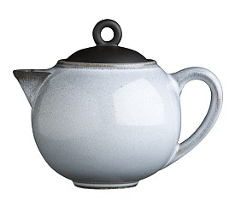
<html>
<head>
<body>
<br>
<table>
<table>
<tr>
<tr>
<img>
<p>
<td>
<table>
<table>
<span>
<tr>
<tr>
<tr>
<tr>
<img>
<td>
<td>
<div>
Summary Database
<p>
<div>
<span>
<div>
<b>
<i>
<img>
<a>
<p>
<i>
<i>
Extraction Rules
<html>
<html>
<body>
<body>
<table>
<table>
<tr>
<tr>
<table>
<td>
<tr>
<img>
Notes:
Every webpage is represented by a tree of html nodes. And this tree can be accessed through the Document Object Model. Every element in a webpage than corresponds to a node in the tree. We use this DOM structure to provide selectable elements to the user. For a given selection, we build an extraction rule that corresponds to the path from the corresponding node to the root of the tree and store the rule and corresponding page element. We build extraction rules for all selectable elements and store the rules and page elements locally. The page elements are stored in a database according to the labels specified by the user. When the user goes to a new webpage, each rule is matched against the new DOM tree. If there is a match, the matching page element can be stored. If there isn’t a matching element, the rule is not used. We group the extraction rules into extraction patterns and as the user creates new patterns, we apply the pattern that matches the highest number of page elements. To compose the gathered content into a visual summary, we use layout templates. The templates are defined with respect to the labels assigned by the user. Each layout template specifies how the elements are organized, the element formatting, and a set of interactions that define how the user can interact with the summary.

Slide 60
<html>
<html>
<body>
<body>
<table>
<table>
<tr>
<tr>
<table>
<table>
<tr>
<tr>
<div>
<div>
Summary Database
<div>
<div>
Extraction Rules
<html>
<html>
<body>
<body>
<table>
<table>
<tr>
<tr>
<table>
<td>
<tr>
<img>
Notes:
Every webpage is represented by a tree of html nodes. And this tree can be accessed through the Document Object Model. Every element in a webpage than corresponds to a node in the tree. We use this DOM structure to provide selectable elements to the user. For a given selection, we build an extraction rule that corresponds to the path from the corresponding node to the root of the tree and store the rule and corresponding page element. We build extraction rules for all selectable elements and store the rules and page elements locally. The page elements are stored in a database according to the labels specified by the user. When the user goes to a new webpage, each rule is matched against the new DOM tree. If there is a match, the matching page element can be stored. If there isn’t a matching element, the rule is not used. We group the extraction rules into extraction patterns and as the user creates new patterns, we apply the pattern that matches the highest number of page elements. To compose the gathered content into a visual summary, we use layout templates. The templates are defined with respect to the labels assigned by the user. Each layout template specifies how the elements are organized, the element formatting, and a set of interactions that define how the user can interact with the summary.

Slide 61

<html>
<head>
<body>
<br>
<table>
<table>
<tr>
<tr>
<img>
<p>
<td>
<table>
<table>
<span>
<tr>
<tr>
<tr>
<tr>
<img>
<td>
<td>
<div>
Summary Database
<p>
<div>
<span>
<div>
name
picture
details
<b>
<i>
<img>
<a>
<p>
<i>
<i>
Extraction Rules
<html>
<html>
<html>
<body>
<body>
<body>
<table>
<table>
<table>
<tr>
<tr>
<tr>
<table>
<table>
<td>
<tr>
<tr>
<img>
<div>
<div>
Notes:
Every webpage is represented by a tree of html nodes. And this tree can be accessed through the Document Object Model. Every element in a webpage than corresponds to a node in the tree. We use this DOM structure to provide selectable elements to the user. For a given selection, we build an extraction rule that corresponds to the path from the corresponding node to the root of the tree and store the rule and corresponding page element. We build extraction rules for all selectable elements and store the rules and page elements locally. The page elements are stored in a database according to the labels specified by the user. When the user goes to a new webpage, each rule is matched against the new DOM tree. If there is a match, the matching page element can be stored. If there isn’t a matching element, the rule is not used. We group the extraction rules into extraction patterns and as the user creates new patterns, we apply the pattern that matches the highest number of page elements. To compose the gathered content into a visual summary, we use layout templates. The templates are defined with respect to the labels assigned by the user. Each layout template specifies how the elements are organized, the element formatting, and a set of interactions that define how the user can interact with the summary.

Slide 62
Summary Database
name
picture
details
Extraction Rules
<html>
<html>
<html>
<body>
<body>
<body>
<table>
<table>
<table>
<tr>
<tr>
<tr>
<table>
<table>
<td>
<tr>
<tr>
<img>
<div>
<div>
Notes:
Every webpage is represented by a tree of html nodes. And this tree can be accessed through the Document Object Model. Every element in a webpage than corresponds to a node in the tree. We use this DOM structure to provide selectable elements to the user. For a given selection, we build an extraction rule that corresponds to the path from the corresponding node to the root of the tree and store the rule and corresponding page element. We build extraction rules for all selected elements and store the rules and page elements locally. The page elements are stored in a database according to the labels specified by the user. When the user goes to a new webpage, each rule is matched against the new DOM tree. If there is a match, the matching page element can be stored. If there isn’t a matching element, the rule is not used. We group the extraction rules into extraction patterns and as the user creates new patterns, we apply the pattern that matches the highest number of page elements. To compose the gathered content into a visual summary, we use layout templates. The templates are defined with respect to the labels assigned by the user. Each layout template specifies how the elements are organized, the element formatting, and a set of interactions that define how the user can interact with the summary.

Slide 63
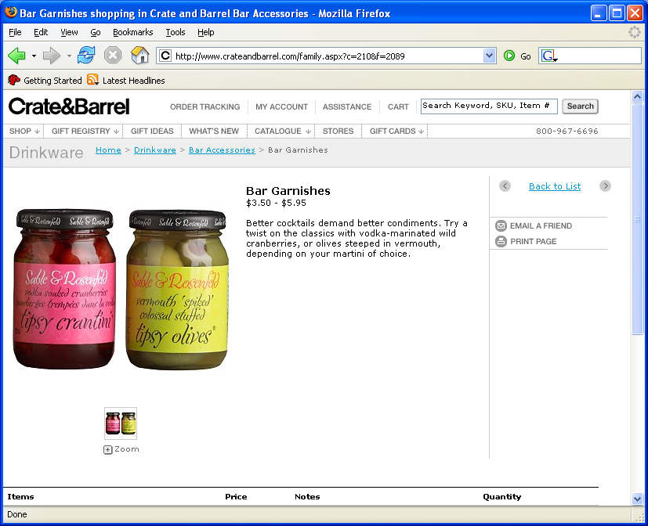
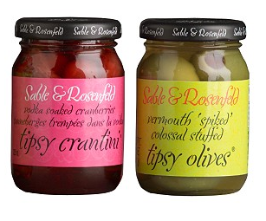

<html>
<head>
<body>
<br>
<table>
<table>
<tr>
<tr>
<img>
<p>
<td>
<table>
<table>
<span>
<tr>
<tr>
<tr>
<tr>
<img>
<td>
<td>
Summary Database
<p>
<div>
<span>
name
picture
details
<b>
<i>
<img>
<a>
Extraction Rules
<html>
<html>
<html>
<body>
<body>
<body>
<table>
<table>
<table>
<tr>
<tr>
<tr>
<table>
<table>
<td>
<tr>
<tr>
<img>
<div>
<div>
Notes:
Every webpage is represented by a tree of html nodes. And this tree can be accessed through the Document Object Model. Every element in a webpage than corresponds to a node in the tree. We use this DOM structure to provide selectable elements to the user. For a given selection, we build an extraction rule that corresponds to the path from the corresponding node to the root of the tree and store the rule and corresponding page element. We build extraction rules for all selectable elements and store the rules and page elements locally. The page elements are stored in a database according to the labels specified by the user. When the user goes to a new webpage, each rule is matched against the new DOM tree. If there is a match, the matching page element can be stored. If there isn’t a matching element, the rule is not used. We group the extraction rules into extraction patterns and as the user creates new patterns, we apply the pattern that matches the highest number of page elements. To compose the gathered content into a visual summary, we use layout templates. The templates are defined with respect to the labels assigned by the user. Each layout template specifies how the elements are organized, the element formatting, and a set of interactions that define how the user can interact with the summary.

Slide 64
<html>
<head>
<body>
<br>
<table>
<table>
<tr>
<tr>
<img>
<p>
<td>
<table>
<table>
<span>
<tr>
<tr>
<tr>
<tr>
<img>
<td>
<td>
Summary Database
<p>
<div>
<span>
name
picture
details
<b>
<i>
<img>
<a>
Extraction Rules
<html>
<html>
<html>
<html>
<body>
<body>
<body>
<body>
<table>
<table>
<table>
<tr>
<table>
<tr>
<tr>
<table>
<table>
<tr>
<tr>
<td>
<tr>
<td>
<div>
<img>
<div>
Notes:
Every webpage is represented by a tree of html nodes. And this tree can be accessed through the Document Object Model. Every element in a webpage than corresponds to a node in the tree. We use this DOM structure to provide selectable elements to the user. For a given selection, we build an extraction rule that corresponds to the path from the corresponding node to the root of the tree and store the rule and corresponding page element. We build extraction rules for all selectable elements and store the rules and page elements locally. The page elements are stored in a database according to the labels specified by the user. When the user goes to a new webpage, each rule is matched against the new DOM tree. If there is a match, the matching page element can be stored. If there isn’t a matching element, the rule is not used. We group the extraction rules into extraction patterns and as the user creates new patterns, we apply the pattern that matches the highest number of page elements. To compose the gathered content into a visual summary, we use layout templates. The templates are defined with respect to the labels assigned by the user. Each layout template specifies how the elements are organized, the element formatting, and a set of interactions that define how the user can interact with the summary.

Slide 65
<html>
<head>
<body>
<br>
<table>
<table>
<tr>
<tr>
<img>
<p>
<td>
<table>
<table>
<span>
<tr>
<tr>
<tr>
<tr>
<img>
<td>
<td>
Summary Database
<p>
<div>
<span>
name
picture
details
<b>
<i>
<img>
<a>
Extraction Rules
<html>
<html>
<html>
<html>
<body>
<body>
<body>
<body>
<table>
<table>
<table>
<table>
<tr>
<tr>
<tr>
<table>
<table>
<tr>
<table>
<tr>
<tr>
<td>
<tr>
<div>
<img>
<img>
<div>

Slide 66
<html>
<head>
<body>
<br>
<table>
<table>
<tr>
<tr>
<img>
<p>
<td>
<table>
<table>
<span>
<tr>
<tr>
<tr>
<tr>
<img>
<td>
<td>
Summary Database
<p>
<div>
<span>
name
picture
details
<b>
<i>
<img>
<a>
Extraction Rules
<html>
<html>
<html>
<html>
<body>
<body>
<body>
<body>
<table>
<table>
<table>
<tr>
<table>
<tr>
<tr>
<table>
<tr>
<table>
<table>
<tr>
<td>
<tr>
<tr>
<div>
<img>
<div>
<div>
<div>
Notes:
Every webpage is represented by a tree of html nodes. And this tree can be accessed through the Document Object Model. Every element in a webpage than corresponds to a node in the tree. We use this DOM structure to provide selectable elements to the user. For a given selection, we build an extraction rule that corresponds to the path from the corresponding node to the root of the tree and store the rule and corresponding page element. We build extraction rules for all selectable elements and store the rules and page elements locally. The page elements are stored in a database according to the labels specified by the user. When the user goes to a new webpage, each rule is matched against the new DOM tree. If there is a match, the matching page element can be stored. If there isn’t a matching element, the rule is not used. We group the extraction rules into extraction patterns and as the user creates new patterns, we apply the pattern that matches the highest number of page elements. To compose the gathered content into a visual summary, we use layout templates. The templates are defined with respect to the labels assigned by the user. Each layout template specifies how the elements are organized, the element formatting, and a set of interactions that define how the user can interact with the summary.

Slide 67
<html>
<head>
<body>
<br>
<table>
<table>
<tr>
<tr>
<img>
<p>
<td>
<table>
<table>
<span>
<tr>
<tr>
<tr>
<tr>
<img>
<td>
<td>
Summary Database
<p>
<div>
<span>
name
picture
details
<b>
<i>
<img>
<a>
Extraction Rules
<html>
<html>
<html>
<body>
<body>
<body>
<table>
<table>
<table>
<tr>
<tr>
<tr>
<table>
<table>
<td>
<tr>
<tr>
<img>
<div>
<div>
Notes:
Every webpage is represented by a tree of html nodes. And this tree can be accessed through the Document Object Model. Every element in a webpage than corresponds to a node in the tree. We use this DOM structure to provide selectable elements to the user. For a given selection, we build an extraction rule that corresponds to the path from the corresponding node to the root of the tree and store the rule and corresponding page element. We build extraction rules for all selectable elements and store the rules and page elements locally. The page elements are stored in a database according to the labels specified by the user. When the user goes to a new webpage, each rule is matched against the new DOM tree. If there is a match, the matching page element can be stored. If there isn’t a matching element, the rule is not used. We group the extraction rules into extraction patterns and as the user creates new patterns, we apply the pattern that matches the highest number of page elements. To compose the gathered content into a visual summary, we use layout templates. The templates are defined with respect to the labels assigned by the user. Each layout template specifies how the elements are organized, the element formatting, and a set of interactions that define how the user can interact with the summary.

Slide 68
Extraction Patterns
<html>
<tr>
<table>
<body>
<table>
<tr>
<table>
<tr>
<table>
<td>
<tr>
<p>
<p>
<b>
<html>
<html>
<body>
<body>
Summary Database
<table>
<tr>
<table>
name
picture
details
<table>
<p>
<tr>
<img>
<span>
.
.
.
<html>
<html>
<html>
<body>
<body>
<body>
<table>
<table>
<table>
<tr>
<tr>
<tr>
<table>
<table>
<td>
<tr>
<tr>
<img>
<div>
<div>
Notes:
Every webpage is represented by a tree of html nodes. And this tree can be accessed through the Document Object Model. Every element in a webpage than corresponds to a node in the tree. We use this DOM structure to provide selectable elements to the user. For a given selection, we build an extraction rule that corresponds to the path from the corresponding node to the root of the tree and store the rule and corresponding page element. We build extraction rules for all selectable elements and store the rules and page elements locally. The page elements are stored in a database according to the labels specified by the user. When the user goes to a new webpage, each rule is matched against the new DOM tree. If there is a match, the matching page element can be stored. If there isn’t a matching element, the rule is not used. We group the extraction rules into extraction patterns and as the user creates new patterns, we apply the pattern that matches the highest number of page elements. To compose the gathered content into a visual summary, we use layout templates. The templates are defined with respect to the labels assigned by the user. Each layout template specifies how the elements are organized, the element formatting, and a set of interactions that define how the user can interact with the summary.

Slide 69
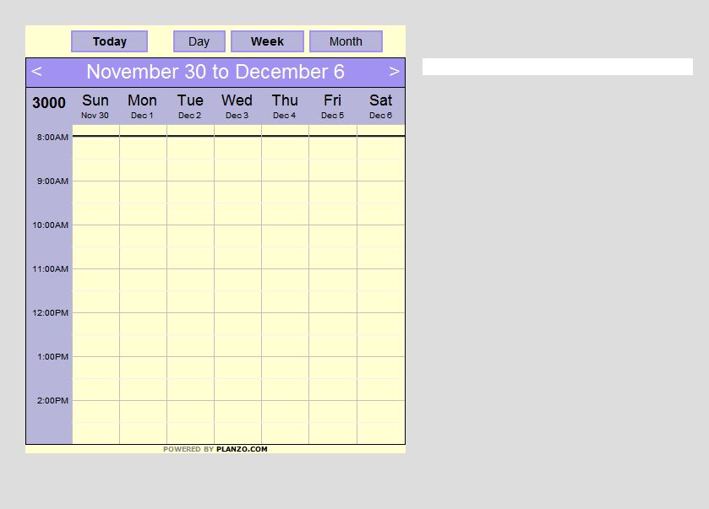
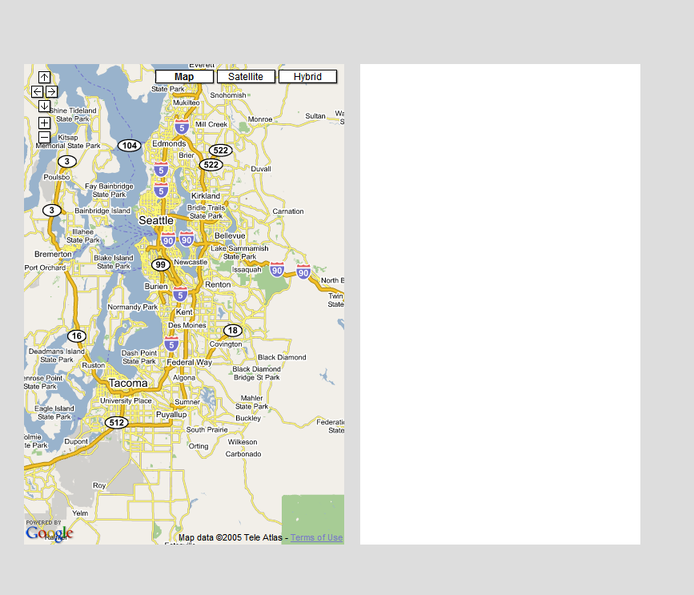
Layout Templates
Summary Database
name
picture
details
Notes:
Every webpage is represented by a tree of html nodes. And this tree can be accessed through the Document Object Model. Every element in a webpage than corresponds to a node in the tree. We use this DOM structure to provide selectable elements to the user. For a given selection, we build an extraction rule that corresponds to the path from the corresponding node to the root of the tree and store the rule and corresponding page element. We build extraction rules for all selectable elements and store the rules and page elements locally. The page elements are stored in a database according to the labels specified by the user. When the user goes to a new webpage, each rule is matched against the new DOM tree. If there is a match, the matching page element can be stored. If there isn’t a matching element, the rule is not used. We group the extraction rules into extraction patterns and as the user creates new patterns, we apply the pattern that matches the highest number of page elements. To compose the gathered content into a visual summary, we use layout templates. The templates are defined with respect to the labels assigned by the user. Each layout template specifies how the elements are organized, the element formatting, and a set of interactions that define how the user can interact with the summary.

Slide 70
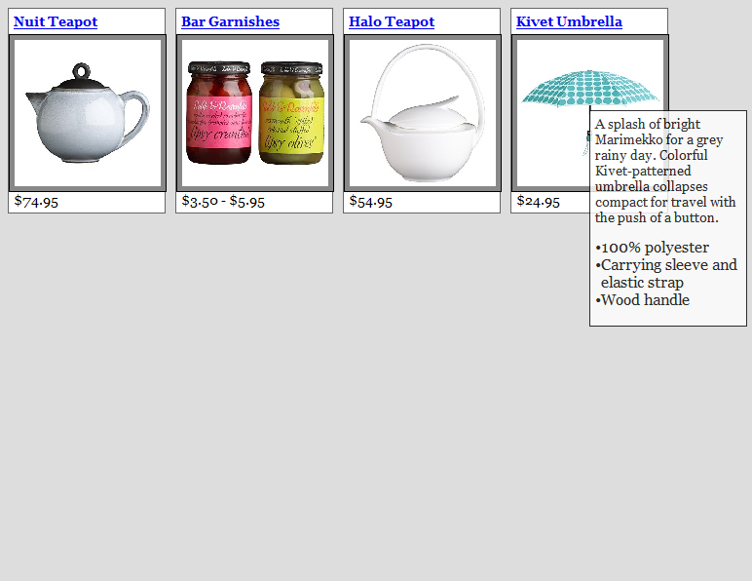
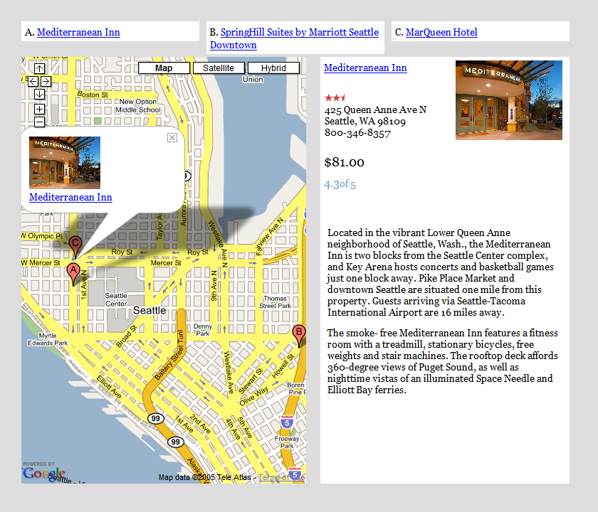
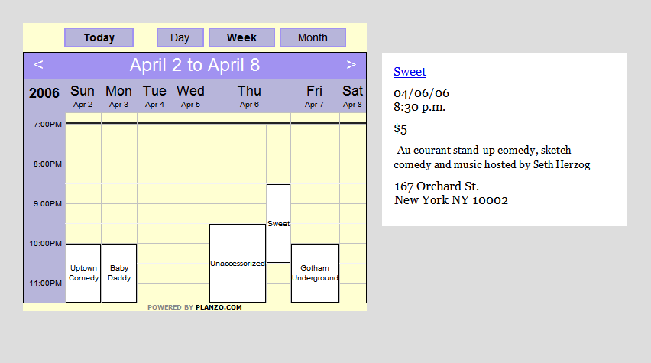
Layout Templates
Summary Database
name
picture
details
Notes:
Every webpage is represented by a tree of html nodes. And this tree can be accessed through the Document Object Model. Every element in a webpage than corresponds to a node in the tree. We use this DOM structure to provide selectable elements to the user. For a given selection, we build an extraction rule that corresponds to the path from the corresponding node to the root of the tree and store the rule and corresponding page element. We build extraction rules for all selectable elements and store the rules and page elements locally. The page elements are stored in a database according to the labels specified by the user. When the user goes to a new webpage, each rule is matched against the new DOM tree. If there is a match, the matching page element can be stored. If there isn’t a matching element, the rule is not used. We group the extraction rules into extraction patterns and as the user creates new patterns, we apply the pattern that matches the highest number of page elements. To compose the gathered content into a visual summary, we use layout templates. The templates are defined with respect to the labels assigned by the user. Each layout template specifies how the elements are organized, the element formatting, and a set of interactions that define how the user can interact with the summary.
So let’s continue our planning and take a look at some of these templates in action.

Slide 71
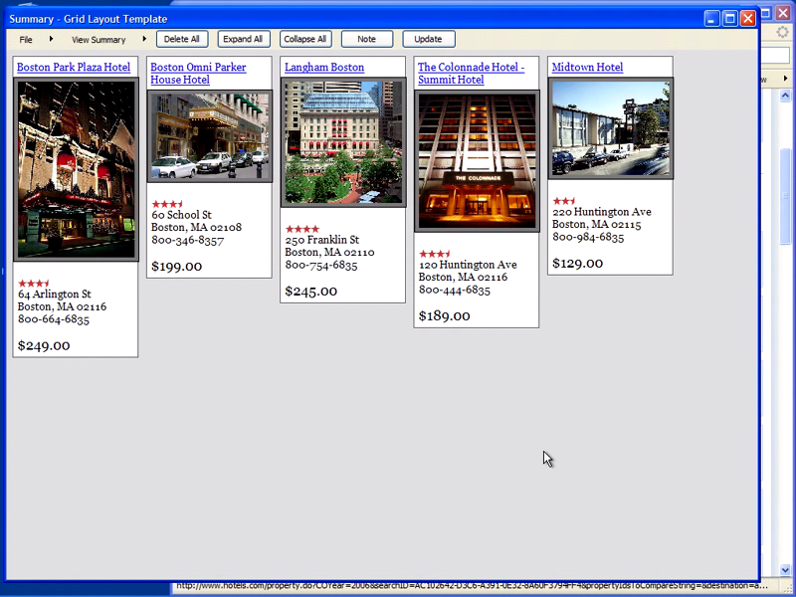
video2
Notes:
So here is where we left off. We had collected some hotels and we were using the grid layout template to view them. Since the hotels have addresses we can also view them on the map layout templates. The map template includes an interactive map and a list of the hotels at the top. As the user clicks on the list, they see detailed view to the right of the map. Now in addition to booking hotel, I often like to see if anything is happening at the city and if there are any fun events. So now let’s go to upcoming.org and collect some events. This wine tasting looks good. I can automatically add it because I have been to this website before and all the patterns are stored locally on my machine. Unfortunately this event is rather far from boston so let’s see if anything else is going on. This one looks good. And it’s much closer to the hotels. Now since we have collected some events we can use the calendar layout template to see if they are happening at the same time. This template only shows items that have a date and time. When I move the mouse over the event, a short summary is displayed, and when I click I see all the details. I should say that we maintain all the hyperlinks and I can click and access the webpages for these different DJs. Layout templates can also be defined for different devices, such as a PDA. The collection is then organized into tabs and each tab includes a list. To get more details I click on an item in the list. If you don’t have a PDA, then you can format your summary as a paper print out and take with you. So in coclusion we have created a framework that allows us to automatically organize the information for the user through the use of layout templates that display content from different sources uniformly.
Demo
the summaries are just another webpage - you can save them and open them later or send them to a friend or colleague.
I’m going to now open another summary so I can show you the map and calendar layout templates
- show calendar and map
talk about them being hyperlinked
Say that for now is static but could be dynamic

Slide 72
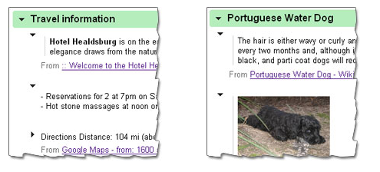
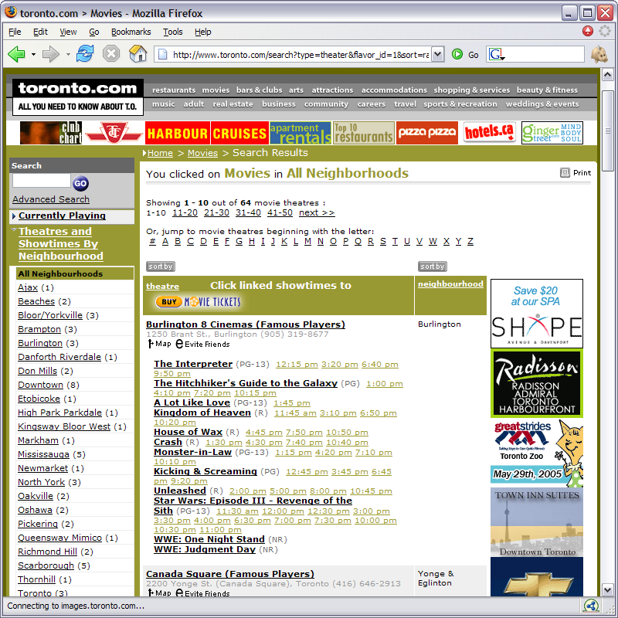
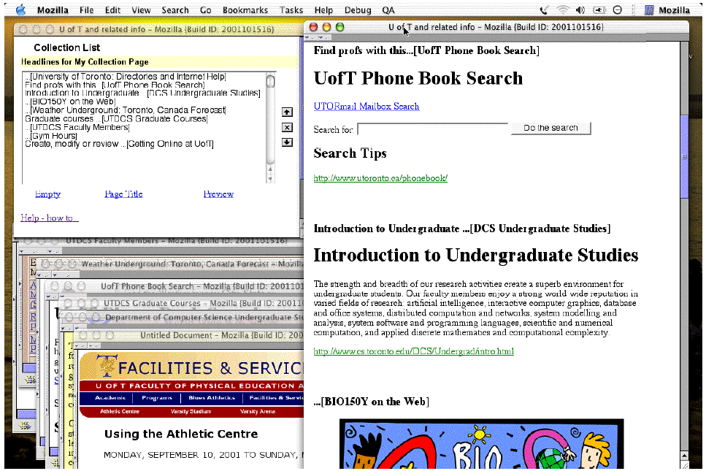
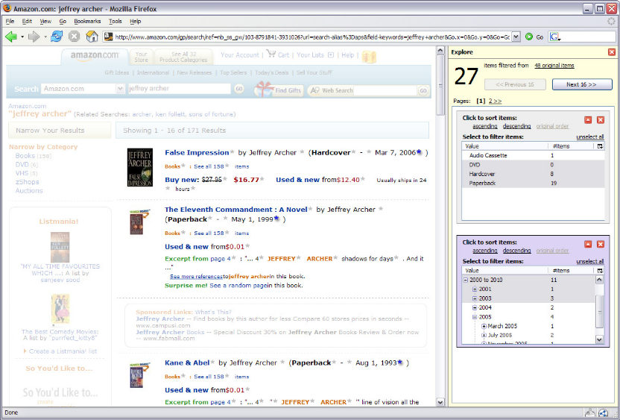
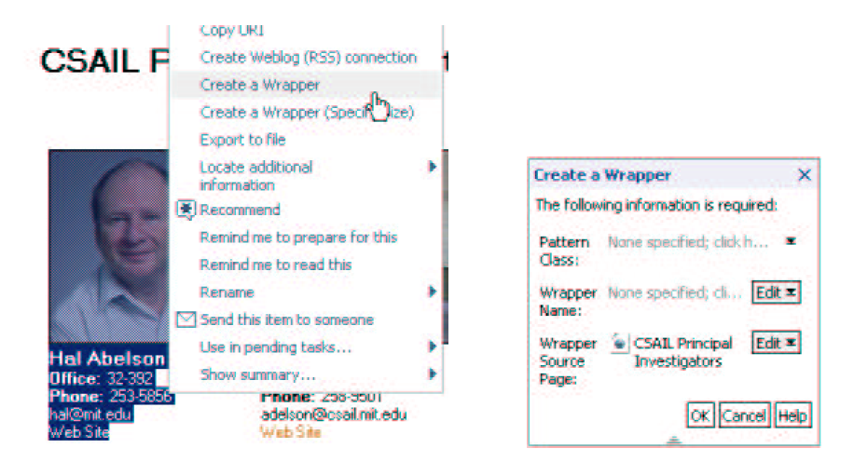


Related Work
Manual
  HunterGatherer
  [schraefel et al., WWW 02]
  Google Notebook, ScrapBook, backpackit.com, clipclip.com
Automatic
  Piggy Bank
  [Huynh et al., ISWC 04]
  Thresher
  [Hogue and Karger, WWW 05]
  Sifter
  [Huynh et al., UIST 06]
Notes:
Related work in this area includes two types of approaches – those that are fully manual and those are that are fully or semi-automatic. The first system to take pieces of webpages and put them together into a composite document was Hunter Gatherer. Their tool allowed users to select pieces of webpages and put them in a collection, which you see on your left. The collections could then be viewed as a webpage. Today, there are a number of commercially available tools that do the exact same thing. These tools don’t provide any automation and allow some very limited layout control. I should note that these tools don’t know anything about the type of content the user is collecting and just treat it as a snipet of text and images. The systems that attempt to automate some of this process come from the semantic web community and focus on automatically extracting structured content from the unstructured webpages. With piggyBank the user can write scripts to extract structured content from a webpage, such as this movie list, and then store it in a database that can then be query to filter and retrieve any information. The cool idea behind piggybank is that includes everyones scripts and once someone has written as script, it can be used by others. Thresher is a system that strives to move away from the scripting interface for collecting content and provides an interactive interface however the user still needs to be familiar with semantic structures.
Our work is the first to combine the very easy and simple selection interface that is present in the manual approaches with automation for content extraction. We are also the first to create visual summaries that automatically format the collected information.
And finally, in the next talk you will hear all about Sifter. Sifter is a system that extends the browser and provides a richer search interface for lists of items.
It is able to automatically find the items in the list and extract each field of an item such as the price, or author in this list of books. It then exposes these fields to the user so he can more quickly find the correct item.
Our work and Sifter are very complimentary. We can employ some of their algorithms to automatically determine the price or rating of a hotel. This can be especially useful for situations where the user is collecting the same type of information from many different websites, such as prices or reviews, and would likely be less willing to keep re-specifying extraction patterns.

Slide 73
Contributions

Slide 74


Future Work
Template authoring

Slide 75

Future Work
Template authoring
Schema authoring

Slide 76





Future Work
Template authoring
Schema authoring
Collaboration

Slide 77

Future Work
Template authoring
Schema authoring
Collaboration
Shared repository

Slide 78

Future Work
Template authoring
Schema authoring
Collaboration
Sharing
New applications

Slide 79
Conclusions: Web Summaries
Interactively specify features to extract
Automatically extract features from slides
Use templates to re-layout, filter, sort information

Slide 80
Digital Photographs
Personal collections growing to tens of thousands
Finding specific photos, general browsing, support for tagging all still awkward
Two projects: MediaFrame and TimeQuilt

Slide 81

MediaFrame Demo
Extract features:
  Still/Video
  Faces
  Indoor/Outdoor
  Time
  Color histogram
  Vectors
Use to filter/select
Cluster on time
  Faciitate labeling
Drucker, S. C. Wong, A. Roseway, S. Glenner, S. De Mar, MediaBrowser: Reclaiming the Shoebox. in Proceedings of AVI2004, Gallipoli, Italy, 2004.

Slide 82

TimeQuilt (Huynh et al. 2005)
Huynh, D., Drucker, S., Baudisch, P., Wong, C.
Time Quilt: Scaling up Zoomable Photo Browsers for Large, Unstructured Photo Collections. CHI 2005. Portland, OR. Apr. 2005

Slide 83

Extract Features (Date/Time)

Slide 84


Calculate distances and cluster

Slide 85

Relayout images in a timeline

Slide 86

Re-layout images

Slide 87

Find/choose representative images

Slide 88

Relayout images (use representative photo)

Slide 89

Video

Slide 90
Related Work
Bederson: PhotoMesa, UIST 2001 → Zooming UI
Platt et al: PhotoTOC, MSR-TR, 2002 →
Representative Images
Refs: MediaBrowser, Photofinder, FotoFile, PhotoTOC
Naming your photo system paper:
Mesa
Frame
Album
Finder
Ware
Mountain
TOC
Triage
Photo
Media
Data
Foto
Auto
Pix

Slide 91
Conclusions:
User Interface is less of a ‘science’ and more like a craft. e.g. architecture:
  Creative/Design discipline, but with principles
Need to design/build/test/iterate
Managing complexity involves finding ways to extract essential features and using those features to represent the important information, adjust the layout and interaction
Use principles of information visualization (brushing, clustering, interaction) to allow users to interact with their content.
Thanks to all interns and collaborators
  Especially Mira Dontcheva, David Huynh
http://research.microsoft.com/~sdrucker

