Slide 1
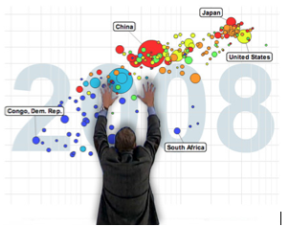
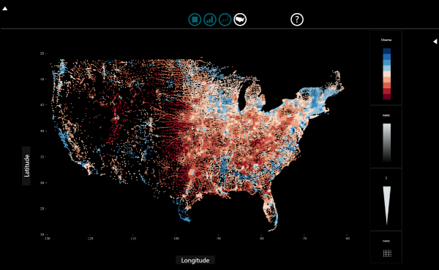
Data Presentations
Steven M. Drucker
Principal Researcher, Microsoft Research

Slide 2

Analysis
Notes:
f The purpose of visualization is insight, not numbers
The purpose of exploratory visualization is finding insight

Slide 3

Communication
Notes:
The purpose of presentation visualization is communicating insight

Slide 4
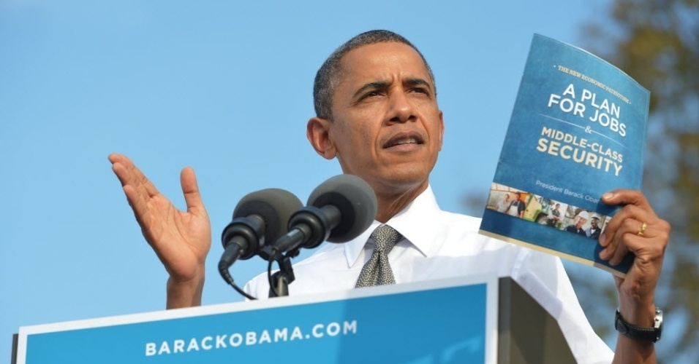
Notes:
Hm.

Slide 5
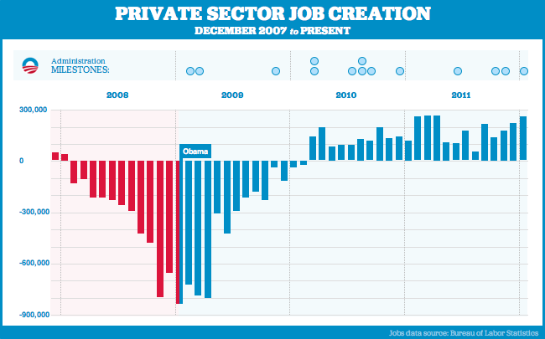
Notes:
The “Bikiin graph”
http://www.youtube.com/watch?v=NJoE0ZJ7Rn8

Slide 6
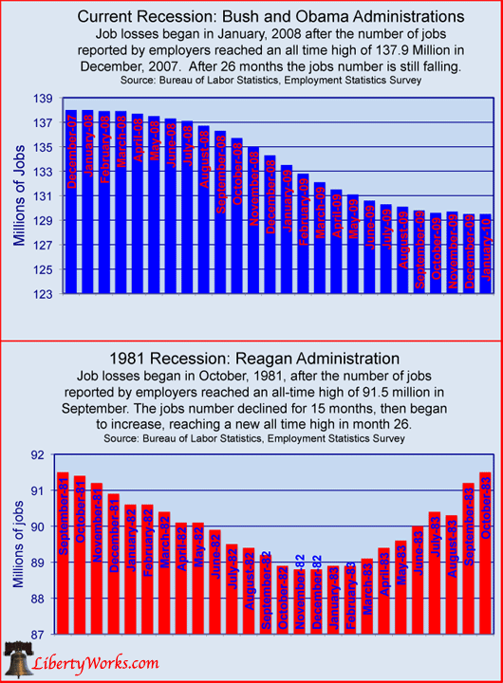

Slide 7
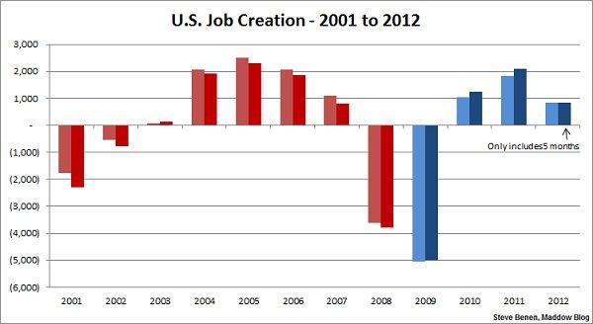
Notes:
Variant of the Bikini graph
(The lighter color refers to the overall jobs picture, while the darker color points only to the private sector.)
http://thepoliticalcarnival.net/2012/08/03/bikini-graph-time-job-growth-far-exceeds-expectations-more-created-since-jan-than-in-5-of-the-8-bush-years/
This is seem as a pro-Dem chart: shows growth year over year

Slide 8
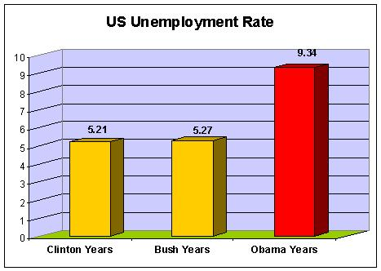

Slide 9
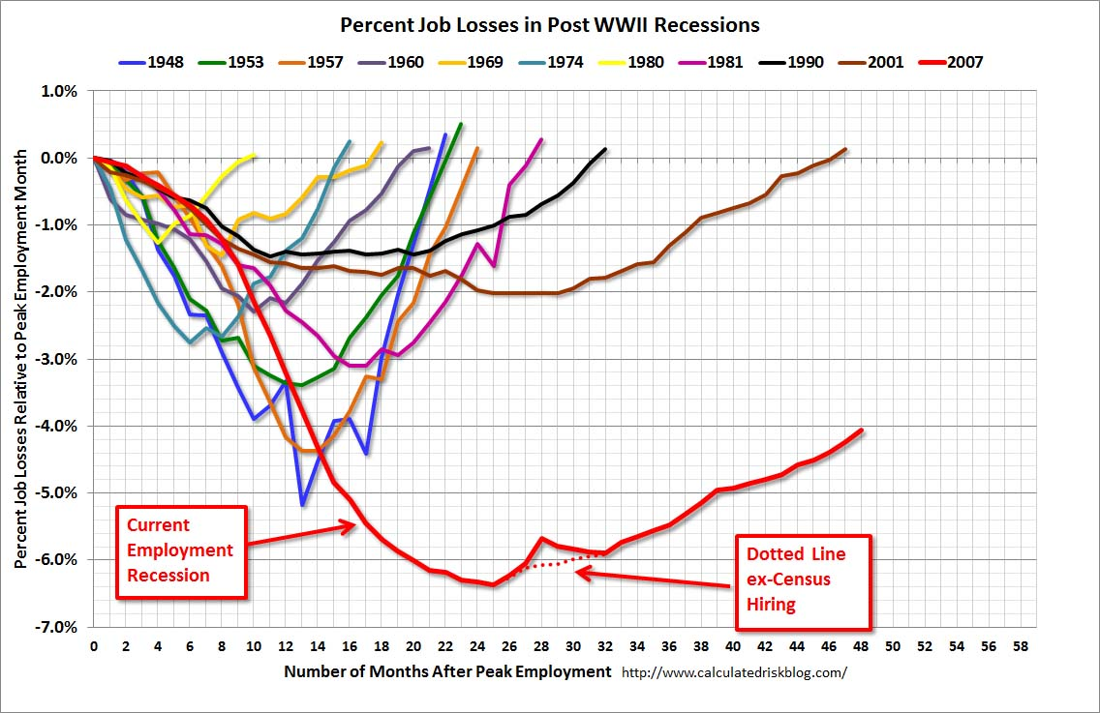

Slide 10
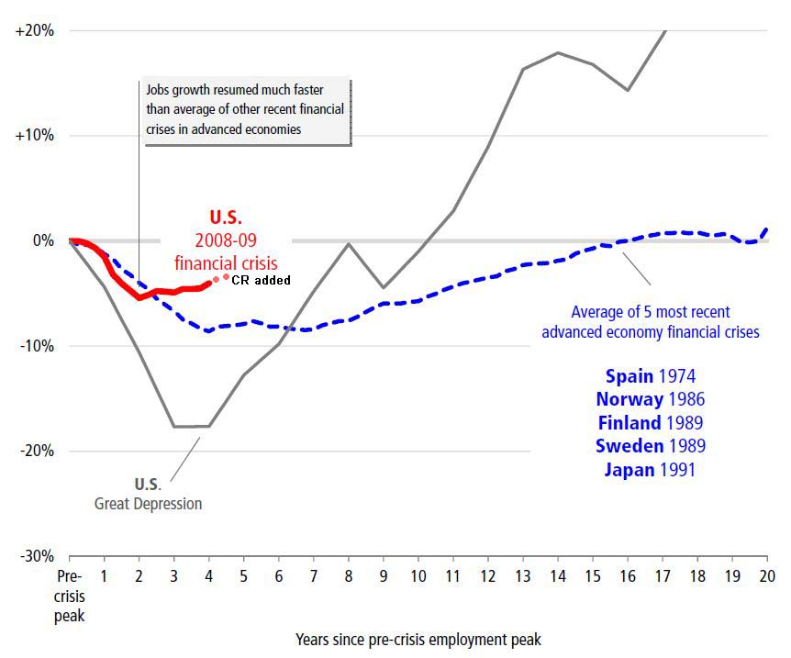

Slide 11
How many 3’s?
1281768756138976546984506985604982826762
9809858458224509856458945098450980943585
9091030209905959595772564675050678904567
8845789809821677654876364908560912949686

Slide 12
How many 3’s?
1281768756138976546984506985604982826762
9809858458224509856458945098450980943585
9091030209905959595772564675050678904567
8845789809821677654876364908560912949686

Slide 13
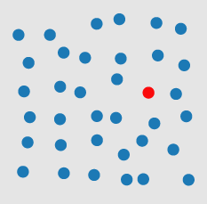

Preattentative
http://www.csc.ncsu.edu/faculty/healey/PP/index.html

Slide 14
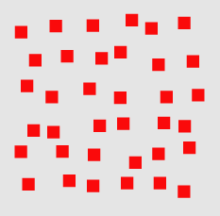
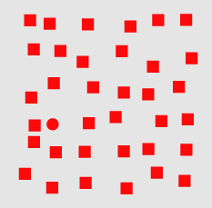
Preattentative

Slide 15
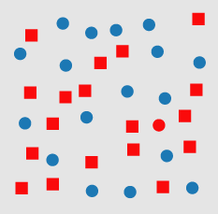
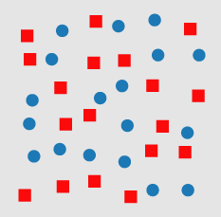
Preattentative

Slide 16
Anscombe's quartet
I |  | II |  | III |  | IV
x | y | x | y | x | y | x | y
10.0 | 8.04 | 10.0 | 9.14 | 10.0 | 7.46 | 8.0 | 6.58
8.0 | 6.95 | 8.0 | 8.14 | 8.0 | 6.77 | 8.0 | 5.76
13.0 | 7.58 | 13.0 | 8.74 | 13.0 | 12.74 | 8.0 | 7.71
9.0 | 8.81 | 9.0 | 8.77 | 9.0 | 7.11 | 8.0 | 8.84
11.0 | 8.33 | 11.0 | 9.26 | 11.0 | 7.81 | 8.0 | 8.47
14.0 | 9.96 | 14.0 | 8.10 | 14.0 | 8.84 | 8.0 | 7.04
6.0 | 7.24 | 6.0 | 6.13 | 6.0 | 6.08 | 8.0 | 5.25
4.0 | 4.26 | 4.0 | 3.10 | 4.0 | 5.39 | 19.0 | 12.50
12.0 | 10.84 | 12.0 | 9.13 | 12.0 | 8.15 | 8.0 | 5.56
7.0 | 4.82 | 7.0 | 7.26 | 7.0 | 6.42 | 8.0 | 7.91
5.0 | 5.68 | 5.0 | 4.74 | 5.0 | 5.73 | 8.0 | 6.89
Property | Value
Mean of x | 9 (exact)
Variance of x | 11 (exact)
Mean of y | 7.50
Variance of y | 4.122 or 4.127
Correlation between x and y | 0.816
Linear regression line | y = 3.00 + 0.500x
Francis Anscombe, 1973

Slide 17
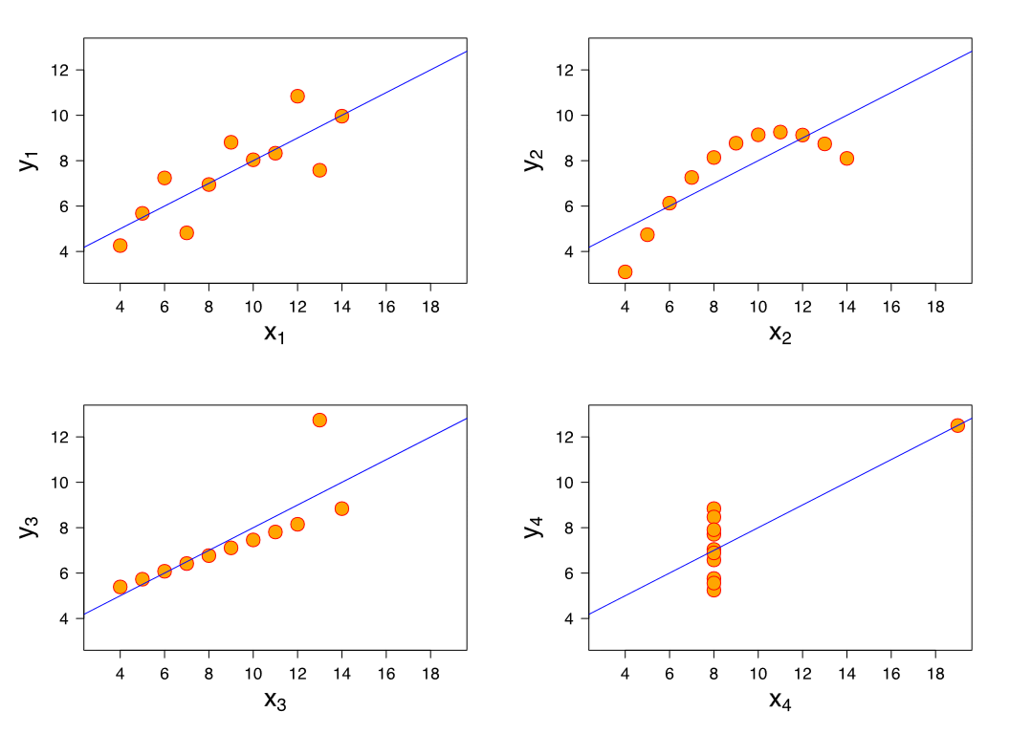
Anscombe’s Quartet (cont’d)

Slide 18
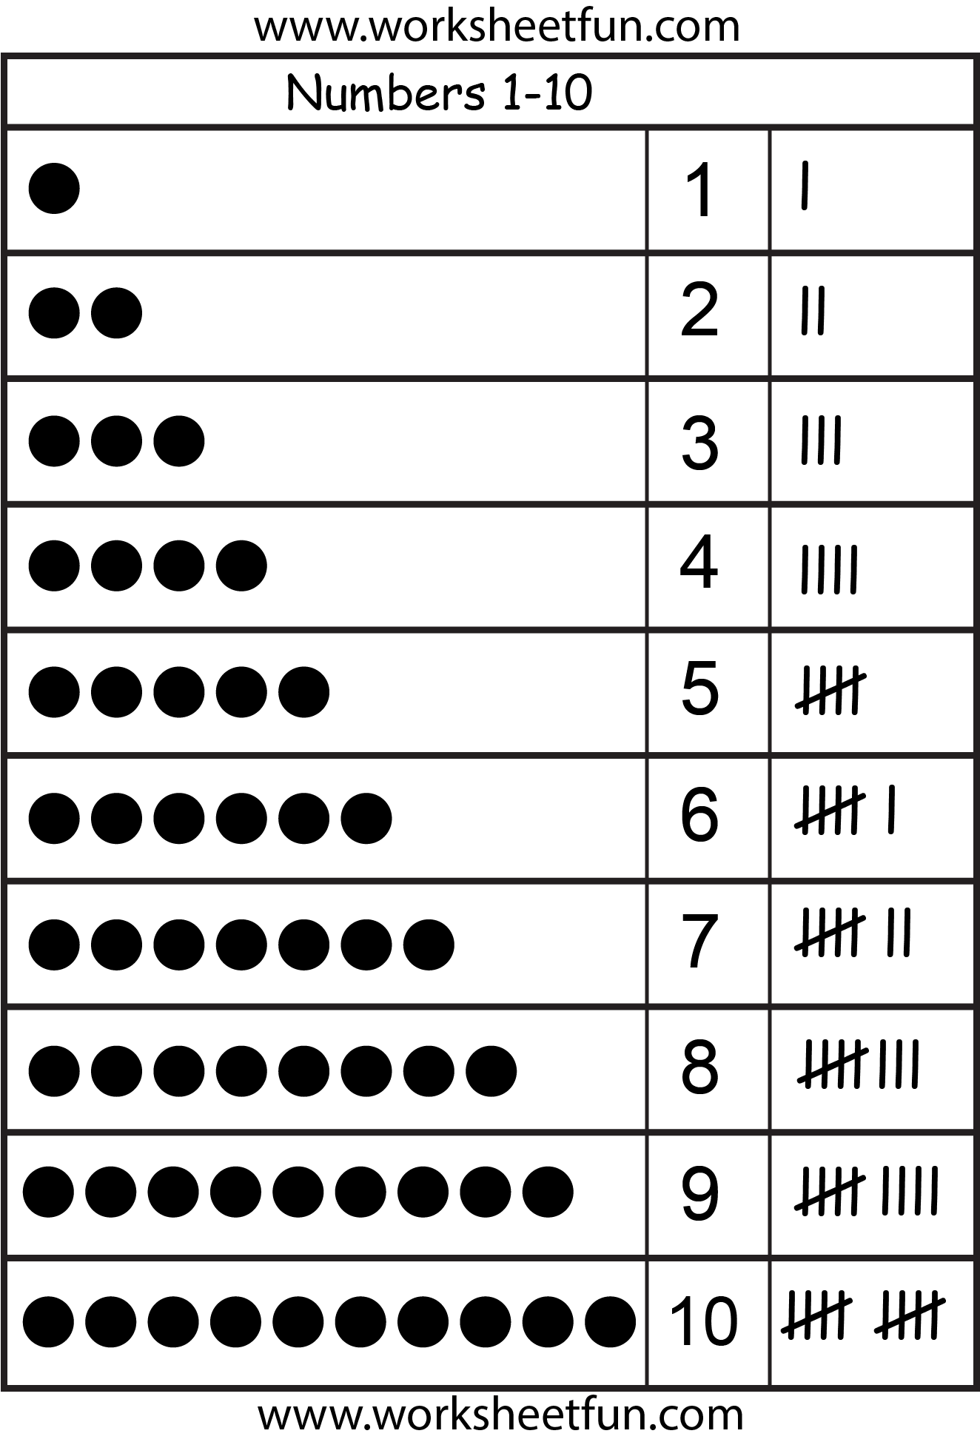
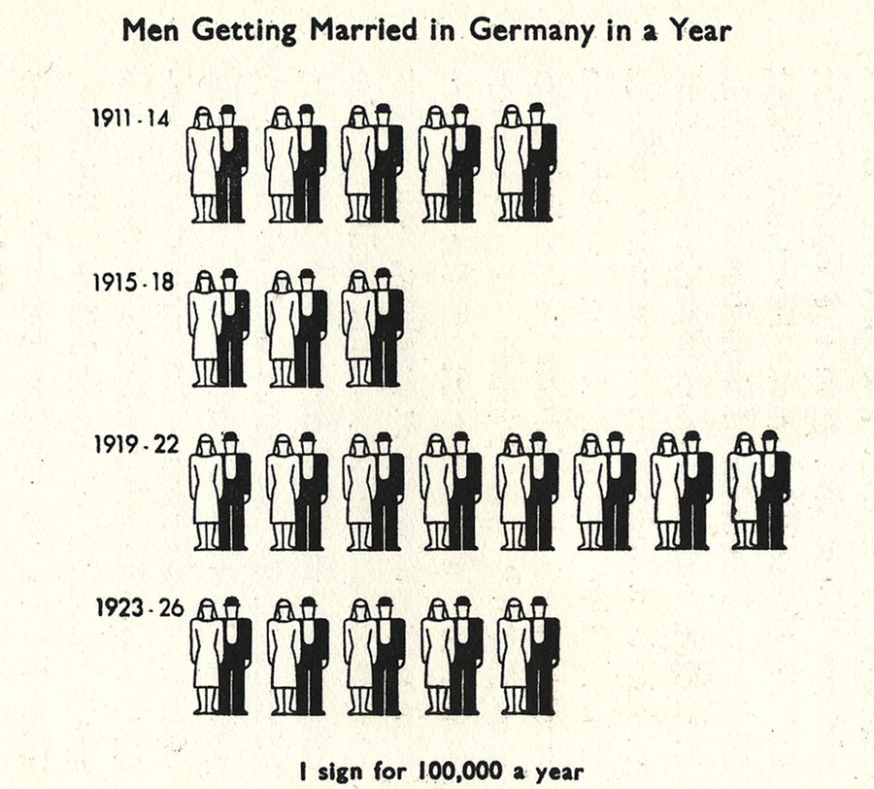
Simple representation with transitions to help maintain context
Tallies
Isotypes, Neurath, 1936

Slide 19
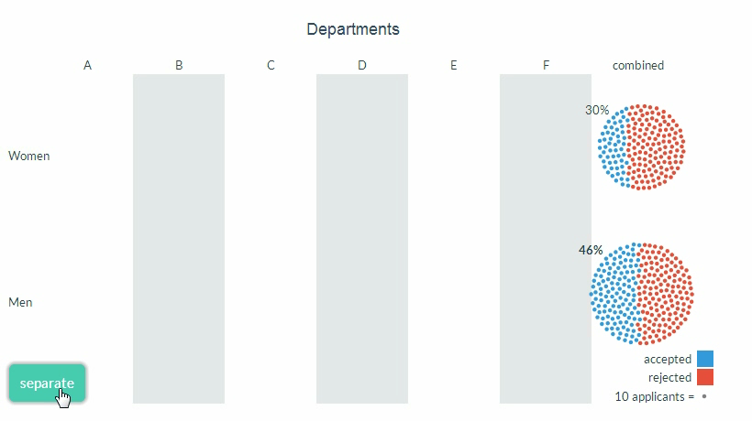
Explaining Data: Simpson’s Paradox

Slide 20
SandDance
SandDance, http://research.Microsoft.com/projects/sanddance
Drucker et al.

Slide 21
SandDance DEMO

